Slide 1
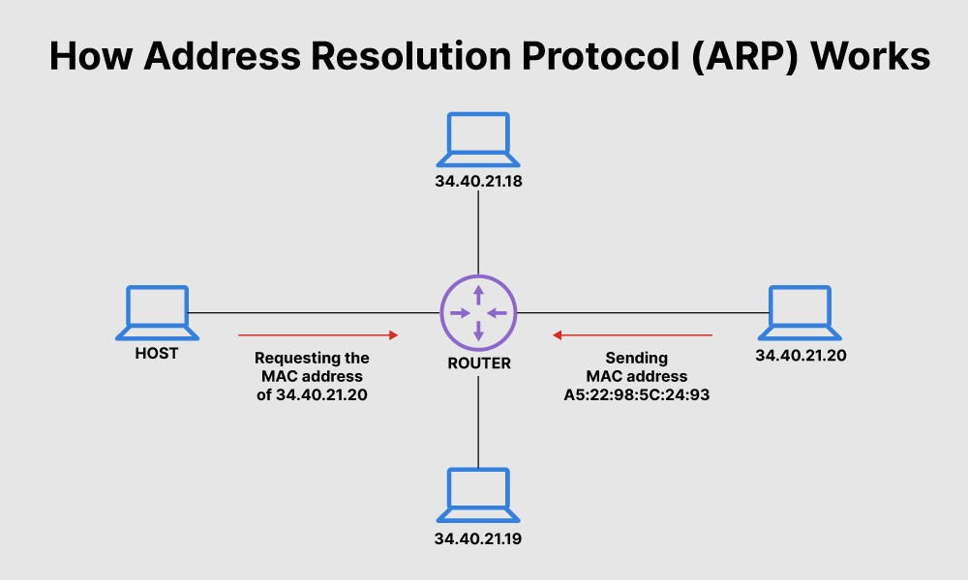
What is ARP?
Address Resolution Protocol (ARP) is a protocol or procedure that connects an ever-changing Internet Protocol (IP) address to a fixed physical machine address, also known as a media access control (MAC) address, in a local-area network (LAN).
This mapping procedure is important because the lengths of the IP and MAC addresses differ, and a translation is needed so that the systems can recognize one another. The most used IP today is IP version 4 (IPv4). An IP address is 32 bits long. However, MAC addresses are 48 bits long. ARP translates the 32-bit address to 48 and vice versa.

Slide 2
Details of sender and receiver
Sender ip address:-10.25.8.47
Target ip address:-10.25.8.46
Target mac address:-cc:96:e5:3b:0f:db

Slide 3
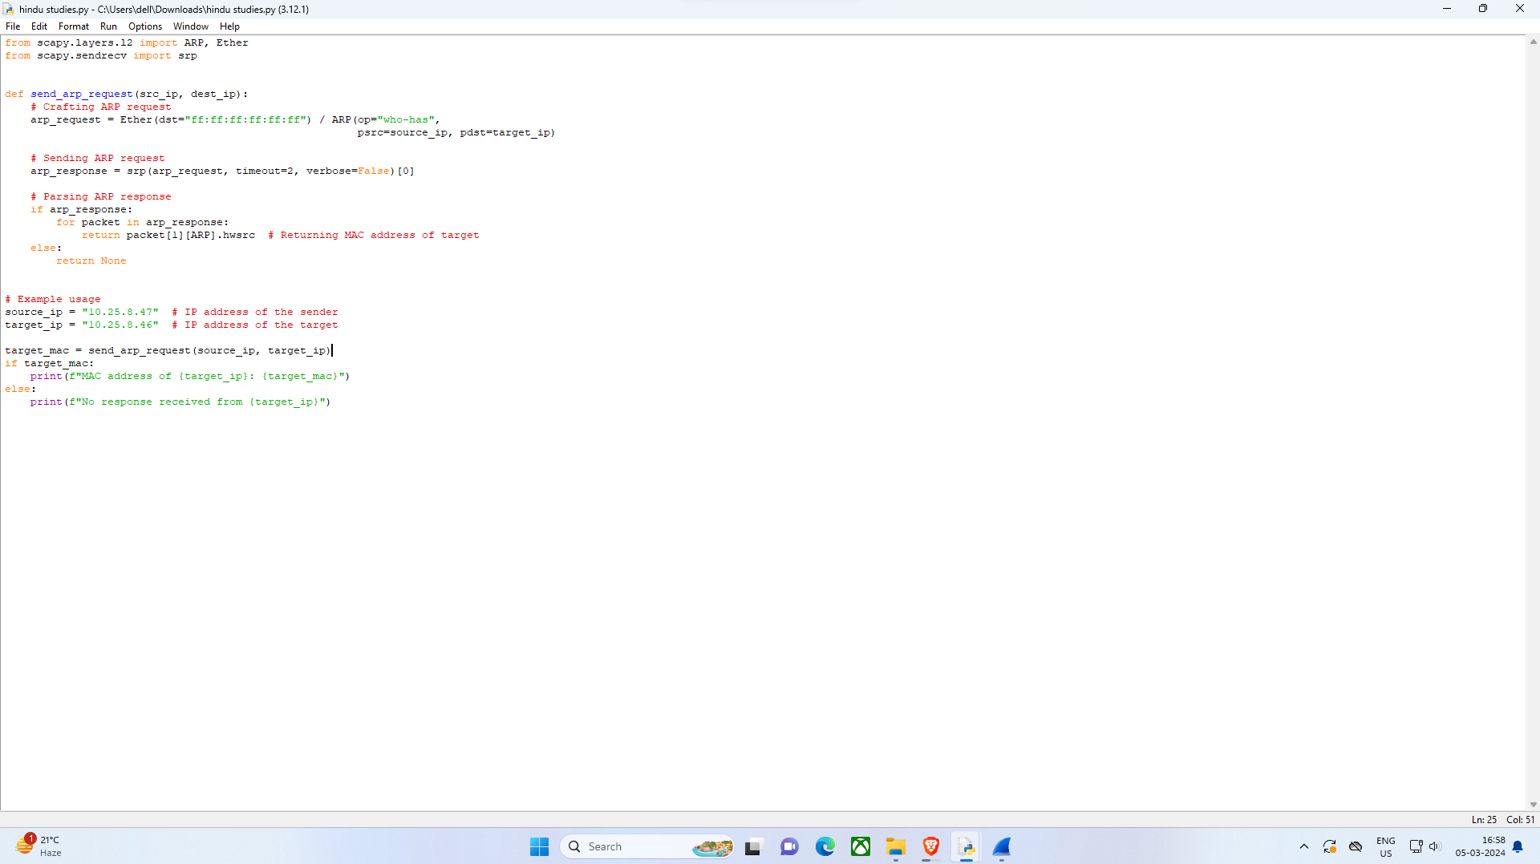
PYTHON CODE

Slide 4

Target machine MAC address

Slide 5
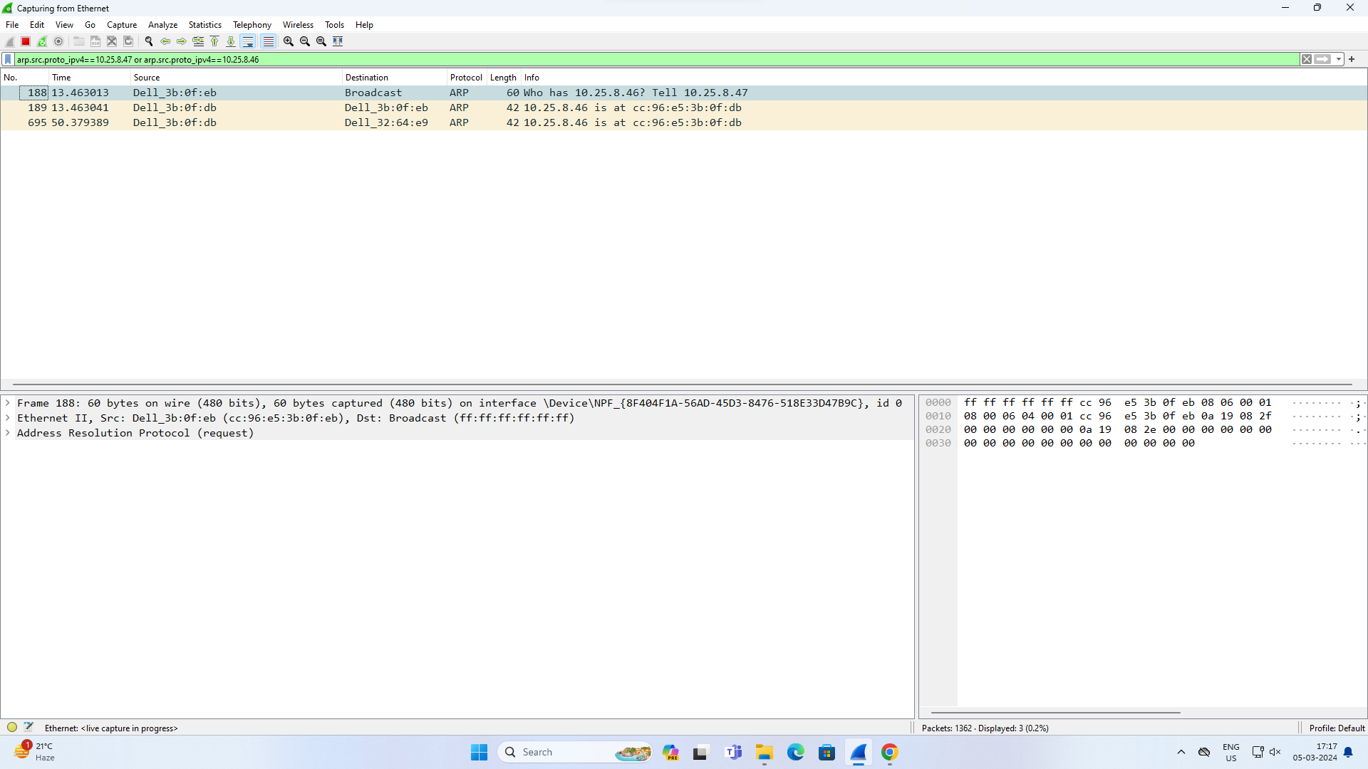
This is target received message Wireshark screenshot

Slide 6
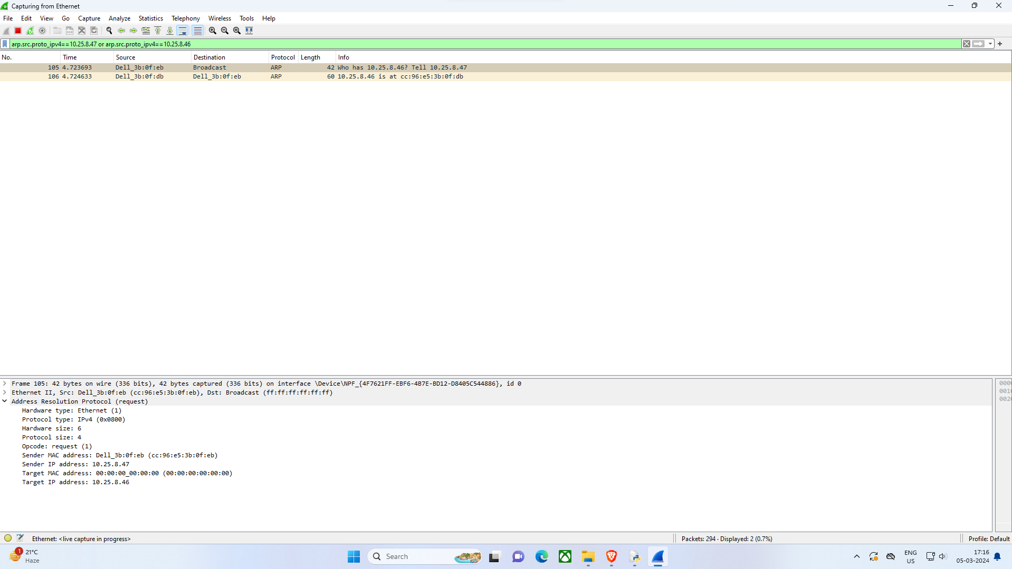
This is sender Wireshark received response screenshot

