Slide 1
IP Packet Transmission Assignment -3

Slide 2
Python code
from scapy.layers.inet import TCP,IP
from scapy.layers.l2 import ARP,Ether
from scapy.sendrecv import srp,send
#creating a packet
a=IP(ttl=128)
a.src="10.25.8.42"
a.dst="10.25.8.43"
a.show2()
send(a)

Slide 3
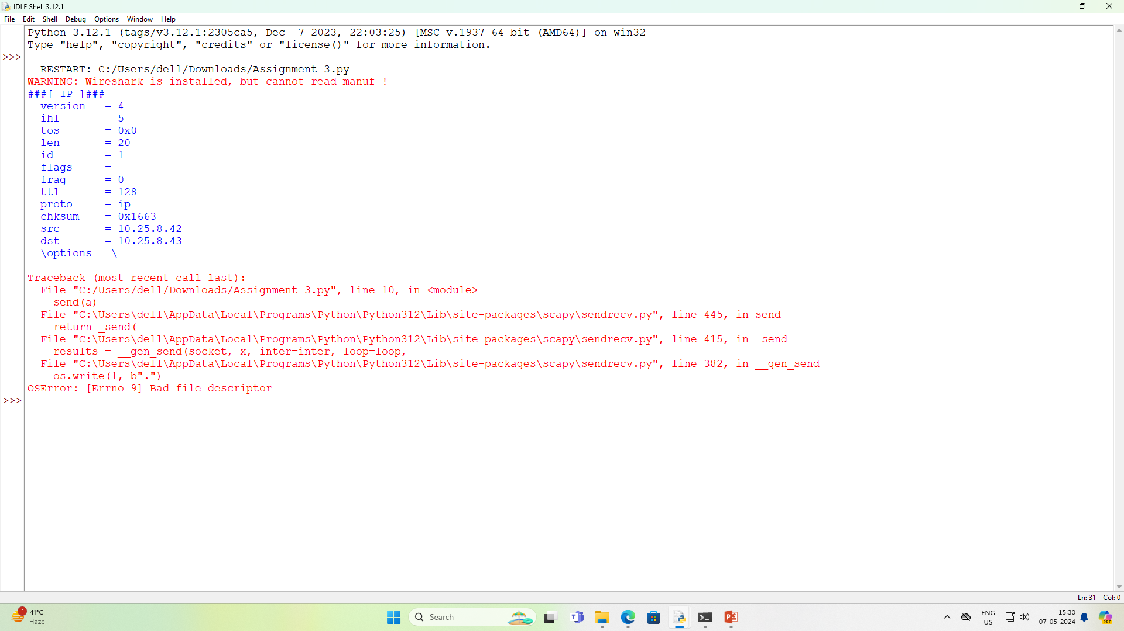
Sender Output

Slide 4
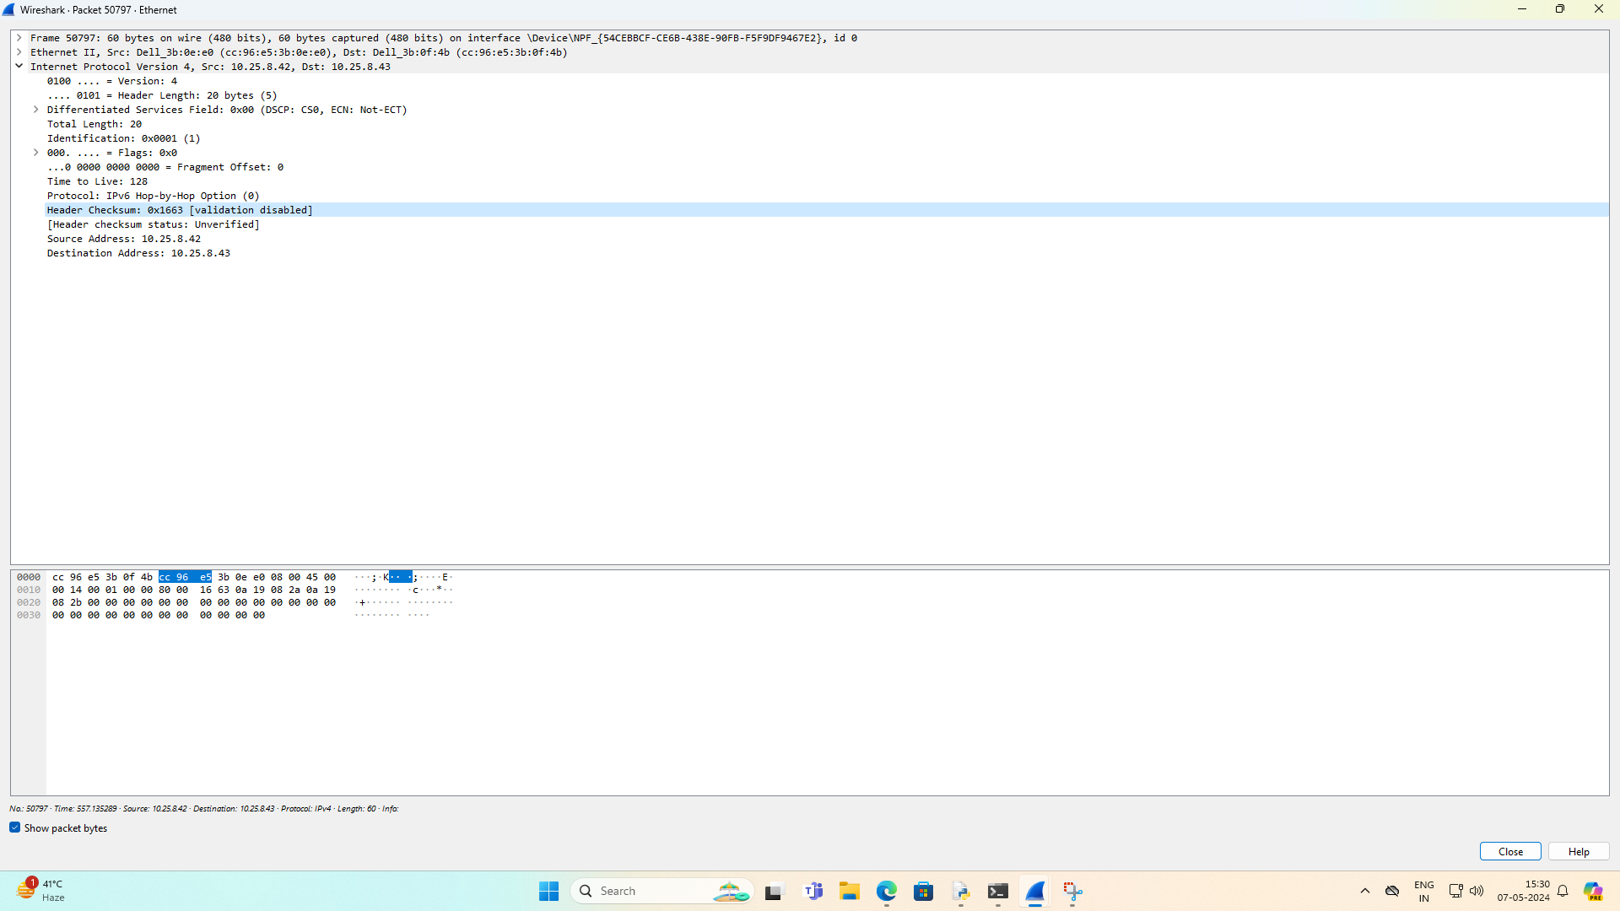
Reciver wireshark output

Slide 5
Name: Sumit kumar
Roll No: 58
MCA 2nd Sem

