Slide 1
TCP/IP Packet Transmission Assignment - 4

Slide 2
Python code
from scapy.all import IP, TCP, send
# Creating a packet
a = IP(ttl=128) / TCP()
a.src = "10.25.8.42"
a.dst = "10.25.8.43"
a[TCP].urgptr = 1
a[TCP].dport = 5394
# Set the Urgent flag
a[TCP].flags = "U"
# Show Assembled Packet's Information, Checksum is Calculated
a.show2()
# Sending the IP Packet
send(a)

Slide 3
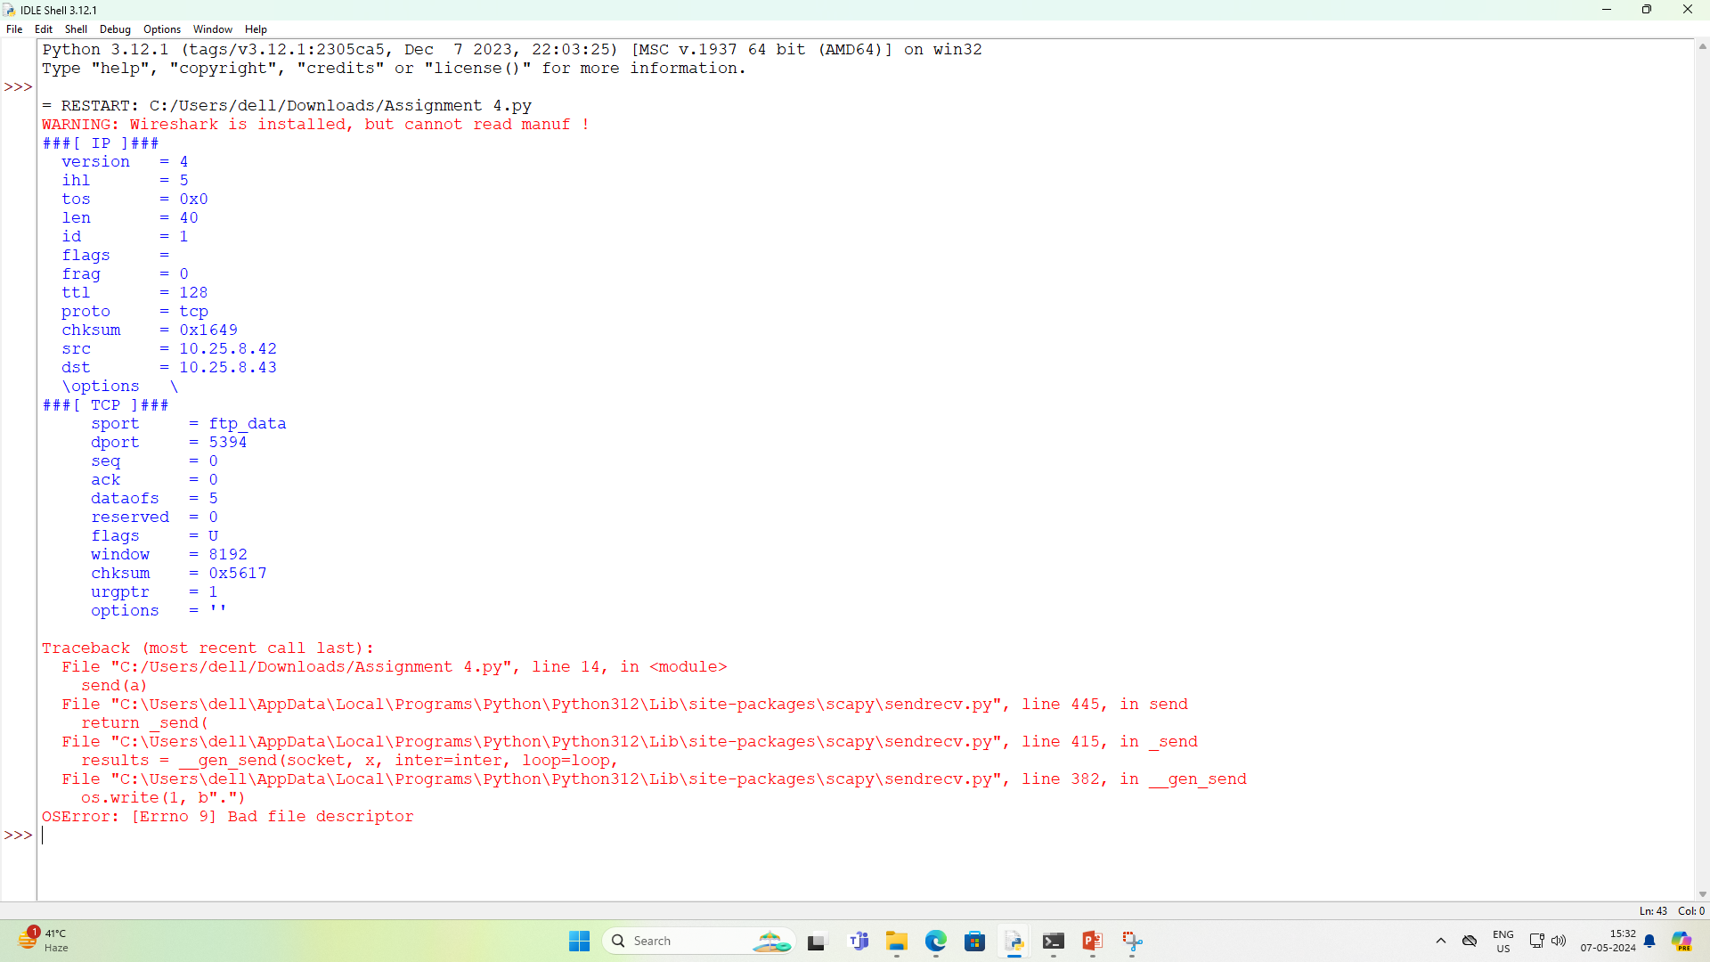
Source Output

Slide 4
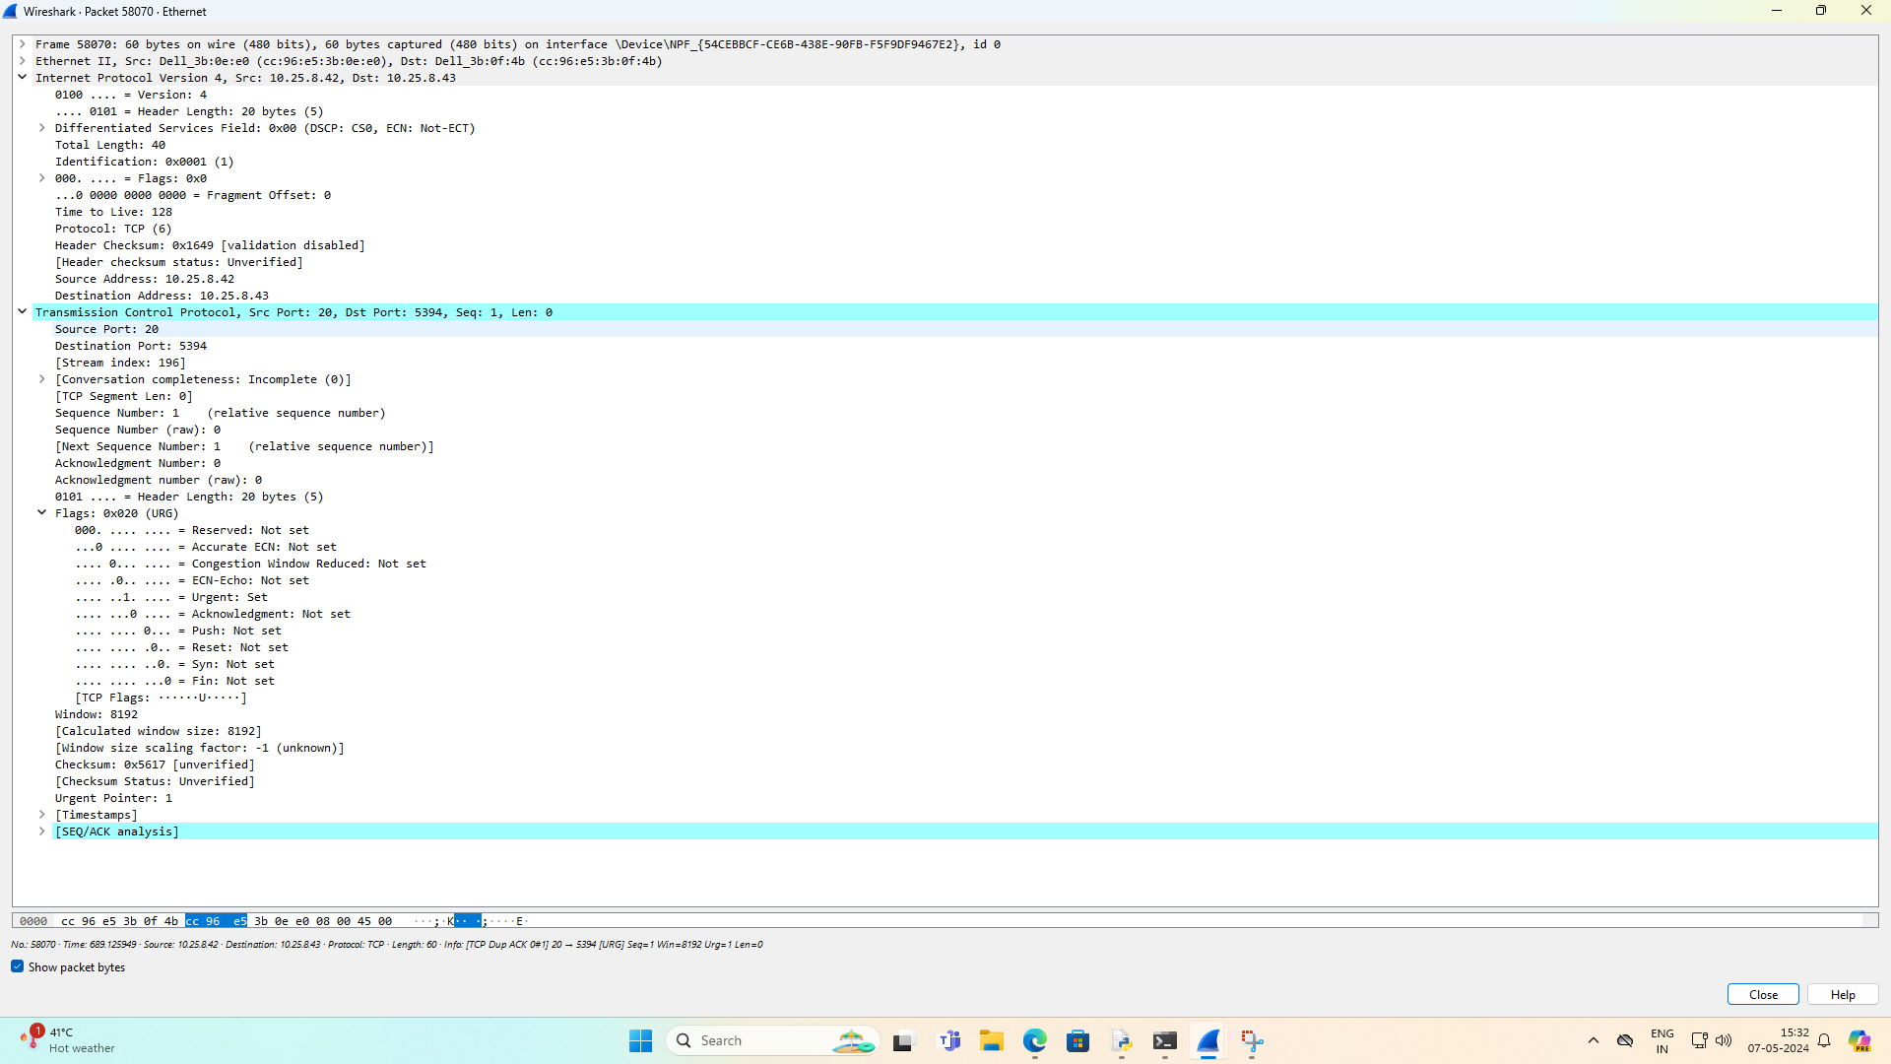
Destination Wireshark output

Slide 5
Name: Sumit kumar
Roll no:58
MCA 2nd Sem

