Slide 1

Chapter 2
Network Models
Copyright © The McGraw-Hill Companies, Inc. Permission required for reproduction or display.
Notes:
1

Slide 2
Chapter 2: Outline
2.1 Protocol Layering
2.2 TCP/IP Protocol Suite
2.3 OSI Model
Notes:
1.#

Slide 3

Chapter 2: Objective
The first section introduces the concept of protocol layering using two scenarios. The section also discusses the two principles upon which the protocol layering is based. The first principle dictates that each layer needs to have two opposite tasks. The second principle dictates that the corresponding layers should be identical. The section ends with a brief discussion of logical connection between two identical layers in protocol layering. Throughout the book, we need to distinguish between logical and physical connections.
Notes:
1.#

Slide 4
Chapter 2: Objective (continued)
The second section discusses the five layers of the TCP/IP protocol suite. We show how packets in each of the five layers (physical, data-link, network, transport, and application) are named. We also mention the addressing mechanism used in each layer. Each layer of the TCP/IP protocol suite is a subject of a part of the book. In other words, each layer is discussed in several chapters; this section is just an introduction and preparation.
The third section gives a brief discussion of the OSI model. This model was never implemented in practice, but a brief discussion of the model and its comparison with the TCP/IP protocol suite may be useful to better understand the TCP/IP protocol suite. In this section we also give a brief reason for the OSI model’s lack of success.
Notes:
1.#

Slide 5
2-1 PROTOCOL LAYERING
A word we hear all the time when we talk about the Internet is protocol. A protocol defines the rules that both the sender and receiver and all intermediate devices need to follow to be able to communicate effectively. When communication is simple, we may need only one simple protocol; when the communication is complex, we need a protocol at each layer, or protocol layering.
2.5
Notes:
1.#

Slide 6
2.1.1 Scenarios
Let us develop two simple scenarios to better understand the need for protocol layering.
In the first scenario, communication is so simple that it can occur in only one layer.
In the second, the communication between Maria and Ann takes place in three layers.
2.6
Notes:
1.#

Slide 7
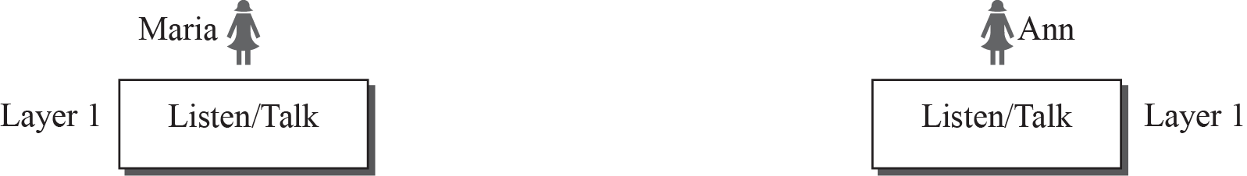
Figure 2.1: A single-layer protocol
2.7
Notes:
1.#

Slide 8
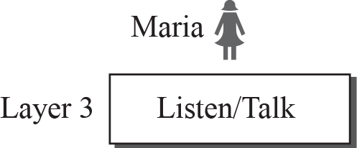
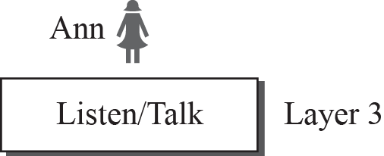
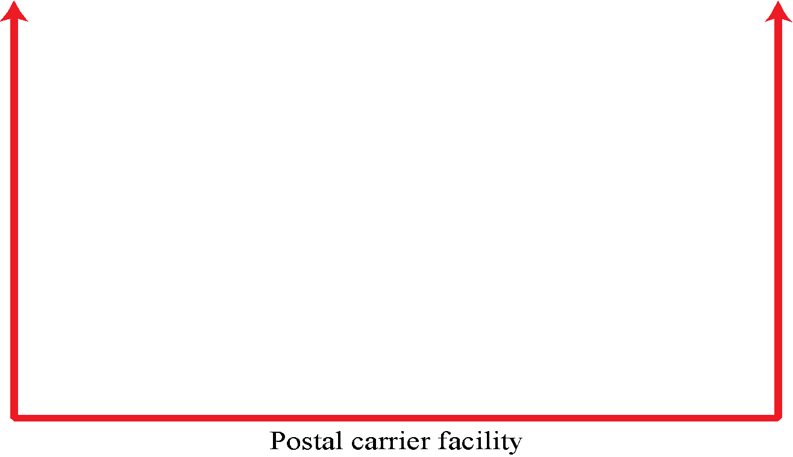

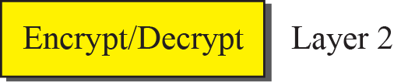
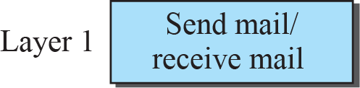
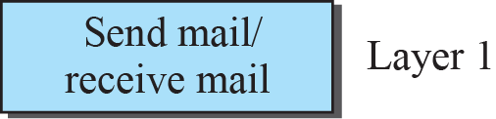
Figure 2.2: A three-layer protocol
2.8
Notes:
1.#

Slide 9
2.1.2 Principles of Protocol Layering
Let us discuss two principles of protocol layering.
The first principle dictates that if we want bidirectional communication, we need to make each layer so that it is able to perform two opposite tasks, one in each direction.
The second principle that we need to follow in protocol layering is that the two objects under each layer at both sites should be identical.
2.9
Notes:
1.#

Slide 10
2.1.3 Logical Connections
After following the above two principles, we can think about logical connection between each layer as shown in Figure 2.3. This means that we have layer-to-layer communication. Maria and Ann can think that there is a logical (imaginary) connection at each layer through which they can send the object created from that layer. We will see that the concept of logical connection will help us better understand the task of layering we encounter in data communication and networking.
2.10
Notes:
1.#

Slide 11
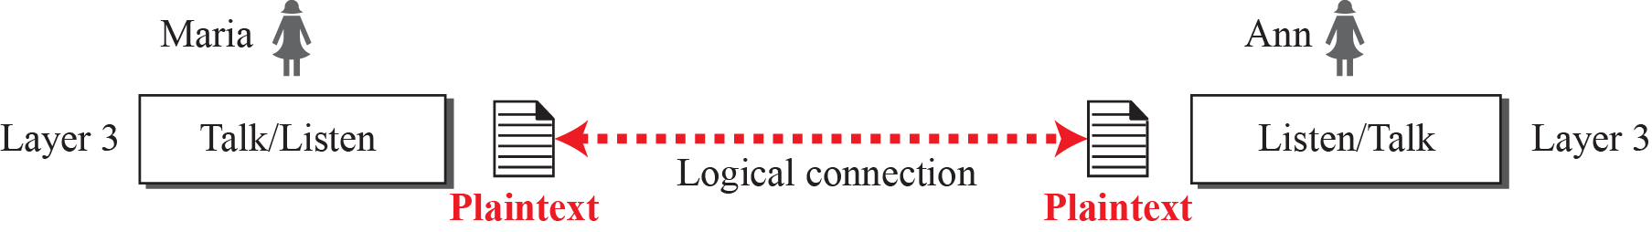
Figure 2.3: Logical connection between peer layers
2.11
Notes:
1.#

Slide 12
2-2 TCP/IP PROTOCOL SUITE
A word we hear all the time when we talk about the Internet is protocol. A protocol defines the rules that both the sender and receiver and all intermediate devices need to follow to be able to communicate effectively. When communication is simple, we may need only one simple protocol; when the communication is complex, we need a protocol at each layer, or protocol layering.
2.12
Notes:
1.#

Slide 13
Figure 2.4: Layers in the TCP/IP protocol suite
2.13
Notes:
1.#

Slide 14
2.2.1 Layered Architecture
To show how the layers in the TCP/IP protocol suite are involved in communication between two hosts, we assume that we want to use the suite in a small internet made up of three LANs (links), each with a link-layer switch. We also assume that the links are connected by one router, as shown in Figure 2.5.
2.14
Notes:
1.#

Slide 15
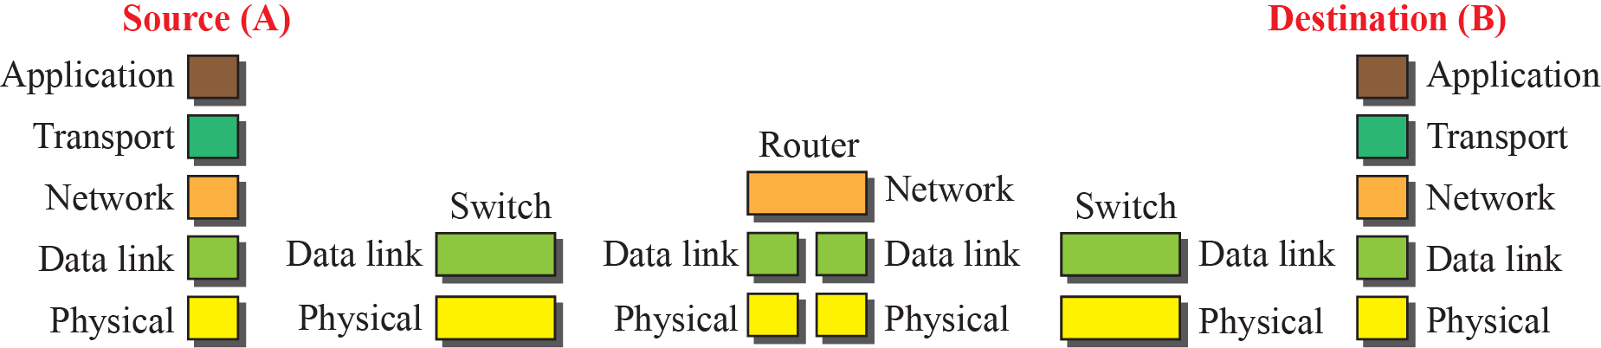
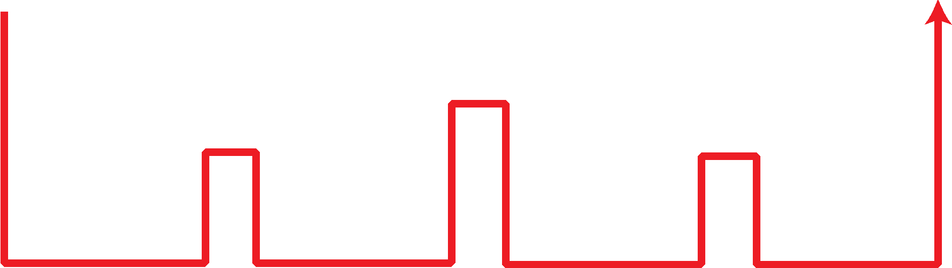
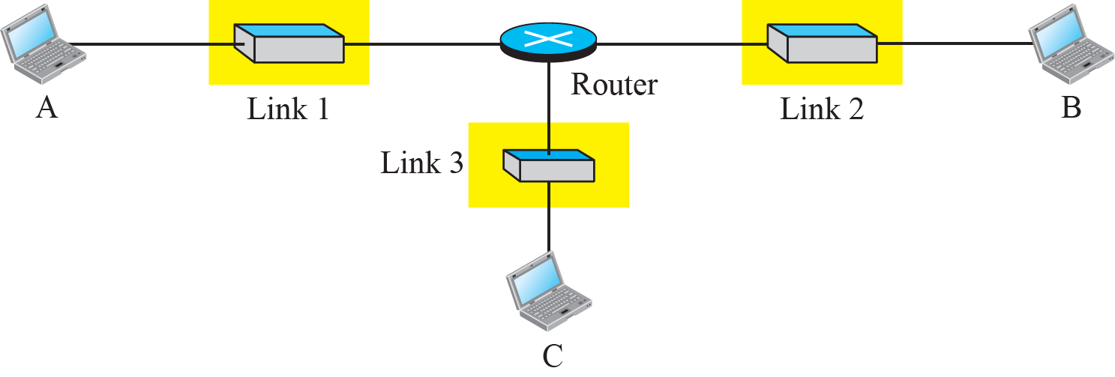
Figure 2.5: Communication through an internet
2.15
Notes:
1.#

Slide 16
2.2.2 Layers in the TCP/IP Protocol Suite
After the above introduction, we briefly discuss the functions and duties of layers in the TCP/IP protocol suite. Each layer is discussed in detail in the next five parts of the book. To better understand the duties of each layer, we need to think about the logical connections between layers. Figure 2.6 shows logical connections in our simple internet.
2.16
Notes:
1.#

Slide 17
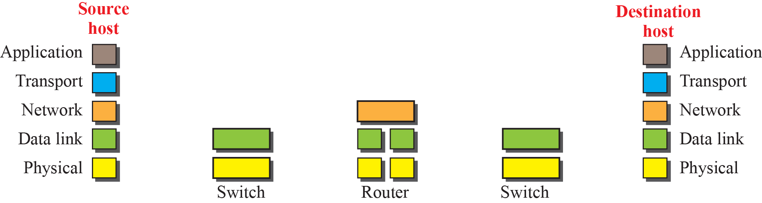
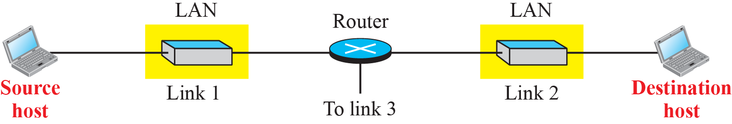
Figure 2.6: Logical connections between layers in TCP/IP
Logical connections
2.17
Notes:
1.#

Slide 18
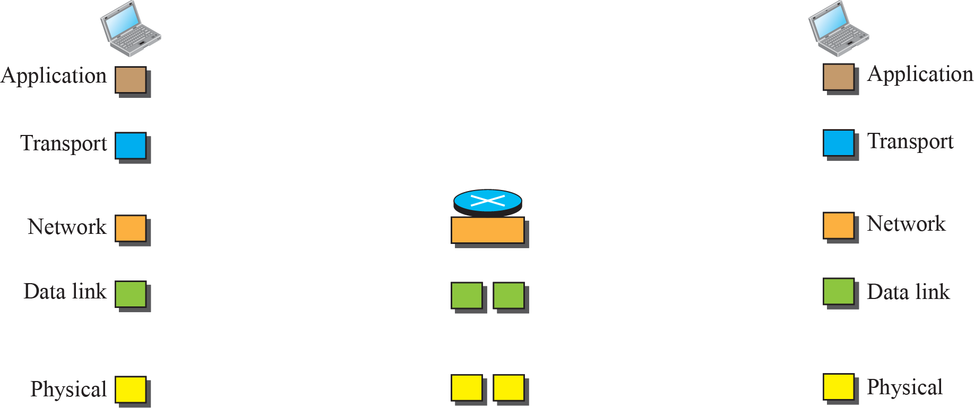
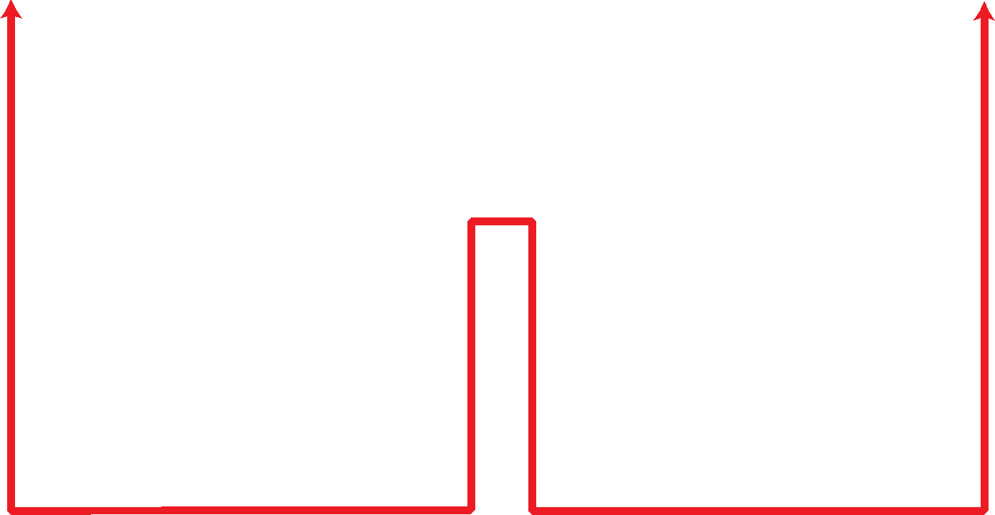
Figure 2.7: Identical objects in the TCP/IP protocol suite
Layer Sortcut:-PDNTA
Object:-BFDSM
Sortcut original layer:-HNITA
Identical objects (messages)
Identical objects (segment or user datagram)
Identical objects (datagram)
Identical objects (datagram)
Identical objects (frame)
Identical objects (frame)
Identical objects (bits)
Identical objects (bits)
2.18
Notes:
1.#

Slide 19
2.2.3 Description of Each Layer
After understanding the concept of logical communication, we are ready to briefly discuss the duty of each layer. Our discussion in this chapter will be very brief, but we come back to the duty of each layer in next five parts of the book.
2.19
Notes:
1.#

Slide 20
2.2.4 Encapsulation and Decapsulation
One of the important concepts in protocol layering in the Internet is encapsulation/ decapsulation. Figure 2.8 shows this concept for the small internet in Figure 2.5.
2.20
Notes:
1.#

Slide 21
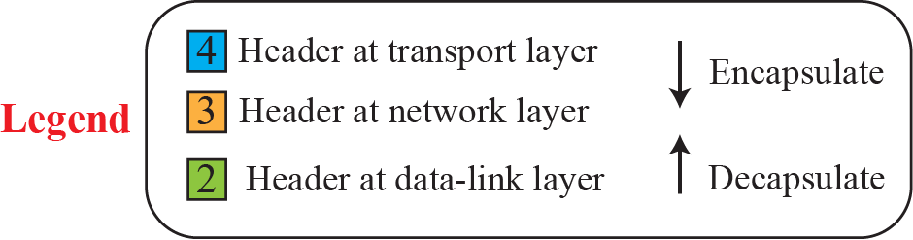
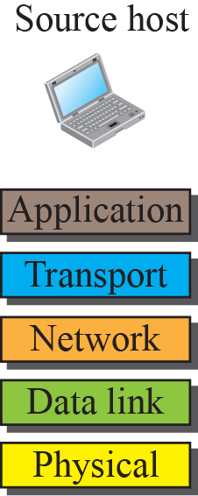
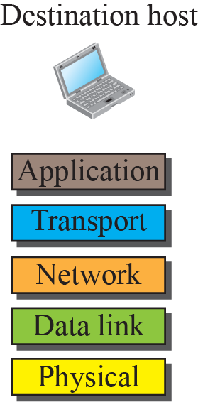
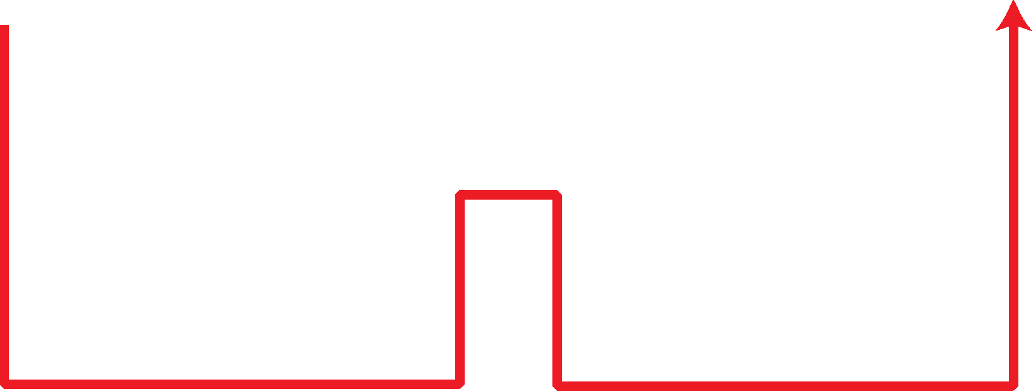
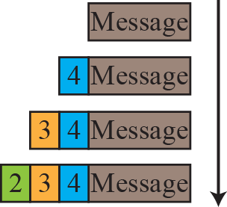
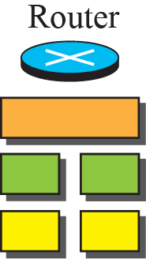
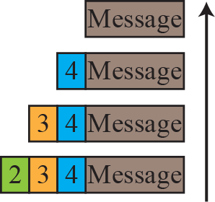
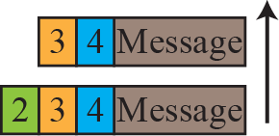
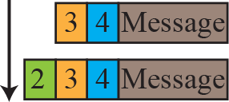
Figure 2.8: Encapsulation / Decapsulation
2.21
Notes:
1.#

Slide 22
2.2.5 Addressing
It is worth mentioning another concept related to protocol layering in the Internet, addressing. As we discussed before, we have logical communication between pairs of layers in this model. Any communication that involves two parties needs two addresses: source address and destination address. Although it looks as if we need five pairs of addresses, one pair per layer, we normally have only four because the physical layer does not need addresses; the unit of data exchange at the physical layer is a bit, which definitely cannot have an address.
2.22
Notes:
1.#

Slide 23


Figure 2.9: Addressing in the TCP/IP protocol suite
2.23
Notes:
1.#

Slide 24
2.2.6 Multiplexing and Demultiplexing
Since the TCP/IP protocol suite uses several protocols at some layers, we can say that we have multiplexing at the source and demultiplexing at the destination. Multiplexing in this case means that a protocol at a layer can encapsulate a packet from several next-higher layer protocols (one at a time); demultiplexing means that a protocol can decapsulate and deliver a packet to several next-higher layer protocols (one at a time). Figure 2.10 shows the concept of multiplexing and demultiplexing at the three upper layers.
2.24
Notes:
1.#

Slide 25
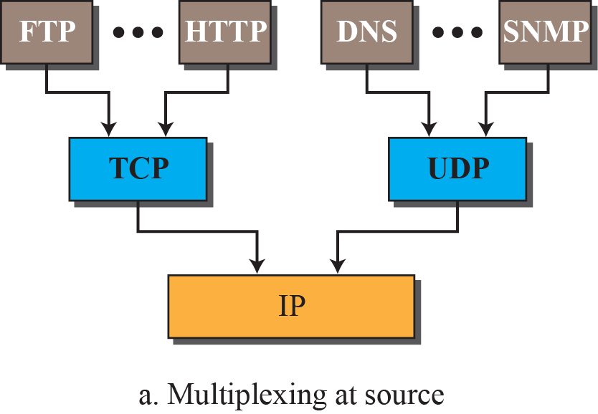
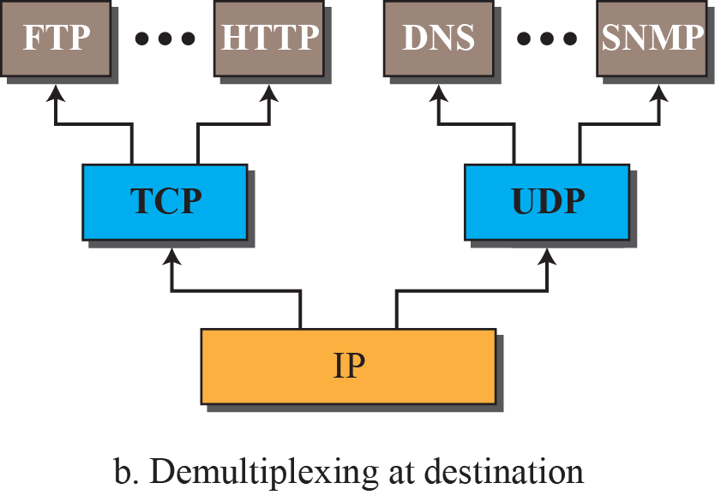
Figure 2.10: Multiplexing and demultiplexing
FTP:-File transfer protocol
HTTP:-Hyper text transfer protocol
DNS:-Domain name system
SNMP:-Simple network management protocol
UDP:-User datagram protocol
2.25
Notes:
1.#

Slide 26
2-3 OSI MODEL
A word we hear all the time when we talk about the Internet is protocol. A protocol defines the rules that both the sender and receiver and all intermediate devices need to follow to be able to communicate effectively. When communication is simple, we may need only one simple protocol; when the communication is complex, we need a protocol at each layer, or protocol layering.
2.26
Notes:
1.#

Slide 27
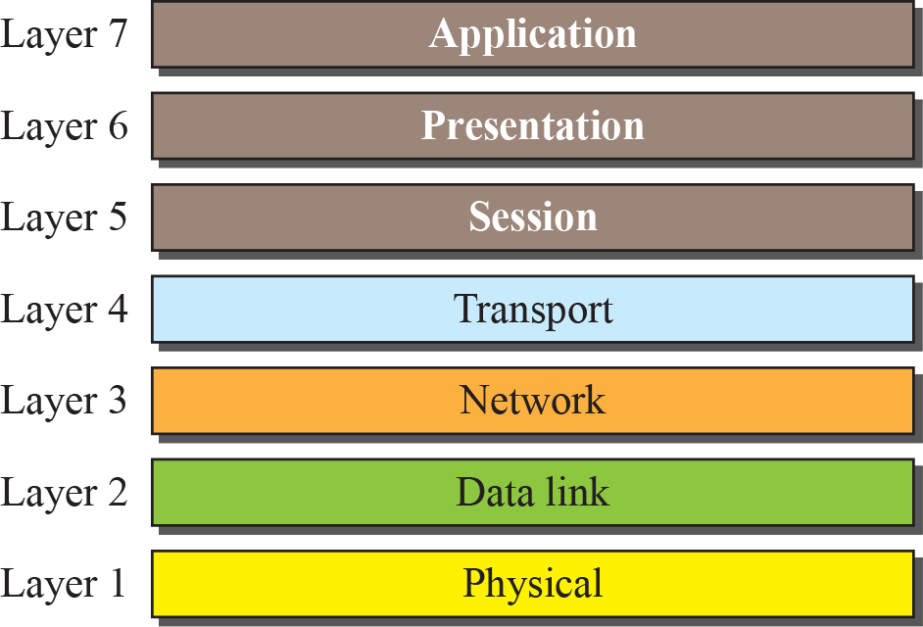
Figure 2.11: The OSI model
2.27
Notes:
1.#

Slide 28
2.3.1 OSI versus TCP/IP
When we compare the two models, we find that two layers, session and presentation, are missing from the TCP/IP protocol suite. These two layers were not added to the TCP/IP protocol suite after the publication of the OSI model. The application layer in the suite is usually considered to be the combination of three layers in the OSI model, as shown in Figure 2.12.
2.28
Notes:
1.#

Slide 29
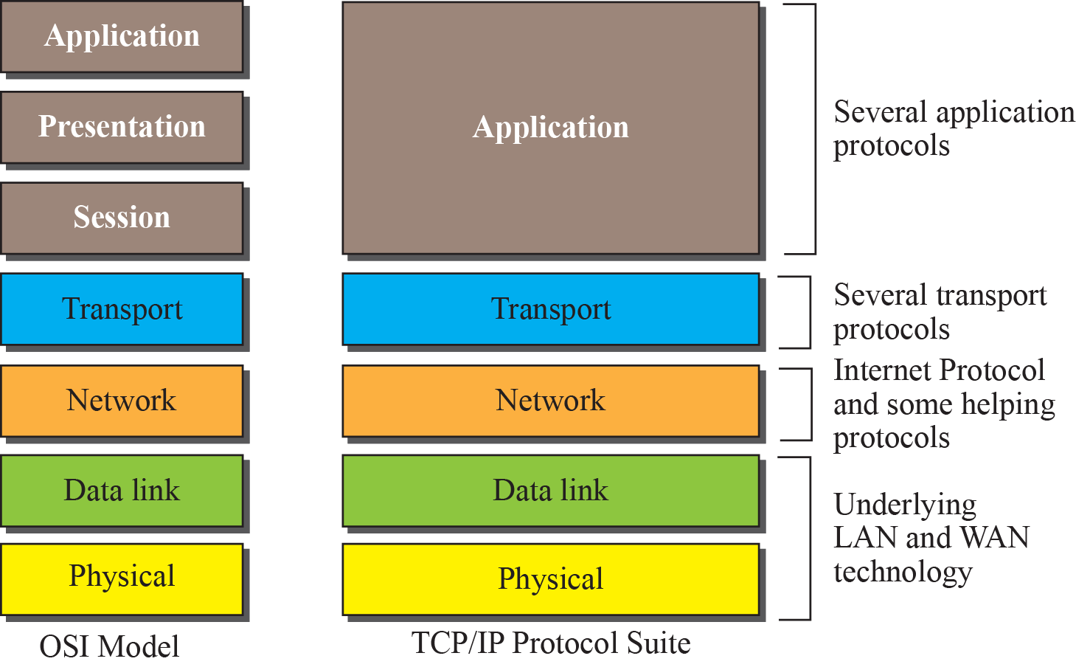
Figure 2.12: TCP/IP and OSI model
2.29
Notes:
1.#

Slide 30
2.3.2 Lack of OSI Model’s Success
The OSI model appeared after the TCP/IP protocol suite. Most experts were at first excited and thought that the TCP/IP protocol would be fully replaced by the OSI model. This did not happen for several reasons, but we describe only three, which are agreed upon by all experts in the field.
2.30
Notes:
1.#

Slide 31
2.3.2 Lack of OSI Model’s Success
First, OSI was completed when TCP/IP was fully in place and a lot of time and money had been spent on the suite; changing it would cost a lot.
Second, some layers in the OSI model were never fully defined. For example, although the services provided by the presentation and the session layers were listed in the document, actual protocols for these two layers were not fully defined, nor were they fully described, and the corresponding software was not fully developed.
Third, when OSI was implemented by an organization in a different application, it did not show a high enough level of performance to entice the Internet authority to switch from the TCP/IP protocol suite to the OSI model.
2.31
Notes:
1.#

