Slide 1
Data Science Process

Slide 2
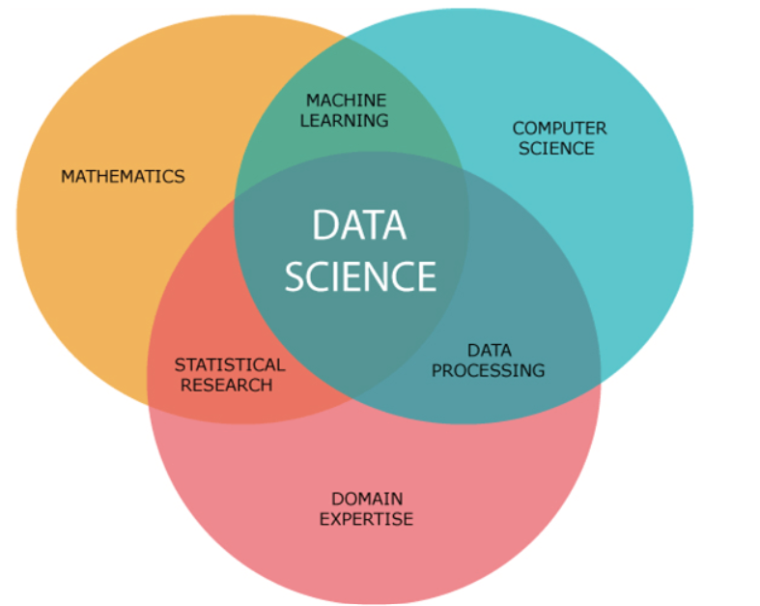
What is Data Science
Data science is a multidisciplinary field that involves the use of statistical and computational methods to extract insights and knowledge from data.
It combines aspects of statistics, computer science, and domain-specific knowledge to solve complex problems and generate valuable insights.
Why the Hype?

Slide 3
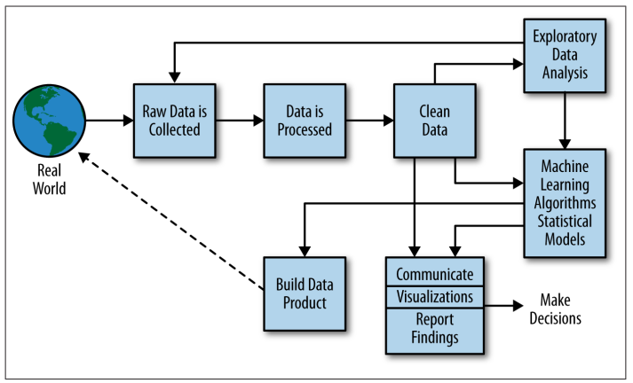
The Data Science Process

Slide 4
Data science Process
Suppose a retail company wants to analyze customer data to identify factors that affect customer satisfaction, and to develop strategies to increase customer retention.
Problem formulation
The retail company works with the data science team to define the problem, which is to increase customer satisfaction.
The objective of the project is to identify the factors that contribute to customer satisfaction, and to develop strategies to improve customer retention.

Slide 5
Data science to increase customer satisfaction
Data collection
The data science team collects relevant data from various sources, such as customer transactions, feedback, demographics, and social media activity.
They clean and preprocess the data, handling missing values and ensuring data quality.

Slide 6
Data science to increase sales and customer satisfaction
Data exploration
The team performs exploratory data analysis (EDA) on the collected data.
They use visualization techniques and statistical methods to gain insights into the data, such as identifying patterns, trends, and correlations between variables.
They may explore factors such as customer demographics, purchase behavior, product preferences, and feedback to understand their impact on customer satisfaction.

Slide 7
Data science to increase sales and customer satisfaction
Data preparation
Based on the EDA findings, the team prepares the data for modeling.
This may involve feature selection, feature engineering, and data transformation.
For example, they may encode categorical variables, normalize numerical variables, and split the data into training and testing sets.

Slide 8
Data science to increase sales and customer satisfaction
Model building
The team selects appropriate modeling techniques, such as regression or classification, and builds predictive models using the prepared data.
They train the models on the training data, tune hyperparameters, and evaluate their performance.

Slide 9
Data science to increase sales and customer satisfaction
Model evaluation
The team evaluates the performance of the models using various metrics, such as accuracy, precision, recall, and F1-score, to assess how well they predict customer satisfaction.
They compare the performance of different models and select the best-performing one for further analysis.

Slide 10
Data science to increase sales and customer satisfaction
Model deployment
The selected model is deployed in a production environment, such as a customer relationship management (CRM) system, to assist the retail company in identifying customers at high risk of churning.
The model can provide real-time predictions and recommendations to help the company take proactive measures, such as offering personalized promotions, improving product quality, or enhancing customer service, to increase customer retention.

Slide 11
Data science to increase sales and customer satisfaction
Monitoring and maintenance
The deployed model is monitored for performance and updated as needed to ensure that it continues to provide accurate predictions. The team also continues to collect and analyze data to identify new trends and patterns that can be used to improve the model and inform business decisions

Slide 12
The Data Science Process

Slide 13
Why Data Preprocessing?
Data in the real world is dirty: Lots of potentially incorrect data, e.g., instrument faulty, human or computer error, transmission error
incomplete: lacking attribute values, lacking certain attributes of interest, or containing only aggregate data
e.g., occupation=“”
noisy: containing errors or outliers
e.g., Salary=“-10”
inconsistent: containing discrepancies in codes or names
e.g., Age=“42” Birthday=“03/07/1997”
e.g., Was rating “1,2,3”, now rating “A, B, C”
e.g., discrepancy between duplicate records

Slide 14
Why Is Data Preprocessing Important?
No quality data, no quality analysis!
Quality decisions must be based on quality data
e.g., duplicate or missing data may cause incorrect or even misleading statistics.

Slide 15
Major Tasks in Data Preprocessing
Data cleaning
Fill in missing values, smooth noisy data, identify or remove outliers, and resolve inconsistencies
Data integration
where multiple data sources may be combined
Data reduction
Dimensionality reduction, Data compression
Data transformation
where data are transformed or consolidated into forms appropriate for analysis by performing summary or aggregation operations

Slide 16
Data Cleaning
Data cleaning tasks
Fill in missing values
Identify outliers and smooth out noisy data
Correct inconsistent data

Slide 17
Incomplete (Missing) Data
Data is not always available
E.g., many tuples have no recorded value for several attributes, such as customer income in sales data
Missing data may be due to
equipment malfunction
inconsistent with other recorded data and thus deleted
data not entered due to misunderstanding
certain data may not be considered important at the time of entry
not register history or changes of the data
Missing data may need to be inferred

Slide 18
How to Handle Missing Data?
Ignore the tuple: usually done when class label is missing (when doing classification—not effective in certain cases)
Fill in the missing value manually: tedious + infeasible?
Fill in it automatically with
a global constant : e.g., “unknown”, a new class?!
the attribute mean
the attribute mean for all samples belonging to the same class: smarter
the most probable value: inference-based such as Bayesian formula or decision tree

Slide 19
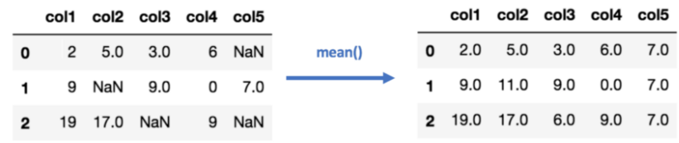
How to Handle Missing Data?

Slide 20
Noisy Data
Noise: random error in a measured variable
Incorrect attribute values may be due to
faulty data collection instruments
data entry problems
data transmission problems
technology limitation
inconsistency in naming convention

Slide 21
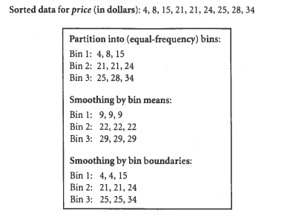
How to Handle Noisy Data?
Binning
first sort data and partition into (equal-frequency) bins
then one can smooth by bin means, smooth by bin median, smooth by bin boundaries, etc.
Regression
smooth by fitting the data into regression functions
Clustering
detect and remove outliers
Combined computer and human inspection
detect suspicious values and check by human (e.g., deal with possible outliers)

Slide 22
Data Transformation
A function that maps the entire set of values of a given attribute to a new set of replacement values s.t. each old value can be identified with one of the new values
Methods
Smoothing: Remove noise from data (binning, clustering, regression)
Normalization: Scaled to fall within a smaller, specified range
min-max normalization
z-score normalization
normalization by decimal scaling

Slide 23
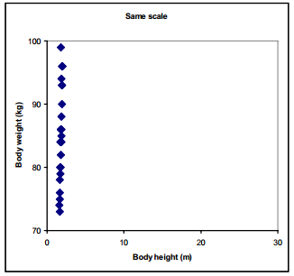
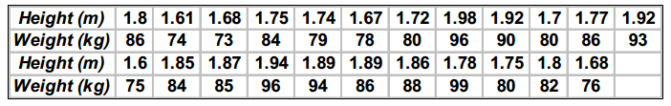
Data Transformation

Slide 24
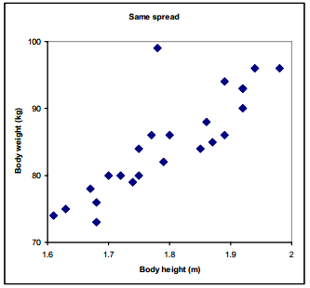
Data Transformation
We can see that the data points only spread in the vertical direction because body weight has much larger numerical range than body height.
Let's zoom the Figure
There is strong correlation between body height and body weight, except for one outlier in the data.

Slide 25
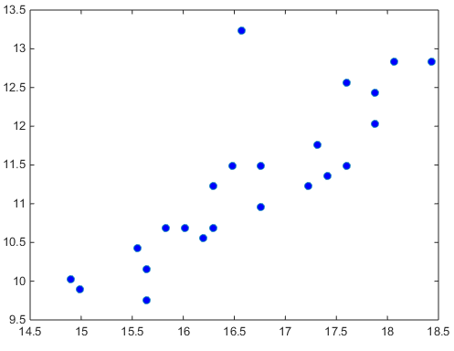
Data Transformation
Solution:
Scaling : In order to give both variable, body weight and height, equal weight in the data, we standardized (scaling or weighting) them.
There are may ways, but the most common techniques are
min-max normalization
z-score normalization
normalization by decimal scaling

Slide 26
min-max normalization
A
8
20
10
15
A
0
1
0.16
0.58
The minimum value is 8
The maximum value is 20
Assume, we want to scale data between 0 and 1,
The new min is 0
The new max is 1

Slide 27
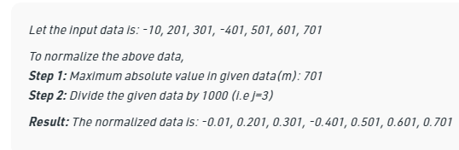
Normalization
Z-score normalization (μ: mean, σ: standard deviation):
Ex. Let μ = 54,000, σ = 16,000. Then $73,000 is mapped to
Normalization by decimal scaling
Where j is the smallest integer such that Max(|ν’|) < 1

Slide 28
Topic for the next class
Exploratory Data Analysis

Slide 29
Acknowledgements
O'Neil, C., & Schutt, R. (2013). Doing data science: Straight talk from the frontline. " O'Reilly Media, Inc.".
Data Mining: Concepts and Techniques (3rd ed.), Jiawei Han, Micheline Kamber, and Jian Pei

