Slide 1
Introduction to the course MCAC204: DATA ANALYSIS AND VISUALIZATION

Slide 2
Suggested Books
McKinney, W.(2017). Python for Data Analysis: Data Wrangling with Pandas, NumPy and IPython. 2nd edition. O’Reilly Media.
O’Neil, C., & Schutt, R. (2013). Doing Data Science: Straight Talk from the Frontline, O’Reilly Media.

Slide 3
Evaluation Pattern
Continuous Internal Assessment (CIA): 30 Marks
Performance will be evaluated based on continuous evaluation.
There will be a minor test, assignments/ laboratory work.
CIA I : 15 Marks
Written Test
CIA II : 15 Marks
Assignment, Laboratory Work, etc.
Assignments are to be completed individually
End of Semester Exam (EoSE): 70 marks
Academic honesty taken seriously
Passing Marks
40% in the End Semester Examination and 40% in the total of End Semester Examination & Internal Assessment
seriously

Slide 4
Syllabus
Data Wrangling: Hierarchical Indexing, Combining and Merging Data Sets Reshaping and Pivoting. Data Visualization matplotlib: Basics of matplotlib, plotting with pandas and seaborn, other python visualization tools.
Unit 1
Unit 2
Unit 3
Unit 4
Unit 5
Introduction to Data Science, Exploratory Data Analysis and Data Science Process. Motivation for using Python for Data Analysis, Introduction of Python shell iPython and Jupyter Notebook. Essential Python Libraries: NumPy, pandas, matplotlib, SciPy, scikit-learn, stats models.
Getting Started with Pandas: Arrays and vectorized computation, Introduction to pandas Data Structures, Essential Functionality, Summarizing and Computing Descriptive Statistics. Data Loading, Storage and File Formats. Reading and Writing Data in Text Format, Web Scraping, Binary Data Formats, Interacting with Web APIs, Interacting with Databases, Data Cleaning and Preparation. Handling Missing Data, Data Transformation, String Manipulation
Data Aggregation and Group operations: Data grouping, Data aggregation, General split-apply-combine, Pivot tables and cross tabulation
Time Series Data Analysis: Date and Time Data Types and Tools, Time series Basics, Frequencies and Shifting, Time Zone Handling, Periods and Periods Arithmetic, Resampling and Frequency conversion, Moving Window Functions.

Slide 5
Overview of Data Analysis and Visualization

Slide 6
Data Terms
Observation
An observation refers to a single unit of data that has been measured or recorded, while a variable represents a characteristic or attribute of that unit.
Variable
Any characteristic of an observation is called a variable.
Dataset
A dataset can be defined as a collection of observations or instances, each of which contains a set of variables or features.

Slide 7
Data set Example
ID | Age | Gender | Occupation | Marital Status | Monthly Income | Education Level | Years of Experience | Years with Current Employer | Credit Score | Loan Amount
1001 | 26 | Female | Teacher | Single | 3000 | Bachelor's degree | 3 | 1 | 740 | 5000
1002 | 38 | Male | Engineer | Married | 8000 | Master's degree | 12 | 5 | 810 | 10000
1003 | 44 | Female | Accountant | Married | 6500 | Bachelor's degree | 20 | 10 | 680 | 7500
1004 | 32 | Male | Programmer | Single | 5000 | High school diploma | 5 | 2 | 670 | 3000
1005 | 29 | Female | Sales | Single | 4500 | Some college | 7 | 3 | 720 | 6000
1006 | 53 | Male | Manager | Married | 12000 | Master's degree | 25 | 15 | 850 | 15000
1007 | 41 | Female | Lawyer | Divorced | 10000 | Doctorate | 18 | 8 | 800 | 12000
1008 | 48 | Male | Doctor | Married | 15000 | Doctorate | 22 | 12 | 890 | 20000
1009 | 37 | Female | Entrepreneur | Single | 6000 | Bachelor's degree | 9 | 4 | 710 | 8000
1010 | 34 | Male | Consultant | Married | 7000 | Master's degree | 8 | 3 | 780 | 9000

Slide 8
Types of Data
Nominal
Ordinal
Discrete
Continious

Slide 9
Types of Data
Nominal: Nominal data are categorical data that have no order or ranking.
It involves categorizing data into distinct groups or classes with no inherent order or ranking.
Examples: gender, race, or political affiliation.

Slide 10
Types of Data
Ordinal: Ordinal data are categorical data that have an order or ranking.
Examples of ordinal data include ratings or rankings, such as a movie rating scale from 1 to 5, level of education (e.g., high school, college, graduate), or the level of agreement (e.g., strongly agree, agree, neutral, disagree, strongly disagree).

Slide 11
Types of Data
Discrete data:
discrete means distinct or separate.
The discrete data contain the values that fall under integers or whole numbers.
These data can’t be broken into decimal or fraction values.
Example: Number of students in the class, Numbers of employees in a company, Days in a week

Slide 12
Types of Data
Continuous data are numerical data that can take on any value within a range.
Examples of continuous data include height, weight, and time

Slide 13
Data Measurement Scales
Interval data: Interval data are numerical data that have equal intervals between each value, but there is no true zero point.
Examples of interval data include temperature measured in Celsius or Fahrenheit, where zero does not represent the absence of temperature.

Slide 14
Data Measurement Scales
Ratio data: Ratio data are numerical data that have equal intervals between each value, and there is a true zero point.
Examples of ratio data include weight, height, and income.

Slide 15
Data set Example
ID | Age | Gender | Occupation | Marital Status | Monthly Income | Education Level | Years of Experience | Years with Current Employer | Credit Score | Loan Amount
1001 | 26 | Female | Teacher | Single | 3000 | Bachelor's degree | 3 | 1 | 740 | 5000
1002 | 38 | Male | Engineer | Married | 8000 | Master's degree | 12 | 5 | 810 | 10000
1003 | 44 | Female | Accountant | Married | 6500 | Bachelor's degree | 20 | 10 | 680 | 7500
1004 | 32 | Male | Programmer | Single | 5000 | High school diploma | 5 | 2 | 670 | 3000
1005 | 29 | Female | Sales | Single | 4500 | Some college | 7 | 3 | 720 | 6000
1006 | 53 | Male | Manager | Married | 12000 | Master's degree | 25 | 15 | 850 | 15000
1007 | 41 | Female | Lawyer | Divorced | 10000 | Doctorate | 18 | 8 | 800 | 12000
1008 | 48 | Male | Doctor | Married | 15000 | Doctorate | 22 | 12 | 890 | 20000
1009 | 37 | Female | Entrepreneur | Single | 6000 | Bachelor's degree | 9 | 4 | 710 | 8000
1010 | 34 | Male | Consultant | Married | 7000 | Master's degree | 8 | 3 | 780 | 9000

Slide 16
Why Do We Analyze Data
The purpose of analyzing data is to obtain usable and useful information.
describe and summarize the data
identify relationships between variables
identify the difference between variables
forecast outcomes

Slide 17
Applications
Credit scoring
Customer behavior modeling
Healthcare
Advertising
Education
Sports

Slide 18
What are the Types of Data Analysis?
Quantitative Data Analysis
Qualitative Data Analysis

Slide 19
What are the Types of Data Analysis?
Quantitative analysis, involves the interpretation of numerical data, such as statistical measures, graphs, and charts.
This type of analysis focuses on identifying patterns, trends, and relationships within the data.
Quantitative analysis typically involves a more objective approach, relying on mathematical and statistical techniques to analyze and interpret the data.
Quantitative analysis is often used in scientific research, business, and economics.

Slide 20
What are the Types of Data Analysis?
Qualitative analysis involves the interpretation of non-numerical data, such as text, images, audio, and video.
This type of analysis focuses on understanding the underlying meaning, context, and themes within the data.
Qualitative analysis typically involves a more subjective approach, relying on the expertise and interpretation of the researcher.
Qualitative analysis is often used in social sciences, humanities, and market research.

Slide 21
What is Data Visualization?
Data Analytics is more involved in bringing some form of structure into unorganized data whereas Data Visualization deals with picturing the information to develop trends and conclusions.
In Data Visualization, information is organized into charts, graphs, and other forms of visual representations.

Slide 22
Data Visualization Techniques
Pie Chart
Bar Chart
Histogram
Gantt Chart
Heat Map
Box and Whisker Plot
Waterfall Chart
Area Chart
Scatter Plot
Pictogram Chart
Timeline
Highlight Table
Bullet Graph
Choropleth Map
Word Cloud
Network Diagram
Correlation Matrices

Slide 23
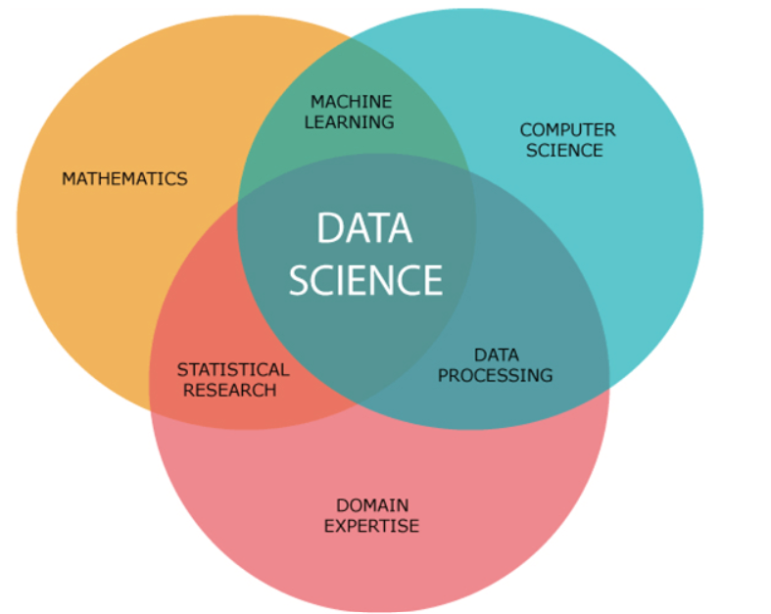
What is Data Science
Data science is a multidisciplinary field that involves the use of statistical and computational methods to extract insights and knowledge from data.
It combines aspects of statistics, computer science, and domain-specific knowledge to solve complex problems and generate valuable insights.

Slide 24
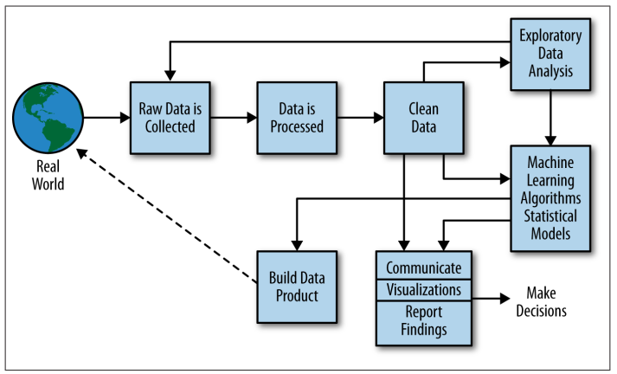
The Data Science Process

Slide 25
References
Introduction to Data Science, Lecture 6: Exploratory Data Analysis, CS 194 Spring 2014, Michael Franklin

