Slide 1
Exploratory Data Analysis
“Exploratory data analysis” is an attitude, a state of flexibility, a willingness to look for those things that we believe are not there, as well as those we believe to be there.
— John Tukey

Slide 2
Exploratory Data Analysis
The analysis of datasets based on various numerical methods and graphical tools.
Exploring data for patterns, trends, underlying structure, deviations from the trend, anomalies and strange structures.
It facilitates discovering unexpected as well as conforming the expected.
Another definition: An approach/philosophy for data analysis that employs a variety of techniques (mostly graphical).

Slide 3
Why is exploratory data analysis important in data science?
Improve understanding of variables by extracting averages, mean, minimum, and maximum values, etc.
Discover errors, outliers, and missing values in the data.
Identify patterns by visualizing data in graphs such as bar graphs, scatter plots, heatmaps and histograms.

Slide 4
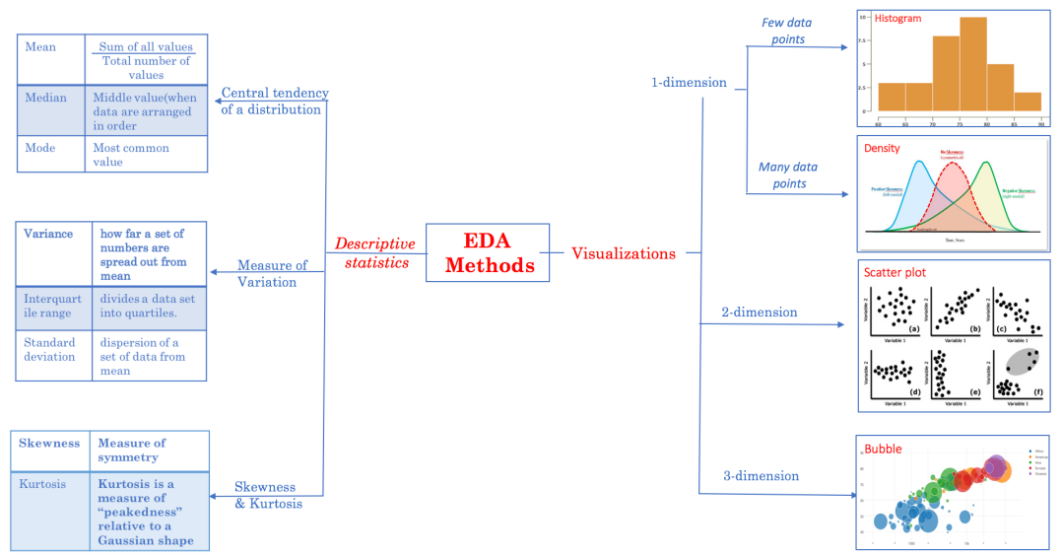
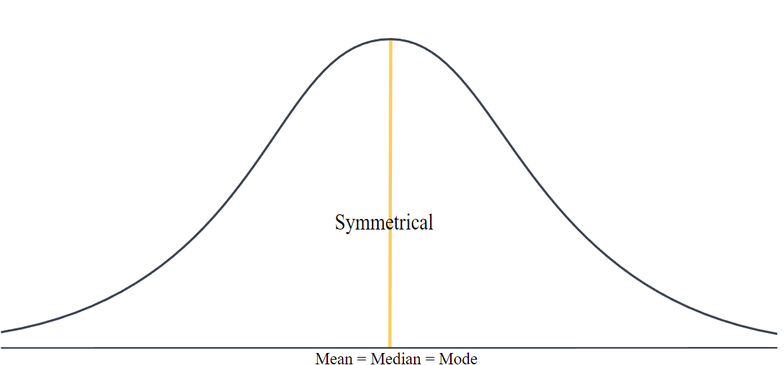
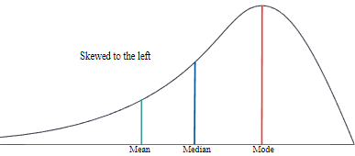
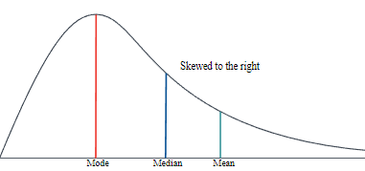
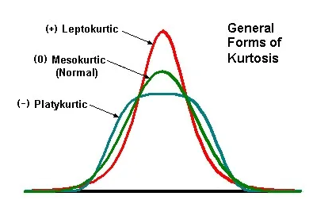
EDA Methods
Describe features of a data set by generating summaries about data samples.
http://users.encs.concordia.ca/~gregb/home/PDF/comp333-eda.pdf

Slide 5
Dimensionality of Data Sets
Univariate: Measurement made on one variable per subject
Bivariate: Measurement made on two variables per subject
Multivariate: Measurement made on many variables per subject

Slide 6
Types of exploratory data analysis
Univariate non-graphical
Mean, std, etc.
Univariate graphical
Stem-and-leaf plots, which show all data values and the shape of the distribution.
Histograms, a bar plot in which each bar represents the frequency (count) or proportion (count/total count) of cases for a range of values.
Box plots, which graphically depict the five-number summary: minimum, first quartile, median, third quartile, and maximum.
Multivariate nongraphical
cross-tabulation or statistics
Multivariate graphical
Scatter plot, Bubble chart, Heat map, etc.
https://www.ibm.com/topics/exploratory-data-analysis#:~:text=Exploratory%20data%20analysis%20(EDA)%20is,often%20employing%20data%20visualization%20methods.

Slide 7
Exploratory data analysis tools
Clustering and dimension reduction techniques, which help create graphical displays of high-dimensional data containing many variables.
Univariate visualization of each field in the raw dataset, with summary statistics.
Bivariate visualizations and summary statistics that allow you to assess the relationship between each variable in the dataset and the target variable you’re looking at.
Multivariate visualizations, for mapping and understanding interactions between different fields in the data.

Slide 8
Motivation for using Python for Data Analysis
Open Source
Easy to Learn
Comprehensive set of libraries for Data Analysis

Slide 9
Acknowledgements
O'Neil, C., & Schutt, R. (2013). Doing data science: Straight talk from the frontline. " O'Reilly Media, Inc.".
Data Mining: Concepts and Techniques (3rd ed.), Jiawei Han, Micheline Kamber, and Jian Pei

