Slide 1
Essential Python Libraries

Slide 2
Python Libraries
Python libraries contain a collection of built-in modules that allow us to perform many actions without writing detailed programs for it.
Each library in Python contains a large number of modules that one can import and use.
NumPy, Pandas, Matplotlib, SciPy, scikit-learn and stats models are well-established Python libraries for scientific and analytical use.

Slide 3
NumPy
Base python does not include true vectorized data structures–vectors, matrices, etc.
For small things one can use lists, lists of lists, and list comprehensions. However, such code will be bulky and slow.
NumPy stands for Numerical Python. A core python library used when working with arrays and for scientific computing.
It also has inbuilt functions for working with linear algebra, matrices and data science.
It has an N-dimensional array object(ndarray) which is in the form of rows and columns.

Slide 4
Importing the NumPy module
import numpy
import numpy as np
from numpy import *
np is pretty much the standard acronym for the numpy and widely used in online documentation.
Which one you will prefer?

Slide 5
Array: The Fundamental Data Structure in Numpy
Numpy is fundamentally based on arrays, N-dimensional data structures
Arrays are similar to lists in Python, except that every element of an array must be of the same type, typically a numeric type like float or int.
Besides arrays, numpy also provides a plethora of functions that operate on the arrays, including vectorized mathematics and logical operations.

Slide 6
Pandas
It is a package useful for data analysis and manipulation.
Pandas provide an easy way to create, manipulate and wrangle the data.
Pandas provide powerful and easy-to-use data structures, as well as the means to quickly perform operations on these structures.

Slide 7
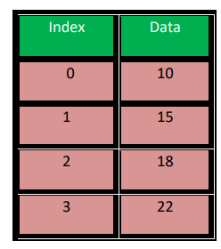
Data Structure In Pandas
Series
Series is a one-dimensional array like structure with homogeneous data, which can be used to handle and manipulate data. What makes it special is its index attribute, which has incredible functionality and is heavily mutable.
It has two parts
Data part (An array of actual data)
Associated index with data (associated array of indexes or data labels)
Data Frame
Panel

Slide 8
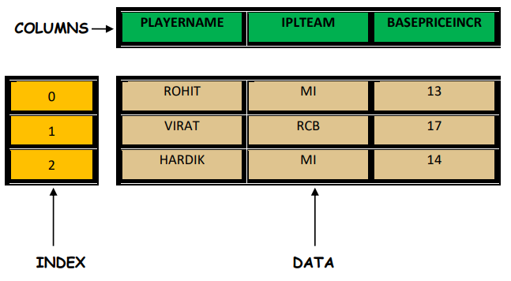
Data Structure In Pandas
Series
Data Frame
It is a two-dimensional object that is useful in representing data in the form of rows and columns. It is similar to a spreadsheet or an SQL table.
A Dataframe contains Heterogeneous data.
Panel
The panel is a 3D data container.

Slide 9
Data Frame data types
Pandas Type | Native Python Type | Description
object | string | The most general dtype. Will be assigned to your column if column has mixed types (numbers and strings).
int64 | int | Numeric characters. 64 refers to the memory allocated to hold this character.
float64 | float | Numeric characters with decimals. If a column contains numbers and NaNs, pandas will default to float64, in case your missing value has a decimal.
datetime64, timedelta[ns] | N/A | Values meant to hold time data. Look into these for time series experiments.

Slide 10
Data Frames attributes
df.attribute | description
dtypes | list the types of the columns
columns | list the column names
axes | list the row labels and column names
ndim | number of dimensions
size | number of elements
shape | return a tuple representing the dimensionality
values | numpy representation of the data

Slide 11
Data Frames methods
df.method() | description
head( [n] ), tail( [n] ) | first/last n rows
describe() | generate descriptive statistics (for numeric columns only)
max(), min() | return max/min values for all numeric columns
mean(), median() | return mean/median values for all numeric columns
std() | standard deviation
sample([n]) | returns a random sample of the data frame
dropna() | drop all the records with missing values

Slide 12
Pandas vs. NumPy
Pandas DataFrame deals with tabular data | Numpy array deals with Numerical data
Heterogenous element | Homogenous element
Pandas has a better performance over large dataset | Numpy has a better performance over smaller dataset

Slide 13
Reading data using pandas
read_csv()
read_excel()
read_json()
read_sql()

Slide 14
Matplotlib

Slide 15
SciPy

Slide 16
Scikit-learn

Slide 17
Statsmodels

Slide 18
Acknowledgements
O'Neil, C., & Schutt, R. (2013). Doing data science: Straight talk from the frontline. " O'Reilly Media, Inc.".

