Slide 1
Introduction to Classification

Slide 2
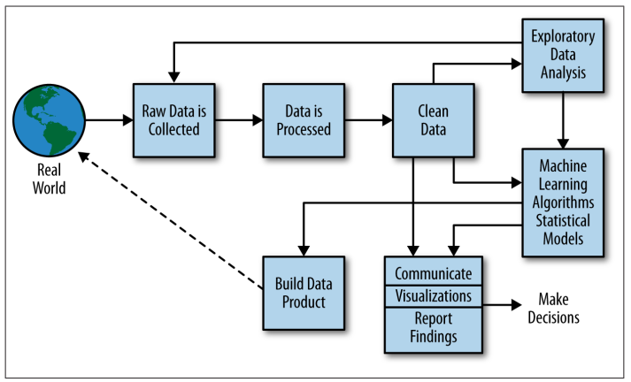
Recall: The Data Science Process

Slide 3
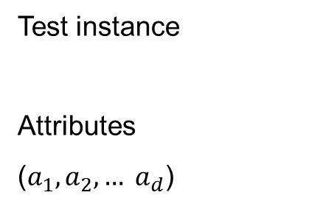
Classification Problem
A machine learning task that deals with identifying the class to which an instance belongs
A classifier performs classification
Classifier
( Textual features : Ngrams )
( Age, Marital status,
Health status, Salary )
( Perceptive inputs )
Test instance
Attributes
($a_{1}, a_{2},… a_{d}$)
Discrete-valued
Class label
Category of document? {Politics, Movies, Biology}
Steer? { Left, Straight, Right }
Issue Loan? {Yes, No}

Slide 4









Classification Problem
Classical Classification
The classes are exclusive, if an example belongs to one class, it can’t be belonging to others
We assign one class label l_{i} from a set L = {l₁, …, l_{k}} to each example
Binary Classification
|L| = 2
Classification of email into spam and non-spam
Multi-class Classification
|L| > 2
Classification of email into one of the predefined classes such as primary, social, promotions, updates, forum, etc.
Instance
Function/Label
$$x_{1}$$
$$+1$$
.
.
.
$$−1$$
$$x_{N}$$
Binary classification
$$x_{1}$$
$$y_{1}$$
.
.
.
$$y_{2}$$
$$x_{N}$$
.
.
.
$$y_{L}$$
Multi-class classification

Slide 5
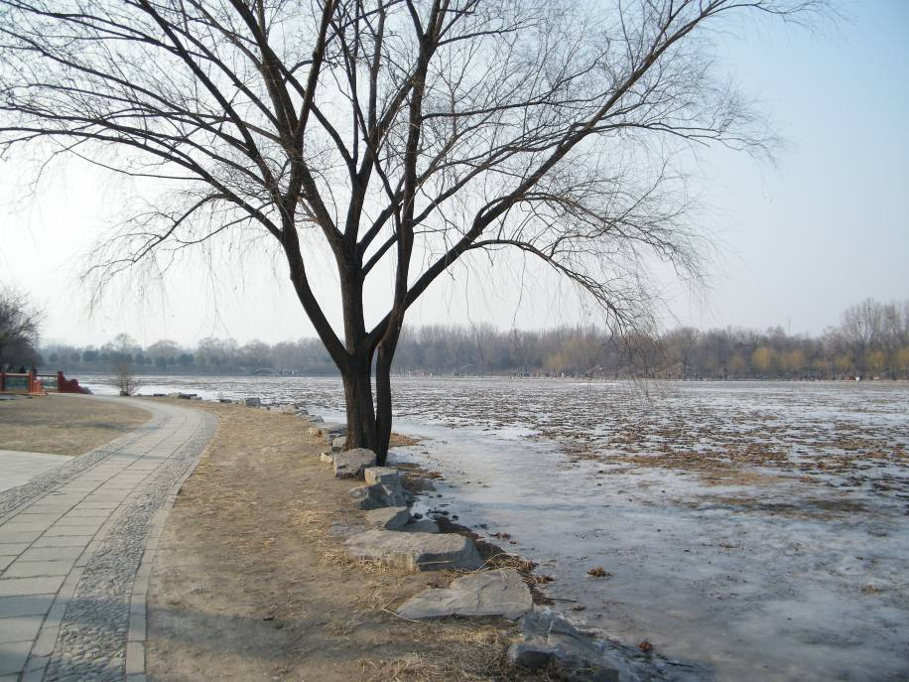
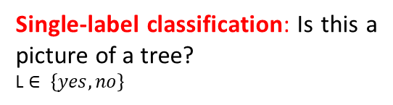
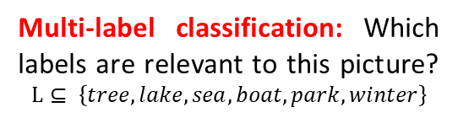
Multi-Label Classification
However, in many real-world classification tasks, the data object can simultaneously belong to one or more classes in L
Example
In protein function prediction, a protein can be associated with a set of functional role such as metabolism, energy, cell fate, storage protein, localization
In web mining, a web page can be classified as news, academic, e-commerce, blog, forum etc.
Similarly, in image classification, an image can be annotated with several classes such as sea, sky, tree, mountain, valley, and so on
Tree
Winter
Park
Lake
Single-label classification: Is this a picture of a tree?
L $∈ \left\{yes, no\right\}$
Multi-label classification: Which labels are relevant to this picture? $$L⊆ \left\{tree, lake, sea, boat, park, winter\right\}$$

Slide 6
Illustrating Classification Task

Slide 7
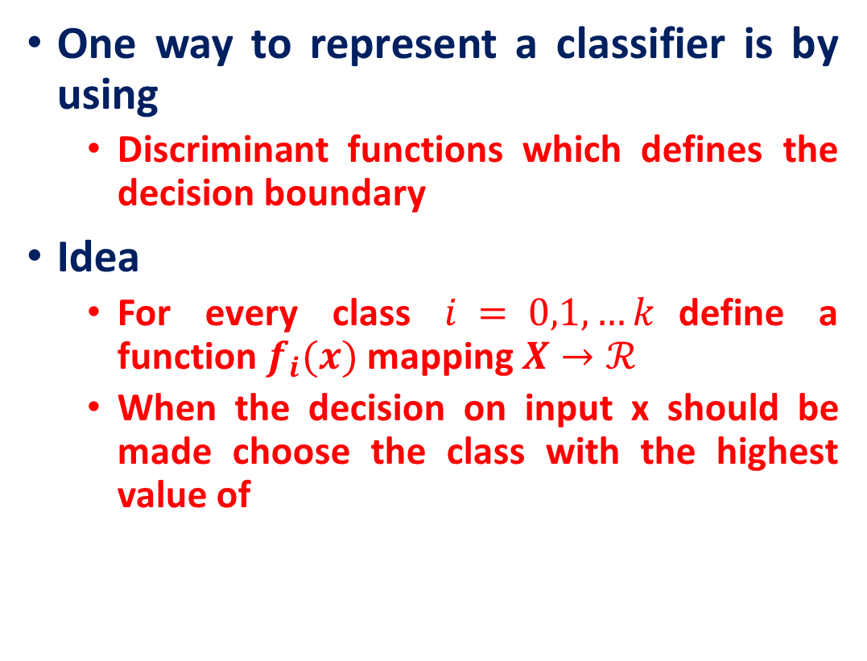
Discriminant Function
One way to represent a classifier is by using
Discriminant functions which defines the decision boundary
Idea
For every class $i = 0,1, …k$define a function $f_{i}(x)$ mapping $X→ℛ$
When the decision on input x should be made choose the class with the highest value of

Slide 8
Discriminant Function
It can be arbitrary functions of x, such as:
Nearest
Neighbor
Decision
Tree
Linear
Functions
Nonlinear
Functions

Slide 9
Nearest-Neighbor Classifier

Slide 10
k-NN Approach
The simplest, most used instance-based learning algorithm is the k-NN algorithm
k-NN assumes that all instances are points in some d-dimensional space and defines neighbors in terms of distance
Where k is the number of neighbors considered

Slide 11
k-NN Approach
Requires three things:
The set of stored records
Distance Metric to compute distance between records
The value of k, the number of nearest neighbors to retrieve
To classify an unknown record:
Compute distance to other training records
Identify k nearest neighbors
Use class labels of nearest neighbors to determine the class label of unknown record (e.g., by taking majority vote)
Source: Nearest-Neighbor Classifier MTL 782 IIT DELHI

Slide 12
Definition of Nearest Neighbor
K-nearest neighbors of a record x are data points that have the k smallest distance to x

Slide 13
k-NN Visualization
+ points
- points
Unknown point
1-NN:

Slide 14
k-NN Visualization
+ points
- points
Unknown point
2-NN:

Slide 15
k-NN Visualization
+ points
- points
Unknown point
3-NN:

Slide 16
k-NN Visualization
+ points
- points
Unknown point
4-NN:
/

Slide 17
k-NN Visualization
+ points
- points
Unknown point
5-NN:

Slide 18
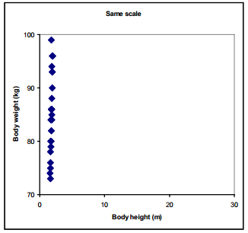
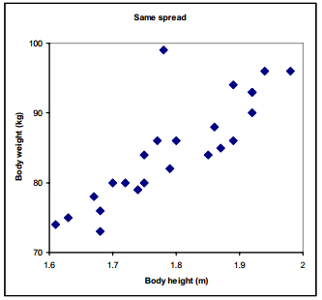
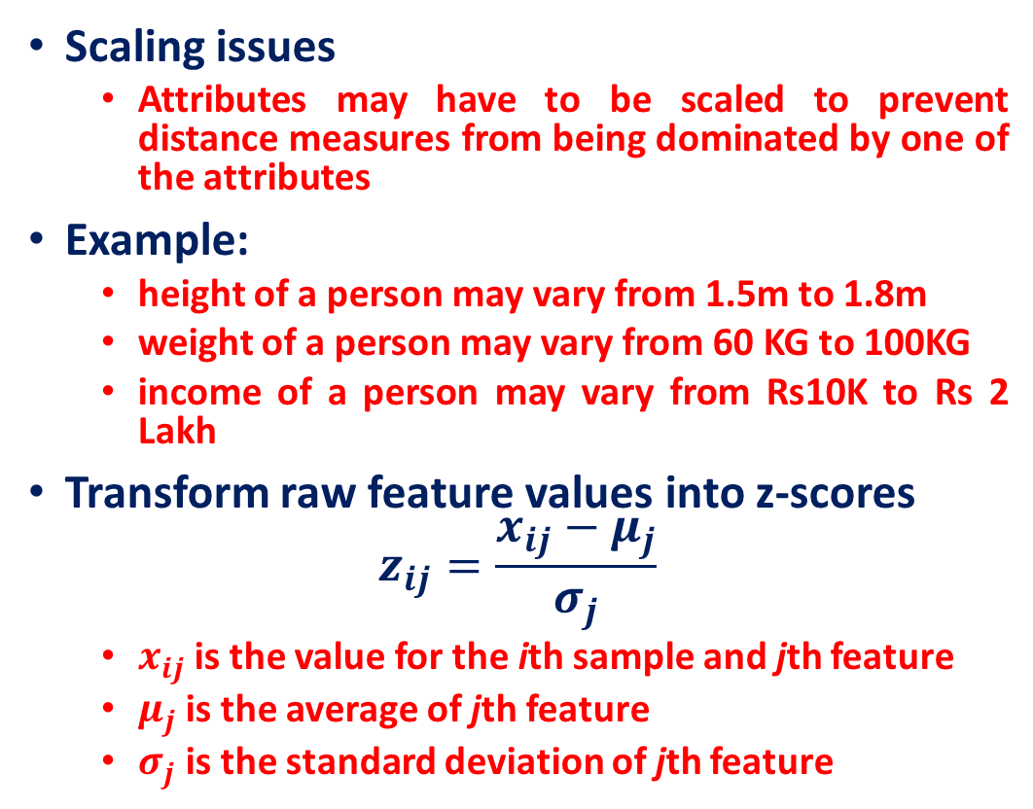
Standardization
Scaling issues
Attributes may have to be scaled to prevent distance measures from being dominated by one of the attributes
Example:
height of a person may vary from 1.5m to 1.8m
weight of a person may vary from 60 KG to 100KG
income of a person may vary from Rs10K to Rs 2 Lakh
Transform raw feature values into z-scores
$$z_{ij}=\frac{x_{ij}−μ_{j}}{σ_{j}}$$
$x_{ij}$is the value for the ith sample and jth feature
$μ_{j}$is the average of jth feature
$σ_{j}$is the standard deviation of jth feature

Slide 19
KNN Example
Example 1 (great, no, no, normal, no)
Most similar: number 2 (1 mismatch, 4 match): yes
Second most similar example: number 1 (2 mismatch, 3 match): yes
Example 2 (mediocre, yes, no, normal, no):
Most similar: number 3 (1 mismatch, 4 match): no
Second most similar example: number 1 (2 mismatch, 3 match): yes
: yes
yes/no
Source: CS 4700: Foundations of Artificial Intelligence, Carla P. Gomes

Slide 20
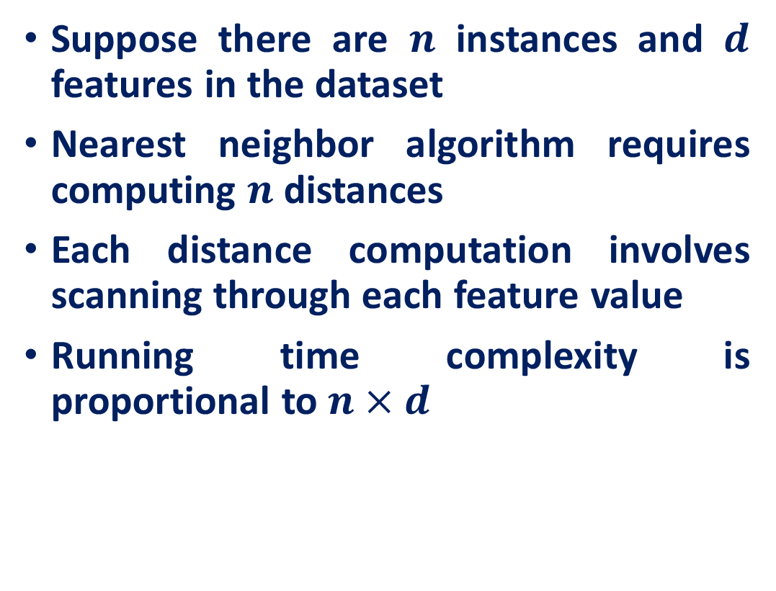
k-NN Time Complexity
Suppose there are $n$ instances and $d$ features in the dataset
Nearest neighbor algorithm requires computing $n$ distances
Each distance computation involves scanning through each feature value
Running time complexity is proportional to $n×d$

Slide 21
k-NN variations
Value of k
Larger k increases confidence in prediction
Note that if k is too large, decision may be skewed
Smaller k leads to unstable decision boundary
Weighted evaluation of nearest neighbors
Plain majority may unfairly skew decision
Revise algorithm so that closer neighbors have greater “vote weight”
Other distance measures

Slide 22
Other distance measures
City-block distance (Manhattan dist)
Add absolute value of differences
Cosine similarity
Measure angle formed by the two samples (with the origin)
Jaccard distance
Determine percentage of exact matches between the samples (not including unavailable data)
Others

Slide 23
Some Remarks
k-NN works well on many practical problems and is fairly noise tolerant (depending on the value of k)
k-NN is subject to the curse of dimensionality (i.e., presence of many irrelevant attributes)
k-NN needs adequate distance measure

Slide 24
Decision Tree

Slide 25
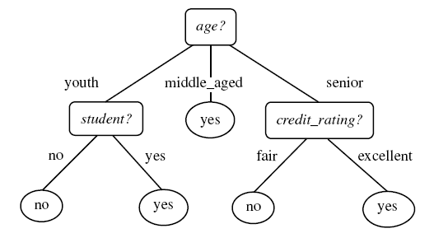
Example tree
Intermediate nodes : Attributes value tests
Edges : Attribute value
Leaf nodes : Class predictions
Example algorithms: ID3, SPRINT, CART

Slide 26
Decision Tree schematic
Training data set
a1 a2 a3 a4 a5 a6
a1 a2 a3 a4 a5 a6
X
Y
Z
Impure node,
Select best attribute
and continue
Impure node,
Select best attribute
and continue
Pure node,
Leaf node:
Class RED

Slide 27
Apply Model to Test Data
Test Data
Start from the root of tree.
Refund
Yes
No
NO
MarSt
Single, Divorced
Married
TaxInc
NO
< 80K
> 80K
NO
YES

Slide 28
Apply Model to Test Data
Test Data
Refund
Yes
No
NO
MarSt
Single, Divorced
Married
TaxInc
NO
< 80K
> 80K
NO
YES

Slide 29
Apply Model to Test Data
Test Data
Refund
Yes
No
NO
MarSt
Single, Divorced
Married
TaxInc
NO
< 80K
> 80K
NO
YES

Slide 30
Apply Model to Test Data
Test Data
Refund
Yes
No
NO
MarSt
Single, Divorced
Married
TaxInc
NO
< 80K
> 80K
NO
YES

Slide 31
Apply Model to Test Data
Test Data
Refund
Yes
No
NO
MarSt
Single, Divorced
Married
TaxInc
NO
< 80K
> 80K
NO
YES

Slide 32
Apply Model to Test Data
Test Data
Refund
Yes
No
NO
MarSt
Single, Divorced
Married
Assign Cheat to “No”
TaxInc
NO
< 80K
> 80K
NO
YES

Slide 33
How to Build Decision Trees
Greedy strategy.
Split the records based on an attribute test that optimizes certain criterion.
Issues
Determine how to split the records
How to specify the attribute test condition?
How to determine the best split?
Determine when to stop splitting

Slide 34
How to determine the Best Split
Before Splitting: 10 records of class 0, 10 records of class 1
Which test condition is the best?

Slide 35
How to determine the Best Split
Greedy approach:
Nodes with homogeneous class distribution are preferred
Need a measure of node impurity:
Non-homogeneous,
High degree of impurity
Homogeneous,
Low degree of impurity

Slide 36
Measures of Node Impurity
Entropy
Gini Index
Misclassification error

Slide 37
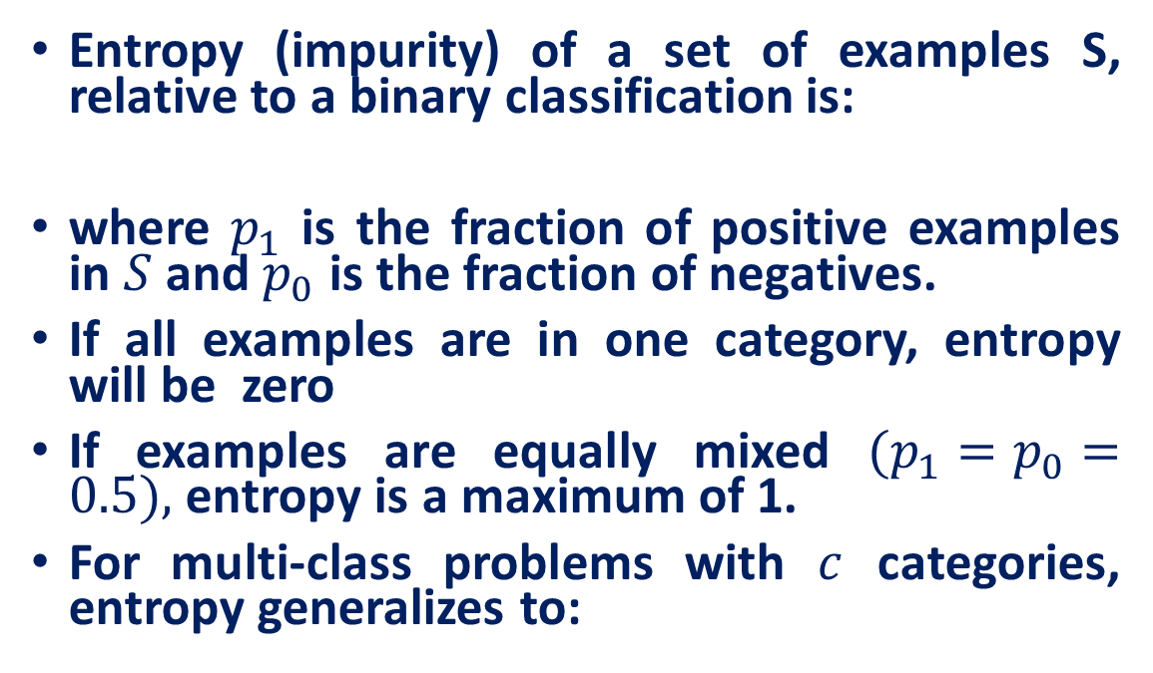
Entropy
Entropy (impurity) of a set of examples S, relative to a binary classification is:
where $p_{1}$ is the fraction of positive examples in $S$ and $p_{0}$ is the fraction of negatives.
If all examples are in one category, entropy will be zero
If examples are equally mixed $(p_{1}=p_{0}=0.5),$entropy is a maximum of 1.
For multi-class problems with $c$ categories, entropy generalizes to:

Slide 38
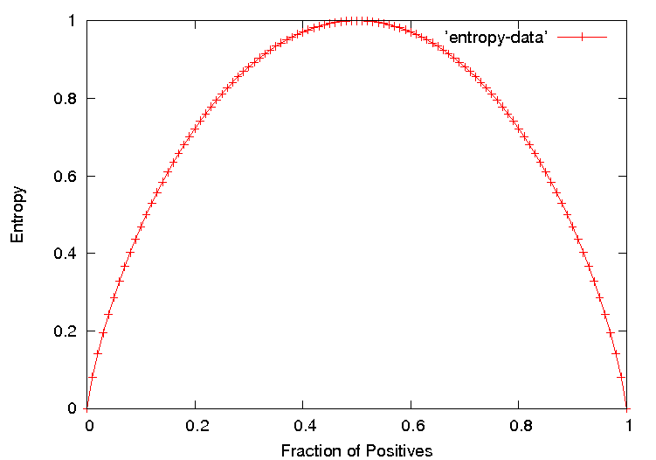
Entropy Plot for Binary Classification

Slide 39
Information Gain
The information gain of an attribute F is the expected reduction in entropy resulting from splitting on this feature.
where S_{v} is the subset of S having value v for feature F.
Entropy of each resulting subset weighted by its relative size.

Slide 40
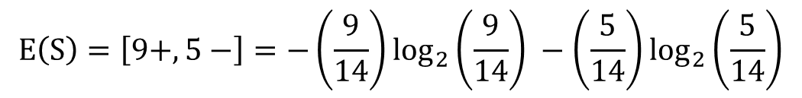

Example
$E\left(S\right)=−P_{⊕}\log_{2}{P_{⊕}} −$ $P_{⊖}\log_{2}{P_{⊖}}$
$$E\left(S\right)=\left[9+,5−\right]=−\left(\frac{9}{14}\right)\log_{2}\left(\frac{9}{14}\right) −\left(\frac{5}{14}\right)\log_{2}\left(\frac{5}{14}\right)$$
$$E\left(S\right)=0.94$$
$$E\left({Outlook}_{sunny}\right)= \left[2+,3−\right]=−\left(\frac{2}{5}\right)\log_{2}\left(\frac{2}{5}\right) −\left(\frac{3}{5}\right)\log_{2}\left(\frac{3}{5}\right)=0.971$$
$E\left({Outlook}_{overcast}\right)=\left[4+,0−\right]=−\left(\frac{4}{4}\right)\log_{2}\left(\frac{4}{4}\right) −\left(\frac{0}{4}\right)\log_{2}\left(\frac{0}{4}\right)$ = 0
$$E\left({Outlook}_{rainy}\right)= \left[3+,2−\right]=−\left(\frac{3}{5}\right)\log_{2}\left(\frac{3}{5}\right) −\left(\frac{2}{5}\right)\log_{2}\left(\frac{2}{5}\right)=0.971$$
S: Data set

Slide 41
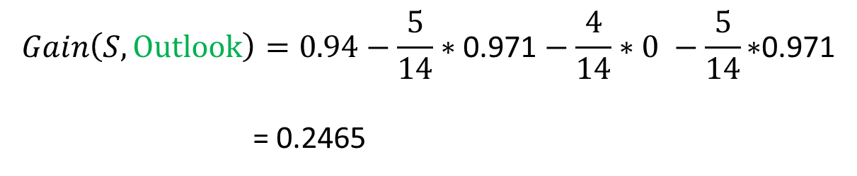
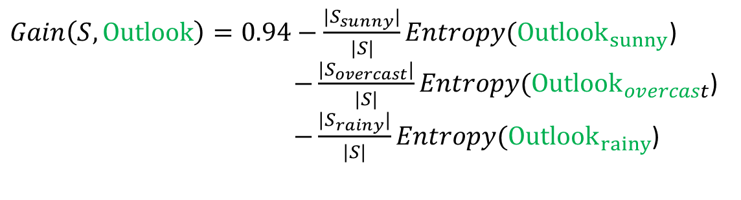
Example
$Gain\left(S,Outlook\right)=0.94−\frac{{|S}_{sunny}|}{|S|}Entropy({Outlook}_{sunny}$) $−\frac{{|S}_{overcast}|}{|S|}Entropy({Outlook}_{overcast}$)
$−\frac{{|S}_{rainy}|}{|S|}Entropy({Outlook}_{rainy}$)
$$Gain\left(S,Outlook\right)=0.94−\frac{5}{14}∗\text{0.971}−\frac{4}{14}∗0 −\frac{5}{14}\text{∗}\text{0.971}$$
= 0.2465
S: Data set

Slide 42
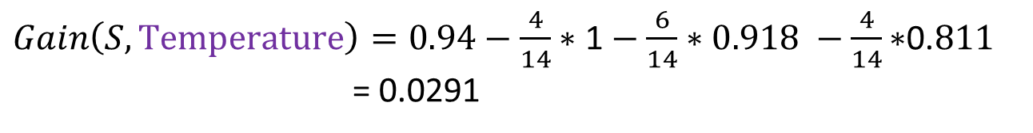
Example
$$E\left({Temperature}_{hot}\right)= \left[2+,2−\right]=−\left(\frac{2}{4}\right)\log_{2}\left(\frac{2}{4}\right) −\left(\frac{2}{4}\right)\log_{2}\left(\frac{2}{4}\right)=1$$
$E\left({Temperature}_{mild}\right)=\left[4+,2−\right]=−\left(\frac{4}{6}\right)\log_{2}\left(\frac{4}{6}\right) −\left(\frac{2}{6}\right)\log_{2}\left(\frac{2}{6}\right)$ = 0.918
$$E\left({Temperature}_{cold}\right)= \left[3+,1−\right]=−\left(\frac{3}{4}\right)\log_{2}\left(\frac{3}{4}\right) −\left(\frac{1}{4}\right)\log_{2}\left(\frac{1}{4}\right)=0.811$$
$Gain\left(S,Temperature\right)=0.94−\frac{4}{14}∗\text{1}−\frac{6}{14}∗0.918 −\frac{4}{14}\text{∗}\text{0.}811$
= 0.0291
S: Data set

Slide 43
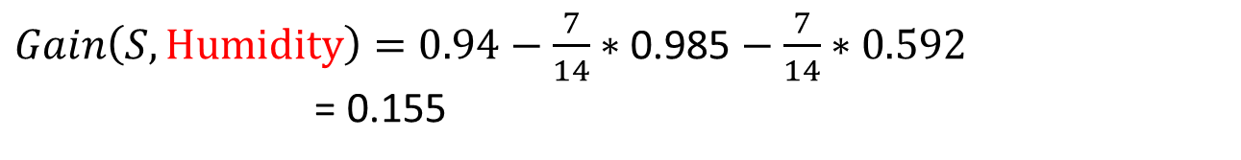
Example
$$E\left({Humidity}_{high}\right)= \left[3+,4−\right]=−\left(\frac{3}{7}\right)\log_{2}\left(\frac{3}{7}\right) −\left(\frac{4}{7}\right)\log_{2}\left(\frac{4}{7}\right)=0.985$$
$E\left({Humidity}_{normal}\right)=\left[6+,1−\right]=−\left(\frac{6}{7}\right)\log_{2}\left(\frac{6}{7}\right) −\left(\frac{1}{7}\right)\log_{2}\left(\frac{1}{7}\right)$ = 0.592
$Gain\left(S,Humidity\right)=0.94−\frac{7}{14}∗\text{0.985}−\frac{7}{14}∗0.592$
= 0.155
S: Data set

Slide 44
Example
$$E\left({Wind}_{weak}\right)=\left[6+,2−\right]=−\left(\frac{6}{8}\right)\log_{2}\left(\frac{6}{8}\right) −\left(\frac{2}{8}\right)\log_{2}\left(\frac{2}{8}\right)=0.811$$
$E\left({Wind}_{strong}\right)=\left[3+,3−\right]=−\left(\frac{3}{6}\right)\log_{2}\left(\frac{3}{6}\right) −\left(\frac{3}{6}\right)\log_{2}\left(\frac{3}{6}\right)$ = 1
$Gain\left(S,Wind\right)=0.94−\frac{8}{14}∗\text{0.811}−\frac{6}{14}∗1$ = 0.0480
S: Data set

Slide 45
Example
D₁, D_{2,} D₁,…, D₁₄
[9+, 5-]
Outlook
Sunny
Overcast
Rainy
D₁, D_{2,} D₈, D₉, D₁₁
[2+, 3-]
D₃, D_{7,} D₁₂, D₁₃
[4+, 0-]
D₄, D_{5,} D₆, D₁₀, D₁₄
[3+, 2-]
?
Yes
?
S: Data set
Which attribute should be tested here ?

Slide 46
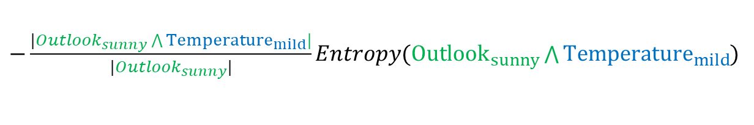
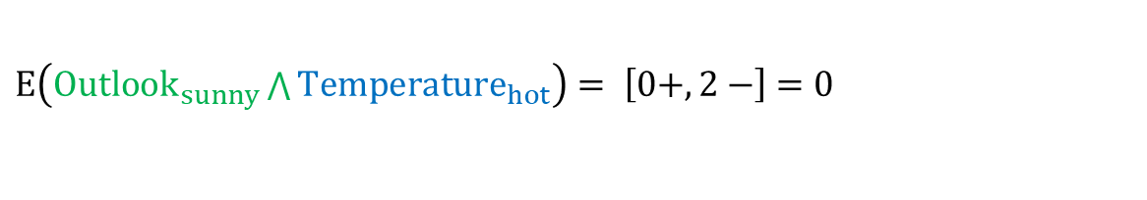
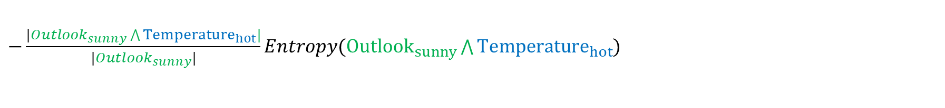

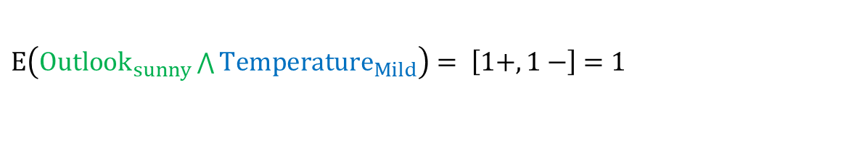
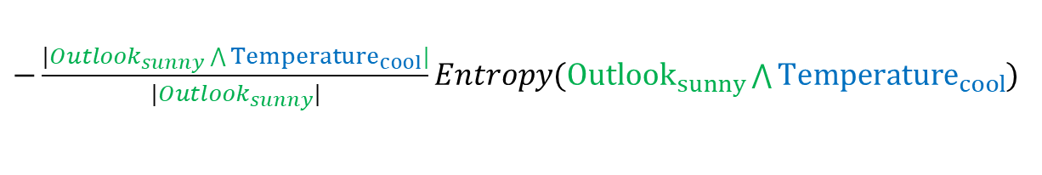
Example
$$E\left({Outlook}_{sunny}\right)= \left[2+,3−\right]=−\left(\frac{2}{5}\right)\log_{2}\left(\frac{2}{5}\right) −\left(\frac{3}{5}\right)\log_{2}\left(\frac{3}{5}\right)=0.971$$
$E\left({Outlook}_{sunny}\bigwedge{Temperature_{hot}}\right)= \left[0+,2−\right]$ $=0$
$E\left({Outlook}_{sunny}\bigwedge{Temperature_{Mild}}\right)= \left[1+,1−\right]$ $=1$
$E\left({Outlook}_{sunny}\bigwedge{Temperature_{cool}}\right)= \left[1+,0−\right]$ $=0$
$$Gain\left({Outlook}_{sunny}, Temperature\right)=E({Outlook}_{sunny})$$
$−\frac{|{Outlook}_{sunny}\bigwedge{Temperature_{hot}}|}{|{Outlook}_{sunny}|}Entropy({Outlook}_{sunny}\bigwedge{Temperature_{hot}}$)
$−\frac{|{Outlook}_{sunny}\bigwedge{Temperature_{mild}}|}{|{Outlook}_{sunny}|}Entropy({Outlook}_{sunny}\bigwedge{Temperature_{mild}}$)
$−\frac{|{Outlook}_{sunny}\bigwedge{Temperature_{cool}}|}{|{Outlook}_{sunny}|}Entropy({Outlook}_{sunny}\bigwedge{Temperature_{cool}}$)
S: Data set

Slide 47
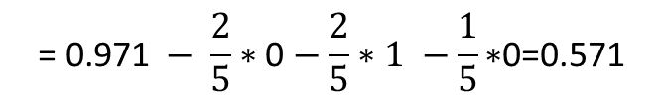

Example
$$Gain\left({Outlook}_{sunny}, Temperature\right)=$$
$$\text{= }\text{0.971} − \frac{2}{5}∗\text{0}−\frac{2}{5}∗1 −\frac{1}{5}\text{∗}\text{0}\text{=0.571}$$
S: Data set

Slide 48
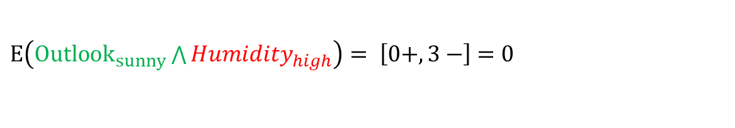
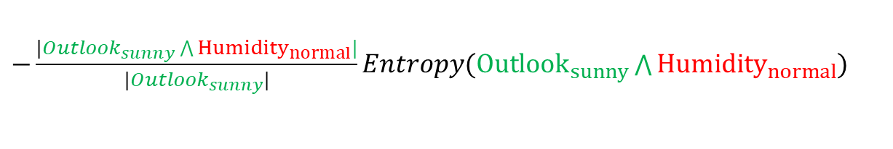
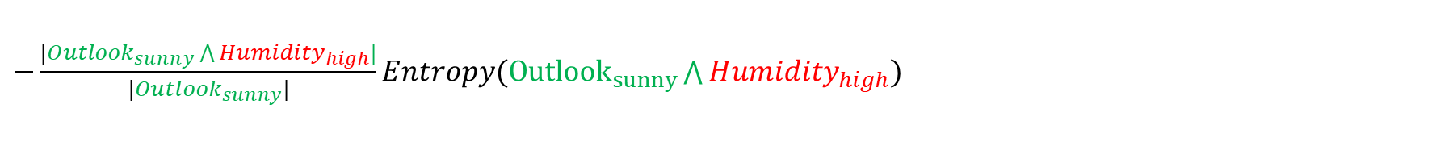
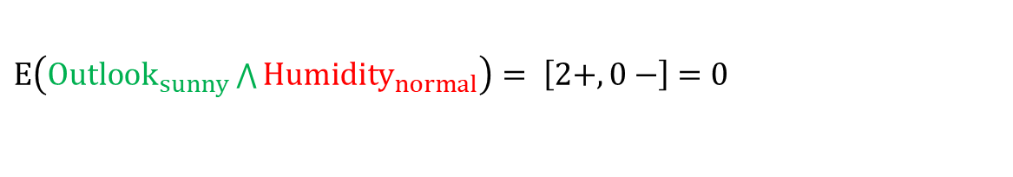
Example
$$E\left({Outlook}_{sunny}\right)= \left[2+,3−\right]=−\left(\frac{2}{5}\right)\log_{2}\left(\frac{2}{5}\right) −\left(\frac{3}{5}\right)\log_{2}\left(\frac{3}{5}\right)=0.971$$
$E\left({Outlook}_{sunny}\bigwedge{Humidity_{high}}\right)= \left[0+,3−\right]$ $=0$
$E\left({Outlook}_{sunny}\bigwedge{{Humidity}_{normal}}\right)= \left[2+,0−\right]$ $=0$
$$Gain\left({Outlook}_{sunny},Humidity\right)=E({Outlook}_{sunny})$$
$−\frac{|{Outlook}_{sunny}\bigwedge{Humidity_{high}}|}{|{Outlook}_{sunny}|}Entropy({Outlook}_{sunny}\bigwedge{Humidity_{high}}$)
$−\frac{|{Outlook}_{sunny}\bigwedge{{Humidity}_{normal}}|}{|{Outlook}_{sunny}|}Entropy({Outlook}_{sunny}\bigwedge{{Humidity}_{normal}}$)
$$Gain\left({Outlook}_{sunny},Humidity\right)=0.971 −\frac{3}{5}∗\text{0}−\frac{2}{5}∗0 \text{=0.}\text{9}\text{71}$$
S: Data set

Slide 49
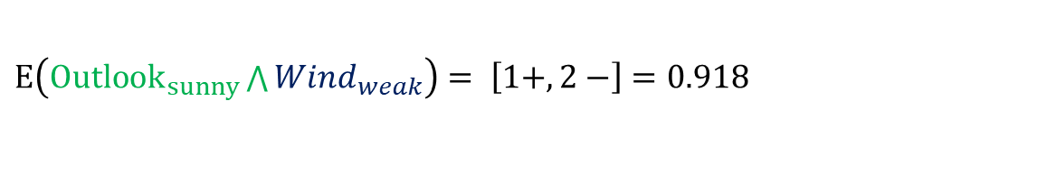
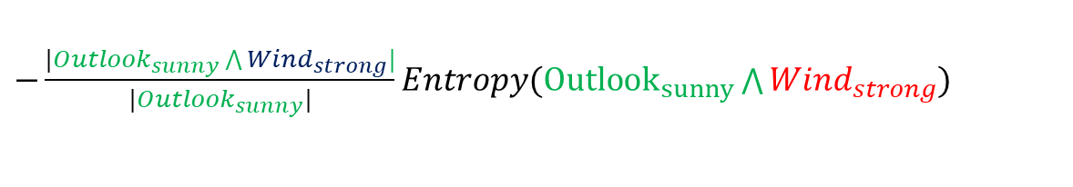
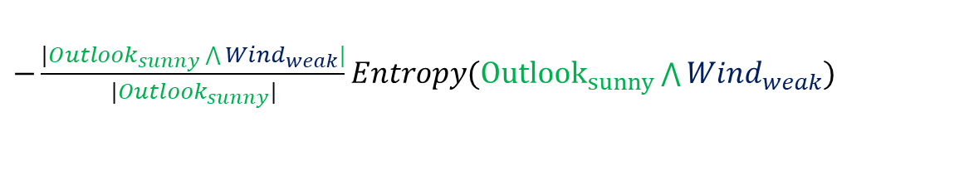
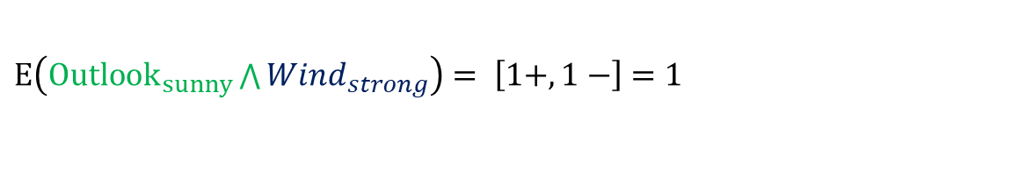
Example
$$E\left({Outlook}_{sunny}\right)= \left[2+,3−\right]=−\left(\frac{2}{5}\right)\log_{2}\left(\frac{2}{5}\right) −\left(\frac{3}{5}\right)\log_{2}\left(\frac{3}{5}\right)=0.971$$
$E\left({Outlook}_{sunny}\bigwedge{Wind_{weak}}\right)= \left[1+,2−\right]$ $=0.918$
$E\left({Outlook}_{sunny}\bigwedge{Wind_{strong}}\right)= \left[1+,1−\right]$ $=1$
$$Gain\left({Outlook}_{sunny},wind\right)=E({Outlook}_{sunny})$$
$−\frac{|{Outlook}_{sunny}\bigwedge{Wind_{weak}}|}{|{Outlook}_{sunny}|}Entropy({Outlook}_{sunny}\bigwedge{Wind_{weak}}$)
$−\frac{|{Outlook}_{sunny}\bigwedge{Wind_{strong}}|}{|{Outlook}_{sunny}|}Entropy({Outlook}_{sunny}\bigwedge{Wind_{strong}}$)
$$Gain\left({Outlook}_{sunny},Wind\right)=0.971 −\frac{3}{5}∗\text{0.918}−\frac{2}{5}∗1 \text{=}\text{0}\text{.02}\text{0}$$
S: Data set

Slide 50
Example
D₁, D_{2,} D₁,…, D₁₄
[9+, 5-]
Outlook
Sunny
Overcast
Rainy
D₁, D_{2,} D₈, D₉, D₁₁
[2+, 3-]
D₃, D_{7,} D₁₂, D₁₃
[4+, 0-]
D₄, D_{5,} D₆, D₁₀, D₁₄
[3+, 2-]
Humidity
Yes
?
High
Normal
D₁, D_{2,} D₈, [0+, 3-]
D₉, D₁₁
[2+, 0-]
No
Yes
S: Data set
Which attribute should be tested here ?

Slide 51
Triangles and Squares
Data Set: A set of classified objects
.
.
.
.
.
.

Slide 52
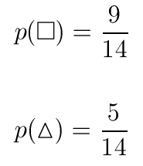

Entropy
5 triangles
9 squares
class probabilities
entropy
.
.
.
.
.
.

Slide 53



Entropy reduction by data set partitioning
.
.
.
.
.
.
.
.
red
Color?
green
.
yellow
.
.
.

Slide 54







Entropy reduction by data set partitioning
.
.
.
.
.
.
.
.
red
Color?
green
.
yellow
.
.
.

Slide 55
Information Gain
.
.
.
.
.
.
.
.
red
Color?
green
.
yellow
.
.
.

Slide 56
Information Gain of The Attribute
Attributes
Gain(Color) = 0.246
Gain(Outline) = 0.151
Gain(Dot) = 0.048
Heuristics: attribute with the highest gain is chosen
This heuristics is local (local minimization of impurity)

Slide 57
.
.
.
.
.
.
.
.
red
Color?
green
.
yellow
.
.
.
Gain(Outline) = 0.971 – 0 = 0.971 bits
Gain(Dot) = 0.971 – 0.951 = 0.020 bits

Slide 58
.
.
.
.
.
.
.
.
red
Gain(Outline) = 0.971 – 0.951 = 0.020 bits
Gain(Dot) = 0.971 – 0 = 0.971 bits
Color?
green
.
yellow
.
.
.
solid
.
Outline?
dashed
.

Slide 59
.
.
.
.
.
.
.
.
red
.
yes
Dot?
.
Color?
no
green
.
yellow
.
.
.
solid
.
Outline?
dashed
.

Slide 60
Decision Tree
.
.
.
.
.
.
Color
red
green
yellow
Dot
square
Outline
yes
no
dashed
solid
triangle
square
triangle
square

Slide 61
Definition
Decision tree is a classifier in the form of a tree structure
Decision node: specifies a test on a single attribute
Leaf node: indicates the value of the target attribute
Arc/edge: split of one attribute
Decision trees classify instances or examples by starting at the root of the tree and moving through it until a leaf node.

Slide 62
key requirements
Attribute-value description: object or case must be expressible in terms of a fixed collection of properties or attributes (e.g., hot, mild, cold).
Predefined classes (target values): the target function has discrete output values (Boolean or Multiclass)
Sufficient data: enough training cases should be provided to learn the model.

Slide 63
Splitting Based on Continuous Attributes
Different ways of handling
Discretization to form an ordinal categorical attribute
Static – discretize once at the beginning
Dynamic – ranges can be found by equal interval bucketing, equal frequency bucketing (percentiles), or clustering.
Binary Decision: (A < v) or (A ≥ v)
consider all possible splits and finds the best cut
can be more compute intensive

Slide 64
Binary Decision
For continuous attribute
Partition the continuous value of attribute A into a discrete set of intervals
Create a new Boolean attribute A_{c} , looking for a threshold c,
How to choose c ?

Slide 65
Continuous Attributes
For efficient computation: for each attribute,
Sort the attribute on values (static or dynamic)
Linearly scan these values
Choose the split position which gives you the in the purity
Sorted Values
Split Positions

Slide 66
Practical Issues of Classification
Underfitting and Overfitting
Missing Values

Slide 67
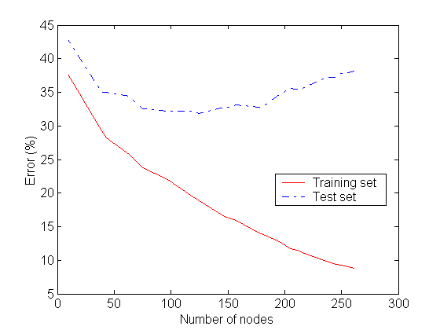
Underfitting and Overfitting
Overfitting
Underfitting: when model is too simple, both training and test errors are large

Slide 68
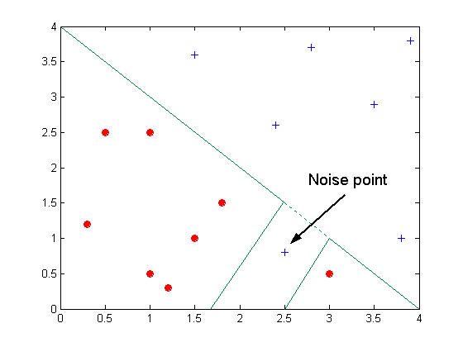
Overfitting due to Noise
Decision boundary is distorted by noise point

Slide 69
Overfitting due to Insufficient Examples
Misclassified Points
Lack of data points in the lower half of the diagram makes it difficult to predict correctly the class labels of that region
Insufficient number of training records in the region causes the decision tree to predict the test examples using other training records that are irrelevant to the classification task

Slide 70
Notes on Overfitting
Overfitting results in decision trees that are more complex than necessary
Training error no longer provides a good estimate of how well the tree will perform on previously unseen records

Slide 71
Occam’s Razor
Given two models of similar generalization errors, one should prefer the simpler model over the more complex model
For complex models, there is a greater chance that it was fitted accidentally by errors in data
Therefore, one should include model complexity when evaluating a model

Slide 72
How to Address Overfitting
Pre-Pruning (Early Stopping Rule)
Stop the algorithm before it becomes a fully-grown tree
Typical stopping conditions for a node:
Stop if all instances belong to the same class
Stop if all the attribute values are the same
More restrictive conditions:
Stop if number of instances is less than some user-specified threshold
Stop if expanding the current node does not improve purity measures.

Slide 73
How to Address Overfitting
Post-pruning
Grow decision tree to its entirety
Trim the nodes of the decision tree in a bottom-up fashion
If generalization error improves after trimming, replace sub-tree by a leaf node.
Class label of leaf node is determined from majority class of instances in the sub-tree

Slide 74
Handling Missing Attribute Values
Assume an attribute can take the value “blank”.
Assign most common value of A among training data at node n.
Assign most common value of A among training data at node n which have the same target class.

Slide 75
Strengths
Can generate understandable rules
Perform classification without much computation
Can handle continuous and categorical variables
Provide a clear indication of which fields are most important for prediction or classification

Slide 76
Weakness
Not suitable for prediction of continuous attribute.
Perform poorly with many class and small data.
Computationally expensive to train.
At each node, each candidate splitting field must be sorted before its best split can be found.
In some algorithms, combinations of fields are used and a search must be made for optimal combining weights.
Pruning algorithms can also be expensive since many candidate sub-trees must be formed and compared.

Slide 77
Measure of impurity: Gini index
Gini index for a given node t :
p( j | t ) is the relative frequency of class j at node t
Maximum (1 – 1 / n_{c} ) when records are equally distributed among all classes, implying least amount of information ( n_{c} = number of classes ).
Minimum ( 0.0 ) when all records belong to one class, implying most amount of information.

Slide 78
Wish list for a purity measure
Properties we require from a purity measure:
When node is pure, measure should be zero
When impurity is maximal (i.e. all classes equally likely), measure should be maximal
Measure should obey multistage property (i.e. decisions can be made in several stages):
Entropy is a function that satisfies all three properties!

Slide 79
Issue with Information Gain
There is a natural bias in the information gain measure that favors attributes with many values over those with few values.
As an extreme example, consider the attribute Date, which has a very large number of possible values, it would have the highest information gain of any of the attributes.
This is because Date alone perfectly predicts the target attribute over the training data.
Thus, it would be selected as the decision attribute for the root node of the tree and lead to a (quite broad) tree of depth one, which perfectly classifies the training data.
Of course, this decision tree would fare poorly on subsequent examples, because it is not a useful predictor despite the fact that it perfectly separates the training data.

Slide 80
The gain ratio
Gain ratio: a modification of the information gain that reduces its bias on high-branch attributes
Gain ratio takes number and size of branches into account when choosing an attribute
It corrects the information gain by taking the intrinsic information of a split into account. Also called split ratio
Intrinsic information: entropy of distribution of instances into branches
(i.e. how much info do we need to tell which branch an instance belongs to)

Slide 81
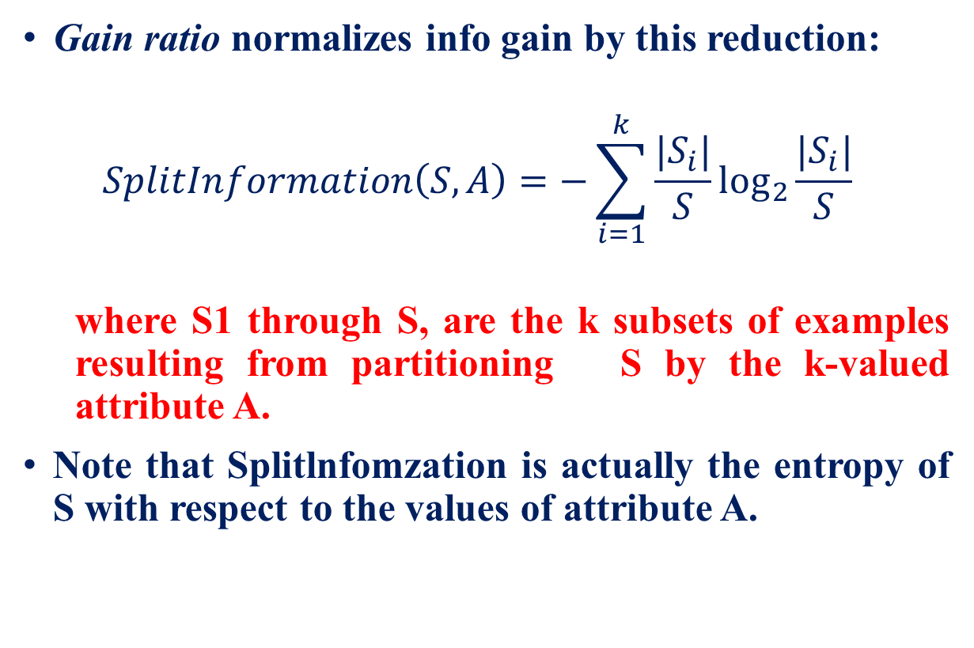
Gain Ratio
Gain ratio normalizes info gain by this reduction:
$$SplitInformation\left(S,A\right)=−\sum_{i=1}^{k}{\frac{|S_{i}|}{S}\log_{2}{\frac{|S_{i}|}{S}}}$$
where S1 through S, are the k subsets of examples resulting from partitioning S by the k-valued attribute A.
Note that Splitlnfomzation is actually the entropy of S with respect to the values of attribute A.

Slide 82
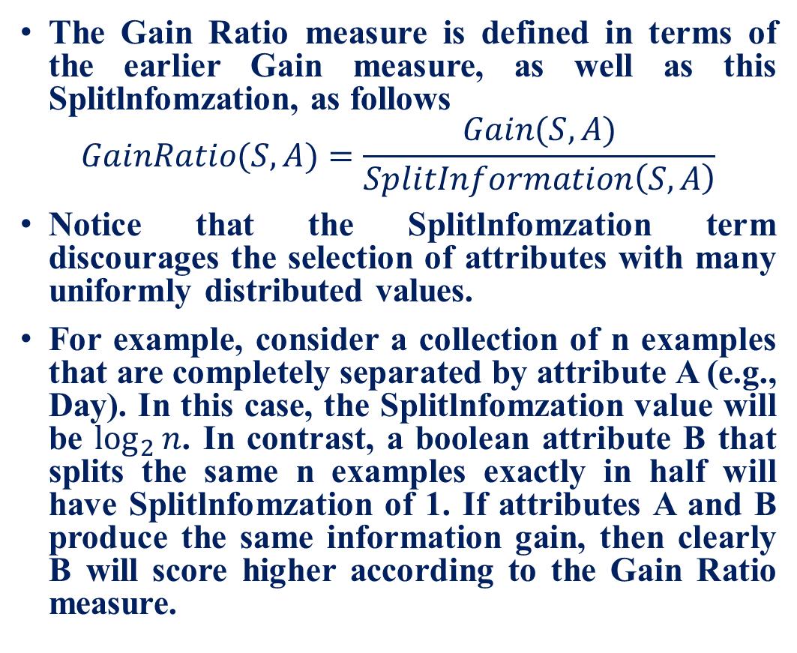
Gain Ratio
The Gain Ratio measure is defined in terms of the earlier Gain measure, as well as this Splitlnfomzation, as follows
$$GainRatio(S,A)=\frac{Gain(S,A)}{SplitInformation\left(S,A\right)}$$
Notice that the Splitlnfomzation term discourages the selection of attributes with many uniformly distributed values.
For example, consider a collection of n examples that are completely separated by attribute A (e.g., Day). In this case, the Splitlnfomzation value will be $\log_{2}{n}$. In contrast, a boolean attribute B that splits the same n examples exactly in half will have Splitlnfomzation of 1. If attributes A and B produce the same information gain, then clearly B will score higher according to the Gain Ratio measure.

Slide 83
CART: Classification and Regression Tree
Perform binary split at each node
For Classification tree Gini index is used as an impurity measure
For regression trees CART uses the following criteria function:

Slide 84
CART
Assign all objects to root node.
Split each attribute at all its possible split points (that is in between all the values observed for that variable in the considered node).
For each split point, split the parent node into two child nodes by separating the objects with values lower and higher than the split point for the considered explanatory variable.
Select the variable and split point with the highest reduction of impurity.
Perform the split of the parent node into the two child nodes according to the selected split point.
Repeat steps 2–5, using each node as a new parent node, until the tree has maximum size.
Prune the tree back using cross-validation to select the optimal sized tree

Slide 85
Acknowledgement
Classifiers, Prof. Pushpak Bhattacharyya and Aditya M Joshi
Nearest-Neighbor Classifier MTL 782 IIT DELHI
CS 4700: Foundations of Artificial Intelligence, Carla P. Gomes

