Slide 1
1) Dimensionality Reduction: PCA
Principal components analysis (also called the Karhunen-Loeve, or K-L method) searches for k n-dimensional orthogonal vectors that can best be used to represent the data, where k ≤ n.
Find a projection that captures the largest amount of variation in data
The original data are projected onto a much smaller space, resulting in dimensionality reduction. We find the eigenvectors of the covariance matrix, and these eigenvectors define the new space
x₂
e
x₁

Slide 2
1) Dimensionality Reduction: PCA
The original data are thus projected onto a much smaller space, resulting in dimensionality reduction.
Normalize input data: Each attribute falls within the same range.
Compute k orthonormal (unit) vectors, i.e., principal components.
Each input data (vector) is a linear combination of the k principal component vectors.
The principal components are sorted in order of decreasing “significance” or strength.
Since the components are sorted, the size of the data can be reduced by eliminating the weak components, i.e., those with low variance (i.e., using the strongest principal components, it is possible to reconstruct a good approximation of the original data)
Works for numeric data only

Slide 3
1) Dimensionality Reduction: PCA
Steps for PCA:
Step 1: Standardization (or Data normalization):
PCA normalized the input data, so that each attribute falls within the same range.
Normalization helps ensure that attributes with large domains will not dominate attributes with smaller domains.
Calculate mean.

Slide 4
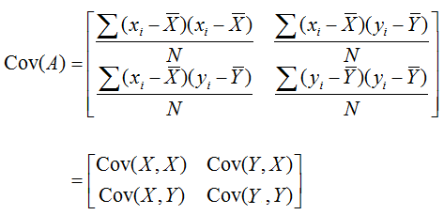
1) Dimensionality Reduction: PCA
Steps for PCA:
Step 2: Covariance matrix (Find Covariance Matrix to identify correlation):
This step calculates the covariance matrix of the standardized data.
Covariance matrix shows how each variable is related to every other variable in the dataset.
If the value of the Covariance Matrix is positive, then it indicates that the variables are correlated. (If X increases, Y also increases and vice versa)
If the value of the Covariance Matrix is negative, then it indicates that the variables are inversely correlated. (If X increases, Y also decreases and vice versa).
If the value of the Covariance Matrix is zero, then the variables are no correlated.

Slide 5
1) Dimensionality Reduction: PCA
Step 3: Calculate eigen value of the Covariance matrix:
Characteristic equation is used to find eigen values.
det(A- λI) = 0
where I is the identity matrix and det(B) is the determinant of the matrix B.
From the determinant of the matrix, we can find Quadratic equation and can find the λ.
The solutions λ of the characteristic equation are the eigenvalues.
An eigenvalue is a number representing the amount of variance present in the data for a given direction.
N by N matrix has N eigen values.

Slide 6
1) Dimensionality Reduction: PCA
Step 4: Find eigen vectors of the Covariance matrix:
[A- λI]X = 0 or AX= λX
The eigenvectors represent the directions in which the data varies the most, while the eigenvalues represent the amount of variation along each eigenvector.
Each eigenvector has its corresponding eigenvalue.

Slide 7
1) Dimensionality Reduction: PCA
Step 5: Find a unit (or feature) eigen vectors:
||X|| $=\sqrt{x^{2}+y^{2}+…+n^{2}}$
Find Magnitude ||X|| of the eigen vector X.
Divide each elements of the eigen vector by ||X||.
At the end we got final eigen vector E₁. Similarity, can find final eigen vector for all the λ.

Slide 8
1) Dimensionality Reduction: PCA
Step 6: Find Principal components:
$E_{i}^{T}.\left[\begin{aligned}\begin{aligned}X_{11}−\overline{X_{1}} \\ X_{12}−\overline{X_{2}}\end{aligned} \\ X_{mn}−\overline{X_{m}}\end{aligned}\right]$
Transpose the final eigen vector and multiply with corresponding values of the original given data.
After multiply both the matrix, we will get the principal component corresponding to each point.

Slide 9
1) Dimensionality Reduction: PCA
Step 7: Transform the data (Visualization):
The final step is to transform the original data into the lower-dimensional space defined by the principal components.
The transformation does not modify the original data itself but instead provides a new perspective to better represent the data.

Slide 10

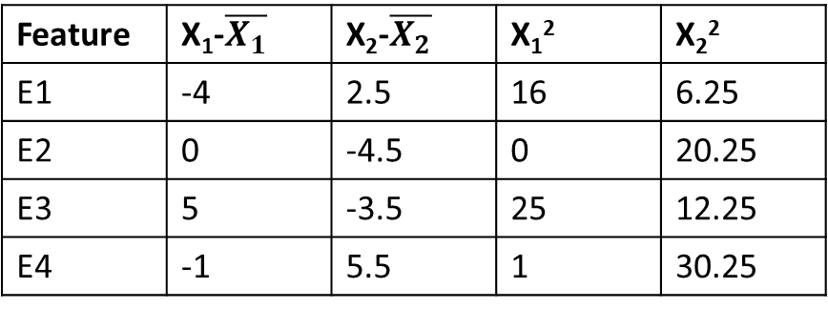


1) Dimensionality Reduction: PCA
Example1:
Step 1: Standardization (or Data normalization):
Calculate mean
$$\overline{X_{1}}=8,$$
$$\overline{X_{2}}=8.5$$
Step 2: Find Covariance matrix:
Feature | X₁ | X₂
E1 | 4 | 11
E2 | 8 | 4
E3 | 13 | 5
E4 | 7 | 14
Feature | X₁-$\overline{X_{1}}$ | X₂-$\overline{X_{2}}$ | X₁² | X₂²
E1 | -4 | 2.5 | 16 | 6.25
E2 | 0 | -4.5 | 0 | 20.25
E3 | 5 | -3.5 | 25 | 12.25
E4 | -1 | 5.5 | 1 | 30.25
(X₁ -$\overline{X_{1} }$)²/n-1(n is 4 here)=14
((X₁ -$\overline{X_{1} }$) * (X₂ -$\overline{X_{2} }$) )/n-1=-11
(X₂ -$\overline{X_{1} }$)²/n-1=23
$$\left[\begin{aligned}\begin{aligned}14 −11\end{aligned} \\ −11 23\end{aligned}\right]$$

Slide 11
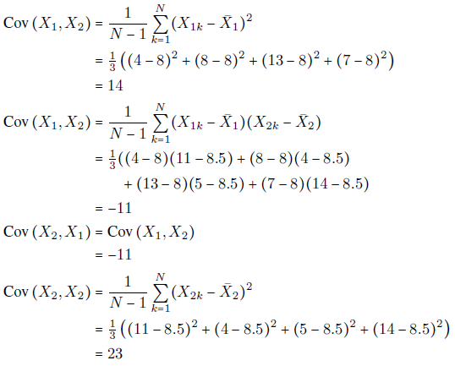

Slide 12
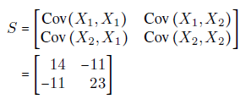
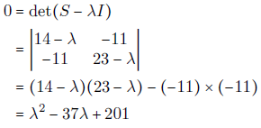

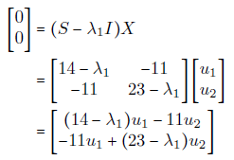

Slide 13
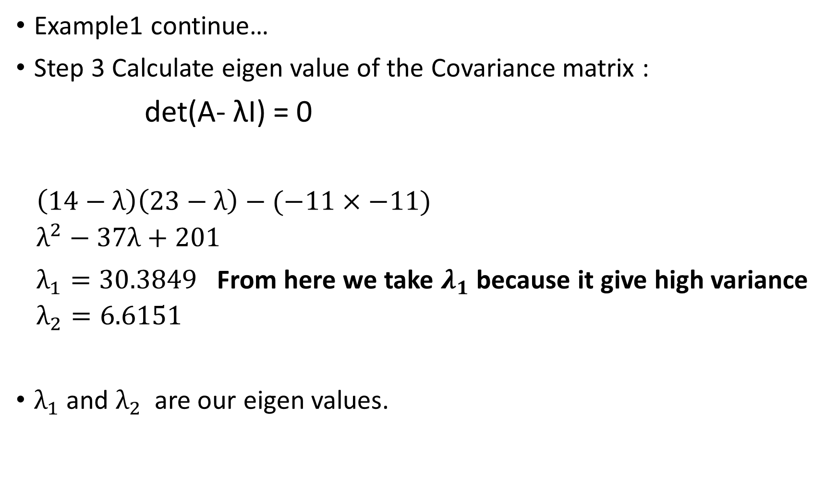
1) Dimensionality Reduction: PCA
Example1 continue…
Step 3 Calculate eigen value of the Covariance matrix :
det(A- λI) = 0
$$\left(14−λ\right)\left(23−λ\right)−(−11×−11)$$
$$λ^{2}−37λ+201$$
$λ_{1}=30.3849$ From here we take $λ_{1}$ because it give high variance
$$λ_{2}=6.6151$$
$λ_{1}$and $λ_{2}$ are our eigen values.
$$\left[\begin{aligned}\begin{aligned}14 −11\end{aligned} \\ −11 23\end{aligned}\right]$$
$$\left[\begin{aligned}\begin{aligned}14−λ −11\end{aligned} \\ −11 23−λ\end{aligned}\right]$$

Slide 14
1) Dimensionality Reduction: PCA
Example1 continue…
Step 4 Find eigen vectors of the Covariance matrix:
[A- λI]X = 0 or AX= λX
$\left[\begin{aligned}\begin{aligned}\left(14−λ\right)X_{1} −11X_{2}\end{aligned} \\ −11X_{1} (23−λ)X_{2}\end{aligned}\right]$ =0
$\left(14−λ\right)X_{1}−11X_{2}=0$ equation1
$−11X_{1}+\left(23−λ\right)X_{2}=0$ equation2
Simplification of equation1:
$$\left[\begin{aligned}\begin{aligned}14−λ −11\end{aligned} \\ −11 23−λ\end{aligned}\right]$$
$\left[\begin{aligned}X_{1} \\ X_{2}\end{aligned}\right]$=0
$\left[\begin{aligned}X_{1} \\ X_{2}\end{aligned}\right]$=
$$\left[\begin{aligned}\begin{aligned}11\end{aligned} \\ 14−λ\end{aligned}\right]$$

Slide 15
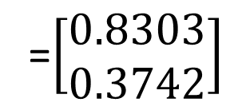

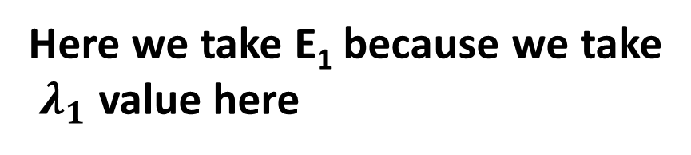
1) Dimensionality Reduction: PCA
$\left[\begin{aligned}X_{1} \\ X_{2}\end{aligned}\right]$=
$$\left[\begin{aligned}\begin{aligned}11\end{aligned} \\ 14−λ\end{aligned}\right]$$
Example1 continue…
Step 5: Find a unit (or feature) eigen vectors:
||X|| $=\sqrt{x^{2}+y^{2}+…+n^{2}}$
= $\sqrt{{11}^{2}+{(14−λ_{1})}^{2}}$
=19.7348
Here we take E₁ because we take
$λ_{1}$ value here
$$E_{1}=\left[\begin{aligned}{11}/{19.7348} \\ {(14−λ_{1})}/{19.7348}\end{aligned}\right]$$
=$\left[\begin{aligned}0.5574 \\ −0.8303\end{aligned}\right]$
$$E_{2}=\left[\begin{aligned}{11}/{19.7348} \\ {(14−λ_{2})}/{19.7348}\end{aligned}\right]$$
=$\left[\begin{aligned}0.8303 \\ 0.3742\end{aligned}\right]$

Slide 16
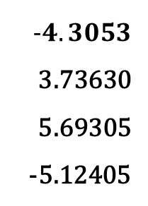
1) Dimensionality Reduction: PCA
Example1 continue…
Step 6: Find Principal components:
$E_{1}^{T}.\left[\begin{aligned}\begin{aligned}X_{12}−\overline{X_{1}} \\ X_{13}−\overline{X_{2}}\end{aligned}\end{aligned}\right]$
Feature | X₁ | X₂
E1 | 4 | 11
E2 | 8 | 4
E3 | 13 | 5
E4 | 7 | 14
$$−4.3053$$
3.73630
5.69305
-5.12405
$E_{1}$=$\left[\begin{aligned}0.5574\end{aligned} −0.8303\right]$. $\left[\begin{aligned}\begin{aligned}X_{12}−\overline{X_{1}} \\ X_{13}−\overline{X_{2}}\end{aligned}\end{aligned}\right]$
$$\overline{X_{1}}=8,$$
$$\overline{X_{2}}=8.5$$
$E_{1}$=$\left[\begin{aligned}0.5574(X_{12}−\overline{X_{1}})\end{aligned} −0.8303(X_{13}−\overline{X_{2}})\right]$
$E_{1}$=$\left[\begin{aligned}0.5574(4−8)\end{aligned} −0.8303(11−8.5)\right]$
$$−4.3053$$
$E_{1}$=$\left[\begin{aligned}0.5574 \\ −0.8303\end{aligned}\right]$

Slide 17
Metrics for Evaluating Classifier Performance
The evaluation metrics assess how good or how accurate your classifier is at predicting the class label of tuples.
Use validation test set of class-labeled tuples instead of training set when assessing accuracy.

Slide 18
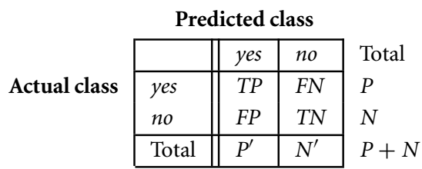
Metrics for Evaluating Classifier Performance
There are four additional terms we need to know that are the “building blocks” used in computing many evaluation measures.
These terms are summarized in the confusion matrix.
True positives (TP): These refer to the positive tuples that were correctly labeled by the classifier. Let TP be the number of true positives.
True negatives (TN): These are the negative tuples that were correctly labeled by the classifier. Let TN be the number of true negatives.

Slide 19
Metrics for Evaluating Classifier Performance
There are four additional terms we need to know that are the “building blocks” used in computing many evaluation measures.
False positives (FP): These are the negative tuples that were incorrectly labeled as positive.
e.g., tuples of class buys_computer = no for which the classifier predicted buys_computer = yes. Let FP be the number of false positives.
False negatives (FN): These are the positive tuples that were mislabeled as negative.
e.g., tuples of class buys_computer = yes for which the classifier predicted buys_computer = no. Let FN be the number of false negatives.

Slide 20
Metrics for Evaluating Classifier Performance
The confusion matrix is a useful tool for analyzing how well your classifier can recognize tuples of different classes.
TP and TN tell us when the classifier is getting things right.
while FP and FN tell us when the classifier is getting things wrong (i.e., mislabeling).
Given m classes (where m ≥ 2), a confusion matrix is a table of at least size m by m. An entry, CM_{i,j} in the first m rows and m columns indicates the number of tuples of class i that were labeled by the classifier as class j.
Good accuracy: ideally most of the tuples would be represented along the diagonal of the confusion matrix, from entry CM_{1,1} to CM_{m,m}.
Rest of the entries being zero or close to zero. That is, ideally, FP and FN are around zero.

Slide 21
Metrics for Evaluating Classifier Performance
The table may have additional rows or columns to provide totals.
For example, in the confusion matrix has P and N as shown in table.
In addition, P’ is the number of tuples that were labeled as positive (TP + FP).
N’ is the number of tuples that were labeled as negative (TN + FN).
The total number of tuples is TP + TN + FP + TN, or P + N, or P’ + N’.

Slide 22
Metrics for Evaluating Classifier Performance
The accuracy (or recognition) of a classifier on a given test set is the percentage of test set tuples that are correctly classified by the classifier.
Accuracy reflects how well the classifier recognizes tuples of the various classes.
Accuracy =$\frac{TP+TN}{TP+FN+FP+TN}$

Slide 23
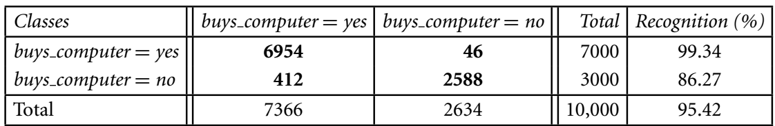
Metrics for Evaluating Classifier Performance
The accuracy (or recognition) of a classifier on a given test set is the percentage of test set tuples that are correctly classified by the classifier.
Accuracy reflects how well the classifier recognizes tuples of the various classes.
Accuracy =$\frac{TP+TN}{TP+FN+FP+TN}$

Slide 24
Metrics for Evaluating Classifier Performance
The accuracy (or recognition) of a classifier on a given test set is the percentage of test set tuples that are correctly classified by the classifier.
Accuracy reflects how well the classifier recognizes tuples of the various classes.
Accuracy =$\frac{TP+TN}{TP+FN+FP+TN}$
Accuracy=$\frac{6954+2588}{10000}∗100=95.42$

Slide 25
Metrics for Evaluating Classifier Performance
Error rate (or misclassification rate) of a classifier, M.
simply 1 − accuracy(M), where accuracy(M) is the accuracy of M.
Error rate=$\frac{FP+FN}{TP+FN+FP+TN}$

Slide 26
Metrics for Evaluating Classifier Performance
Error rate (or misclassification rate) of a classifier, M.
simply 1 − accuracy(M), where accuracy(M) is the accuracy of M.
Error rate=$\frac{FP+FN}{TP+FN+FP+TN}$

Slide 27
Metrics for Evaluating Classifier Performance
Class Imbalance Problem:
where the main class of interest is rare. That is, the data set distribution reflects a significant majority of the negative class and a minority positive class.
For example, in fraud detection applications, the class of interest (or positive class) is “fraud,” which occurs much less frequently than the negative “nonfraudulant” class.
In medical data, there may be a rare class, such as “cancer.” Suppose that you have trained a classifier to classify medical data tuples, where the class label attribute is “cancer” and the possible class values are “yes” and “no.” An accuracy rate of, say, 97% may make the classifier seem quite accurate.
But what if only, say, 3% of the training tuples are actually cancer? Clearly, an accuracy rate of 97% may not be acceptable—the classifier could be correctly labeling only the noncancer tuples, for instance, and misclassifying all the cancer tuples.

Slide 28
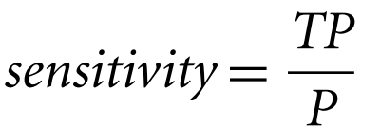
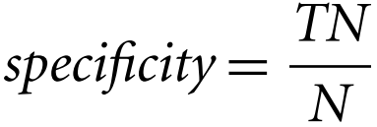
Metrics for Evaluating Classifier Performance
The sensitivity and specificity measures can be used to overcome the Class Imbalance Problem.
sensitivity is also referred to as the true positive (recognition) rate (i.e., the proportion of positive tuples that are correctly identified),
specificity is the true negative rate (i.e., the proportion of negative tuples that are correctly identified).

Slide 29
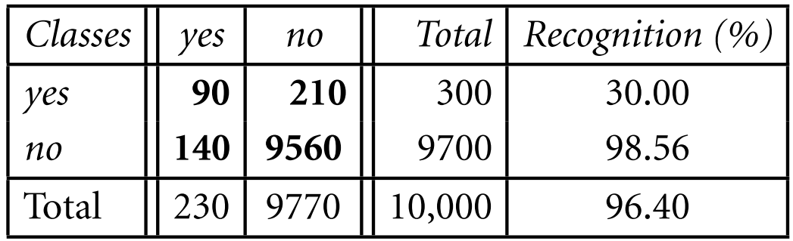
Metrics for Evaluating Classifier Performance
The sensitivity and specificity measures can be used to overcome the Class Imbalance Problem.
sensitivity is also referred to as the true positive (recognition) rate (i.e., the proportion of positive tuples that are correctly identified),
specificity is the true negative rate (i.e., the proportion of negative tuples that are correctly identified).

Slide 30
Metrics for Evaluating Classifier Performance
The sensitivity and specificity measures can be used to overcome the Class Imbalance Problem.
Although the classifier has a high accuracy, it’s ability to correctly label the positive (rare) class is poor given its low sensitivity.
It has high specificity, meaning that it can accurately recognize negative tuples.

Slide 31


Metrics for Evaluating Classifier Performance
The precision and recall measures are also widely used in classification.
Precision can be thought of as a measure of exactness (i.e., what percentage of tuples labeled as positive are actually such).
The recall is a measure of completeness (what percentage of positive tuples are labeled as such).
If recall seems familiar, that’s because it is the same as sensitivity (or the true positive rate).

Slide 32
Metrics for Evaluating Classifier Performance
A perfect precision score of 1.0 for a class C means that every tuple that the classifier labeled as belonging to class C does indeed belong to class C.
However, it does not tell us anything about the number of class C tuples that the classifier mislabeled.
A perfect recall score of 1.0 for C means that every item from class C was labeled as such, but it does not tell us how many other tuples were incorrectly labeled as belonging to class C.
There tends to be an inverse relationship between precision and recall, where it is possible to increase one at the cost of reducing the other.

Slide 33
Metrics for Evaluating Classifier Performance
An alternative way to use precision and recall is to combine them into a single measure.
The F measure (also known as F₁ score or F-score) the F_{β} measure.
The F measure is the harmonic mean of precision and recall.
It gives equal weight to precision and recall.
$$F−Score=\frac{2∗precision∗recall}{precision+recall}$$

Slide 34

Metrics for Evaluating Classifier Performance
where β is a non-negative real number.
The F_{β} measure is a weighted measure of precision and recall. It assigns β times as much weight to recall as to precision.
Commonly used F_{β} measures are F₂ (which weights recall twice as much as precision) and
F_{0.5} (which weights precision twice as much as recall).

Slide 35
Metrics for Evaluating Classifier Performance
In addition to accuracy-based measures, classifiers can also be compared with respect to the following additional aspects:
Speed: This refers to the computational costs involved in generating and using the given classifier.
Robustness: This is the ability of the classifier to make correct predictions given noisy data or data with missing values. Robustness is typically assessed with a series of synthetic data sets representing increasing degrees of noise and missing values.
Scalability: This refers to the ability to construct the classifier efficiently given large amounts of data. Scalability is typically assessed with a series of data sets of increasing size.

Slide 36
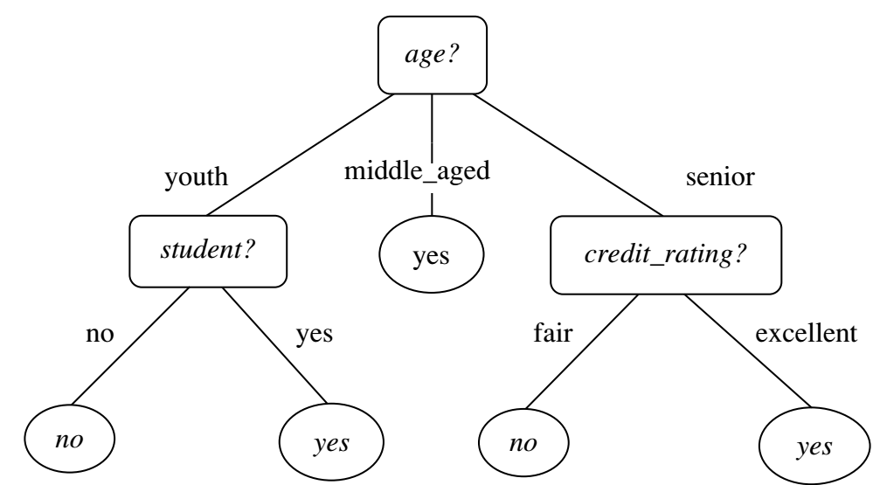
Decision Tree
A decision tree is a flowchart-like tree structure:
Each internal node (non leaf node) denotes a test on an attribute
Each branch represents an outcome of the test.
Each leaf node (or terminal node) holds a class label.
Internal nodes are denoted by rectangles.
Leaf nodes are denoted by ovals.
Some decision tree algorithms produce only binary trees.
Others can produce nonbinary trees.

Slide 37
Decision Tree
How are decision trees used for classification?
Given a tuple, X, for which the associated class label is unknown, the attribute values of the tuple are tested against the decision tree.
A path is traced from the root to a leaf node, which holds the class prediction for that tuple.
Decision trees can easily be converted to classification rules.
Decision tree classifiers have good accuracy. However, successful use may depend on the data at hand.

Slide 38
Decision Tree
Popular traditional Decision Tree Algorithms:
ID3 (Iterative Dichotomiser)
C4.5 (a successor of ID3)
CART (Classification And Regression Trees)
ID3, C4.5, and CART adopt a greedy (i.e., nonbacktracking) approach in which decision trees are constructed in a top-down recursive divide-and-conquer manner.

Slide 39
Decision Tree
Decision tree algorithm has three parameters:
D: data partition, Initially, it is the complete set of training tuples and their associated class labels.
Parameter attribute list: the set of candidate attributes.
Attribute selection method: specifies a heuristic procedure for selecting the attribute that “best” discriminates the given tuples according to class.
The criterion consists of a splitting attribute and, possibly, either a split-point or splitting subset.
Attribute selection measure such as information gain or the Gini index.
Gini index: Tree is strictly binary
Information gain: Multiway splits (i.e., two or more branches to be grown from a node)

Slide 40
Decision Tree
If the tuples in D are all of the same class, then node N becomes a leaf and is labeled with that class (Stopping criteria).
Otherwise, the algorithm calls Attribute selection method to determine the splitting criterion.
All the tuples in partition D (represented at node N) belong to the same class.
Stopping criteria: Recursive partitioning stops only when any one of the following terminating conditions is true :
All the tuples in partition D (represented at node N) belong to the same class.
There are no remaining attributes on which the tuples may be further partitioned.
There are no tuples for a given branch, that is, a partition D_{j} is empty.

Slide 41
Decision Tree
Let A be the splitting attribute. A has v distinct values, {a₁, a₂,..., a_{v}}, based on the training data.
A is discrete-valued: In this case, the outcomes of the test at node N correspond directly to the known values of A.
A branch is created for each known value, a_{j}, of A and labeled with that value.
A is continuous-valued: In this case, the test at node N has two possible outcomes, corresponding to the conditions A ≤ split point and A > split point, respectively.

Slide 42
Decision Tree: Attribute Selection Measures
Three popular attribute selection measures—
Information gain (ID3)
Gain ratio (C4.5)
Gini index (CART)

Slide 43
Decision Tree: Attribute Selection Measures- Information gain
Information Gain:
ID3 uses information gain as its attribute selection measure.
The attribute with the highest information gain is chosen as the splitting attribute for node N.
To classify the tuples in the resulting partitions and reflects the least randomness or “impurity” in these partitions.

Slide 44
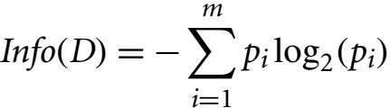
Decision Tree: Attribute Selection Measures- Information gain
Entropy (Information Theory)
A measure of uncertainty associated with a random variable.
High entropy -> higher uncertainty
Lower entropy -> lower uncertainty
The expected information (or entropy) needed to classify a tuple in D is:

Slide 45
Decision Tree: Attribute Selection Measures- Information gain
The expected information (or entropy) needed to classify a tuple in D is:
where p_{i} is the nonzero probability that an arbitrary tuple in D belongs to class C_{i} and is estimated by |C_{i,D}|/|D|.
A log function to the base 2 is used, because the information is encoded in bits.
Info(D) is just the average amount of information needed to identify the class label of a tuple in D.

Slide 46
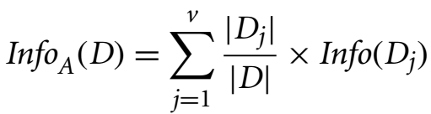

Decision Tree: Attribute Selection Measures- Information gain
Information needed (after using A to split D into v partitions) to classify D:
The term acts as the weight of the j^{th} partition.
Info_{A}(D) is the expected information required to classify a tuple from D based on the partitioning by A.
The smaller the expected information (still) required, the greater the purity of the partitions.
Ye info(D) ham phale ek attribute lange usme dakhege ki kitne tuples alag alag h phir un tuples ki yes no ke problability nikalkar yha previous formula ki thare use karange
Ye ek attribute me jo alag alag tuples h uski probability nikal dange(weigh le lnge yha)

Slide 47

Decision Tree: Attribute Selection Measures- Information gain
Information gain is defined as the difference between the original information requirement (i.e., based on just the proportion of classes) and the new requirement (i.e., obtained after partitioning on A).
Information gained by branching on attribute A

Slide 48
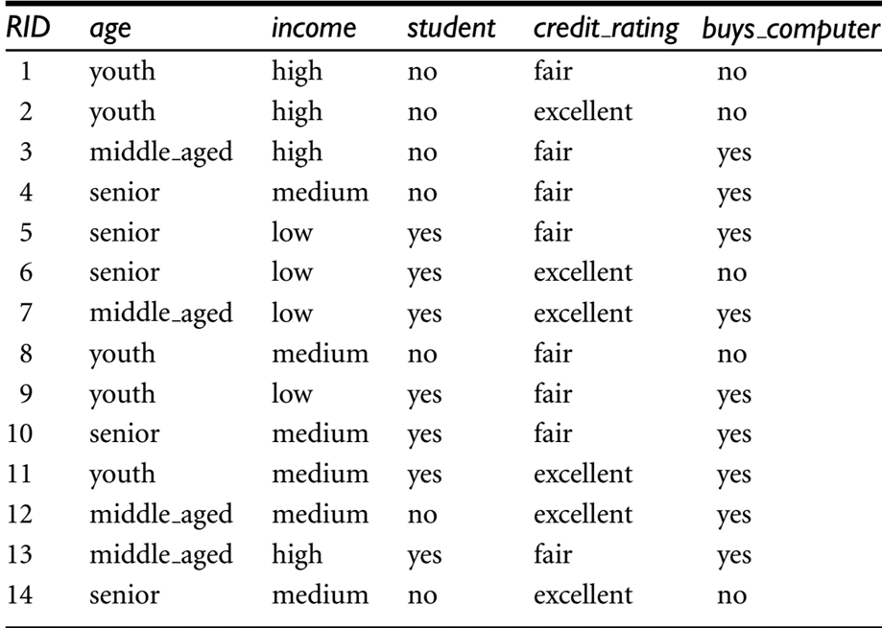
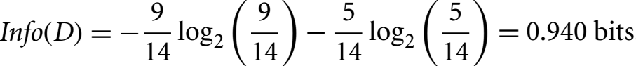
Decision Tree: Attribute Selection Measures- Information gain
In this example, class label attribute, buys_computer, has two distinct values (namely, yes, no).
There are nine tuples of class yes and five tuples of class no.
A (root) node N is created for the tuples in D.
To find the splitting criterion for these tuples, we first need to compute the expected information to classify a tuple in D.
Probability of yes of buys computer or not
Probability of no of buys computer or not

Slide 49
Decision Tree: Attribute Selection Measures- Information gain
Next, we need to compute the expected information requirement for each attribute.
Let’s start with the attribute age. We need to look at the distribution of yes and no tuples for each category of age.

Slide 50
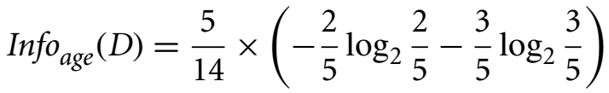
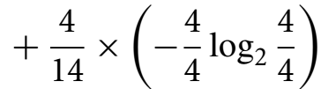
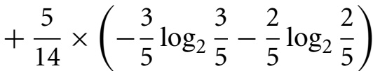

Decision Tree: Attribute Selection Measures- Information gain
For the age category “youth,” there are two yes tuples and three no tuples.
For the category “middle aged,” there are four yes tuples and zero no tuples.
For the category “senior,” there are three yes tuples and two no tuples.
Yha ham ek attribute me jo jo
tuples same h unke probability
nikalege yes or no ki

Slide 51
Decision Tree: Attribute Selection Measures- Information gain
Similarly, we can compute Gain(income) =0.029 bits, Gain(student) = 0.151 bits, and Gain(credit_rating) = 0.048 bits.
Because age has the highest information gain among the attributes, it is selected as the splitting attribute.

Slide 52
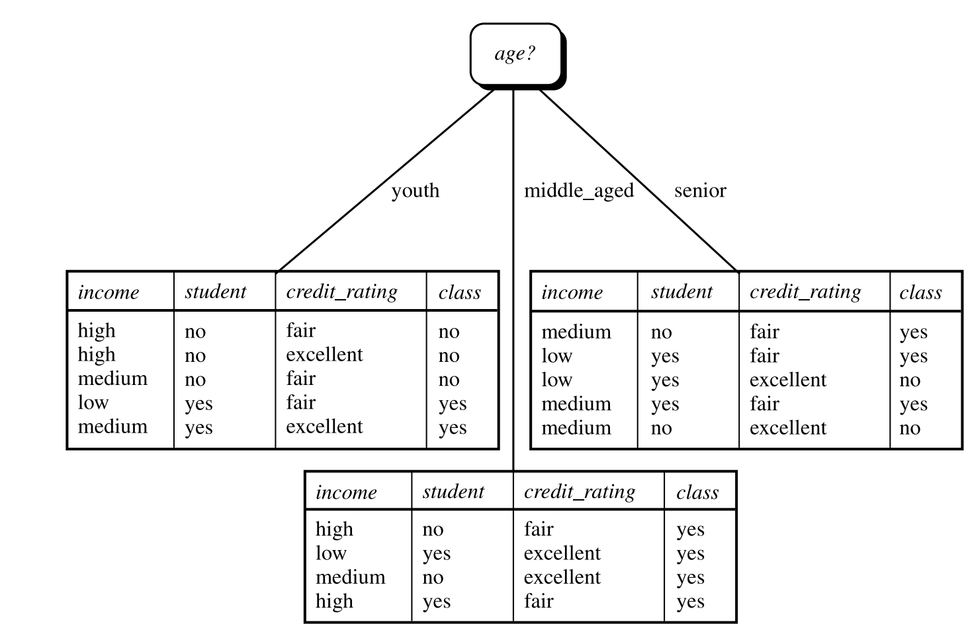
Income | Student | Credit_rating | Class
High | No | Fair | No
High | No | Excellent | No
Medium | No | Fair | no
Income | Student | Credit_rating | Class
Low | Yes | Fair | Yes
Medium | Yes | Excellent | yes

Slide 53
Income | Student | Credit | Class
Low | Yes | Fair | Yes
Medium | Yes | Excellent | yes
Income | Student | Credit | Class
High | No | Fair | No
High | No | Excellent | No
Medium | No | Fair | no
Income | Student | Credit | Class
Medium | No | Fair | Yes
Low | Yes | Fair | Yes
Medium | Yes | Fair | yes
Income | Student | Credit | Class
Low | Yes | Excellent | No
Medium | No | Excellent | no

Slide 54
Decision Tree: Attribute Selection Measures- Information gain
*Note the tuples falling into the partition for age D middle aged all belong to the same class.
Therefore be created at the end of this branch and labeled “yes.”

Slide 55
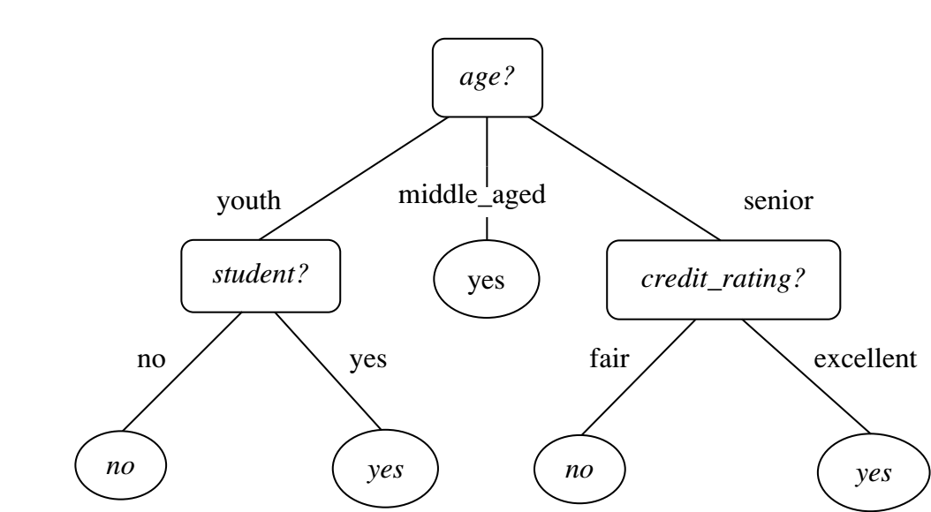
Decision Tree: Attribute Selection Measures- Information gain

Slide 56
Decision Tree: Attribute Selection Measures
Computing Information-Gain for Continuous-Valued Attributes:
Let attribute A be a continuous-valued attribute
Must determine the best split point for A
Sort the value A in increasing order
Typically, the midpoint between each pair of adjacent values is considered as a possible split point
(a_{i}+a_{i+1})/2 is the midpoint between the values of a_{i} and a_{i+1}
The point with the minimum expected information requirement for A is selected as the split-point for A
Split:
D1 is the set of tuples in D satisfying A ≤ split-point, and D2 is the set of tuples in D satisfying A > split-point

Slide 57
Decision Tree: Attribute Selection Measures- Gain Ratio
Information gain measure is biased toward tests with many outcomes.
Information gain prefers to select attributes having a large number of values.
For example, consider an attribute that acts as a unique identifier such as product ID.
A split on product ID would result in a large number of partitions (as many as there are values), each one containing just one tuple.
Each partition is pure, the information required to classify data set D based on this partitioning would be Info_{product_ID}(D)= 0.
Therefore, the information gained by partitioning on this attribute is maximal.

Slide 58
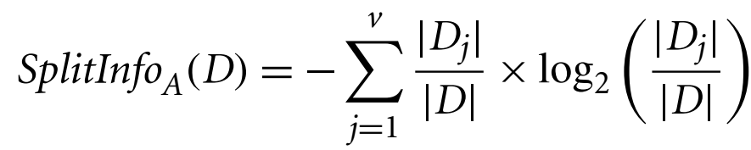
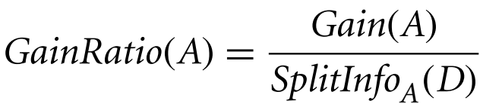
Decision Tree: Attribute Selection Measures- Gain Ratio
C4.5, a successor of ID3, uses an extension to information gain known as gain ratio, which attempts to overcome this bias.
For each outcome, it considers the number of tuples having that outcome with respect to the total number of tuples in D.
The attribute with the maximum gain ratio is selected as the splitting attribute.

Slide 59

Decision Tree: Attribute Selection Measures- Gain Ratio
Computation of gain ratio for the attribute income.
We have Gain(income) = 0.029.
Therefore,
GainRatio(income) 0.029/1.557
= 0.019.
Yha ham attribute me dakhange ki usme jo tuple multiple aa rehe h unki probability keya hogi

Slide 60
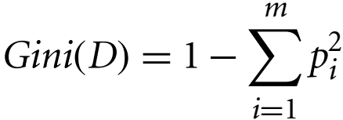
Decision Tree: Attribute Selection Measures- Gini Index
Gini index measures the impurity of a data partition or set of training tuples.
where p_{i} is the probability that a tuple in D belongs to class C_{i} and is estimated by |C_{i,D}|/|D|. The sum is computed over m classes.
Gini index considers a binary split for each attribute.
To determine the best binary split on A, we examine all the possible subsets that can be formed using known values of A.
For example, if income has three possible values, namely {low, medium, high}, then the possible subsets are {low, medium, high}, {low, medium}, {low, high}, {medium, high}, {low}, {medium}, {high}, and {}.

Slide 61
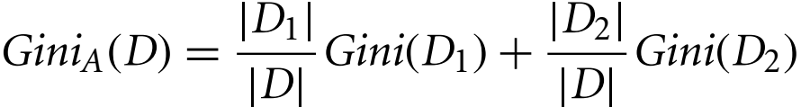
Decision Tree: Attribute Selection Measures- Gini Index
We exclude the power set, {low, medium, high}, and the empty set {} from consideration since, conceptually, they do not represent a split.
Therefore, there are 2^{v} − 2 possible ways to form two partitions of the data D, based on a binary split on A.
When considering a binary split, we compute a weighted sum of the impurity of each resulting partition.
For example, if a binary split on A partitions D into D₁ and D₂, the Gini index of D given that partitioning is:
For a discrete-valued attribute, the subset that gives the minimum Gini index for that attribute is selected as its splitting subset.

Slide 62
Decision Tree: Attribute Selection Measures- Gini Index
The reduction in impurity that would be incurred by a binary split on a discrete- or continuous-valued attribute A is:
The attribute that maximizes the reduction in impurity (or, equivalently, has the minimum Gini index) is selected as the splitting attribute.

Slide 63
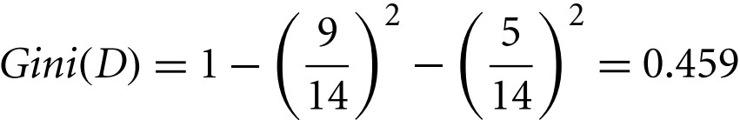
Decision Tree: Attribute Selection Measures- Gini Index
Gini index to compute the impurity of D:
To find the splitting criterion for the tuples in D, we need to compute the Gini index for each attribute.
Probability of yes or no of child(buys_computer)
For attribute income and consider each of the possible splitting subsets.
The subset {low, medium} in 10 tuples in partition D₁ satisfying the condition “income ∈ {low, medium}.”
The remaining four tuples of D would be assigned to partition D₂.

Slide 64
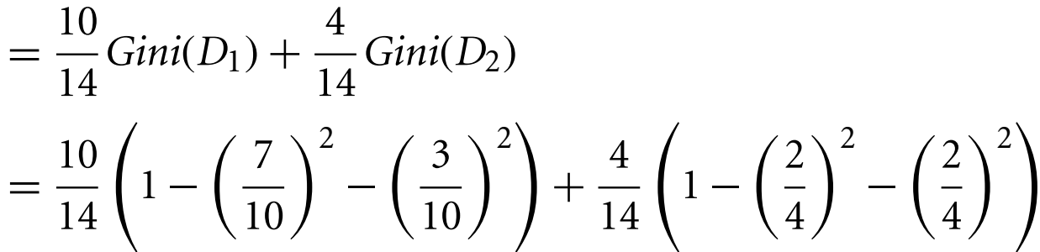


Decision Tree: Attribute Selection Measures- Gini Index
Gini index value computed based on partitioning {low, medium} is
Gini_{{income}}=_{{medium and low ,} _{high}}(D)
This is probability of yes and no of the medium and low combined
This is probability of yes and no of only high
Gini index for the subsets {low, high} and {medium} is 0.458
{medium, high} and {low}= 0.450.
The best binary split for attribute income is on {low, medium*} (or {high}) because it minimizes the Gini index.

Slide 65
Decision Tree: Attribute Selection Measures- Gini Index
Evaluating age, we obtain {youth, senior} (or {middle aged}) as the best split for age with a Gini index of 0.375.
The attributes student and credit_rating are both binary, with Gini index values of 0.367 and 0.429, respectively.
Gini index for the subsets {low, high} and {medium} is 0.458
{medium, high} and {low}= 0.450

Slide 66
Age
youth:-1-(2/5)²-(3/5)²=0.48
Middle:-1-(4/4)²=0
Senior:-1-(3/5)²-(2/5)²=0.48
0.48*(5/14)+0*(4/14)+0.48*(5/14)=0.029
Income
High:-1-(2/4)²-(2/4)²=0.5
Medium=1-(4/6)²-(2/6)²=0.44
Low:-1-(3/4)²-(1/4)²=0.375
0.5*(4/14)+0.44*(6/14)+0.375(4/14)=0.438
So here age gini is smallest from all so we devide from age
Student
Yes:-1-(6/7)²-(1/7)²=0.24
No:-1-(3/7)²-(4/7)²=0.65
0.24*(7/14)+0.65*(7/14)=0.44
Credit
Fair:-1-(6/8)²-(2/8)²=0.375
Excellent:-1-(3/6)²-(3/6)²=0.5
0.375*(8/14)+0.5*(6/14)=0.42

Slide 67
Income
High:-1-(2/2)²=0
Medium=1-(1/2)²-(1/2)²=0.5
Low:-1-(1/1)²=0
0*(2/5)+0.5*(2/5)+0(1/5)=0.2
So here student gini is smallest from all so we devide from student
Student
Yes:-1-(3/3)²=0
No:-1-(2/2)²=0
0*(3/5)+0*(2/5)=0
Credit
Fair:-1-(1/3)²-(2/3)²=0.44
Excellent:-1-(1/2)²-(1/2)²=0.5
0.44*(3/5)+0.5*(2/5)=0.46

Slide 68
Income
medium:-1-(2/3)²-(1/3)²=0.44
Low:-1-(1/2)²-(1/2)²=0.5
0.44*(3/5)+0.5*(2/5)+0(1/5)=0.46
So here credit gini is smallest from all so we devide from credit
Student
Yes:-1-(2/3)²-(1/3)²=0.44
No:-1-(1/2)²-(1/2)²=0.5
0.44*(3/5)+0.5*(2/5)+0(1/5)=0.46
Credit
Fair:-1-(3/3)²=0
Excellent:-1-(2/2)²=0
0*(3/5)+0*(2/5)=0

Slide 69
Income | Student | Credit_rating | Class
High | No | Fair | No
High | No | Excellent | No
Medium | No | Fair | no
Income | Student | Credit_rating | Class
Low | Yes | Fair | Yes
Medium | Yes | Excellent | yes

Slide 70
Income | Student | Credit | Class
Low | Yes | Fair | Yes
Medium | Yes | Excellent | yes
Income | Student | Credit | Class
High | No | Fair | No
High | No | Excellent | No
Medium | No | Fair | no
Income | Student | Credit | Class
Medium | No | Fair | Yes
Low | Yes | Fair | Yes
Medium | Yes | Fair | yes
Income | Student | Credit | Class
Low | Yes | Excellent | No
Medium | No | Excellent | no

Slide 71
Decision Tree: Attribute Selection Measures- Information gain

Slide 72
Decision Tree
The three measures, in general, return good results but
Information gain:
biased towards multivalued attributes
Gain ratio:
tends to prefer unbalanced splits in which one partition is much smaller than the others
Gini index:
biased to multivalued attributes
has difficulty when # of classes is large
tends to favor tests that result in equal-sized partitions and purity in both partitions

Slide 73
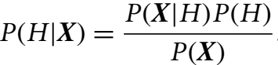
Bayes Classification
Bayesian classifiers are statistical classifiers.
Bayesian classifier can predict class membership probabilities such as the probability that a given tuple belongs to a particular class.
Bayesian classification is based on Bayes’ theorem.
A simple Bayesian classifier known as the naïve Bayesian classifier.
Naïve Bayesian classifiers assume that the effect of an attribute value on a given class is independent of the values of the other attributes.
Bayes’ theorem is useful in that it provides a way of calculating the posterior probability, P(H|X) from P(H), P(X|H), and P(X).

Slide 74
Bayes Classification
For example, X is a 35-year-old customer with an income of $40,000. Suppose that H is the hypothesis that our customer will buy a computer.
Then P(H|X) reflects the probability that customer X will buy a computer given that we know the customer’s age and income.

Slide 75
Bayes Classification
Naïve Bayesian classifiers assume that the effect of an attribute value on a given class is independent of the values of the other attributes.
For example, X is a 35-year-old customer with an income of $40,000. Suppose that H is the hypothesis that our customer will buy a computer.
Then P(H|X) reflects the probability that customer X will buy a computer given that we know the customer’s age and income.

Slide 76
Examples
1. SpamAssassin works as a mail filter to identify the spam in which users train the system. In emails, it considers patterns in the words which are marked as spam by the users. For Example, it may have learned that the word “release” is marked as spam in 30% of the emails. Concluding 0.8% of non-spam mails which includes the word “release” and 40% of all emails which are received by the user is spam. Find the probability that a mail is a spam if the word “release” seems in it.
Solution :
Given, P(Release | Spam) = 0.30
P(Release | Non Spam) = 0.008
P(Spam) = 0.40 => P(Non Spam) = 0.40
Now, using Bayes’ Theorem: P(Spam | Release) = P(Release | Spam) * P(Spam) / P(Release)
= 0.30 * 0.40 / (0.40 * 0.30 + 0.30 * 0.008) = 0.980
Hence, the required probability is 0.980.

Slide 77
2. Bag1 contains 4 white and 8 black balls and Bag2 contains 5 white and 3 black balls. From one of the bag one ball is drawn at random and the ball which is drawn comes out as black. Find the probability that the ball is drawn from Bag1.
Solution: Given, Let E1, E2 and A be the three events where,
E1 = Event of selecting Bag1
E2 = Event of selecting Bag2
A = Event of drawing black ball
Now,
P(E1) = P(E2) = 1/2 P(drawing a black ball from Bag1) = P(A|E1) = 8/12 = 2/3
P(drawing a black ball from Bag2) = P(A|E2) = 3/8
By using Bayes' Theorem, the probability of drawing a black ball from Bag1,
P(E1|A) = P(A|E1) * P(E1) / P(A|E1) * P(E1) + P(A|E2) * P(E2) [P(A|E1) * P(E1) + P(A|E2) * P(E2) = Total Probability]
= (2/3 * 1/2) / (2/3 * 1/2 + 3/8 * 1/2) = 16/25
Hence, the probability that the ball is drawn from Bag1 is 16/25

Slide 78
Naïve Bayesian Classification
Naïve Bayesian classifier, or simple Bayesian classifier, works as follows:
Let D be a training set of tuples and their associated class labels. As usual, each tuple is represented by an n-dimensional attribute vector, X = (x₁, x₂,…, x_{n}), depicting n measurements made on the tuple from n attributes, respectively, A₁, A₂,…, A_{n}.
Suppose that there are m classes, C1, C2,:::, Cm. Given a tuple, X, the classifier will predict that X belongs to the class having the highest posterior probability, conditioned on X. That is, the na¨ıve Bayesian classifier predicts that tuple X belongs to the class Ci if and only if

Slide 79

Naïve Bayesian Classification
Naïve Bayesian classifier, or simple Bayesian classifier, works as follows:
Suppose that there are m classes, C1, C2,…, C_{m}. Given a tuple, X, the classifier will predict that X belongs to the class having the highest posterior probability, conditioned on X. That is, the naïve Bayesian classifier predicts that tuple X belongs to the class C_{i} if and only if
Thus, we maximize P(C_{i}|X). The class C_{i} for which P(C_{i}|X) is maximized is called the maximum posteriori hypothesis. By Bayes’ theorem:

Slide 80

Naïve Bayesian Classification
As P(X) is constant for all classes, only P(X|C_{i})P(C_{i}) needs to be maximized. Note that the class prior probabilities may be estimated by P(C_{i})=|C_{i,D}|/|D|, where |C_{i,D}| is the number of training tuples of class C_{i} in D.
A simplified assumption: attributes are conditionally independent (i.e., no dependence relation between attributes):
This greatly reduces the computation cost: Only counts the class distribution.

Slide 81

Naïve Bayesian Classification
Predicting a class label using naïve Bayesian classification.
For example, we wish to classify
We need to maximize P(X|C_{i})P(C_{i}), for i=1, 2.
P(C_{i}), the prior probability of each class, can be computed based on the training tuples:

Slide 82
Naïve Bayesian Classification
Predicting a class label using naïve Bayesian classification.
For example, we wish to classify
We need to maximize P(X|C_{i})P(C_{i}), for i=1, 2.
To compute P(X|C_{i}), we compute the following conditional probabilities:

Slide 83
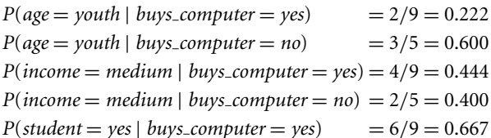

Naïve Bayesian Classification
Predicting a class label using naïve Bayesian classification.
To compute P(X|C_{i}), we compute the following conditional probabilities:

Slide 84
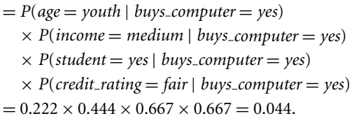
Naïve Bayesian Classification

Slide 85
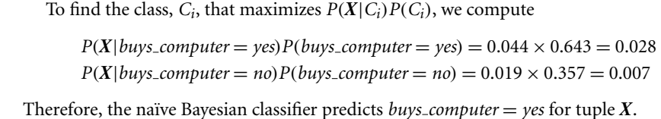
Naïve Bayesian Classification

Slide 86
Rule-Based Classification
Rule-based classifiers, where the learned model is represented as a set of IF-THEN rules:
IF condition THEN conclusion
Example: IF age = youth AND student = yes THEN buys_computer = yes
Rule-based classifiers can be generated, either from a decision tree or
Directly from the training data using a sequential covering algorithm.

Slide 87
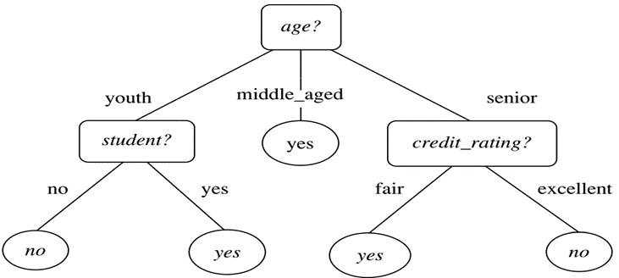
Rule-Based Classification: Using Decision Tree
Rules are easier to understand than large trees.
One rule is created for each path from the root to a leaf.
Each attribute-value pair along a path forms a conjunction: the leaf holds the class prediction.
Rules are mutually exclusive and exhaustive.
Example: Rule extraction from our buys_computer decision-tree.
IF age = young AND student = no THEN buys_computer = no
IF age = young AND student = yes THEN buys_computer = yes
IF age = mid-age THEN buys_computer = yes
IF age = old AND credit_rating = excellent THEN buys_computer = no
IF age = old AND credit_rating = fair THEN buys_computer = yes

Slide 88
Rule-Based Classification: Using Sequential Covering Algorithm
Sequential covering algorithm: Extracts rules directly from training data.
Typical sequential covering algorithms: FOIL, AQ, CN2, RIPPER.
Rules are learned sequentially, each for a given class C_{i} will cover many tuples of Ci but none (or few) of the tuples of other classes.
Steps:
Rules are learned one at a time
Each time a rule is learned, the tuples covered by the rules are removed
Repeat the process on the remaining tuples until termination condition, e.g., when no more training examples or when the quality of a rule returned is below a user-specified threshold
Comp. w. decision-tree induction: learning a set of rules simultaneously.

Slide 89
Instance-based Classification
Instance-based learning (sometimes called memory-based learning) compares new problem instances with instances seen in training, which have been stored in memory.
Because computation is postponed until a new instance is observed, these algorithms are sometimes referred to as "lazy“.
Store training examples and delay the processing until a new instance must be classified.

Slide 90
Instance-based Classification
Lazy vs Eager learning
Lazy learning:
Simply stores training data (or only minor processing) and waits until it is given a test tuple.
Lazy learning as sees the test tuple it performs generalization to classify the tuple based on its similarity to the stored training tuples.
Eager learning:
Given a set of training tuples, constructs a classification model before receiving new (e.g., test) data to classify.
Eager learning model are ready and eager to classify previously unseen tuples.
Lazy: less time in training but more time in predicting.

