Slide 1
Introduction MCSC202: ADVANCED OPERATING SYSTEMS[4-1-0]

Slide 2
Course Outline
http://cs.du.ac.in/programmes/mcs/
http://www.du.ac.in/du/uploads/RevisedSyllabi1/Annexure-42.%20MSc%20Computer%20Science.pdf

Slide 3
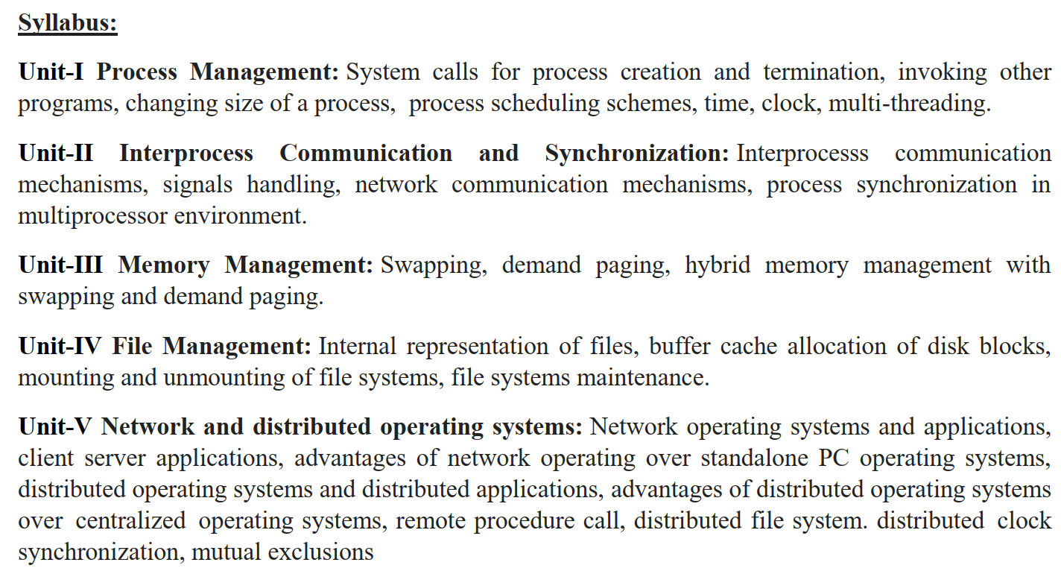
Syllabus

Slide 4
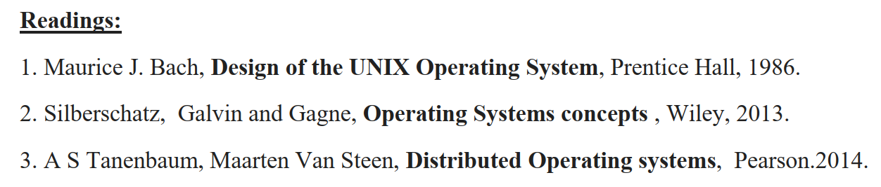
Readings

Slide 5
Grading Scheme
Max. Marks: 100
End-term Examination: 70
Internal Assessment: 30
Tests and Minor: 15-20
One Minor (10-12)
2 to 3 Quizzes (5-8)
Assignments: 10-15

Slide 6
Assignment
Questions
Mini-projects
Presentations
It will be decided over a period of time

Slide 7
“Teachers can open the door, but you must enter it yourself.”
I am still Learning!
Good Luck!

