Slide 1
Introduction to Operating System

Slide 2
Introduction
1960’s: Series of design changes, implementation improvements
IBM mainframes
Lots of different open problems
Rapid changes in hardware
Reliability
Performance
First operating system
An operating system was to allow a program to run

Slide 3
Introduction (contd…)
Interface
Applications can be implemented independently
Security, modularity and Performance

Slide 4
History
1965s: Multics
Bell Laboratories + General Electric Company and Project MAC of MIT
Purpose:
To provide simultaneous computer access to a large community of users,
To supply ample computation power and data storage, and
To allow users to share their data easily, if desired
Issue:
Did not provide the general service computing for which it was intended, nor was it clear when its development goals would be met

Slide 5
History (contd…)
Ken Thompson, Dennis Ritchie, and others sketched a paper design of a file system
Thompson
Encoded a simple kernel for GE 645
Simulated behavior of file system
"Space Travel," in Fortran for a GECOS system
Unsatisfactory
Attempted for PDP-7
required cross-assembly of the program on the GECOS machine
Thompson and Ritchie
Implemented their system design on the PDP-7, including an early version of the UNIX file system, the process subsystem, and a small set of utility programs
Early version of the UNIX system

Slide 6
History (contd…)
UNIX System was moved to a PDP- 1 1 in 1971 .
The system was characterized by its small size:
16K bytes for the system,
8K bytes for user programs,
a disk of 512K bytes, and
a limit of 64K bytes per file.
Thompson
Attempted to implement a Fortran compiler for the new system,
but instead came up with the language B, influenced by BCPL
Ritchie
Developed C,
Allowing generation of machine code,
Declaration of data types, and
Definition of data structures

Slide 7
History (contd…)
In 1973, the operating system was rewritten in C
In 1974, published paper in Communications of ACM
Support to universities
1977, Interactive systems corporation, first Value added reseller (VAR)
1977-82: UNIX System-II, III
1983: UNIX System-V
Watch: https://youtu.be/tc4ROCJYbm0

Slide 8
Features of UNIX
Written in a high-level language
Easy to read, understand, change, and move to other machines.
Ritchie estimates that the first system in C was 20 to 40 percent larger and slower because it was not written in assembly language, but the advantages of using a higher-level language far outweigh the disadvantages.
Simple user interface
Provides primitives that permit complex programs to be built from simpler programs

Slide 9
Features of UNIX contd…
Uses a hierarchical file system that allows easy maintenance and efficient implementation
Uses a consistent format for files, the byte stream, making application programs easier to write
Provides a simple, consistent interface to peripheral devices
A multi-user, multiprocess system;
each user can execute several processes simultaneously
Hides the machine architecture from the user, making it easier to write programs that run on different hardware implementations

Slide 10
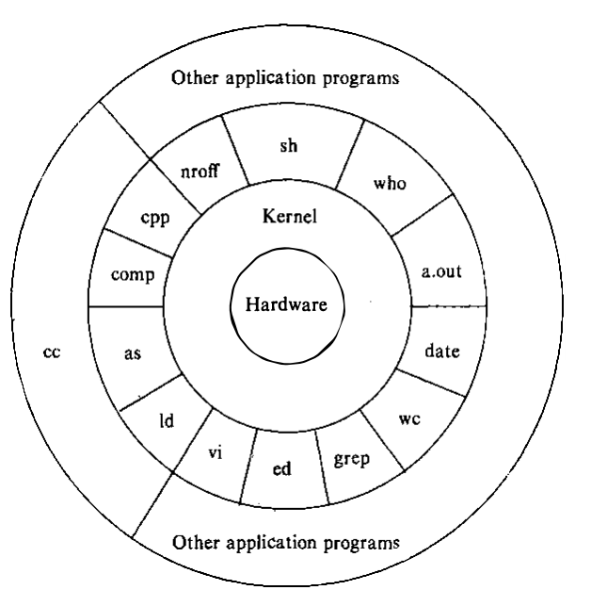

Architecture
3-layers:
Kernel
Shell
System program
Utilities

Slide 11
File system
The UNIX file system is characterized by
A hierarchical structure,
Consistent treatment of file data,
The ability to create and delete files,
Dynamic growth of files,
The protection of file data
The treatment of peripheral devices (such as terminals and tape units) as files
The file system is organized as a tree with a single root node called root (/)

Slide 12
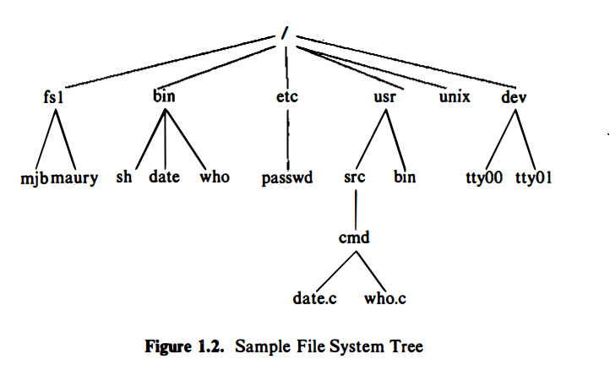
File system (contd…)
Pathnames
Components
The treatment of peripheral devices (such as terminals and tape units) as files
Absolute Path
Relative Path
Programs have no knowledge of internal format in which kernel stores file data

Slide 13
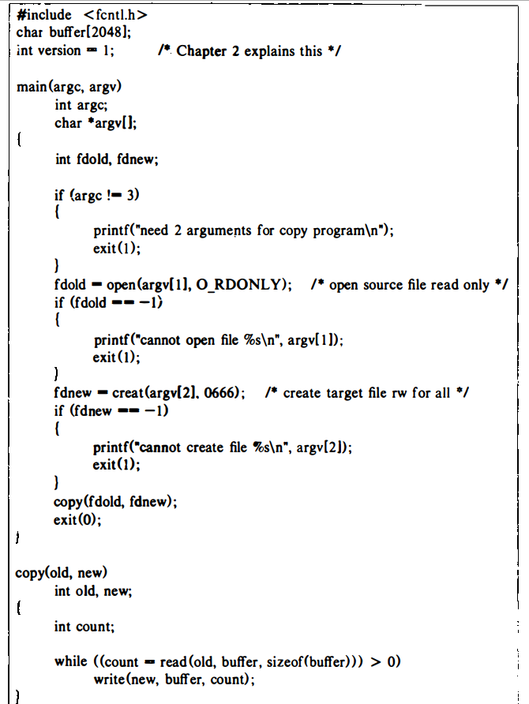

copy oldfile newfile

Slide 14

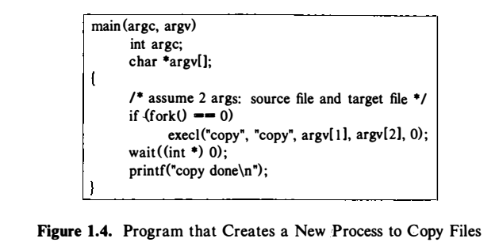
Processing environment
Program
Process

Slide 15
shell
Three types of command
Executable files containing object code
Executable files containing sequencing of shell commands
Internal commands
Synchronous and asynchronous execution
who
who &

Slide 16
Building Block Primitives
Three files:
Standard input file: read data,
Standard output file: write or output, and
standard error file: error messages
Redirect I/O
Pipe

Slide 17
redirect I/O
ls: lists all files in the current directory on the standard output
ls > output
mail mjb < letter
opens the file "letter" for its standard input and mails its contents to the user named "mjb.“

Slide 18
pipe
Process A
Process B
A mechanism that allows a stream of data to be passed between reader and writer processes.
For example, the program grep searches a set of files (parameters to grep) for a given pattern:
grep main a.c b.c c.c
grep main a.c b.c c.c | wc -1

Slide 19
Operating System Services
Controlling the execution of processes by allowing
Creation,
Termination or suspension, and
Communication
Scheduling processes
Time-shared manner
Allocating main memory for an executing process
Protects the private address space of a process
Swap system
Swapping system
paging
Allocating secondary memory for efficient storage and retrieval of user data
Allowing processes controlled access to peripheral devices

Slide 20
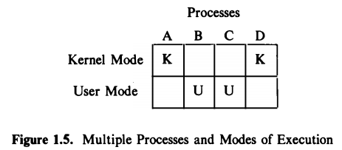
User mode and Kernel mode
Processes in user mode can access their own instructions and data but not kernel instructions and data (or those of other processes).
Processes in kernel mode, however, can access kernel and user addresses.
Kernel runs on the behalf of a user process.
The kernel is not a separate set of processes that run in parallel to user processes, but it is part of- each user process.

Slide 21
Interrupts and Exceptions
Exceptions
_______________ occurs "in the middle" of the execution of an instruction, and the system attempts to restart the instruction after handling it;
____________are considered to happen between the execution of two instructions, and the system continues with the next instruction after servicing it.
Interrupts

Slide 22
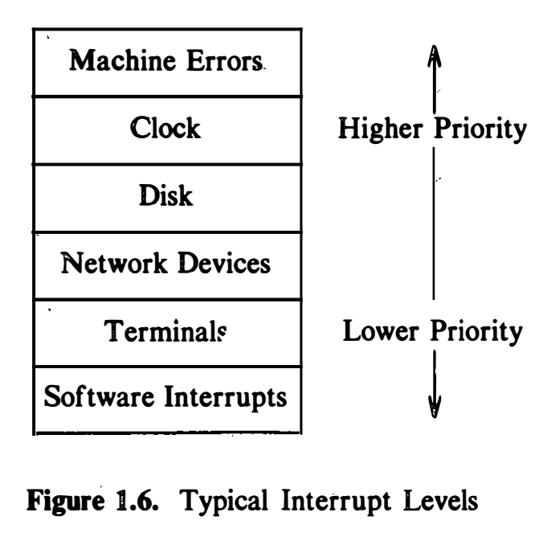
Processor execution levels

Slide 23
Memory Management
Kernel resides in the main memory
Virtual and physical addresses

Slide 24
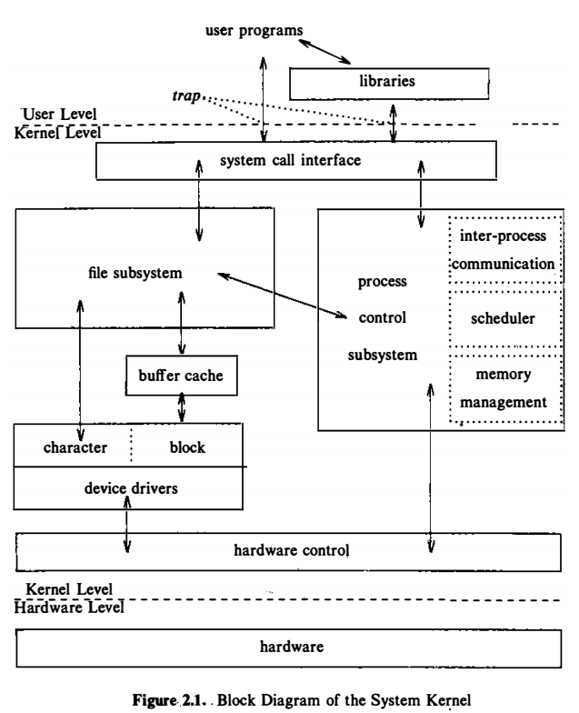
Block Diagram of System Kernel
File system:
Manages files,
Allocating file space,
Administering free space,
Controlling access to files
retrieving data for users.
Process Control System
Process synchronization,
Inter-process communication
Memory management, and
Process scheduling
Swapping and demand paging

Slide 25
System calls
File system:
open (to open a file for reading or writing) ,
close, read, write, stat (query the attributes of a file) ,
chown (change the record of who owns the file)
chmod (change the access permissions of a file)
Process Control System
fork (create a new process)
exec (overlay the image of a program onto the running process)
exit (finish executing a process)
wait (synchronize process execution with the exit of a previously forked process)
brk (control the size of memory allocated to a process) and
signal (control process response to extraordinary events)

Slide 26
Reference
The Design of the UNIX Operating System, by Maurice J. Bach

