Slide 1
File Management

Slide 2
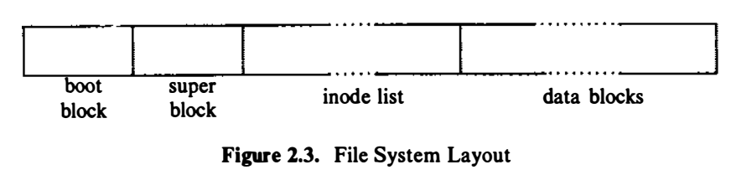
File system

Slide 3
File system
The boot block occupies the beginning of a file system, typically the first sector,
May contain the bootstrap code that is read into the machine to boot, or initialize, the operating system. Although only one boot block is needed to boot the system, every file system has a (possibly empty) boot block.
The super block describes the state of a file system
How large it is,
How many files it can store,
Where to find free space on the file system, and other information.

Slide 4
File system
The inode list is a list of inodes that follows the super block in the file system.
Administrators specify the size of the inode list when configuring a file system.
The kernel references inodes by index into the inode list.
One inode is the root inode of the file system: it is the inode by which the directory structure of the file system is accessible after execution of the mount system call
The data blocks start at the end of the inode list
contain file data and administrative data.
An allocated data block can belong to one and only one file in the file system.

Slide 5
File Management
File Management mainly focus on internal structure of files.
UNIX system has a unique inode.
The inode contains the information necessary for a process to access a file, such as file ownership, access rights, file size, and location of the file's data in the file system.
Processes access files by a well defined set of system calls and specify a file by a character string that is the path name.
Each path name uniquely specifies a file, and the kernel converts the path name to the file's inode.

Slide 6
Inode
Inodes exist in a static form on disk, and the kernel reads them into an in-core inode to manipulate them.
Disk inodes consist of the following fields:
File owner identifier
Ownership is divided between an individual owner and a "group" owner and defines the set of users who have access rights to a file.
The super-user has access rights to all files in the system.
File type
Files may be of type regular, directory, character or block special, or FIFO (pipes).

Slide 7
Inode
File access permissions
Three classes:
The owner
The group owner of the file, and
Other users;
Each class has access rights to read, write and execute the file, which can be set individually.
File access times
The time the file was last modified, when it was last accessed, and when the inode was last modified.
Number of links to the file
Representing the number of names the file has in the directory hierarchy.

Slide 8
Inode
Table of contents for the disk addresses of data in a file
Although users treat the data in a file as a logical stream of bytes, the kernel saves the data in discontiguous disk blocks.
The inode identifies the disk blocks that contain the file's data.
File size
Data in a file is addressable by the number of bytes from the beginning of the file, starting from byte offset 0.

Slide 9
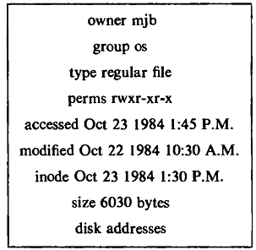
Inode
Fig: Sample Disk inode

Slide 10
Inode
The in-core copy of the inode contains the following fields in addition to the fields of the disk inode:
The status of the in-core inode, indicating whether
The inode is locked,
A process is waiting for the inode to become unlocked,
The in-core representation of the inode differs from the disk copy as a result of a change to the data in the inode,
The in-core representation of the file differs from the disk copy as a result of a change to the file data,
The file is a mount point

Slide 11
Inode
The logical device number of the file system that contains the file.
The inode number:
inodes are stored in a linear array on disk, the kernel identifies the number of a disk inode by its position in the array.
The disk inode does not need this field.
Pointers to other in-core inodes:
The kernel links inodes on hash queues and on a free list in the same way that it links buffers on buffer hash queues and on the buffer free list.
A reference count:
Indicates the number of instances of the file that are active

Slide 12
Inode
Inode is similar to buffer header?

Slide 13
Accessing Inode
The kernel identifies particular Inodes by their file system and Inode number and allocates in-core Inodes at the request of higher-level algorithms.
The kernel maps the device number and Inode number into a hash queue and searches the queue for the Inode.
If it cannot find the Inode, it allocates one from the free list and locks it.
The kernel then prepares to read the disk copy of the newly accessed Inode into the in-core copy.

Slide 14

Accessing Inode (contd…)
Given an inode number and logical device, computes the logical disk block that contains the inode according to how many disk inodes fit into a disk block. The computation follows the formula:
where the division operation returns the integer part of the quotient.
For example,
Assuming that block 2 is the beginning of the inode list and that there are 8 inodes per block, then
inode number 8 is in disk block ???? , and
inode number 9 is in disk block ????.

Slide 15
Accessing Inode (contd…)
where the division operation returns the integer part of the quotient.
For example,
Assuming that block 2 is the beginning of the inode list and that there are 16 inodes per block, then
inode number 8 is in disk block ???? , and
inode number 9 is in disk block ????.
inode number 17 is in disk block ????.

Slide 16
Accessing Inode (contd…)
Formula to compute the byte offset of the inode in the block:
For example,
if each disk inode occupies 64 bytes
there are 8 inodes per disk block,
then inode number 8 starts at byte offset __________ in the disk block.
448

Slide 17
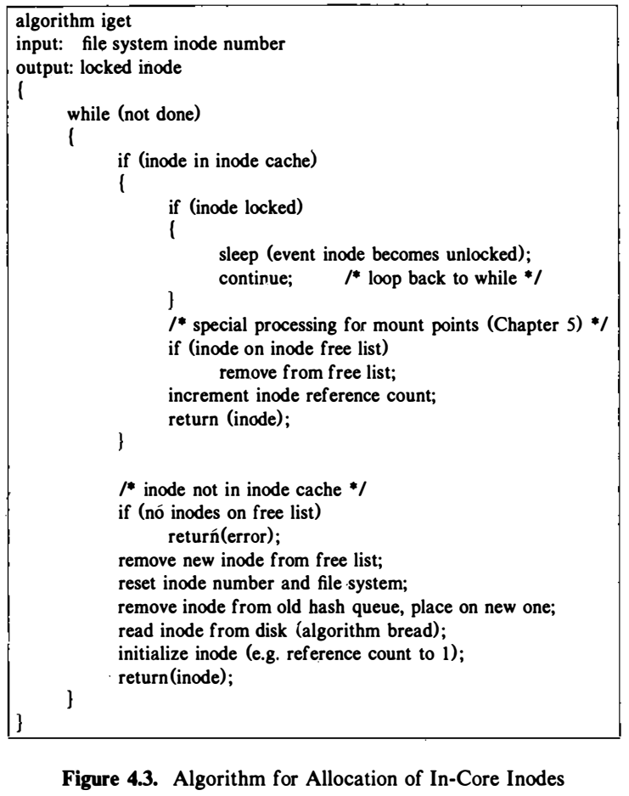
Accessing Inode (contd…)
Reference count
Inode lock and reference count work independently

Slide 18
Releasing Inode
When the kernel releases an Inode, it decrements its in-core reference count.
If the count drops to 0, the kernel writes the Inode to disk if the in-core copy differs from the disk copy.
They differ if the file data has changed, if the file access time has changed, or if the file owner or access permissions have changed.

Slide 19
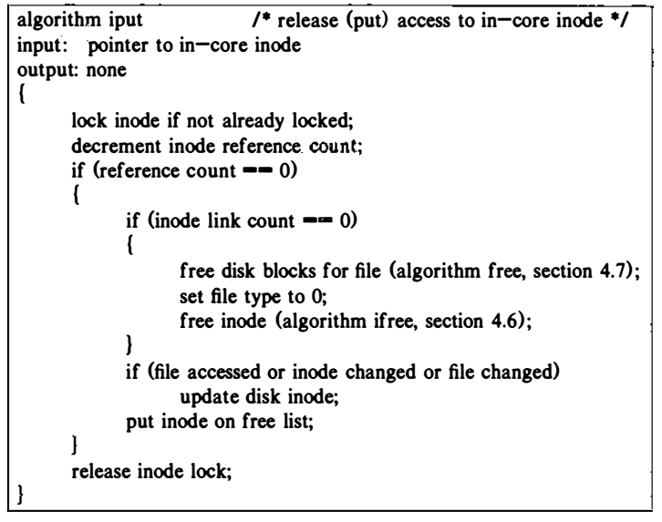
Releasing an Inode

Slide 20
Structure of a Regular File
The inode contains the table of contents to locate a file's data on disk.
Since each block on a disk is addressable by number
The table of contents consists of a set of disk block numbers.
If the data in a file were stored in a contiguous section of the disk,
Inode
the start block address
the file size

Slide 21
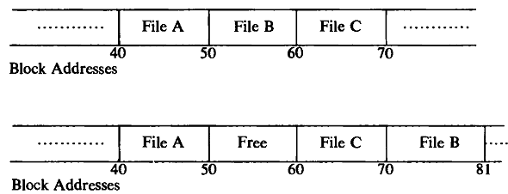
Structure of a Regular File
For example, files, A, B and C, each consisting of 10 disk blocks of storage, and suppose the system allocated storage for the three files contiguously.
If the user then wishes to add 5 blocks of data to the middle file, B, the kernel would have to copy file B to a place in the file system
Fig 4.5: Allocation of Contiguous Files and Fragmentation of Free Space

Slide 22
Structure of a Regular File
Flexibility is desired
Solution:
Allocate one block at a time
Use multiple blocks and retain block number for a file in ToC
Problem?

Slide 23
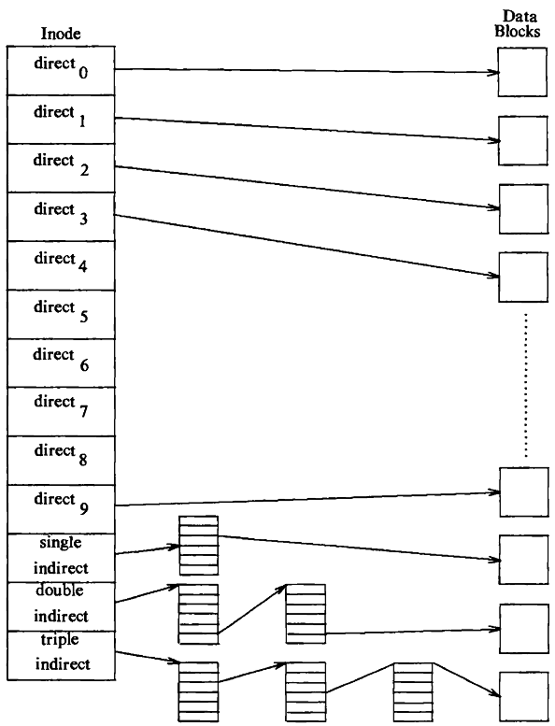
Structure of a Regular File
To keep the inode structure small yet still allow large files, the table of contents of disk blocks
Levels of indirection
Single indirection
Double indirection
Triple indirection
Fig 4.6: Direct and Indirect Blocks in inode

Slide 24
Byte Capacity of a File – 1K Bytes Per Block
10 direct blocks with 1K bytes each = 10K bytes
1 indirect block with 256 direct blocks = 256K bytes
1 double indirect block with 256 indirect blocks = 64M bytes
1 triple indirect block with 256 double indirect blocks = 16G bytes

Slide 25
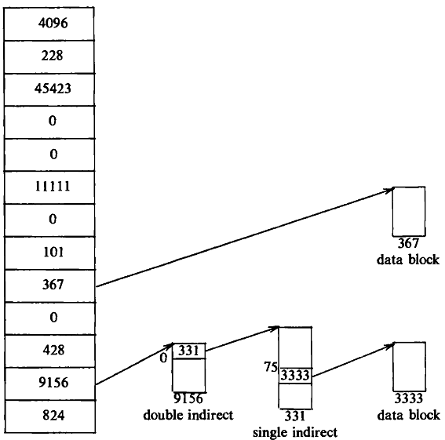
Structure of a Regular File
To keep the inode structure small yet still allow large files, the table of contents of disk blocks
Kernel Converts user view of byte to block view
Fig: Block Layout of a Sample File and its inode

Slide 26
An example:
Assume that a disk block contains 1024 bytes. If a process wants to access byte offset 9000, the kernel calculates that the byte is in direct block _____ in the file.
If it wants the 350000 in the file?
4096
228
45423
0
0
11111
0
101
367
0
428
9156
824
367
Data block
331
0
331
331
75
3333
3333
9156 Double indirect
Data block
331 Single indirect

Slide 27
An example:
An indirect block has room for 256 block numbers, the first byte accessed via the double indirect block is byte number 272,384 (256K + 10K) ;
Byte number 350,000 in a file is therefore byte number 77,616 of the double indirect block.
Since each single indirect block accesses 256K bytes, byte number 350,000 must be in the 0th single indirect block of the double indirect block - block number 331
Since each direct block in a single indirect block contains 1 K bytes, byte number 7l,616 of a single indirect block is in the 75th direct block in the single indirect block – block number 3333.
Finally, byte number 350,000 in the file is at byte number 816 in block 3333.

Slide 28
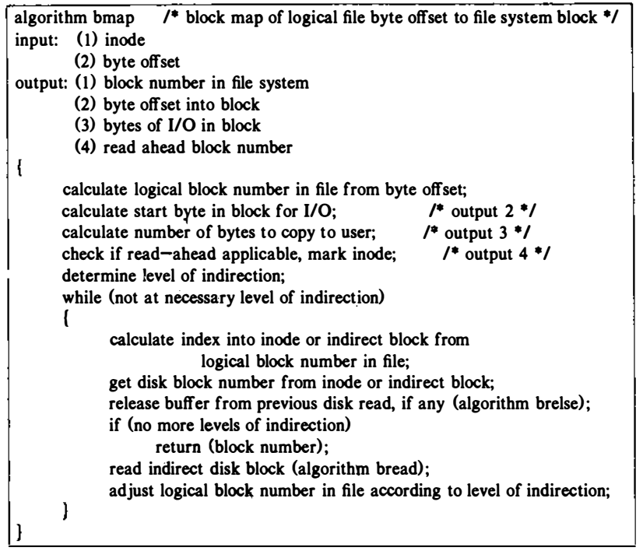
Figure 4.8. Conversion of Byte Offset to Block Number in File System

Slide 29
Directories
Give the file system its hierarchical structure
Important role in conversion of a file name to an inode number
Initial access: open, chdir, link system calls
Algorithm namei uses intermediate inodes as it parses a path name

Slide 30
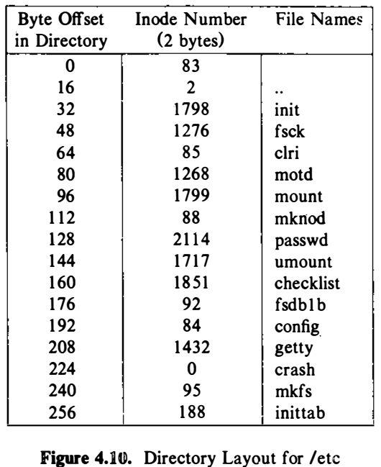

Slide 31
Example
For example, to open /home/mjd/profile:
/ is in inode 2 of the root file system (Unless the process has done chroot) making root its current working inode
After checking access permissions, Open inode 2, read in the data, look for “home”, get the i-number
Open the inode for home, read in the data, look for mjd, get the i-number
Open the inode for mjd, read in the data, look for profile, get the i-number

Slide 32
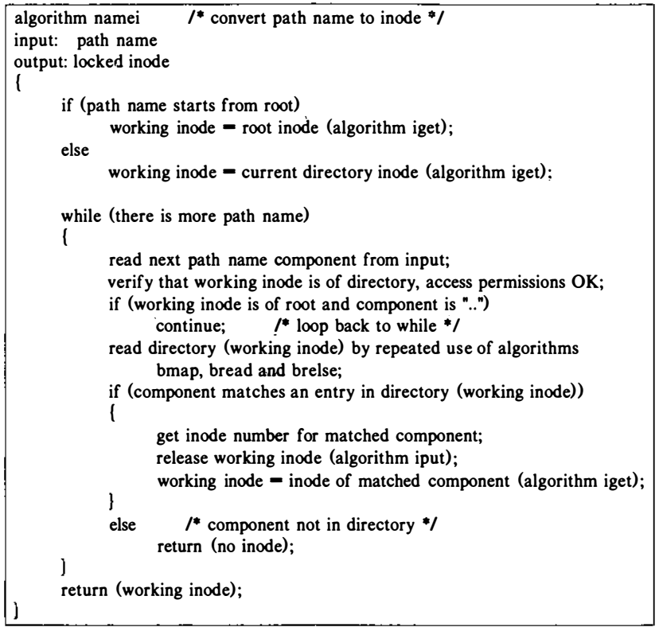
Algorithm for conversion of path name to an inode

Slide 33
Question:
suppose a process wants to open the file "/etc/passwd"

Slide 34
File System
A file system is a collection of files and directories on a disk or tape.
Each UNIX file system contains four major parts:
Boot block
Super block
i-node table
Data block
Boot
block
Super
block
I nodes
Data blocks

Slide 35
Super Block
The size of the file system
The number of free blocks in the file system
A list of free blocks available on the file system
The index of the next free block in the free block list
The size of the inode list
The number of free inodes in the file system
A list of free inodes in the file system
The index of the next free inode in the free inode list
Lock fields for the free block and free inode lists
A flag indicating that the super block has been modified

Slide 36
Inode Assignment to a new File
Problem :
How to assign a disk inode to a newly created file?
Solution:
The file system contains a linear list of inodes.
An inode is free if its type field is zero.
When a process needs a new inode, the kernel could theoretically search the inode list for a free inode
Problem with Solution:
Such a search would be expensive, requiring at least one read operation for every inode.
To improve performance, the file system super block contains an array to cache the numbers of free inodes in the file system.
Algorithm ialloc assigns a disk inode to a newly created file

Slide 37
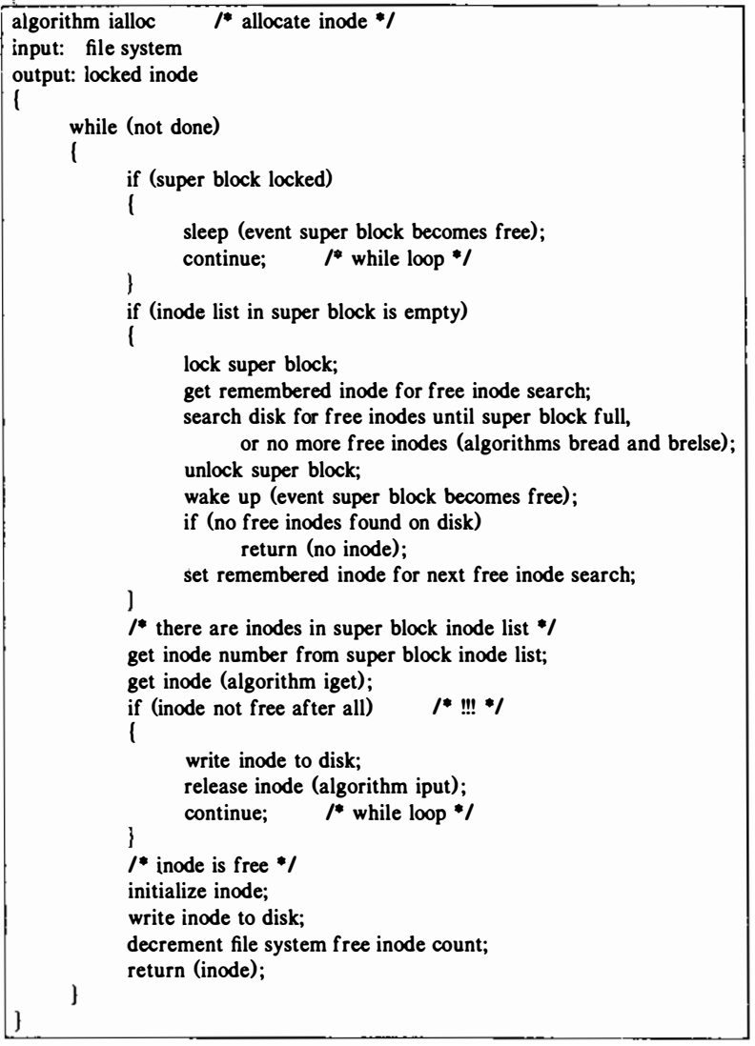
Algorithm for assigning new inodes

Slide 38
Remembered inodes
If the super block list of free inodes is empty, the kernel searches the disk and places as many free inode numbers as possible into the super block.
The kernel reads the inode list on disk, block by block, and fills the super block list of inode numbers to capacity, remembering the highest-numbered inode that it finds. Call that inode the “remembered” inode; it is the last one saved in the super block.
The next time the kernel searches the disk for free inodes, it uses the remembered inode as its starting point, thereby assuring that it wastes no time reading disk blocks where no free inodes should exist.

Slide 39
Algorithm for assigning new inodes

Slide 40
Assigning Free Inode from Middle of List
Super Block Free Inode List
Free inodes
empty
83
48
18
19
20
array 1
index
Super Block Free Inode List
Free inodes
empty
83
18
19
20
array 2
index

Slide 41
Assigning Free Inode – Super Block List Empty
Super Block Free Inode List
470
empty
0
array 1
index
Remembered inode
Super Block Free Inode List
array 2
535
free inodes
476
475
471
0
48
49
50
index

Slide 42
Freeing an inode
535 476 475 471
free inodes
remembered inode
index
Original Super Block List of Free Inodes
499 476 475 471
free inodes
remembered inode
index
Free Inode 499
499 476 475 471
free inodes
remembered inode
index
Free Inode 601

Slide 43
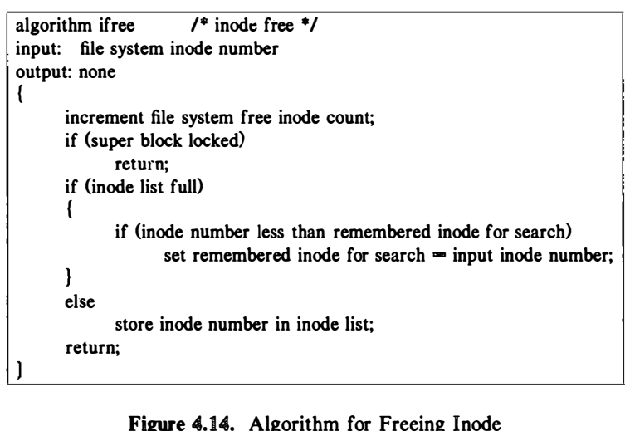
Freeing an inode

Slide 44
Allocation of disk blocks
Scenario:
When a process writes data to the file, kernel must allocate disk block.
The system Super block contains an array that is used to cache the number of free disk cache blocks.

Slide 45
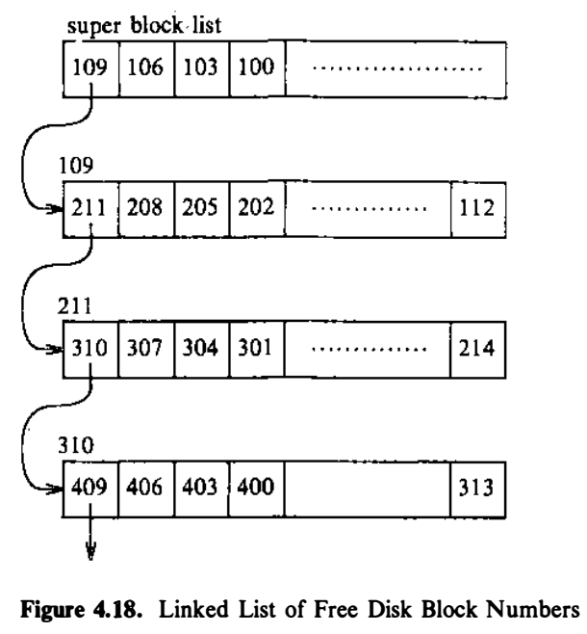
Allocation of disk blocks
In UNIX, data blocks of a file system are stored in a linked list, such that
Each link of the list is disk block that contains
An array of free disk block numbers
And one array entry is the number of the next block of the linked list.

Slide 47
Allocation of disk blocks
Algorithm alloc
- The kernel wants to allocate a block from a file system
it allocates the next available block in the super block list
- Once allocated , the block cannot be reallocated until it becomes free
- If the allocated block is the last block , the kernel treats it as a pointer to a block that contains a list of free blocks
• The kernel locks super block, reads block just taken from
free list, copies block numbers in block into super
block, releases block buffer, and unlocks super block
- Otherwise,
• The kernels gets buffer for block removed from super
block list , zero buffer contents, decrements total count
of free blocks, and marks super block modified

Slide 48
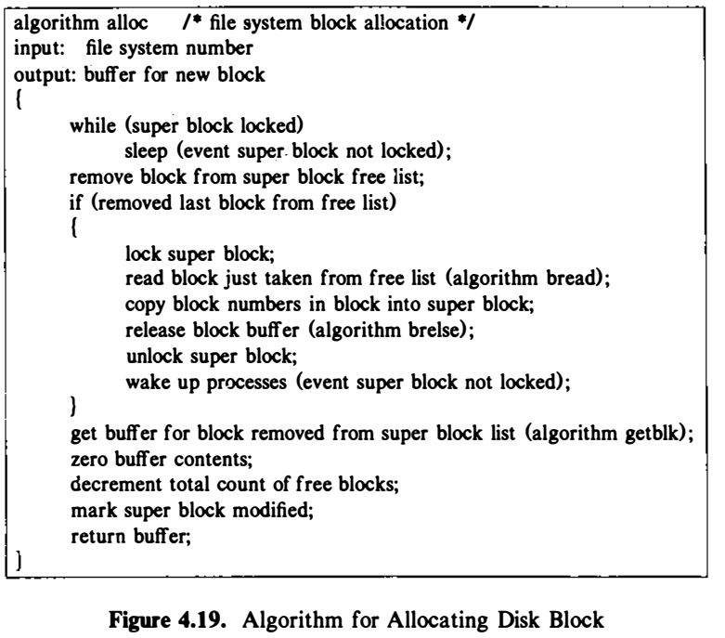
Allocation of disk blocks

Slide 49
Freeing a Disk Block
If the super list is not full,
The block number of the newly freed block is placed on the super block list.
If, the super block list is full,
The newly freed block becomes a link block.
The kernel writes the super block list into the block and writes the block to disk.

Slide 50
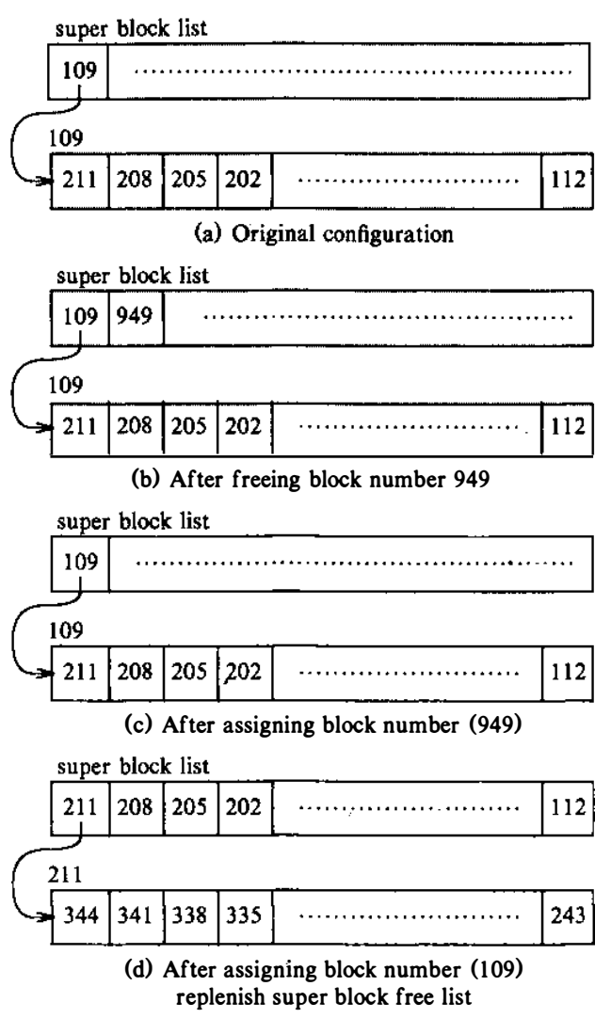
Allocation and freeing of disk blocks

Slide 51
Allocation and freeing of disk blocks

Slide 52
Data structure used
A linked list of free block number in the file system vs no such list of free inodes.
The kernel can determine whether an inode is free by inspection
Disk blocks lend themselves to the use of linked lists
Users tend to consume disk block resources more quickly than they consume inodes

Slide 53
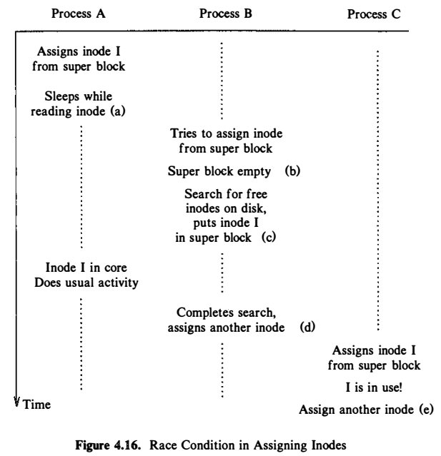
Race condition
Consider three processes, A, B, and C,
(a) Suppose that the kernel, acting on behalf of process A assigns inode I but goes to sleep before it copies the disk inode into the in-core copy. Algorithms iget (invoked by ialloc) and bread (invoked by iget) give process A ample opportunity to go to sleep.
(b) While process A is asleep, suppose process B attempts to assign a new inode but discovers that the super block list of free inodes is empty.
(c) Process B searches the disk for free inodes, and suppose it starts its search for free inodes at an inode number lower than that of the inode that A is assigning.
It is possible for process B to find inode I free on the disk since process A is still asleep, and the kernel does not know that the inode is about to be assigned.
(d) Process B, not realizing the danger, completes its search of the disk, fills up the super btock with (supposedly) free inodes, assigns an inode, and departs from the scene.

Slide 54
Race condition
However, inode I is in the super block free list of inode numbers.
When process A wakes up, it completes the assignment of inode I.
(e) Now suppose process C later requests an inode and happens to pick inode I from the super block free list.
When it gets the in-core copy of the inode, it will find its file type set, implying that the inode was already assigned. The kernel checks for this condition and, finding that the inode has been assigned, tries to assign a new one. Writing the updated inode to disk immediately after its assignment in ialloc makes the chance of the race smaller, because the file type field will mark the inode in use

Slide 55
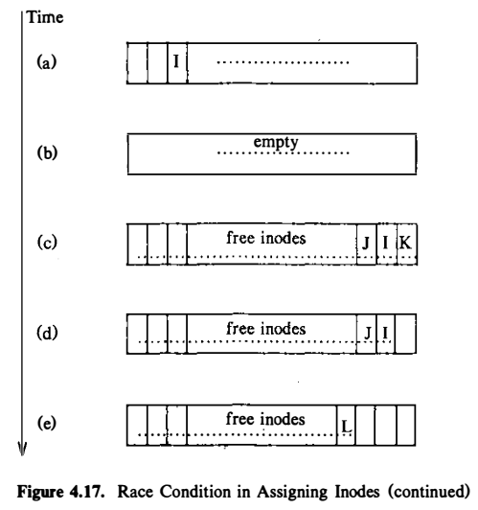
Race condition

Slide 56
Reference
The Design of the UNIX Operating System, by Maurice J. Bach

