Slide 1
System calls for File System
PART-1

Slide 2
System calls for files
Create new files: creat and mknod
Accessing existing files: open, read, write, lseek, and close
Manipulate the inode: chdir, chroot, chown, chmod, stat, and fstat
Advanced system calls: pipe and dup are important for the implementation of pipes
File system tree visible: mount and umount
Change the structure of the file system hierarchy: link and unlink

Slide 3
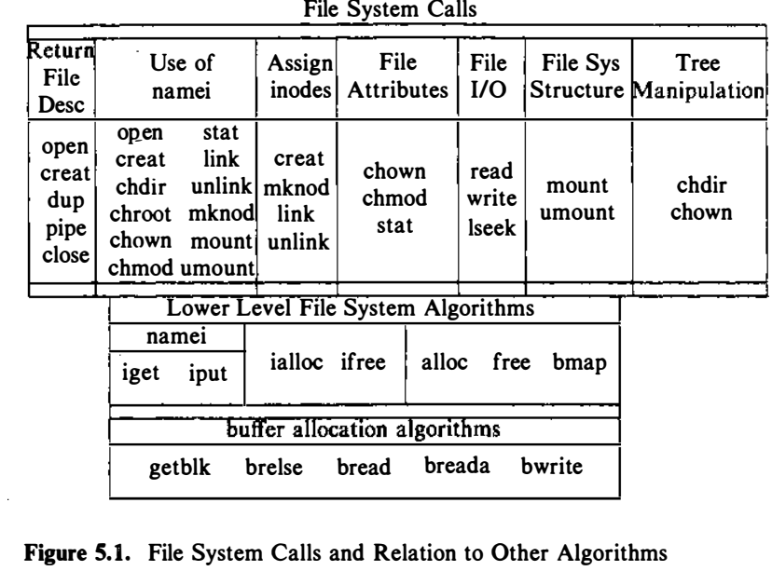
Relationship between the system calls and the various algorithms

Slide 4
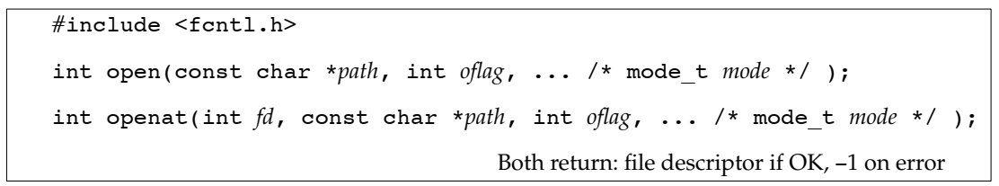
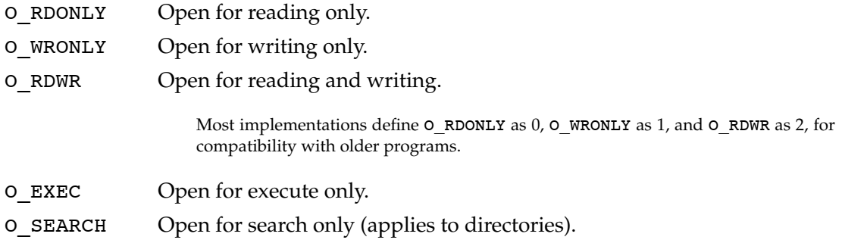
Opening a File
The path parameter is the name of the file to open or create.

Slide 5
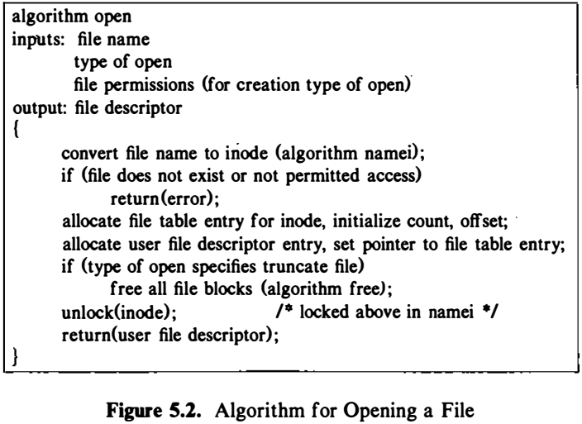
Opening a File

Slide 6
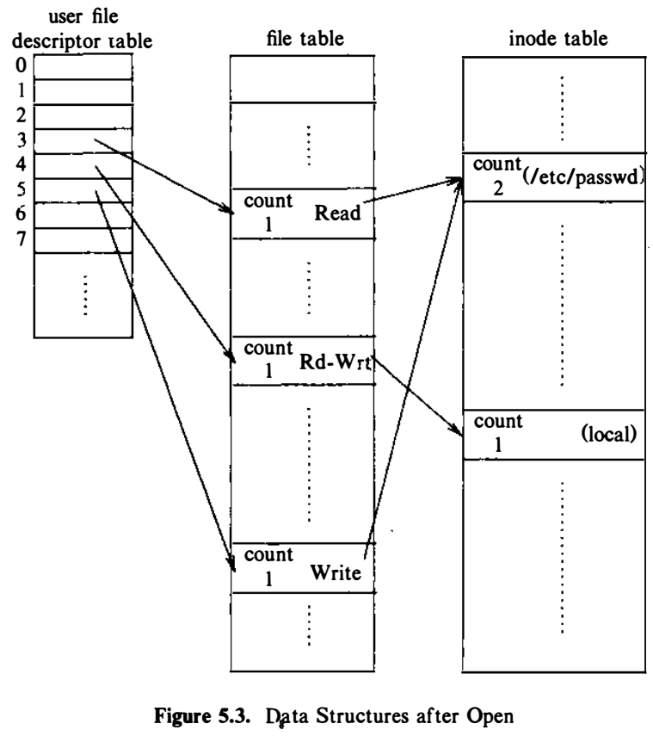
Opening a File
Process A
fd1 = open ("/etc/passwd", O_RDONLY) ;
fd2 = open ("local", 0 RDWR) ;
fd3 = open ("/etc/passwd", O_WRONLY) ;

Slide 7
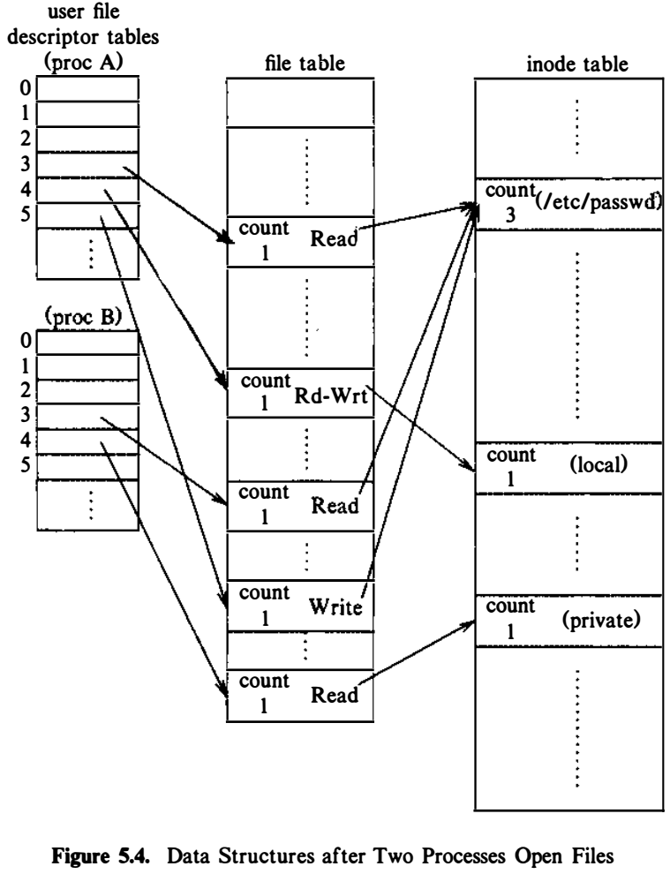
Opening a File
Process A
fd 1 = open ("/etc/passwd", O_RDONLY) ;
fd2 = open ("local", 0 RDWR) ;
fd3 = open ("/etc/passwd", O_WRONLY) ;
Process B
fd 1 = open ("/etc/passwd", O_RDONLY) ;
fd2 = open ("private", 0_RDONLY) ;

Slide 8
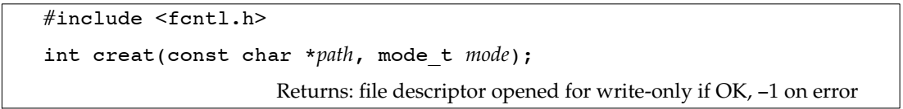
Create new files
Mode: defines the file's access permissions.
The mode is usually specified as an octal number such as 0666 that would mean read/write permission for owner, group.
constants for the mode argument as defined in sys/stat.h
#define S_IREAD 0000400 read permission, owner
#define S_IWRITE 0000200 write permission, owner
#define S_IRGRP 0000040 read permission, group
#define S_IROTH 0000004 read permission, other

Slide 9
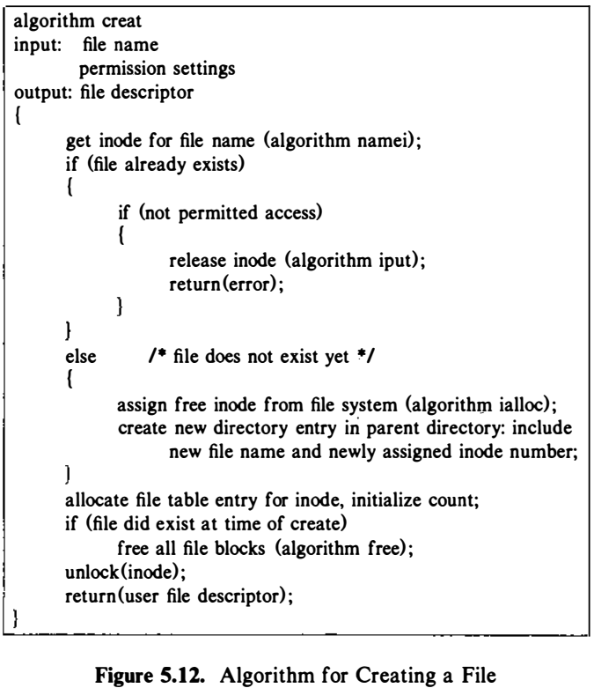
Algorithm to create a file

Slide 10
Create new files
Only the superuser has the permission to use the mknod() system call to create a new directory
an ordinary user cannot use mknod() to create a directory.
we use fork/exec to call upon the UNIX system's mkdir command that anyone can use to create a directory.

Slide 11
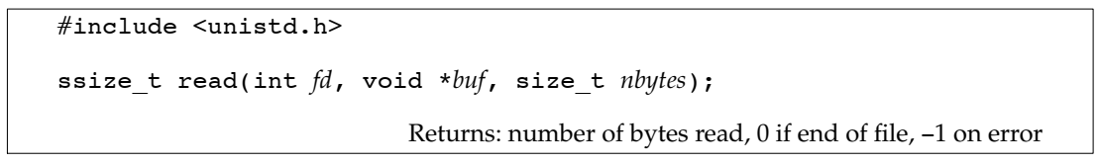
Read a file
fd file descriptor identifies the I/O channel. fd returned by open()
buf buffer pointer points to the area in memory where the data is stored.
nbytes is the number of bytes the user wants to read.
read() returns the number of bytes actually read().

Slide 12
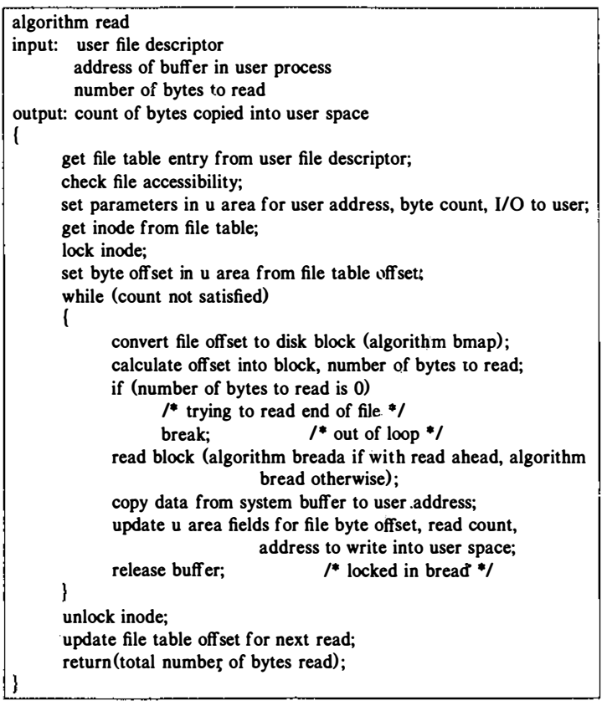
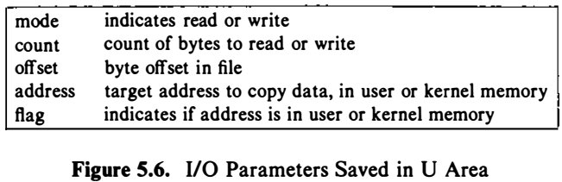
Algorithm for Reading a File

Slide 13
Accessing existing files
There are several cases in which the number of bytes actually read is less than the amount requested:
Reading from a regular file,
If the end of file is reached before the requested number of bytes has been read.
For example, if 30 bytes remain until the end of file and we try to read 100 bytes, read returns 30.
Reading from a terminal device
Normally, up to one line is read at a time.
Reading from a network
Buffering within the network may cause less than the requested amount to be returned.
Reading from a pipe or FIFO
If the pipe contains fewer bytes than requested, read will return only what is available.

Slide 14
Accessing existing files
Treats an ordinary file as a sequence of bytes.
Generally, a file is read or written sequentially -- that is, from beginning to the end of the file.
Sometimes sequential reading and writing is not appropriate.
The UNIX system lets you read and write anywhere in the file known as "random access“.
This capability is made possible with the lseek() system call.
Random access I/O is achieved by changing the value of this file pointer using the lseek() system call.

Slide 15
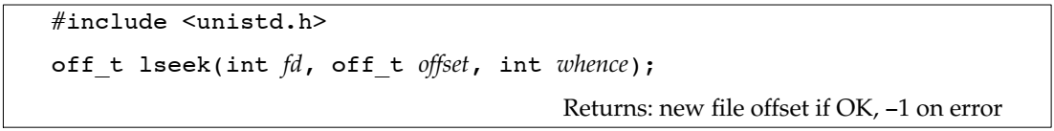
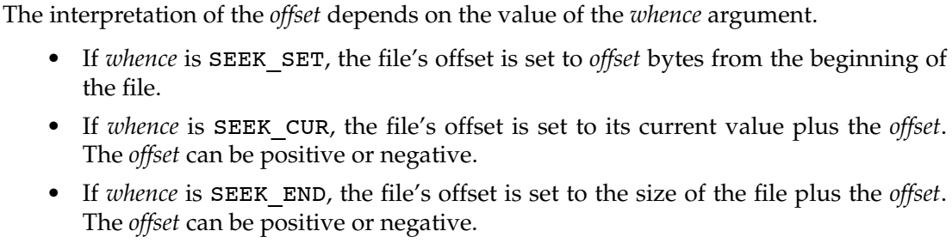
lseek function

Slide 16
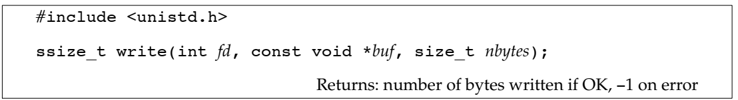
Write function
int write(int fd, char *buf, unsigned nbytes);
The return value is usually equal to the nbytes argument; otherwise, an error has occurred.
For a regular file, the write operation starts at the file’s current offset.
After a successful write, the file’s offset is incremented by the number of bytes actually written.

Slide 17
Accessing existing files
Every open file has an associated "current file offset"
#include <unistd.h>
int lseek(int fd, off_t offset, int whence);
Returns: new file offset if OK, −1 on error
The interpretation of the offset depends on the value of the whence argument.
0 (or SEEK_SET) offset bytes into the file
1 (or SEEK_CUR) current position in the file plus offset
2 (or SEEK_END) current end-of-file position plus offset.
If successful, lseek() returns a long integer that defines the new file pointer value measured in bytes from the beginning of the file.
If unsuccessful, the file position does not change.

Slide 18
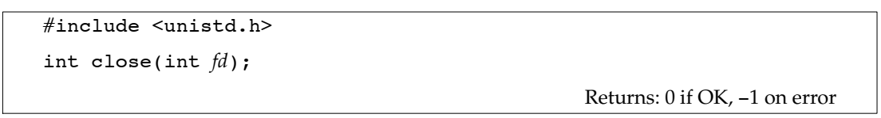
Close a file
fd returned by open()
Closing a file also releases any record locks that the process may have on the file.
When a process terminates, all of its open files are closed automatically by the kernel.

Slide 19
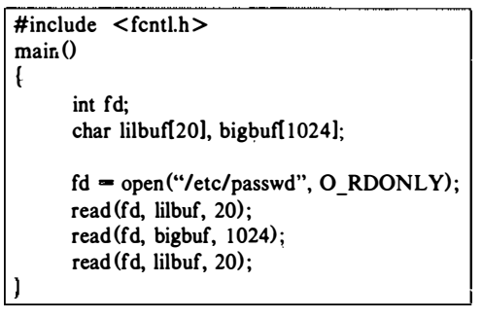
Reading: Example (1)

Slide 20
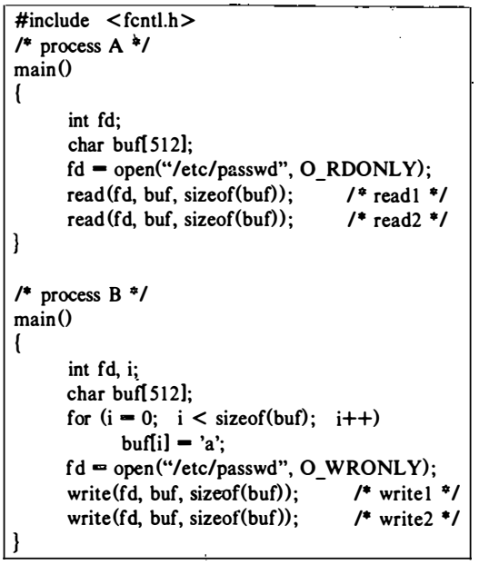
Read & write: Example (2)

Slide 21
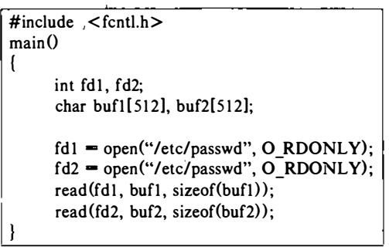
Read: Example (3)

Slide 22
Writing
Suppose a process writes byte number 10,240 to a file?

Slide 23
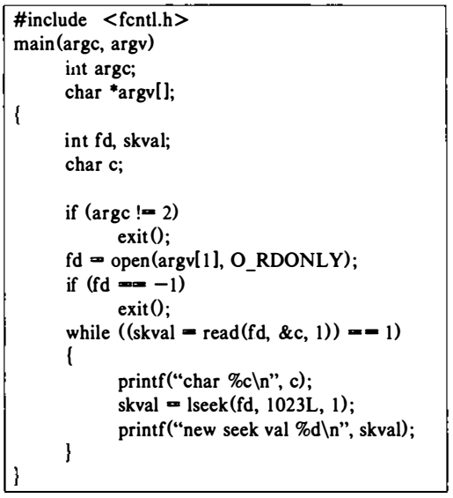
lseek: Example (4)

Slide 24
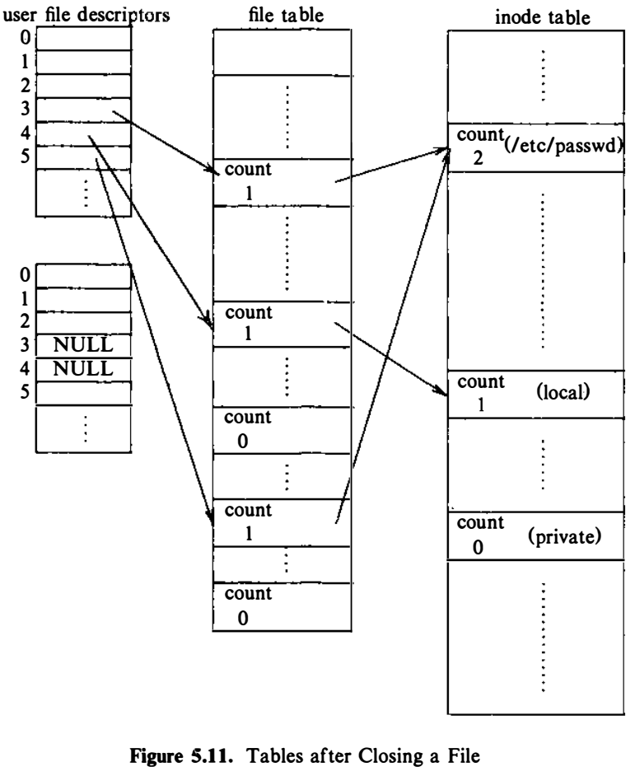
Process B closes files

Slide 25
Creation of Special Files
To create pipes, device files, and directories
Similar to creat
The kernel allocates an inode for the file
mknod(pathname, type and permissions, dev)
where
pathname is the name of the node to be created,
type and permissions give the node type (directory, for example) and access permissions for the new file to be created, and
dev specifies the major and minor device numbers for block and character special files

Slide 26
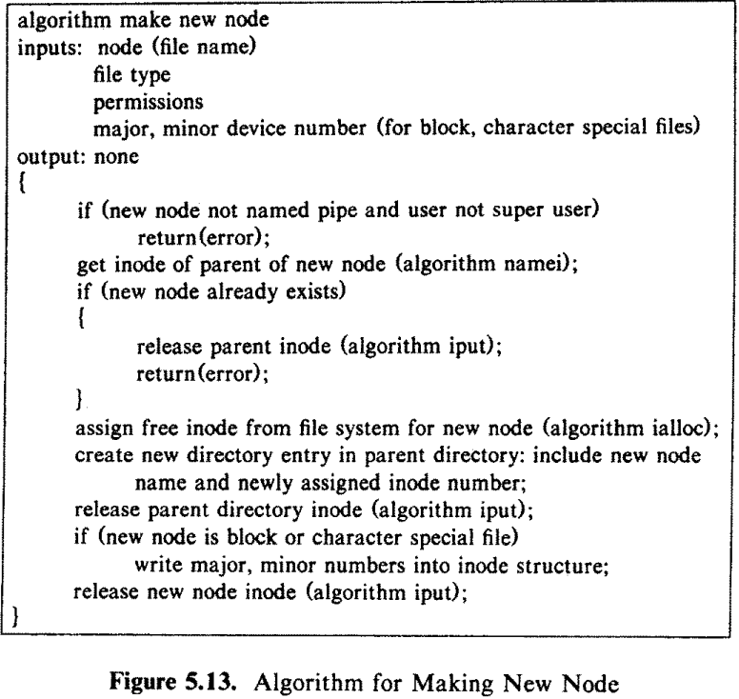
Algorithm for mknod

Slide 27
Reference
The Design of the UNIX Operating System, by Maurice J. Bach

