Slide 1
Deadlocks

Slide 2
Deadlock
In a multiprogramming environment, several processes may compete for a finite number of resources.
A process requests resources; if the resources are not available at that time, the Process enters a waiting state.
Sometimes, a waiting Process can never again change state, because the resources it has requested are held by other waiting threads.
This situation is called a deadlock.

Slide 3
Deadlock
System consists of resources
Resource types R₁, R₂, . . ., R_{m}
CPU cycles, memory space, I/O devices
Each resource type R_{i} has W_{i} instances.
Each process utilizes a resource as follows:
Request: The process requests the resource. If the request cannot be granted immediately (for example, if a mutex lock is currently held by another thread), then the requesting thread must wait until it can acquire the resource.
Use: The process can operate on the resource (for example, if the resource is a mutex lock, the thread can access its critical section).
Release: The thread releases the resource.

Slide 4
Deadlock
A set of processes is in a deadlocked state when every process in the set is waiting for an event that can be caused only by another process in the set.
The events with which we are mainly concerned here are resource acquisition and release.
In the dining-philosophers problem, resources are represented by chopsticks.
If all the philosophers get hungry at the same time, and each philosopher grabs the chopstick on her left, there are no longer any available chopsticks.
Each philosopher is then blocked waiting for her right chopstick to become available.

Slide 5
Deadlock with Semaphores
Data:
A semaphore S1 initialized to 1
A semaphore S2 initialized to 1
Two processes P1 and P2
P1:
wait(s1)//s1=0
wait(s2)//s2=0
P2:
wait(s2)//busy waiting
wait(s1)//busy waiting

Slide 6
Deadlock Characterization
Deadlock can arise if four conditions hold simultaneously.
Mutual exclusion: only one process at a time can use a resource.
Hold and wait: a process holding at least one resource is waiting to acquire additional resources held by other processes.
No preemption: a resource can be released only voluntarily by the process holding it, after that process has completed its task.
Circular wait: there exists a set {P₀, P₁, …, P_{n}} of waiting processes such that P₀ is waiting for a resource that is held by P₁, P₁ is waiting for a resource that is held by P₂, …, P_{n–1} is waiting for a resource that is held by P_{n}, and P_{n} is waiting for a resource that is held by P₀.

Slide 7
Resource-Allocation Graph
A set of vertices V and a set of edges E.
V is partitioned into two types:
P = {P₁, P₂, …, P_{n}}, the set consisting of all the processes in the system
R = {R₁, R₂, …, R_{m}}, the set consisting of all resource types in the system
request edge – directed edge P_{i} → R_{j}
p_{i} is request for R_{j} resource
assignment edge – directed edge R_{j} → P_{i}
p_{i} has R_{j} resource

Slide 8
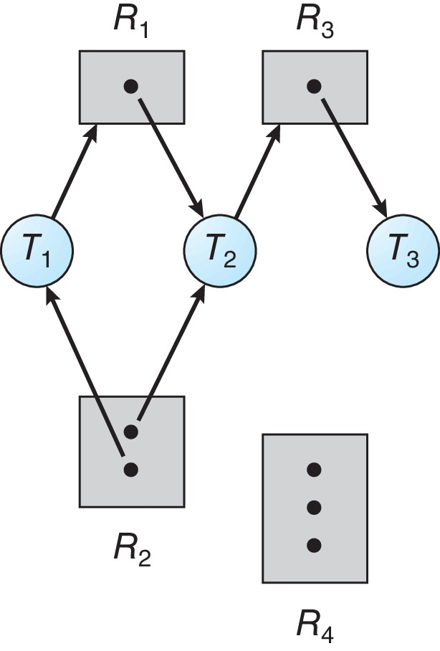
Resource Allocation Graph Example
One instance of R₁
Two instances of R₂
One instance of R₃
Three instance of R₄
T₁ holds one instance of R₂ and is waiting for an instance of R₁
T₂ holds one instance of R₁, one instance of R₂, and is waiting for an instance of R₃
T₃ is holds one instance of R₃

Slide 9
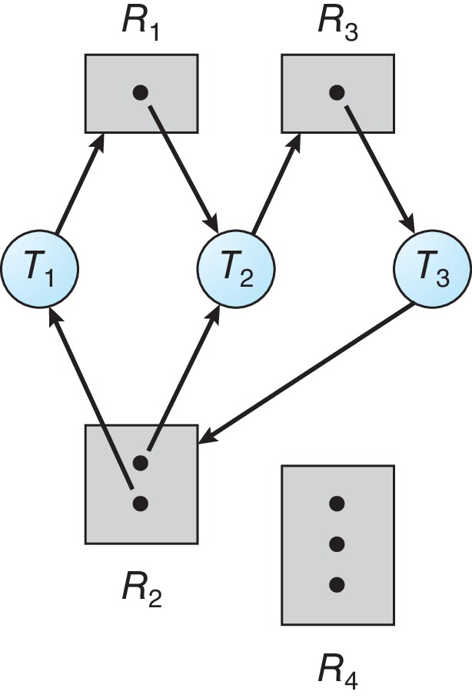
Resource Allocation Graph with a Deadlock
Processes T₁, T₂, and T₃ are deadlocked.
Process T₂ is waiting for the resource R₃, which is held by thread T₃.
Thread T₃ is waiting for either thread T₁ or thread T₂ to release resource R₂.
In addition, thread T₁ is waiting for thread T₂ to release resource R₁.

Slide 10
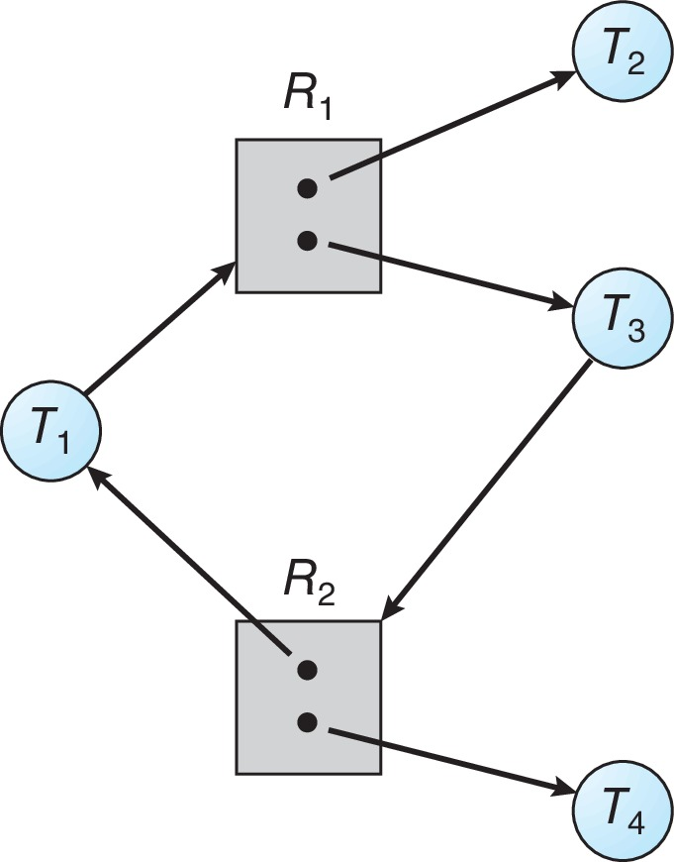
Graph with a Cycle But no Deadlock
In this example, we also have a cycle.
However, there is no deadlock.
Observe that thread T₄ may release its instance of resource type R₂.
That resource can then be allocated to T₃, breaking the cycle.

Slide 11
Basic Facts
If graph contains no cycles ⇒ no deadlock
If graph contains a cycle ⇒
If only one instance per resource type, then deadlock
If several instances per resource type, possibility of deadlock

Slide 12
Methods for Handling Deadlocks
Ensure that the system will never enter a deadlock state:
Deadlock prevention
Deadlock avoidance
Allow the system to enter a deadlock state, detect it, and then recover
Ignore the problem and pretend that deadlocks never occur in the system.

Slide 13
Deadlock Prevention
Deadlock prevention provides a set of methods to ensure that at least one of the necessary conditions cannot hold.

Slide 14
Deadlock Prevention
Invalidate one of the four necessary conditions for deadlock:
Mutual Exclusion – at least one resource must be non-sharable. Sharable resources do not require mutually exclusive access and thus cannot be involved in a deadlock.
Hold and Wait – must guarantee that whenever a process requests a resource, it does not hold any other resources.
Require process to request and be allocated all its resources before it begins execution, or allow process to request resources only when the process has none allocated to it.
Low resource utilization; starvation possible

Slide 15
Deadlock Prevention
No Preemption:
If a process is holding some resources and requests another resource that cannot be immediately allocated to it (that is, the process must wait), then all resources the process is currently holding are preempted.
Preempted resources are added to the list of resources for which the process is waiting
Process will be restarted only when it can regain its old resources, as well as the new ones that it is requesting
Circular Wait:
Impose a total ordering of all resource types, and require that each process requests resources in an increasing order of enumeration

Slide 16
Deadlock Avoidance
Requires that the system has some additional a priori information available
Simplest and most useful model requires that each process declare the maximum number of resources of each type that it may need.
The deadlock-avoidance algorithm dynamically examines the resource-allocation state to ensure that there can never be a circular-wait condition.
Resource-allocation state is defined by the number of available and allocated resources, and the maximum demands of the processes.

Slide 17
Safe State
When a process requests an available resource, system must decide if immediate allocation leaves the system in a safe state.
System is in safe state if there exists a sequence <P₁, P₂, …, P_{n}> of ALL the processes in the systems such that for each P_{i}, the resources that P_{i} can still request can be satisfied by currently available resources + resources held by all the P_{j}, with j < i
That is:
If P_{i} resource needs are not immediately available, then P_{i} can wait until all P_{j} have finished
When P_{j} is finished, P_{i} can obtain needed resources, execute, return allocated resources, and terminate
When P_{i} terminates, P_{i +1} can obtain its needed resources, and so on.

Slide 18
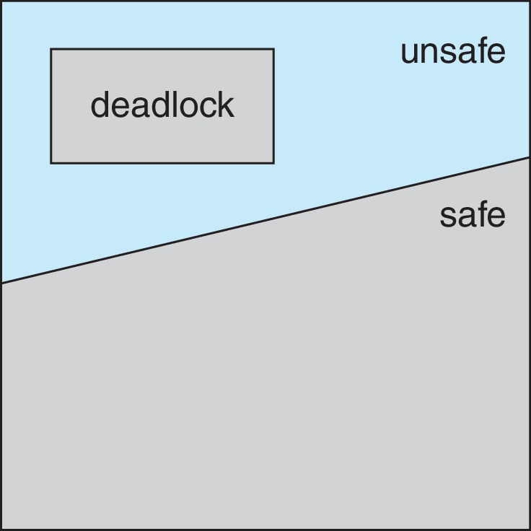
Basic Facts
If a system is in safe state ⇒ no deadlocks
If a system is in unsafe state ⇒ possibility of deadlock
Avoidance ⇒ ensure that a system will never enter an unsafe state.

Slide 19
Avoidance Algorithms
Single instance of a resource type
Use a modified resource-allocation graph
Multiple instances of a resource type
Use the Banker’s Algorithm

Slide 20
Modified Resource-Allocation Graph Scheme
Claim edge P_{i} --> R_{j} indicates that process P_{i} may request resource R_{j}
Request edge P_{i} → R_{j} indicates that process P_{i} requests resource R_{j}
Claim edge converts to request edge when a process requests a resource.
Assignment edge R_{j} → P_{i} indicates that resource R_{j} was allocated to process P_{i}
Request edge converts to an assignment edge when the resource is allocated to the process
When a resource is released by a process, assignment edge reconverts to a claim edge.
Resources must be claimed a priori in the system.

Slide 21
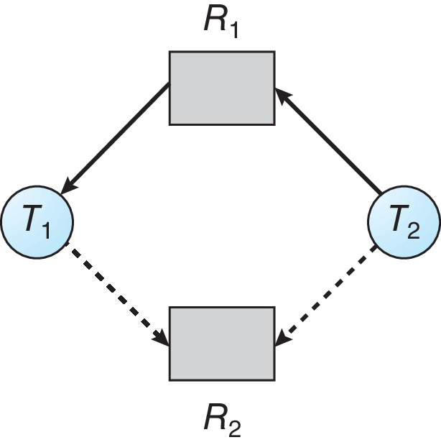
Resource-Allocation Graph
Process T_{i} requests resource R_{j}.
The request can be granted only if converting the request edge T_{i} → R_{j} to an assignment edge R_{j} → T_{i} does not result in the formation of a cycle in the resource-allocation graph.

Slide 22
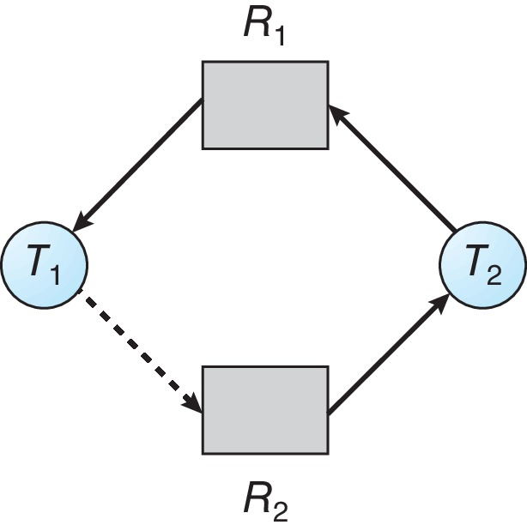
Unsafe State In Resource-Allocation Graph
If no cycle exists, then the allocation of the resource will leave the system in a safe state.
If a cycle is found, then the allocation will put the system in an unsafe state.

Slide 23
Banker’s Algorithm
Multiple instances of resources
Each process must a priori claim maximum use
When a process requests a resource it may have to wait
When a process gets all its resources it must return them in a finite amount of time.

Slide 24
Data Structures for the Banker’s Algorithm
Let n = number of processes, and m = number of resources types.
Available: Vector of length m. If available [j] = k, there are k instances of resource type R_{j} available
Max: n x m matrix. If Max [i,j] = k, then process P_{i} may request at most k instances of resource type R_{j}
Allocation: n x m matrix. If Allocation[i,j] = k then P_{i} is currently allocated k instances of R_{j}
Need: n x m matrix. If Need[i,j] = k, then P_{i} may need k more instances of R_{j} to complete its task
Need [i,j] = Max[i,j] – Allocation [i,j]

Slide 25
Safety Algorithm
Let Work and Finish be vectors of length m and n, respectively. Initialize:
Work = Available
Finish [i] = false for i = 0, 1, …, n- 1
Find an i such that both:
(a) Finish [i] = false
(b) Need_{i} ≤ Work
If no such i exists, go to step 4
Work = Work + Allocation_{i} Finish[i] = true go to step 2
If Finish [i] == true for all i, then the system is in a safe state

Slide 26
Resource-Request Algorithm for Process P_{i}
Request_{i} = request vector for process P_{i}. If Request_{i} [j] = k then process P_{i} wants k instances of resource type R_{j}
If Request_{i} ≤ Need_{i} go to step 2. Otherwise, raise error condition, since process has exceeded its maximum claim
If Request_{i} ≤ Available, go to step 3. Otherwise P_{i} must wait, since resources are not available
Pretend to allocate requested resources to P_{i} by modifying the state as follows:
Available = Available – Request_{i};
Allocation_{i} = Allocation_{i} + Request_{i};
Need_{i} = Need_{i} – Request_{i};
If safe ⇒ the resources are allocated to P_{i}
If unsafe ⇒ P_{i} must wait, and the old resource-allocation state is restored

Slide 27
Example of Banker’s Algorithm
5 processes P₀ through P₄;
3 resource types:
A (10 instances), B (5 instances), and C (7 instances)
Snapshot at time T₀:
Allocation Max Available
A B C A B C A B C
P₀ 0 1 0 7 5 3 3 3 2
P₁ 2 0 0 3 2 2
P₂ 3 0 2 9 0 2
P₃ 2 1 1 2 2 2
P₄ 0 0 2 4 3 3

Slide 28
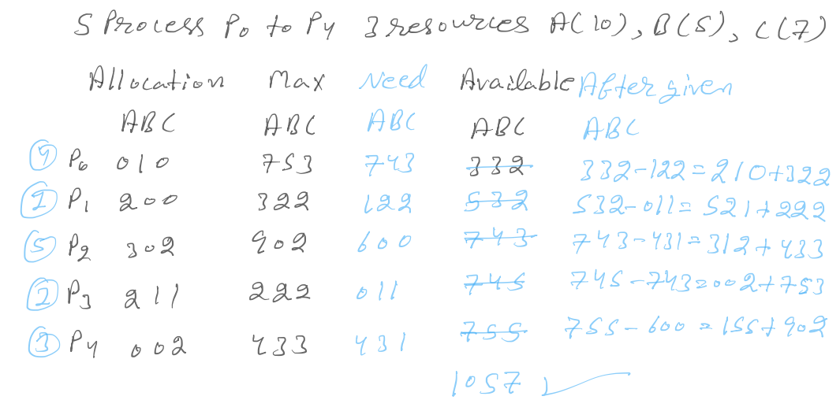

Slide 29
Example of Banker’s Algorithm
Snapshot at time T₀:
Allocation Max Available Need
A B C A B C A B C A B C
P₀ 0 1 0 7 5 3 3 3 2 7 4 3
P₁ 2 0 0 3 2 2 1 2 2
P₂ 3 0 2 9 0 2 6 0 0
P₃ 2 1 1 2 2 2 0 1 1
P₄ 0 0 2 4 3 3 4 3 1
The system is in a safe state since the sequence < P₁, P₃, P₄, P₂, P₀> satisfies safety criteria

Slide 30
Example: P₁ Request (1,0,2)
Check that Request ≤ Available (that is, (1,0,2) ≤ (3,3,2) ⇒ true
Allocation Need Available
A B C A B C A B C
P₀ 0 1 0 7 4 3 2 3 0
P₁ 3 0 2 0 2 0
P₂ 3 0 2 6 0 0
P₃ 2 1 1 0 1 1
P₄ 0 0 2 4 3 1
Executing safety algorithm shows that sequence < P₁, P₃, P₄, P₀, P₂> satisfies safety requirement
Can request for (3,3,0) by P₄ be granted?
Can request for (0,2,0) by P₀ be granted?

Slide 31
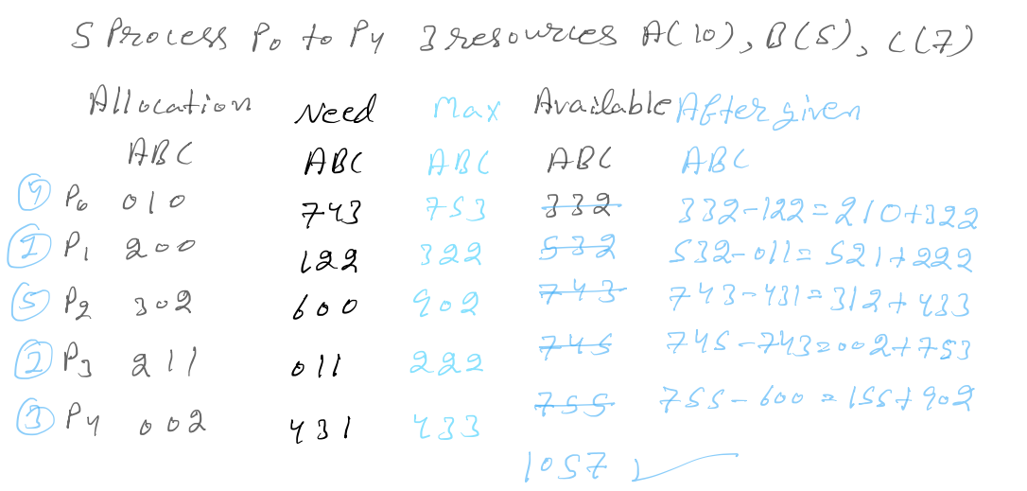

Slide 32
Deadlock Detection
Allow system to enter deadlock state
If a system does not employ either a deadlock-prevention or a deadlock avoidance algorithm, then a deadlock situation may occur.
Detection algorithm
Recovery scheme

Slide 33
Single Instance of Each Resource Type
If all resources have only a single instance, then we can define a deadlock detection algorithm that uses a variant of the resource-allocation graph, called a wait-for graph.
We obtain this graph from the resource-allocation graph by removing the resource nodes and collapsing the appropriate edges.

Slide 34
Single Instance of Each Resource Type
Maintain wait-for graph
Nodes are processes
P_{i} → P_{j} if P_{i} is waiting for P_{j}
Periodically invoke an algorithm that searches for a cycle in the graph. If there is a cycle, there exists a deadlock.
An algorithm to detect a cycle in a graph requires an order of n² operations, where n is the number of vertices in the graph.

Slide 35
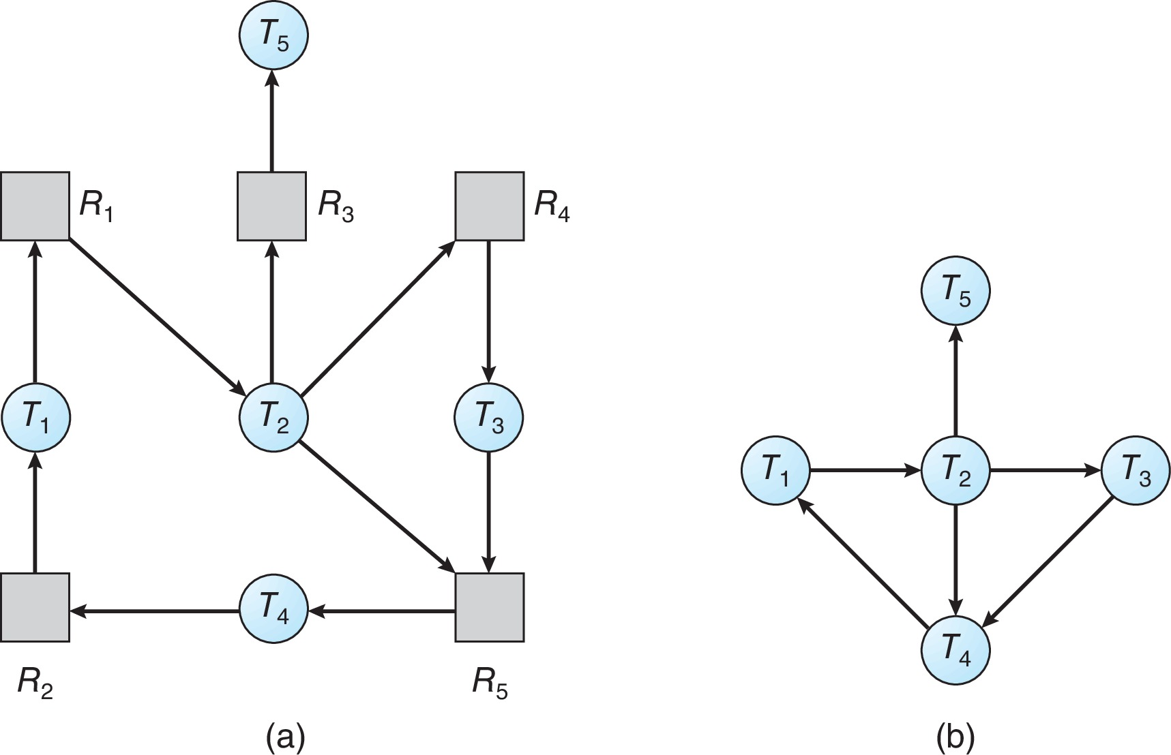
Resource-Allocation Graph & Wait-for Graph
Resource-Allocation Graph
Corresponding wait-for graph

Slide 36
Several Instances of a Resource Type
The wait-for graph scheme is not applicable to a resource-allocation system with multiple instances of each resource type.
We turn now to a deadlockdetection algorithm that is applicable to such a system.
The algorithm employs several time-varying data structures that are similar to those used in the banker’s algorithm.

Slide 37
Several Instances of a Resource Type
Available: A vector of length m indicates the number of available resources of each type.
Allocation: An n x m matrix defines the number of resources of each type currently allocated to each process,
Request: An n x m matrix indicates the current request of each process.
If Request [i][j] = k, then process P_{i} is requesting k more instances of resource type R_{j}.

Slide 38
Detection Algorithm
Let Work and Finish be vectors of length m and n, respectively Initialize:
Work = Available
For i = 1,2, …, n, if Allocation_{i} ≠ 0, then Finish[i] = false; otherwise, Finish[i] = true
Find an index i such that both:
Finish[i] == false
Request_{i} ≤ Work
If no such i exists, go to step 4
Work = Work + Allocation_{i} Finish[i] = true go to step 2
If Finish[i] == false, for some i, 1 ≤ i ≤ n, then the system is in deadlock state. Moreover, if Finish[i] == false, then P_{i} is deadlocked

Slide 39
Detection Algorithm
Algorithm requires an order of O(m x n²) operations to detect whether the system is in deadlocked state.

Slide 40
Example of Detection Algorithm
Five processes P₀ through P₄; three resource types A (7 instances), B (2 instances), and C (6 instances)
Snapshot at time T₀:
Allocation Request Available
A B C A B C A B C
P₀ 0 1 0 0 0 0 0 0 0
P₁ 2 0 0 2 0 2
P₂ 3 0 3 0 0 0
P₃ 2 1 1 1 0 0
P₄ 0 0 2 0 0 2
Sequence <P₀, P₂, P₃, P₄ ,P₁> will result in Finish[i] = true for all i

Slide 41
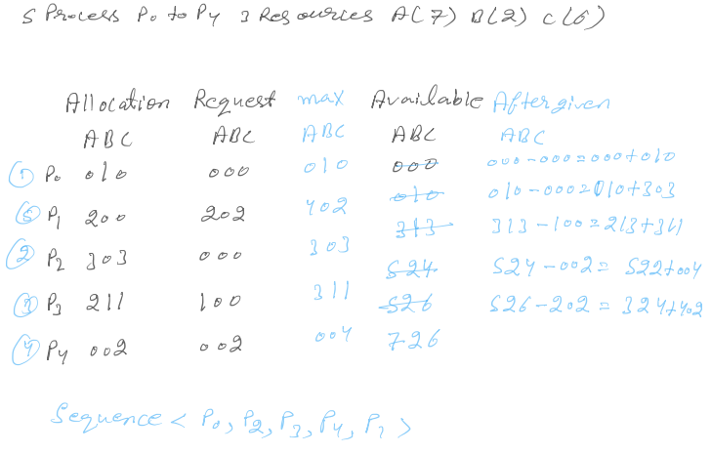

Slide 42
Example of Detection Algorithm
P₂ requests an additional instance of type C
Request
A B C
P₀ 0 0 0
P₁ 2 0 2
P₂ 0 0 1
P₃ 1 0 0
P₄ 0 0 2
State of system?
Can reclaim resources held by process P₀, but insufficient resources to fulfill other processes; requests
Deadlock exists, consisting of processes P₁, P₂, P₃, and P₄

Slide 43
Detection-Algorithm Usage
When, and how often, to invoke depends on:
How often a deadlock is likely to occur?
How many processes will need to be rolled back?
One for each disjoint cycle
If detection algorithm is invoked arbitrarily, there may be many cycles in the resource graph and so we would not be able to tell which of the many deadlocked processes “caused” the deadlock.

Slide 44
Recovery from Deadlock: Process Termination
When a detection algorithm determines that a deadlock exists, several alternatives are available.
One possibility is to inform the operator that a deadlock has occurred and to let the operator deal with the deadlock manually.
Another possibility is to let the system recover from the deadlock automatically.
There are two options for breaking a deadlock.
One is simply to abort one or more threads to break the circular wait.
The other is to preempt some resources from one or more of the deadlocked threads.

Slide 45
Recovery from Deadlock: Process Termination
Abort all deadlocked processes
Abort one process at a time until the deadlock cycle is eliminated
In which order should we choose to abort?
Priority of the process
How long process has computed, and how much longer to completion
Resources the process has used
Resources process needs to complete
How many processes will need to be terminated
Is process interactive or batch?

Slide 46
Recovery from Deadlock: Resource Preemption
Selecting a victim – minimize cost
Rollback – return to some safe state, restart process for that state
Starvation – same process may always be picked as victim, include number of rollback in cost factor

Slide 47
Summary
Deadlock: situation in which a set of threads/processes cannot proceed because each requires resources held by another member of the set.
Prevention: design resource allocation strategies that guarantee that one of the necessary conditions never holds
Avoidance: don't allocate a resource if it would introduce a cycle.
Safe State
Single instance of a resource type
Use a modified resource-allocation graph
Multiple instances of a resource type
Use the Banker’s Algorithm
Detection and recovery: recognize deadlock after it has occurred and break it.

