Slide 1
Executable
execl, execv, execle, execve, execlp, execvp
&
fexecve

Slide 2
Executable
exec() makes a process execute a given executable.
Many variants exist of exec() system calls with different arguments.
The exec family of functions shall replace the current process image with a new process image.
The new image shall be constructed from a regular, executable file called the new process image file.
There shall be no return from a successful exec, because the calling process image is overlaid by the new process image.
When a C-language program is executed as a result of a call to one of the exec family of functions, it shall be entered as a C-language function call as follows:
The arguments specified by a program with one of the exec functions shall be passed on to the new process image in the corresponding main() arguments.

Slide 3
Executable
When a C-language program is executed as a result of a call to one of the exec family of functions, it shall be entered as a C-language function call as follows:
int main (int argc, char *argv[]);
where argc is the argument count and argv is an array of character pointers to the arguments themselves.
int main(int argc, char *argv[], char * environ[]);
extern char **environ is initialized as a pointer to an array of character pointers to the environment strings.
The argv and environ arrays are each terminated by a null pointer.
The null pointer terminating the argv array is not counted in argc.

Slide 4
environ: user environment
USER The name of the logged-in user.
HOME A user's login directory.
PATH The sequence of directories, separated by colons.
PWD Absolute path to the current working directory.
SHELL The full pathname of the user’s login shell.
EDITOR Default editor name.
Many more …
A process can query, update, and delete these strings using the getenv(), setenv(), and unsetenv() functions, respectively.

Slide 5
Executable
int execl(const char *pathname, const char *arg0, ... /* (char *)0 */ );
int execv(const char *pathname, char *const argv[]);
int execle(const char *pathname, const char *arg0,.../* (char *)0, char *const envp[] */ );
int execve(const char *pathname, char *const argv[], char *const envp[]);
int execlp(const char *filename, const char *arg0, ... /* (char *)0 */ );
int execvp(const char *filename, char *const argv[]);
int fexecve(int fd, char *const argv[], char *const envp[]);
l stands for list of arguments,
v stands for vector (an argv[] vector),
p stands for path and
e stands for environment (an envp[] array).
All seven return: −1 on error, no return on success.

Slide 6
Executable
The first difference in these functions is that the first four (l,v,le,ve) take a pathname argument.
The next two (lp,vp) take a filename argument, and
The last one (fexecve) takes a file descriptor argument. When a filename argument is specified,
If filename contains a slash, it is taken as a pathname.
Otherwise, the executable file is searched for in the directories specified by the PATH environment variable.
The PATH variable contains a list of directories, called path prefixes, that are separated by colons, eg.
PATH=/bin:/usr/bin:/usr/local/bin/:.

Slide 7
Executable
The functions execl, execlp, and execle require each of the command-line arguments to the new program to be specified as separate arguments.
We mark the end of the arguments with a null pointer.
For the other four functions (execv, execvp, execve, and fexecve), we have to build an array of pointers to the arguments.
The three functions whose names end in an e (execle, execve, and fexecve) allow us to pass a pointer to an array of pointers to the environment strings.
The other four functions, however, use the environ variable in the calling process to copy the existing environment for the new program.

Slide 8
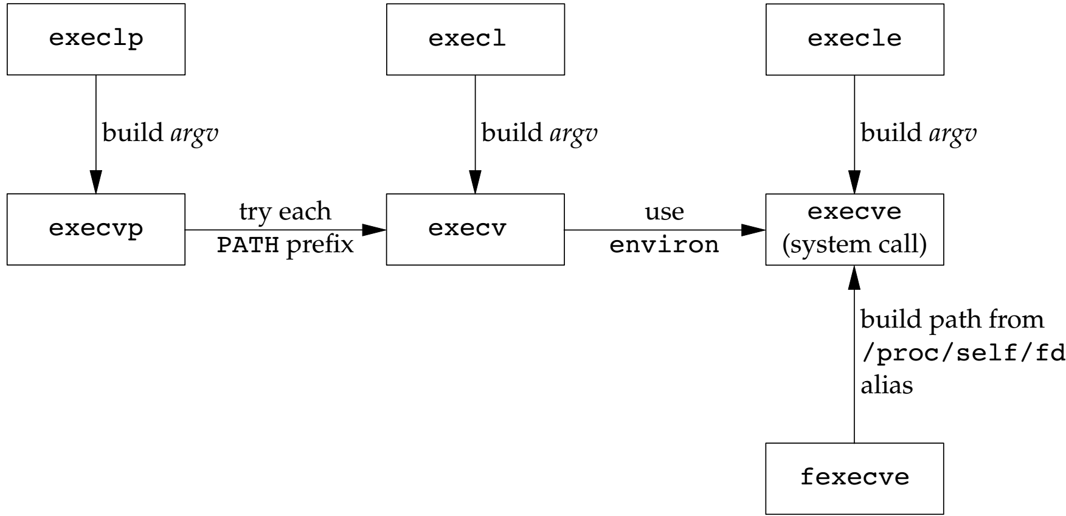
Executable
Relationship of the seven exec functions:

Slide 9
#include<stdio.h>
#include<unistd.h>
#include<sys/types.h>
#include<sys/wait.h>
int main()
{
pid_t pid=fork();
if(pid>0)
{
wait(NULL);
printf("\nhere parent lies\n");
}
else
{
// Child process
//remember here give the executable file location
execl("/media/sumit/New Volume/Study/Du_mca/2nd_semester/Operating_system/Lab/1_getpid","1_getpid.c",NULL);
// If execl() fails
printf("\nexecl");
return 1;
}
return 0;
}

Slide 10
Example: prog.c
#include <stdio.h>
#include <stdlib.h>
#include <unistd.h>
#include <string.h>
#include <sys/wait.h>
main(int argc, char *argv[])
{
printf("hello (pid:%d)\n", (int) getpid());
int id = fork();
if (id< 0) { // fork failed; exit
printf("fork failed\n");
exit(1);
}
else if (id ==0) { // child (new process)
printf(“Child pid:%d \n", (int) getpid());
char *myargs[3];
myargs[0] = “prog_ other”;
myargs[1] = “prog_other”;
myargs[2] = NULL; //end of array
execvp (myargs[0], myargs);
printf("this shouldn't print out");
}
else { // parent goes down this path (main)
int wc= wait (NULL);
printf("Parent of %d (wc:%d), pid:%d\n", id, wc, (int)getpid());
}
return 0;
}

Slide 11
Example- Executable: echoall.c
#include <sys/wait.h>
char *env[]={"USER=unknown", "PATH=/tmp",NULL};
int main(void)
{
pid_t pid;
if ((pid = fork()) < 0) {
err_sys("fork error");
}
else if (pid == 0) {
if (execle(“../home/bin/echoall", "echoall", "myarg1", "MY ARG2", (char *)0, env) < 0)
err_sys("execle error");
}
if (waitpid(pid, NULL, 0) < 0)
err_sys("wait error");
if ((pid = fork()) < 0) {
err_sys("fork error");
} else if (pid == 0) {
if (execlp("echoall", "echoall", "only one arg", (char *)0) < 0)
err_sys("execlp error");
}
exit(0);
}

Slide 12
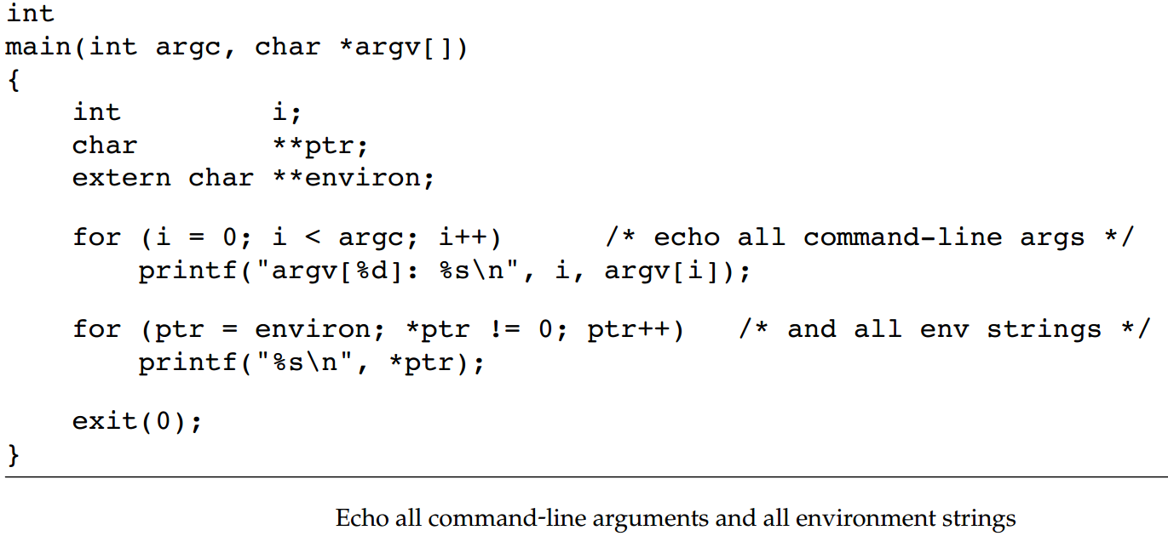

Slide 13
More about Executable
http://www.it.uu.se/education/course/homepage/os/vt18/module-2/exec/
https://www.baeldung.com/linux/exec-functions

