Slide 1
File Access
INODES
&
System Calls

Slide 2
I-NODE
Every file on a UNIX system has a unique inode (Index-node).
The inode contains the information necessary for a process to access a file, such as file ownership, access rights, file size, and location of the file's data in the file system.
Inodes exist in a static form on disk.
The i-node data structure holds all the information about a file except the file's name and its contents.

Slide 3
I-NODE
Disk inodes consist of the following fields:
File owner identifier: an individual owner and a "group" owner.
File type: Files may be of type regular, directory, character or block special, or FIFO (pipes).
File access permissions: the owner and the group owner of the file, and other users.
File access times: giving the time the file was last modified, when it was last accessed.
Number of links to the file: representing the number of names the file has in the directory hierarchy.
Table of contents for the disk addresses of data in a file.
File size: number of bytes.

Slide 4
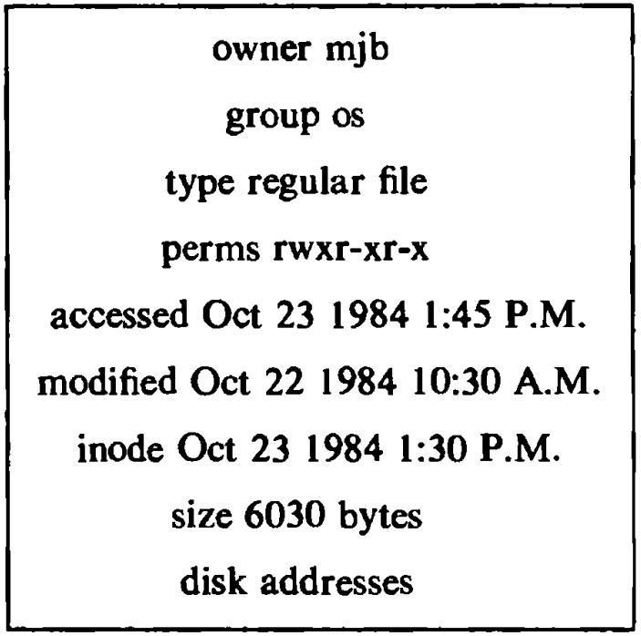
I-NODE
Disk inodes consist of the following fields:
File owner identifier: an individual owner and a "group" owner
File type: Files may be of type regular, directory, character or block special, or FIFO (pipes).
File access permissions: the owner and the group owner of the file, and other users.
File access times: giving the time the file was last modified, when it was last accessed.
Number of links to the file: representing the number of names the file has in the directory hierarchy.
Table of contents for the disk addresses of data in a file.
File size: number of bytes.

Slide 5
System calls for file system
int creat(const char *path, mode_t mode);
In place of path we can write the name of file that we want to create
*path is a pointer that names the file
mode defines the file’s access permissions. The mode constants are defined in sys/stat.h.
Multiple mode values may be combined by or (|) operator.
#define S_IRWXU 0000700 /* -rwx------ */
#define S_IREAD 0000400 /* read permission, owner */
#define S_IRUSR S_IREAD
#define S_IWRITE 0000200 /* write permission, owner */
#define S_IWUSR S_IWRITE
#define S_IEXEC 0000100 /* execute/search permission, owner */
#define S_IXUSR S_IEXEC
#define S_IRWXG 0000070 /* ----rwx--- */
#define S_IRGRP 0000040 /* read permission, group */
#define S_IWGRP 0000020 /* write " " */
#define S_IXGRP 0000010 /* execute/search " " */
#define S_IRWXO 0000007 /* -------rwx */
#define S_IROTH 0000004 /* read permission, other */
#define S_IWOTH 0000002 /* write " " */
#define S_IXOTH 0000001 /* execute/search " " */

Slide 6
System calls for file system
int open(const char *path, int oflag, ... );
The open() function establishes the connection between a file and a file descriptor.
creat(path, mode) is equivalent to:
open(path, O_WRONLY|O_CREAT|O_TRUNC, mode)
The open() function will return a file descriptor for the named file that is the lowest file descriptor not currently open for that process.
Applications must specify exactly one of the first three values (file access modes) below in the value of oflag:
#define O_RDONLY 0 /* Open the file for reading only */
#define O_WRONLY 1 /* Open the file for writing only */
#define O_RDWR 2 /* Open the file for both reading and writing*/
#define O_NDELAY 04 /* Non-blocking I/O */
#define O_APPEND 010 /* append (writes guaranteed at the end) */
#define O_CREAT 00400 /*open with file create (uses third open arg) */
#define O_TRUNC 01000 /* open with truncation */
#define O_EXCL 02000 /* exclusive open */

Slide 7
Example: creat and open
#include<stdio.h>
#include<sys/types.h>
#include <sys/stat.h> /* defines S_IREAD & S_IWRITE */
int main()
{
int fd;
fd=creat("data.txt", S_IREAD | S_IWRITE);
if (fd == -1)
printf("Error in file opening \n");
else
{
printf(“file opened for read/write\n");
printf(“file is currently empty\n");
}
close(fd);
exit (0);
}
#include <fcntl.h> /* defines options flags */
#include <sys/types.h> /*defines types used by sys/stat.h */
#include <sys/stat.h> /* defines S_IREAD & S_IWRITE */
static char msg[] = "Hello, world";
int main()
{
int fd;
char buffer[80];
fd = open("data.txt",O_RDWR | O_CREAT | O_EXCL, S_IREAD | S_IWRITE);
if (fd != -1)
{
printf(“file opened for read/write access\n");
write(fd, msg, sizeof(msg));
lseek(fd, 0L, 0); /*go back to beginning of the file */
if(read(fd, buffer,sizeof(msg))== sizeof(msg))
printf("\"%s\“was written to file\n", buffer);
else
printf("*** error reading data.dat ***\n");
close(fd);
}
else
printf("*** data.dat already exists ***\n");
exit (0);
}

Slide 8
System calls for file system
int fcntl(int fildes, int cmd, ...);
The fcntl() function provides for control over open files.
The fildes argument is a file descriptor.
The values for cmd are defined in the header <fcntl.h>.
F_DUPFD: Return a new file descriptor which is the lowest numbered available.
F_GETFD: Get the file descriptor flags defined in <fcntl.h>.
F_SETFD: Set the file descriptor flags defined in <fcntl.h>.
F_GETFL: Get the file status flags and file access modes, defined in <fcntl.h>.
F_SETFL: Set the file status flags, defined in <fcntl.h>. Bits corresponding to the file access mode and the oflag values that are set in arg are ignored.
Upon successful completion, the value returned depends on cmd as : F_DUPFD,…,etc. In case of failure, -1 is returned and errno is set to indicate the error.

Slide 9
System calls for file system
ssize_t read(int fildes, void *buf, size_t nbyte);
ssize_t write(int fildes, const void *buf, size_t nbyte);
#include<unistd.h>
fd identifies the I/O channer.
buf points to the area in memory where the data is stored for a read() or where the data is taken from a write().
nbyte defines the maximum number of characters or bytes transferred between the file and the buffer.
read() and write() return the number of bytes transferred.
There is no limit on nbyte size or depends on SSIZE_MAX (implementation dependent).
A nbyte of 1 is used to transfer a byte at a time so called unbuffered I/O.
Most efficient value for nbyte is the size of the largest physical record the I/O channel is likely to have to handle.
read() and write() return a non-negative integer indicating the number of byte actually read and write.
In case of failure, returned -1 and errno is set to indicate the error.

Slide 10
System calls for file system
int close(int fildes);
#include<unistd.h>
The close() function will deallocate the file descriptor indicated by fildes.
To deallocate means to make the file descriptor available for return by subsequent calls to open() or other functions that allocate file descriptors.
All outstanding record locks owned by the process on the file associated with the file descriptor will be removed.
Upon successful completion, 0 is returned. Otherwise, -1 is returned and errno is set to indicate the error.

Slide 11
System calls for file system
int access(const char *path, int amode);
#include<unistd.h>
It checks the file named by the pathname pointed to by the path argument for accessibility according to the bit pattern contained in amode, using the real user ID in place of the effective user ID and the real group ID.
The value of amode is either the bitwise inclusive OR of the access permissions to be checked (R_OK, W_OK, X_OK) or the existence test, F_OK.
If the requested access is permitted, access() succeeds and returns 0. Otherwise, -1 is returned and errno is set to indicate the error.
access() only answers the question do I have this permission?.
It cannot answer the question what permissions do I have?
Access modes are often defined in sys/file.h.
00 existence F_OK
01 execute X_OK
02 write W_OK
04 read R_OK

Slide 12
System calls for file system
off_t lseek(int fildes, off_t offset, int whence); #include<unistd.h>
The UNIX system file system treats an ordinary file as a sequence of bytes. No internal structure is imposed on a file by the operating system.
Generally, a file is read or written sequentially -- that is, from beginning to the end of the file.
Sometimes sequential reading and writing is not appropriate.
lseek() provides an opportunity to access the data randomly.
The lseek() function will set the file offset for the open file description associated with the file descriptor fildes, as follows:
If whence is SEEK_SET or 0 the file offset is set to offset bytes.
If whence is SEEK_CUR or 1 the file offset is set to its current location plus offset.
If whence is SEEK_END or 2 the file offset is set to the size of the file plus offset.
The symbolic constants SEEK_SET, SEEK_CUR and SEEK_END are defined in the header <unistd.h>.
go back to the beginning of the file lseek(fd, 0L, 0);

Slide 13
System calls for file system
int link(const char original_name, const char * alias_name);
#include<unistd.h>
The UNIX system file structure allows more than one named reference to a given file, a feature called "aliasing".
Making an alias to a file means that the file has more than one name, but all names of the file refer to the same data.
The link() function creates a new link (directory entry) for the existing file, original_name.
The link() function will atomically create a new link for the existing file and the link count of the file is incremented by one.
Upon successful completion, 0 is returned. Otherwise, -1 is returned and errno is set to indicate the error.

Slide 14
System calls for file system
int unlink(char *file_name);
#include<unistd.h>
The unlink() function removes a link to a file.
It simply reduces the link count field in the file's inode by 1.
When the file's link count becomes 0 and no process has the file open, the space occupied by the file will be freed and the file will no longer be accessible.
Upon successful completion, 0 is returned. Otherwise, -1 is returned and errno is set to indicate the error. If -1 is returned, the named file will not be changed..

Slide 15
System calls for file system
int dup(int fildes);
int dup2(int fildes, int fildes2);
#include<unistd.h>
The dup() and dup2() functions provide an alternative interface to the service provided by fcntl() using the F_DUPFD command.
Upon successful completion a non-negative integer, namely the file descriptor, is returned. Otherwise, -1 is returned and errno is set to indicate the error.
The call: fid = dup(fildes);
is equivalent to: fid = fcntl(fildes, F_DUPFD, 0);
The call: fid = dup2(fildes, fildes2);
is equivalent to: close(fildes2);
fid = fcntl(fildes, F_DUPFD, fildes2);

Slide 16
Reading and Writing to a file
#include. <fcntl.h>
char string[] = "hello";
main(argc, argv)
{
int fd;
char buf[1256];
if (argc== 2)
fd = open("Wfile.txt", O_WRONLY) ;
else
fd = open("Rfile.txt", O_RDONLY) ;
for (;;)
if (argc == 2)
write(fd,“string”,6) ;
else
read(fd, buf,6);
}

Slide 17
sys.stat.h
It defines the structure of the data returned by the functions fstat(), lstat(), and stat().
int chmod(const char *, mode_t);
int fchmod(int, mode_t);
int fstat(int, struct stat *);
int lstat(const char *, struct stat *);
int mkdir(const char *, mode_t);
int mkfifo(const char *, mode_t);
int mknod(const char *, mode_t, dev_t);
int stat(const char *, struct stat *);
mode_t umask(mode_t);

Slide 18
sys.stat.h
int chmod(const char *, mode_t);
It changes the file permission by mode.
S_ISUID sets user ID on execution.
S_ISGID sets group ID on execution.
S_ISVTX sets on the directory, restricted deletion flag.
The effective user ID of the process must match the owner of the file or the process must have appropriate privileges in order to do this.
Upon successful completion, 0 is returned. Otherwise, -1 is returned and no change to the file mode will occur.
The effective user ID of the process is the same as that of the owner ID of the file or directory.

Slide 19
sys.stat.h
int fchmod(int fildes, mode_t mode);
It has the same effect as chmod() except that the file whose permissions are to be changed is specified by the file descriptor fildes.

Slide 20
sys.stat.h
mode_t umask(mode_t cmask);
It set and get file mode creation mask.
The umask() function sets the process' file mode creation mask to cmask and returns the previous value of the mask.
It sets the process’s file mode.
Return previous value of the mask.
No errors are defined.

Slide 21
sys.stat.h
int stat(const char *path, struct stat *buf);
It gets the status of file specified by *path.
It obtains information about the named file and writes it to the area pointed to by the buf argument.
Read, write or execute permission of the named file is not required.
Upon successful completion, 0 is returned. Otherwise, -1 is returned.
int fstat(int fildes, struct stat *buf);
It has the same effect as stat(). In fstat() takes fd instead of path.

Slide 22
sys.stat.h
int lstat(const char *path, struct stat *buf);
The lstat() function has the same effect as stat(), except when path refers to a symbolic link. In that case lstat() returns information about the link, while stat() returns information about the file the link references.

Slide 23
sys.stat.h
int mkdir(const char *path, mode_t mode);
It creates a new directory with name path. The file permission bits of the new directory are initialised from mode.
The newly created directory will be an empty directory.
Upon successful completion, mkdir() will mark for update the st_atime, st_ctime and st_mtime fields of the directory. Also, the st_ctime and st_mtime fields of the directory.
Upon successful completion, mkdir() returns 0. Otherwise, -1 is returned.

Slide 24
sys.stat.h
int mknod(const char *path, mode_t mode, dev_t dev);
It creates a new file named by path.
The only portable use of mknod() is to create a FIFO-special file. If mode is not S_IFIFO or dev is not 0, the behaviour of mknod() is unspecified.
The file type for path is OR-ed into the mode argument, and must be selected from one of the following symbolic constants:
S_IFIFO FIFO-special
S_IFCHR Character-special (non-portable)
S_IFDIR Directory (non-portable)
S_IFBLK Block-special (non-portable)
S_IFREG Regular (non-portable)
Upon successful completion, mknod() returns 0. Otherwise, it returns -1.

Slide 25
References
The Design of the Unix Operating System by Maurice J. Bach, PHI Publication.
http://www.di.uevora.pt/~lmr/syscalls.html

