Slide 1
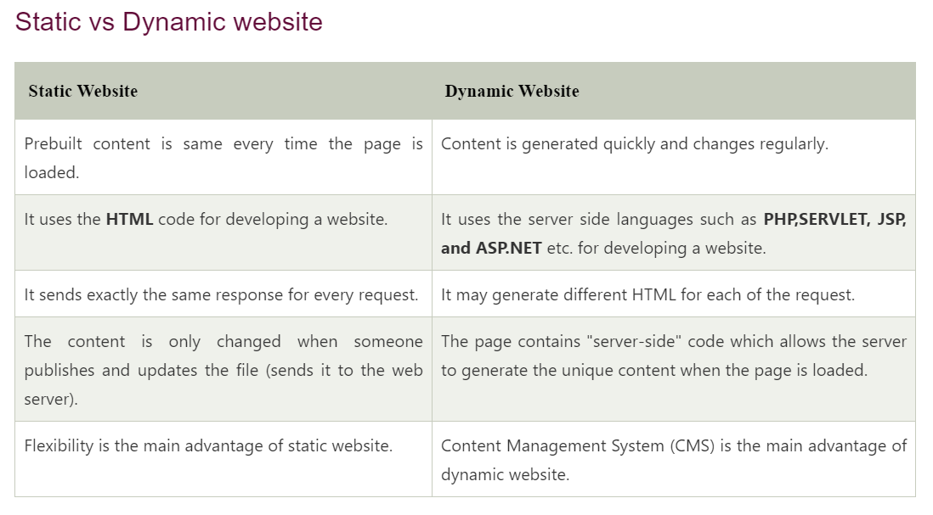

Slide 2
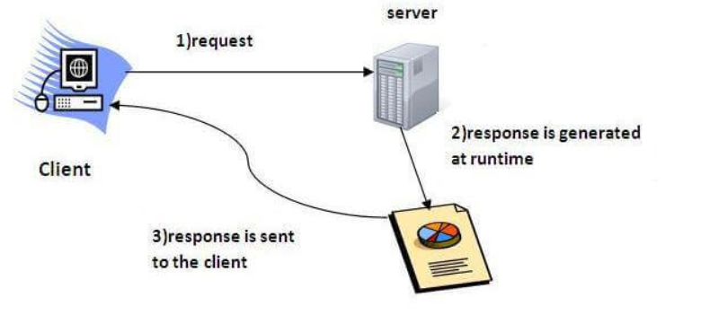

Slide 3
Servlet
Servlet is a technology which is used to create a web application.
Servlet is an API that provides many interfaces and classes including documentation.
Servlet is an interface that must be implemented for creating any Servlet.
Servlet is a class that extends the capabilities of the servers and responds to the incoming requests. It can respond to any requests.
Servlet is a web component that is deployed on the server to create a dynamic web page.

Slide 4
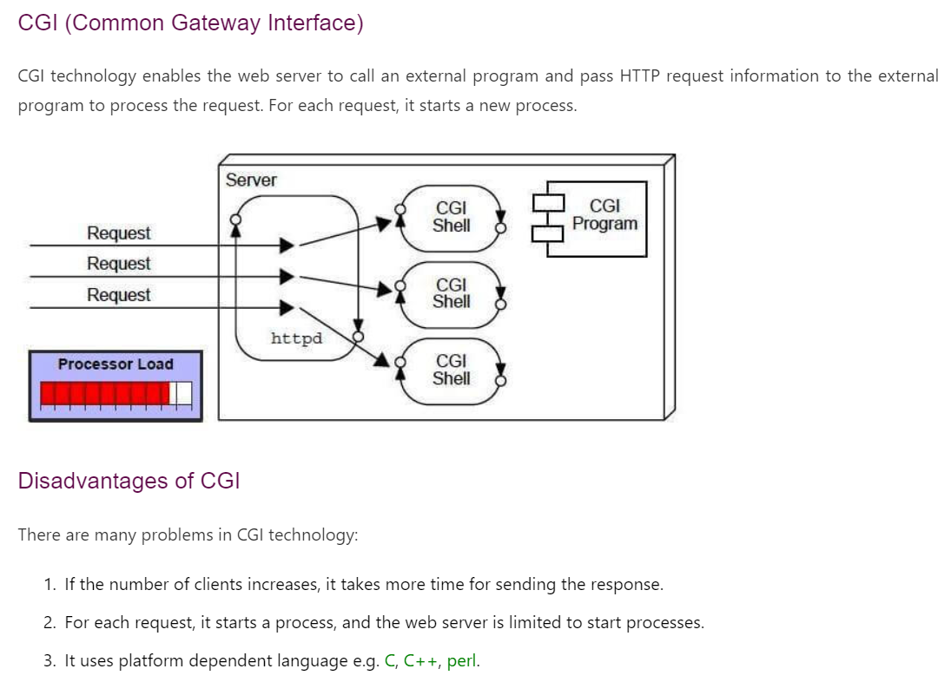

Slide 5
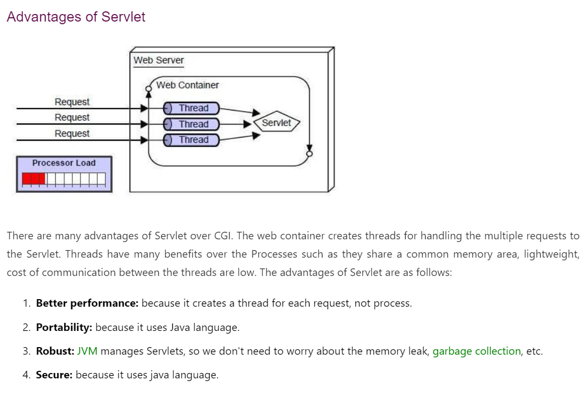

Slide 6
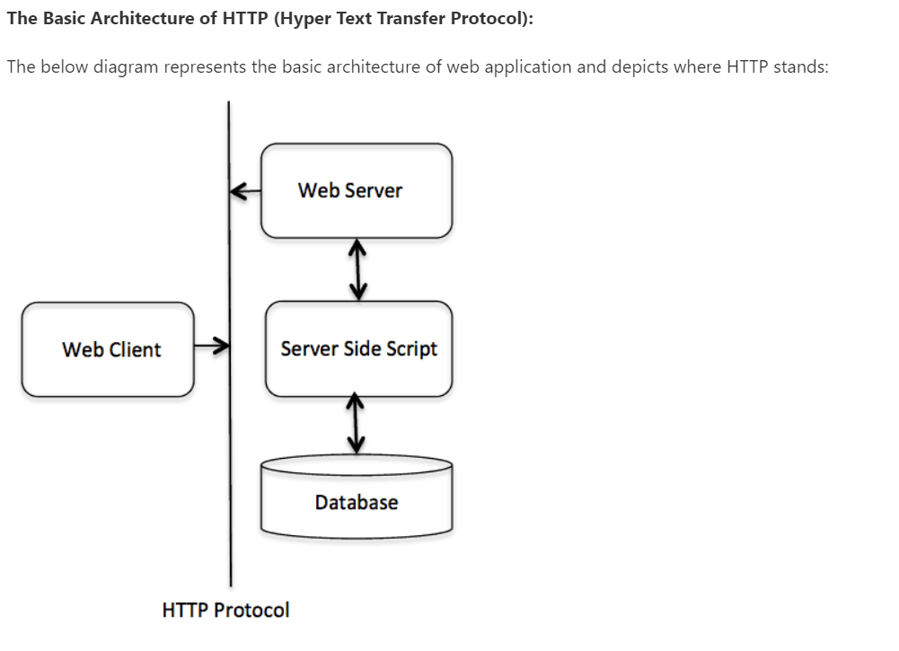

Slide 7
The Basic Characteristics of HTTP (Hyper Text Transfer Protocol)
It is the protocol that allows web servers and browsers to exchange data over the web.
It is a request response protocol.
It uses the reliable TCP connections by default on TCP port 80.
It is stateless means each request is considered as the new request. In other words, server doesn't recognize the user by default.

Slide 8
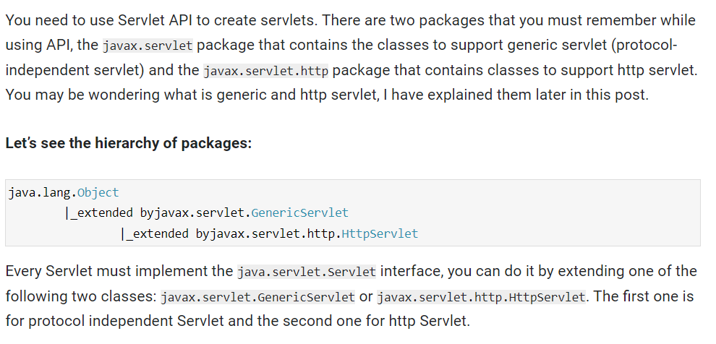
Servlet

Slide 9
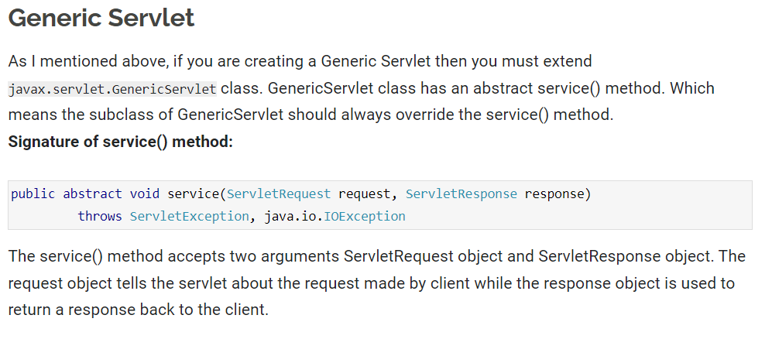
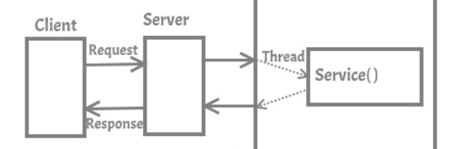
Generic Servlet

Slide 10
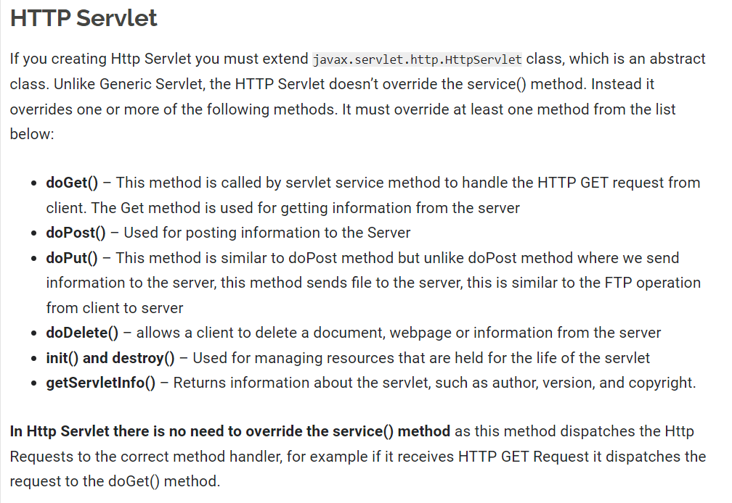
Http Servlet

Slide 11
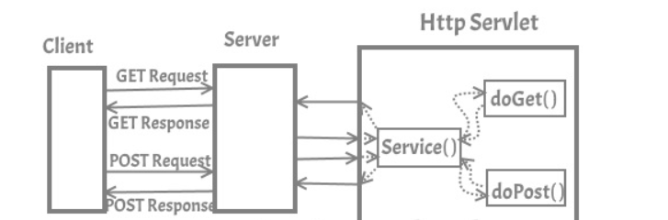
Http Servlet

Slide 12
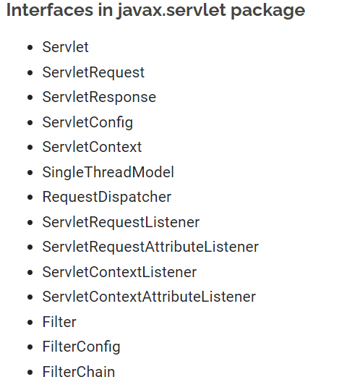
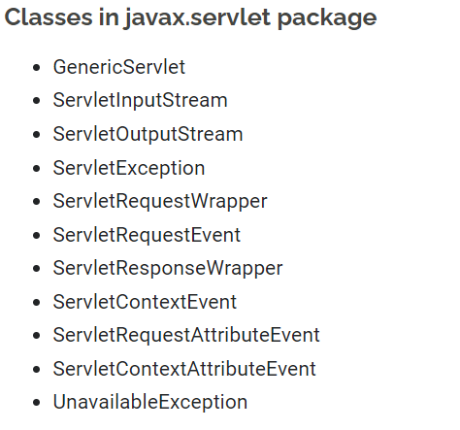

Slide 13
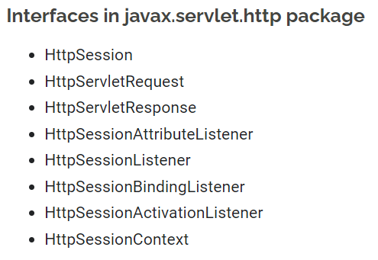
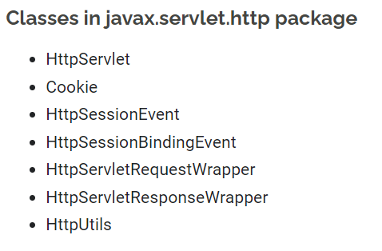

Slide 14
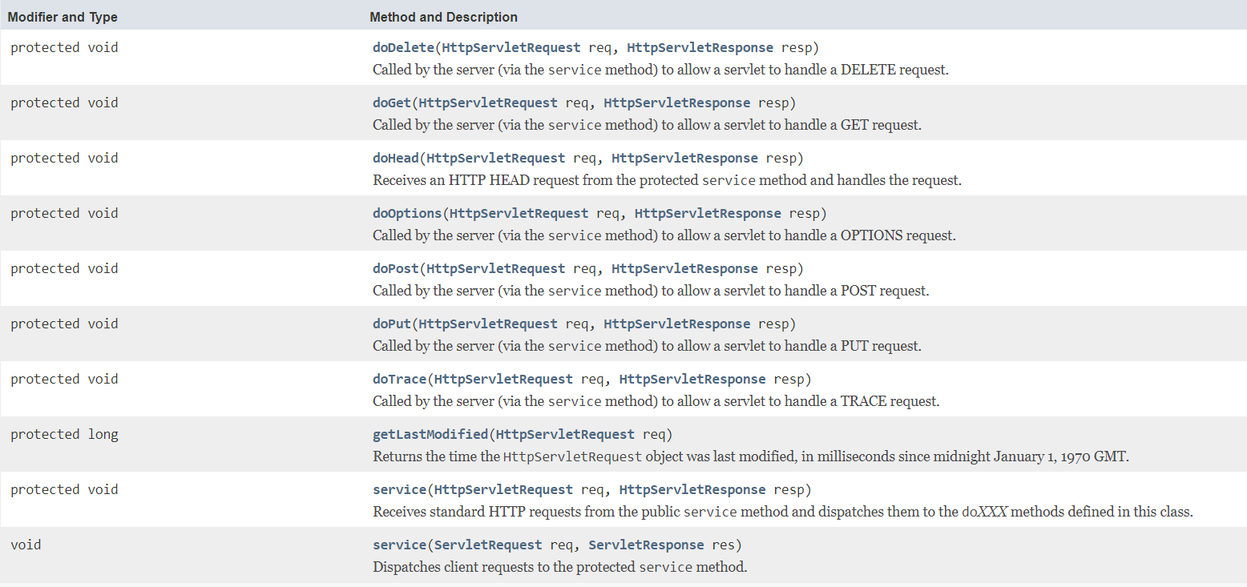
HttpServlet Method

Slide 15
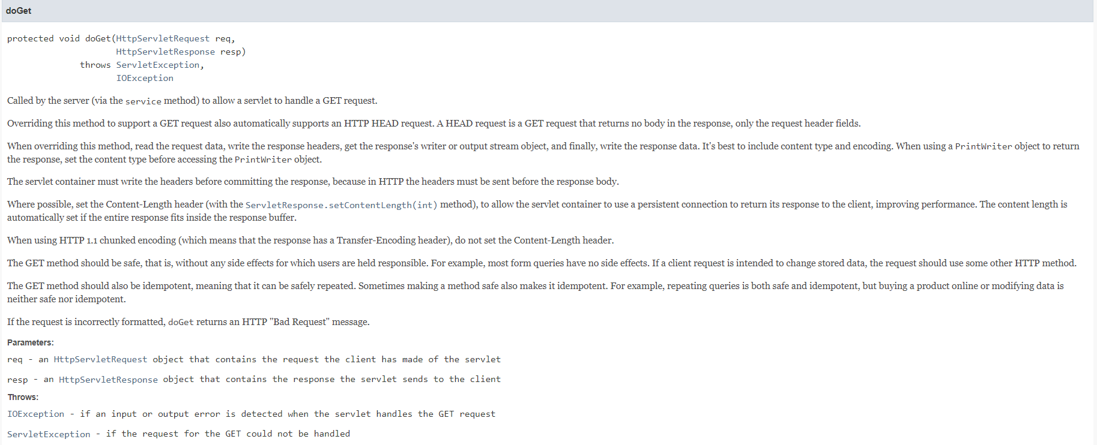

Slide 16
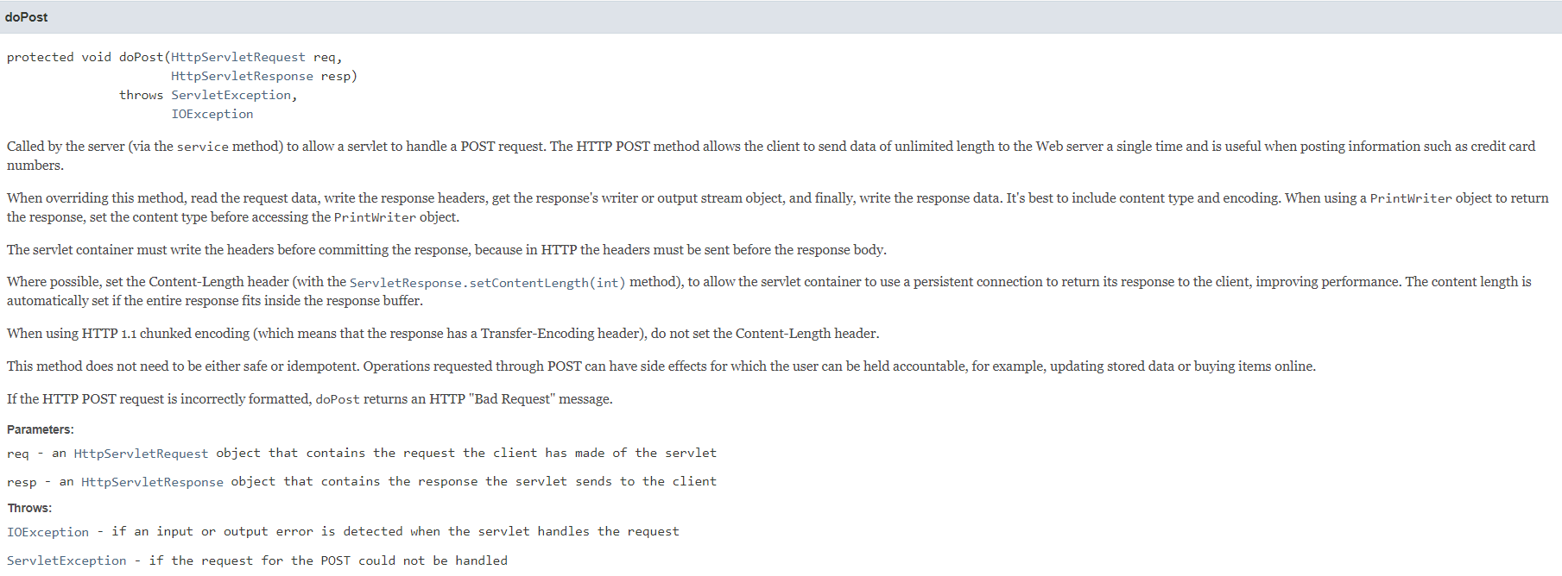

Slide 17
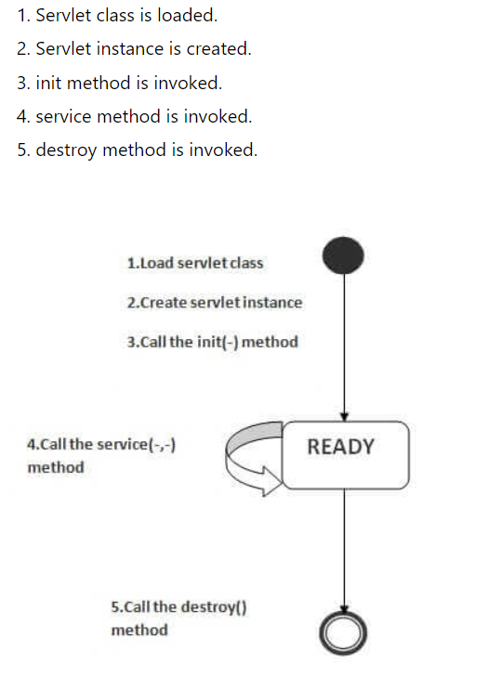
Servlet Life Cycle

Slide 18
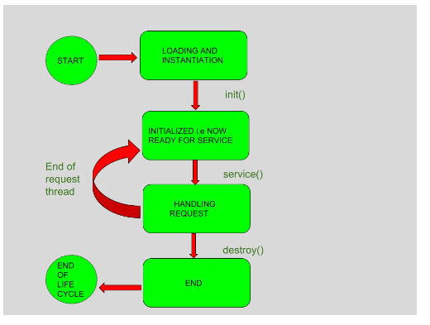
Servlet Life Cycle

Slide 19
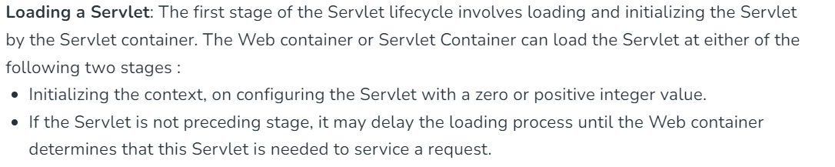
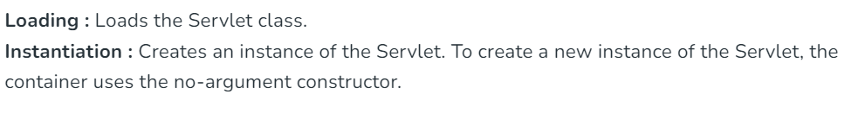

Slide 20
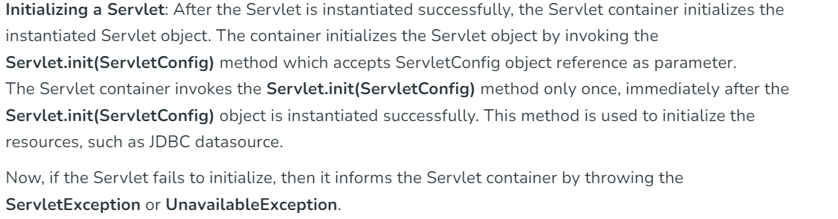
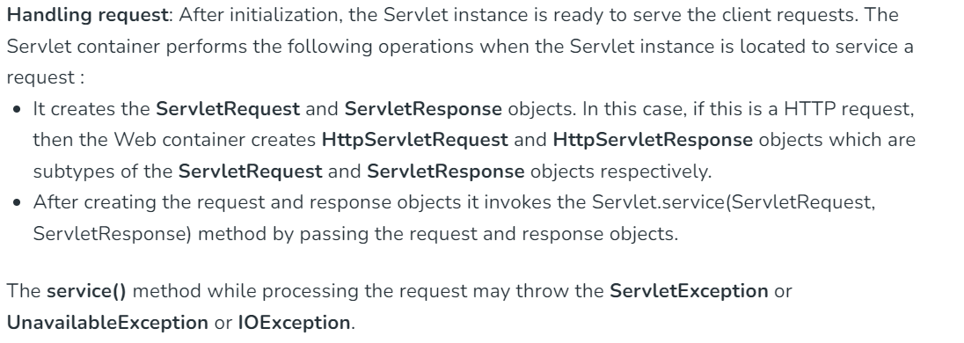

Slide 21
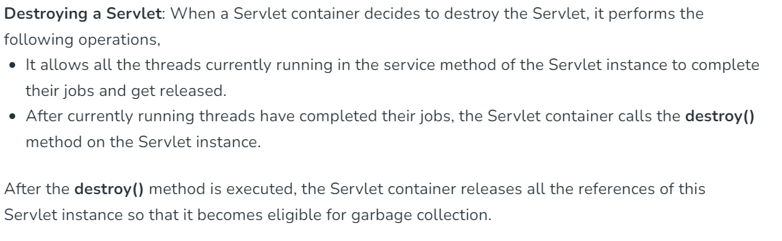

Slide 22
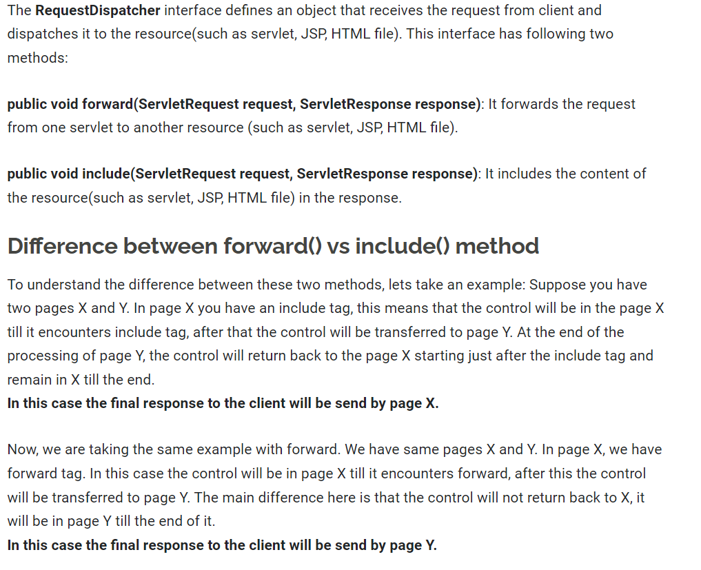

Slide 23
JSP Implicit Objects
There are 9 jsp implicit objects. These objects are created by the web container that are available to all the jsp pages.
The available implicit objects are out, request, config, session, application etc.
A list of the 9 implicit objects is given below:

Slide 24
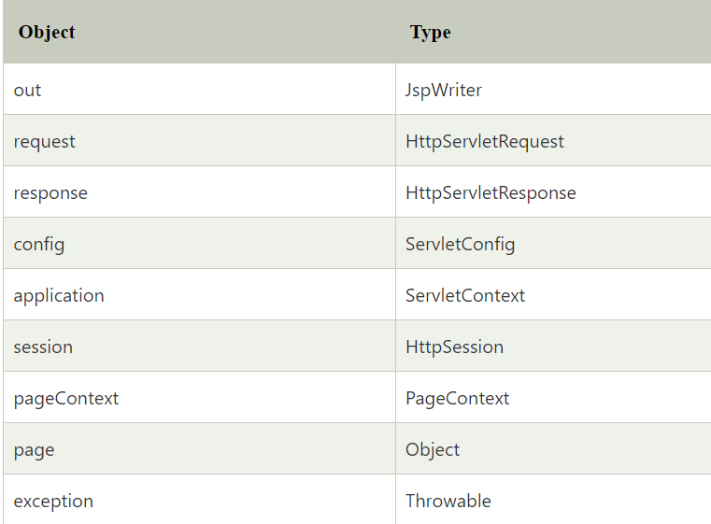
JSP Implicit Objects

