Slide 1

ABSTRACT WINDOW TOOLKIT
CONTAINERS
Kinshuk Vasisht (19)
Arnav Kumar Jain (59)

Slide 2

INTRODUCTION
AWT: Java's first GUI Framework (since Java 1.0, in 1995)
Contains classes and methods to create windows and controls.
Provides native UI controls, a robust even-handling model, graphics and imaging tools, and layout managers.
Underpins modern UI toolkits like Swing and JavaFX.
Used heavily in Legacy code.
Superseded, but not forgotten

Slide 3
AWT CLASSES
Classes and interfaces utilized by the toolkit to provide various features.
Contained in the java.awt package
Modular structure to enhance extensibility and provide a generic interface.
Divisible into categories based on tasks:
Graphics (Graphics, Graphics2D, Font, etc.)
GUI (Component, Container, Frame, etc.)
Events (Event, EventQueue, *Listener, etc.)
Miscellaneous (AWTException, AWTPermission)

Slide 4
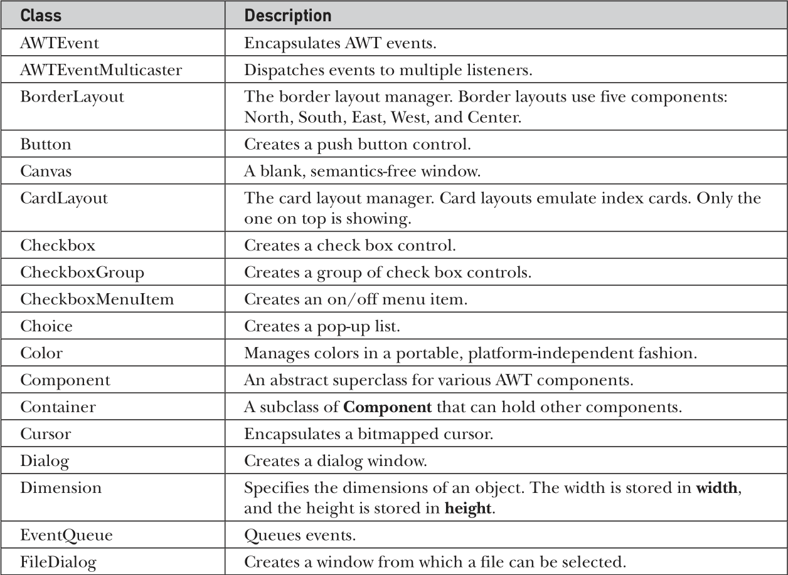

Slide 5
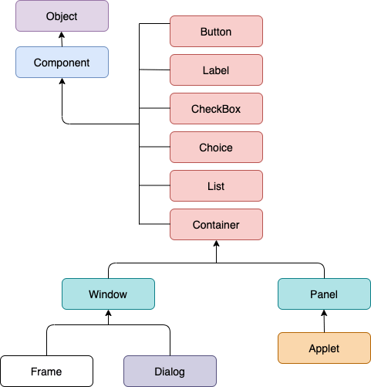
CLASS HIERARCHY
The Container class is a subclass to Component and a parent class to Window and Panel

Slide 6
COMPONENT
It is at the top of the AWT Hierarchy
Abstract in nature
Encapsulates all attributes of a visual component
Defines methods for actions like
Mouse and Keyboard input
Positioning and sizing the Window
Repainting

Slide 7
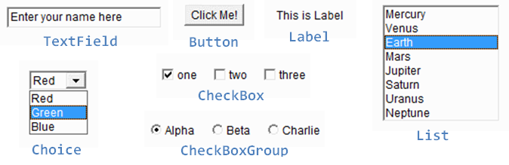

Slide 8
Method | Description
public void add<Type>Listener(<Type>Listener listener) | Register listener of specific types
public Rectangle getBounds() | Gets the bounds of this component in the form of a Rectangle object.
public int getWidth(), getHeight() | Returns the current width and height of this component.
public void setVisible(boolean status) | Changes the visibility of the component, by default false.
public void paint(Graphics g) | Paints the component using the graphics object.
public void repaint() public void repaint(int x, int y, int w, int h) | Repaints complete or specific region of the component.
public void setBounds(int x, int y, int w, int h) | Moves and resizes this component. (No effect with Layout Managers)

Slide 9
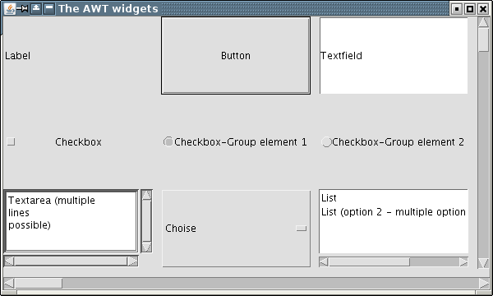
CONTAINER
Direct subclass of Component
Provides methods to:
Nest other components (even other Containers) inside itself.
Lay out (position) contained components via use of LayoutManagers.
Added components tracked via a list, whose order determines the front-to-back stack order.

Slide 10
Method | Description
public void add(Component c) public void add(Component c, Object constraints) public void add(Component c, int index) | Inserts a component on this component, optionally at given index or with given constraints.
public Component[] getComponents() | Gets all the components in this container.
public void setLayout(LayoutManager m) | Defines the layout manager for the component.
public void remove(Component c) public void remove(int index) | Remove component by reference or index.

Slide 11
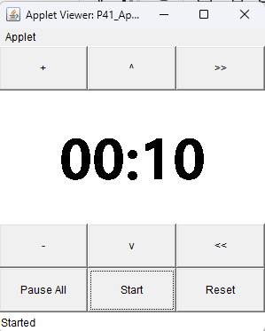
PANEL
A recursively nestable and concrete screen component.
Super class for Applet.
Lacks a title bar, menu bar and a border
Provides space in which an application can attach any other component (via add() from Container), including other panels.
Default layout: FlowLayout

Slide 12
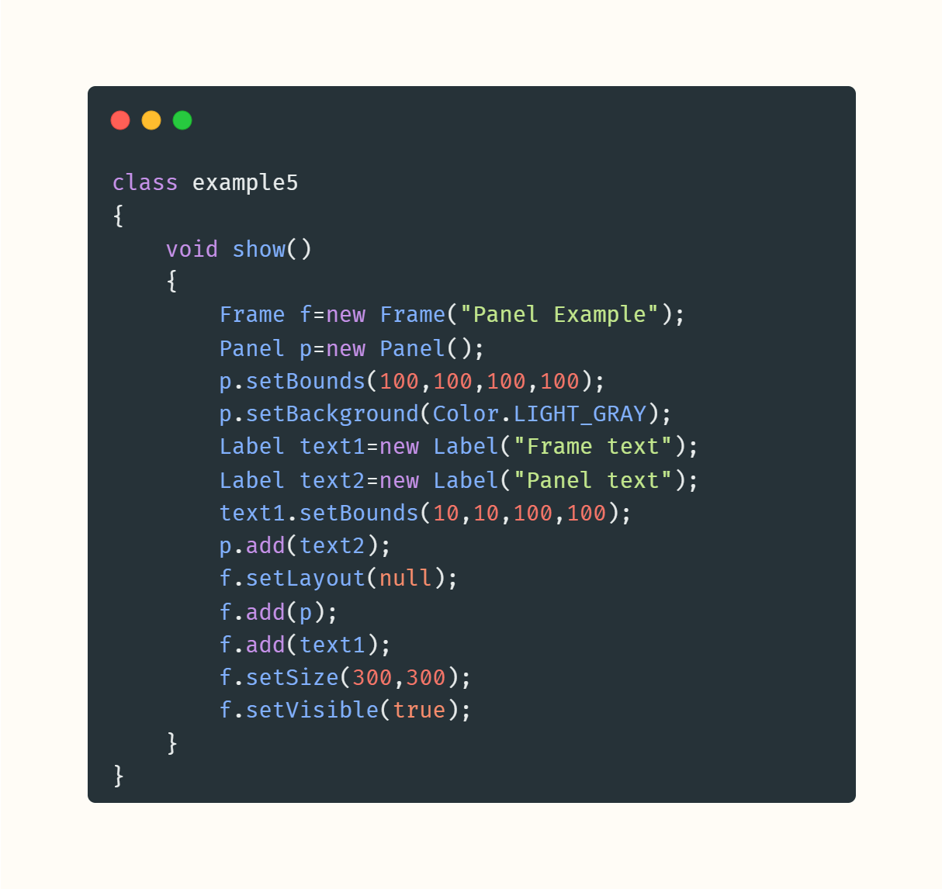
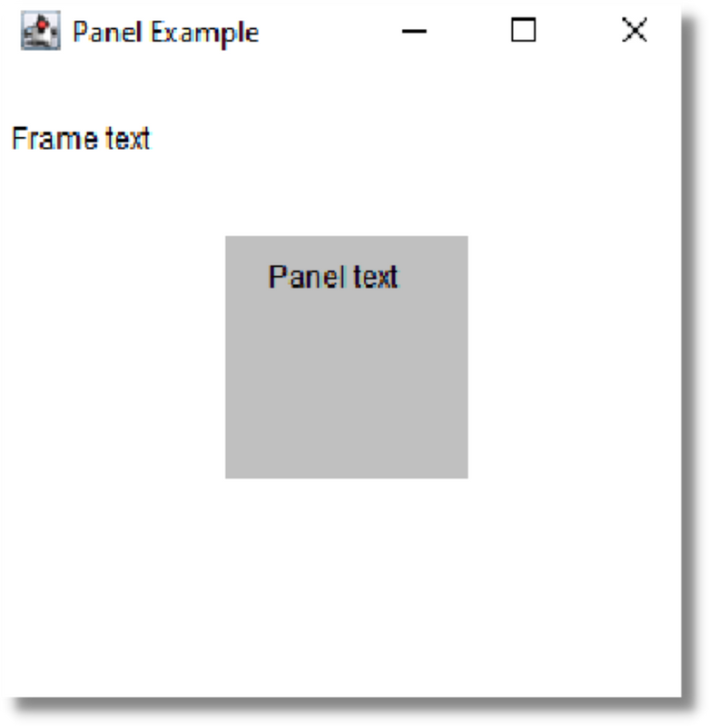
06/10

Slide 13
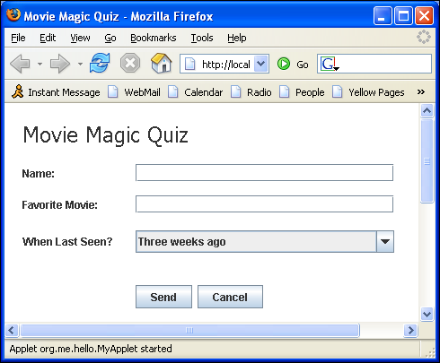
APPLET
Subclass of Panel.
Special kind of Java program that a Java-enabled browser can download from the internet and run.
Embedded inside a web page or another app and runs in the browser/application context.
Part of AWT, but components accessed via the java.applet package.

Slide 14
Method | Description
public void init() | Called by the browser or applet viewer to inform this applet that it has been loaded into the system.
public void start() | Called by the browser or applet viewer to inform this applet that it should start its execution.
public void stop() | Called by the browser or applet viewer to inform this applet that it should stop its execution.
public void destroy() | Called by the browser or applet viewer to inform this applet that it is being reclaimed and that it should destroy any resources that it has allocated.
public URL getDocumentBase() | Gets the URL of the document in which this applet is embedded.
public AppletContext getAppletContext | Determines this applet's context, which allows the applet to query and affect the run environment .

Slide 15
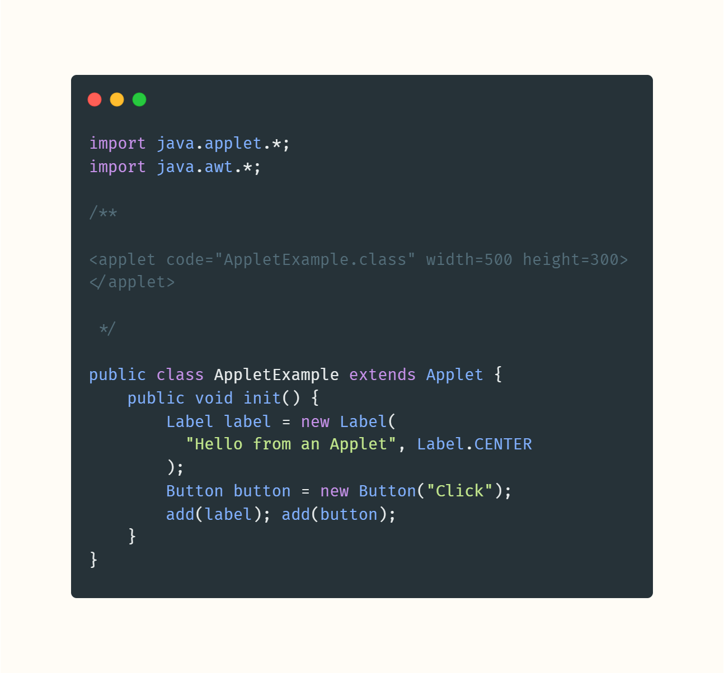
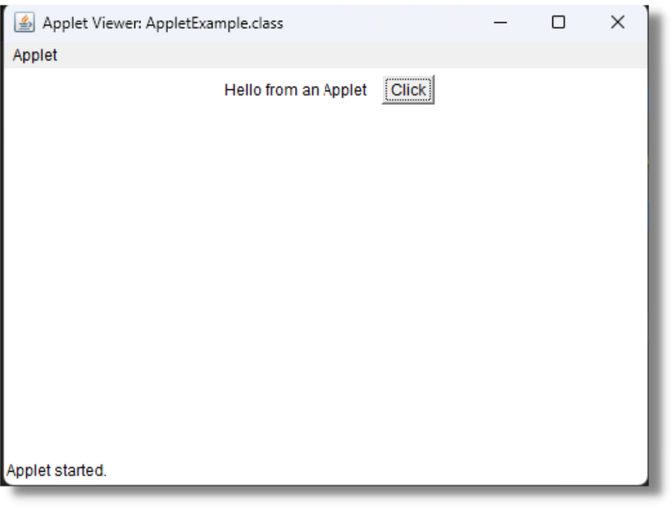
06/10

Slide 16
WINDOW
Creates a top level window, which is not contained within any other object.
Contains no borders or menu bar.
Generally created using a subclass Frame.
May have either a frame, dialog, or another window defined as its owner when it's constructed.

Slide 17
Method | Description
public void addWindowListener(WindowListener l) | Adds the specified window listener to receive window events from this window.
public Window getOwner() | Returns the owner of this window.
public Window[] getWindows() | Returns an array of all Windows, both owned and ownerless, created by this application.
public void toBack() public void toFront() | Send the window to the back or front , additionally altering focus state.

Slide 18
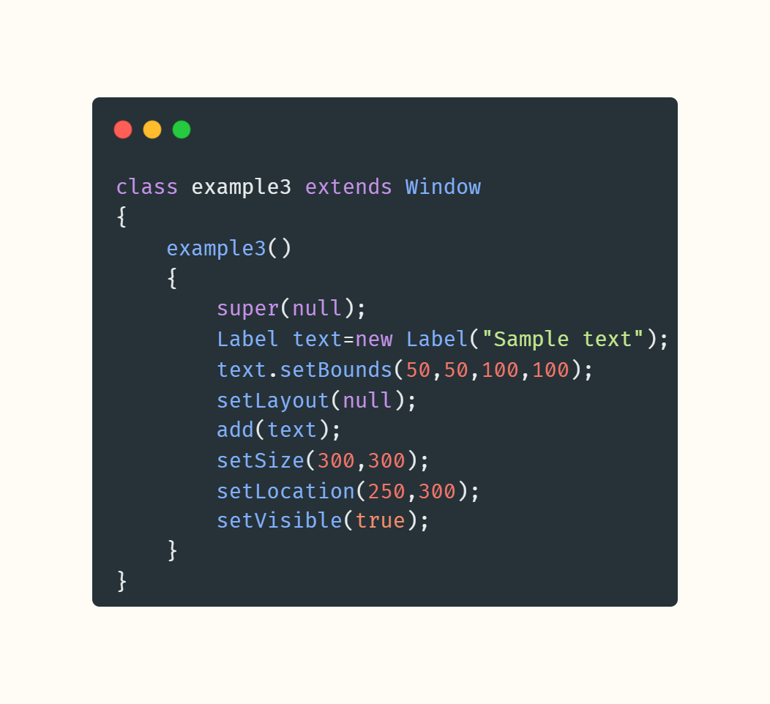
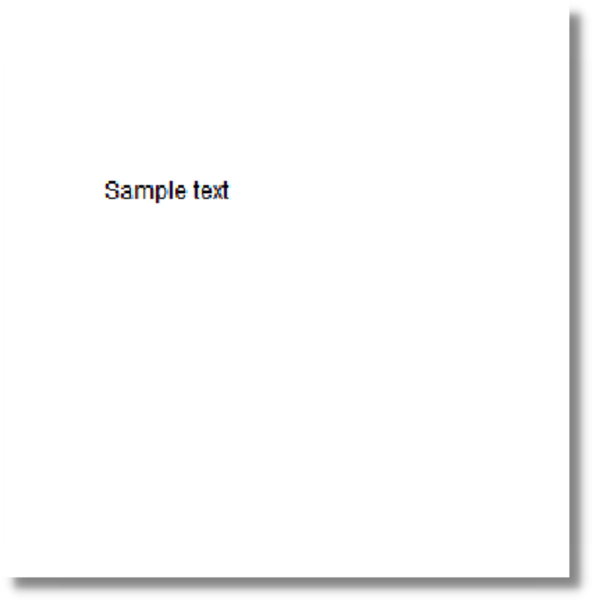
06/10

Slide 19
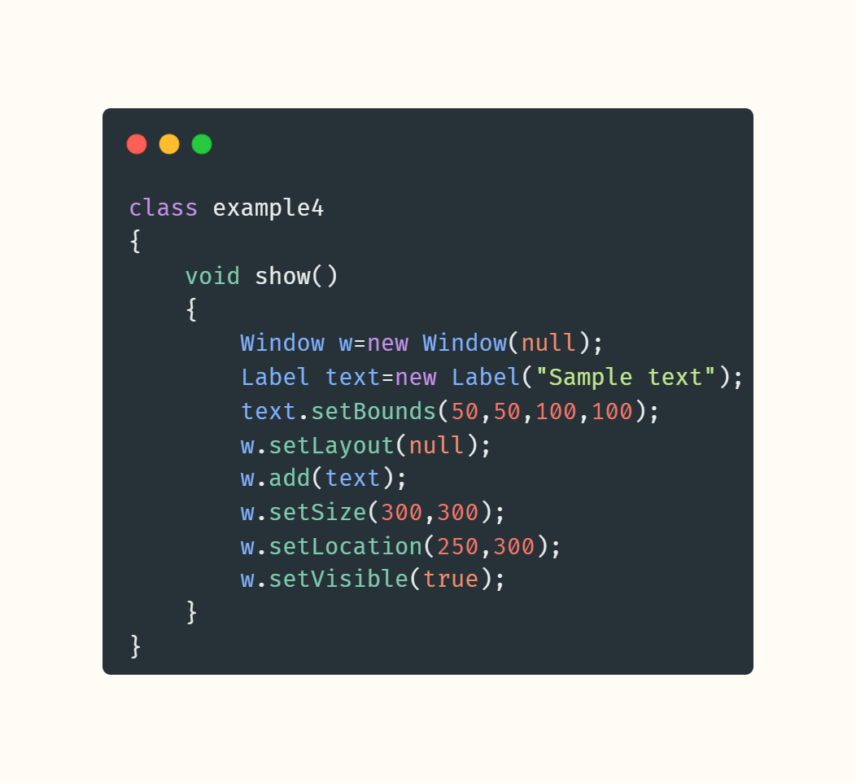
06/10

Slide 20
FRAME
Subclass of Window.
Top-level window with title and border.
Allows for defining menus (on a provided menu bar).
Standalone, displayable, resizable and moveable.
Appearance is platform (OS, Window manager) dependent.
Default layout: BorderLayout

Slide 21
Method | Description
public void setTitle(String title) | Sets the title for this frame to the specified string.
public void setMenuBar(MenuBar mb) | Sets the menu bar for this frame to the specified menu bar.
public void setResizable(boolean resizable) | Sets whether this frame is resizable by the user.

Slide 22
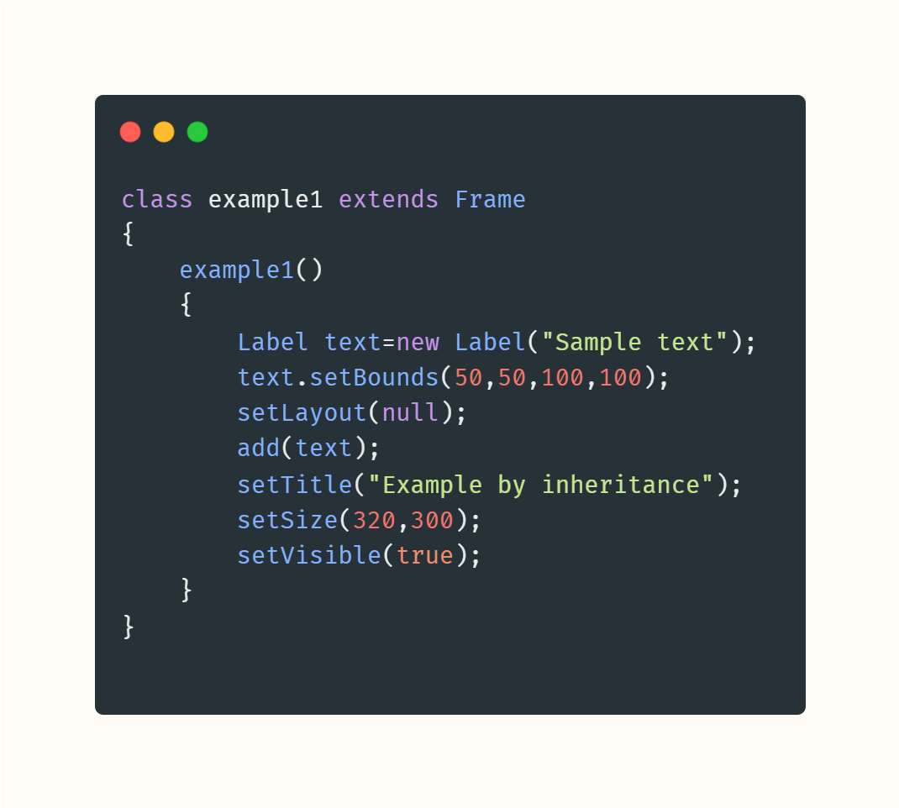
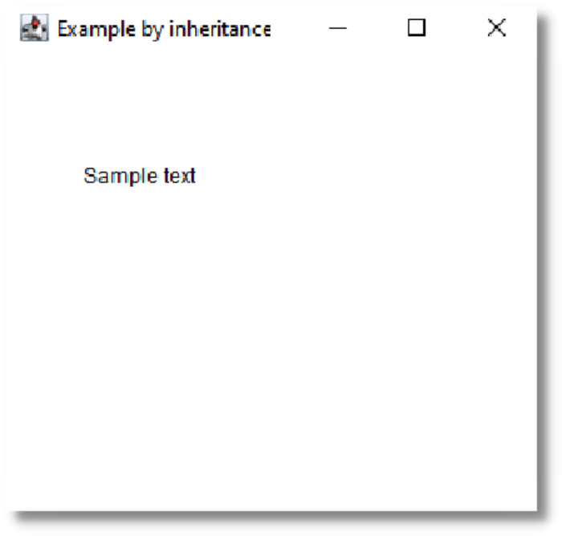
06/10

Slide 23
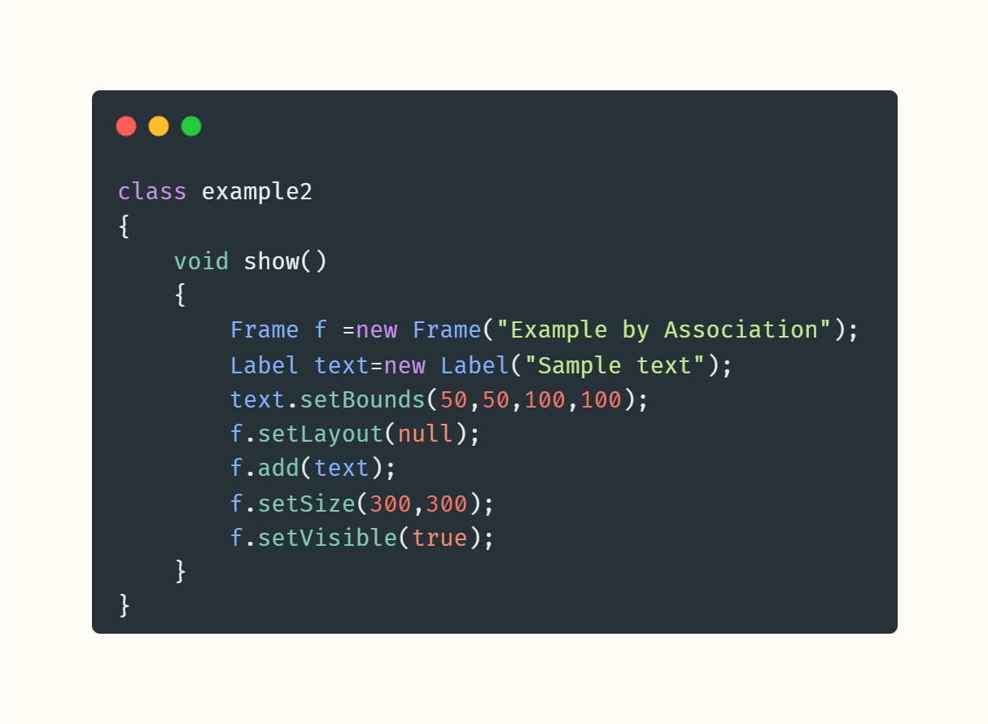
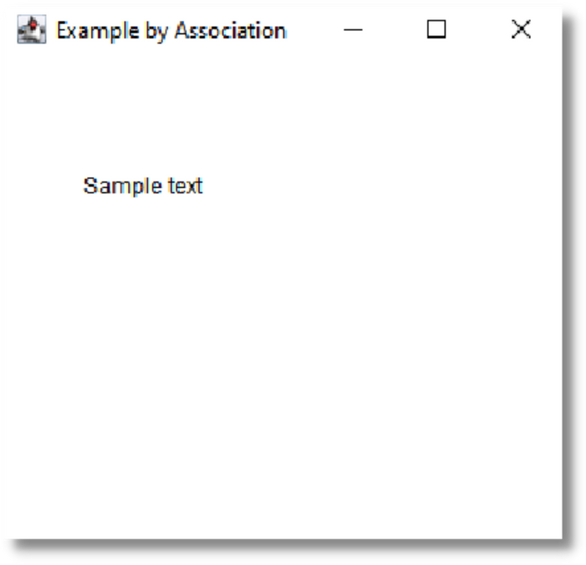
06/10

Slide 24
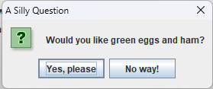
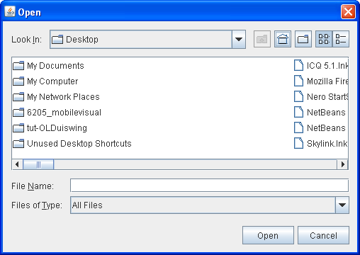
DIALOG
Another Subclass of Window.
Defines a top-level window with a title and border that is used to take an input of some form from the user.
May be modeless (default) or modal.
May register another Window as its owner for consistent behavior.
Default Layout: BorderLayout
Popular subclasses using dialog: FileDialog, JOptionPane

Slide 25
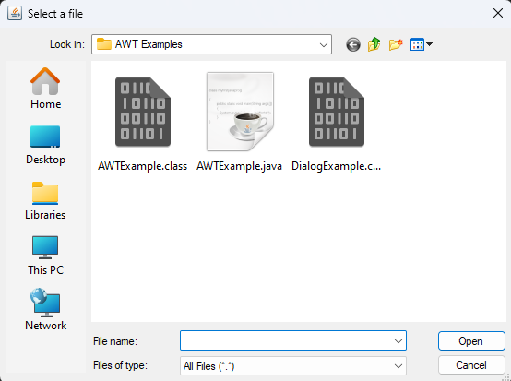
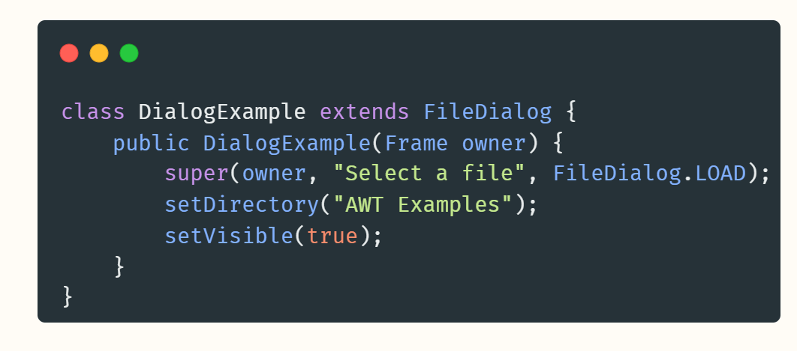
06/10

