Slide 1
Balanced Iterative Reducing and Clustering Using Hierarchies (BIRCH)
Agglomerative Clustering designed for clustering a large amount of numerical data
It introduces two concepts :
Clustering feature
Clustering feature tree (CF tree)
These structures help the clustering method achieve good speed and scalability in large databases.
What Birch algorithm tries to solve?
Most of the existing algorithms DO NOT consider the case that datasets can be too large to fit in main memory
They DO NOT concentrate on minimizing the number of scans of the dataset
I/O costs are very high
The complexity of BIRCH is O(n) where n is the number of objects to be clustered.

Slide 2
BIRCH: Key Components
Clustering Feature (CF)
Summary of the statistics for a given cluster: the 0-th, 1st and 2nd moments of the cluster from the statistical point of view
A CF entry has sufficient information to calculate the centroid, radius, diameter and many other distance measures
Additively theorem allows us to merge sub-clusters incrementally
CF-Tree
height-balanced tree
two parameters:
number of entries in each node
The diameter of all entries in a leaf node
Leaf nodes are connected via prev and next pointers

Slide 3
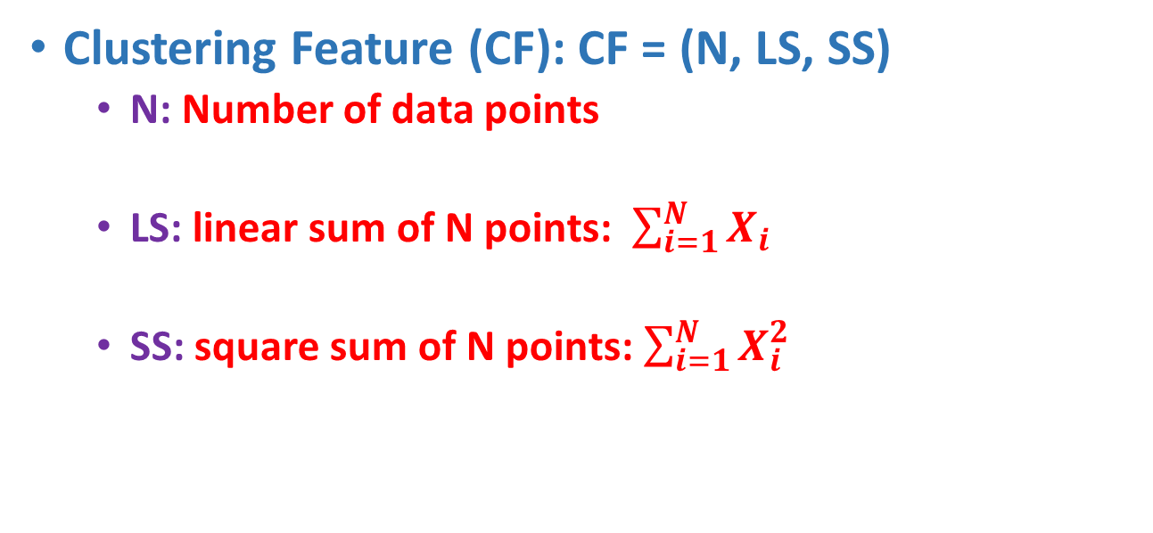
Clustering Feature
Clustering Feature (CF): CF = (N, LS, SS)
N: Number of data points
LS: linear sum of N points: $\sum_{i=1}^{N}{X_{i}}$
SS: square sum of N points: $\sum_{i=1}^{N}{X_{i}^{2}}$

Slide 4
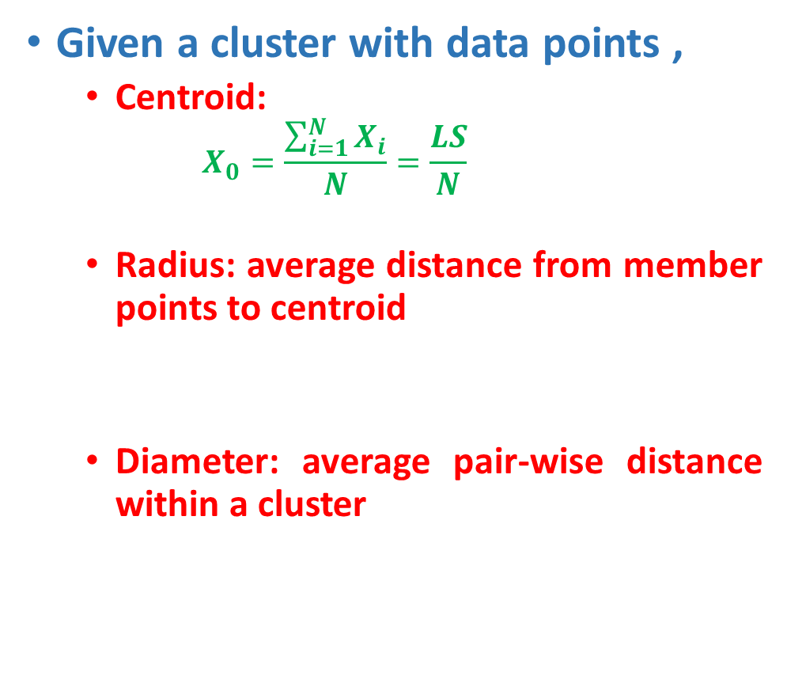
Distance Measures
Given a cluster with data points ,
Centroid:
$$X_{0}=\frac{\sum_{i=1}^{N}{X_{i}}}{N}=\frac{LS}{N}$$
Radius: average distance from member points to centroid
Diameter: average pair-wise distance within a cluster

Slide 5
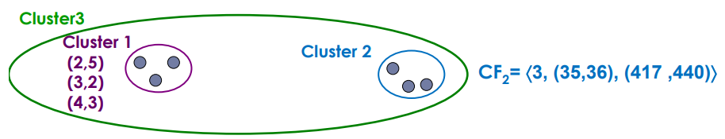
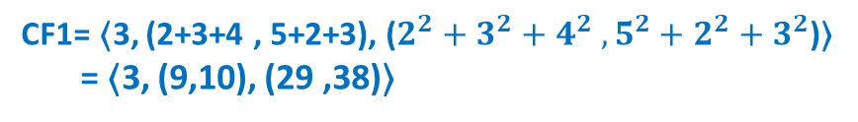
Clustering Feature
Suppose cluster C₁ has CF₁=(N₁, LS₁ ,SS₁), cluster C₂ has CF₂ =(N₂,LS₂,SS₂)
If we merge C₁ with C₂, the CF for the merged cluster C is
Why CF?
Summarized info for single cluster
Summarized info for two clusters
Additive theorem
CF1= 〈3, (2+3+4 , 5+2+3), ($2^{2}+3^{2}+4^{2} , 5^{2}+2^{2}+3^{2}$)〉
= 〈3, (9,10), (29 ,38)〉
CF3=CF1+CF2= 〈3+3, (9+35, 10+36), (29+417 , 38+440)〉 = 〈6, (44,46), (446 ,478)〉

Slide 6
CF-Tree
A CF tree is a height-balanced tree with two parameters: branching factor B and threshold T.
Branching factor
B : Each non-leaf node contains at most B entries of the form [CF_{i}, child_{i}] , where I = 1, 2, …, B, and child_{i} is a pointer to its i-th child node. CF_{i} Is the CF of the sub-cluster represented by the child_{i}.
L : A leaf node contains at most L entries, each of the form [CF_{i}], where I = 1, 2, …, L. In addition, each leaf node has two pointers, “prev” and “next” which are used to chain all leaf node together
A leaf node also represent a cluster made up of all the sub-clusters represented by its entries.
Threshold T
The diameter (alternatively, the radius) of all entries in a leaf node is at most T
Leaf nodes are connected via prev and next pointers

Slide 7
Example of CF Tree
Root
B = 6
L = 5
CF₁
CF₂
CF₃
CF₆
child₁
child₂
child₃
child₆
Non-leaf node
CF₉
CF₁₀
CF₁₁
CF₁₃
child₁
child₂
child₃
child₅
Leaf node
Leaf node
prev
CF₉₀
CF₉₁
CF₉₄
next
prev
CF₉₅
CF₉₆
CF₉₈
next

Slide 8
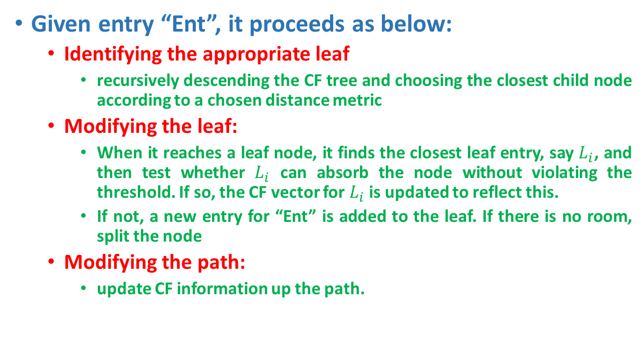
CF Tree Insertion
Given entry “Ent”, it proceeds as below:
Identifying the appropriate leaf
recursively descending the CF tree and choosing the closest child node according to a chosen distance metric
Modifying the leaf:
When it reaches a leaf node, it finds the closest leaf entry, say $L_{i}$, and then test whether $L_{i}$ can absorb the node without violating the threshold. If so, the CF vector for $L_{i}$ is updated to reflect this.
If not, a new entry for “Ent” is added to the leaf. If there is no room, split the node
Modifying the path:
update CF information up the path.

Slide 9
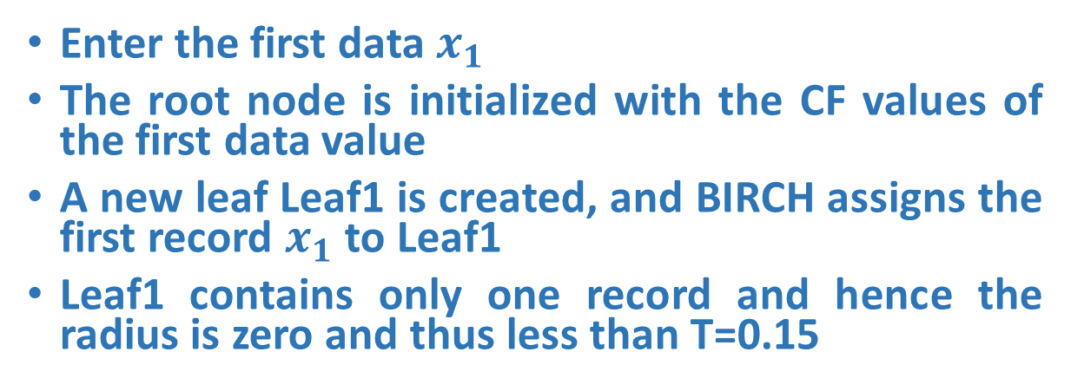
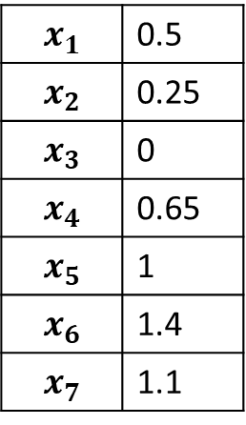

Example
$$x_{1}$$ | 0.5
$$x_{2}$$ | 0.25
$$x_{3}$$ | 0
$$x_{4}$$ | 0.65
$$x_{5}$$ | 1
$$x_{6}$$ | 1.4
$$x_{7}$$ | 1.1
Enter the first data $x_{1}$
The root node is initialized with the CF values of the first data value
A new leaf Leaf1 is created, and BIRCH assigns the first record $x_{1}$ to Leaf1
Leaf1 contains only one record and hence the radius is zero and thus less than T=0.15
Root-Node 0
CF1: n=1, Ls=0.5, SS = 0.25
T = 0.15
L = 2
B = 2
Leaf1:R=0
$x_{1}$=0.5

Slide 10
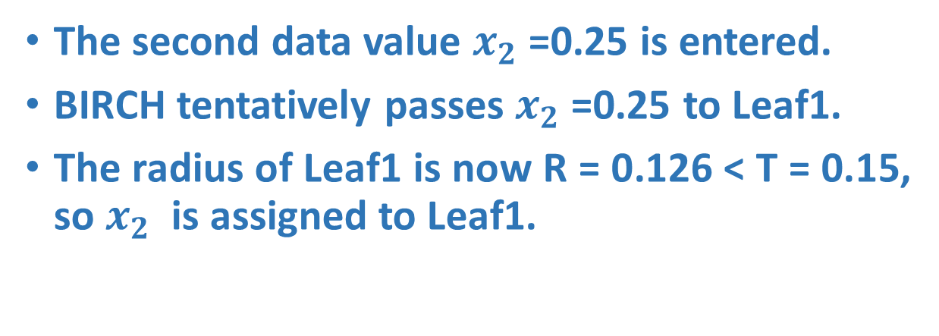

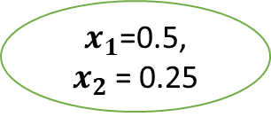
Example
$$x_{1}$$ | 0.5
$$x_{2}$$ | 0.25
$$x_{3}$$ | 0
$$x_{4}$$ | 0.65
$$x_{5}$$ | 1
$$x_{6}$$ | 1.4
$$x_{7}$$ | 1.1
The second data value $x_{2}$=0.25 is entered.
BIRCH tentatively passes $x_{2}$=0.25 to Leaf1.
The radius of Leaf1 is now R = 0.126 < T = 0.15, so $x_{2}$ is assigned to Leaf1.
Root-Node 0
CF1: n=1, Ls=0.5, SS = 0.25
Root-Node 0
CF1: n=2, Ls=0.75, SS = 0.313
T = 0.15
L = 2
B = 2
Leaf1:R=0
Leaf1:R=0.126
$x_{1}$=0.5
$x_{1}$=0.5, $x_{2}$= 0.25

Slide 11


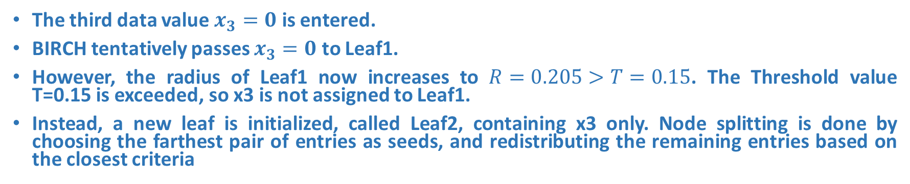
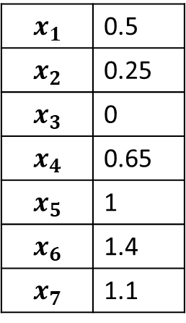
Example
The third data value $x_{3}=0$ is entered.
BIRCH tentatively passes $x_{3}=0$ to Leaf1.
However, the radius of Leaf1 now increases to $R=0.205>T=0.15$. The Threshold value T=0.15 is exceeded, so x3 is not assigned to Leaf1.
Instead, a new leaf is initialized, called Leaf2, containing x3 only. Node splitting is done by choosing the farthest pair of entries as seeds, and redistributing the remaining entries based on the closest criteria
Root-Node 0
$$x_{1}$$ | 0.5
$$x_{2}$$ | 0.25
$$x_{3}$$ | 0
$$x_{4}$$ | 0.65
$$x_{5}$$ | 1
$$x_{6}$$ | 1.4
$$x_{7}$$ | 1.1
CF1: n=2, Ls=0.75, SS = 0.313
CF2: n=1, Ls=0.0, SS = 0
T = 0.15
L = 2
B = 2
Leaf1:R=0.126
Leaf2:R=0
$x_{1}$=0.5, $x_{2}$= 0.25
$x_{3}$=0

Slide 12
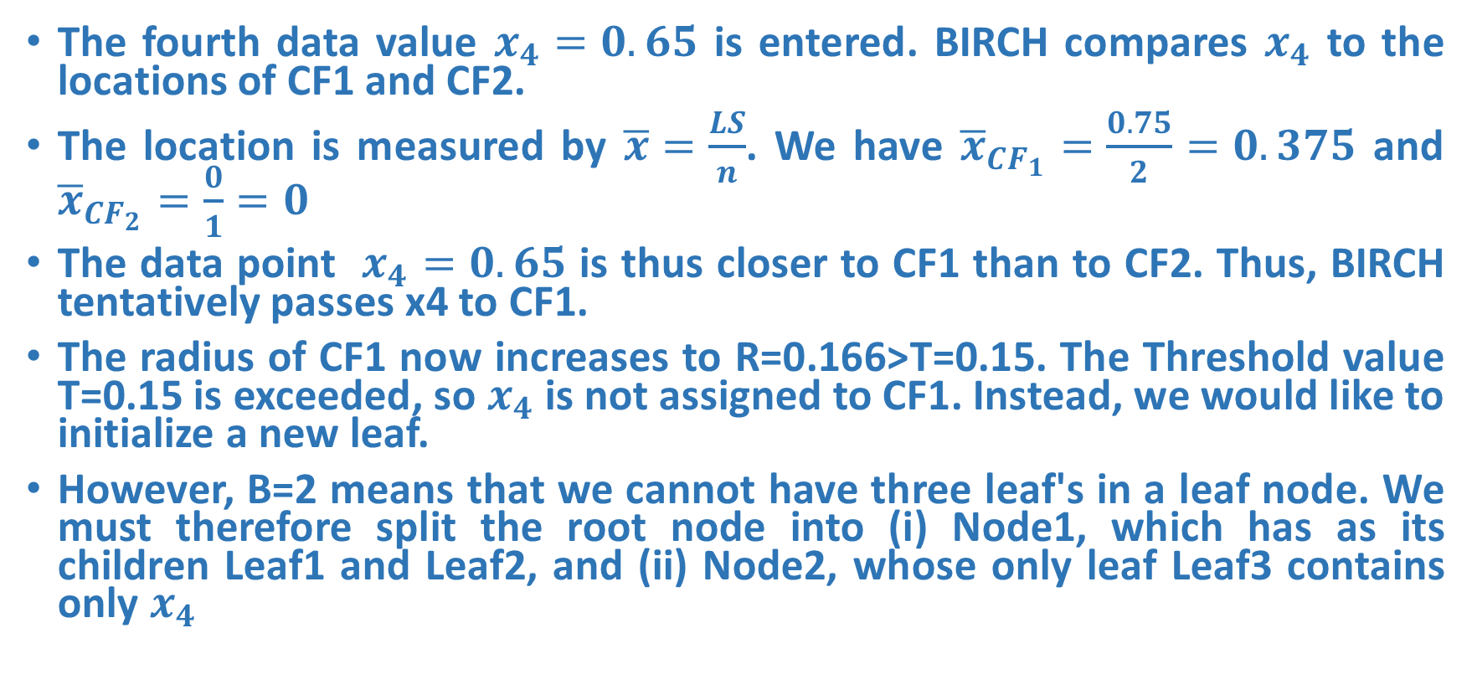
Example
The fourth data value $x_{4}=0.65$ is entered. BIRCH compares $x_{4}$ to the locations of CF1 and CF2.
The location is measured by $\overline{x}=\frac{LS}{n}$. We have ${\overline{x}}_{CF_{1}}=\frac{0.75}{2}=0.375$ and ${\overline{x}}_{CF_{2}}=\frac{0}{1}=0$
The data point $x_{4}=0.65$ is thus closer to CF1 than to CF2. Thus, BIRCH tentatively passes x4 to CF1.
The radius of CF1 now increases to R=0.166>T=0.15. The Threshold value T=0.15 is exceeded, so $x_{4}$ is not assigned to CF1. Instead, we would like to initialize a new leaf.
However, B=2 means that we cannot have three leaf's in a leaf node. We must therefore split the root node into (i) Node1, which has as its children Leaf1 and Leaf2, and (ii) Node2, whose only leaf Leaf3 contains only $x_{4}$

Slide 13

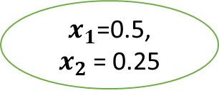

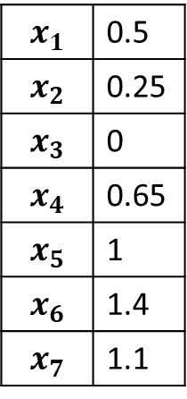
Example
T = 0.15
L = 2
B = 2
$$x_{1}$$ | 0.5
$$x_{2}$$ | 0.25
$$x_{3}$$ | 0
$$x_{4}$$ | 0.65
$$x_{5}$$ | 1
$$x_{6}$$ | 1.4
$$x_{7}$$ | 1.1
Root-Node 0
CF12: n=3, Ls=0.75, SS = 0.313
CF3: n=1, Ls=0.65, SS = 0.423
Node 1
Node 2
CF1: n=2, Ls=0.75, SS = 0.313
CF2: n=1, Ls=0.0, SS = 0
CF3: n=1, Ls=0.65, SS = 0.423
Leaf1:R=0.126
Leaf2:R=0.
Leaf3:R=0.
$x_{1}$=0.5, $x_{2}$= 0.25
$x_{3}$=0
$x_{4}$=0.65

Slide 14
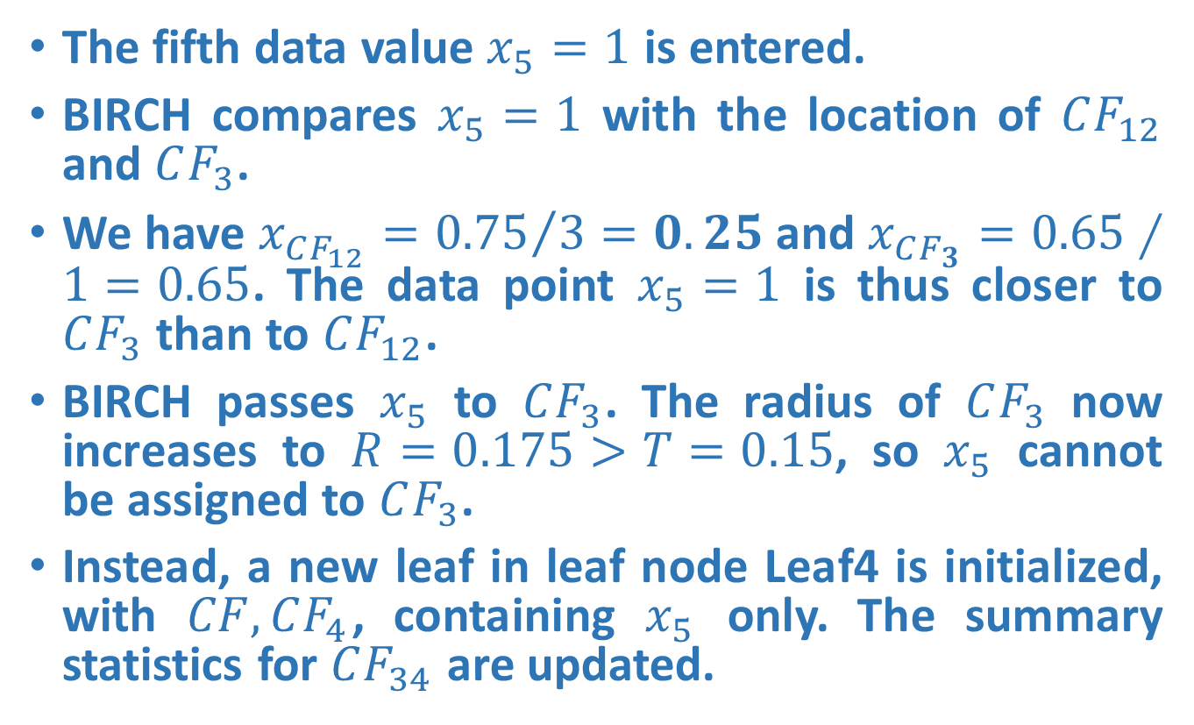
Example
The fifth data value $x_{5}=1$ is entered.
BIRCH compares $x_{5}=1$ with the location of $CF_{12}$ and $CF_{3}$.
We have $x_{CF_{12}}={0.75}/3=0.25$ and $x_{CF_{3}}=0.65∕1=0.65$. The data point $x_{5}=1$ is thus closer to $CF_{3}$ than to $CF_{12}$.
BIRCH passes $x_{5}$ to $CF_{3}$. The radius of $CF_{3}$ now increases to $R=0.175>T=0.15$, so $x_{5}$ cannot be assigned to $CF_{3}$.
Instead, a new leaf in leaf node Leaf4 is initialized, with $CF, CF_{4}$, containing $x_{5}$ only. The summary statistics for $CF_{34}$ are updated.

Slide 15

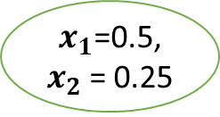


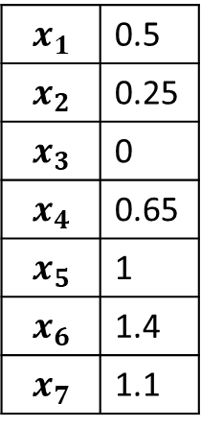
T = 0.15
L = 2
B = 2
$$x_{1}$$ | 0.5
$$x_{2}$$ | 0.25
$$x_{3}$$ | 0
$$x_{4}$$ | 0.65
$$x_{5}$$ | 1
$$x_{6}$$ | 1.4
$$x_{7}$$ | 1.1
Example
Root-Node 0
CF12: n=3, Ls=0.75, SS = 0.313
CF34: n=2, Ls=1.65, SS = 1.423
Node 1
Node 2
CF1: n=2, Ls=0.75, SS = 0.313
CF2: n=1, Ls=0.0, SS = 0
CF3: n=1, Ls=0.65, SS = 0.423
CF4: n=1, Ls=1, SS = 1
Leaf1:R=0.126
Leaf2:R=0.
Leaf3:R=0.
Leaf4:R=0.
$x_{1}$=0.5, $x_{2}$= 0.25
$x_{3}$=0
$x_{4}$=0.65
$x_{5}$=1
15

Slide 16
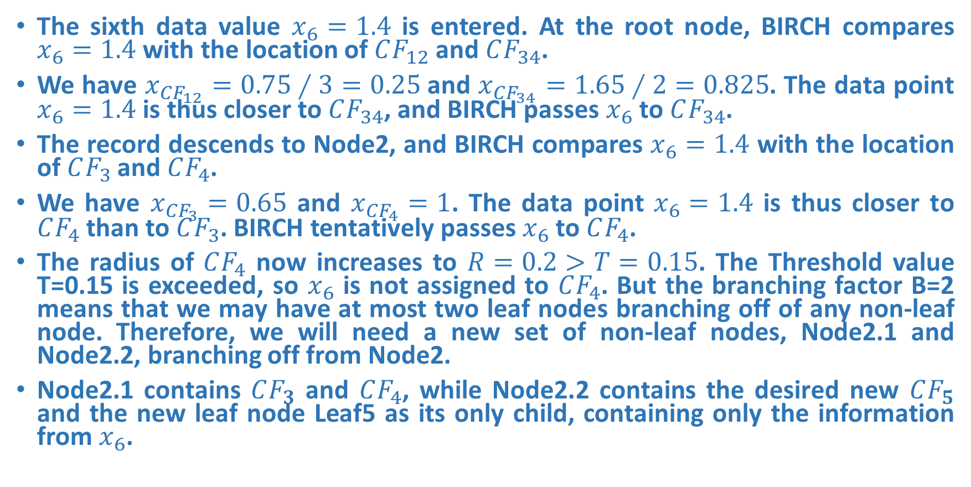
Example
The sixth data value $x_{6}=1.4$ is entered. At the root node, BIRCH compares $x_{6}=1.4$ with the location of $CF_{12}$ and $CF_{34}$.
We have $x_{CF_{12}}=0.75∕3=0.25$and $x_{CF_{34}}=1.65∕2=0.825$. The data point $x_{6}=1.4$ is thus closer to $CF_{34}$, and BIRCH passes $x_{6}$ to $CF_{34}$.
The record descends to Node2, and BIRCH compares $x_{6}=1.4$ with the location of $CF_{3}$ and $CF_{4}$.
We have $x_{CF_{3}}=0.65$ and $x_{CF_{4}}=1$. The data point $x_{6}=1.4$ is thus closer to $CF_{4}$than to $CF_{3}$. BIRCH tentatively passes $x_{6}$ to $CF_{4}$.
The radius of $CF_{4}$ now increases to $R=0.2>T=0.15$. The Threshold value T=0.15 is exceeded, so $x_{6}$ is not assigned to $CF_{4}$. But the branching factor B=2 means that we may have at most two leaf nodes branching off of any non-leaf node. Therefore, we will need a new set of non-leaf nodes, Node2.1 and Node2.2, branching off from Node2.
Node2.1 contains $CF_{3}$ and $CF_{4}$, while Node2.2 contains the desired new $CF_{5}$ and the new leaf node Leaf5 as its only child, containing only the information from $x_{6}$.

Slide 17


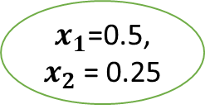


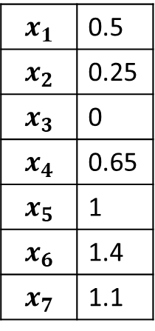
T = 0.15
L = 2
B = 2
$$x_{1}$$ | 0.5
$$x_{2}$$ | 0.25
$$x_{3}$$ | 0
$$x_{4}$$ | 0.65
$$x_{5}$$ | 1
$$x_{6}$$ | 1.4
$$x_{7}$$ | 1.1
Example
Root-Node 0
CF12: n=3, Ls=0.75, SS = 0.313
CF345: n=3, Ls=3.05, SS = 3.393
Node 1
Node 2
CF1: n=2, Ls=0.75, SS = 0.313
CF2: n=1, Ls=0.0, SS = 0
CF34: n=2, Ls=1.65, SS = 1.423
CF5: n=1, Ls=1.4, SS = 1.96
Node 2.1
Node 2.2
Leaf1:R=0.126
Leaf2:R=0.
CF3: n=1, Ls=0.65, SS = 0.423
CF4: n=1, Ls=1, SS = 1
CF5: n=1, Ls=1.4, SS = 1.96
$x_{1}$=0.5, $x_{2}$= 0.25
$x_{3}$=0
Leaf3:R=0.
Leaf4:R=0.
Leaf5:R=0.
$x_{4}$=0.65
$x_{5}$=1
$x_{6}$=1.4
Do height balancing and continue
17

Slide 18
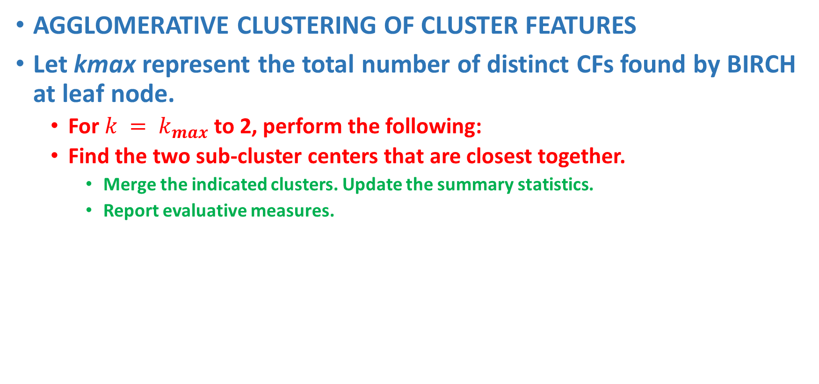
CLUSTERING THE SUB-CLUSTERS
AGGLOMERATIVE CLUSTERING OF CLUSTER FEATURES
Let kmax represent the total number of distinct CFs found by BIRCH at leaf node.
For $k = k_{max}$to 2, perform the following:
Find the two sub-cluster centers that are closest together.
Merge the indicated clusters. Update the summary statistics.
Report evaluative measures.

Slide 19
Clustering Using Representative (CURE)
Drawbacks of Traditional Clustering Algorithms
Centroid-based approach (using d_{mean}) considers only one point as representative of a cluster - the cluster centroid.
All-points approach (based on d_{min}) makes the clustering algorithm extremely sensitive to outliers.
Both of them can’t work well for non-spherical or arbitrary shaped clusters.

Slide 20
CURE: Approach
CURE is positioned between centroid based and all point extremes.
A constant number of well scattered points is used to capture the shape and extend of a cluster.
The points are shrunk towards the centroid of the cluster by a factor α.
These well scattered and shrunk points are used as representative of the cluster.

Slide 21
CURE: Approach
Scattered points approach alleviates shortcomings of centroid based and all point based methods.
Since multiple representatives are used, the splitting of large clusters is avoided.
Multiple representatives allow for discovery of non spherical clusters.
The shrinking phase will affect outliers more than other points since their distance from the centroid will be decreased more than that of regular points.

Slide 22
CURE: Approach
Initially since all points are in separate clusters, each cluster is defined by the point in the cluster.
Clusters are merged until they contain at least c points.
The first scattered point in a cluster in one which is farthest away from the clusters centroid.
Other scattered points are chosen so that their distance from previously chosen scattered points in maximal.
When c well scattered points are calculated they are shrunk by some factor α (r = p + α*(mean-p)).
After clusters have c representatives the distance between two clusters is the distance between two of the closest representatives of each cluster
Every time two clusters are merged their representatives are re-calculated.

Slide 23
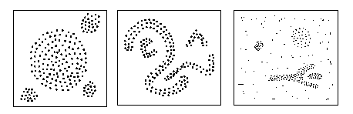
Density-Based Clustering Methods
Clustering based on local connectivity and density functions
Basic idea
Clusters are dense regions in the data space, separated by regions of lower object density
A cluster is defined as a maximal set of density connected points
Each cluster has a considerable higher density of points than outside of the cluster
Major features:
Discover clusters of arbitrary shape
One scan

Slide 24
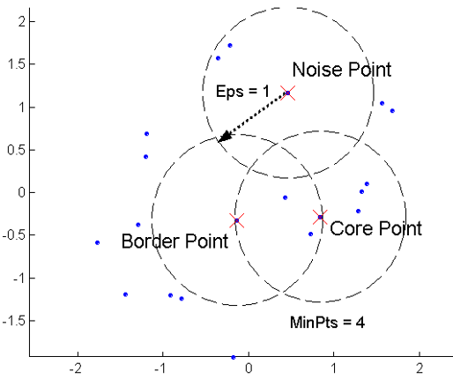
Density Based Spatial Clustering of Application of Noise (DBSCAN)
Two global parameters:
Eps: Maximum radius of the neighbourhood
MinPts: Minimum number of points in an Eps-neighbourhood of that point
Density = number of points within a specified radius r (Eps)
A point is a core point if it has more than a specified number of points (MinPts) within Eps
These are points that are at the interior of a cluster
A border point has fewer than MinPts within Eps, but is in the neighborhood of a core point
A noise point is any point that is not a core point or a border point.

Slide 25
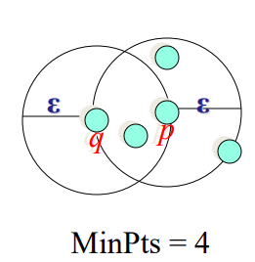
Density-reachability
An object q is directly density-reachable from object p, if p is a core object and q is in p’s Eps-neighborhood
q is directly density-reachable from p
p is not directly density-reachable from q
Density-reachability is asymmetric

Slide 26
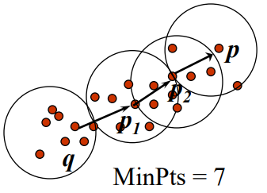
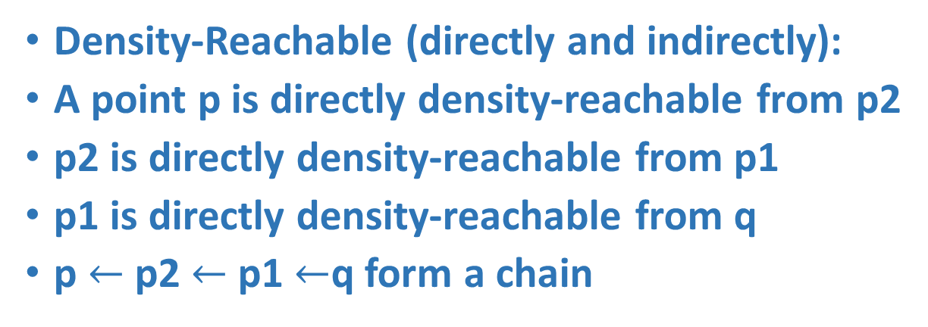
Density-reachability
Density-Reachable (directly and indirectly):
A point p is directly density-reachable from p2
p2 is directly density-reachable from p1
p1 is directly density-reachable from q
p $←$p2 $←$p1 $←$q form a chain
p is (indirectly) density-reachable from q
q is not density-reachable from p

Slide 27
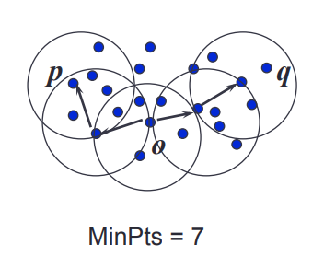
Density-Connectivity
A pair of points p and q are density-connected, If they are commonly density-reachable from a point o
Density-connectivity is symmetric

Slide 28
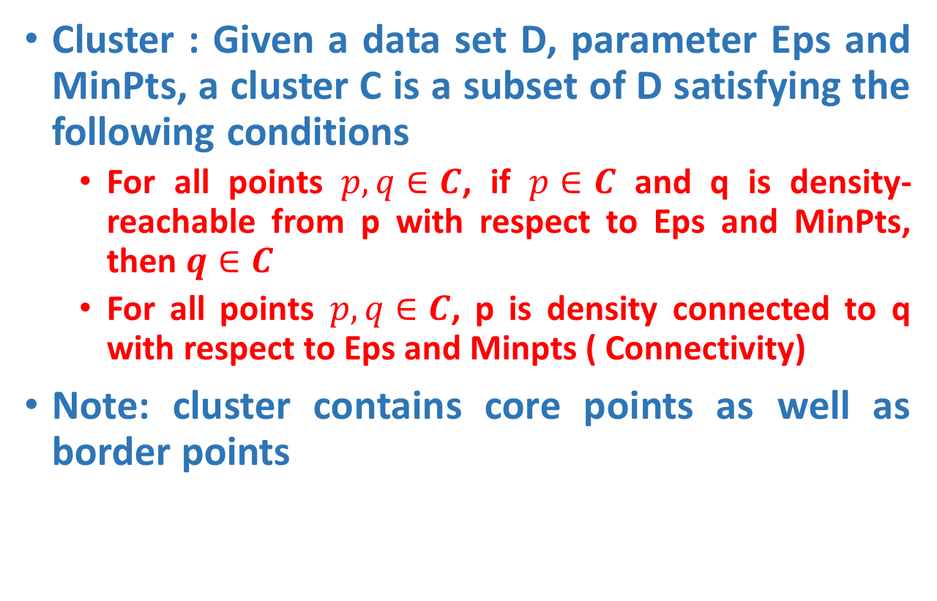
DBSCAN
Cluster : Given a data set D, parameter Eps and MinPts, a cluster C is a subset of D satisfying the following conditions
For all points $p, q∈C$, if $p∈C$ and q is density-reachable from p with respect to Eps and MinPts, then $q∈C$
For all points $p, q∈C$, p is density connected to q with respect to Eps and Minpts ( Connectivity)
Note: cluster contains core points as well as border points

Slide 29
DBSCAN-Algorithm
Input: The data set D
Parameter: ε, MinPts
For each object p in D
if p is a core object and not processed then
C = retrieve all objects density-reachable from p
mark all objects in C as processed
report C as a cluster
else mark p as outlier
end if
End For

Slide 30
DBSCAN-Example
Parameter
ε = 2 cm
MinPts = 3
for each o ∈ D do if o is not yet classified then if o is a core-object then collect all objects density-reachable from o and assign them to a new cluster. else assign o to NOISE

Slide 31
DBSCAN-Example
Parameter
ε = 2 cm
MinPts = 3
for each o ∈ D do if o is not yet classified then if o is a core-object then collect all objects density-reachable from o and assign them to a new cluster. else assign o to NOISE

Slide 32
DBSCAN-Example
Parameter
ε = 2 cm
MinPts = 3
for each o ∈ D do if o is not yet classified then if o is a core-object then collect all objects density-reachable from o and assign them to a new cluster. else assign o to NOISE

Slide 33
MinPts = 5
ε
P₁
ε
ε
C₁
P
P
C₁
C₁
1. Check the ε-neighborhood of p;
2. If p has less than MinPts neighbors then mark p as outlier and continue with the next object
3. Otherwise mark p as processed and put all the neighbors in cluster C
1. Check the unprocessed objects in C
2. If no core object, return C
3. Otherwise, randomly pick up one core object p₁, mark p₁ as processed, and put all unprocessed neighbors of p₁ in cluster C

Slide 34
ε
ε
C₁
C₁
ε
ε
C₁
C₁

Slide 35
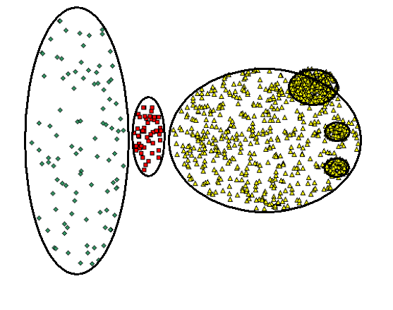
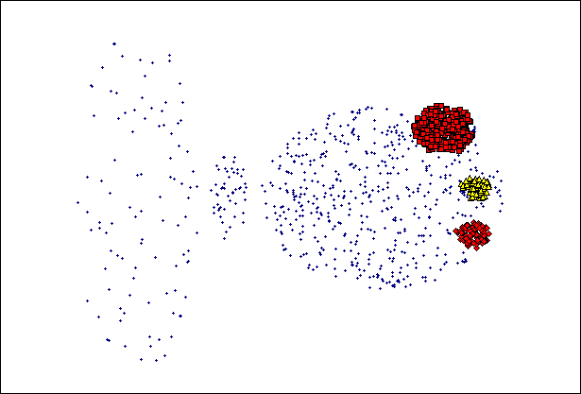
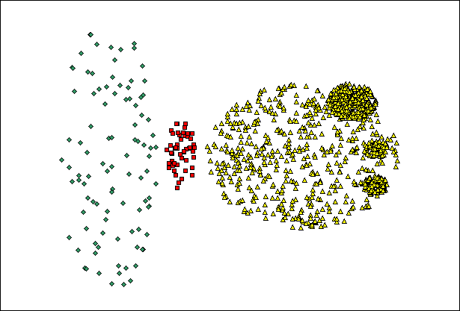
When DBSCAN Does NOT Work Well
Original Points
Cannot handle Varying densities
sensitive to parameters
(MinPts=4, Eps=9.75)

Slide 36
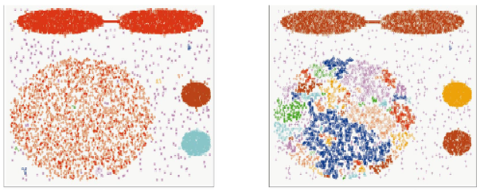
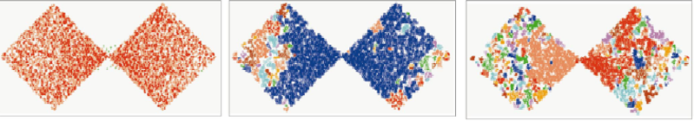
DBSCAN: Sensitive to Parameters

Slide 37
Density Based Clustering: Discussion
Advantages
Clusters can have arbitrary shape and size
Number of clusters is determined automatically
Can separate clusters from surrounding noise
Disadvantages
Input parameters may be difficult to determine
In some situations very sensitive to input parameter setting

Slide 38
Validation Measures for Clustering
External
use external information not present in the data
Internal
measures evaluate the goodness of a clustering structure without respect to external information

Slide 39
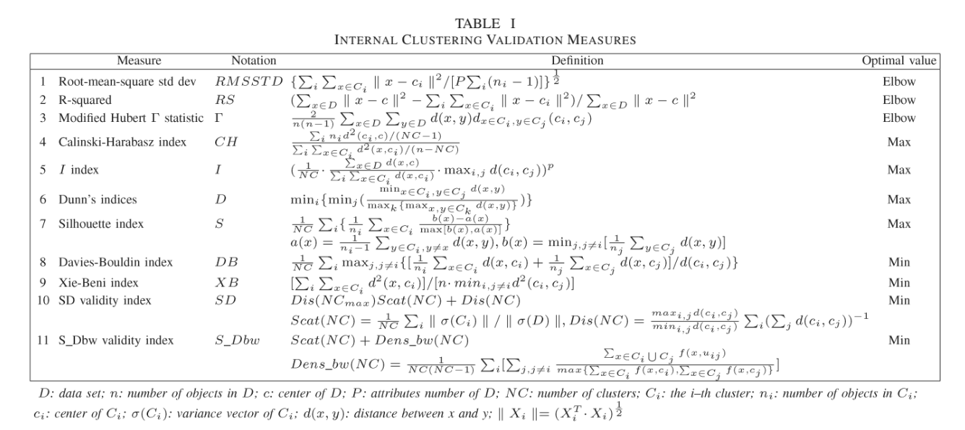
Validation Measures for Clustering

Slide 40
Validation Measures for Clustering
External
Dice Coefficient
Similarity
Accuracy

