Slide 1
Introduction to Computer Systems Architecture

Slide 2
Computer Systems Architecture
A computer system is basically a machine that simplifies complicated tasks.
Computer Architecture is concern with the structure and behaviour of the computer as seen by the user. It includes the information, the instruction set and techniques for addressing memory. The architectural design of a computer system is concerned with the specifications of the functional modules, such as processor, memory and structuring them together into a computer system.
“Computer Architecture is a study of computer systems”

Slide 3
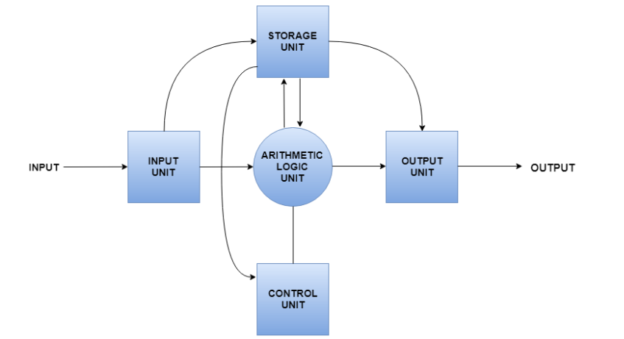
Components in the Computer System Architecture
Input Unit, Output Unit, Storage Unit, Arithmetic Logic Unit and Control Unit etc.

Slide 4
Broad categories
A computer system is subdivided into two functional entities:
Hardware of the computer system consists of all the electronic components and electromechanical devices that comprise the physical entity of the device.
Software consists of the instructions and data that the computer manipulates to perform various data-processing tasks.

Slide 5
Broad categories
Hardware of the computer system is usually divided into three major parts.
Input devices
CPU (ALU,CU and Memory)
Output devices
Software consists of a collection of programs whose purpose is to make more efficient use of the computer.
Program: A set of instructions that directs a computer's hardware to perform a task.
Instructions are basic commands used to communicate with the processor. A computer can execute billions of instructions per second.

Slide 6
How Computer System Works ?
Program
Information
Processor
results
Program – List of instructions given to the computer
Information– data, images, files, videos
Processor– Process the information according to the instructions in the program
6

Slide 7
Binary System & Logic Gates
Computer is a digital device, which works on two levels of signal. These two levels of signal as High and Low.
Digital computers use the binary number system, which has two digits: 0 and 1.
0 means Low
1 means High
Manipulation of binary information is done by logic circuits called Gates.
Each gate has a distinct graphic symbol and its operation can be described by means of an algebraic expression.
Input-Output relationship of the binary variables for each gate can be represented in tabular form by a truth table.

Slide 8
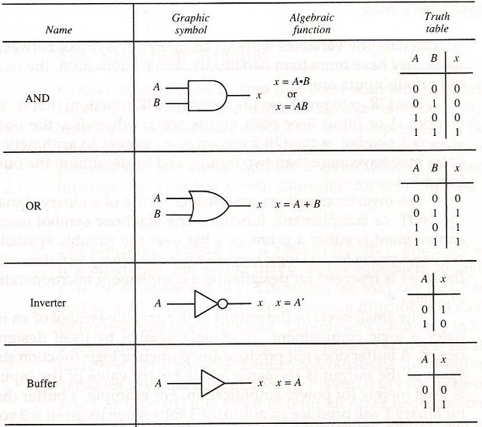

Slide 9
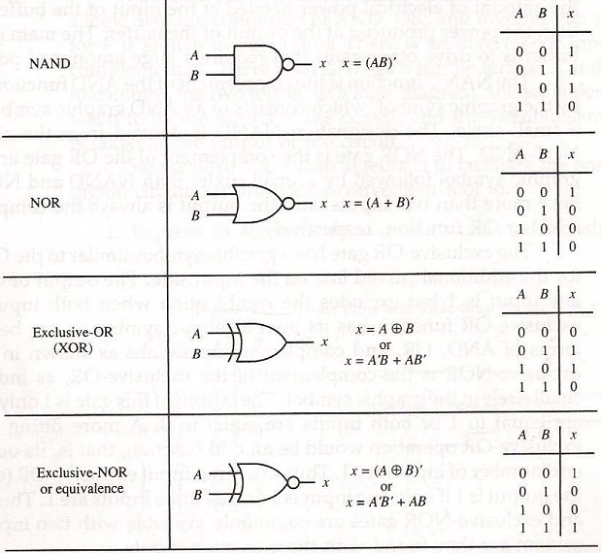

Slide 10
Book
Morris Mano, Computer System Architecture, 3rd Edition, Pearson

