Slide 1
Data Transfer Modes
Programmed I/O, Interrupt-initiated I/O
&
Direct memory access (DMA)

Slide 2
Data Transfer Modes
Data transfer between the central computer and I/O devices may be handled in a variety of modes.
Programmed I/O
Interrupt-initiated I/O
Direct memory access (DMA)

Slide 3
Programmed I/O
In the programmed I/O method, the I/O device does not have direct access to memory.
Each data item transfer is initiated by an instruction in the program.
Usually, the transfer is to and from a CPU register and peripheral.
Transferring data under program control requires constant monitoring of the peripheral by the CPU.
Once a data transfer is initiated, the CPU is required to monitor the interface to see when a transfer can again be made.

Slide 4
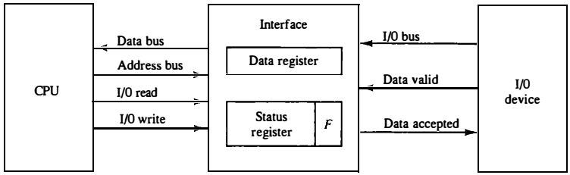
Programmed I/O
The device transfers bytes of data one at a time as they are available.
When a byte of data is available, the device places it in the I/O bus and enables its data valid line.
The interface accepts the byte into its data register and enables the data accepted line.
The interface sets a bit in the status register that we will refer to as an F or "flag" bit.
Fig: Data transfer from I/O device to CPU

Slide 5
Programmed I/O
The I/O device can now disable the data valid line, but it will not transfer another byte until the data accepted line is disabled by the interface.
CPU checks the flag in the status register to determine if a byte has been placed in the data register by the I/O device.
This is done by reading the status register into a CPU register and checking the value of the flag bit.
Fig: Data transfer from I/O device to CPU

Slide 6
Programmed I/O
If the flag is equal to 1, the CPU reads the data from the data register.
When the flag is cleared, the interface disables the data accepted line and the device can then transfer the next data byte.
The programmed I/O method is particularly useful in small low-speed computers or in systems that are dedicated to monitor a device continuously.
Fig: Data transfer from I/O device to CPU

Slide 7
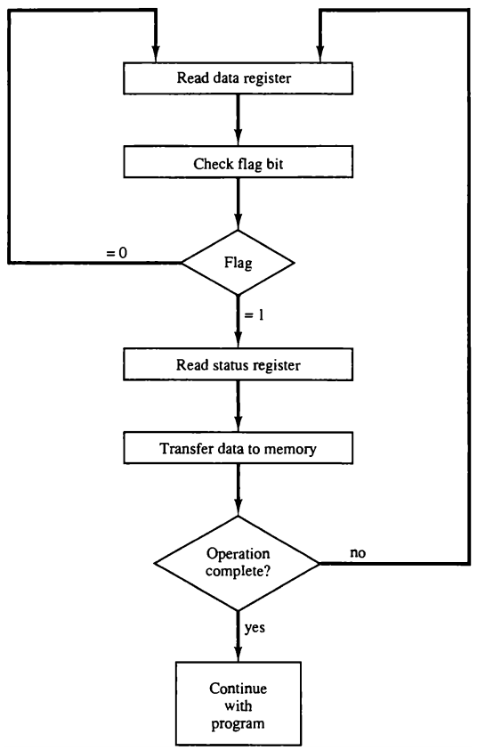
Programmed I/O
The transfer of each byte requires three instructions:
Read the status register.
Check the status of the flag bit and branch to step 1 if not set or to step 3 if set.
Read the data register
Each byte is read into a CPU register and then transferred to memory with a store instructions.
Fig: Flowchart for CPU program to input data

Slide 8
Programmed I/O
This type of transfer is inefficient because of the difference in information transfer rate between the CPU and the I/O device.
CPU stays in a program loop until the I/O unit indicates that it is ready for data transfer.
This is a time-consuming process since it keeps the processor busy needlessly.

Slide 9
Interrupt-initiated I/O
Interrupt-initiated I/O can overcome the limitations of Programmed I/O.
It uses an interrupt facility and special commands to inform the interface to issue an interrupt request signal when the data are available from the device.
In the meantime the CPU can proceed to execute another program.
The interface meanwhile keeps monitoring the device.
When the interface determines that the device is ready for data transfer, it generates an interrupt request to the CPU.

Slide 10
Direct Memory Access
Transfer of data under programmed I/O is between CPU and peripheral.
In direct memory access (DMA), the interface transfers data into and out of the memory unit through the memory bus.
The transfer of data between a fast storage device such as magnetic disk and memory is often limited by the speed of the CPU.
Removing the CPU from the path and letting the peripheral device manage the memory buses directly would improve the speed of transfer.

Slide 11
Direct Memory Access
During the DMA transfer, the CPU is idle and has no control of the memory buses.
A DMA Controller takes over the buses to manage the transfer directly between the I/O device and memory.
Two control signals in the CPU that facilitates the DMA transfer.
The Bus Request (BR) input is used by the DMA controller to request the CPU.

Slide 12
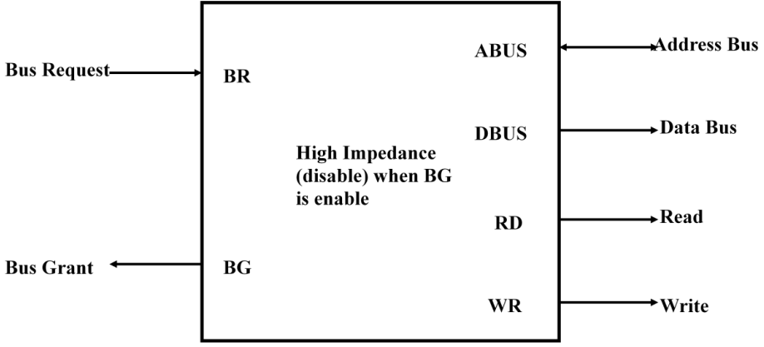
Direct Memory Access
When BR input is active, the CPU terminates the execution of the current instruction and places the address bus, data bus and read write lines into a high Impedance state.
High Impedance state means that the output is disconnected.
Fig: CPU bus signals for DMA transfer

Slide 13
Direct Memory Access
The CPU activates the Bus Grant (BG) output to inform the external DMA that the Bus Request (BR) can now take control of the buses to conduct memory transfer without processor.
When the DMA terminates the transfer, it disables the Bus Request (BR) line.
The CPU disables the Bus Grant (BG), takes control of the buses and return to its normal operation.
Fig: CPU bus signals for DMA transfer

Slide 14
Direct Memory Access
The transfer can be made in several ways that are:
i. DMA Burst
ii. Cycle Stealing
i) DMA Burst :- In DMA Burst transfer, a block sequence consisting of a number of memory words is transferred in continuous burst while the DMA controller is master of the memory buses.
ii) Cycle Stealing :- Cycle stealing allows the DMA controller to transfer one data word at a time, after which it must returns control of the buses to the CPU.

Slide 15
Direct Memory Access Controller
The DMA controller has three registers:
Address Register: contains an address to specify the desired location in memory.
ii. Word Count Register: holds the number of words to be transferred. The register is increment/decrement by one after each word transfer and internally tested for zero.
iii. Control Register: specifies the mode of transfer
When the BG (Bus Grant) input is 0, the CPU can communicate with the DMA registers through the data bus to read from or write to the DMA registers.
When BG =1, the DMA can communicate directly with the memory by specifying an address in the address bus and activating the RD or WR control.

Slide 16
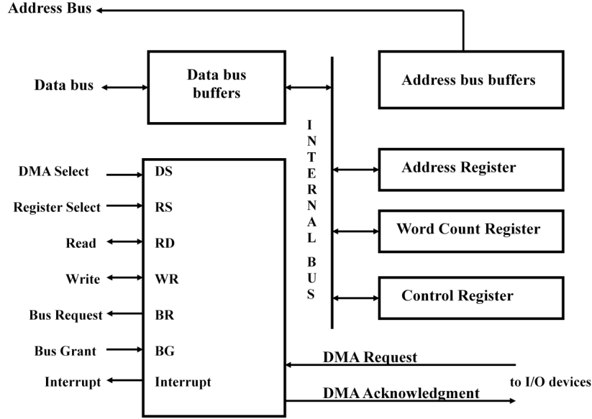
Direct Memory Access Controller
The CPU communicates with the DMA through the address and data buses as with any interface unit. The DMA has its own address, which activates the DS and RS lines.
Fig: Block diagram of DMA Controller

Slide 17
Direct Memory Access Controller
The CPU initializes the DMA through the data bus.
Once the DMA receives the start control command, it can transfer between the peripheral and the memory.
Fig: Block diagram of DMA Controller

