Slide 1
Logic Gates

Slide 2
Basic logic gates
Not
And
Or
Nand
Nor
Xor
x
x y
x y
x
xy
x+y
x y
xy
x y
x y
x+y
x⊕y

Slide 3

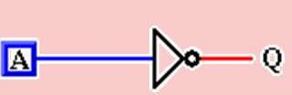
Inversion (NOT)
A | Q
0 | 1
1 | 0
Logic:
Q = A

Slide 4
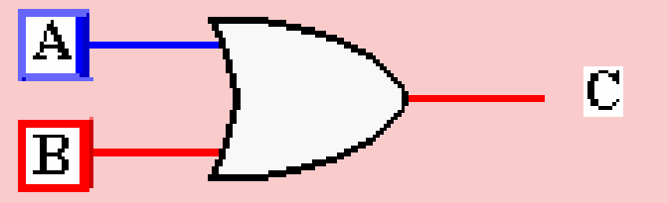

OR Gate
Current flows if either switch is closed
– Logic notation A + B = C
A | B | C
0 | 0 | 0
0 | 1 | 1
1 | 0 | 1
1 | 1 | 1

Slide 5


AND Gate
In order for current to flow, both switches must be closed
– Logic notation A•B = C (Sometimes AB = C)
A | B | C
0 | 0 | 0
0 | 1 | 0
1 | 0 | 0
1 | 1 | 1

Slide 6




Properties of AND and OR
Commutation
A + B = B + A
A • B = B • A
Same as
Same as

Slide 7

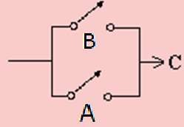
Commutation Circuit
A • B
B • A
A + B
B + A

Slide 8
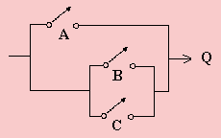
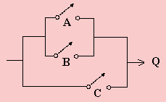

Properties of AND and OR
Associative Property
A + (B + C) = (A + B) + C
=
A • (B • C) = (A • B) • C

Slide 9
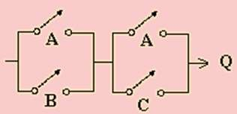
Distributive Property
(A + B) • (A + C)
A | B | C | Q
0 | 0 | 0 | 0
0 | 0 | 1 | 0
0 | 1 | 0 | 0
0 | 1 | 1 | 1
1 | 0 | 0 | 1
1 | 0 | 1 | 1
1 | 1 | 0 | 1
¹, | ¹ | 1 | 1

Slide 10
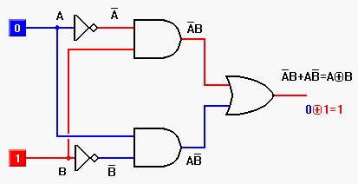
Circuit for XOR
A ⊕ B = A⋅B + A⋅ B

Slide 11
Circuits
Combinational Circuit:
A combinational circuit consists of logic gates whose outputs, at any time, are determined by combining the values of the inputs.
Sequential Circuit:
Sequential circuit is the type of circuit where output not only relies on the current input but also depends on the previous output.
The combinational circuit does not use any memory.
Sequential circuit has memory.

Slide 12
Combinational vs. Sequential Circuits
n-inputs
Combinational
Circuit
m-outputs
(Depend only on inputs)
Combinational Circuit
n-inputs
m-outputs
Combinational
Circuit
Storage
Elements
Next
state
Present
state
Sequential Circuit

Slide 13
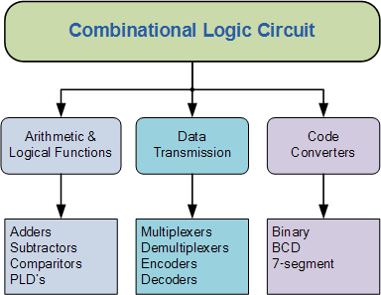
Classification of Combinational Logic

Slide 14
Classification of Sequential Logic
There are two main types of sequential circuits:
Synchronous
Asynchronous
Example of sequential circuits:
Flip-Flops
Counters
Shift registers

