Slide 1
Combinational Circuits

Slide 2
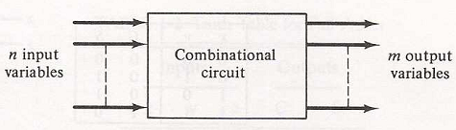
Circuits
Combinational Circuit:
output of this circuit mainly depends on the input terminals at any time.
n binary input variables come and m binary output variables go out.
This circuit doesn’t include any memory.

Slide 3
Adder
An adder is a digital logic circuit that is used for the addition of numbers.
Adders are basically classified into two types:
Half-Adder
Full-Adder.

Slide 4
Half-Adder
Half Adder performs the arithmetic addition of two bits.
The half adder accepts two binary digits on its inputs and produce two binary digits outputs, sum (S) and carry (C) bit.
The carry (C) output is 0 unless both the inputs are 1.
S represents the least significant bit of the sum.

Slide 5
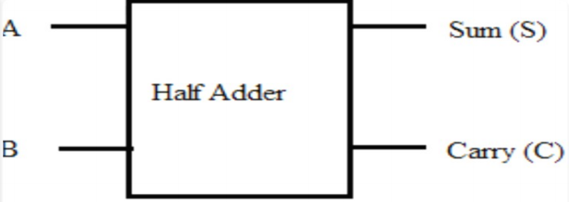
Half-Adder
Logical Expression of Half-Adder:
Sum (S) = A⋅B + A⋅B = A ⊕ B
Carry (C) = A⋅ B = A AND B
A | B | C | S
0 | 0 | 0 | 0
0 | 1 | 0 | 1
1 | 0 | 0 | 1
1 | 1 | 1 | 0
Table: Truth Table
Fig: Block diagram of Half-Adder

Slide 6
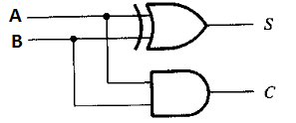
Half-Adder
Logical Expression of Half-Adder:
Sum (S) = A⋅B + A⋅B = A ⊕ B
Carry (C) = A⋅ B = A AND B
A | B | C | S
0 | 0 | 0 | 0
0 | 1 | 0 | 1
1 | 0 | 0 | 1
1 | 1 | 1 | 0
Table: Truth Table
Fig: Logic diagram of Half-Adder

Slide 7
Full-Adder
Full Adder performs the arithmetic sum of three bits.
The Full-Adder accepts three inputs and produce two outputs.
The S output is equal to 1 when only one input is equal to 1 or when all three inputs are equal to 1.
The C output has carry of 1 if two or three inputs are equal to 1.

Slide 8
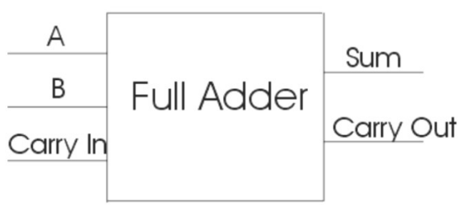
Full-Adder
Logical Expression of Full-Adder:
Sum (S) = A⋅B⋅C_{in} + A⋅B⋅ C_{in} + A⋅B⋅ C_{in} + A⋅B⋅C_{in} = A ⊕ B ⊕ C_{in}
Carry (C_{out}) = A⋅ B +A⋅ C_{in} + B⋅ C_{in}
A | B | C_{in} | C_{out} | S
0 | 0 | 0 | 0 | 0
0 | 0 | 1 | 0 | 1
0 | 1 | 0 | 0 | 1
0 | 1 | 1 | 1 | 0
1 | 0 | 0 | 0 | 1
1 | 0 | 1 | 1 | 0
1 | 1 | 0 | 1 | 0
1 | 1 | 1 | 1 | 1
Fig: Block diagram of Full-Adder
Table: Truth Table

Slide 9
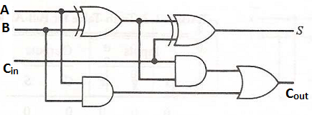
Full-Adder
Logical Expression of Full-Adder:
Sum (S) = A⋅B⋅C_{in} + A⋅B⋅ C_{in} + A⋅B⋅ C_{in} + A⋅B⋅C_{in} = A ⊕ B ⊕ C_{in}
Carry(C_{out})=A⋅B+A⋅C_{in}+B⋅C_{in}=A⋅ B+(A⋅B+A⋅B)⋅C_{in}
A | B | C_{in} | C_{out} | S
0 | 0 | 0 | 0 | 0
0 | 0 | 1 | 0 | 1
0 | 1 | 0 | 0 | 1
0 | 1 | 1 | 1 | 0
1 | 0 | 0 | 0 | 1
1 | 0 | 1 | 1 | 0
1 | 1 | 0 | 1 | 0
1 | 1 | 1 | 1 | 1
=A⋅ B+(A ⊕ B )⋅C_{in}
Fig: Logic diagram of Full-Adder
Table: Truth Table

Slide 10
Subtractor
Subtractor: each subtrahend bit of the number is subtracted from its corresponding significant minuend bit to form a difference bit.
If the minuend bit is smaller than the subtrahend bit, a 1 is borrowed from the next significant position.
Half-Subtractor
Full-Subtractor.

Slide 11
Half-Subtractor
A half-subtractor is a circuit that subtracts two bits and produces their difference.
The half-subtractor needs two outputs.
One output generates the difference (D).
The second output for borrow (B).
To perform x-y, we have to check the relative magnitudes of x and y. If x>= y, we have three possibilities:
0-0=0, 1-0=1 and 1-1=0.
If x<y, we have 0-1 and it is necessary to borrow a 1 from the next higher stage.

Slide 12
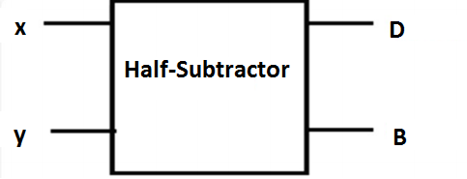
Half- Subtractor
Logical Expression of Half-Subtractor:
Difference (D) = x⋅y + x⋅y = A ⊕ B
Borrow (B) = x⋅y = x AND y
x | y | B | D
0 | 0 | 0 | 0
0 | 1 | 1 | 1
1 | 0 | 0 | 1
1 | 1 | 0 | 0
Table: Truth Table
Fig: Block diagram of Half-Subtractor

Slide 13
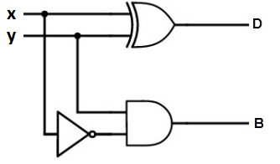
Half- Subtractor
Logical Expression of Half-Subtractor:
Difference (D) = x⋅y + x⋅y = A ⊕ B
Borrow (B) = x⋅y = x AND y
x | y | B | D
0 | 0 | 0 | 0
0 | 1 | 1 | 1
1 | 0 | 0 | 1
1 | 1 | 0 | 0
Table: Truth Table
Fig: Logic diagram of Half-Subtractor

Slide 14
Full-Subtractor
A Full-subtractor performs a subtraction between two bits and taking into account the borrow bit.
This circuit has three inputs and two outputs
The three inputs x, y and B_{in}, where B_{in} is previous borrow.
The two outputs, D and B_{out} represent the difference and output borrow, respectively.

Slide 15
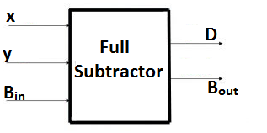
Full-Subtractor
Logical Expression of Full-Subtractor:
Difference (D) = x⋅y⋅ B_{in} + x⋅y⋅ B_{in} + x⋅y⋅ B_{in} + x⋅y⋅ B_{in} = x ⊕ y ⊕ B_{in}
Borrow (B_{out}) = x⋅ y +x⋅ B_{in} + y⋅ B_{in}
x | y | B_{in} | B_{out} | D
0 | 0 | 0 | 0 | 0
0 | 0 | 1 | 1 | 1
0 | 1 | 0 | 1 | 1
0 | 1 | 1 | 1 | 0
1 | 0 | 0 | 0 | 1
1 | 0 | 1 | 0 | 0
1 | 1 | 0 | 0 | 0
1 | 1 | 1 | 1 | 1
Fig: Block diagram of Full-Subtractor
Table: Truth Table

Slide 16
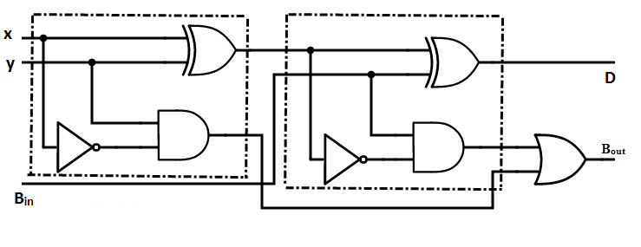
Full-Subtractor
Logical Expression of Full-Subtractor:
Difference (D) = x⋅y⋅ B_{in} + x⋅y⋅ B_{in} + x⋅y⋅ B_{in} + x⋅y⋅ B_{in} = x ⊕ y ⊕ B_{in}
Borrow (B_{out}) = x⋅ y+( x ⊕ y)⋅B_{in}
x | y | B_{in} | B_{out} | D
0 | 0 | 0 | 0 | 0
0 | 0 | 1 | 1 | 1
0 | 1 | 0 | 1 | 1
0 | 1 | 1 | 1 | 0
1 | 0 | 0 | 0 | 1
1 | 0 | 1 | 0 | 0
1 | 1 | 0 | 0 | 0
1 | 1 | 1 | 1 | 1
Fig: Logic diagram of Full-Subtractor
Table: Truth Table

