Slide 1
Combinational Circuits (Decoder and Encoder)

Slide 2
Decoder
The name Decoder means to translate or decode coded information from one format into another.
A decoder is a combinational circuit that converts binary information from n input lines to a maximum of 2^{n} unique output lines.
n inputs
2^{n} outputs
If a binary decoder receives n inputs it activates one and only one of its 2^{n} outputs based on that input with all other outputs deactivated.
A decoder has n inputs and m outputs is referred to as an n × m decoder

Slide 3
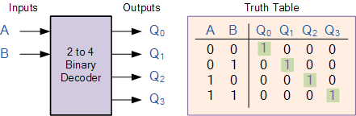
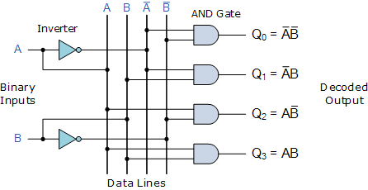
Decoder

Slide 4
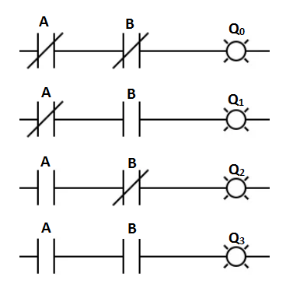
Decoder

Slide 5
Decoder with Enable input
Decoders include one or more enable inputs to control the operation of the circuit.
The decoder is enabled when E is equal to 1 and disabled when E is equal to 0.
Out₀
W
B
I₀
high-level
enable
Out₁
X
A
I₁
Y
Out₂
Out₃
Z
Enable
En
En | A | B | W | X | Y | Z
1 | 0 | 0 | 1 | 0 | 0 | 0
1 | 0 | 1 | 0 | 1 | 0 | 0
1 | 1 | 0 | 0 | 0 | 1 | 0
1 | 1 | 1 | 0 | 0 | 0 | 1
0 | x | x | 0 | 0 | 0 | 0
enabled
disabled

Slide 6
Decoder with Enable input
Out₀
W
B
I₀
low-level
enable
Out₁
X
A
I₁
Y
Out₂
Out₃
Z
Enable
En
En | A | B | W | X | Y | Z
0 | 0 | 0 | 1 | 0 | 0 | 0
0 | 0 | 1 | 0 | 1 | 0 | 0
0 | 1 | 0 | 0 | 0 | 1 | 0
0 | 1 | 1 | 0 | 0 | 0 | 1
1 | x | x | 0 | 0 | 0 | 0
enabled
disabled

Slide 7
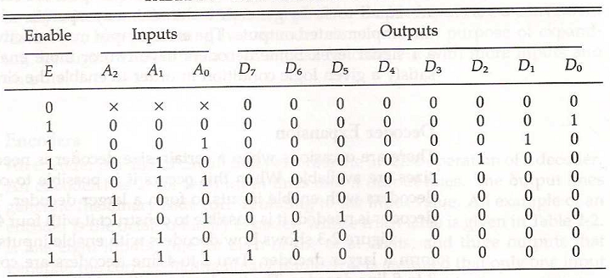
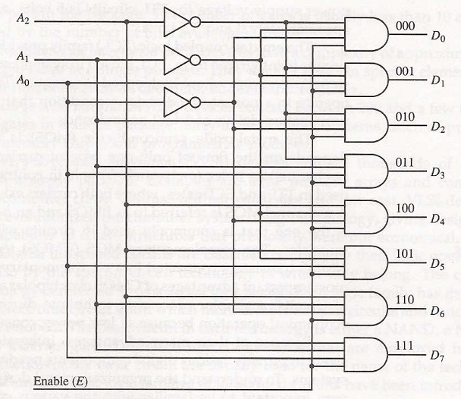
3-to-8 line Decoder

Slide 8
Encoder
Encoder is a combinational circuit that perform the inverse operation of the decoder.
An encoder has 2^{n} input lines and n output lines.
Encoders assume that only one input line is active at a time.

Slide 9
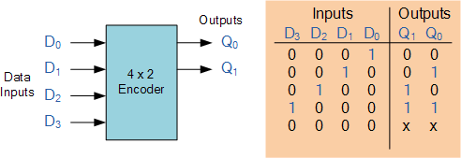
4 × 2 Encoder

Slide 10
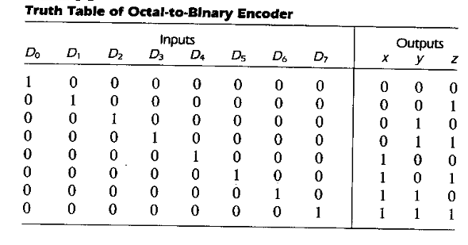
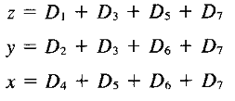
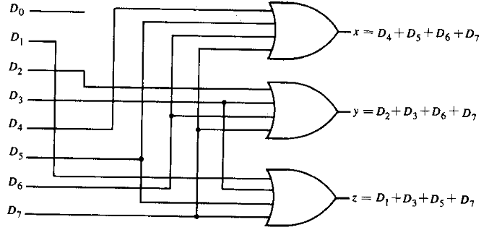
8 × 3 Encoder

Slide 11
Encoder Design Issues
There are two ambiguities associated with the design of a simple encoder:
Only one input can be active at any given time. If two inputs are active simultaneously, the output produces an undefined combination (for example, if D3 and D6 are 1 simultaneously, the output of the encoder will be 111.
An output with all 0's can be generated when all the inputs are 0's,or when D₀ is equal to 1.

Slide 12
Priority Encoder
Multiple asserted inputs are allowed; one has priority over all others.
Separate indication of no asserted inputs.
A priority encoder is a special type of encoder that includes the priority function.
If two or more inputs are equal to 1 at the same time, the input having the highest priority will take precedence.

Slide 13
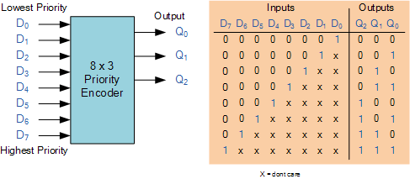
Priority Encoder

Slide 14
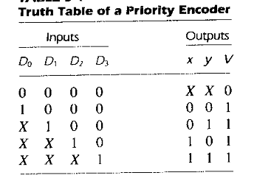
Valid-output indicator
A valid-output indicator, designed by V, is set to 1 only when one or more of the inputs are equal to 1. If all inputs are 0, V is equal to 0 and the other outputs of the circuit are not used.

