Slide 1
Combinational Circuits (Multiplexer and De-Multiplexer )

Slide 2
Multiplexer
A Multiplexer is a combinational circuit that selects binary information from one of many input lines and directs it to a single output line.
2^{n} input lines
1 output line
n selection lines: combinations determine which input is selected.
Multiplexers are also known as parallel to serial convertor, data selector and many to one circuit.
often abbreviated as MUX.

Slide 3
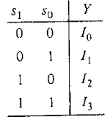
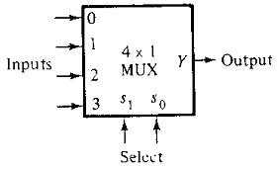
4-to-1-line Multiplexer
Input lines = 4
Selection lines = 2
Table: Truth table
Fig: Block diagram

Slide 4
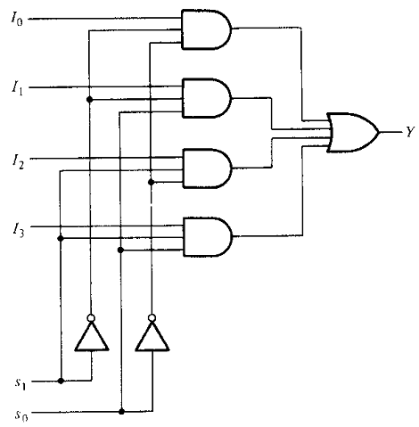
4-to-1-line Multiplexer
Table: Truth table
Similarly, you can implement 8x1 Multiplexer and 16x1 multiplexer by following the same procedure.
Fig: Logical diagram

Slide 5
Multiplexer with enable input
As in decoders, multiplexer circuits may have an enable input to control the operation.
When the enable input is in the inactive state, the outputs are disabled.
When it is in the active state, the circuit functions as a normal multiplexer.

Slide 6
Implement of higher-order Multiplexers using lower-order Multiplexers.
Implement 8x1 Multiplexer using 4x1 Multiplexers and 2x1 Multiplexer.
We know that 4x1 Multiplexer has 4 data inputs, 2 selection lines and one output. Whereas, 8x1 Multiplexer has 8 data inputs, 3 selection lines and one output.
So, we require two 4x1 Multiplexers.
Each 4x1 Multiplexer produces one output, we require a 2x1 Multiplexer considering the outputs of 4x1 Multiplexers as inputs and to produce the final output.

Slide 7
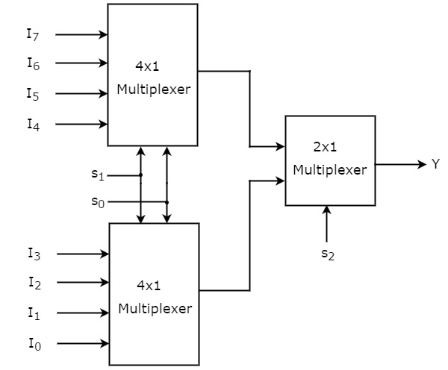
Implement of higher-order Multiplexers using lower-order Multiplexers.
Implement 8x1 Multiplexer using 4x1 Multiplexers and 2x1 Multiplexer.
Selection Inputs |  |  | Output
S₂ | S₁ | S₀ | Y
0 | 0 | 0 | I₀
0 | 0 | 1 | I₁
0 | 1 | 0 | I₂
0 | 1 | 1 | I₃
1 | 0 | 0 | I₄
1 | 0 | 1 | I₅
1 | 1 | 0 | I₆
1 | 1 | 1 | I₇

Slide 8
Applications of Multiplexer
Signal routing
Data communications (Time Division Multiplexing)
Data bus control
Advantage of Multiplexer
Only one serial data line is required instead of multiple parallel data lines.

Slide 9
Demultiplexer
A demultiplexer is a circuit that receives information on a single line and transmits this information on one of the 2^{n} possible output lines.
Reverse of the Multiplexer
1 input line
2^{n} output lines
n selection lines: combinations determine which output line is selected.
Demultiplexers are also known as serial to parallel convertor, Data Distributor and one to many circuit.
often abbreviated as Demux.

Slide 10
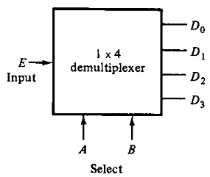
1-to-4-line Demultiplexer
Output lines = 4
Selection lines = 2
A | B | Y
0 | 0 | D₀
0 | 1 | D₁
1 | 0 | D₂
1 | 1 | D₃
Table: Truth table
Fig: Block diagram

Slide 11
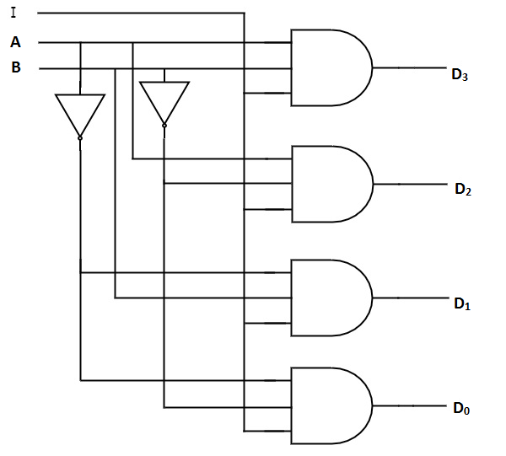
1-to-4-line Demultiplexer
A | B | Y
0 | 0 | D₀
0 | 1 | D₁
1 | 0 | D₂
1 | 1 | D₃
Table: Truth table
Fig: Logical diagram
Similarly, you can implement 1x8 Demultiplexer and 1x16 Demultiplexer by following the same procedure.

Slide 12
Demultiplexer with enable output
Demultiplexer circuits may have an enable output to control the operation.
When the enable output is in the inactive state, the outputs are disabled.
When it is in the active state, the circuit functions as a normal Demultiplexer.

Slide 13
Difference between of Multiplexer and Demultiplexer
MULTIPLEXER | DEMULTIPLEXER
Multiplexer processes the digital information from various sources into a single source. | Demultiplexer receives digital information from a single source and converts it into several sources
It is known as Data Selector | It is known as Data Distributor
It follows combinational logic type | It also follows combinational logic type
It has n data input | It has single data input
It has a single data output | It has n data outputs
It works on many to one operational principle | It works on one to many operational principle
In time division Multiplexing, multiplexer is used at the transmitter end | In time division Multiplexing, demultiplexer is used at the receiver end

