Slide 1
Sequential Logic Circuit (Shift Register)

Slide 2
Register
Flip-flop: A flip-flop can store one-bit of information.
Register: Group of flip-flops are used to store the binary data. To store multiple bits of information, we need multiple flip-flops.
n-bit register has a group of n flip-flops and is capable of storing of information of n bits.
Storage.

Slide 3
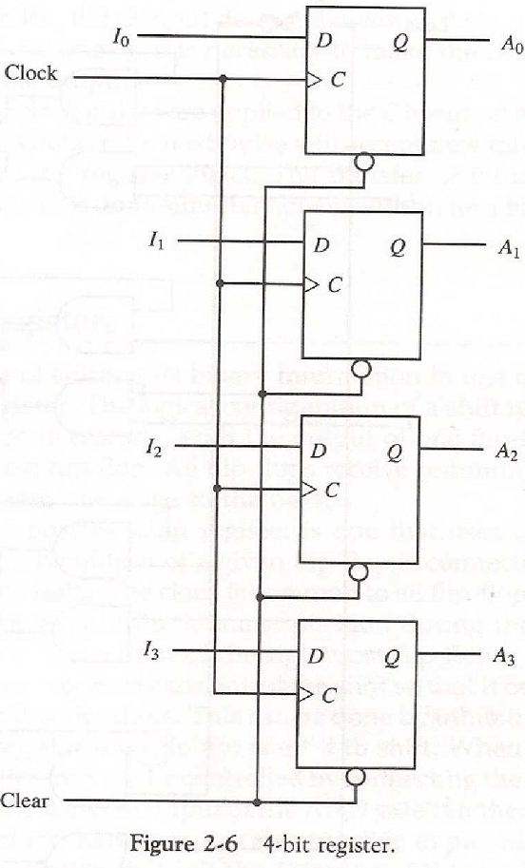
Register
Load: Transfer of new information into a register.
Clear: Clear the register to all 0’s .
Clock pulse: Applied to all flip-flops.
Load all four inputs in parallel.
Fig: 4-bit Register

Slide 4
Shift Register
Shift Register: The Shift Register is another type of sequential logic circuit that can be used for the storage or the transfer of binary data.
Shift Register: A register capable of shifting its binary information either to the right or to the left.
Storage or the transfer
Shift Register loads the data present on its inputs and then moves or “shifts” it to its output once every clock cycle.
The logical configuration of a shift register consists of a chain of flip-flops connected in cascade, with the output of one flip-flop connected to the input of the next flip-flop.

Slide 5



Shift Register
Direction or Date shifting
Left shift
Right shift
Rotate (right or left)
Bidirectional

Slide 6
Shift Operation
A single shift is multiplication by 2
Consider the operation 6 x 2 = 12
0110
x 0010
0000
0110
01100

Slide 7
Shift Operation
In binary number we can move or shift the binary point:
Right by 1 position to multiply by 2
Left by 1 position to divide by 2
Move or shift the binary point:
Left by 1 position to multiply by 2
1110 x 2 → 11100.
Right by 1 position to divide by 2
11100 ÷ 2 → 1110.

Slide 8

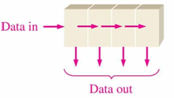
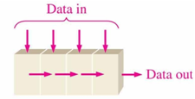
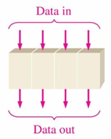
Types of Shift Register
Shift registers operate in one of four different modes with the basic movement of data.
Serial-in, Serial-out
Serial-in, Parallel-out
Parallel-in, Serial-out
Parallel-in, Parallel-out

Slide 9
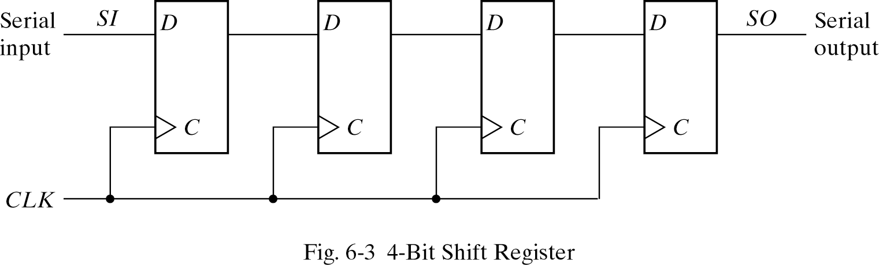
Serial-In Serial-Out
Data bits come in one at a time and leave one at a time.
One Flip-Flop is used to handle each bit.
The output of a Flip-Flop is connected to the D input of the Flip-Flop at its right.

Slide 10
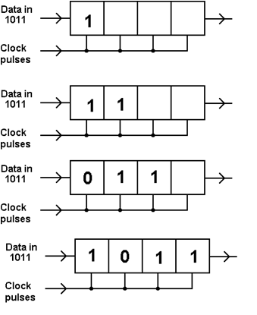
Example
The 4-bit data word “1011” is to be shifted into a 4-bit shift register.
One shift per clock pulse.
Data is shown entering at left and shifting right.

Slide 11
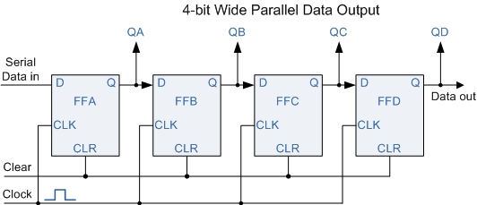
Serial-In Parallel -Out
Serial-in to Parallel-out (SIPO) - the register is loaded with serial data, one bit at a time, with the stored data being available at the output in parallel form.
Shift the data contents of each stage one place.
Data value can now be read directly from the outputs.

Slide 12
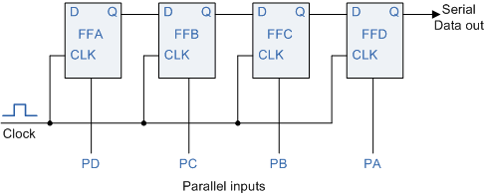
Parallel-In Serial-Out
Parallel-in to Serial-out (PISO)- the parallel data is loaded into the register simultaneously and is shifted out of the register serially one bit at a clock pulse.
Act in the opposite way to the serial-in parallel-out
Data is loaded in a parallel format in which all the data bits enter their inputs simultaneously.
The data is then read out sequentially in the normal shift-right mode.

Slide 13
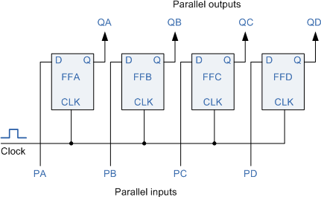
Parallel -In Parallel -Out
Parallel-in to Parallel-out (PIPO)- the parallel data is loaded simultaneously into the register, and transferred together to their respective outputs by the same clock pulse.
One clock pulse loads and unloads the register.
No interconnections between the individual flip-flops since no serial shifting of the data is required.

Slide 14
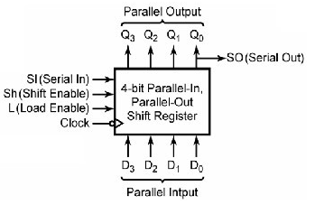
Universal Shift Register
Universal shift register can do any combination of parallel and serial input/output operations.
Can be used in either serial-to-serial, serial-to-parallel, parallel-to-serial, or as a parallel-to-parallel data shifting.
Requires additional inputs to specify desired function.
Universal shift registers are frequently used in arithmetic operations to shift data to the left or right for multiplication or division.

