Slide 1
Sequential Logic Circuit (Counters)

Slide 2
Counters
Counter is a sequential circuit.
Counter is a digital circuit used for counting purpose, they can count specific event happening in the circuit.
Counters calculate or note down the number that how many times an event occurred.
Counting means incrementing or decrementing the values of an operator, with respect to its previous state value.
Counters are well known as Timers.
Counter is the widest application of flip-flops.

Slide 3
Types of counters
Depending on the type of clock inputs, counters are of two types:
Asynchronous counters
Synchronous counters
Depending on the way in which the counting progresses, the synchronous or asynchronous counters are classified as follows −
Up counters
Down counters
Up/Down counters or Bidirectional Counters

Slide 4
Up-Counter:
An up-counter counts events in increasing order.
The binary count is incremented by 1 with every input clock pulse.
Down-Counter:
A down-counter counts events in the decreasing order.
A binary counter with a reverse count. In a down-counter, the binary count is decremented by 1 with every input clock pulse.
Up-Down-Counter:
An up-down counter is a combination of an up-counter and a down-counter. It can count in both directions, increasing as well as decreasing.

Slide 5
Asynchronous Counters
Clock input of the flip-flops are not all driven by the same clock signal, therefore called Asynchronous Counters.
The counters in which the change in transition doesn’t depend upon the clock signal input is known as “Asynchronous counters”.
Asynchronous Counters use flip-flops which are serially connected together so that the input clock pulse appears to ripple through the counter.
Asynchronous counters don’t use universal clock, only first flip flop is driven by main clock.

Slide 6
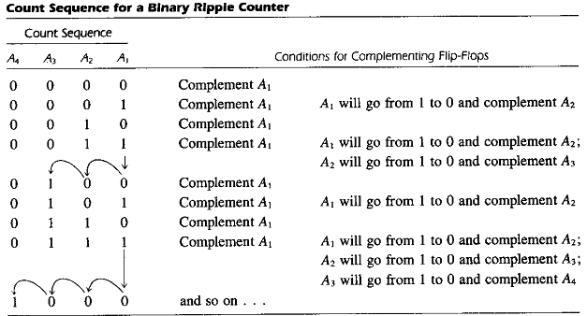
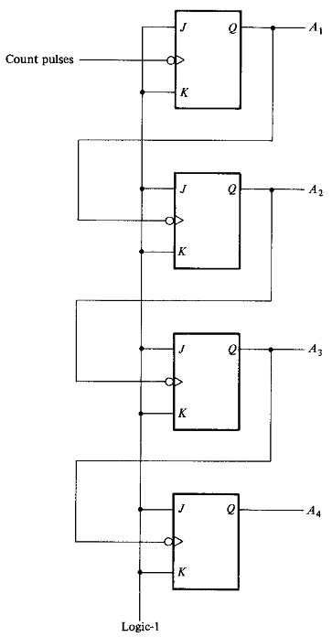
Asynchronous Counters
All J and K inputs are equal to 1.
The lowest-order bit A₁ must be complemented with each count pulse. Every time A₁ goes from 1 to 0, it complements A₂. Every time A₂ goes from 1 to 0, it complements A₃, and so on.
The flip-flops change one at a time in rapid succession, and the signal propagates through the counter in a ripple fashion So asynchronous counters are also called Ripple counters.
Fig: 4-bit Ripple counter

Slide 7
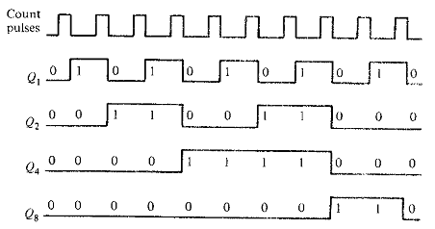
Asynchronous Counters
Fig: Timing Diagram

Slide 8
Synchronous Counters
All flip flops in the synchronous counters are triggered by same clock signal.
Synchronous Counters are so called because the clock input of all the individual flip-flops within the counter are all clocked together at the same time by the same clock signal.
Synchronous Counter, the external clock signal is connected to the clock input of EVERY individual flip-flop within the counter so that all of the flip-flops are clocked together simultaneously (in parallel) at the same time giving a fixed time relationship.

Slide 9
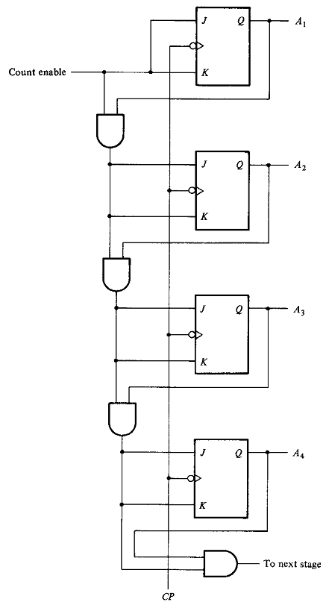
Synchronous Counters
The flip-flop in the lowest-order position is complemented with every pulse.
A flip-flop in any other position is complemented with a pulse provided all the bits in the lowest-order position are equal to 1, because the lowest-order bits (when all 1's) will change to 0's on the next count pulse.
Synchronous binary counters have a regular pattern and can easily be constructed with complementing flip-flops and gates.
Synchronous Counters are faster and more reliable as they use the same clock signal for all flip-flops.
Fig: 4-bit Synchronous Counter

Slide 10
Asynchronous Vs Synchronous Counters
SYNCHRONOUS COUNTERS | ASYNCHRONOUS COUNTERS
All flip-flops are given the same clock simultaneously | The flip-flops are not given the same clock
There is no connection between the output of a flip-flop and the clock input of the next flip-flop. | The output of a flip-flop is given as the clock input to the next flip-flop
These are faster than that of ripple counters. | These are slow in operation.
Large number of logic gates are required to design | Less number of logic gates required.
It is known as a parallel counter | It is known as a serial counter
Synchronous circuits are easy to design. | Complex to design.
Standard logic packages available for synchronous. | For asynchronous counters, Standard logic packages are not available.

Slide 11
Application of counters
Digital clock
Time measurement
Frequency counters
Analog to digital convertors.
Frequency divider circuits
Digital triangular wave generator.
In time measurement. That means calculating time in timers such as electronic devices like ovens and washing machines.

