Slide 1
The Abstract Data Type Queue
A queue is a list from which items are deleted from one end (front) and into which items are inserted at the other end (rear, or back)
  It is like line of people waiting to purchase tickets:
Queue is referred to as a first-in-first-out (FIFO) data structure.
  The first item inserted into a queue is the first item to leave
Queues have many applications in computer systems:
  Any application where a group of items is waiting to use a shared resource will use a queue. e.g.
    jobs in a single processor computer
    print spooling
    information packets in computer networks.
1

Slide 2

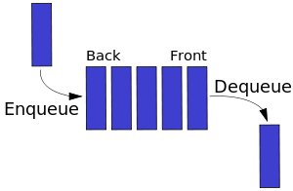
A Queue

Slide 3
A Queue
dequeue
enqueue
front
rear

Slide 4
ADT Queue Operations
createQueue()
  Create an empty queue
destroyQueue()
  Destroy a queue
isEmpty():boolean
  Determine whether a queue is empty
enqueue(in newItem:QueueItemType) throw QueueException
  Inserts a new item at the end of the queue (at the rear of the queue)
dequeue() throw QueueException
dequeue(out queueFront:QueueItemType) throw QueueException
  Removes (and returns) the element at the front of the queue
  Remove the item that was added earliest
getFront(out queueFront:QueueItemType) throw QueueException
  Retrieve the item that was added earliest (without removing)

Slide 5
Some Queue Operations
Operation Queue after operation
x.createQueue() an empty queue
front
↓
x.enqueue(5) 5
x.enqueue(3) 5 3
x.enqueue(2) 5 3 2
x.dequeue() 3 2
x.enqueue(7) 3 2 7
x.dequeue(a) 2 7 (a is 3)
x.getFront(b) 2 7 (b is 2)

Slide 6
An Application -- Reading a String of Characters
A queue can retain characters in the order in which they are typed
  aQueue.createQueue()
  while (not end of line) {
  Read a new character ch
  aQueue.enqueue(ch)
  }
Once the characters are in a queue, the system can process them as necessary

Slide 7
Recognizing Palindromes
A palindrome
  A string of characters that reads the same from left to right as its does from right to left
Solution ideas?

Slide 8
Recognizing Palindromes
A palindrome
  A string of characters that reads the same from left to right as its does from right to left
To recognize a palindrome, a queue can be used in conjunction with a stack
  A stack reverses the order of occurrences
  A queue preserves the order of occurrences
A nonrecursive recognition algorithm for palindromes
  As you traverse the character string from left to right, insert each character into both a queue and a stack
  Compare the characters at the front of the queue and the top of the stack

Slide 9
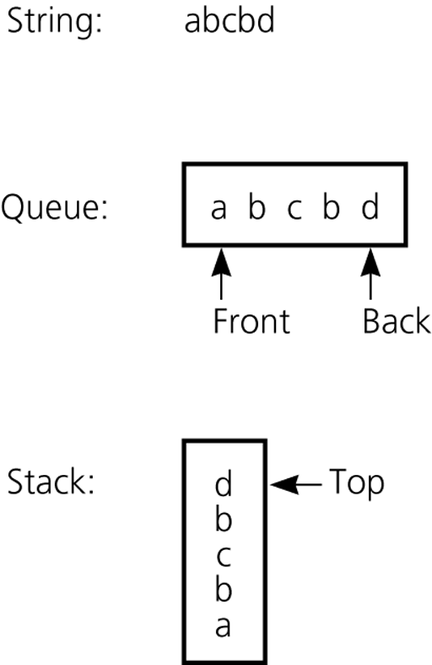
Recognizing Palindromes (cont.)
The results of inserting a string into both a queue and a stack

Slide 10
Recognizing Palindromes -- Algorithm
isPal(in str:string) : boolean // Determines whether str is a palindrome or not
aQueue.createQueue(); aStack.createStack();
len = length of str;
for (i=1 through len) {
nextChar = ith character of str;
aQueue.enqueue(nextChar);
aStack.push(nextChar);
}
charactersAreEqual = true;
while (aQueue is not empty and charactersAreEqual) {
aQueue.getFront(queueFront);
aStack.getTop(stackTop);
if (queueFront equals to stackTop) { aQueue.dequeue(); aStack.pop()}; }
else charactersAreEqual = false; }
return charactersAreEqual;

Slide 11
Recognizing Palindromes -- Algorithm
bool isPal(char str[], int left, int right) {
A recursive one???????????
}

Slide 12
Recognizing Palindromes -- Algorithm
bool isPal(char str[], int left, int right) {
//to be called from main as isPal(“rotator”, 0, 6);
if (left >= right) //Could I have used == instead?
return true;
if (str[left] == str[right])
return isPal(str, left+1, right-1);
return false;
}
//idea: rotator is pal if otato is pal, if tat is pal, if a is pal

Slide 13
Implementations of the ADT Queue
Pointer-based implementations of queue
  A linear linked list with two external references
    A reference to the front
    A reference to the back
  A circular linked list with one external reference
    A reference to the back
Array-based implementations of queue
  A naive array-based implementation of queue
  A circular array-based implementation of queue

Slide 14
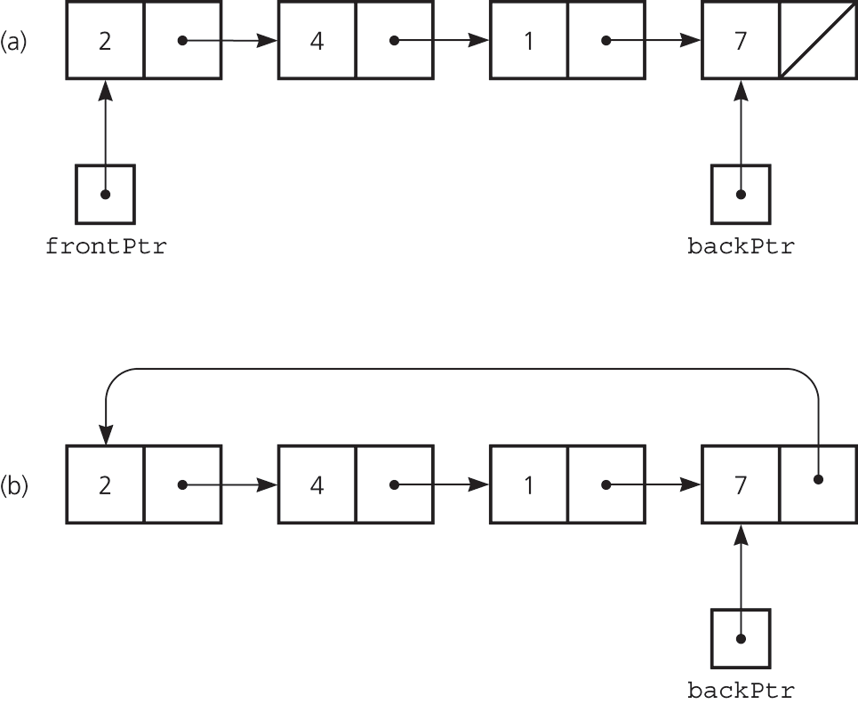
Pointer-based implementations of queue
a linear linked list with two external pointers
a circular linear linked list with one external pointer

Slide 15
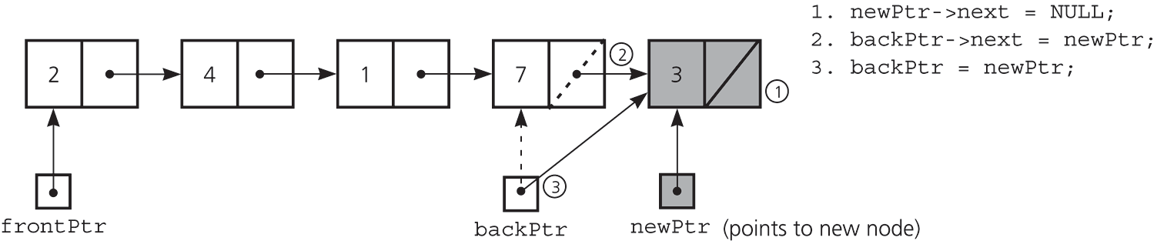
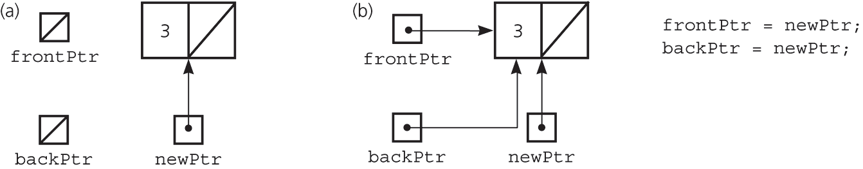
A linked list Implementation -- enqueue
Inserting an item into a nonempty queue
Inserting an item into an empty queue
a) before insertion
b) after insertion

Slide 16
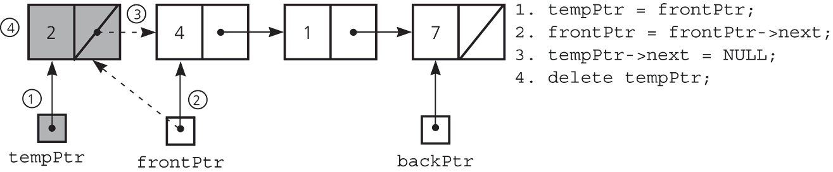
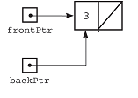
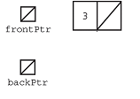
A Linked list Implementation -- dequeue
Deleting an item from a queue of more than one item
Deleting an item from a queue with one item
tempPtr = frontPtr;
frontPtr = NULL;
backPtr = NULL;
delete tempPtr;
tempPtr
before deletion
after deletion

Slide 17
Linked List implementation- Queue Node Class
// QueueNode class for the nodes of the Queue
template <class Object>
class QueueNode
{
public:
QueueNode(const Object& e = Object(), QueueNode* n = NULL)
: item(e), next(n) {}
Object item;
QueueNode* next;
};

Slide 18
A Linked list Implementation – Queue Class
#include "QueueException.h"
template <class T>;
class Queue {
public:
Queue(); // default constructor
Queue(const Queue& rhs); // copy constructor
~Queue(); // destructor
Queue& operator=(const Queue & rhs); //assignment operator
bool isEmpty() const; // Determines whether the queue is empty
void enqueue(const T& newItem); // Inserts an item at the back of a queue
void dequeue() throw(QueueException); // Dequeues the front of a queue
// Retrieves and deletes the front of a queue.
void dequeue(T& queueFront) throw(QueueException);
// Retrieves the item at the front of a queue.
void getFront(T& queueFront) const throw(QueueException);
private:
QueueNode<T> *backPtr;
QueueNode<T> *frontPtr;
}

Slide 19
Linked List Implementation – constructor, deconstructor, isEmpty
template<class T>
Queue<T>::Queue() : backPtr(NULL), frontPtr(NULL){} // default constructor
template<class T>
Queue<T>::~Queue() { // destructor
while (!isEmpty())
dequeue(); // backPtr and frontPtr are NULL at this point
}
template<class T>
bool Queue<T>::isEmpty() const{
return backPtr == NULL;
}

Slide 20
A Linked list Implementation – enqueue
template<class T>
void Queue<T>::enqueue(const T& newItem) {
// create a new node
QueueNode<T> *newPtr = new QueueNode;
// set data portion of new node
newPtr->item = newItem;
newPtr->next = NULL;
// insert the new node
if (isEmpty()) // insertion into empty queue
frontPtr = newPtr;
else // insertion into nonempty queue
backPtr->next = newPtr;
backPtr = newPtr; // new node is at back
}

Slide 21
A Linked list Implementation – dequeue
template<class T>
void Queue<T>::dequeue() throw(QueueException) {
if (isEmpty())
throw QueueException("QueueException: empty queue, cannot dequeue");
else { // queue is not empty; remove front
QueueNode<T> *tempPtr = frontPtr;
if (frontPtr == backPtr) { // one node in queue
frontPtr = NULL;
backPtr = NULL;
}
else
frontPtr = frontPtr->next;
tempPtr->next = NULL; // defensive strategy
delete tempPtr;
}
}

Slide 22
A Pointer-Based Implementation – dequeue, getFront
template<class T>
void Queue<T>::dequeue(T& queueFront) throw(QueueException) {
if (isEmpty())
throw QueueException("QueueException: empty queue, cannot dequeue");
else { // queue is not empty; retrieve front
queueFront = frontPtr->item;
dequeue(); // delete front
}
}
template<class T>
void Queue<T>::getFront(T& queueFront) const throw(QueueException) {
if (isEmpty())
throw QueueException("QueueException: empty queue, cannot getFront");
else // queue is not empty; retrieve front
queueFront = frontPtr->item;
}

Slide 23
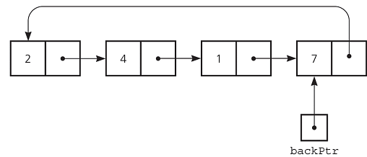
A circular linked list with one external pointer
Queue Operations
constructor ?
isEmpty ?
enqueue ?
dequeue ?
getFront ?

Slide 24
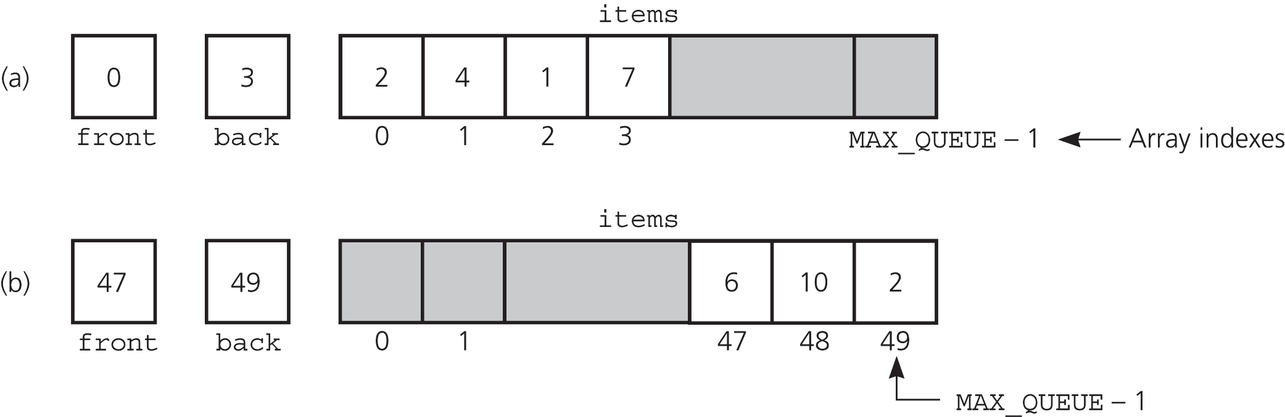
A Naive Array-Based Implementation of Queue
Rightward drift can cause the queue to appear full even
though the queue contains few entries.
We may shift the elements to left in order to compensate
for rightward drift, but shifting is expensive
Solution: A circular array eliminates rightward drift.

Slide 25
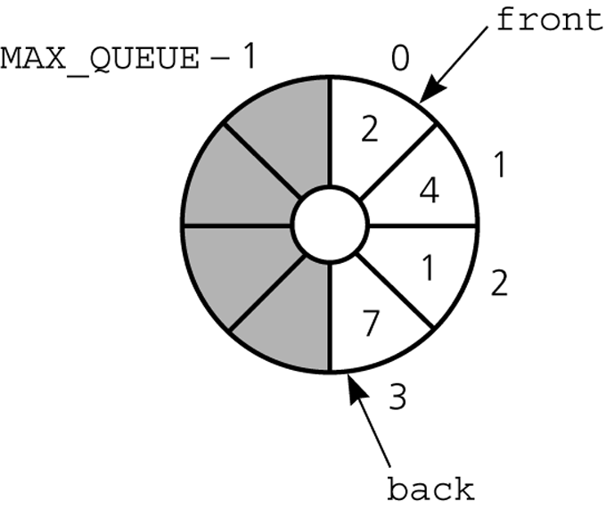
A Circular Array-Based Implementation
When either front or back
advances past MAX_QUEUE-1
it wraps around to 0.

Slide 26
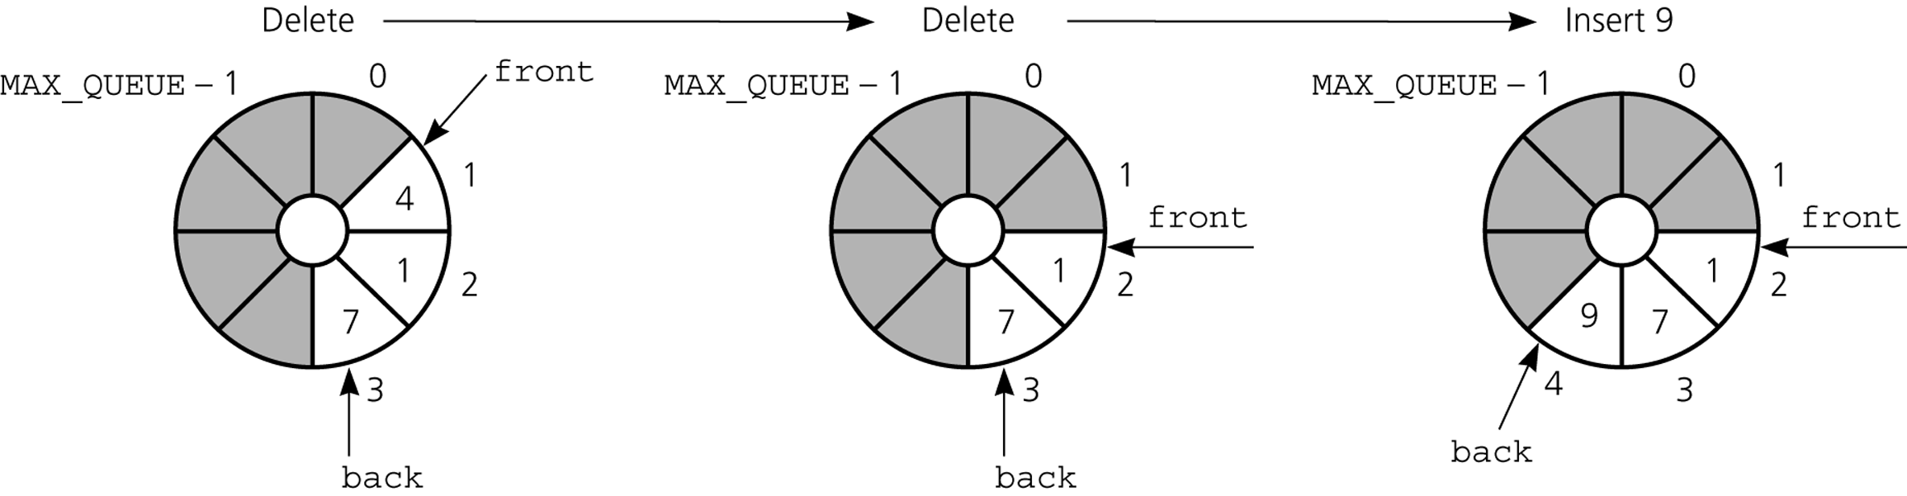
The effect of some operations of the queue
Initialize: front=0; back=MAX_QUEUE-1;
Insertion : back = (back+1) % MAX_QUEUE;
items[back] = newItem;
Deletion : front = (front+1) % MAX_QUEUE;
NOT ENOUGH

Slide 27
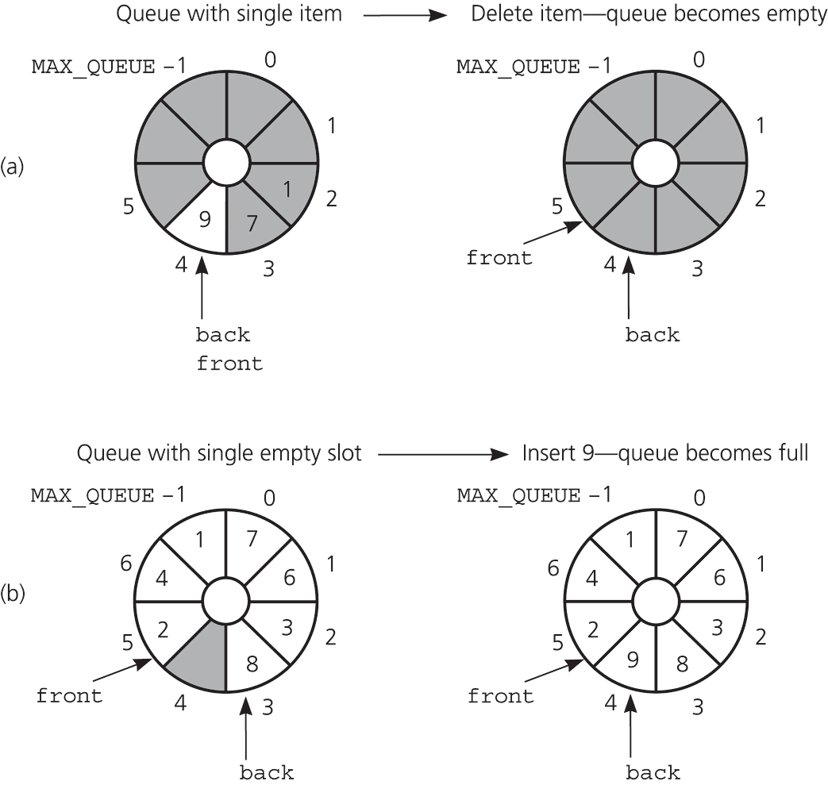
PROBLEM – Queue is Empty or Full
front and back cannot be used
to distinguish between queue-full
and queue-empty conditions.
? Empty
(back+1)%MAX_QUEUE == front
? Full
(back+1)%MAX_QUEUE == front
So, we need extra mechanism to
distinguish between queue-full
and queue-empty conditions.

Slide 28
Solutions for Queue-Empty/Queue-Full Problem
Using a counter to keep the number items in the queue.
  Initialize count to 0 during creation; Increment count by 1 during insertion; Decrement count by 1 during deletion.
  count=0 ➔ empty; count=MAX_QUEUE ➔ full
Using isFull flag to distinguish between the full and empty conditions.
  When the queue becomes full, set isFullFlag to true; When the queue is not full set isFull flag to false;
Using an extra array location (and leaving at least one empty location in the queue). ( MORE EFFICIENT )
  Declare MAX_QUEUE+1 locations for the array items, but only use MAX_QUEUE of them. We do not use one of the array locations.
  Full: front equals to (back+1)%(MAX_QUEUE+1)
  Empty: front equals to back

Slide 29
Using a counter
To initialize the queue, set
  front to 0
  back to MAX_QUEUE–1
  count to 0
Inserting into a queue
  back = (back+1) % MAX_QUEUE;
  items[back] = newItem;
  ++count;
Deleting from a queue
  front = (front+1) % MAX_QUEUE;
  --count;
Full: count == MAX_QUEUE
Empty: count == 0

Slide 30
Array-Based Implementation Using a counter – Header File
#include "QueueException.h"
const int MAX_QUEUE = maximum-size-of-queue;
template <class T>;
class Queue {
public:
Queue(); // default constructor
bool isEmpty() const;
void enqueue(const T& newItem) throw(QueueException);
void dequeue() throw(QueueException);
void dequeue(T& queueFront) throw(QueueException);
void getFront(T& queueFront) const throw(QueueException);
private:
T items[MAX_QUEUE];
int front;
int back;
int count;
};

Slide 31
Array-Based Implementation Using a counter – constructor, isEmpty
template<class T>
Queue<T>::Queue():front(0), back(MAX_QUEUE-1), count(0) {}
template<class T>
bool Queue<T>::isEmpty() const
{
return count == 0);
}

Slide 32
Array-Based Implementation Using a counter - enqueue
template<class T>
void Queue<T>::enqueue(const T& newItem) throw(QueueException) {
if (count == MAX_QUEUE)
throw QueueException("QueueException: queue full on enqueue");
else { // queue is not full; insert item
back = (back+1) % MAX_QUEUE;
items[back] = newItem;
++count;
}
}

Slide 33
Array-Based Implementation Using a counter –dequeue
template<classT>
void Queue<T>::dequeue() throw(QueueException) {
if (isEmpty())
throw QueueException("QueueException: empty queue, cannot dequeue");
else { // queue is not empty; remove front
front = (front+1) % MAX_QUEUE;
--count;
}}
void Queue::dequeue(T& queueFront) throw(QueueException) {
if (isEmpty())
throw QueueException("QueueException: empty queue, cannot dequeue");
else { // queue is not empty; retrieve and remove front
queueFront = items[front];
front = (front+1) % MAX_QUEUE;
--count;
}}

Slide 34
Array-Based Implementation Using a counter –getFront
template <class T>
void Queue<T>::getFront(T& queueFront) const throw(QueueException)
{
if (isEmpty())
throw QueueException("QueueException: empty queue, cannot getFront");
else
// queue is not empty; retrieve front
queueFront = items[front];
}

Slide 35
Using isFull flag
To initialize the queue, set
  front = 0; back = MAX_QUEUE–1; isFull = false;
Inserting into a queue
  back = (back+1) % MAX_QUEUE; items[back] = newItem;
  if ((back+1)%MAX_QUEUE == front)) isFull = true;
Deleting from a queue
  front = (front+1) % MAX_QUEUE;
  isFull = false;
Full: isFull == true
Empty: isFull==false && ((back+1)%MAX_QUEUE == front))

Slide 36
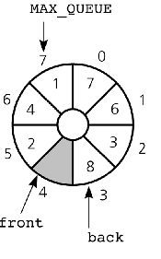
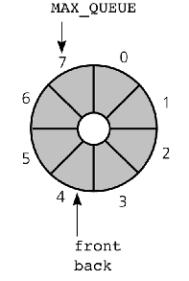
Using an extra array location
full queue
To initialize the queue, allocate (MAX_QUEUE+1) locations
  front=0; back=0;
front holds the index of the location before the front of the queue.
Inserting into a queue (if queue is not full)
  back = (back+1) % (MAX_QUEUE+1);
  items[back] = newItem;
Deleting from a queue (if queue is not empty)
  front = (front+1) % (MAX_QUEUE+1);
Full:
(back+1)%(MAX_QUEUE+1) == front
Empty:
front == back
empty queue

Slide 37
An Implementation That Uses the ADT List Class
If the item in first() of a list aList represents the front of the queue, the following implementations can be used
  dequeue()
    aList.remove(aList.first()->element)
  getFront(queueFront)
    aList.first()->element
If the item at the end of the list represents the back of the queue, the following implementations can be used
  enqueue(newItem)
    aList.insert(newItem, aList.lastNode())
Simple to implement, but inefficient.

Slide 38
Comparing Implementations
Fixed size versus dynamic size
  A statically allocated array
    Prevents the enqueue operation from adding an item to the queue if the array is full
  A resizable array or a reference-based implementation
    Does not impose this restriction on the enqueue operation
Pointer-based implementations
  A linked list implementation
    More efficient; no size limit
  The ADT list implementation
    Simpler to write; inefficient

Slide 39
A Summary of Position-Oriented ADTs
Position-oriented ADTs: List, Stack, Queue
Stacks and Queues
  Only the end positions can be accessed
Lists
  All positions can be accessed
Stacks and queues are very similar
  Operations of stacks and queues can be paired off as
    createStack and createQueue
    Stack isEmpty and queue isEmpty
    push and enqueue
    pop and dequeue
    Stack getTop and queue getFront
ADT list operations generalize stack and queue operations
  insert, remove, first()

Slide 40
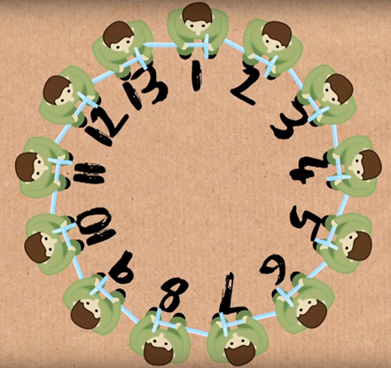
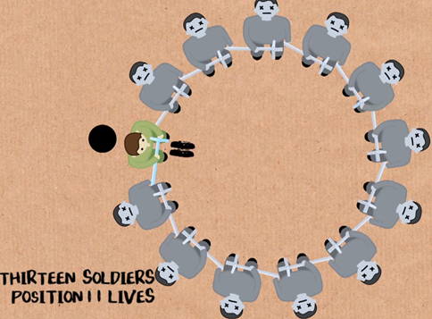
Application: Josephus Problem
N men. Circular arrangement. Kill every second. Where to sit to survive?
History: N men surrounded by enemies. Preferred suicide rather than captured as slaves. Every men killed the next living men until 1 man is left. That guy (Josephus) then surrendered (did not tell this initially ‘cos others’d turn on him)

Slide 41
Application: Josephus Problem
N men. Circular arrangement. Kill every second. Where to sit to survive?
List winners/survivors for each N to see a pattern
  N W(N)
  1 1
  2 1
  3 3
  4 1
  5 3
  6 5
  7 7
  8 1
  9 3
  10 5
  11 7
  12 9
  13 11
  14 13
  15 15
  16 1
  17 3

Slide 42
Application: Josephus Problem
N men. Circular arrangement. Kill every second. Where to sit to survive?
List winners/survivors for each N to see a pattern
  N W(N)
  1 1
  2 1
  3 3
  4 1 Pattern # 1
  5 3 Winner always odd!
  6 5 Makes sense as the first loop kills all the evens
  7 7
  8 1
  9 3
  10 5
  11 7
  12 9
  13 11
  14 13
  15 15
  16 1
  17 3

Slide 43
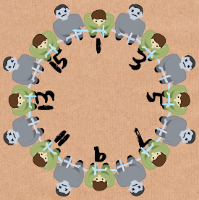
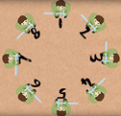
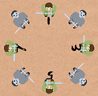
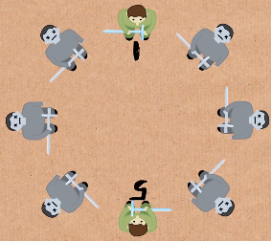
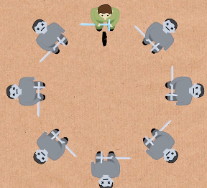
Application: Josephus Problem
N men. Circular arrangement. Kill every second. Where to sit to survive?
List winners/survivors for each N to see a pattern
  N W(N)
  1 1
  2 1
  3 3
  4 1 Pattern # 2
  5 3 Jump by 2; reset at 2ª for some a!
  6 5 Makes sense: Assume 2ª men in circle. 1 pass
  7 7 removes half of them; at 1; repeat on 2^{a-1} men; so
  8 1 winner is the starting point (1)
  9 3
  10 5
  11 7
  12 9
  13 11
  14 13
  15 15
  16 1
  17 3

Slide 44
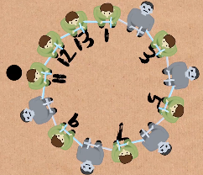
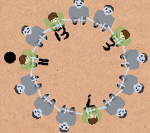
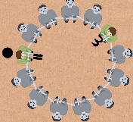
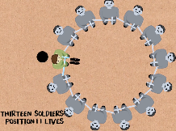
Application: Josephus Problem
N men. Circular arrangement. Kill every second. Where to sit to survive?
List winners/survivors for each N to see a pattern
  N W(N)
  1 1
  2 1
  3 3
  4 1 Pattern # 2 (cont’d)
  5 3 Jump by 2; reset at 2ª for some a!
  6 5 Makes sense: Assume 2ª + b men in circle, where a
  7 7 is the biggest possible power; hence b < 2ª (binary
  8 1 notation idea); after b men we are left with 2ª men,
  9 3 whose winner is the starting point (11 for below)
  10 5
  11 7
  12 9
  13 11
  14 13
  15 15
  16 1
  17 3
8 left
4 left
2 left
1 left

Slide 45
Application: Josephus Problem
N men. Circular arrangement. Kill every second. Where to sit to survive?
List winners/survivors for each N to see a pattern
  N W(N)
  1 1
  2 1
  3 3
  4 1 Pattern # 2 (cont’d)
  5 3 Jump by 2; reset at 2ª for some a!
  6 5 So what is 11 for N=13?
  7 7 N = 2³ + 5 (a=3, b=5); and 11 = 2*5 + 1
  8 1 In general, after b steps, we arrive at the
  9 3 position 2*b + 1 (every 2nd is killed). Hence,
  10 5
  11 7
  12 9
  13 11
  14 13
  15 15
  16 1
  17 3
W(N) = 2*b + 1
where N = 2ª + b and b < 2ª
8 left
4 left
2 left
1 left

Slide 46
Application: Josephus Problem
Based on W(N) = 2*b + 1 where N = 2ª + b and b < 2ª we can write a simple program that returns the winner/survivor index
int W(int N) {
}

Slide 47
Application: Josephus Problem
Based on W(N) = 2*b + 1 where N = 2ª + b and b < 2ª we can write a simple program that returns the winner/survivor index
int W(int N) {
int a = 0;
while (N > 1) {
N /= 2;
a++;
}
return 2*(N – pow(2, a)) + 1;
//or you could compute pow(2, a) in variable V like this:
//int V = 1; for (int i = 0; i < a; i++) V *= 2;
}

Slide 48
Application: Josephus Problem
Based on W(N) = 2*b + 1 where N = 2ª + b and b < 2ª we can write a simple program that returns the winner/survivor index
If you do not like math and cannot extract W(N) above, you can write the code using a Queue
Math gets way complicated for the generic problem where you kill every k^{th} man where k > 1
int Josephus(Q, k) { //Queue Q is built in advance with e.g., 1, 2, 3, 4, 5, 6.
}

Slide 49
Application: Josephus Problem
Based on W(N) = 2*b + 1 where N = 2ª + b and b < 2ª we can write a simple program that returns the winner/survivor index
If you do not like math and cannot extract W(N) above, you can write the code using a Queue
Math gets way complicated for the generic problem where you kill every k^{th} man where k > 1
int Josephus(Q, k) { //Queue Q is built in advance with e.g., 1, 2, 3, 4, 5, 6.
while (Q.size() > 1) {
for (i = 1; i <= k-1; i++) //skip the k-1 men without killing
Q.enqueue( Q.dequeue() );
killed = Q.dequeue();
}
return Q.dequeue(); } //only one left in the Q, the winner ☺

Slide 50
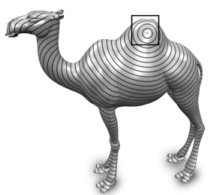

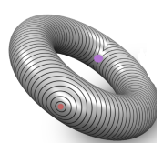
Example: BFS
Breadth-First Search
  To be explored while discussing Graphs
  Key search algorithm to explore graphs, e.g., network of people like Facebook

Slide 51
Summary
The definition of the queue operations gives the ADT queue first-in, first-out (FIFO) behavior
A pointer-based implementation of a queue uses either
  A circular linked list
  A linear linked list with a front reference and a back reference
A circular array eliminates the problem of rightward drift in an array-based implementation
  Distinguishing between the queue-full and queue-empty conditions in a circular array
    Count the number of items in the queue
    Use a isFull flag
    Leave one array location empty

