Slide 1
Maps

Slide 2
Maps
A map models a searchable collection of key-value entries
The main operations of a map are for searching, inserting, and deleting items
Multiple entries with the same key are not allowed
Applications:
address book (yellowpage)
student-record database

Slide 3
Entry ADT
An entry stores a key-value pair (k,v)
Methods:
key(): return the associated key
value(): return the associated value
setKey(k): set the key to k
setValue(v): set the value to v
We call this “item” or “element” or “record” exchangeably.
Then, MAP stores multiple a collection of Entries

Slide 4

The Map ADT
find(k): if the map M has an entry with key k, return and iterator to it; else, return special iterator end
put(k, v): if there is no entry with key k, insert entry (k, v), and otherwise set its value to v. Return an iterator to the new/modified entry
erase(k): if the map M has an entry with key k, remove it from M
size(), empty()
begin(), end(): return iterators to beginning and end of M
Important Issue? Using what data structure and algorithm, we implement Map?

Slide 5
Example
Operation Output Map
empty() true Ø
put(5,A) [(5,A)] (5,A)
put(7,B) [(7,B)] (5,A),(7,B)
put(2,C) [(2,C)] (5,A),(7,B),(2,C)
put(8,D) [(8,D)] (5,A),(7,B),(2,C),(8,D)
put(2,E) [(2,E)] (5,A),(7,B),(2,E),(8,D)
find(7) [(7,B)] (5,A),(7,B),(2,E),(8,D)
find(4) end (5,A),(7,B),(2,E),(8,D)
find(2) [(2,E)] (5,A),(7,B),(2,E),(8,D)
size() 4 (5,A),(7,B),(2,E),(8,D)
erase(5) — (7,B),(2,E),(8,D)
erase(2) — (7,B),(8,D)
find(2) end (7,B),(8,D)
empty() false (7,B),(8,D)

Slide 6
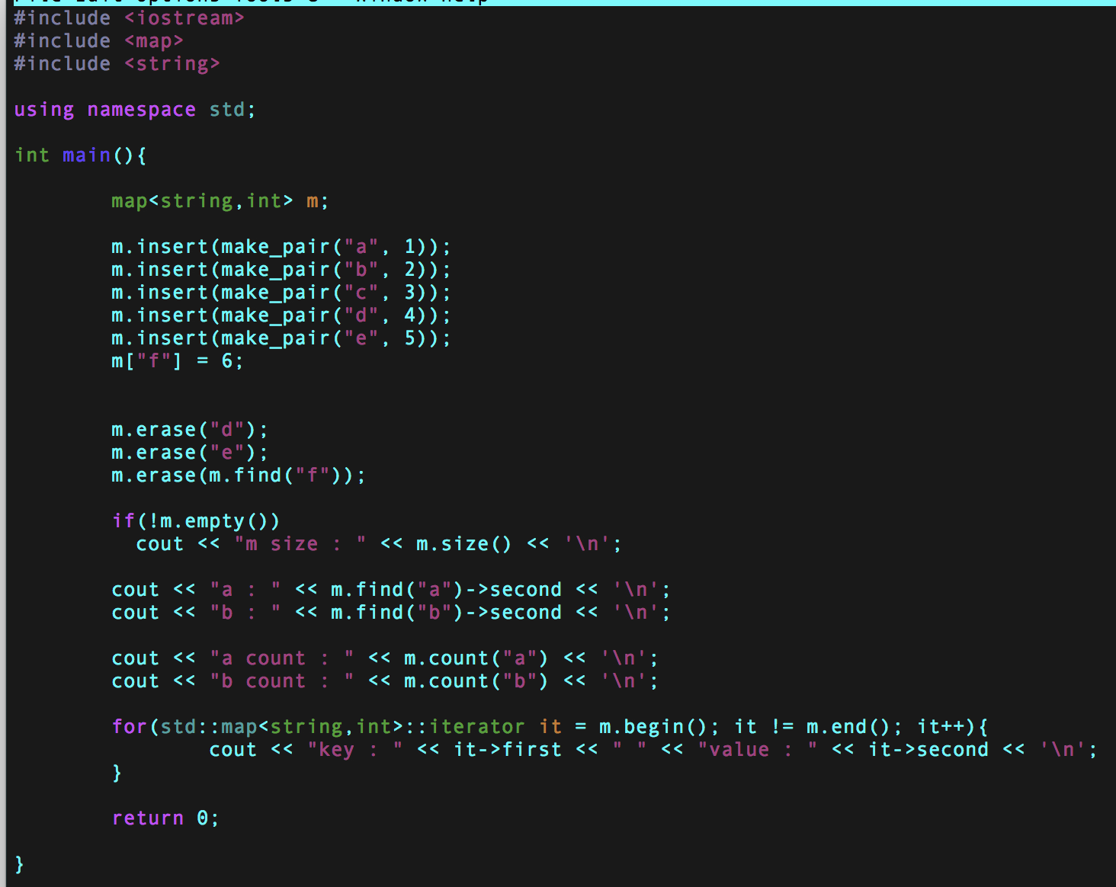
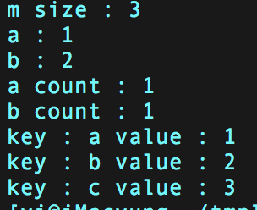
map in C++

Slide 7
A Simple List-Based Map
An easiest way of implementing Map
We can efficiently implement a map using an unsorted list
We store the items of the map in a list S (based on a doubly-linked list), in arbitrary order
header
nodes/positions
trailer
9
c
6
c
5
c
8
c
entries

Slide 8
The find Algorithm
Algorithm find(k):
for each p in [S.begin(), S.end()) do
if p→key() = k then
return p
return S.end() {there is no entry with key equal to k}
We use p→key() as a shortcut for (*p).key()

Slide 9
The put Algorithm
Algorithm put(k,v):
for each p in [S.begin(), S.end()) do
if p→key() = k then
p→setValue(v)
return p
p = S.insertBack((k,v)) {there is no entry with key k}
n = n + 1 {increment number of entries}
return p

Slide 10
The erase Algorithm
Algorithm erase(k):
for each p in [S.begin(), S.end()) do
if p.key() = k then
S.erase(p)
n = n – 1 {decrement number of entries}

Slide 11
Performance of a List-Based Map
Performance:
put takes O(n) time since we need to determine whether it is already in the sequence
find and erase take O(n) time since in the worst case (the item is not found) we traverse the entire sequence to look for an item with the given key
The unsorted list implementation is effective only for maps of small size or for maps in which puts are the most common operations, while searches and removals are rarely performed (e.g., historical record of logins to a workstation)
Can we improve?

Slide 12
Hash Tables
0
∅
1
025-612-0001
2
981-101-0002
3
∅
4
451-229-0004

Slide 13
Recall the Map ADT
find(k): if the map M has an entry with key k, return its associated value; else, return null
put(k, v): insert entry (k, v) into the map M; if key k is not already in M, then return null; else, return old value associated with k
erase(k): if the map M has an entry with key k, remove it from M and return its associated value; else, return null
size(), empty()
entrySet(): return a list of the entries in M
keySet(): return a list of the keys in M
values(): return a list of the values in M

Slide 14
What about this idea?
We design a table for a map storing entries as (SSN, Name), where SSN (social security number) is a nine-digit positive integer
Our table uses an array of size N = 10,000 and classify each person based on the last four digits of his/her SSN
Do you think that we can speed up searching using this method?
0
∅
1
025-612-0001
2
981-101-0002
3
∅
4
451-229-0004
…
9997
∅
9998
200-751-9998
9999
∅

Slide 15
Hash Table: Overview
Use key as an “address” for a value
Worst-case performance: still O(n)
But, usually expected performance: O(1)
Practically very fast
Consists of two major components
1. Bucket array
2. Hash function

Slide 16
Bucket Array
An array of size N, where each cell of A is “bucket”
Two Issues
How to choose the bucket size N?
Large N?
Small N?
Keys should be integers, but in practice, not always.
Key: string “yiyung”
Bucket
0
∅
1
025-612-0001
2
981-101-0002
3
∅
4
451-229-0004
…
9997
∅
9998
200-751-9998
9999
∅

Slide 17
Hash Functions and Hash Tables
A hash function h maps keys of a given type to integers in a fixed interval [0, N - 1]
Example: h(x) = x mod N is a hash function for integer keys
The integer h(x) is called the hash value of key x
A hash table for a given key type consists of
Hash function h
Array (called table or bucket array) of size N
When implementing a map with a hash table, the goal is to store item (k, o) at index i = h(k)

Slide 18
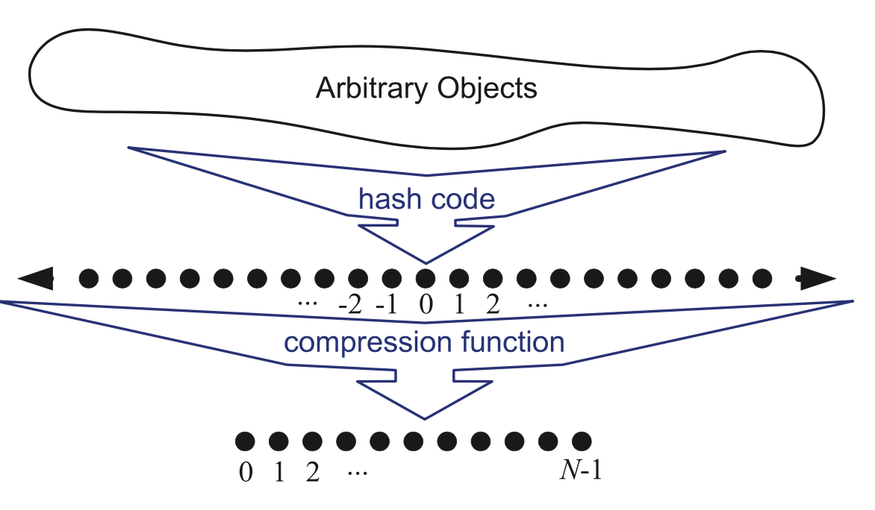
Hash Functions
A hash function is usually specified as the composition of two functions:
Hash code: h₁: keys → integers
Compression function: h₂: integers → [0, N - 1]
(Note) Keys can be arbitrary objects, e.g., string “yiyung”
The hash code is applied first, and the compression function is applied next on the result, i.e., h(x) = h₂(h₁(x))
The goal of the hash function is to “disperse” the keys in an apparently random way

Slide 19
Hash Code and Compress Function
There are extensive theoretical and experiment research about “good” hash code and compress functions
In the next 3 slides,
We will discuss some basic hash codes and compress functions.
Looking at their more details is not the beyond of our scope.

Slide 20
(1) Hash Codes
Memory address:
We reinterpret the memory address of the key object as an integer
Integer cast:
We reinterpret the bits of the key as an integer
Suitable for keys of length less than or equal to the number of bits of the integer type (e.g., byte, short, int and float in C++)
Component sum:
We partition the bits of the key into components of fixed length (e.g., 16 or 32 bits) and we sum the components (ignoring overflows)
Suitable for numeric keys of fixed length greater than or equal to the number of bits of the integer type (e.g., long and double in C++)
But, not good for strings
“temp01” and “temp10”
“stop”, “tops”, “pots”, “spot”

Slide 21
Polynomial Hash Code
Polynomial accumulation:
We partition the bits of the key into a sequence of components of fixed length (e.g., 8, 16 or 32 bits) a₀ a₁ … a_{n-1}
We evaluate the polynomial
p(z) = a₀ + a₁ z + a₂ z² + … … + a_{n-1}z^{n-1}
at a fixed value z, ignoring overflows
Especially suitable for strings (e.g., the choice z = 33 gives at most 6 collisions on a set of 50,000 English words)
Polynomial p(z) can be evaluated in O(n) time using Horner’s rule:
The following polynomials are successively computed, each from the previous one in O(1) time
p₀(z) = a_{n-1}
p_{i} (z) = a_{n-i-1} + zp_{i-1}(z) (i = 1, 2, …, n -1)
We have p(z) = p_{n-1}(z)
Lots of research about “good hash code”

Slide 22
(2) Compression Functions
Division:
h₂ (y) = |y| mod N
The size N of the hash table is usually chosen to be a prime
The reason has to do with number theory and is beyond the scope of this course
Multiply, Add and Divide (MAD):
h₂ (y) = |ay + b| mod N
a and b are nonnegative integers such that a mod N ≠ 0
Otherwise, every integer would map to the same value b

Slide 23
Collision Handling
0
∅
Insert the entry:
032-637-0004
1
025-612-0001
2
981-101-0002
3
∅
4
451-229-0004
…
9997
∅
9998
200-751-9998
9999
∅
Collisions occur when different elements are mapped to the same cell

Slide 24
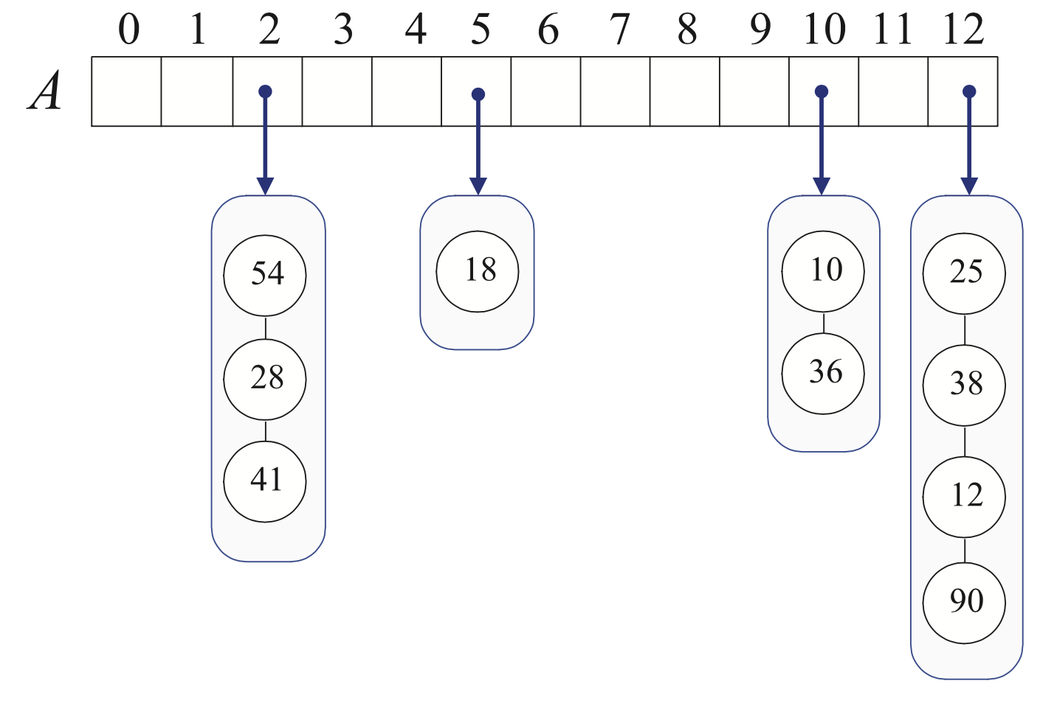
Collision Handling
Separate Chaining: let each cell in the table point to a linked list of entries that map there
Separate chaining is simple, but requires additional memory outside the table
h(y) = y mod 13

Slide 25
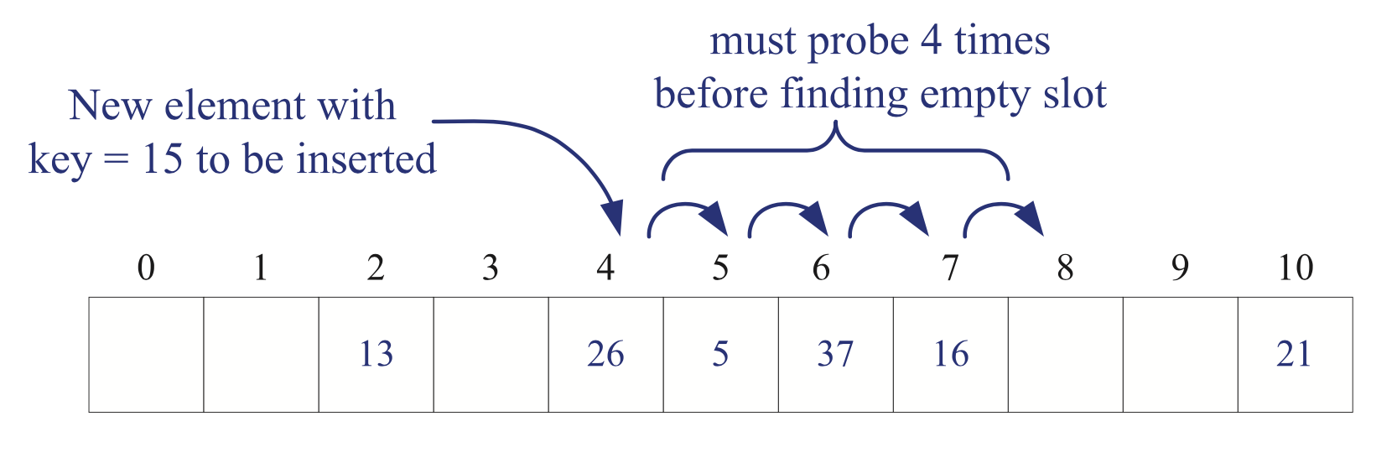
Open Addressing: Linear Probing
Open addressing: the colliding item is placed in a different cell of the table
Linear probing: handles collisions by placing the colliding item in the next (circularly) available table cell
Each table cell inspected is referred to as a “probe”
Colliding items lump together, causing future collisions to cause a longer sequence of probes
h(x) = x mod 11

Slide 26
Linear Probing: Example
Example:
h(x) = x mod 13
Insert keys 18, 41, 22, 44, 59, 32, 31, 73, in this order
0
1
2
3
4
5
6
7
8
9
10
11
12
41
18
44
59
32
22
31
73
0
1
2
3
4
5
6
7
8
9
10
11
12

Slide 27
Search with Linear Probing
Consider a hash table A that uses linear probing
find(k)
We start at cell h(k)
We probe consecutive locations until one of the following occurs
An item with key k is found, or
An empty cell is found, or
N cells have been unsuccessfully probed
Algorithm find(k)
i ← h(k)
p ← 0
repeat
c ← A[i]
if c = ∅
return null
else if c.key () = k
return c.value()
else
i ← (i + 1) mod N
p ← p + 1
until p = N
return null

Slide 28
Updates with Linear Probing
To handle insertions and deletions, we introduce a special marker, called AVAILABLE, which replaces deleted elements
Avoids a lot of shift operations
erase(k)
We search for an entry with key k
If such an entry (k, o) is found, we replace it with the special item AVAILABLE and we return element o
Else, we return null
put(k, o)
We throw an exception if the table is full
We start at cell h(k)
We probe consecutive cells until one of the following occurs
A cell i is found that is either empty or stores AVAILABLE, or
N cells have been unsuccessfully probed
We store (k, o) in cell i

Slide 29
Other Issues
Search with Linear Probing
Clustering problem
Other open addressing method
Quadratic Probing, Double Hashing (the details in the book)
The load factor a = n/N affects the performance of a hash table
Keeping the load factor below a certain threshold is vital
Open addressing (requires a < 0.5)
Separate-chaining (requires a < 0.9)
Resize the hash table, i.e., rehashing a new table

Slide 30
Performance of Hashing
In the worst case, searches, insertions and removals on a hash table take O(n) time
The worst case occurs when all the keys inserted into the map collide
The load factor a = n/N
Assuming that the hash values are like random numbers, it can be shown that the expected number of probes for an insertion with open addressing is 1 / (1 - a)
But, when well designed, the expected running time of all the MAP ADT operations in a hash table is O(1)
In practice, hashing is very fast provided the load factor is not close to 100%

