Slide 1
Recurrences and Running Time

Slide 2
Recurrences and Running Time
An equation or inequality that describes a function in terms of its value on smaller inputs.
T(n) = T(n-1) + n
Recurrences arise when an algorithm contains recursive calls to itself
What is the actual running time of the algorithm?
Need to solve the recurrence
Find an explicit formula of the expression
Bound the recurrence by an expression that involves n

Slide 3
Example Recurrences
T(n) = T(n-1) + n Θ(n²)
Recursive algorithm that loops through the input to eliminate one item
T(n) = T(n/2) + c Θ(lgn)
Recursive algorithm that halves the input in one step
T(n) = T(n/2) + n Θ(n)
Recursive algorithm that halves the input but must examine every item in the input
T(n) = 2T(n/2) + 1 Θ(n)
Recursive algorithm that splits the input into 2 halves and does a constant amount of other work

Slide 4
Methods for Solving Recurrences
Iteration method
Substitution method
Recursion tree method
Master method

Slide 5
The Iteration Method
Convert the recurrence into a summation and try to bound it using known series
Iterate the recurrence until the initial condition is reached.
Use back-substitution to express the recurrence in terms of n and the initial (boundary) condition.

Slide 6
The Iteration Method
T(n) = c + T(n/2)
T(n) = c + T(n/2)
= c + c + T(n/4)
= c + c + c + T(n/8)
Assume n = 2^{k}
T(n) = c + c + … + c + T(1)
= clgn + T(1)
= Θ(lgn)
T(n/2) = c + T(n/4)
T(n/4) = c + T(n/8)
k times

Slide 7
Iteration Method – Example
T(n) = n + 2T(n/2)
T(n) = n + 2T(n/2)
= n + 2(n/2 + 2T(n/4))
= n + n + 4T(n/4)
= n + n + 4(n/4 + 2T(n/8))
= n + n + n + 8T(n/8)
… = in + 2^{i}T(n/2^{i})
= kn + 2^{k}T(1)
= nlgn + nT(1) = Θ(nlgn)
Assume: n = 2^{k}
T(n/2) = n/2 + 2T(n/4)

Slide 8
The substitution method
Guess a solution
Use induction to prove that the solution works

Slide 9
Substitution method
Guess a solution
T(n) = O(g(n))
Induction goal: apply the definition of the asymptotic notation
T(n) ≤ d g(n), for some d > 0 and n ≥ n₀
Induction hypothesis: T(k) ≤ d g(k) for all k < n
Prove the induction goal
Use the induction hypothesis to find some values of the constants d and n₀ for which the induction goal holds
(strong induction)

Slide 10
Example: Binary Search
T(n) = c + T(n/2)
Guess: T(n) = O(lgn)
Induction goal: T(n) ≤ d lgn, for some d and n ≥ n₀
Induction hypothesis: T(n/2) ≤ d lg(n/2)
Proof of induction goal:
T(n) = T(n/2) + c ≤ d lg(n/2) + c
= d lgn – d + c ≤ d lgn
if: – d + c ≤ 0, d ≥ c

Slide 11
Example 2
T(n) = T(n-1) + n
Guess: T(n) = O(n²)
Induction goal: T(n) ≤ c n², for some c and n ≥ n₀
Induction hypothesis: T(n-1) ≤ c(n-1)² for all k < n
Proof of induction goal:
T(n) = T(n-1) + n ≤ c (n-1)² + n
= cn² – (2cn – c - n) ≤ cn²
if: 2cn – c – n ≥ 0 ⇔ c ≥ n/(2n-1) ⇔ c ≥ 1/(2 – 1/n)
For n ≥ 1 ⇒ 2 – 1/n ≥ 1 ⇒ any c ≥ 1 will work

Slide 12
Example 3
T(n) = 2T(n/2) + n
Guess: T(n) = O(nlgn)
Induction goal: T(n) ≤ cn lgn, for some c and n ≥ n₀
Induction hypothesis: T(n/2) ≤ cn/2 lg(n/2)
Proof of induction goal:
T(n) = 2T(n/2) + n ≤ 2c (n/2)lg(n/2) + n
= cn lgn – cn + n ≤ cn lgn
if: - cn + n ≤ 0 ⇒ c ≥ 1

Slide 13
Changing variables
T(n) = 2T( ) + lgn
Rename: m = lgn ⇒ n = 2^{m}
T (2^{m}) = 2T(2^{m/2}) + m
Rename: S(m) = T(2^{m})
S(m) = 2S(m/2) + m ⇒ S(m) = O(mlgm) (demonstrated before)
T(n) = T(2^{m}) = S(m) = O(mlgm)=O(lgnlglgn)
Idea: transform the recurrence to one that you have seen before

Slide 14
The recursion-tree method
Convert the recurrence into a tree:
Each node represents the cost incurred at various levels of recursion
Sum up the costs of all levels
Used to “guess” a solution for the recurrence

Slide 15
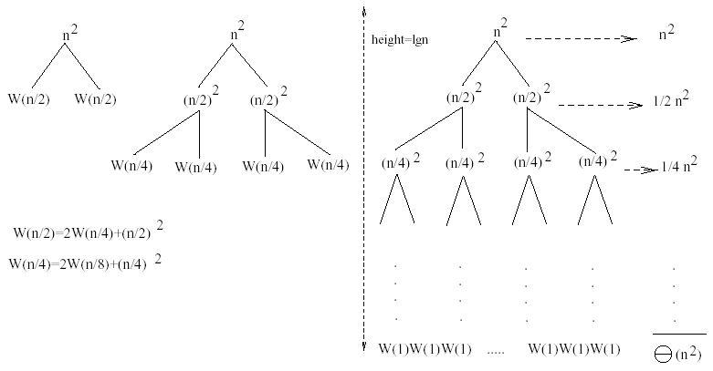
Example 1
W(n) = 2W(n/2) + n²
Subproblem size at level i is: n/2^{i}
Subproblem size hits 1 when 1 = n/2^{i} ⇒ i = lgn
Cost of the problem at level i = (n/2^{i})² No. of nodes at level i = 2^{i}
Total cost:
⇒ W(n) = O(n²)

Slide 16
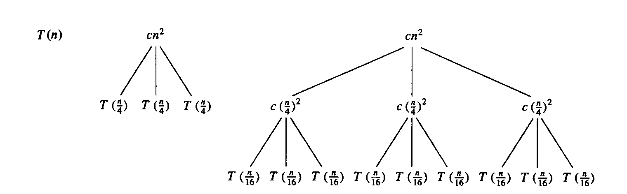
Example 2
E.g.: T(n) = 3T(n/4) + cn²
Subproblem size at level i is: n/4^{i}
Subproblem size hits 1 when 1 = n/4^{i} ⇒ i = log₄n
Cost of a node at level i = c(n/4^{i})²
Number of nodes at level i = 3^{i} ⇒ last level has 3^{log}₄^{n} = n^{log}₄³ nodes
Total cost:
⇒ T(n) = O(n²)

Slide 17
Example 2 - Substitution
T(n) = 3T(n/4) + cn²
Guess: T(n) = O(n²)
Induction goal: T(n) ≤ dn², for some d and n ≥ n₀
Induction hypothesis: T(n/4) ≤ d (n/4)²
Proof of induction goal:
T(n) = 3T(n/4) + cn²
≤ 3d (n/4)² + cn²
= (3/16) d n² + cn²
≤ d n² if: d ≥ (16/13)c
Therefore: T(n) = O(n²)

Slide 18
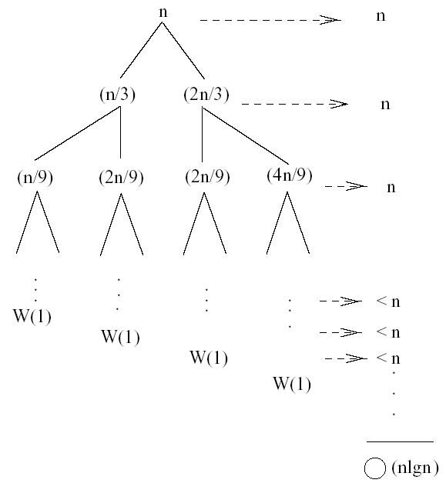
Example 3 (simpler proof)
W(n) = W(n/3) + W(2n/3) + n
The longest path from the root to a leaf is: n → (2/3)n → (2/3)² n → … → 1
Subproblem size hits 1 when 1 = (2/3)^{i}n ⇔ i=log_{3/2}n
Cost of the problem at level i = n
Total cost:
⇒ W(n) = O(nlgn)

Slide 19
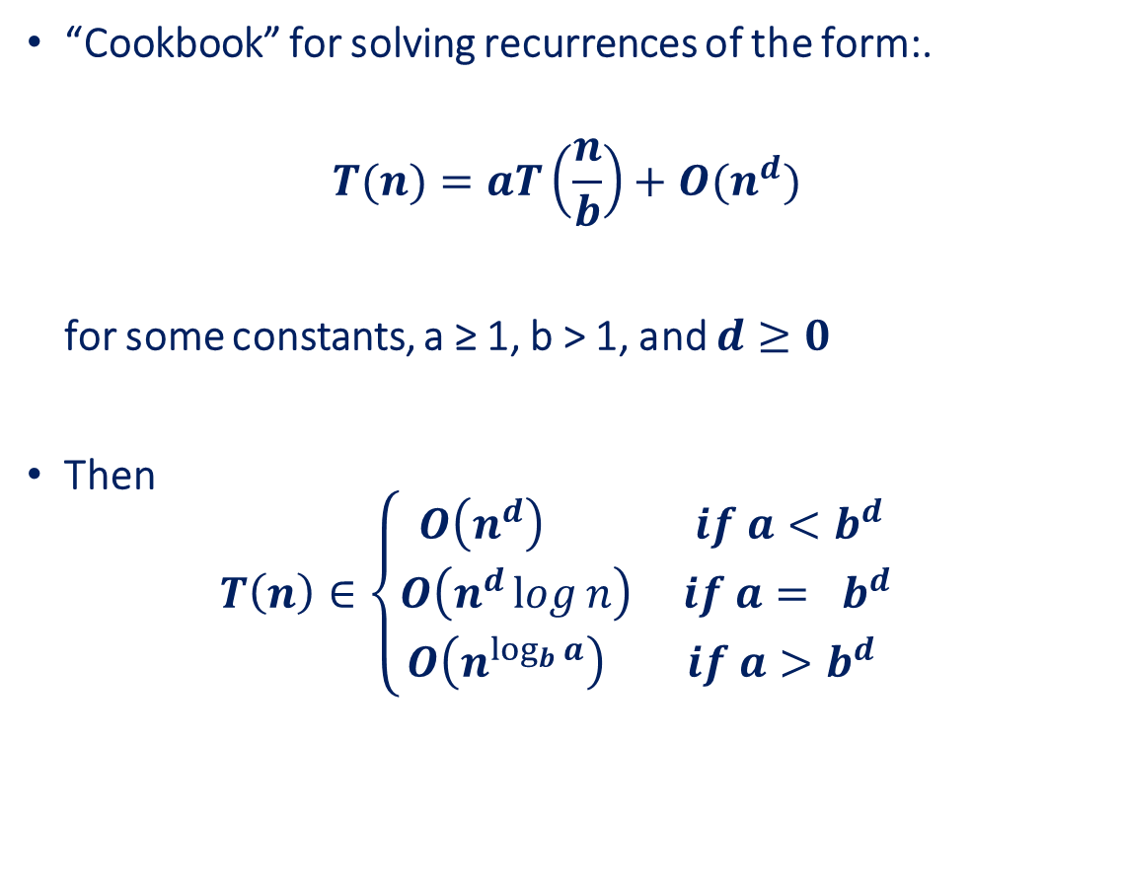
Master’s method
“Cookbook” for solving recurrences of the form:.
$$T(n)=aT\left(\frac{n}{b}\right)+O(n^{d})$$
for some constants, a ≥ 1, b > 1, and $d≥0$
Then
$$T\left(n\right)∈\left\{\begin{aligned}O\left(n^{d}\right) if a<b^{d} \\ O\left(n^{d}\log{n}\right) if a= b^{d} \\ O\left(n^{\log_{b}{a}}\right) if a>b^{d} \end{aligned}\right.$$

Slide 20
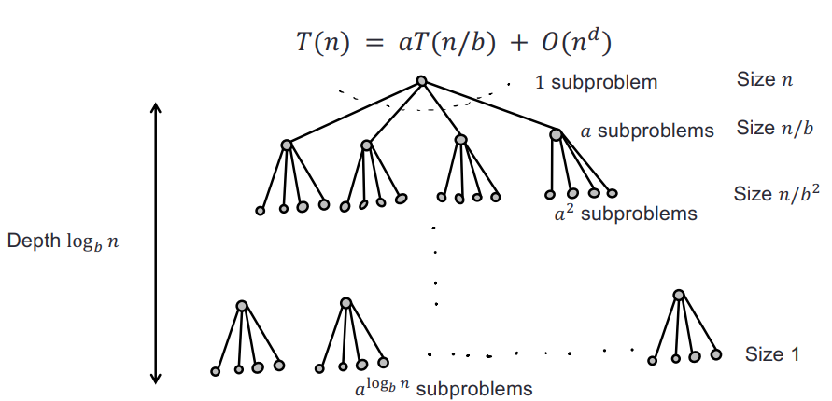
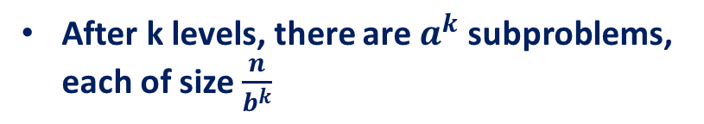

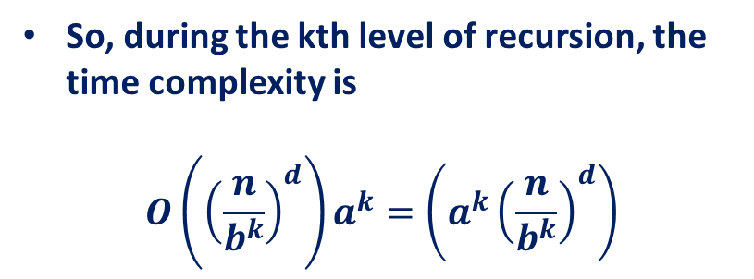
Master Theorem: Solving the recurrence
After k levels, there are $a^{k}$ subproblems, each of size $\frac{n}{b^{k}}$
So, during the kth level of recursion, the time complexity is
$$O\left({\left(\frac{n}{b^{k}}\right)}^{d}\right)a^{k}=\left(a^{k}{\left(\frac{n}{b^{k}}\right)}^{d}\right)$$
$$=O\left(n^{d}{\left(\frac{a}{b^{d}}\right)}^{k}\right)$$

Slide 21
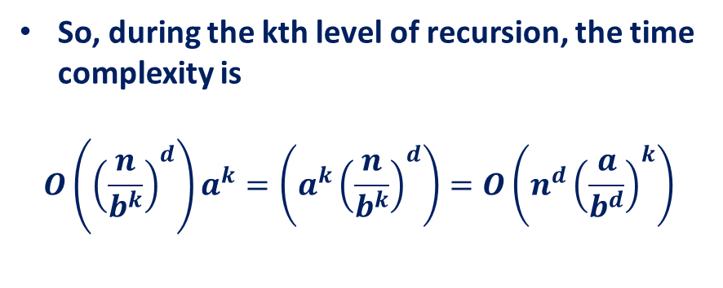
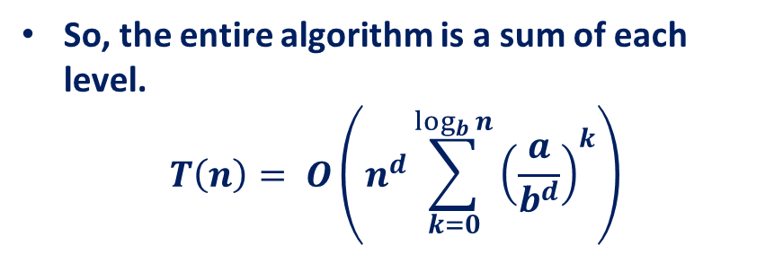
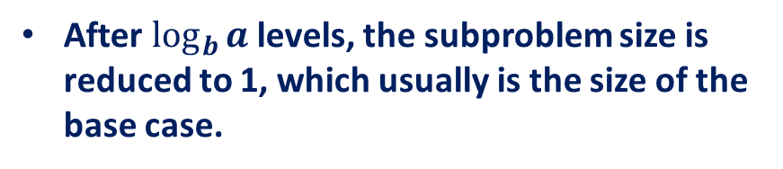
Master Theorem: Solving the recurrence
So, during the kth level of recursion, the time complexity is
$$O\left({\left(\frac{n}{b^{k}}\right)}^{d}\right)a^{k}=\left(a^{k}{\left(\frac{n}{b^{k}}\right)}^{d}\right)=O\left(n^{d}{\left(\frac{a}{b^{d}}\right)}^{k}\right)$$
After $\log_{b}{a}$ levels, the subproblem size is reduced to 1, which usually is the size of the base case.
So, the entire algorithm is a sum of each level.
$$T\left(n\right)= O\left(n^{d}\sum_{k=0}^{\log_{b}{n}}{{\left(\frac{a}{b^{d}}\right)}^{k}}\right)$$

Slide 22
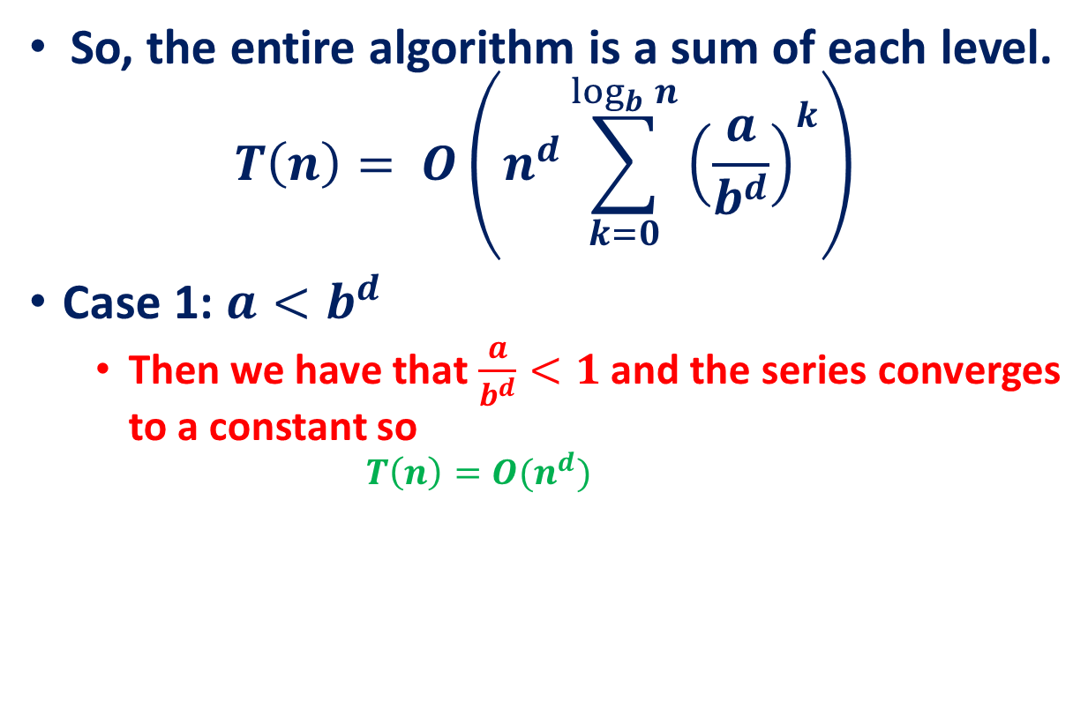
Master Theorem: Solving the recurrence
So, the entire algorithm is a sum of each level.
$$T\left(n\right)= O\left(n^{d}\sum_{k=0}^{\log_{b}{n}}{{\left(\frac{a}{b^{d}}\right)}^{k}}\right)$$
Case 1: $a<b^{d}$
Then we have that $\frac{a}{b^{d}}<1$ and the series converges to a constant so
$$T\left(n\right)=O(n^{d})$$

Slide 23
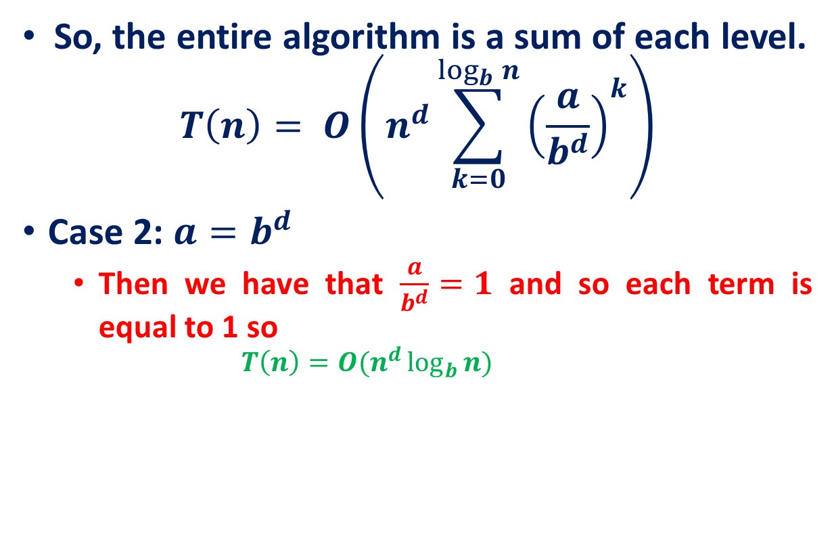
Master Theorem: Solving the recurrence
So, the entire algorithm is a sum of each level.
$$T\left(n\right)= O\left(n^{d}\sum_{k=0}^{\log_{b}{n}}{{\left(\frac{a}{b^{d}}\right)}^{k}}\right)$$
Case 2: $a=b^{d}$
Then we have that $\frac{a}{b^{d}}=1$ and so each term is equal to 1 so
$$T\left(n\right)=O(n^{d}\log_{b}{n})$$

Slide 24
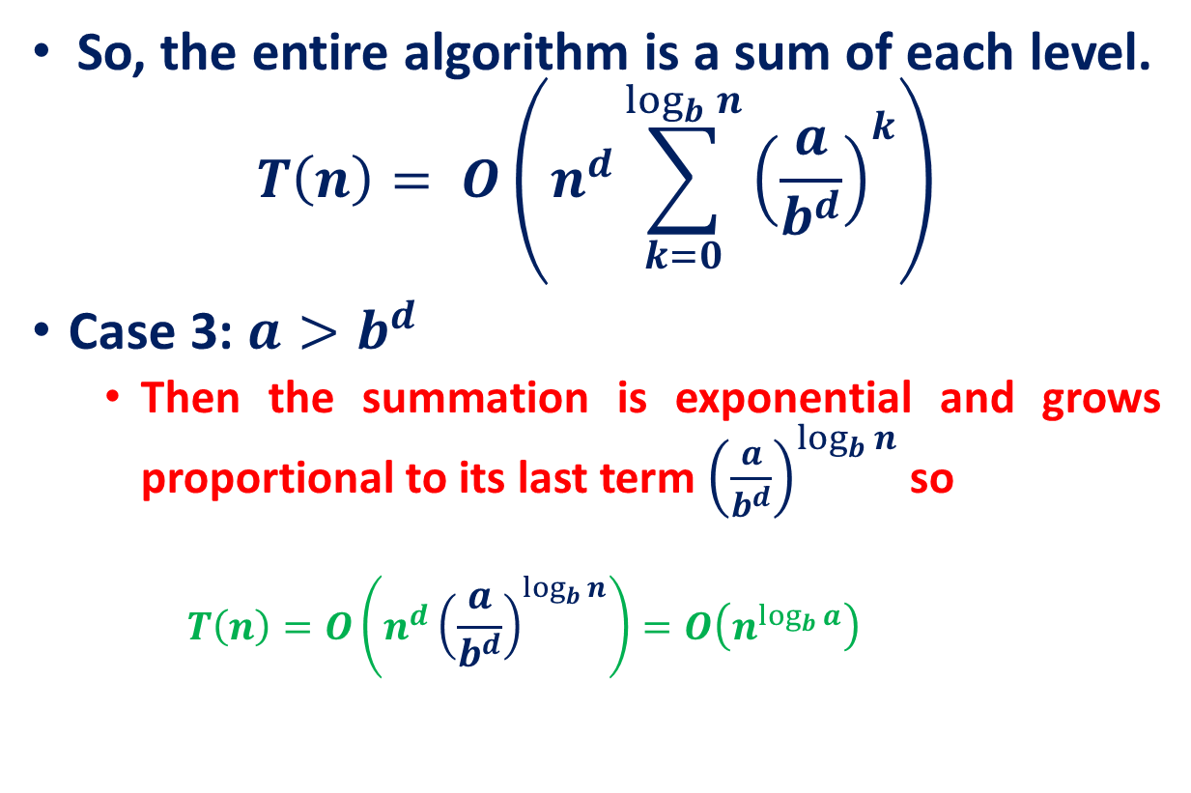
Master Theorem: Solving the recurrence
So, the entire algorithm is a sum of each level.
$$T\left(n\right)= O\left(n^{d}\sum_{k=0}^{\log_{b}{n}}{{\left(\frac{a}{b^{d}}\right)}^{k}}\right)$$
Case 3: $a>b^{d}$
Then the summation is exponential and grows proportional to its last term ${\left(\frac{a}{b^{d}}\right)}^{\log_{b}{n}}$ so
$$T\left(n\right)=O\left(n^{d}{\left(\frac{a}{b^{d}}\right)}^{\log_{b}{n}}\right)=O\left(n^{\log_{b}{a}}\right)$$

Slide 25
Examples
T(n) = 2T(n/2) + n
T(n) = 2T(n/2) + n²

Slide 26

Master Theorem
You cannot use the Master Theorem if
T(n) is not monotone, ex: $T\left(n\right)= sin n$
f(n) is not a polynomial, ex: $T(n) = 2T( n/2 ) +2^{n}$
b cannot be expressed as a constant, ex: T(n) = T( √ n)

Slide 27
References
Data Structure and Algorithms for Electrical Engineering by Yung Yi

