Slide 1
Array and Linked List

Slide 2
Array
Storing data in a sequential memory locations
Access each element using integer index
Very basic, popular, and simple
int a[10]; int *a = new int(10);
Memory
a
b
c
d
start

Slide 3
Array: Problems
New insertion and deletion: difficult
Need to shift to make space for insertion
Need to fill empty positions after deletion
Why don’t we connect all elements just “logically” not “physically”?
Linked List

Slide 4
Linked List Basics
Linked lists and arrays are similar since they both store collections of data.
The array's features all follow from its strategy of allocating the memory for all its elements in one block of memory.
Linked lists use an entirely different strategy: linked lists allocate memory for each element separately and only when necessary.

Slide 5
Linked List Basics
Linked lists are used to store a collection of information (like arrays)
A linked list is made of nodes that are pointing to each other
We only know the address of the first node (head)
Other nodes are reached by following the “next” pointers
The last node points to NULL
5

Slide 6
Linked Lists
head
next
next
next
next
a
b
c
d
First node
Last node

Slide 7
Empty List
Empty Linked list is a single pointer having the value NULL.
head = NULL;
head

Slide 8
Linked List Basics
Each node has (at least) two fields:
Data
Pointer to the next node
data
ptr
8

Slide 9
Linked List vs. Array
In a linked list, nodes are not necessarily contiguous in memory (each node is allocated with a separate “new” call)
Compare this to arrays which are contiguous
Array
head
Linked List
NULL
9

Slide 10
Linked List vs. Array
Advantages of Arrays
Can directly select any element
No memory wasted for storing pointers
Disadvantages of Arrays:
Fixed size (cannot grow or shrink dynamically)
Need to shift elements to insert an element to the middle
Memory wasted due to unused elements
Advantages of Linked Lists:
Dynamic size (can grow and shrink as needed)
No need to shift elements to insert into the middle
Size can exactly match the number of elements (no wasted memory)
Disadvantages of Linked Lists
Cannot directly select any element (need to follow ptrs)
Extra memory usage for storing pointers
10

Slide 11
Linked List vs. Array
In general, we use linked lists if:
The number of elements that will be stored cannot be predicted at compile time
Elements may be inserted in the middle or deleted from the middle
We are less likely to make random access into the data structure (because random access is expensive for linked lists)
11

Slide 12
Linked List Implementation
A linked list node can be represented as follows:
template <class T>
class Node {
public:
T element;
Node *next;
};
12

Slide 13
Linked List Node Implementation
We can add a constructor to simplify creating a new node:
template <class T>
class Node {
public:
Node(const T& e = T(), Node *n = NULL) :
element(e), next(n) { }
T element;
Node *next;
};
13

Slide 14
Constructor
Node(const T& e = T(), Node *n = NULL) : element(e), next(n) { }
(const T& e = T(), Node *n = NULL) is the constructor for the Node class. It takes two parameters, e and n, with default values.
const T& e = T(): This parameter e is of type T, which is a template parameter. It represents the element that the node will store.
The & symbol indicates that a reference to an object of type T is being passed.
The = T() part means that if no value is provided for e when creating a node, it will be initialized with a default value of T().
Node *n = NULL:
This parameter n is a pointer to another Node object. It represents the next node in the linked list. If no value is provided for n, it is initialized to NULL. This is common for the last node in the list, indicating the end of the list.

Slide 15
Constructor
Node(const T& e = T(), Node *n = NULL) : element(e), next(n) { }
element(e), next(n) { }
element(e), next(n) { } is the constructor's initialization list.
It initializes the member variables of the Node class.
element(e): This initializes the element member variable with the value of the e parameter that was passed to the constructor.
next(n): This initializes the next member variable with the value of the n parameter that was passed to the constructor.

Slide 16
Linked List Implementation
A linked list can be defined as follows
Note that the constructor creates an empty list by making the head point to NULL
template <class T>
class List {
private:
Node<T> *head;
public:
List() : head(NULL) {}
};
16

Slide 17
Basic Linked List Operations
Insert a node
Delete a node
List Traversal
Searching a node
Is Empty

Slide 18
Linked List Operations
isEmpty(): returns true if the list is empty, false otherwise
template <class T>
class List {
private:
Node<T> *head;
public:
List() : head(NULL) {}
bool isEmpty() const;
};
18

Slide 19
Linked List Operations
isEmpty(): returns true if the list is empty, false otherwise
template <class T>
bool List<T>::isEmpty() const {
return head == NULL;
}
19

Slide 20
Linked List Operations
first(): returns the first node of the list
template <class T>
class List {
private:
Node<T> *head;
public:
List() : head(NULL) {}
bool isEmpty() const;
Node<T>* first();
};
20

Slide 21
Linked List Operations
template <class T>
Node<T>* List<T>::first() {
return head;
}
21

Slide 22
Insertion in a linked list
…
a
b
…
p
x
newNode

Slide 23
Insertion
For insertion, we have to consider two cases:
Insertion to the middle
Insertion before the head (or to an empty list)
In the second case, we have to update the head pointer as well
23

Slide 24
Linked List Operations : insert
insert(const T& data, Node<T>* p): inserts a new element containing data after node p
template <class T>
class List {
private:
Node<T> *head;
public:
...
void insert(const T& data, Node<T>* p);
...
};
24

Slide 25
Linked List Operations
template <class T>
void List<T>::insert(const T& data, Node<T>* p) {
if (p != NULL) { // case 1
Node<T>* newNode = new Node<T>(data, p->next);
p->next = newNode;
}
else { // case 2
Node<T>* newNode = new Node<T>(data, head);
head = newNode;
}
}
25

Slide 26
Linked List Operations
To avoid this if-check at every insertion, we can add a dummy head to our list (also useful for deletion)
This dummy head will be our zeroth node and its next pointer will point to the actual head (first node)
dummyHead (refer to this as `head’ in code – next slides)
next
next
next
next
X
a
b
c
First node
26

Slide 27
Linked List Operations
An empty list will look like this (the contents of the node is irrelevant):
dummyHead
next
X
27

Slide 28
Linked List Operations
Now, insertion code is simplified:
template <class T>
void List<T>::insert(const T& data, Node<T>* p) {
// now p should not be NULL. To insert to the
// first position, it should point to dummy head
Node<T>* newNode = new Node<T>(data, p->next);
p->next = newNode;
}
28

Slide 29
Linked List Operations
We must make some changes to support the dummy head version:
template <class T>
class List {
private:
Node<T> *dummyHead;
public:
List() {
dummyHead = new Node<T>(T(), NULL);
}
};
29

Slide 30
Linked List Operations
template <class T>
class List {
private:
Node<T> *dummyHead;
public:
Node<T>* zeroth() {
return dummyHead;
}
Node<T>* first() {
return dummyHead->next;
}
const Node<T>* first() const {
return dummyHead->next;
}
bool isEmpty() const {first() == NULL;}
};
“Note that if we don't have a constant first() function, we cannot make isEmpty const as well”
30

Slide 31
Searching for an Element
To find an element, we must loop through all elements until we find the element or we reach the end:
template <class T>
class List {
private:
Node<T> *dummyHead;
public:
...
Node<T>* find(const T& data);
...
};
31

Slide 32
Searching for an Element
To find an element, we must loop through all elements until we find the element or we reach the end:
template <class T>
Node<T>* List<T>::find(const T& data) {
Node<T>* p = first();
while (p) {
if (p->element == data)
return p;
p = p->next;
}
return NULL;
}
32

Slide 33
Removing a node from a linked list
tmp
…
a
x
b
…
p

Slide 34
Removing an Element
To remove a node containing an element, we must find the previous node of that node. So we need a findPrevious function
template <class T>
class List {
private:
Node<T> *dummyHead;
public:
...
Node<T>* findPrevious(const T& data);
...
};
34

Slide 35
Finding Previous Node
template <class T>
Node<T>* List<T>::findPrevious(const T& data) {
Node<T>* p = zeroth();
while (p->next) {
if (p->next->element == data)
return p;
p = p->next;
}
return NULL;
}
35

Slide 36
Removing an Element
Now we can implement the remove function:
template <class T>
class List {
private:
Node<T> *dummyHead;
public:
...
void remove(const T& data);
...
};
36

Slide 37
Removing an Element
Note that, because we have a dummy head, removal of an element is simplified as well
template <class T>
void List<T>::remove(const T& data) {
Node<T>* p = findPrevious(data);
if (p) {
Node<T>* tmp = p->next;
p->next = tmp->next;
delete tmp;
}
}
37

Slide 38
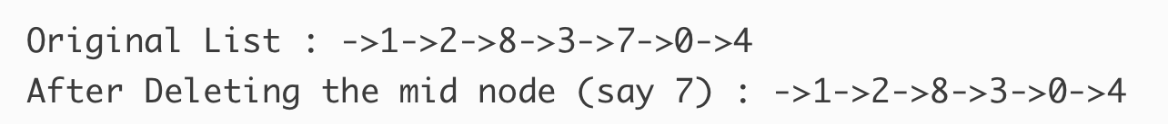
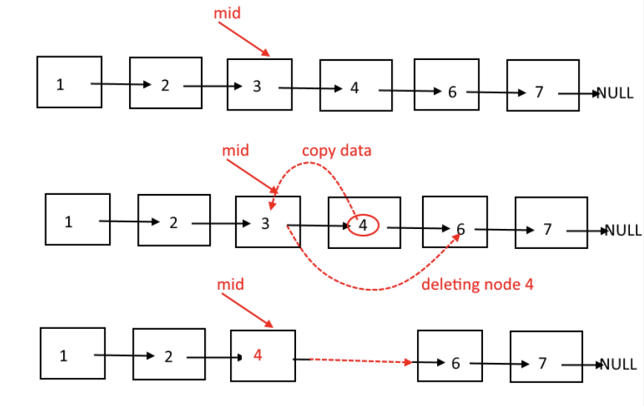
Removing an Element
Implement an algorithm to delete a node in the middle of a single linked list, given only access to that node (no findPrevious).
38

Slide 39
Printing All Elements (Traversal)
List traversal is straightforward:
template <class T>
class List {
private:
Node<T> *dummyHead;
public:
...
void print() const;
...
};
39

Slide 40
Printing All Elements (Traversal)
List traversal is straightforward:
“Again, the constant first() function allows print() to be const as well”
template <class T>
void List<T>::print() const
{
const Node<T>* p = first();
while(p) {
std::cout << p->element << std::endl;
p = p->next;
} }
40

Slide 41
Removing All Elements
We can make the list empty by deleting all nodes (except the dummy head)
template <class T>
class List {
private:
Node<T> *dummyHead;
public:
...
void makeEmpty();
...
};
41

Slide 42
Removing All Elements
template <class T>
void List<T>::makeEmpty()
{
while(!isEmpty()) {
remove(first()->element());
} }
42

Slide 43
Destructor
We must release allocated memory in the destructor
template <class T>
class List {
private:
Node<T> *dummyHead;
public:
...
~List();
...
};
43

Slide 44
Destructor
template <class T>
List<T>::~List()
{
makeEmpty();
delete dummyHead; }
44

Slide 45
Assignment Operator
As the list has pointer members, we must provide an assignment operator
template <class T>
class List {
private:
Node<T> *dummyHead;
public:
...
List& operator=(const List& rhs);
...
};
45

Slide 46
Assignment Operator
template <class T>
List<T>& List<T>::operator=(const List& rhs)
{
if (this != &rhs) {
makeEmpty();
const Node<T>* r = rhs.first();
Node<T>* p = zeroth();
while (r) {
insert(r->element, p);
r = r->next;
p = p->next;
}
}
return *this; }
Uses the const
version
46

Slide 47
Copy Constructor
Finally, we must implement the copy constructor
template <class T>
class List {
private:
Node<T> *dummyHead;
public:
...
List(const List& rhs);
...
};
47

Slide 48
Copy Constructor
template <class T>
List<T>::List(const List& rhs)
{
dummyHead = new Node<T>(T(), NULL);
*this = rhs; // use operator= }
48

Slide 49
Testing the Linked List Class
Let's check if our implementation works by implementing a test driver file
int main() {
List<int> list;
list.insert(0, list.zeroth());
Node<int>* p = list.first();
for (int i = 1; i <= 10; ++i)
{
list.insert(i, p);
p = p->next;
}
std::cout << "printing original list" << std::endl;
list.print();
49

Slide 50
Testing the Linked List Class
for (int i = 0; i <= 10; ++i)
{
if (i % 2 == 0)
list.remove(i);
}
std::cout << "printing odd number list" << std::endl; list.print();
50

Slide 51
Testing the Linked List Class
List<int> list2 = list;
cout << "printing copy constructed list" << endl;
list2.print();
List<int> list3;
list3 = list;
cout << "printing assigned list" << endl;
list3.print();
list.makeEmpty();
cout << "printing emptied list" << endl;
list.print();
51

Slide 52
Testing the Linked List Class
for (int i = 0; i <= 10; ++i) {
if (i % 2 == 0) {
if (list2.find(i) == NULL)
cout << "could not find element " << i << endl;
}
else {
if (list2.find(i) != NULL)
cout << "found element " << i << endl;
}
}
52

Slide 53
Variations of Linked Lists
The linked list that we studied so far is called singly linked list
Other types of linked lists exist, namely:
Circular linked linked list
Doubly linked list
Circular doubly linked list
Each type of linked list may be suitable for a different kind of application
They may also use a dummy head for simplifying insertions and deletions
53

Slide 54
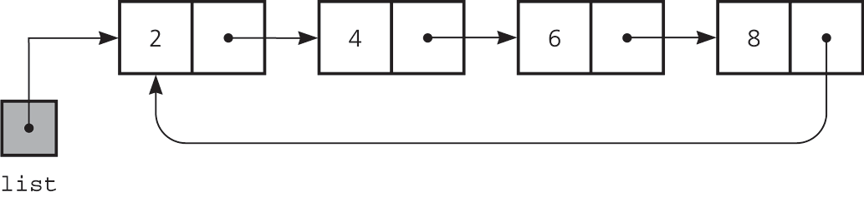
Circular Linked Lists
Last node references the first node
Every node has a successor
No node in a circular linked list contains NULL
E.g. a turn-based game may use a circular linked list to switch between players
54

Slide 55
Doubly Linked Lists
pHead
a
b
c
Advantages:
Convenient to traverse the list backwards.
E.g. printing the contents of the list in backward order
Disadvantage:
Increase in space requirements due to storing two pointers instead of one
55

Slide 56
Deletion
oldNode
oldNode->prev->next = oldNode->next;
oldNode->next->prev = oldNode->prev;
delete oldNode;

Slide 57
Insertion
current
newNode = new Node(x,NULL);
newNode->prev = current;
newNode->next = current->next;
newNode->prev->next = newNode;
newNode->next->prev = newNode;
newNode

Slide 58
Circular Doubly Linked Lists
Circular doubly linked list
prev pointer of the dummy head node points to the last node
next reference of the last node points to the dummy head node
No special cases for insertions and deletions
58

Slide 59
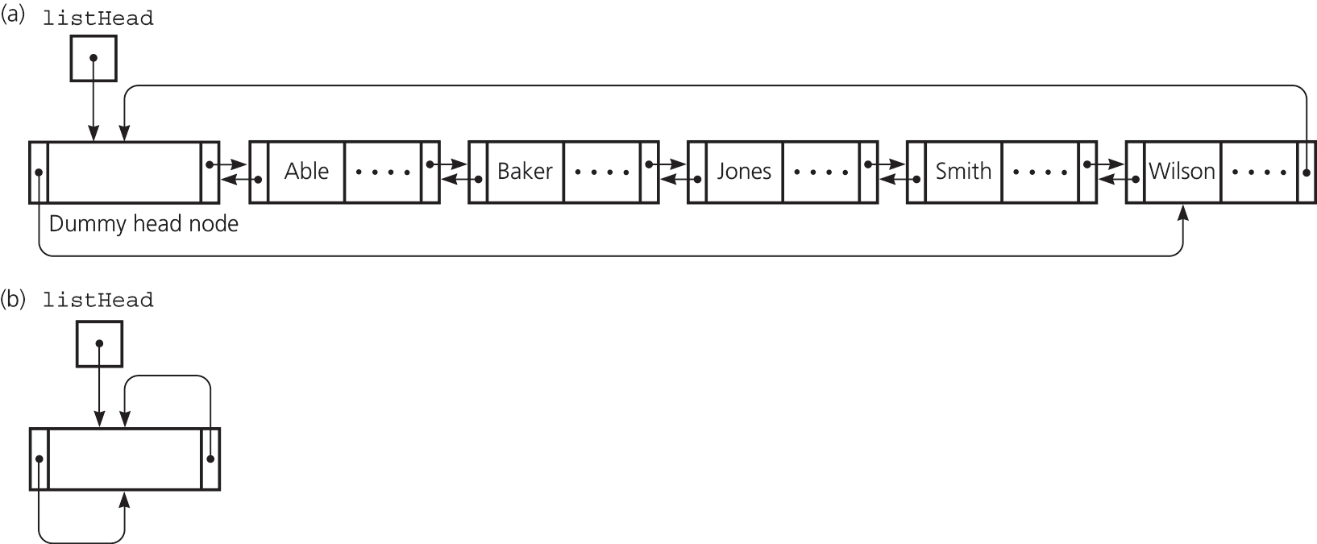
Circular Doubly Linked Lists
(a) A circular doubly linked list with a dummy head node
(b) An empty list with a dummy head node
59

Slide 60
Linked List Problems
See http://cslibrary.stanford.edu/105/ for some
Here are some cool interview questions
Find nth-to-last element with one for-loop
Keep pointers A & B. Move A n times. Then move both until A ends.
Find if linked list has a loop
A is half speed of B. They will collide if there is a loop.
Print linked list in reverse order
Reverse pointers, then print new list: 1-> 2 -> 3 becomes 1 <- 2 <- 3
After each recursion, print out the first node
printRev(1->2->3)
printRev(2->3)
printRev(3) //print out 3 (and so on, read to top)
printRev(NULL) //print out nothing – do nothing
No additional stack space in non-rec, but needs 2 passes. Both O(N).
void printRev(Node* n) {
if (! n) return;
printRev(n->next);
printf("%d\n", n->val);
}

Slide 61
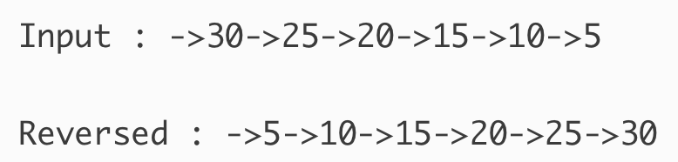
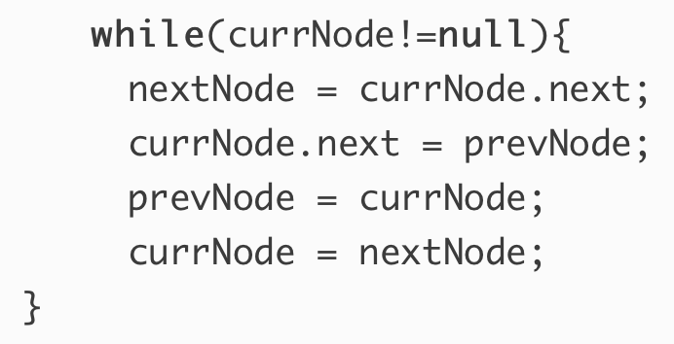
Linked List Problems
More on reversing; assume no Stack around
Cre­ate 3 nodes, cur­rN­ode, Pre­vN­ode and nextNode
Ini­tial­ize them as cur­rN­ode=head; nextN­ode=null;pre­vN­ode = null;
Now keep revers­ing the point­ers one by one till currNode!=null
In the end set head = prevNode

Slide 62
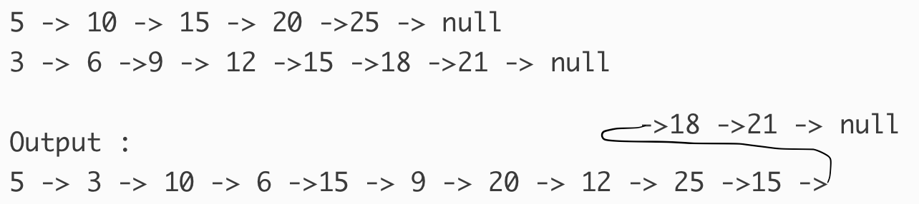
Linked List Problems
Merge linked list L2 into L1 at alternate positions
void List<T>::alternateWith(List L2) {
Node<T>* p = first();
while (p) {
insert(L2.first()->element, p);
L2.remove(L2.first()->element);
p = p->next->next; } //end of while
}

Slide 63
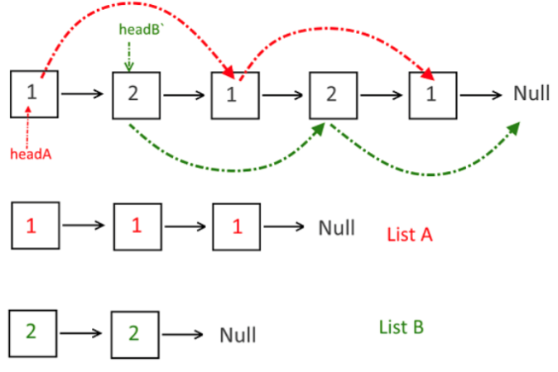
Linked List Problems
Split linked list L into L1 and L2. New linked lists will con­tain the alter­nate nodes from the given linked list
void List<T>::alternateSplit(List<T> L1, List<T> L2) {
Node<T>* p = first(), * A = L1.zeroth(), * B = L2.zeroth();
while (p) {
L1.insert(p->element, A); A = A->next;
p = p->next;
if (p) {
L2.insert(p->element, B); B = B->next; }
p = p->next; } //end of while
}

Slide 64
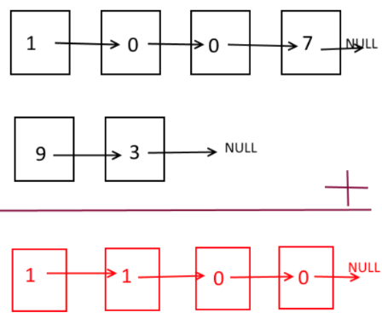
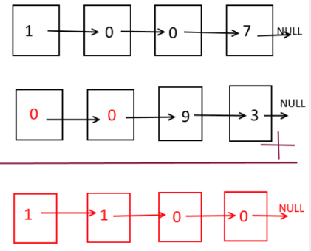
Linked List Problems
Add two numbers represented by linked a linked list
void List<T>::add(List<T> L1, List<T> L2) {
if (L1.length() > L2.length()) L2.pad(L1.length() - L2.length());
if (L1.length() < L2.length()) L1.pad(L2.length() – L1.length());
L1.setPrevs(); L2.setPrevs();
Node<T>* p = L1.first(), * q = L2.first();
while(p->next) p = p->next; while(q->next) q = q->next;
int c = 0; List<T> R; //carry and resulting list
while (p) {//or while (q)
int v = p->element + q->element + c;
if (v < 10) { R.insert(v, R.zeroth()); c = 0; }
else { R.insert(v%10, R.zeroth()); c = 1; }
p = p->prev; q = q->prev; }
if (c > 0) R.insert(1, R.zeroth()); }

Slide 65
Linked List Problems
Add two numbers represented by linked a linked list
void List<T>::pad(int n) {
for (int i = 0; i < n; i++)
insert(0, zeroth());
}
void List<T>::setPrevs() {
Node<T>* p = first(), pr = NULL;
while (p) {
p->prev = pr;
pr = p;
p = p->next; }
}

Slide 66
Linked List Problems
Add two numbers represented by linked a linked list
Solve using Stack
Traverse L1 and L2 and push elements into S1 and S2
S1.topAndPop(e1); S2.topAndPop(e2); //call-by-reference
v = (e1==-1?0:e1) + (e2==-1?0:e2) + carry;
R.insert(v < 10 ? v : v % 10); carry = (v < 10 ?0 :1);

Slide 67
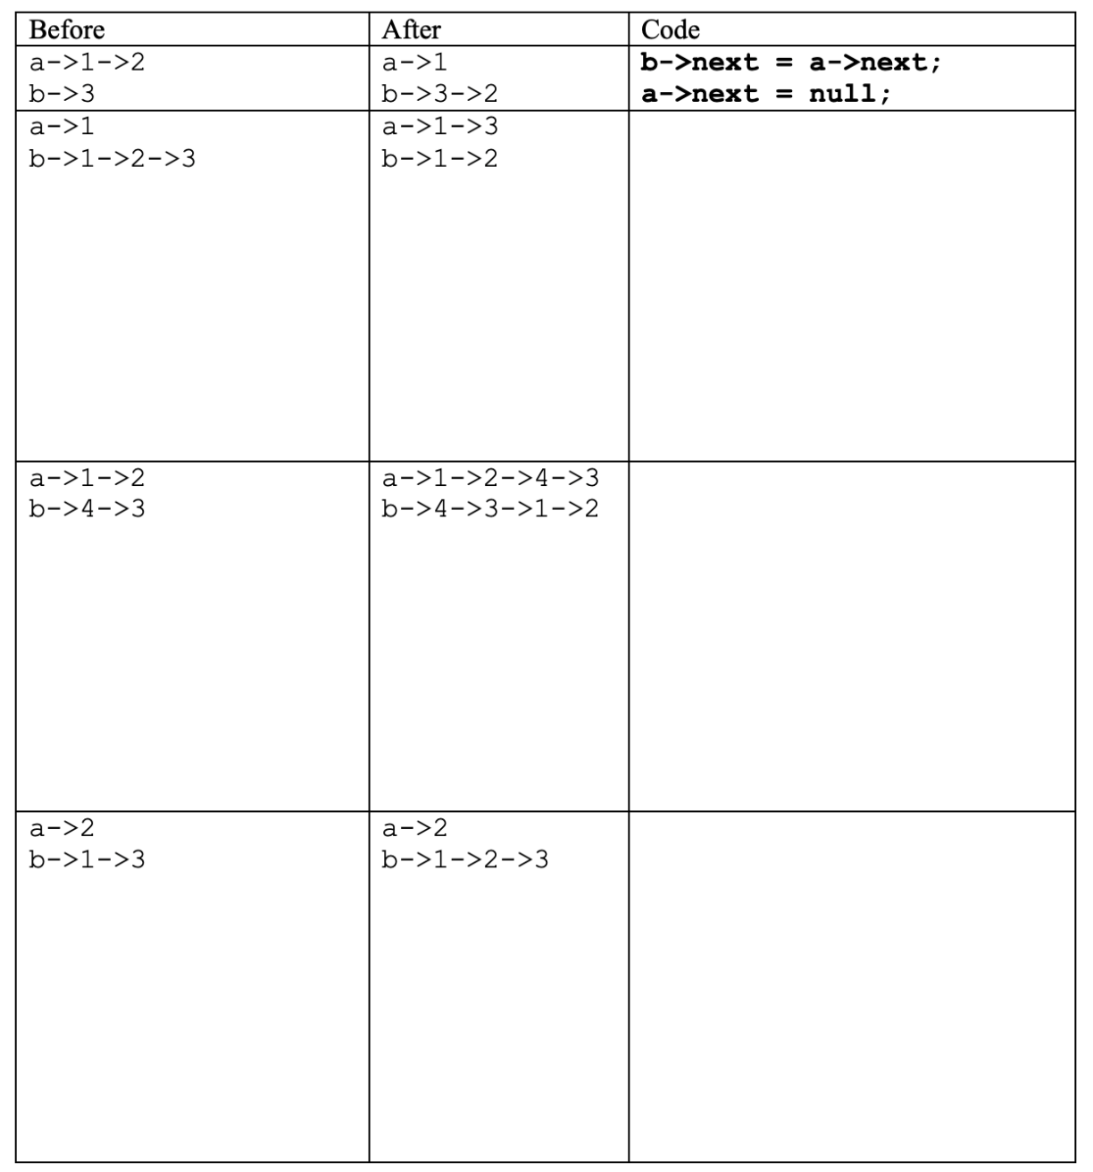
Linked List Problems
Fill in the boxes:
You are not allowed to change any existing
node’s value field, but you are allowed to use
temporary node(s) if necessary. I filled the first
entry for you in bold. All lists are terminated by null
and the variables a and b have value null when they
do not point to anything Use next pointers and not
the ADT functions. Size of the given space is
arbitrary and does not give a hint about the solution.

Slide 68
References
CENG707 - Data Structures and Algorithms by Yusuf Sahillioğlu

