Slide 1
Trees

Slide 2
Outline
Preliminaries
What is Tree?
Implementation of Trees using C++
Tree traversals and applications
Binary Trees
Binary Search Trees
Structure and operations
Analysis
AVL Trees
B and B+ Trees
Heaps, Priority Queues

Slide 3
What is a Tree?
A tree is a collection of nodes with the following properties:
The collection can be empty.
Otherwise, a tree consists of a distinguished node r, called root, and zero or more nonempty sub-trees T₁, T₂, … , T_{k}, each of whose roots are connected by a directed edge from r.
The root of each sub-tree is said to be child of r, and r is the parent of each sub-tree root.
If a tree is a collection of N nodes, then it has N-1 edges.
root
T₁
T₂
...
T_{k}

Slide 4
Preliminaries
Node A has 6 children: B, C, D, E, F, G.
B, C, H, I, P, Q, K, L, M, N are leaves in the tree above.
K, L, M are siblings since F is parent of all of them.
A
B
C
D
E
F
G
H
I
J
K
L
M
N
P
Q

Slide 5
Preliminaries (continued)
A path from node n₁ to n_{k} is defined as a sequence of nodes n₁, n₂, …, n_{k} such that n_{i} is parent of n_{i+1} (1 ≤i < k)
The length of a path is the number of edges on that path.
There is a path of length zero from every node to itself.
There is exactly one path from the root to each node.
The depth of node n_{i} is the length of the path from root to node n_{i}
The height of node n_{i} is the length of longest path from node n_{i} to a leaf.
If there is a path from n₁ to n₂, then n₁ is ancestor of n₂, and n₂ is descendent of n₁.
If n₁ ≠ n₂ then n₁ is proper ancestor of n₂, and n₂ is proper descendent of n₁.

Slide 6
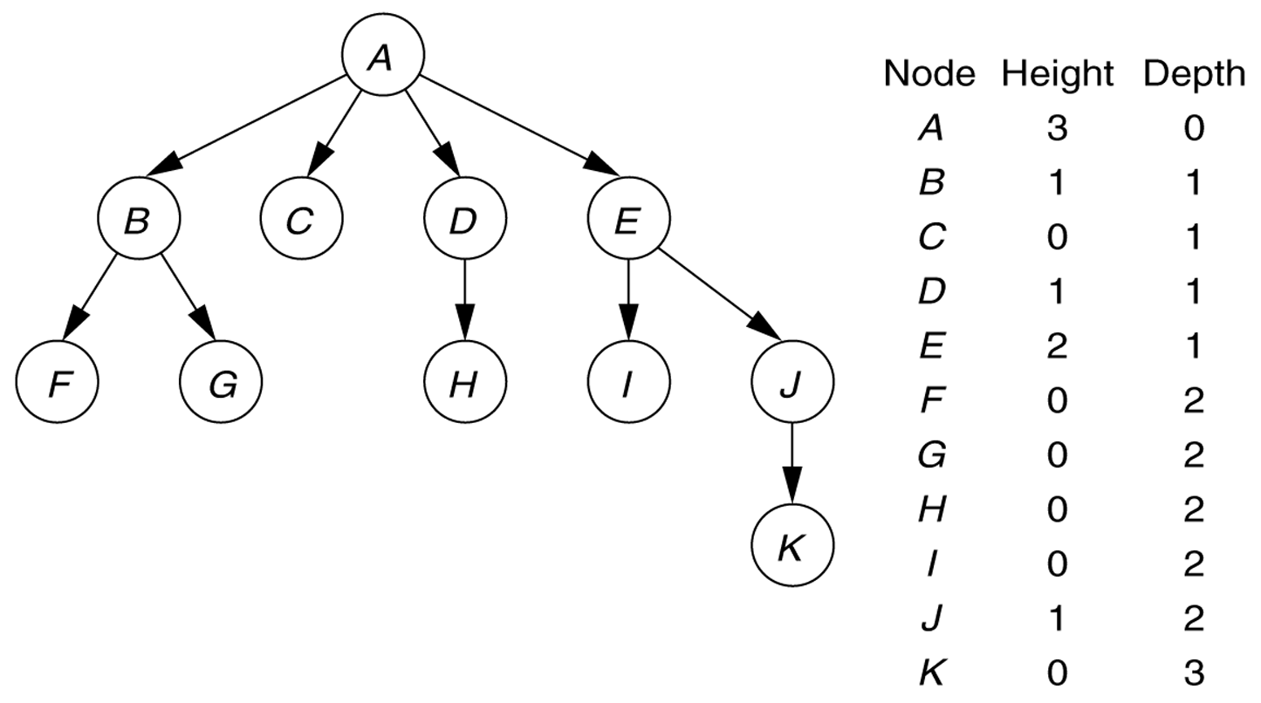
A tree, with height and depth information

Slide 7
Implementation of Trees
A
element
struct TreeNode {
Object element;
struct TreeNode *firstChild;
struct TreeNode *nextSibling;
};
firstChild
NULL
nextSibling
B
C
D
NULL
NULL
A
H
NULL
NULL
B
C
D
E
F
G
H
I
J
K
L
M
N
P
Q

Slide 8
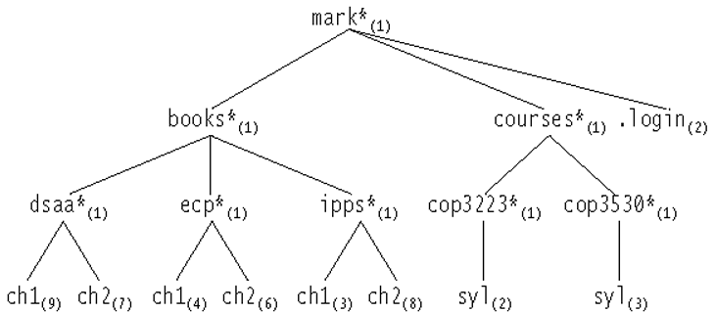
The Unix directory with file sizes

Slide 9
Binary Trees
A binary tree is a tree in which no node can have more than two children
The depth can be as large as N-1 in the worst case.
root
A binary tree consisting
of a root and
two subtrees T_{L} and T_{R},
both of which could
possibly be empty.
T_{L}
T_{R}
Non-binary tree
The depth of node n_{i} is the length of the path from root to node n_{i}
The height of node n_{i} is the length of longest path from node n_{i} to a leaf.

Slide 10
Binary Tree Terminology
Left Child – The left child of node n is a node directly below and to the left of node n in a binary tree.
Right Child – The right child of node n is a node directly below and to the right of node n in a binary tree.
Left Subtree – In a binary tree, the left subtree of node n is the left child (if any) of node n plus its descendants.
Right Subtree – In a binary tree, the right subtree of node n is the right child (if any) of node n plus its descendants.

Slide 11
Binary Tree -- Example
A is the root.
B is the left child of A, and
C is the right child of A.
D doesn’t have a right child.
H doesn’t have a left child.
B, F, G and I are leaves.
• A
• B
• C
• D
• E
• F
• G
• H
• I

Slide 12
Tree Traversal Algorithms

Slide 13
Preorder Traversal
A traversal visits the nodes of a tree in a systematic manner
In a preorder traversal, a node is visited before its descendants
Application: print a structured document
Algorithm preOrder(v)
visit(v)
for each child w of v
preorder (w)
1
Make Money Fast!
2
5
9
1. Motivations
2. Methods
References
3
4
6
7
8
1.1 Greed
1.2 Avidity
2.1 Stock Fraud
2.2 Ponzi Scheme
2.3 Bank Robbery

Slide 14
Postorder Traversal
In a postorder traversal, a node is visited after its descendants
Application: compute space used by files in a directory and its subdirectories
Algorithm postOrder(v)
for each child w of v
postOrder (w)
visit(v)
9
cs16/
8
3
7
homeworks/
programs/
todo.txt 1K
1
2
4
5
6
h1c.doc 3K
h1nc.doc 2K
DDR.cpp 10K
Stocks.cpp 25K
Robot.cpp 20K

Slide 15
Inorder Traversal
In an inorder traversal a node is visited after its left subtree and before its right subtree
Application: draw a binary tree
x(v) = inorder rank of v
y(v) = depth of v
Algorithm inOrder(v)
if ¬ v.isExternal()
inOrder(v.left())
visit(v)
if ¬ v.isExternal()
inOrder(v.right())
6
2
8
1
4
7
9
3
5

Slide 16
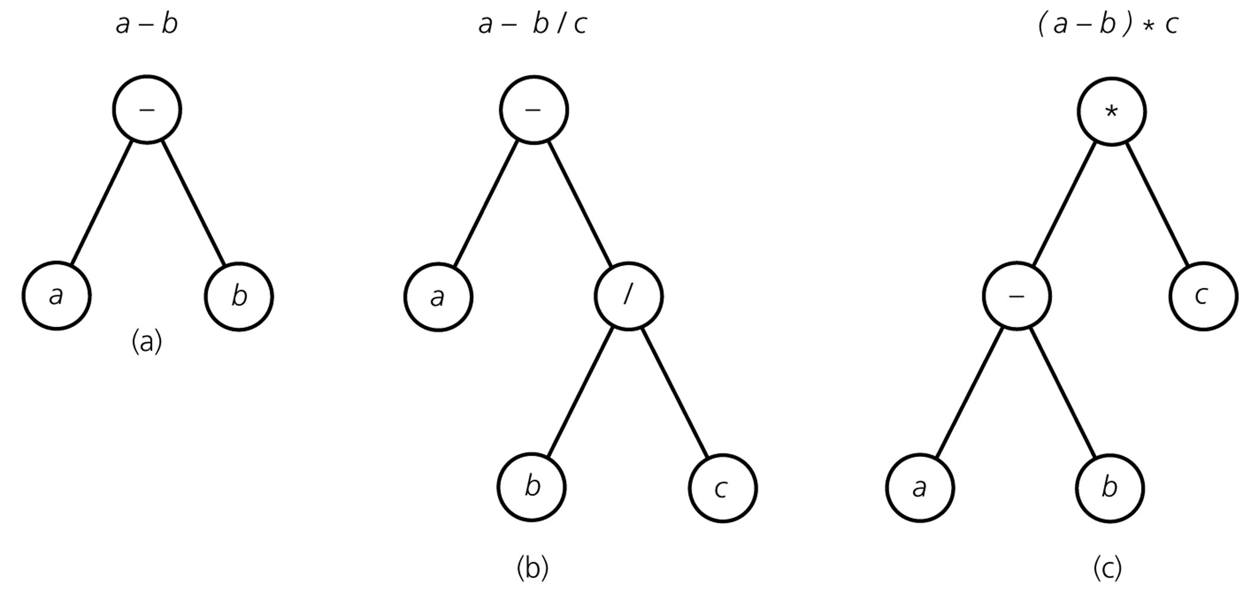
Binary Tree – Representing Algebraic Expressions
Preorder traversal: left-Root-right

Slide 17
Construct Binary Tree from traversal sequence
inOrder = {2,5,6,10,12,14,15};
preOrder = {10,5,2,6,14,12,15};

Slide 18
Height of Binary Tree
The height of a binary tree T can be defined recursively as:
If T is empty, its height is -1.
If T is non-empty tree, then since T is of the form
r
T_{L} T_{R}
the height of T is 1 greater than the height of its root’s taller subtree; i.e.
height(T) = 1 + max{height(T_{L}), height(T_{R})}

Slide 19
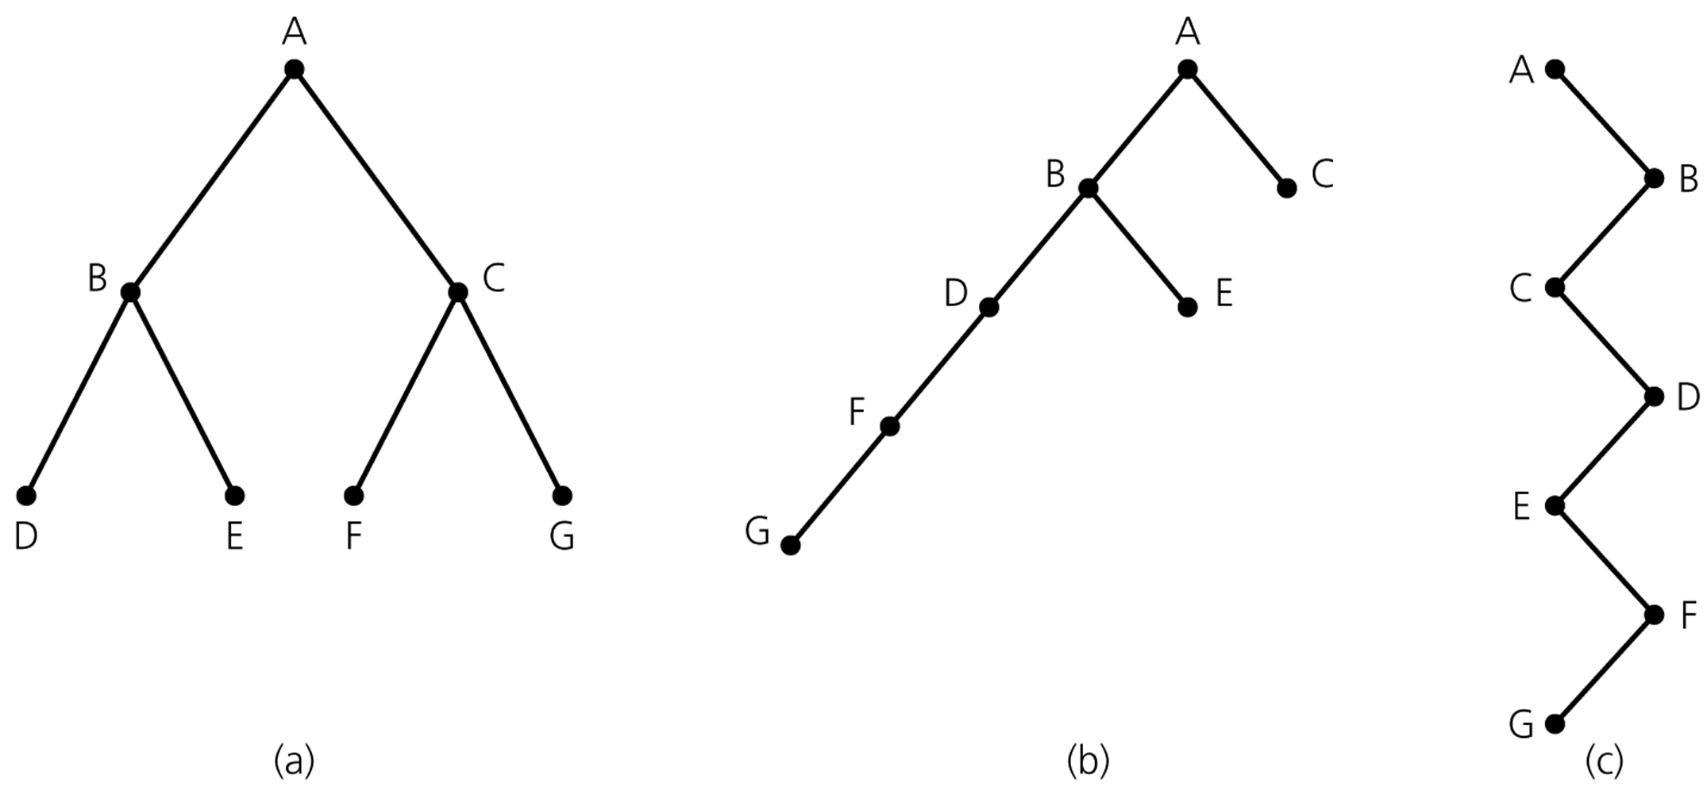
Height of Binary Tree (cont.)
Binary trees with the same nodes but different heights

Slide 20
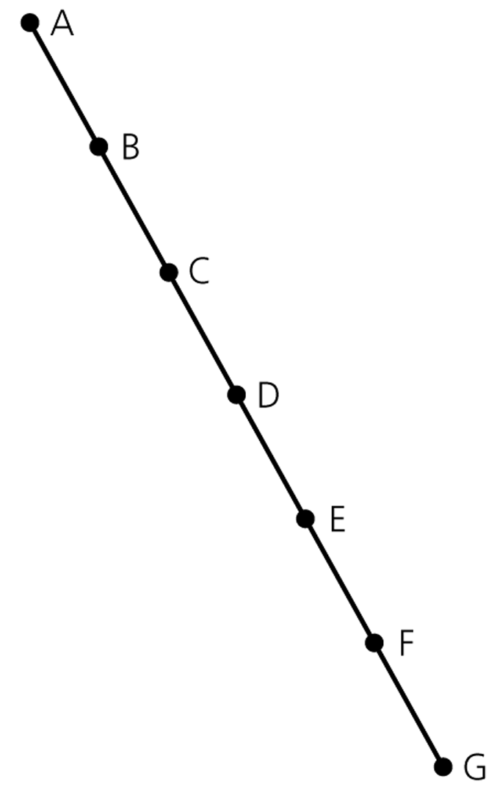
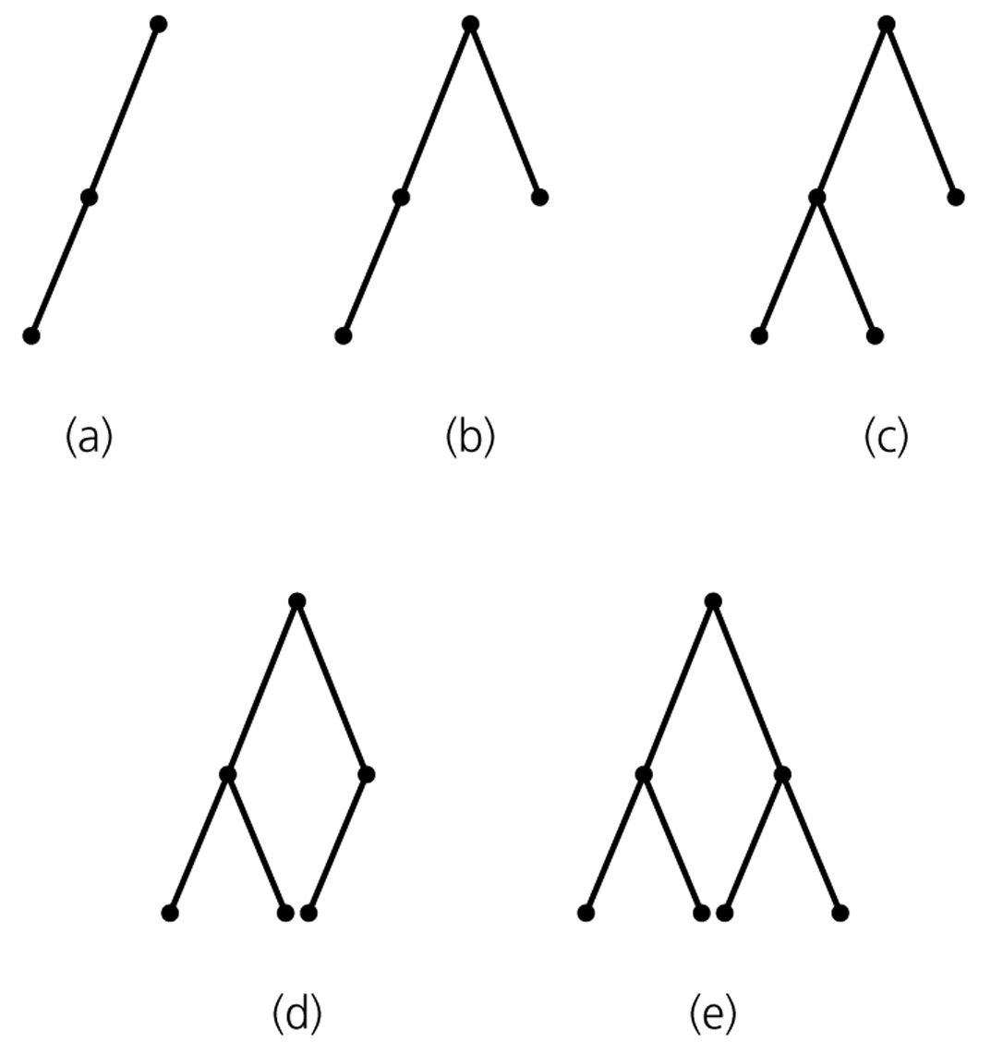
Maximum and Minimum Heights of a Binary Tree
The maximum height of a binary tree with N nodes is N-1.
Each level of a minimum height tree, except the last level, must contain as many nodes as possible.
A maximum-height binary tree
with seven nodes
Some binary trees of height 2
All but (a) is minimum-height

Slide 21
Some Height Theorems
Theorem 1: The maximum number of nodes that a binary tree of height h can have is 2^{h+1}-1.
Theorem 2: The minimum height of a binary tree with N nodes is ⎡log₂(N+1)-1⎤ .
Let’s prove these two theorems.

Slide 22
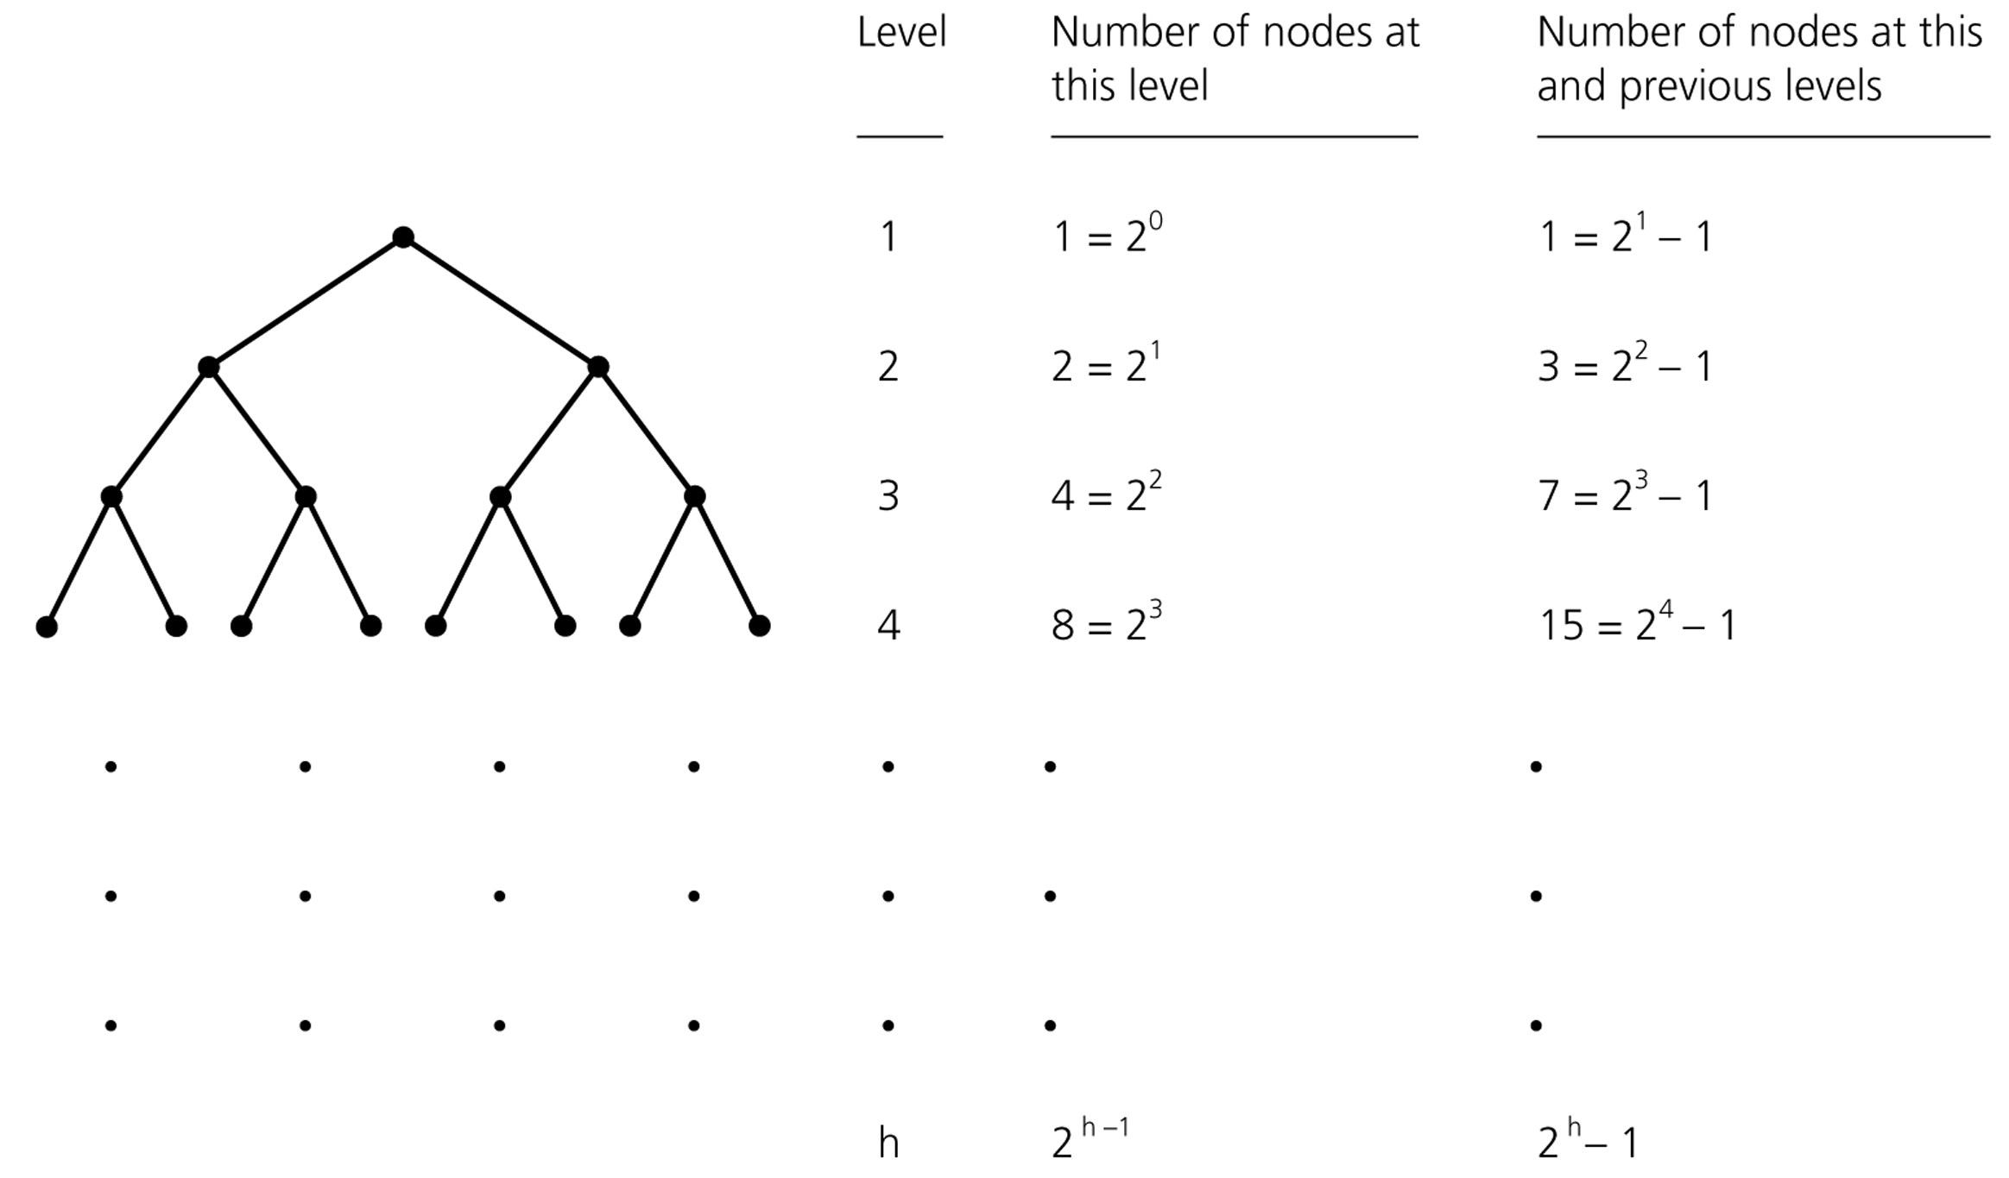
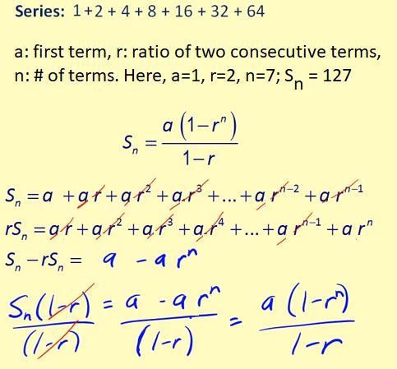
Counting the nodes in a binary tree
Height
--------
Theorem 1:
N = 2⁰ + 2¹ + 2² + .. + 2^{h-1}+ 2^{h}
= 1*(1-2^{h+1}) / (1-2) = 2^{h+1}-1
First line is a geometric series where a=1, r=2, n=h+1
0
1
2
3
h-1
h

Slide 23
Counting the nodes in a binary tree
Height
--------
Theorem 1:
N = 2⁰ + 2¹ + 2² + .. + 2^{h-1}+ 2^{h}
= 1*(1-2^{h+1}) / (1-2) = 2^{h+1}-1
This is the max # of nodes for height h, as we cannot insert one node without increasing the height. So, in general N <= 2^{h+1}-1
0
1
2
3
h-1
h

Slide 24
Counting the nodes in a binary tree
Height
--------
Theorem 2:
N = 2^{h+1}-1
N+1=2^{h+1} //take logs of sides
log(N+1) = log(2^{h+1}) = h+1
h = log(N+1)-1
This is the minimum height when N+1 is a power of 2.
Height does not change when some nodes missing at the last level, e.g., N+1=13 instead of 16.
Same h must be produced there.
So, in general h = ⎡log₂(N+1)-1⎤
0
1
2
3
h-1
h

Slide 25
Number of Binary trees with Same # of Nodes
n=0 ➔ empty tree
n=1 ➔
•
(1 tree)
•
•
n=2 ➔
(2 trees)
•
•
n=3 ➔
(? trees)

Slide 26

Number of Binary trees with Same # of Nodes
n=0 ➔ empty tree
n=1 ➔
•
(1 tree)
•
•
n=2 ➔
(2 trees)
•
•
n=3 ➔
•
•
•
•
•
•
•
(5 trees)
•
•
•
•
•
•
•
•

Slide 27
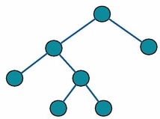
Full Binary Tree
In a full binary tree a tree in which every node in the tree has either 0 or 2 children

Slide 28

Full Binary Tree – Example
A full binary tree of height 2

Slide 29
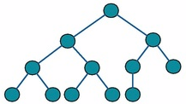
Complete Binary Tree
In a complete binary tree every level, except possibly the last, is completely filled, and all nodes in the last level are as far left as possible

Slide 30
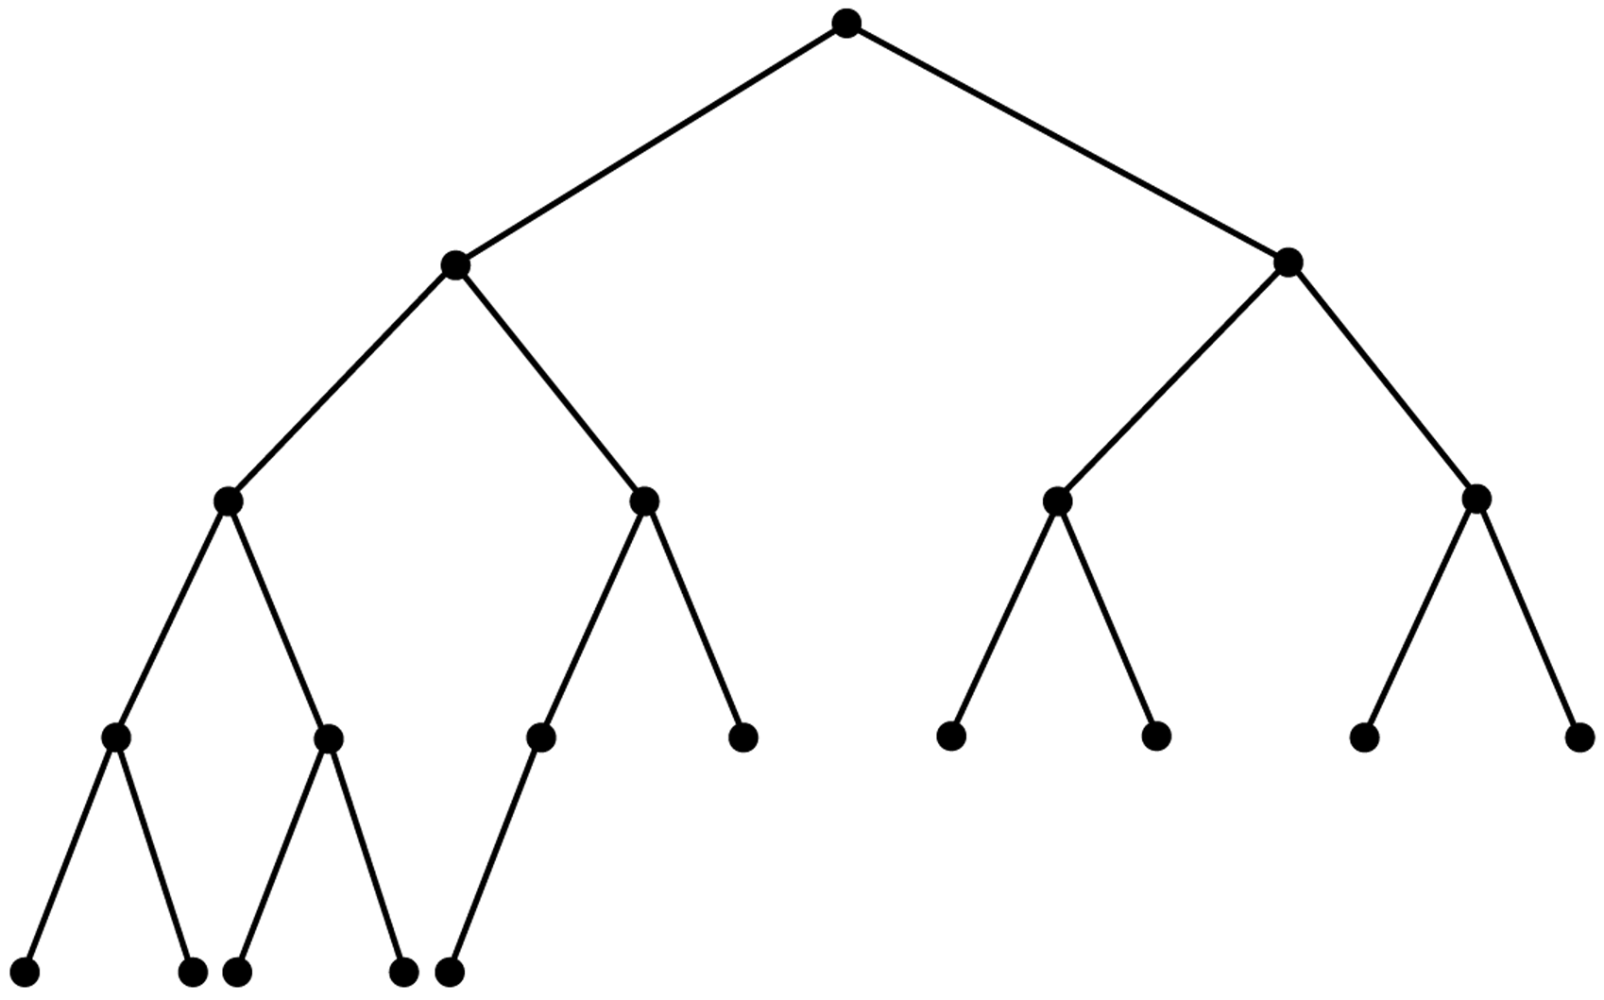
Complete Binary Tree – Example

Slide 31
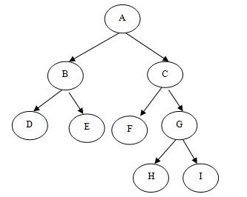
Full but Not Complete Binary Tree – Example

Slide 32

Neither Full Nor Complete Binary Tree – Example

Slide 33
Full and Complete Binary Tree – Example

Slide 34
Balanced Binary Tree
A binary tree is height balanced (or balanced), if the height of any node’s right subtree differs from the height of the node’s left subtree by no more than 1.
A complete binary tree is a balanced tree.
Other height balanced trees:
AVL trees //binary search tree (BST)
Red-Black trees //binary search tree
B-trees //generalization of a BST (3+ children allowed) ....

Slide 35
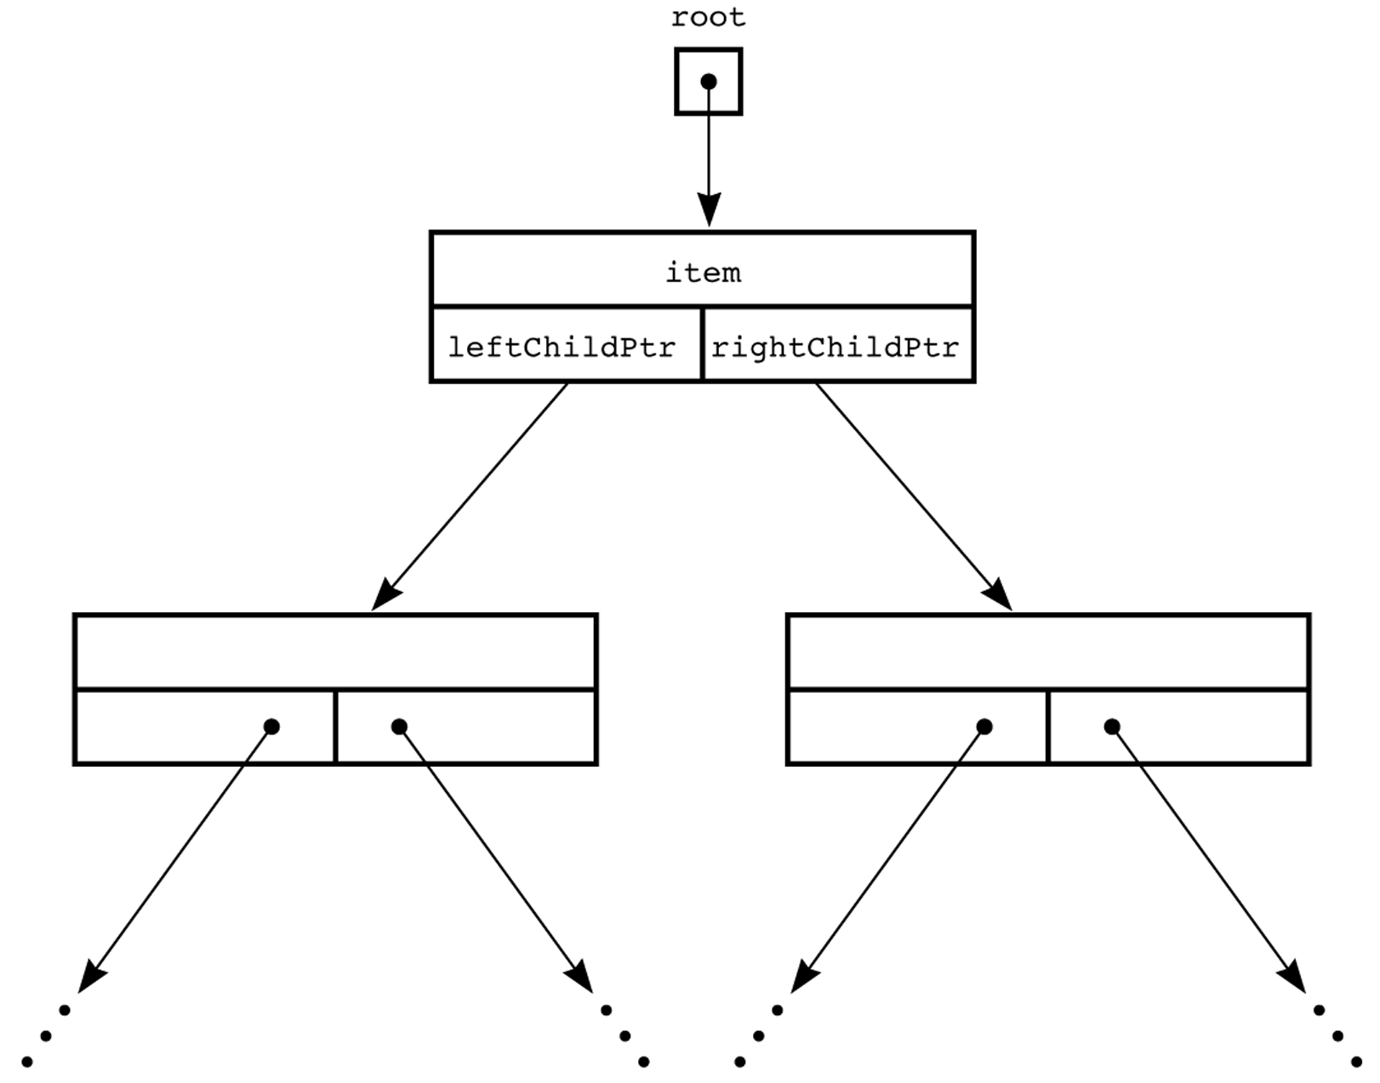
A Pointer-Based Implementation of Binary Trees
struct BinaryNode {
Object element;
struct BinaryNode *left;
struct BinaryNode *right;
};

Slide 36
Binary Tree Traversals
Preorder Traversal
the node is visited before its left and right subtrees,
Postorder Traversal
the node is visited after both subtrees.
Inorder Traversal
the node is visited between the subtrees,
Visit left subtree, visit the node, and visit the right subtree.

Slide 37
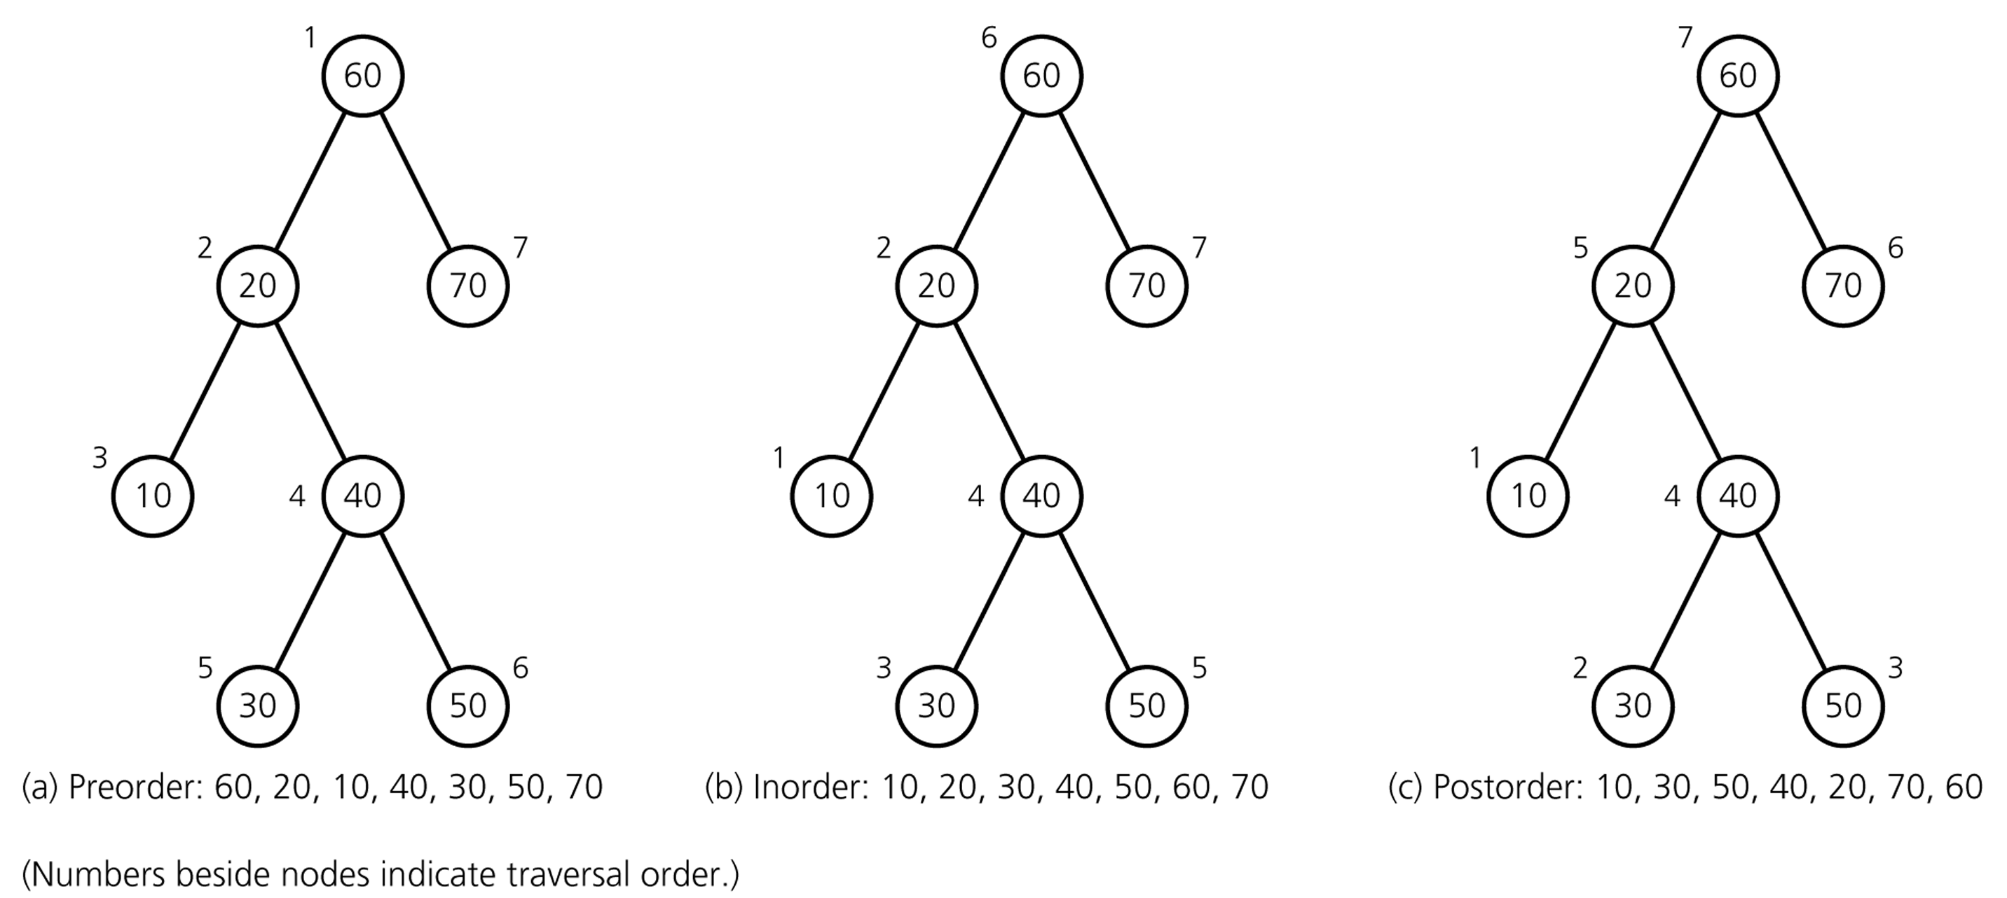
Binary Tree Traversals

Slide 38
Preorder
void preorder(struct tree_node * p)
{ if (p !=NULL) {
cout << p->data << endl;
preorder(p->left_child);
preorder(p->right_child);
}
}

Slide 39
Inorder
void inorder(struct tree_node *p)
{ if (p !=NULL) {
inorder(p->left_child);
cout << p->data << endl;
inorder(p->right_child);
}
}

Slide 40
Postorder
void postorder(struct tree_node *p)
{ if (p !=NULL) {
postorder(p->left_child);
postorder(p->right_child);
cout << p->data << endl;
}
}

Slide 41
Finding the maximum value in a binary tree
int FindMax(struct tree_node *p)
{
int root_val, left, right, max;
max = -1; // Assuming all values are positive integers
if (p!=NULL) {
root_val = p -> data;
left = FindMax(p ->left_child);
right = FindMax(p->right_child);
// Find the largest of the three values.
if (left > right)
max = left;
else
max = right;
if (root_val > max)
max = root_val;
}
return max;
}

Slide 42
Adding up all values in a Binary Tree
int add(struct tree_node *p)
{
if (p == NULL)
return 0;
else
return (p->data + add(p->left_child)+
add(p->right_child));
}

Slide 43
Exercises
Write a function that will count the leaves of a binary tree.
Write a function that will find the height of a binary tree.
Write a function that will interchange all left and right subtrees in a binary tree.

Slide 44
Binary Search Trees
An important application of binary trees is their use in searching.
Binary search tree is a binary tree in which every node X contains a data value that satisfies the following:
all data values in its left subtree are smaller than the data value in X
the data value in X is smaller than all the values in its right subtree.
the left and right subtrees are also binary search tees.

Slide 45
Example
6
6
2
8
2
8
1
4
1
4
3
3
7
A binary search tree
Not a binary search tree, but a binary tree

Slide 46
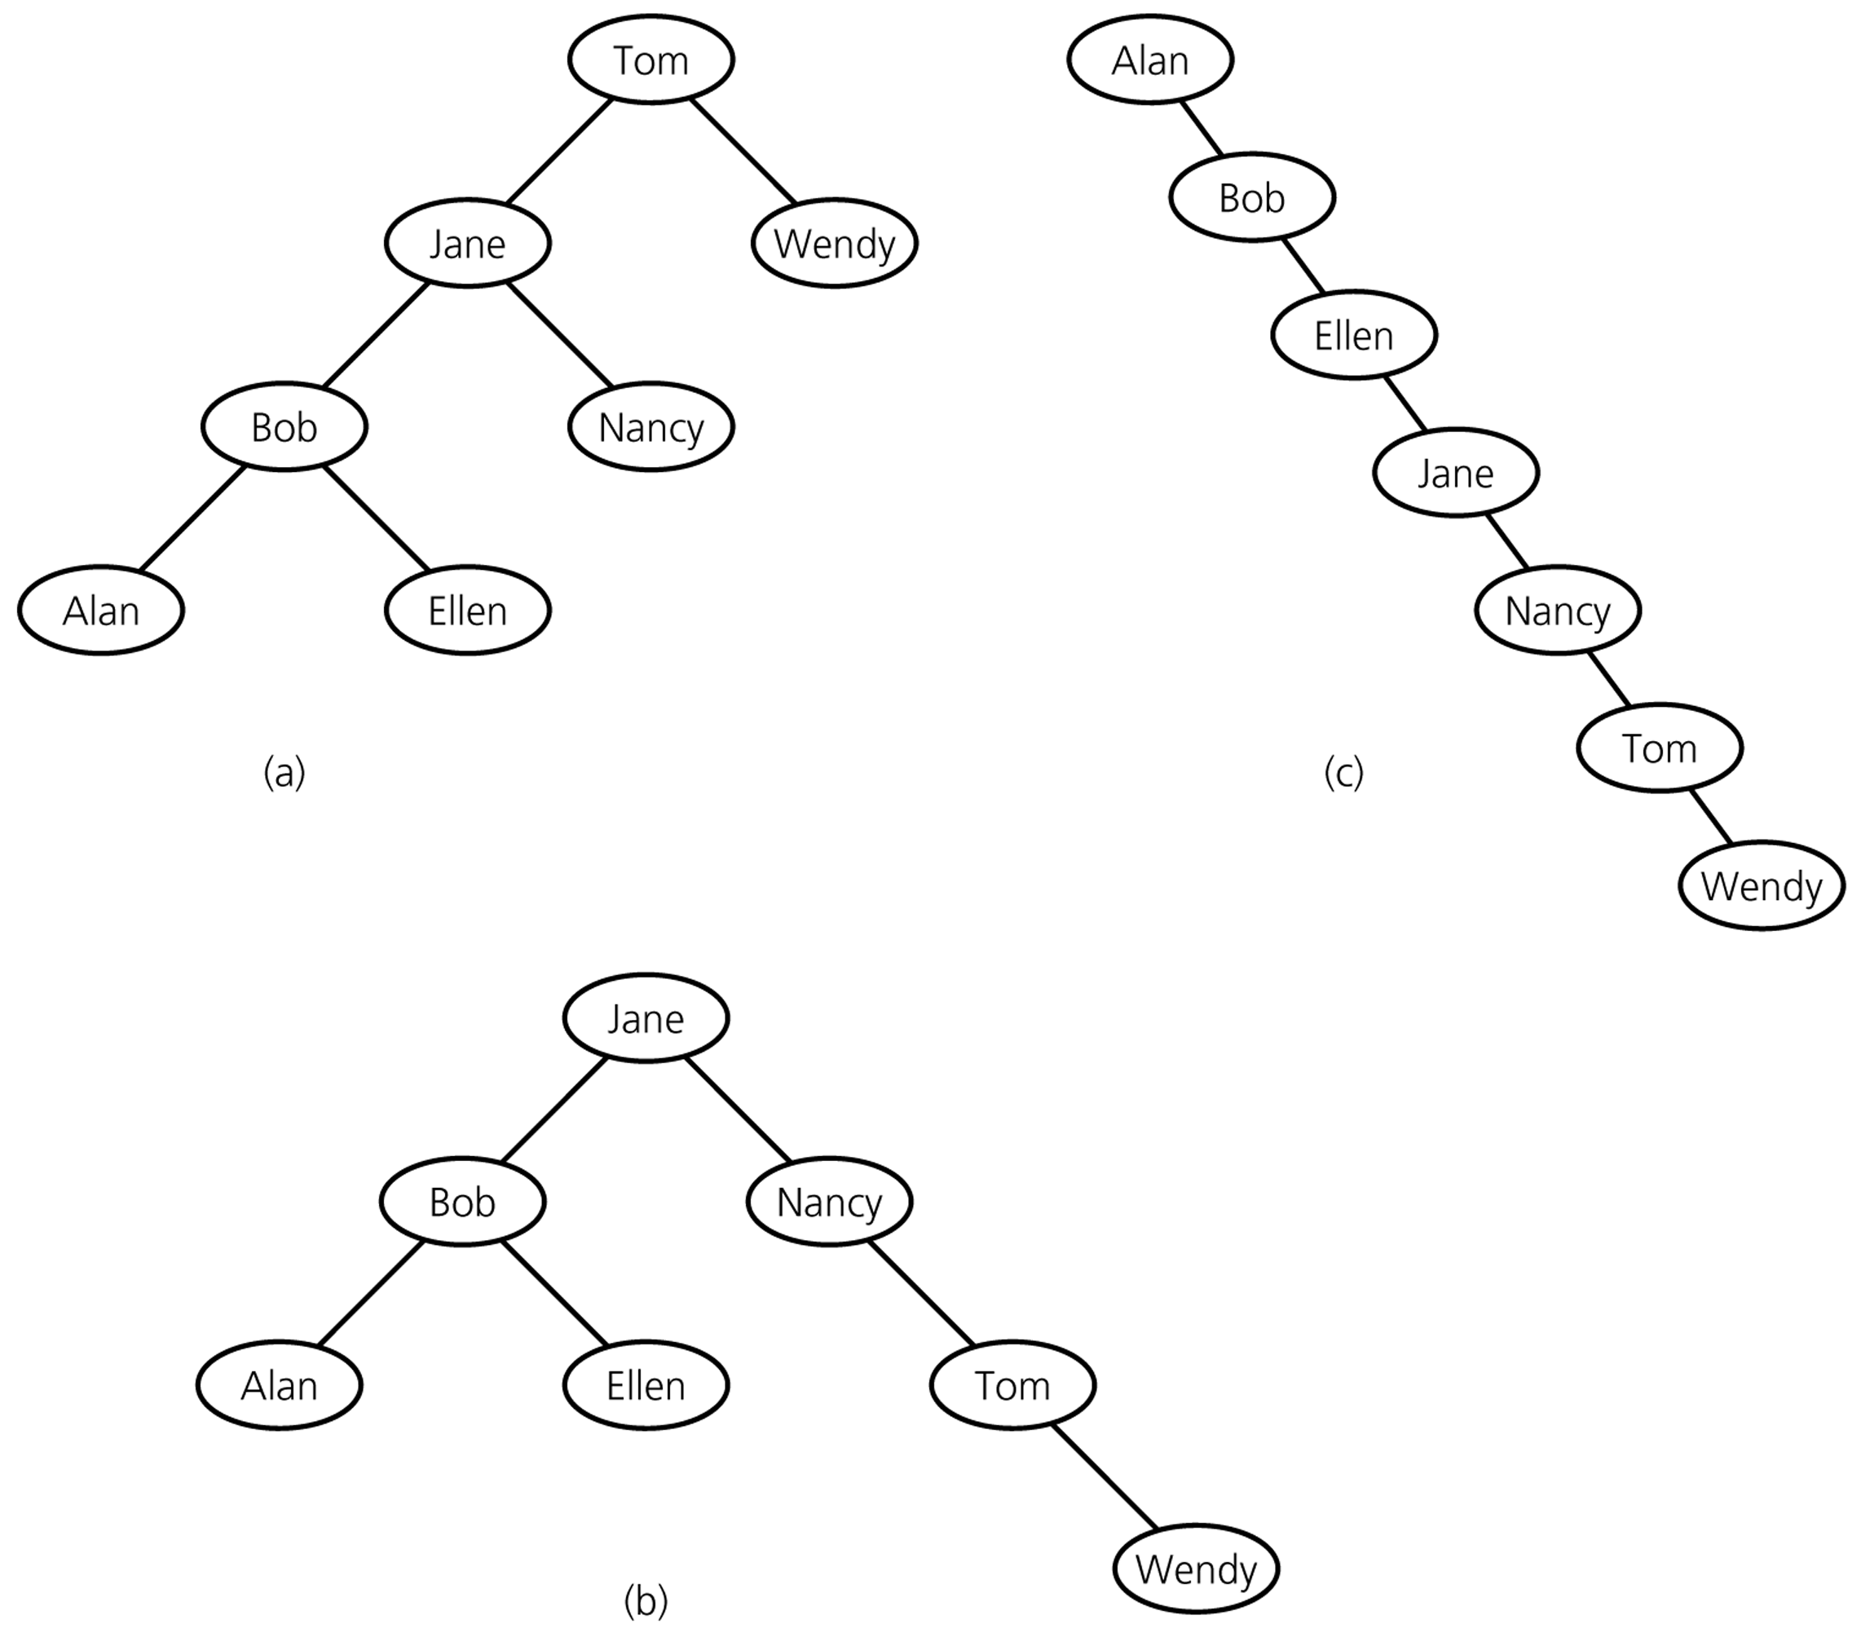
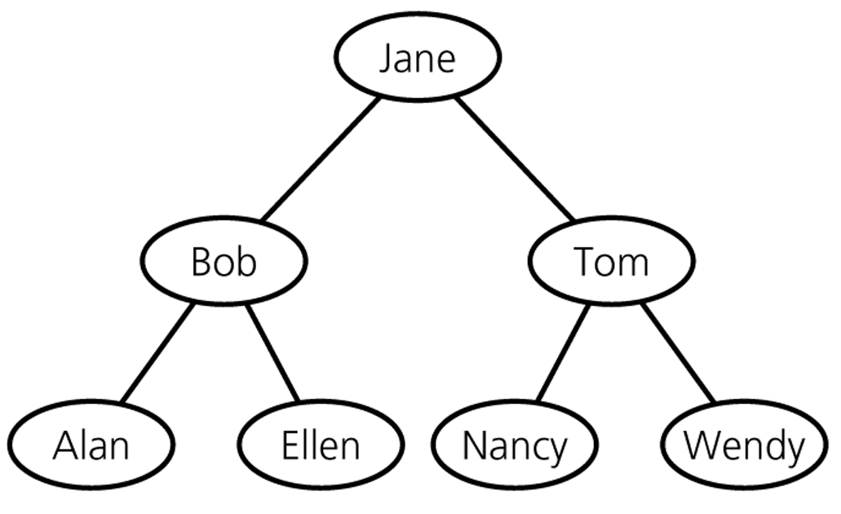
Binary Search Trees – containing same data

Slide 47
Operations on BSTs
Most of the operations on binary trees are O(logN).
This is the main motivation for using binary trees rather than using ordinary lists to store items.
Most of the operations can be implemented using recursion.
we generally do not need to worry about running out of stack space, since the average depth of binary search trees is O(logN).

Slide 48
Insert operation
Algorithm for inserting X into tree T:
Proceed down the tree as you would with a find operation.
if X is found
do nothing, (or “update” something) else
insert X at the last spot on the path traversed.

Slide 49
Deletion operation
There are three cases to consider:
Deleting a leaf node
Replace the link to the deleted node by NULL.
Deleting a node with one child:
The node can be deleted after its parent adjusts a link to bypass the node.
Deleting a node with two children:
The deleted value must be replaced by an existing value that is either one of the following:
The largest value in the deleted node’s left subtree
The smallest value in the deleted node’s right subtree.

Slide 50
Deletion – Case1: A Leaf Node
To remove the leaf containing the item, we have to set the pointer in its parent to NULL.
Delete 70 (A leaf node)
50
50
➔
40
60
40
60
30
45
70
30
45
42
42

Slide 51
Deletion – Case2: A Node with only a left child
Delete 45 (A node with only a left child)
50
50
40
60
➔
40
60
30
45
70
30
42
70
42

Slide 52
Deletion – Case2: A Node with only a right child
Delete 60 (A node with only a right child)
50
50
➔
40
70
40
60
70
30
45
30
45
42
42

Slide 53
Deletion – Case3: A Node with two children
Locate the inorder successor of the node.
Copy the item in this node into the node which contains the item which will be deleted.
Delete the node of the inorder successor.
Delete 40 (A node with two children)
50
50
40
60
➔
42
60
30
45
70
30
45
70
42

Slide 54
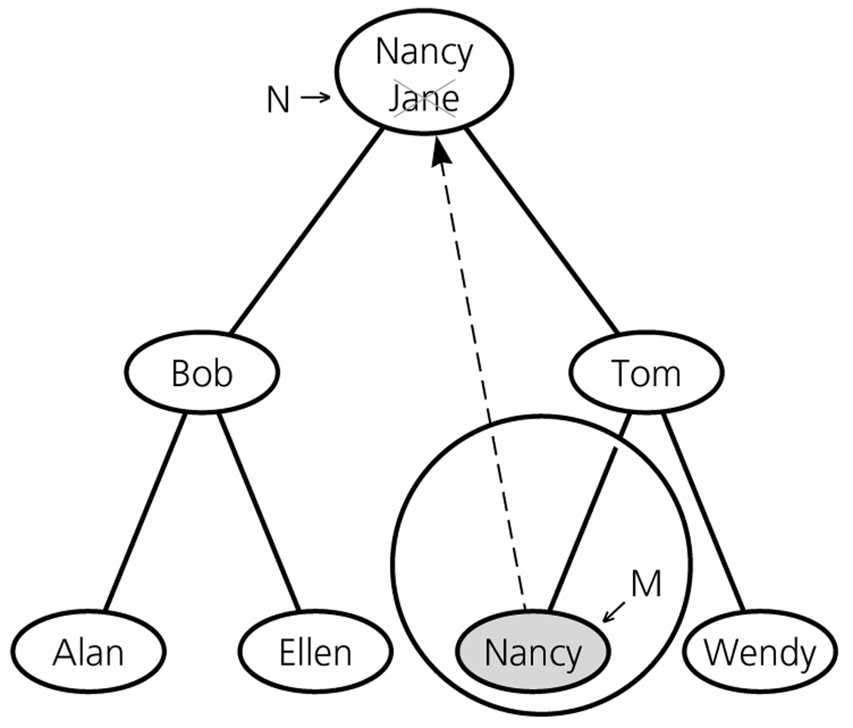
Deletion – Case3: A Node with two children

Slide 55
Analysis of BST Operations
The cost of an operation is proportional to the depth of the last accessed node.
The cost is logarithmic for a well-balanced tree, but it could be as bad as linear for a degenerate tree.
In the best case we have logarithmic access cost, and in the worst case we have linear access cost.

Slide 56
Minimum Height
That is, the height of an n-node binary search tree is:
Best Case – ⎡log₂(n+1)-1⎤ (see slide 25) ➔ O(log₂n)
Worst Case – n-1 ➔ O(n)
Average Case – close to ⎡log₂(n+1)-1⎤ ➔ O(log₂n)

Slide 57
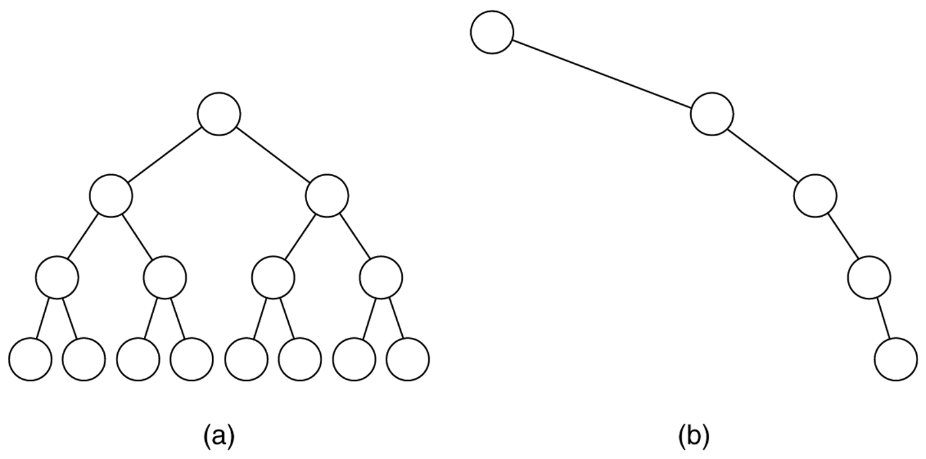
(a) The balanced tree has a height of log N; (b) the unbalanced tree has a height of N – 1.

Slide 58
Number of BSTs
Suppose we’re inserting n items into an empty binary search tree to create a
binary search tree with n nodes,
➔ How many different binary search trees with n nodes, and
What are their probabilities,
There are n! different orderings of n keys.
But how many different binary search trees with n nodes?
n=0 ➔ 1 BST (empty tree)
n=1 ➔ 1 BST (a binary tree with a single node)
n=2 ➔ 2 BSTs
n=3 ➔ 5 BSTs

Slide 59
Number of BSTs
•
•
•
•
•
n=3 ➔
•
•
•
•
•
•
•
•
•
•
Probabilities: 1/6 1/6 2/6 1/6 1/6
Insertion Order: 3,2,1 3,1,2 2,1,3 1,3,2 1,2,3
2,3,1
In general, given n elements, the number of binary search trees that can be made from those elements is given by the n^{th} Catalan Number (denoted C_{n}).
(2n)! C_{n} = ---------- (n+1)!n!

Slide 60
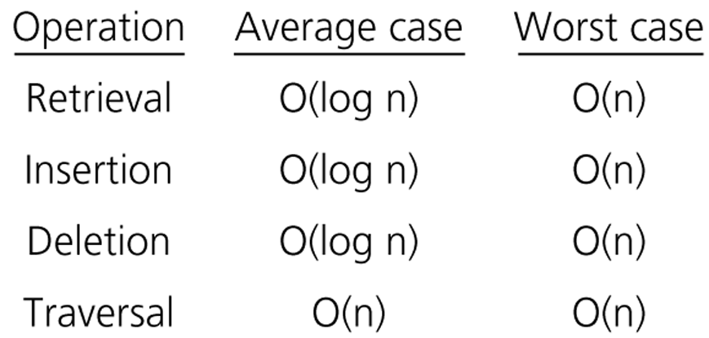
Order of Operations on BSTs

Slide 61
References
CENG707 - Data Structures and Algorithms by Yusuf Sahillioğlu

