Slide 1


Slide 2


Slide 3
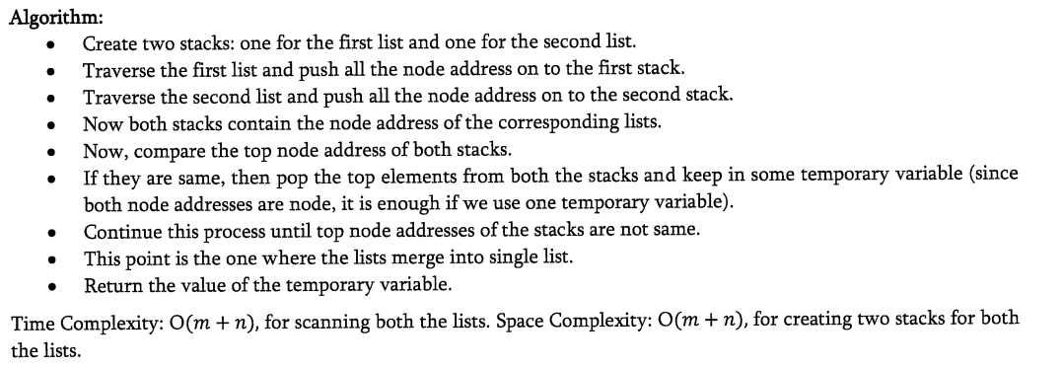

Slide 4

Can we solve this problem in one scan?

Slide 5
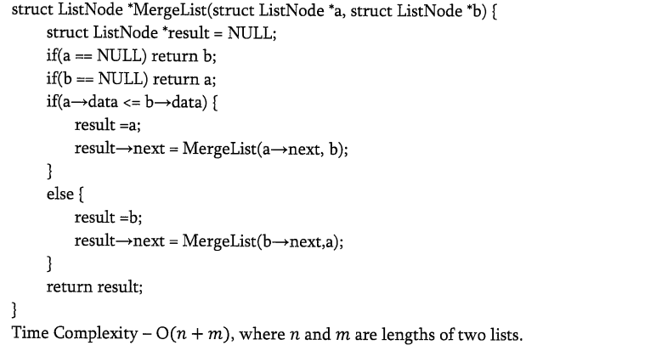

Slide 6


