Slide 1
Copyright © 2017 Pearson India Education Services Pvt. Ltd
CHAPTER 2
Database System Concepts and Architecture

Slide 2
Data Models
Data Model:
A set of concepts to describe the structure of a database, the operations for manipulating these structures, and certain constraints that the database should obey.
Data Model Structure and Constraints:
Constructs are used to define the database structure
Constructs typically include elements (and their data types) as well as groups of elements (e.g. entity, record, table), and relationships among such groups
Constraints specify some restrictions on valid data; these constraints must be enforced at all times
Copyright © 2017 Pearson India Education Services Pvt. Ltd

Slide 3
Data Models (continued)
Data Model Operations:
These operations are used for specifying database retrievals and updates by referring to the constructs of the data model.
Operations on the data model may include basic model operations (e.g. generic insert, delete, update) and user-defined operations (e.g. compute_student_gpa, update_inventory)
Copyright © 2017 Pearson India Education Services Pvt. Ltd

Slide 4
Schemas versus Instances
Database Schema:
The description of a database.
Includes descriptions of the database structure, data types, and the constraints on the database.
Schema Diagram:
An illustrative display of (most aspects of) a database schema.
Schema Construct:
A component of the schema or an object within the schema, e.g., STUDENT, COURSE.
Copyright © 2017 Pearson India Education Services Pvt. Ltd

Slide 5
Schemas versus Instances
Database State:
The actual data stored in a database at a particular moment in time. This includes the collection of all the data in the database.
Also called database instance (or occurrence or snapshot).
The term instance is also applied to individual database components, e.g. record instance, table instance, entity instance
Copyright © 2017 Pearson India Education Services Pvt. Ltd

Slide 6
Database Schema vs. Database State
Database State:
Refers to the content of a database at a moment in time.
Initial Database State:
Refers to the database state when it is initially loaded into the system.
Valid State:
A state that satisfies the structure and constraints of the database.
Copyright © 2017 Pearson India Education Services Pvt. Ltd

Slide 7
Database Schema
vs. Database State (continued)
Distinction
The database schema changes very infrequently.
The database state changes every time the database is updated.
Schema is also called intension.
State is also called extension.
Copyright © 2017 Pearson India Education Services Pvt. Ltd

Slide 8
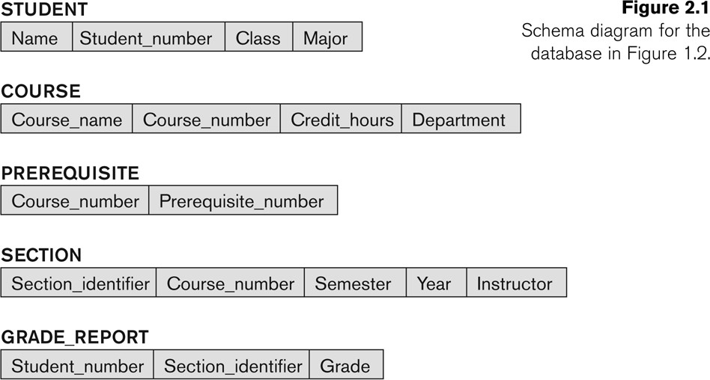
Example of a Database Schema
Copyright © 2017 Pearson India Education Services Pvt. Ltd

Slide 9
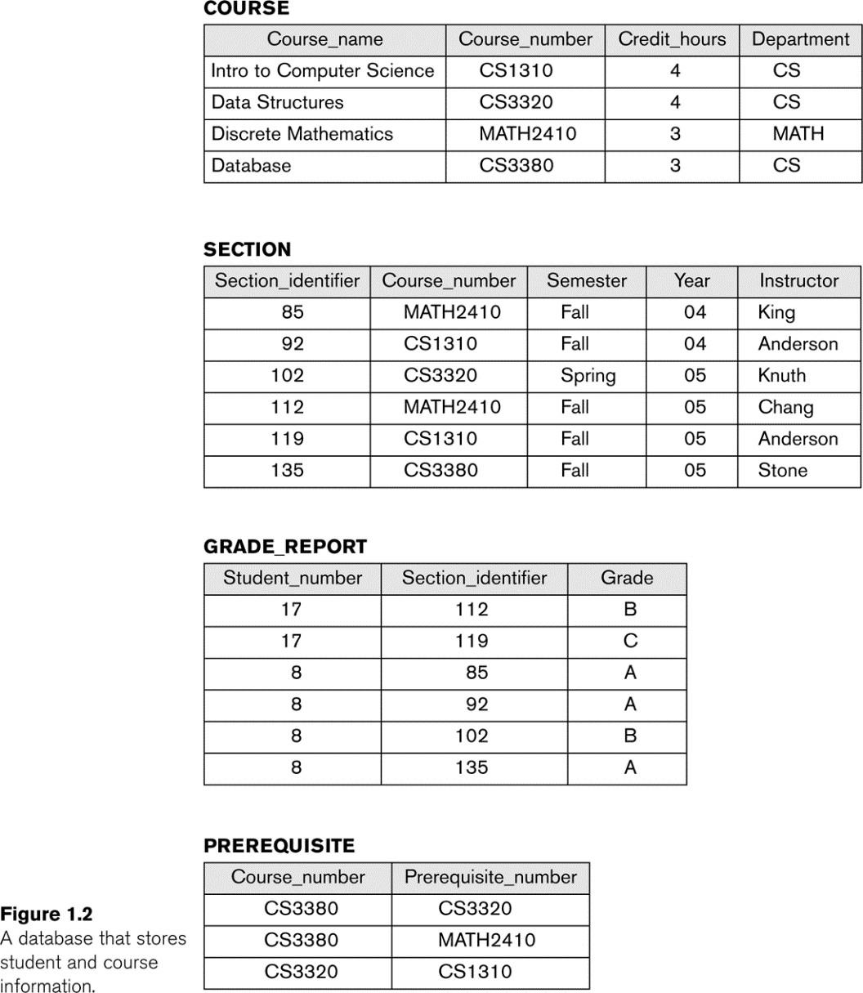
Example of a database state
Copyright © 2017 Pearson India Education Services Pvt. Ltd

Slide 10
Three-Schema Architecture
Proposed to support DBMS characteristics of:
Program-data independence.
Support of multiple views of the data.
Not explicitly used in commercial DBMS products, but has been useful in explaining database system organization
Copyright © 2017 Pearson India Education Services Pvt. Ltd

Slide 11
Three-Schema Architecture
Defines DBMS schemas at three levels:
Internal schema at the internal level to describe physical storage structures and access paths (e.g indexes).
Typically uses a physical data model.
Conceptual schema at the conceptual level to describe the structure and constraints for the whole database for a community of users.
Uses a conceptual or an implementation data model.
External schemas at the external level to describe the various user views.
Usually uses the same data model as the conceptual schema.
Copyright © 2017 Pearson India Education Services Pvt. Ltd

Slide 12
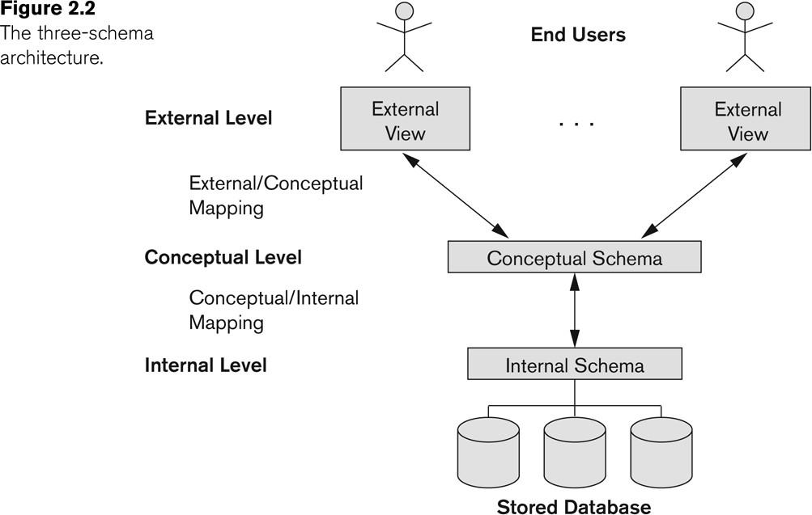
The three-schema architecture
Copyright © 2017 Pearson India Education Services Pvt. Ltd

Slide 13
Three-Schema Architecture
Mappings among schema levels are needed to transform requests and data.
Programs refer to an external schema, and are mapped by the DBMS to the internal schema for execution.
Data extracted from the internal DBMS level is reformatted to match the user’s external view (e.g. formatting the results of an SQL query for display in a Web page)
Copyright © 2017 Pearson India Education Services Pvt. Ltd

Slide 14
Data Independence
Logical Data Independence:
The capacity to change the conceptual schema without having to change the external schemas and their associated application programs.
Physical Data Independence:
The capacity to change the internal schema without having to change the conceptual schema.
For example, the internal schema may be changed when certain file structures are reorganized or new indexes are created to improve database performance
Copyright © 2017 Pearson India Education Services Pvt. Ltd

Slide 15
Data Independence (continued)
When a schema at a lower level is changed, only the mappings between this schema and higher- level schemas need to be changed in a DBMS that fully supports data independence.
The higher-level schemas themselves are
unchanged.
Hence, the application programs need not be changed since they refer to the external schemas.
Copyright © 2017 Pearson India Education Services Pvt. Ltd

Slide 16
DBMS Languages
Data Definition Language (DDL)
Data Manipulation Language (DML)
High-Level or Non-procedural Languages: These include the relational language SQL
May be used in a standalone way or may be embedded in a programming language
Low Level or Procedural Languages:
These must be embedded in a programming language
Copyright © 2017 Pearson India Education Services Pvt. Ltd

Slide 17
DBMS Languages
Data Definition Language (DDL):
Used by the DBA and database designers to specify the conceptual schema of a database.
In many DBMSs, the DDL is also used to define internal and external schemas (views).
In some DBMSs, separate storage definition language (SDL) and view definition language (VDL) are used to define internal and external schemas.
SDL is typically realized via DBMS commands provided to the DBA and database designers
Copyright © 2017 Pearson India Education Services Pvt. Ltd

Slide 18
DBMS Languages
Data Manipulation Language (DML):
Used to specify database retrievals and updates
DML commands (data sublanguage) can be embedded in a general-purpose programming language (host language), such as COBOL, C, C++, or Java.
A library of functions can also be provided to access
the DBMS from a programming language
Alternatively, stand-alone DML commands can be applied directly (called a query language).
Copyright © 2017 Pearson India Education Services Pvt. Ltd

Slide 19
Types of DML
High Level or Non-procedural Language:
For example, the SQL relational language
Are “set”-oriented and specify what data to retrieve rather than how to retrieve it.
Also called declarative languages.
Low Level or Procedural Language:
Retrieve data one record-at-a-time;
Constructs such as looping are needed to retrieve multiple records, along with positioning pointers.
Copyright © 2017 Pearson India Education Services Pvt. Ltd

Slide 20
DBMS Interfaces
Stand-alone query language interfaces
Example: Entering SQL queries at the DBMS interactive SQL interface (e.g. SQL*Plus in ORACLE)
Programmer interfaces for embedding DML in programming languages
User-friendly interfaces
Menu-based, forms-based, graphics-based, etc.
Mobile Interfaces:interfaces allowing users to perform transactions using mobile apps
Copyright © 2017 Pearson India Education Services Pvt. Ltd

Slide 21
DBMS Programming Language Interfaces
Programmer interfaces for embedding DML in a programming languages:
Embedded Approach: e.g embedded SQL (for C, C++, etc.),
SQLJ (for Java)
Procedure Call Approach: e.g. JDBC for Java, ODBC (Open Databse Connectivity) for other programming languages as API’s (application programming interfaces)
Database Programming Language Approach: e.g. ORACLE has PL/SQL, a programming language based on SQL; language incorporates SQL and its data types as integral components
Scripting Languages: PHP (client-side scripting) and Python (server-side scripting) are used to write database programs.
Copyright © 2017 Pearson India Education Services Pvt. Ltd

Slide 22
User-Friendly DBMS Interfaces
Menu-based (Web-based), popular for browsing on the web
Forms-based, designed for naïve users used to filling in entries on a form
Graphics-based
Point and Click, Drag and Drop, etc.
Specifying a query on a schema diagram
Natural language: requests in written English
Combinations of the above:
For example, both menus and forms used
extensively in Web database interfaces
Copyright © 2017 Pearson India Education Services Pvt. Ltd

Slide 23
Other DBMS Interfaces
Natural language: free text as a query
Speech : Input query and Output response
Web Browser with keyword search
Parametric interfaces, e.g., bank tellers using function keys.
Interfaces for the DBA:
Creating user accounts, granting authorizations
Setting system parameters
Changing schemas or access paths
Copyright © 2017 Pearson India Education Services Pvt. Ltd

Slide 24
Centralized and
Client-Server DBMS Architectures
Centralized DBMS:
Combines everything into single system including- DBMS software, hardware, application programs, and user interface processing software.
User can still connect through a remote terminal – however, all processing is done at centralized site.
Copyright © 2017 Pearson India Education Services Pvt. Ltd

Slide 25
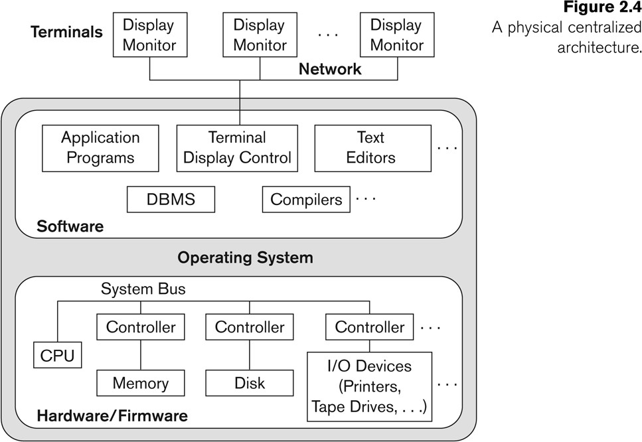
A Physical Centralized Architecture
Copyright © 2017 Pearson India Education Services Pvt. Ltd

Slide 26
Review Questions
2.1. Define the following terms: data model, database schema, database state,internal schema,conceptual schema, external schema, data independence,DDL, DML, SDL, VDL, query language, host language, data sublanguage,database utility,catalog,
client/server architecture, three-tier architecture,
and n-tier architecture.
2.2. Discuss the main categories of data models. What are the basic differences
among the relational model, the object model, and the XML model?

Slide 27
2.3. What is the difference between a database schema and a database state?
2.4. Describe the three-schema architecture. Why do we need mappings among schema levels? How do different schema definition languages support this
architecture?
2.5. What is the difference between logical data independence and physical data
independence? Which one is harder to achieve? Why?
2.6. What is the difference between procedural and nonprocedural DMLs?
2.7. Discuss the different types of user-friendly interfaces and the types of users who typically use each.

Slide 28
2.8. With what other computer system software does a DBMS interact?
2.9. What is the difference between the two-tier and three-tier client/server architectures?
2.10. Discuss some types of database utilities and tools and their functions.
2.11. What is the additional functionality incorporated in n-tier architecture (n . 3)?
Exercises
2.12. Think of different users for the database shown in Figure 1.2. What types of applications would each user need? To which user category would each
belong, and what type of interface would each need?

Slide 29
2.13. Choose a database application with which you are familiar. Design a schema and show a sample database for that application, using the notation of Figures1.2 and 2.1. What types of additional information and constraints would you like to represent in the schema? Think of several users of your database, and design a view for each.
2.14. If you were designing a Web-based system to make airline reservations and sell airline tickets, which DBMS architecture would you choose from Section 2.5? Why? Why would the other architectures not be a good choice?

Slide 30
2.15. Consider Figure 2.1. In addition to constraints relating the values of columns in one table to columns in another table, there are also constraints that impose restrictions on values in a column or a combination of columns within a table. One such constraint dictates that a column or a group of columns must be unique across all rows in the table. For example, in the STUDENT table, the Student_number column must be unique (to prevent two different students from having the same Student_number). Identify the column or the group of columns in the other tables that must be unique across all rows in the table.

