Slide 1
Copyright © 2017 Pearson India Education Services Pvt. Ltd
CHAPTER 3
Data Modeling Using the Entity-Relationship (ER) Model

Slide 2
Chapter Outline
Overview of Database Design Process
Example Database Application (COMPANY)
ER Model Concepts
Entities and Attributes
Entity Types, Value Sets, and Key Attributes
Relationships and Relationship Types
Weak Entity Types
Roles and Attributes in Relationship Types
ER Diagrams - Notation
ER Diagram for COMPANY Schema
Alternative Notations – UML class diagrams, others
Relationships of Higher Degree
Copyright © 2017 Pearson India Education Services Pvt. Ltd

Slide 3
Overview of Database Design Process
Two main activities:
Database design
Applications design
Focus in this chapter on conceptual database design
To design the conceptual schema for a database application
Applications design focuses on the programs and interfaces that access the database
Generally considered part of software engineering
Copyright © 2017 Pearson India Education Services Pvt. Ltd

Slide 4
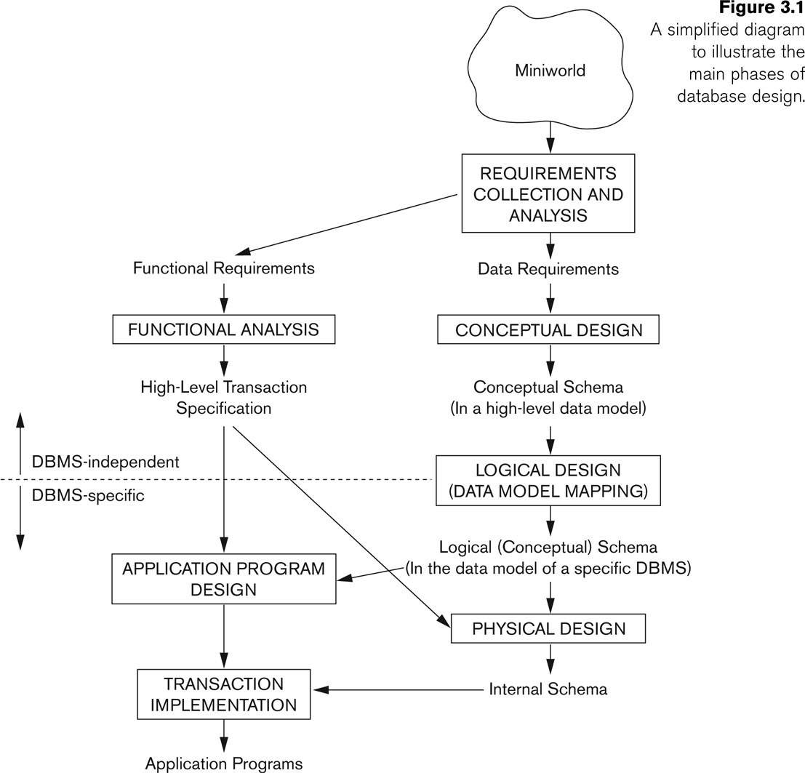
Overview of Database Design Process
Copyright © 2017 Pearson India Education Services Pvt. Ltd

Slide 5
Methodologies for Conceptual Design
Entity Relationship (ER) Diagrams (This Chapter)
Enhanced Entity Relationship (EER) Diagrams (Chapter 4)
Use of Design Tools in industry for designing and documenting large scale designs
The UML (Unified Modeling Language) Class Diagrams are popular in industry to document conceptual database designs
Copyright © 2017 Pearson India Education Services Pvt. Ltd

Slide 6
Example COMPANY Database
We need to create a database schema design based on the following (simplified) requirements of the COMPANY Database:
The company is organized into DEPARTMENTs. Each department has a name, number and an employee who manages the department. We keep track of the start date of the department manager. A department may have several locations.
Each department controls a number of PROJECTs. Each project has a unique name, unique number and is located at a single location.
Copyright © 2017 Pearson India Education Services Pvt. Ltd

Slide 7
Example COMPANY Database (Continued)
The database will store each EMPLOYEE’s social security number, address, salary, sex, and birthdate.
Each employee works for one department but may
work on several projects.
The DB will keep track of the number of hours per week that an employee currently works on each project.
It is required to keep track of the direct supervisor of each employee.
Each employee may have a number of DEPENDENTs.
For each dependent, the DB keeps a record of name, sex, birthdate, and relationship to the employee.
Copyright © 2017 Pearson India Education Services Pvt. Ltd

Slide 8
ER Model Concepts
Entities and Attributes
Entity is a basic concept for the ER model. Entities are specific things or objects in the mini-world that are represented in the database.
For example the EMPLOYEE John Smith, the Research
DEPARTMENT, the ProductX PROJECT
Attributes are properties used to describe an entity.
For example an EMPLOYEE entity may have the attributes Name, SSN, Address, Sex, BirthDate
A specific entity will have a value for each of its attributes.
For example a specific employee entity may have Name='John Smith', SSN='123456789', Address ='731, Fondren, Houston, TX', Sex='M', BirthDate='09-JAN-55‘
Each attribute has a value set (or data type) associated with
it – e.g. integer, string, date, enumerated type, …
Copyright © 2017 Pearson India Education Services Pvt. Ltd

Slide 9
Types of Attributes (1)
Simple
Each entity has a single atomic value for the attribute. For example, SSN or Sex.
Composite
The attribute may be composed of several components. For
example:
Address(Apt#, House#, Street, City, State, ZipCode, Country), or
Name(FirstName, MiddleName, LastName).
Composition may form a hierarchy where some components
are themselves composite.
Multi-valued
An entity may have multiple values for that attribute. For example, Color of a CAR or PreviousDegrees of a STUDENT.
Denoted as {Color} or {PreviousDegrees}.
Copyright © 2017 Pearson India Education Services Pvt. Ltd

Slide 10
Types of Attributes (2)
In general, composite and multi-valued attributes may be nested arbitrarily to any number of levels, although this is rare.
For example, PreviousDegrees of a STUDENT is a composite multi-valued attribute denoted by
{PreviousDegrees (College, Year, Degree, Field)}
Multiple PreviousDegrees values can exist
Each has four subcomponent attributes:
College, Year, Degree, Field
Copyright © 2017 Pearson India Education Services Pvt. Ltd

Slide 11
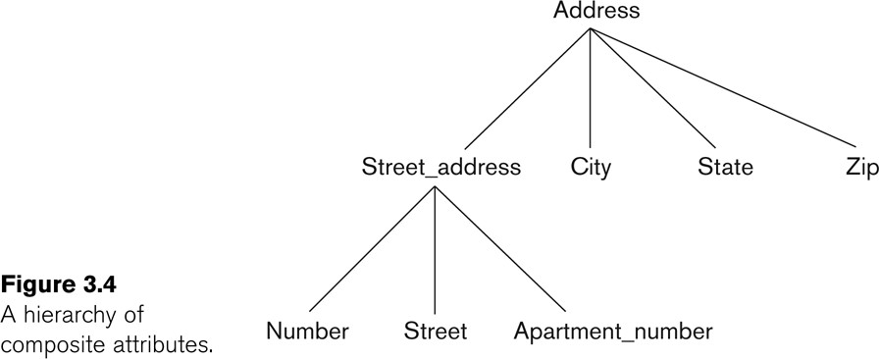
Example of a composite attribute
Copyright © 2017 Pearson India Education Services Pvt. Ltd

Slide 12
Entity Types and Key Attributes (1)
Entities with the same basic attributes are grouped or typed into an entity type.
For example, the entity type EMPLOYEE and PROJECT.
An attribute of an entity type for which each entity must have a unique value is called a key attribute of the entity type.
For example, SSN of EMPLOYEE.
Copyright © 2017 Pearson India Education Services Pvt. Ltd

Slide 13
Entity Types and Key Attributes (2)
A key attribute may be composite.
VehicleTagNumber is a key of the CAR entity type with components (Number, State).
An entity type may have more than one key.
The CAR entity type may have two keys:
VehicleIdentificationNumber (popularly called VIN)
VehicleTagNumber (Number, State), aka license plate number.
Each key is underlined (Note: this is different from the relational schema where only one “primary key is underlined).
Copyright © 2017 Pearson India Education Services Pvt. Ltd

Slide 14
Entity Set
Each entity type will have a collection of entities stored in the database
Called the entity set or sometimes entity collection
Previous slide shows three CAR entity instances in the entity set for CAR
Same name (CAR) used to refer to both the entity type and the entity set
However, entity type and entity set may be given different names
Entity set is the current state of the entities of that type that are stored in the database
Copyright © 2017 Pearson India Education Services Pvt. Ltd

Slide 15
Value Sets (Domains) of Attributes
Each simple attribute is associated with a value set
E.g., Lastname has a value which is a character string of upto 15 characters, say
Date has a value consisting of MM-DD-YYYY where each letter is an integer
A value set specifies the set of values associated with an attribute
Copyright © 2017 Pearson India Education Services Pvt. Ltd

Slide 16
Attributes and Value Sets
Value sets are similar to data types in most programming languages – e.g., integer, character (n), real, bit
Mathematically, an attribute A for an entity type E whose value set is V is defined as a function
A : E -> P(V)
Where P(V) indicates a power set (which means all possible subsets) of V. The above definition covers simple and multivalued attributes.
We refer to the value of attribute A for entity e as A(e).
Copyright © 2017 Pearson India Education Services Pvt. Ltd

Slide 17
Displaying an Entity type
In ER diagrams, an entity type is displayed in a rectangular box
Attributes are displayed in ovals
Each attribute is connected to its entity type
Components of a composite attribute are connected to the oval representing the composite attribute
Each key attribute is underlined
Multivalued attributes displayed in double ovals
See the full ER notation in advance on the next slide
Copyright © 2017 Pearson India Education Services Pvt. Ltd

Slide 18
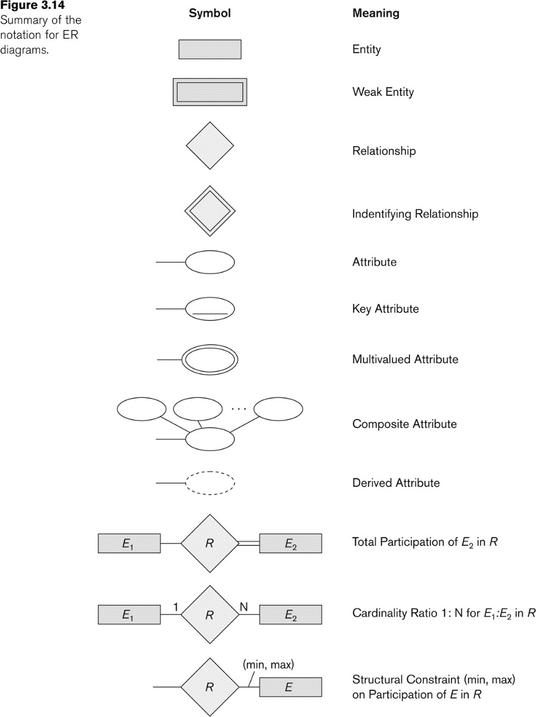
NOTATION for ER diagrams
Copyright © 2017 Pearson India Education Services Pvt. Ltd
This is used to define the relation between the strong entity
This is used to define the relation between the strong and weak entity

Slide 19
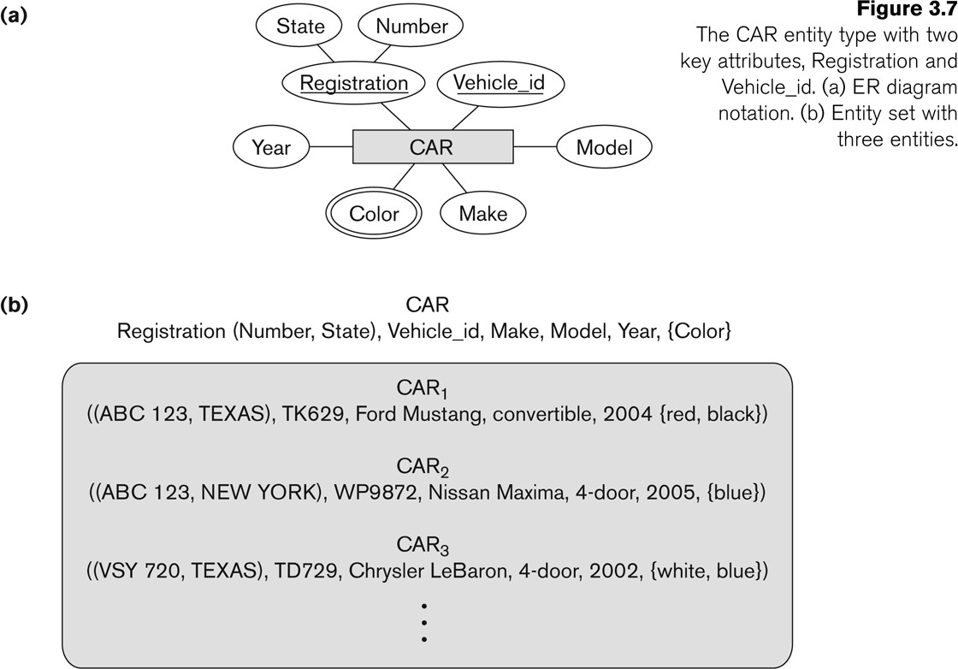
Entity Type CAR with two keys and a corresponding Entity Set
Copyright © 2017 Pearson India Education Services Pvt. Ltd

Slide 20
Initial Conceptual Design of Entity Types for the COMPANY Database Schema
Based on the requirements, we can identify four initial entity types in the COMPANY database:
DEPARTMENT
PROJECT
EMPLOYEE
DEPENDENT
Their initial conceptual design is shown on the following slide
The initial attributes shown are derived from the requirements description
Copyright © 2017 Pearson India Education Services Pvt. Ltd

Slide 21
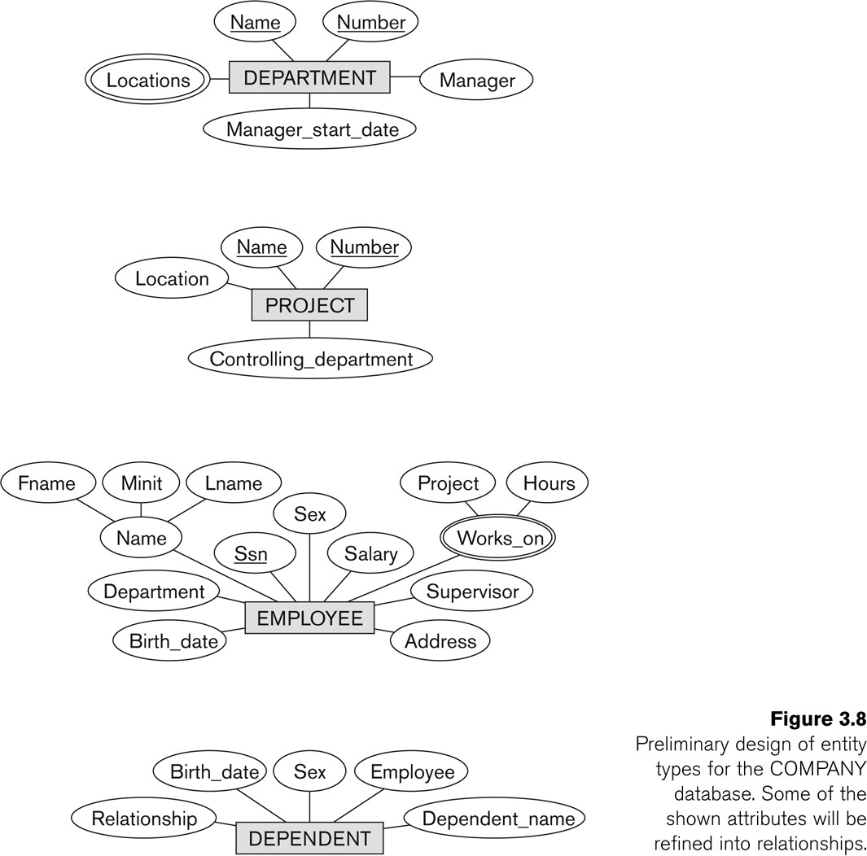
Initial Design of Entity Types:
EMPLOYEE, DEPARTMENT, PROJECT
Copyright © 2017 Pearson India Education Services Pvt. Ltd

Slide 22
Refining the initial design by introducing
relationships
The initial design is typically not complete
Some aspects in the requirements will be represented as relationships
ER model has three main concepts:
Entities (and their entity types and entity sets)
Attributes (simple, composite, multivalued)
Relationships (and their relationship types and relationship sets)
We introduce relationship concepts next
Copyright © 2017 Pearson India Education Services Pvt. Ltd

Slide 23
Relationships and Relationship Types (1)
A relationship relates two or more distinct entities with a specific meaning.
For example, EMPLOYEE John Smith works on the ProductX PROJECT, or EMPLOYEE Franklin Wong manages the Research DEPARTMENT.
Relationships of the same type are grouped or typed into a relationship type.
For example, the WORKS_ON relationship type in which EMPLOYEEs and PROJECTs participate, or the MANAGES relationship type in which EMPLOYEEs and DEPARTMENTs participate.
The degree of a relationship type is the number of participating entity types.
Both MANAGES and WORKS_ON are binary relationships.
Copyright © 2017 Pearson India Education Services Pvt. Ltd

Slide 24
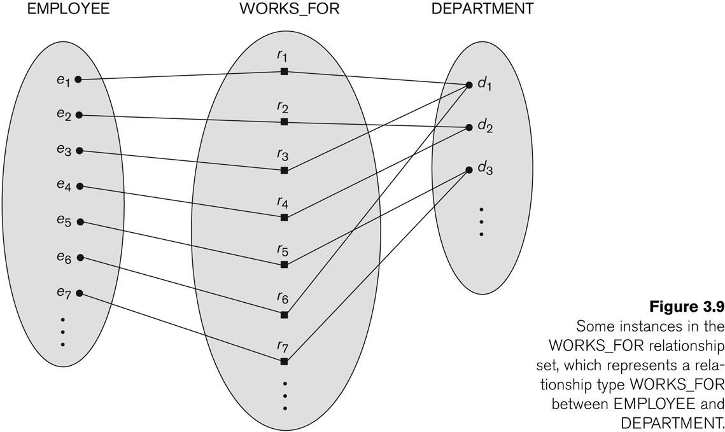
Relationship instances of the WORKS_FOR N:1 relationship between EMPLOYEE and DEPARTMENT
Copyright © 2017 Pearson India Education Services Pvt. Ltd

Slide 25
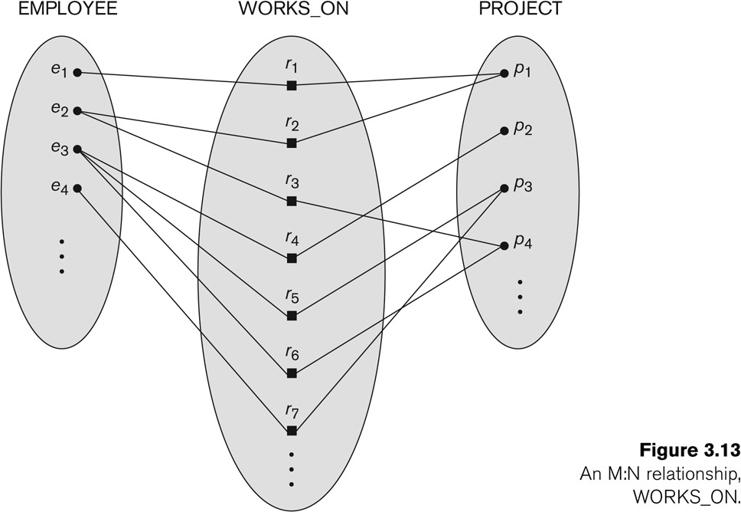
Relationship instances of the M:N WORKS_ON relationship between EMPLOYEE and PROJECT
Copyright © 2017 Pearson India Education Services Pvt. Ltd

Slide 26
Relationship type vs. relationship set (1)
Relationship Type:
Is the schema description of a relationship
Identifies the relationship name and the participating entity types
Also identifies certain relationship constraints
Relationship Set:
The current set of relationship instances represented in the database
The current state of a relationship type
Copyright © 2017 Pearson India Education Services Pvt. Ltd

Slide 27
Relationship type vs. relationship set (2)
Previous figures displayed the relationship sets
Each instance in the set relates individual participating entities – one from each participating entity type
In ER diagrams, we represent the relationship type as
follows:
Diamond-shaped box is used to display a relationship type
Connected to the participating entity types via straight lines
Note that the relationship type is not shown with an arrow. The name should be typically be readable from left to right and top to bottom.
Copyright © 2017 Pearson India Education Services Pvt. Ltd

Slide 28
Refining the COMPANY database schema by introducing relationships
By examining the requirements, six relationship types are identified
All are binary relationships( degree 2)
Listed below with their participating entity types:
WORKS_FOR (between EMPLOYEE, DEPARTMENT)
MANAGES (also between EMPLOYEE, DEPARTMENT)
CONTROLS (between DEPARTMENT, PROJECT)
WORKS_ON (between EMPLOYEE, PROJECT)
SUPERVISION (between EMPLOYEE (as subordinate), EMPLOYEE (as supervisor))
DEPENDENTS_OF (between EMPLOYEE, DEPENDENT)
Copyright © 2017 Pearson India Education Services Pvt. Ltd

Slide 29
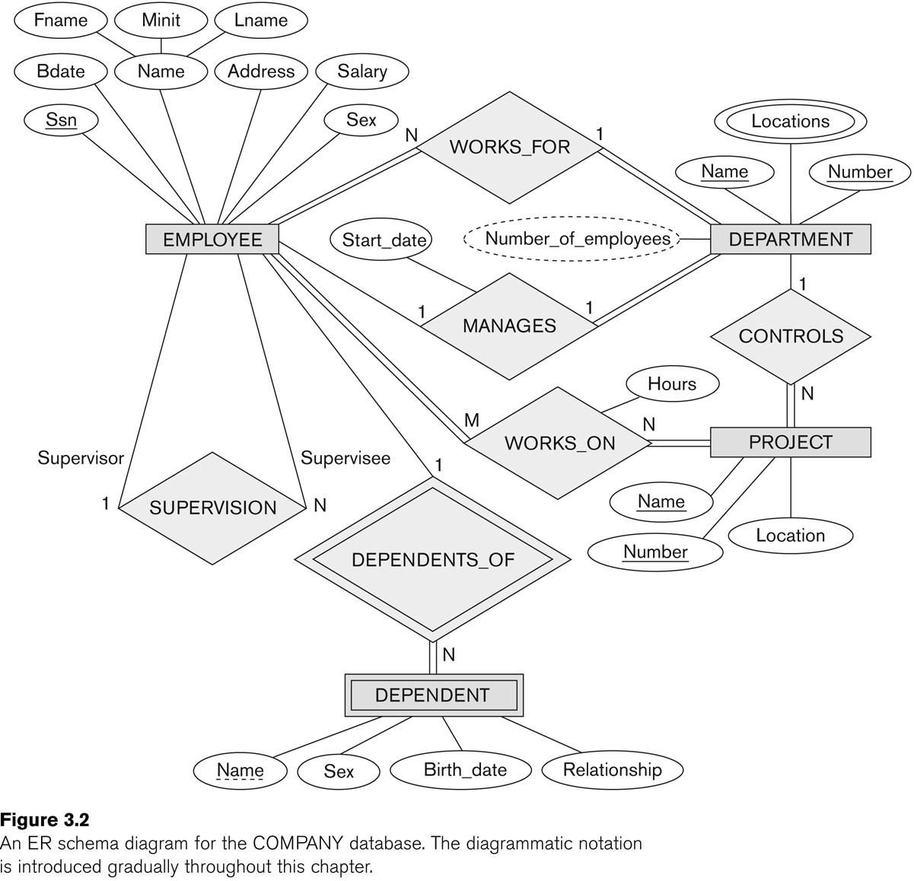
ER DIAGRAM – Relationship Types are:
WORKS_FOR, MANAGES, WORKS_ON, CONTROLS, SUPERVISION, DEPENDENTS_OF
Copyright © 2017 Pearson India Education Services Pvt. Ltd

Slide 30
Discussion on Relationship Types
In the refined design, some attributes from the initial entity types are refined into relationships:
Manager of DEPARTMENT -> MANAGES
Works_on of EMPLOYEE -> WORKS_ON
Department of EMPLOYEE -> WORKS_FOR
etc
In general, more than one relationship type can exist between the same participating entity types
MANAGES and WORKS_FOR are distinct relationship types between EMPLOYEE and DEPARTMENT
Different meanings and different relationship instances.
Copyright © 2017 Pearson India Education Services Pvt. Ltd

Slide 31
Constraints on Relationships
Constraints on Relationship Types
(Also known as ratio constraints)
Cardinality Ratio (specifies maximum participation)
One-to-one (1:1)
One-to-many (1:N) or Many-to-one (N:1)
Many-to-many (M:N)
Existence Dependency Constraint (specifies minimum
participation) (also called participation constraint)
zero (optional participation, not existence-dependent)
one or more (mandatory participation, existence-dependent)
Copyright © 2017 Pearson India Education Services Pvt. Ltd

Slide 32
Many-to-one (N:1) Relationship
Copyright © 2017 Pearson India Education Services Pvt. Ltd

Slide 33
Many-to-many (M:N) Relationship
Copyright © 2017 Pearson India Education Services Pvt. Ltd

Slide 34
Recursive Relationship Type
A relationship type between the same participating entity type in distinct roles
Also called a self-referencing relationship type.
Example: the SUPERVISION relationship
EMPLOYEE participates twice in two distinct roles:
supervisor (or boss) role
supervisee (or subordinate) role
Each relationship instance relates two distinct EMPLOYEE entities:
One employee in supervisor role
One employee in supervisee role
Copyright © 2017 Pearson India Education Services Pvt. Ltd

Slide 35
Displaying a recursive relationship
In a recursive relationship type.
Both participations are same entity type in different roles.
For example, SUPERVISION relationships between EMPLOYEE (in role of supervisor or boss) and (another) EMPLOYEE (in role of subordinate or worker).
In following figure, first role participation labeled with 1 and second role participation labeled with 2.
In ER diagram, need to display role names to distinguish participations.
Copyright © 2017 Pearson India Education Services Pvt. Ltd

Slide 36
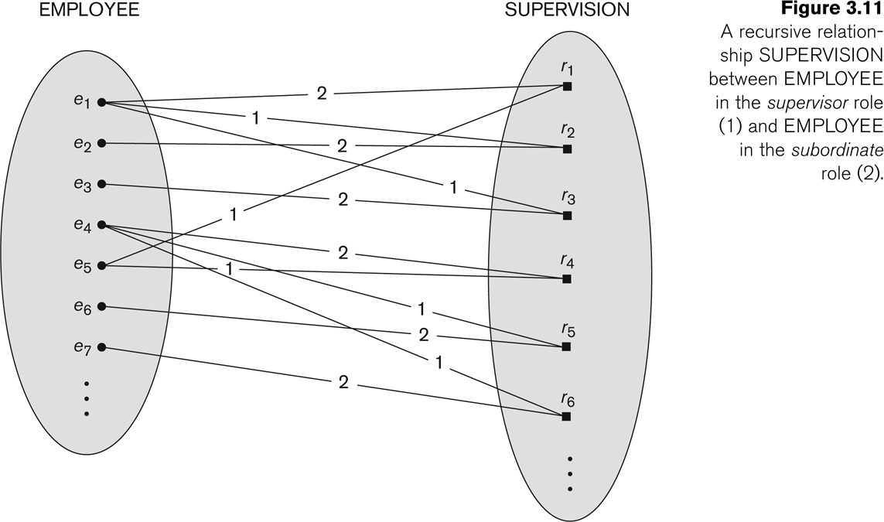
A Recursive Relationship Supervision`
Copyright © 2017 Pearson India Education Services Pvt. Ltd

Slide 37

Recursive Relationship Type is: SUPERVISION
(participation role names are shown)
Copyright © 2017 Pearson India Education Services Pvt. Ltd

Slide 38
Weak Entity Types
An entity that does not have a key attribute and that is identification- dependent on another entity type.
A weak entity must participate in an identifying relationship type with an owner or identifying entity type
Entities are identified by the combination of:
A partial key of the weak entity type
The particular entity they are related to in the identifying relationship type
Example:
A DEPENDENT entity is identified by the dependent’s first name,
and the specific EMPLOYEE with whom the dependent is related
Name of DEPENDENT is the partial key
DEPENDENT is a weak entity type
EMPLOYEE is its identifying entity type via the identifying
relationship type DEPENDENT_OF
Copyright © 2017 Pearson India Education Services Pvt. Ltd

Slide 39
Attributes of Relationship types
A relationship type can have attributes:
For example, HoursPerWeek of WORKS_ON
Its value for each relationship instance describes the number of hours per week that an EMPLOYEE works on a PROJECT.
A value of HoursPerWeek depends on a particular (employee, project) combination
Most relationship attributes are used with M:N relationships
In 1:N relationships, they can be transferred to the entity type on the N-side of the relationship
Copyright © 2017 Pearson India Education Services Pvt. Ltd

Slide 40
Example Attribute of a Relationship Type: Hours of WORKS_ON
Copyright © 2017 Pearson India Education Services Pvt. Ltd

Slide 41
Notation for Constraints on Relationships
Cardinality ratio (of a binary relationship): 1:1, 1:N, N:1, or M:N
Shown by placing appropriate numbers on the relationship edges.
Participation constraint (on each participating entity type): total (called existence dependency) or partial.
Total shown by double line, partial by single line.
NOTE: These are easy to specify for Binary Relationship Types.
Copyright © 2017 Pearson India Education Services Pvt. Ltd

Slide 42
Alternative (min, max) notation for relationship structural constraints:
Specified on each participation of an entity type E in a relationship
type R
Specifies that each entity e in E participates in at least min and at most max relationship instances in R
Default(no constraint): min=0, max=n (signifying no limit)
Must have min≤max, min≥0, max ≥1
Derived from the knowledge of mini-world constraints
Examples:
A department has exactly one manager and an employee can manage at most one department.
Specify (0,1) for participation of EMPLOYEE in MANAGES
Specify (1,1) for participation of DEPARTMENT in MANAGES
An employee can work for exactly one department but a department can have any number of employees.
Specify (1,1) for participation of EMPLOYEE in WORKS_FOR
Specify (0,n) for participation of DEPARTMENT in WORKS_FOR
Copyright © 2017 Pearson India Education Services Pvt. Ltd

Slide 43
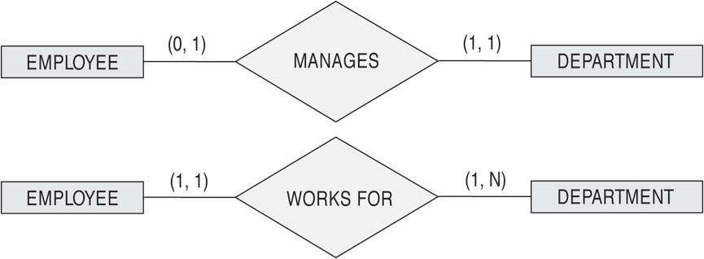
The (min,max) notation for relationship constraints
Copyright © 2017 Pearson India Education Services Pvt. Ltd
Read the min,max numbers next to the entity type and looking away from the entity type

Slide 44
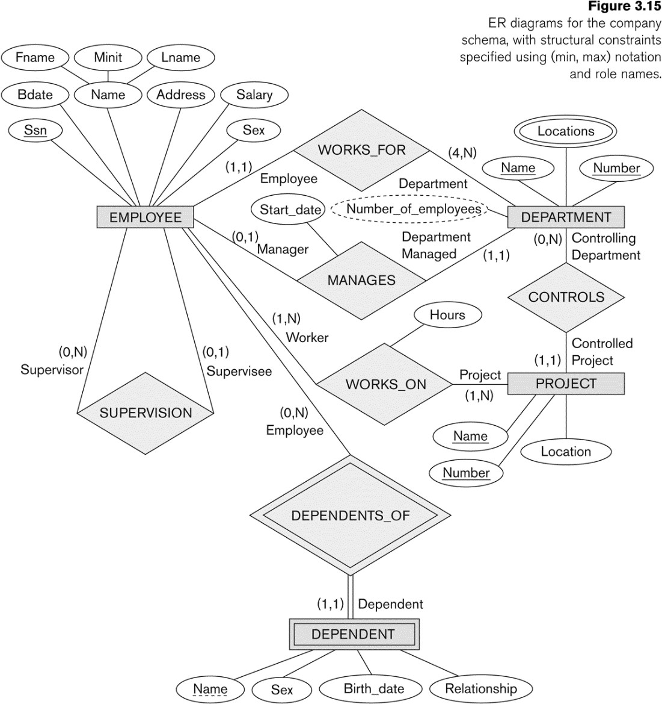
COMPANY ER Schema Diagram using (min, max) notation
Copyright © 2017 Pearson India Education Services Pvt. Ltd

Slide 45
Alternative diagrammatic notation
ER diagrams is one popular example for displaying database schemas
Many other notations exist in the literature and in various database design and modeling tools
Appendix A illustrates some of the alternative notations that have been used
UML class diagrams is representative of another way of displaying ER concepts that is used in several commercial design tools
Copyright © 2017 Pearson India Education Services Pvt. Ltd

Slide 46
Summary of notation for ER diagrams
Copyright © 2017 Pearson India Education Services Pvt. Ltd

Slide 47
Relationships of Higher Degree
Relationship types of degree 2 are called binary
Relationship types of degree 3 are called ternary and of degree n are called n-ary
In general, an n-ary relationship is not equivalent to n binary relationships
Constraints are harder to specify for higher- degree relationships (n > 2) than for binary relationships
Copyright © 2017 Pearson India Education Services Pvt. Ltd

Slide 48
Discussion of n-ary relationships (n > 2)
In general, 3 binary relationships can represent different information than a single ternary relationship (see Figure 3.17a and b on next slide)
If needed, the binary and n-ary relationships can all be included in the schema design (see Figure 3.17a and b, where all relationships convey different meanings)
In some cases, a ternary relationship can be represented as a weak entity if the data model allows a weak entity type to have multiple identifying relationships (and hence multiple owner entity types) (see Figure 3.17c)
Copyright © 2017 Pearson India Education Services Pvt. Ltd

Slide 49
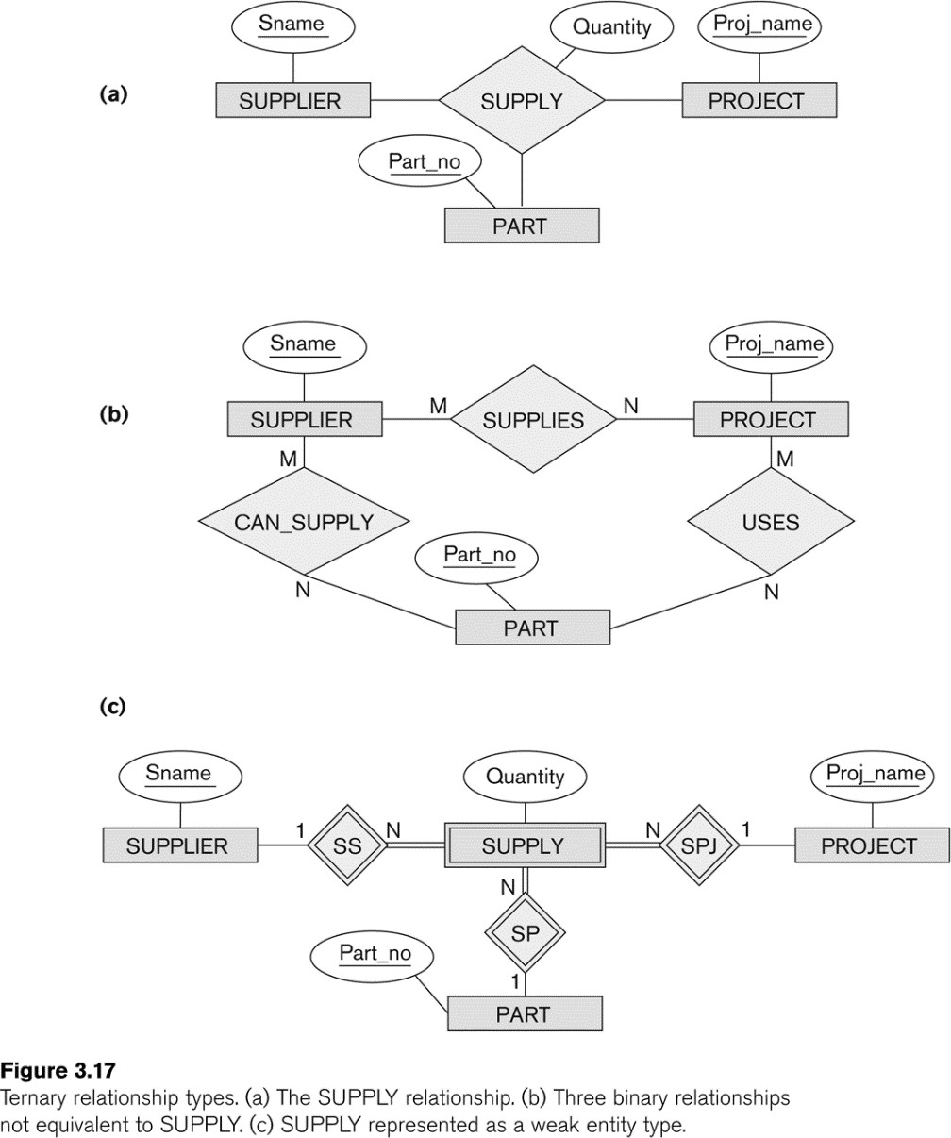
Example of a ternary relationship
Copyright © 2017 Pearson India Education Services Pvt. Ltd

Slide 50
Discussion of n-ary relationships (n > 2)
If a particular binary relationship can be derived from a higher-degree relationship at all times, then it is redundant
For example, the TAUGHT_DURING binary relationship in Figure 3.18 (see next slide) can be derived from the ternary relationship OFFERS (based on the meaning of the relationships)
Copyright © 2017 Pearson India Education Services Pvt. Ltd

Slide 51
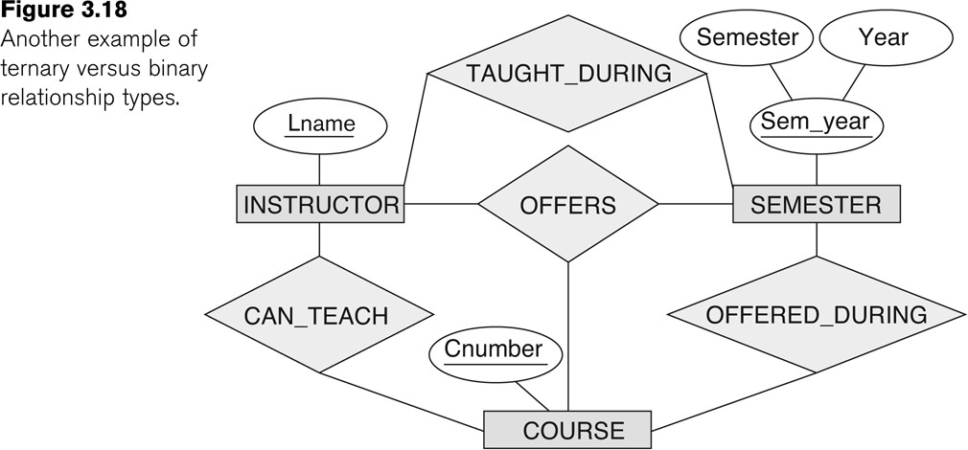
Another example of a ternary relationship
Copyright © 2017 Pearson India Education Services Pvt. Ltd

Slide 52
Displaying constraints on higher-degree relationships
The (min, max) constraints can be displayed on the edges
– however, they do not fully describe the constraints
Displaying a 1, M, or N indicates additional constraints
An M or N indicates no constraint
A 1 indicates that an entity can participate in at most one relationship instance that has a particular combination of the other participating entities
In general, both (min, max) and 1, M, or N are needed to
describe fully the constraints
Overall, the constraint specification is difficult and possibly ambiguous when we consider relationships of a degree higher than two.
Copyright © 2017 Pearson India Education Services Pvt. Ltd

Slide 53
Another Example: A UNIVERSITY Database
To keep track of the enrollments in classes and student grades, another database is to be designed.
It keeps track of the COLLEGEs, DEPARTMENTs within each college, the COURSEs offered by departments, and SECTIONs of courses, INSTRUCTORs who teach the sections etc.
These entity types and the relationships among these entity types are shown on the next slide in Figure 3.20.
Copyright © 2017 Pearson India Education Services Pvt. Ltd

Slide 54
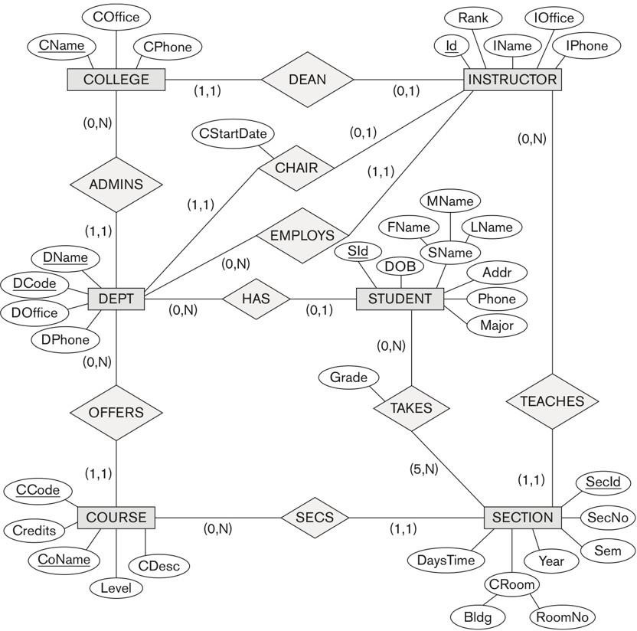
UNIVERSITY database conceptual schema
Copyright © 2017 Pearson India Education Services Pvt. Ltd

Slide 55
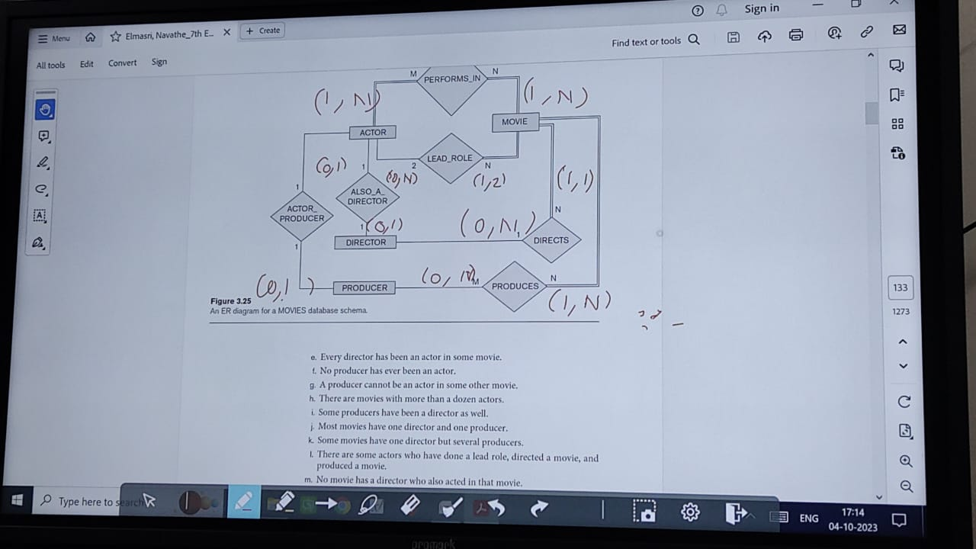

Slide 56
Review Questions 3.1. Discuss the role of a high-level data model in the database design process. 3.2. List the various cases where use of a NULL value would be appropriate. 3.3. Define the following terms: entity, attribute, attribute value, relationship instance, composite attribute, multivalued attribute, derived attribute, complex attribute, key attribute, and value set (domain).

Slide 57
3.4. What is an entity type? What is an entity set? Explain the differences among an entity, an entity type, and an entity set. 3.5. Explain the difference between an attribute and a value set. 3.6. What is a relationship type? Explain the differences among a relationship instance, a relationship type, and a relationship set.

Slide 58
3.7. What is a participation role? When is it necessary to use role names in the description of relationship types? 3.8. Describe the two alternatives for specifying structural constraints on relationship types. What are the advantages and disadvantages of each? 3.9. Under what conditions can an attribute of a binary relationship type be migrated to become an attribute of one of the participating entity types?

Slide 59
3.10. When we think of relationships as attributes, what are the value sets of these attributes? What class of data models is based on this concept? 3.11. What is meant by a recursive relationship type? Give some examples of recursive relationship types. 3.12. When is the concept of a weak entity used in data modeling? Define the terms owner entity type, weak entity type, identifying relationship type, and partial key. .

Slide 60
3.13. Can an identifying relationship of a weak entity type be of a degree greater than two? Give examples to illustrate your answer. 3.14. Discuss the conventions for displaying an ER schema as an ER diagram. 3.15. Discuss the naming conventions used for ER schema diagrams.

Slide 61
Exercises 3.16. Which combinations of attributes have to be unique for each individual SECTION entity in the UNIVERSITY database shown in Figure 3.20 to enforce each of the following miniworld constraints: a. During a particular semester and year, only one section can use a particular classroom at a particular DaysTime value.

Slide 62
b. During a particular semester and year, an instructor can teach only one section at a particular DaysTime value. c. During a particular semester and year, the section numbers for sections offered for the same course must all be different. Can you think of any other similar constraints?

Slide 63
Some more questions are pending

