Slide 1
Copyright © 2017 Pearson India Education Services Pvt. Ltd
CHAPTER 4
Enhanced Entity-Relationship (EER) Modeling

Slide 2
Subclasses and Superclasses (1)
An entity type may have additional meaningful subgroupings of its entities
Example: EMPLOYEE may be further grouped into:
SECRETARY, ENGINEER, TECHNICIAN, …
Based on the EMPLOYEE’s Job
MANAGER
EMPLOYEEs who are managers (the role they play)
SALARIED_EMPLOYEE, HOURLY_EMPLOYEE
Based on the EMPLOYEE’s method of pay
EER diagrams extend ER diagrams to represent these additional subgroupings, called subclasses or subtypes
Copyright © 2017 Pearson India Education Services Pvt. Ltd

Slide 3
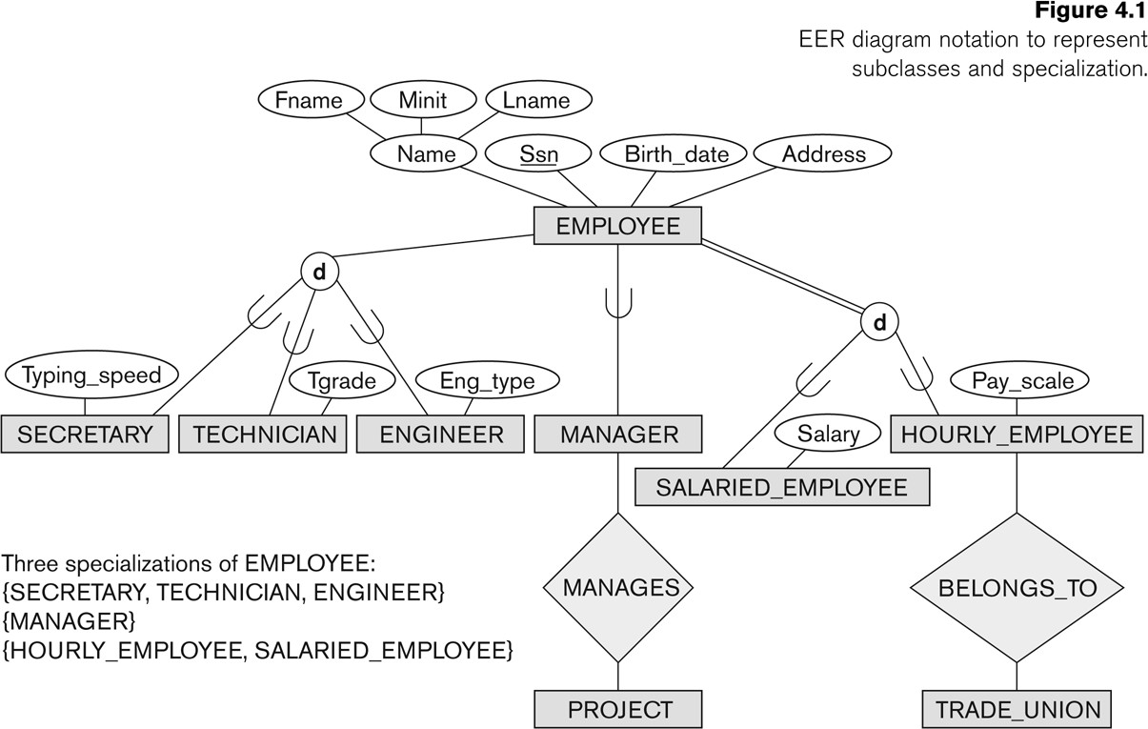
Subclasses and Superclasses
Copyright © 2017 Pearson India Education Services Pvt. Ltd

Slide 4
Subclasses and Superclasses (2)
Each of these subgroupings is a subset of EMPLOYEE entities
Each is called a subclass of EMPLOYEE
EMPLOYEE is the superclass for each of these subclasses
These are called superclass/subclass relationships:
EMPLOYEE/SECRETARY
EMPLOYEE/TECHNICIAN
EMPLOYEE/MANAGER
…
These are also called IS-A relationships
SECRETARY IS-A EMPLOYEE, TECHNICIAN IS-A EMPLOYEE, ….
Copyright © 2017 Pearson India Education Services Pvt. Ltd

Slide 5
Subclasses and Superclasses (4)
Examples:
A salaried employee who is also an engineer belongs to the two subclasses:
ENGINEER, and
SALARIED_EMPLOYEE
A salaried employee who is also an engineering manager belongs to the three subclasses:
MANAGER,
ENGINEER, and
SALARIED_EMPLOYEE
It is not necessary that every entity in a superclass be a member of some subclass
Copyright © 2017 Pearson India Education Services Pvt. Ltd

Slide 6
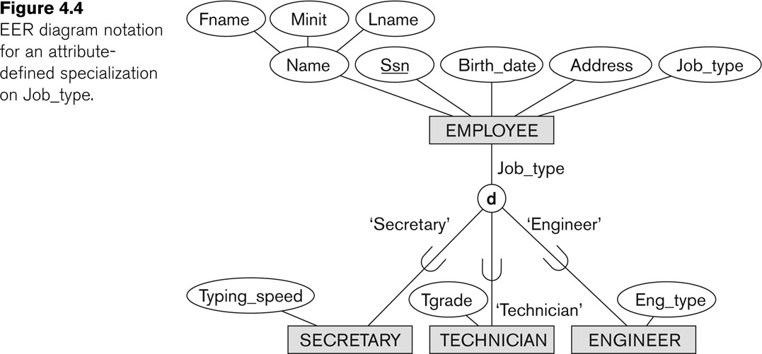
Representing Specialization in EER Diagrams
Copyright © 2017 Pearson India Education Services Pvt. Ltd

Slide 7
Attribute Inheritance in Superclass / Subclass Relationships
An entity that is member of a subclass inherits
All attributes of the entity as a member of the superclass
All relationships of the entity as a member of the superclass
Example:
In the previous slide, SECRETARY (as well as TECHNICIAN and ENGINEER) inherit the attributes Name, SSN, …, from EMPLOYEE
Every SECRETARY entity will have values for the inherited attributes
Copyright © 2017 Pearson India Education Services Pvt. Ltd

Slide 8
Specialization (1)
Specialization is the process of defining a set of subclasses of a superclass
The set of subclasses is based upon some distinguishing characteristics of the entities in the superclass
Example: {SECRETARY, ENGINEER, TECHNICIAN} is a specialization of EMPLOYEE based upon job type.
Example: MANAGER is a specialization of EMPLOYEE based on the role the employee plays
May have several specializations of the same superclass
Copyright © 2017 Pearson India Education Services Pvt. Ltd

Slide 9
Specialization (2)
Example: Another specialization of EMPLOYEE based on method of pay is {SALARIED_EMPLOYEE, HOURLY_EMPLOYEE}.
Superclass/subclass relationships and specialization can be
diagrammatically represented in EER diagrams
Attributes of a subclass are called specific or local
attributes.
For example, the attribute TypingSpeed of SECRETARY
The subclass can also participate in specific relationship types.
For example, a relationship BELONGS_TO of
HOURLY_EMPLOYEE
Copyright © 2017 Pearson India Education Services Pvt. Ltd

Slide 10
Specialization (3)
Copyright © 2017 Pearson India Education Services Pvt. Ltd

Slide 11
Generalization
Generalization is the reverse of the specialization process
Several classes with common features are generalized into a superclass;
original classes become its subclasses
Example: CAR, TRUCK generalized into VEHICLE;
both CAR, TRUCK become subclasses of the superclass VEHICLE.
We can view {CAR, TRUCK} as a specialization of VEHICLE
Alternatively, we can view VEHICLE as a generalization of CAR and TRUCK
Copyright © 2017 Pearson India Education Services Pvt. Ltd

Slide 12
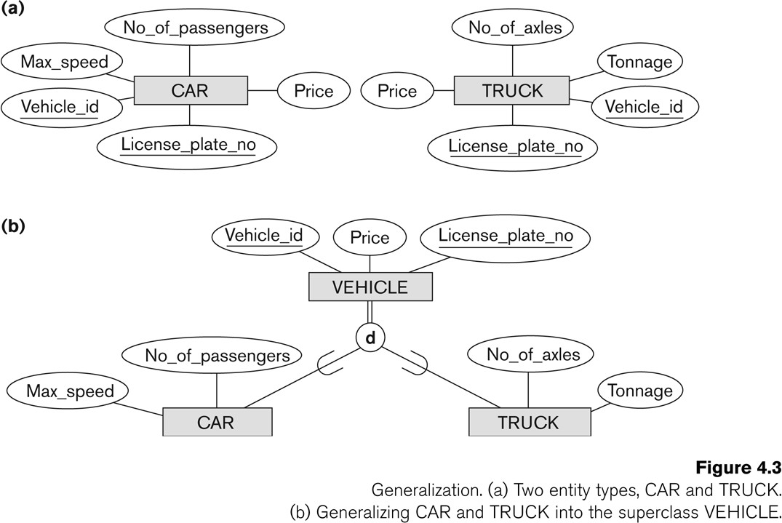
Generalization (2)
Copyright © 2017 Pearson India Education Services Pvt. Ltd

Slide 13
Generalization and Specialization (1)
Diagrammatic notations are sometimes used to distinguish between generalization and specialization
Arrow pointing to the generalized superclass represents a generalization
Arrows pointing to the specialized subclasses represent a specialization
We do not use this notation because it is often subjective as to which process is more appropriate for a particular situation
We advocate not drawing any arrows
Copyright © 2017 Pearson India Education Services Pvt. Ltd

Slide 14
Generalization and Specialization (2)
Data Modeling with Specialization and Generalization
A superclass or subclass represents a collection (or set or grouping) of entities
It also represents a particular type of entity
Shown in rectangles in EER diagrams (as are entity types)
We can call all entity types (and their corresponding collections) classes, whether they are entity types, superclasses, or subclasses
Copyright © 2017 Pearson India Education Services Pvt. Ltd

Slide 15
Types of Specialization
Predicate-defined ( or condition-defined) : based on some predicate. E.g., based on value of an attribute, say, Job-type, or Age.
Attribute-defined: shows the name of the attribute next to the line drawn from the superclass toward the subclasses (see Fig. 4.1)
User-defined: membership is defined by the user on an entity by entity basis
Copyright © 2017 Pearson India Education Services Pvt. Ltd

Slide 16
Constraints on Specialization and Generalization (1)
If we can determine exactly those entities that will become members of each subclass by a condition, the subclasses are called predicate- defined (or condition-defined) subclasses
Condition is a constraint that determines subclass members
Display a predicate-defined subclass by writing the predicate condition next to the line attaching the subclass to its superclass
Copyright © 2017 Pearson India Education Services Pvt. Ltd

Slide 17
Constraints on Specialization and Generalization (2)
If all subclasses in a specialization have membership condition on same attribute of the superclass, specialization is called an attribute-defined specialization
Attribute is called the defining attribute of the specialization
Example: JobType is the defining attribute of the specialization {SECRETARY, TECHNICIAN, ENGINEER} of EMPLOYEE
If no condition determines membership, the subclass is called user-defined
Membership in a subclass is determined by the database users by applying an operation to add an entity to the subclass
Membership in the subclass is specified individually for each entity in the superclass by the user
Copyright © 2017 Pearson India Education Services Pvt. Ltd

Slide 18
Displaying an attribute-defined specialization in EER diagrams
Copyright © 2017 Pearson India Education Services Pvt. Ltd

Slide 19
Constraints on Specialization and Generalization (3)
Two basic constraints can apply to a specialization/generalization:
Disjointness Constraint:
Completeness Constraint:
Copyright © 2017 Pearson India Education Services Pvt. Ltd

Slide 20
Constraints on Specialization and Generalization (4)
Disjointness Constraint:
Specifies that the subclasses of the specialization must be disjoint:
an entity can be a member of at most one of the subclasses of the specialization
Specified by d in EER diagram
If not disjoint, specialization is overlapping:
that is the same entity may be a member of more than one subclass of the specialization
Specified by o in EER diagram
Copyright © 2017 Pearson India Education Services Pvt. Ltd

Slide 21
Constraints on Specialization and Generalization (5)
Completeness (Exhaustiveness) Constraint:
Total specifies that every entity in the superclass must be a member of some subclass in the specialization/generalization
Shown in EER diagrams by a double line
Partial allows an entity not to belong to any of the subclasses
Shown in EER diagrams by a single line
Copyright © 2017 Pearson India Education Services Pvt. Ltd

Slide 22
Constraints on Specialization and Generalization (6)
Hence, we have four types of specialization/generalization:
Disjoint, total
Disjoint, partial
Overlapping, total
Overlapping, partial
Note: Generalization usually is total because the superclass is derived from the subclasses.
Copyright © 2017 Pearson India Education Services Pvt. Ltd

Slide 23
Example of disjoint partial Specialization
Copyright © 2017 Pearson India Education Services Pvt. Ltd

Slide 24
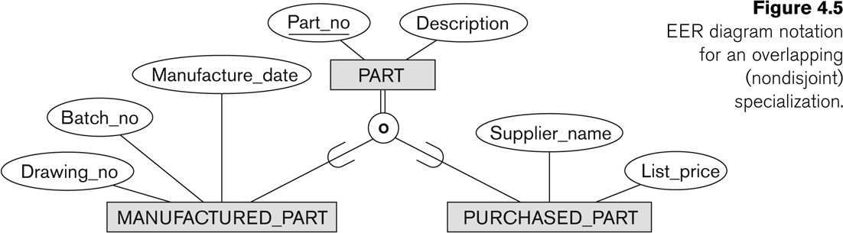
Example of overlapping total Specialization
Copyright © 2017 Pearson India Education Services Pvt. Ltd

