Slide 1
CHAPTER 6
Copyright © 2017 Pearson India Education Services Pvt. Ltd
Basic SQL

Slide 2
Basic SQL
SQL language
Considered one of the major reasons for the commercial success of relational databases
SQL
SQL Actually comes from the word “SEQUEL” termed by Chamberlin and Boyce. IBM could not copyright that term, so they abbreviated to SQL and copyrighted the term SQL.
Now popularly known as “Structured Query language”.
Copyright © 2017 Pearson India Education Services Pvt. Ltd

Slide 3
SQL Data Definition, Data Types, Standards
Terminology:
Table, row, and column used for relational model terms relation, tuple, and attribute
CREATE statement
Main SQL command for data definition
Copyright © 2017 Pearson India Education Services Pvt. Ltd

Slide 4
The CREATE TABLE Command in SQL
Specifying a new relation
Provide name of table
Specify attributes, their types and initial constraints
CREATE TABLE EMPLOYEE ...
Copyright © 2017 Pearson India Education Services Pvt. Ltd

Slide 5
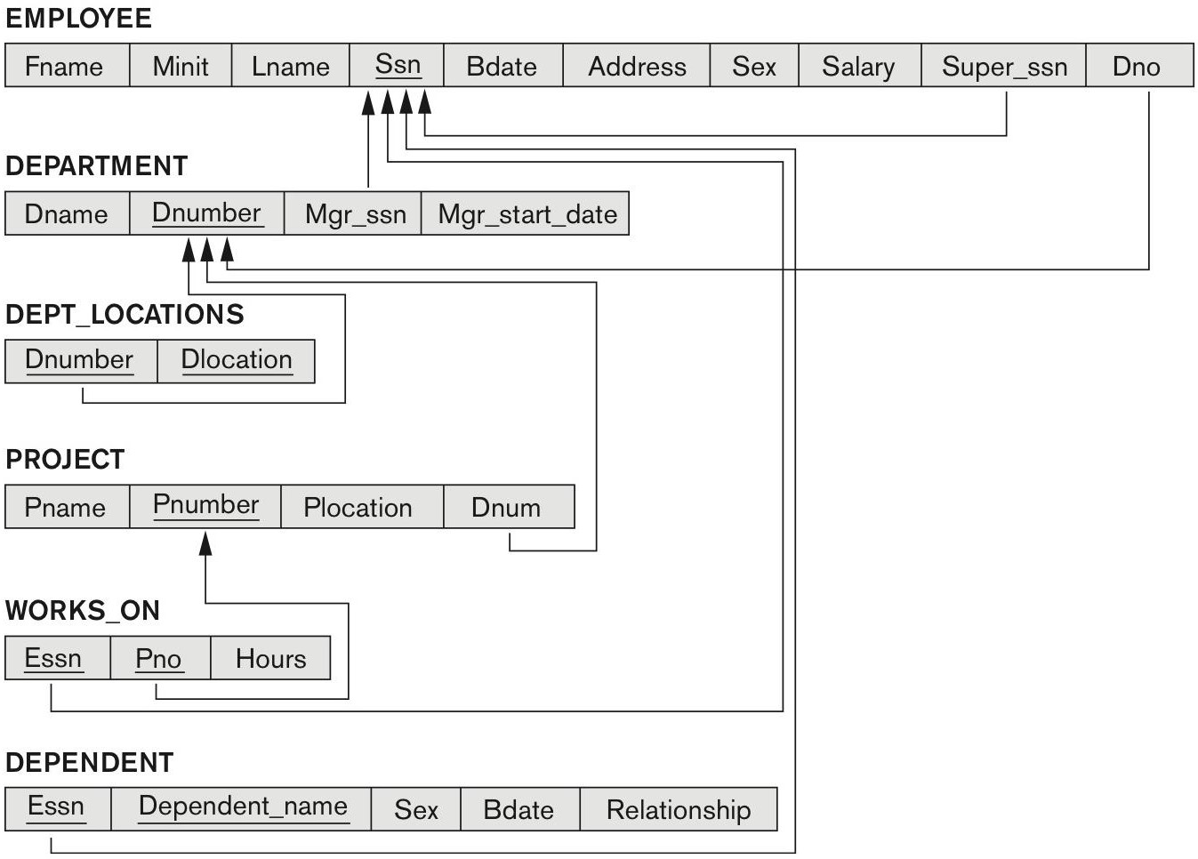
COMPANY relational database schema (Fig. 5.7)
Copyright © 2017 Pearson India Education Services Pvt. Ltd

Slide 6
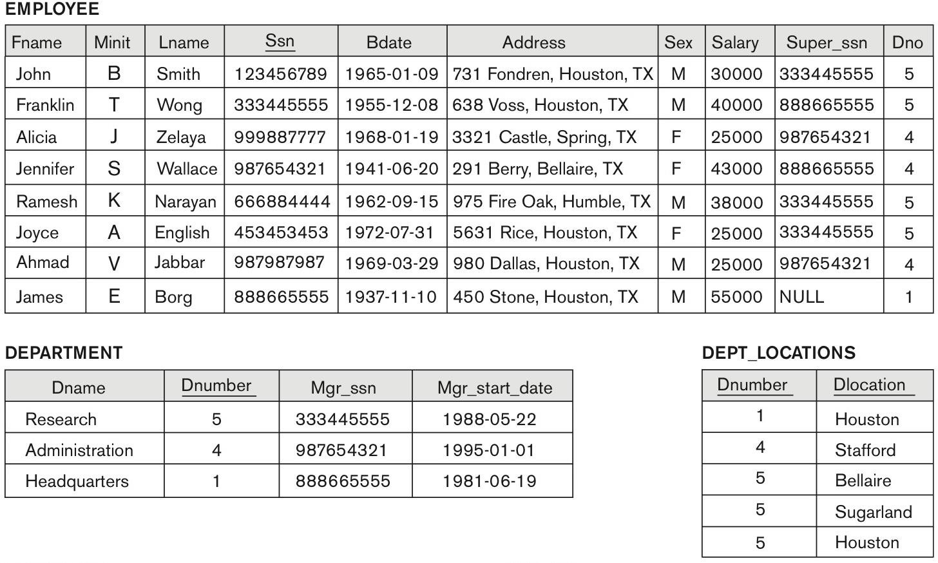
One possible database state for the COMPANY relational database schema (Fig. 5.6)
Copyright © 2017 Pearson India Education Services Pvt. Ltd

Slide 7
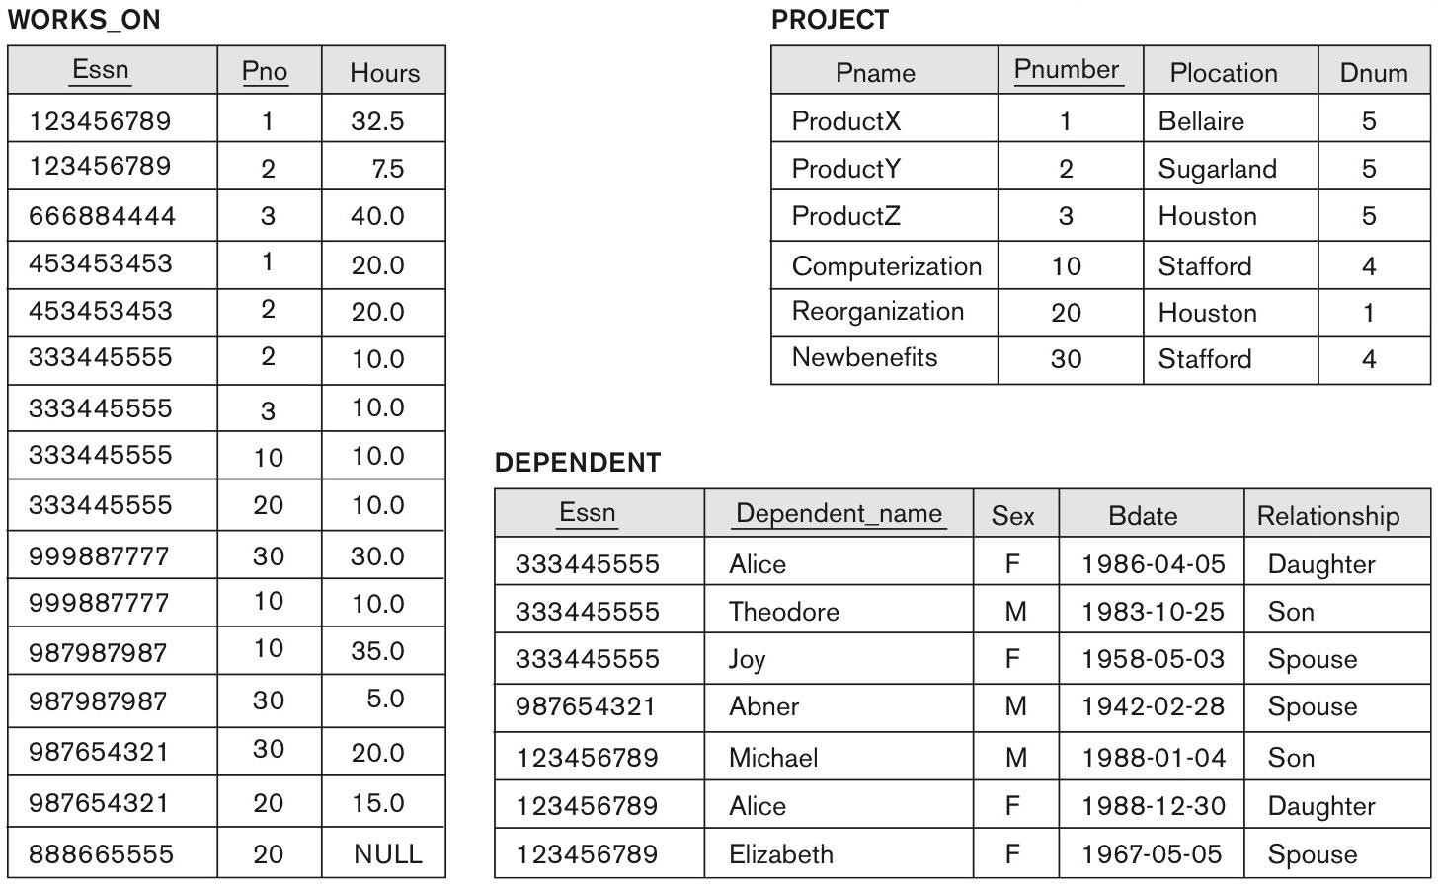
One possible database state for the COMPANY relational database schema – continued (Fig. 5.6)
Copyright © 2017 Pearson India Education Services Pvt. Ltd

Slide 8
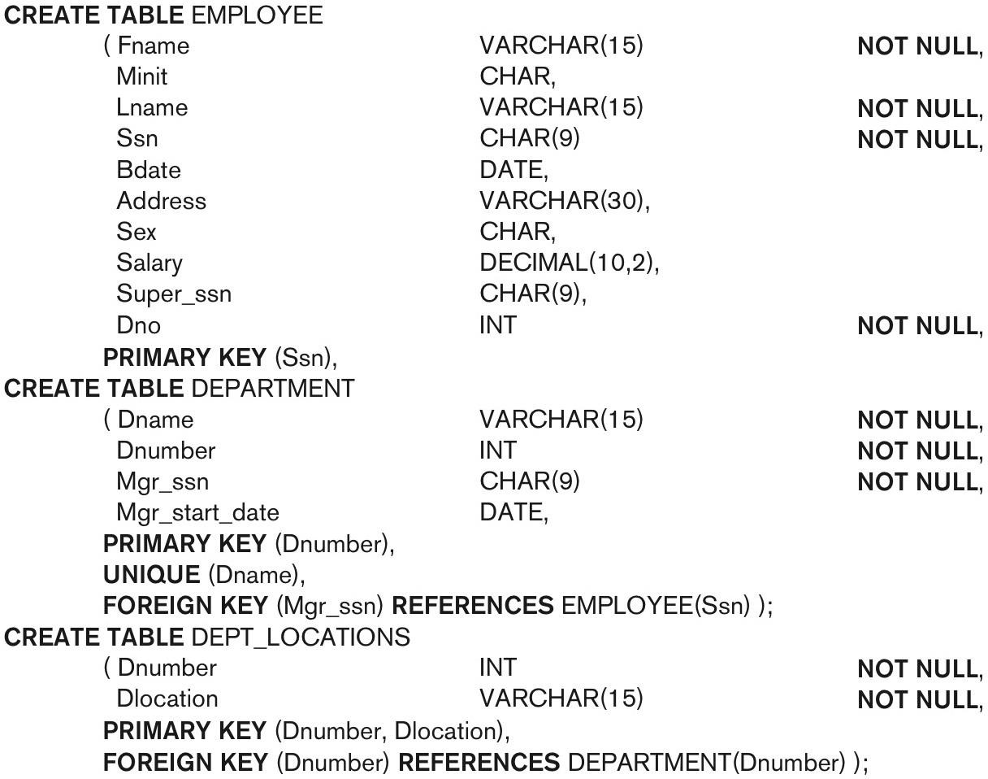
SQL CREATE TABLE data definition statements for defining the COMPANY schema from Figure
5.7 (Fig. 6.1)
Copyright © 2017 Pearson India Education Services Pvt. Ltd
continued on next slide

Slide 9
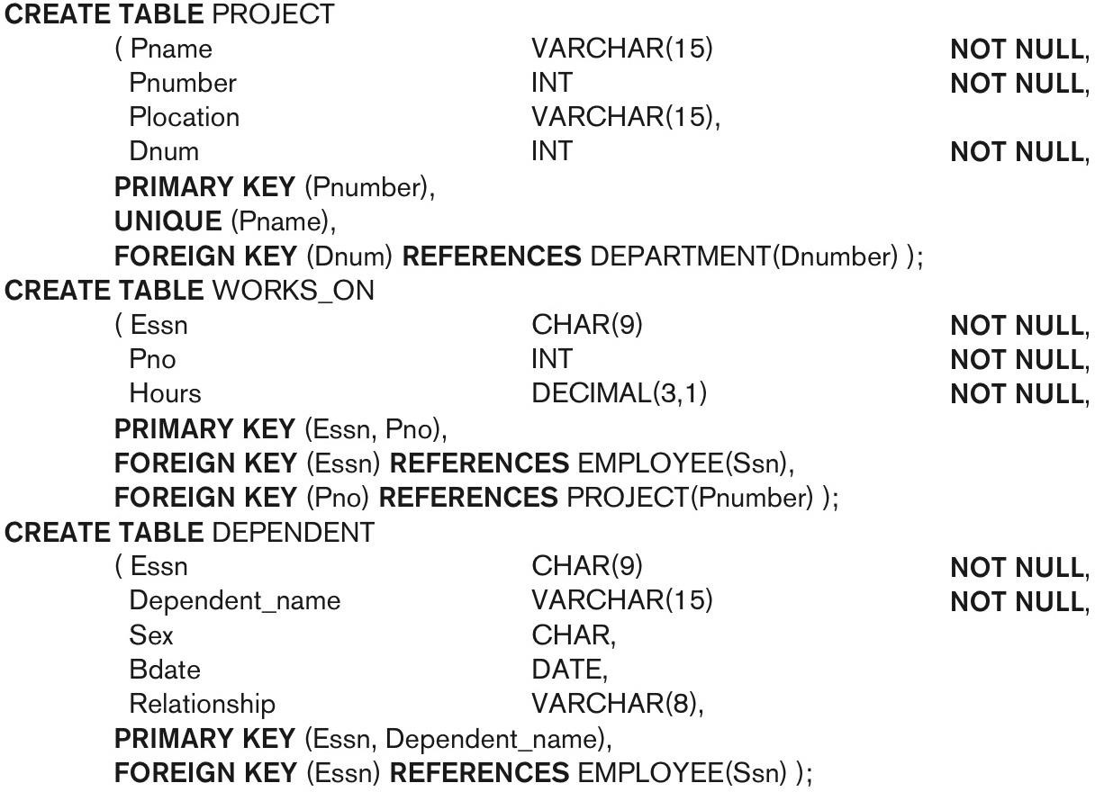
SQL CREATE TABLE data definition statements for defining the COMPANY schema from Figure 5.7 (Fig. 6.1)-continued
Copyright © 2017 Pearson India Education Services Pvt. Ltd

Slide 10
Attribute Data Types and Domains in SQL
Basic data types
Numeric data types
Integer numbers: INTEGER, INT, and SMALLINT
Floating-point (real) numbers: FLOAT or REAL, and
DOUBLE PRECISION
Character-string data types
Fixed length: CHAR(n), CHARACTER(n)
Varying length: VARCHAR(n), CHAR
VARYING(n), CHARACTER VARYING(n)
Copyright © 2017 Pearson India Education Services Pvt. Ltd

Slide 11
Attribute Data Types and Domains in SQL (cont’d.)
Bit-string data types
Fixed length: BIT(n)
Varying length: BIT VARYING(n)
Boolean data type
Values of TRUE or FALSE or NULL
DATE data type
Ten positions
Components are YEAR, MONTH, and DAY in the form YYYY-MM-DD/MM-DD-YYYY
Multiple mapping functions available in RDBMSs to change date formats
Copyright © 2017 Pearson India Education Services Pvt. Ltd

Slide 12
Specifying Constraints in SQL
Basic constraints:
Relational Model has 3 basic constraint types that are supported in SQL:
Key constraint: A primary key value cannot be duplicated
Entity Integrity Constraint: A primary key value cannot be null
Referential integrity constraints : The “foreign key “ must have a value that is already present as a primary key, or may be null.
Copyright © 2017 Pearson India Education Services Pvt. Ltd

Slide 13
Specifying Attribute Constraints
Other Restrictions on attribute domains:
Default value of an attribute
DEFAULT <value>
NULL is not permitted for a particular attribute (NOT NULL)
CHECK clause
Dnumber INT NOT NULL CHECK (Dnumber > 0 AND Dnumber < 21);
Copyright © 2017 Pearson India Education Services Pvt. Ltd

Slide 14
Specifying Key and Referential Integrity Constraints
PRIMARY KEY clause
Specifies one or more attributes that make up the primary key of a relation
Dnumber INT PRIMARY KEY;
UNIQUE clause
Specifies alternate (secondary) keys (called CANDIDATE keys in the relational model).
Dname VARCHAR(15) UNIQUE;
Copyright © 2017 Pearson India Education Services Pvt. Ltd

Slide 15
Specifying Key and Referential Integrity Constraints (cont’d.)
FOREIGN KEY clause
Default operation: reject update on violation
Attach referential triggered action clause
Options include SET NULL, CASCADE, and SET
DEFAULT
Action taken by the DBMS for SET NULL or SET DEFAULT is the same for both ON DELETE and ON UPDATE
CASCADE option suitable for “relationship” relations
Copyright © 2017 Pearson India Education Services Pvt. Ltd

Slide 16
Giving Names to Constraints
Using the Keyword CONSTRAINT
Name a constraint
Useful for later altering
Copyright © 2017 Pearson India Education Services Pvt. Ltd

Slide 17
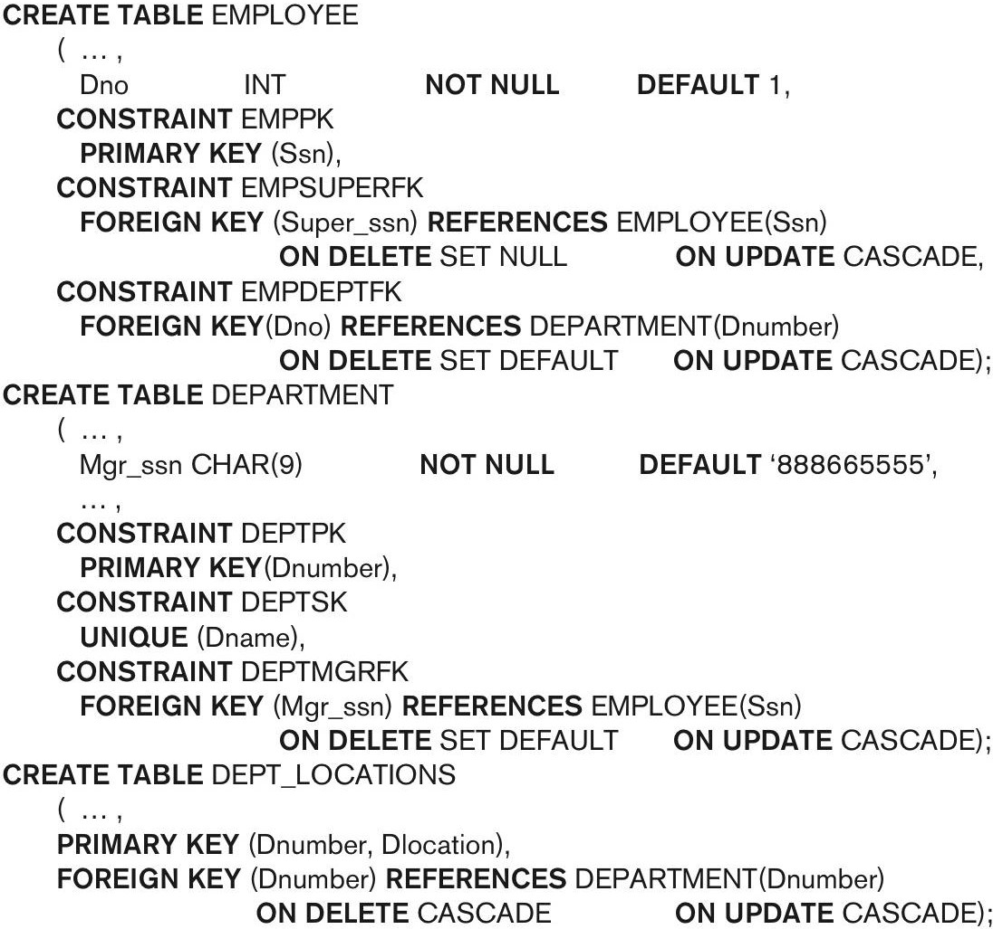
Default attribute values and referential integrity triggered action specification (Fig. 6.2)
Copyright © 2017 Pearson India Education Services Pvt. Ltd

Slide 18
Basic Retrieval Queries in SQL
SELECT statement
One basic statement for retrieving information from a database
SQL allows a table to have two or more tuples that are identical in all their attribute values
Unlike relational model (relational model is strictly set-theory based)
Multiset or bag behavior
Copyright © 2017 Pearson India Education Services Pvt. Ltd

Slide 19
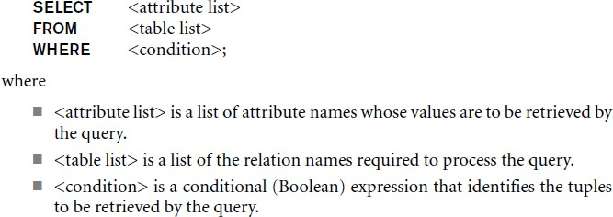
The SELECT-FROM-WHERE
Structure of Basic SQL Queries
Basic form of the SELECT statement:
Copyright © 2017 Pearson India Education Services Pvt. Ltd

Slide 20
The SELECT-FROM-WHERE Structure of Basic SQL Queries (cont’d.)
Copyright © 2017 Pearson India Education Services Pvt. Ltd
Logical comparison operators
■ =, <, <=, >, >=, and <>
Projection attributes
Attributes whose values are to be retrieved
Selection condition
Boolean condition that must be true for any retrieved tuple. Selection conditions include join conditions (see Ch.8) when multiple relations are involved.

Slide 21
One possible database state for the COMPANY relational database schema (Fig. 5.6)
Copyright © 2017 Pearson India Education Services Pvt. Ltd

Slide 22
One possible database state for the COMPANY relational database schema – continued (Fig. 5.6)
Copyright © 2017 Pearson India Education Services Pvt. Ltd

Slide 23
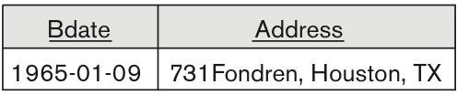
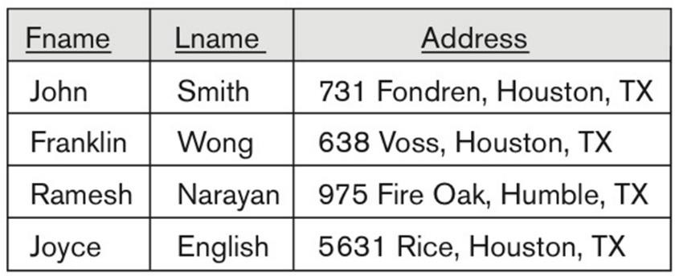
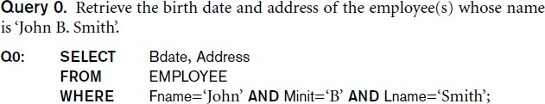
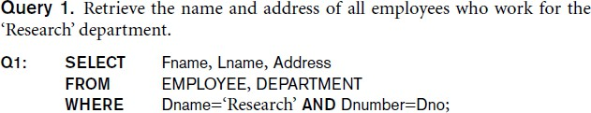
Basic Retrieval Queries
Copyright © 2017 Pearson India Education Services Pvt. Ltd

Slide 24

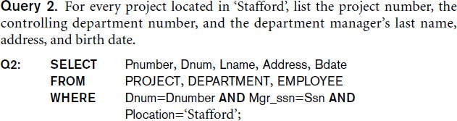
Basic Retrieval Queries (Contd.)
Copyright © 2017 Pearson India Education Services Pvt. Ltd

Slide 25

Ambiguous Attribute Names
Same name can be used for two (or more) attributes in different relations
As long as the attributes are in different relations
Must qualify the attribute name with the relation name to prevent ambiguity
Copyright © 2017 Pearson India Education Services Pvt. Ltd

Slide 26
Aliasing, and Renaming
Aliases or tuple variables
Declare alternative relation names E and S to refer to the EMPLOYEE relation twice in a query:
Query 8. For each employee, retrieve the employee’s first and last name and the first and last name of his or her immediate supervisor.
Copyright © 2017 Pearson India Education Services Pvt. Ltd
SELECT E.Fname, E.Lname, S.Fname, S.Lname
FROM EMPLOYEE AS E, EMPLOYEE AS S
WHERE E.Super_ssn=S.Ssn;
Recommended practice to abbreviate names and to prefix same or similar attribute from multiple tables.
■

Slide 27
Aliasing,Renaming and Tuple Variables (contd.)
The attribute names can also be renamed
EMPLOYEE AS E(Fn, Mi, Ln, Ssn, Bd,
Addr, Sex, Sal, Sssn, Dno)
Note that the relation EMPLOYEE now has a variable name E which corresponds to a tuple variable
The “AS” may be dropped in most SQL implementations
Copyright © 2017 Pearson India Education Services Pvt. Ltd

Slide 28
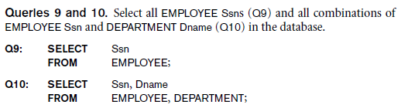
Unspecified WHERE Clause and Use of the Asterisk
Missing WHERE clause
Indicates no condition on tuple selection
Effect is a CROSS PRODUCT
Result is all possible tuple combinations (or the Algebra operation of Cartesian Product– see Ch.8) result
Copyright © 2017 Pearson India Education Services Pvt. Ltd

Slide 29
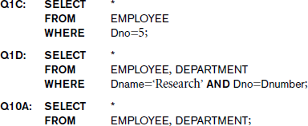
Unspecified WHERE Clause and Use of the Asterisk (cont’d.)
Specify an asterisk (*)
Retrieve all the attribute values of the selected tuples
The * can be prefixed by the relation name; e.g., EMPLOYEE *
Copyright © 2017 Pearson India Education Services Pvt. Ltd

Slide 30
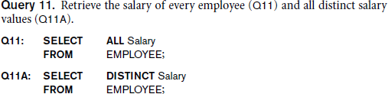
Tables as Sets in SQL
SQL does not automatically eliminate duplicate tuples in
query results
For aggregate operations (See sec 7.1.7) duplicates must be accounted for
Use the keyword DISTINCT in the SELECT clause
Only distinct tuples should remain in the result
Copyright © 2017 Pearson India Education Services Pvt. Ltd

Slide 31
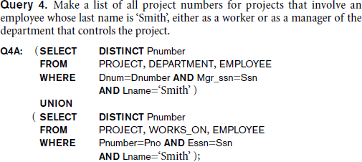
Tables as Sets in SQL (cont’d.)
Set operations
UNION, EXCEPT (difference), INTERSECT
Corresponding multiset operations: UNION ALL, EXCEPT ALL, INTERSECT ALL)
Type compatibility is needed for these operations to be valid for table go to this TABLE1,TABLE2
Copyright © 2017 Pearson India Education Services Pvt. Ltd

Slide 32
Substring Pattern Matching and Arithmetic Operators
LIKE comparison operator
Used for string pattern matching
% replaces an arbitrary number of zero or more characters
underscore (_) replaces a single character
Examples: WHERE Address LIKE ‘%Houston,TX%’;
WHERE Ssn LIKE ‘_ _ 1_ _ 8901’;
BETWEEN comparison operator
E.g., in Q14 :
WHERE(Salary BETWEEN 30000 AND 40000)
AND Dno = 5;
Copyright © 2017 Pearson India Education Services Pvt. Ltd

Slide 33
Arithmetic Operations
Copyright © 2017 Pearson India Education Services Pvt. Ltd
Standard arithmetic operators:
Addition (+), subtraction (–), multiplication (*), and division (/) may be included as a part of SELECT
Query 13. Show the resulting salaries if every employee working on the ‘ProductX’ project is given a 10 percent raise.
SELECT E.Fname, E.Lname, 1.1 * E.Salary AS Increased_sal
FROM EMPLOYEE AS E, WORKS_ON AS W, PROJECT AS P
WHERE E.Ssn=W.Essn AND W.Pno=P.Pnumber AND
P.Pname=‘ProductX’;

Slide 34
Ordering of Query Results
Use ORDER BY clause
Keyword DESC to see result in a descending order of values
Keyword ASC to specify ascending order explicitly
Typically placed at the end of the query
ORDER BY D.Dname DESC, E.Lname ASC,
E.Fname ASC
Copyright © 2017 Pearson India Education Services Pvt. Ltd

Slide 35
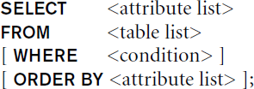
Basic SQL Retrieval Query Block
Copyright © 2017 Pearson India Education Services Pvt. Ltd

Slide 36
INSERT, DELETE, and UPDATE
Statements in SQL
Three commands used to modify the database:
INSERT, DELETE, and UPDATE
INSERT typically inserts a tuple (row) in a relation (table)
UPDATE may update a number of tuples (rows) in a relation (table) that satisfy the condition
DELETE may also update a number of tuples (rows) in a relation (table) that satisfy the condition
Copyright © 2017 Pearson India Education Services Pvt. Ltd

Slide 37
INSERT
In its simplest form, it is used to add one or more tuples to a relation
Attribute values should be listed in the same order as the attributes were specified in the CREATE TABLE command
Constraints on data types are observed automatically
Any integrity constraints as a part of the DDL specification are enforced
Copyright © 2017 Pearson India Education Services Pvt. Ltd

Slide 38


The INSERT Command
Specify the relation name and a list of values for the tuple. All values including nulls are supplied.
Copyright © 2017 Pearson India Education Services Pvt. Ltd
The variation below inserts multiple tuples where a new table is loaded values from the result of a query.

Slide 39
DELETE
Removes tuples from a relation
Includes a WHERE-clause to select the tuples to be deleted
Referential integrity should be enforced
Tuples are deleted from only one table at a time (unless CASCADE is specified on a referential integrity constraint)
A missing WHERE-clause specifies that all tuples in the relation are to be deleted; the table then becomes an empty table
The number of tuples deleted depends on the number of tuples in the relation that satisfy the WHERE-clause
Copyright © 2017 Pearson India Education Services Pvt. Ltd

Slide 40
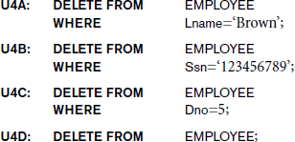
The DELETE Command
Removes tuples from a relation
Includes a WHERE clause to select the tuples to be deleted. The number of tuples deleted will vary.
Copyright © 2017 Pearson India Education Services Pvt. Ltd

Slide 41
UPDATE
Used to modify attribute values of one or more selected tuples
A WHERE-clause selects the tuples to be modified
An additional SET-clause specifies the attributes to be modified and their new values
Each command modifies tuples in the same relation
Referential integrity specified as part of DDL specification is enforced
Copyright © 2017 Pearson India Education Services Pvt. Ltd

Slide 42
UPDATE (contd.)
Example: Change the location and controlling department number of project number 10 to 'Bellaire' and 5, respectively
Copyright © 2017 Pearson India Education Services Pvt. Ltd
U5:
UPDATE SET
PROJECT
PLOCATION = 'Bellaire', DNUM = 5
PNUMBER=10
WHERE

Slide 43
UPDATE (contd.)
Example: Give all employees in the 'Research'
department a 10% raise in salary.
Copyright © 2017 Pearson India Education Services Pvt. Ltd
U6:UPDATE SET WHERE
EMPLOYEE
SALARY = SALARY *1.1
DNO IN (SELECT DNUMBER
FROM DEPARTMENT
WHERE DNAME='Research')
In this request, the modified SALARY value depends on the original SALARY value in each tuple
The reference to the SALARY attribute on the right of = refers to the old SALARY value before modification
The reference to the SALARY attribute on the left of = refers to the new SALARY value after modification

