Slide 1
More SQL: Complex Queries and
Views
Copyright © 2017 Pearson India Education Services Pvt. Ltd
CHAPTER 7

Slide 2
More Complex SQL Retrieval Queries
Additional features allow users to specify more complex retrievals from database:
Nested queries, joined tables, and outer joins (in the FROM clause), aggregate functions, and grouping
Copyright © 2017 Pearson India Education Services Pvt. Ltd

Slide 3
Comparisons Involving NULL and Three-Valued Logic
Meanings of NULL
Unknown value
Unavailable or withheld value
Not applicable attribute
Each individual NULL value considered to be different from every other NULL value
SQL uses a three-valued logic:
TRUE, FALSE, and UNKNOWN (like Maybe)
NULL = NULL comparison is avoided
Copyright © 2017 Pearson India Education Services Pvt. Ltd

Slide 4

Comparisons Involving NULL and Three-Valued Logic (cont’d.)
SQL allows queries that check whether an attribute value is NULL
IS or IS NOT NULL
Copyright © 2017 Pearson India Education Services Pvt. Ltd

Slide 5
Nested Queries, Tuples,
and Set/Multiset Comparisons
Nested queries
Complete select-from-where blocks within WHERE clause of another query
Outer query and nested subqueries
Comparison operator IN
Compares value v with a set (or multiset) of values
V
Evaluates to TRUE if v is one of the elements in V
Copyright © 2017 Pearson India Education Services Pvt. Ltd

Slide 6
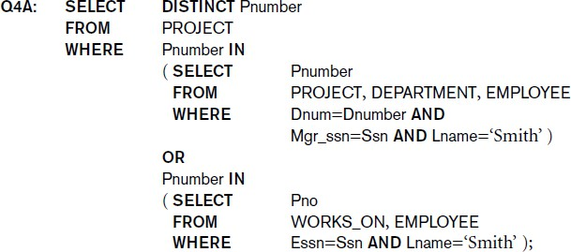
Nested Queries (cont’d.)
Copyright © 2017 Pearson India Education Services Pvt. Ltd

Slide 7
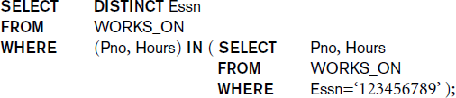
Nested Queries (cont’d.)
Use tuples of values in comparisons
Place them within parentheses
Copyright © 2017 Pearson India Education Services Pvt. Ltd

Slide 8
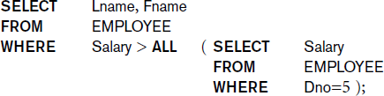
Nested Queries (cont’d.)
Use other comparison operators to compare a single value v
■ = ANY (or = SOME) operator
Returns TRUE if the value v is equal to some value in
the set V and is hence equivalent to IN
Other operators that can be combined with ANY (or
SOME): >, >=, <, <=, and <>
ALL: value must exceed all values from nested query
Copyright © 2017 Pearson India Education Services Pvt. Ltd

Slide 9
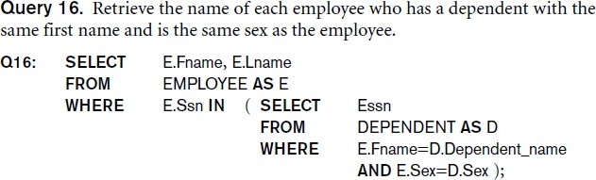
Nested Queries (cont’d.)
Avoid potential errors and ambiguities
Create tuple variables (aliases) for all tables referenced in SQL query
Copyright © 2017 Pearson India Education Services Pvt. Ltd

Slide 10
Correlated Nested Queries
Queries that are nested using the = or IN comparison operator can be collapsed into one single block: E.g., Q16 can be written as:
Copyright © 2017 Pearson India Education Services Pvt. Ltd
Q16A: FROM
WHERE
SELECT
E.Fname, E.Lname EMPLOYEE AS E, DEPENDENT AS D
E.Ssn=D.Essn AND E.Sex=D.Sex
AND
E.Fname=D.Dependent_name;
Correlated nested query
Evaluated once for each tuple in the outer query

Slide 11
The EXISTS and UNIQUE Functions in SQL for correlating queries
EXISTS function
Check whether the result of a correlated nested query is empty or not. They are Boolean functions that return a TRUE or FALSE result.
EXISTS and NOT EXISTS
Typically used in conjunction with a correlated nested query
SQL function UNIQUE(Q)
Returns TRUE if there are no duplicate tuples in the result of query Q
Copyright © 2017 Pearson India Education Services Pvt. Ltd

Slide 12
USE of EXISTS
Copyright © 2017 Pearson India Education Services Pvt. Ltd
Q7:
SELECT Fname, Lname FROM Employee
WHERE EXISTS (SELECT *
FROM DEPENDENT
WHERE Ssn= Essn)
AND EXISTS (SELECT *
FROM Department WHERE Ssn= Mgr_Ssn)

Slide 13
USE OF NOT EXISTS
To achieve the “for all” (universal quantifier- see Ch.8) effect,
we use double negation this way in SQL:
Query: List first and last name of employees who work on ALL projects controlled by Dno=5.
SELECT Fname, Lname FROM Employee
WHERE NOT EXISTS ( (SELECT Pnumber
FROM PROJECT
WHERE Dno=5)
EXCEPT (SELECT Pno
FROM WORKS_ON WHERE Ssn= ESsn)
The above is equivalent to double negation: List names of those
employees for whom there does NOT exist a project managed by
Fundam^{d}e^{e}n^{p}taªls^{rt}o^{m}f Dea^{n}ta^{t}b^{n}aºse. S⁵ys^{t}t^{h}eªm^{t}s^{t},^{h}7ee^{y do NOT}Au^{w}thºo^{r}r^{k}s:ºE^{n}lm. asri and Navathe
Copyright © 2017 Pearson India Education Services Pvt. Ltd

Slide 14
Double Negation to accomplish “for all” in SQL
Q3B: SELECT FROM WHERE
Lname, Fname
EMPLOYEE
Copyright © 2017 Pearson India Education Services Pvt. Ltd
NOT EXISTS (
FROM WHERE
SELECT * WORKS_ON B
( B.Pno IN ( SELECT Pnumber
FROM PROJECT
WHERE Dnum=5
AND
NOT EXISTS (SELECT *
FROM WORKS_ON C
WHERE C.Essn=Ssn
AND C.Pno=B.Pno )));
The above is a direct rendering of: List names of those employees for whom there does NOT exist a project managed by department no. 5 that they do NOT work on.

Slide 15

Explicit Sets and Renaming of Attributes in SQL
Can use explicit set of values in WHERE clause
Q17: SELECT DISTINCT Essn
Copyright © 2017 Pearson India Education Services Pvt. Ltd
FROM WHERE
WORKS_ON Pno IN (1, 2, 3);
Use qualifier AS followed by desired new name
Rename any attribute that appears in the result of a query

Slide 16

Specifying Joined Tables in the FROM Clause of SQL
Joined table
Permits users to specify a table resulting from a join operation in the FROM clause of a query
The FROM clause in Q1A
Contains a single joined table. JOIN may also be called INNER JOIN
Copyright © 2017 Pearson India Education Services Pvt. Ltd

Slide 17
Different Types of JOINed Tables in SQL
Copyright © 2017 Pearson India Education Services Pvt. Ltd
Specify different types of join
NATURAL JOIN
Various types of OUTER JOIN (LEFT, RIGHT, FULL )
NATURAL JOIN on two relations R and S
No join condition specified
Is equivalent to an implicit EQUIJOIN condition for each pair of attributes with same name from R and S

Slide 18
NATURAL JOIN
Rename attributes of one relation so it can be joined with
another using NATURAL JOIN:
Q1B: SELECT Fname, Lname, Address
Copyright © 2017 Pearson India Education Services Pvt. Ltd
FROM
(EMPLOYEE NATURAL JOIN
(DEPARTMENT AS DEPT (Dname, Dno, Mssn,
Msdate))) Dname=‘Research’;
WHERE
The above works with EMPLOYEE.Dno = DEPT.Dno as an implicit join condition

Slide 19
INNER and OUTER Joins
INNER JOIN (versus OUTER JOIN)
Default type of join in a joined table
Tuple is included in the result only if a matching tuple exists in the other relation
LEFT OUTER JOIN
Every tuple in left table must appear in result
If no matching tuple
Padded with NULL values for attributes of right table
RIGHT OUTER JOIN
Every tuple in right table must appear in result
If no matching tuple
Padded with NULL values for attributes of left table
Copyright © 2017 Pearson India Education Services Pvt. Ltd

Slide 20
Example: LEFT OUTER JOIN
Copyright © 2017 Pearson India Education Services Pvt. Ltd
Retrieve the last name of each employee and his or her supervisor while renaming the
resulting attribute names as Employee_name and Supervisor_name.
SELECT E.Lname AS Employee_Name S.Lname AS Supervisor_Name
FROM Employee AS E LEFT OUTER JOIN EMPLOYEE AS S
ON E.Super_ssn = S.Ssn)

Slide 21
FULL OUTER JOIN
FULL OUTER JOIN – combines result if LEFT and RIGHT OUTER JOIN
SELECT E.Lname AS Employee_Name
S.Lname AS Supervisor_Name
FROM Employee AS E FULL OUTER JOIN EMPLOYEE AS S
ON E.Super_ssn = S.Ssn)
Copyright © 2017 Pearson India Education Services Pvt. Ltd

Slide 22
Aggregate Functions in SQL
Used to summarize information from multiple tuples into a single-tuple summary
Built-in aggregate functions
COUNT, SUM, MAX, MIN, and AVG
Grouping
Create subgroups of tuples before summarizing
To select entire groups, HAVING clause is used
Aggregate functions can be used in the SELECT
clause or in a HAVING clause
Copyright © 2017 Pearson India Education Services Pvt. Ltd

Slide 23
Renaming Results of Aggregation
Following query returns a single row of computed values
from EMPLOYEE table:
Copyright © 2017 Pearson India Education Services Pvt. Ltd
Q19:
SELECT
SUM (Salary), MAX (Salary), MIN (Salary), AVG
(Salary)
FROM EMPLOYEE;
The result can be presented with new names:
Q19A:
SELECT
SUM (Salary) AS Total_Sal, MAX (Salary) AS Highest_Sal, MIN (Salary) AS Lowest_Sal, AVG (Salary) AS Average_Sal
FROM
EMPLOYEE;

Slide 24
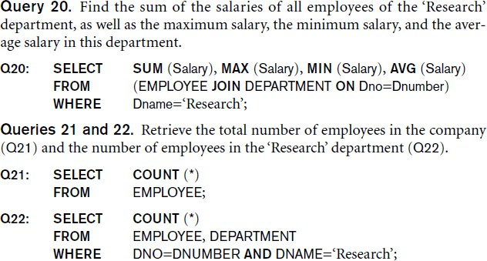
Aggregate Functions in SQL (cont’d.)
NULL values are discarded when aggregate functions are applied to a particular column
Copyright © 2017 Pearson India Education Services Pvt. Ltd

Slide 25
Grouping: The GROUP BY Clause
Partition relation into subsets of tuples
Based on grouping attribute(s)
Apply function to each such group independently
GROUP BY clause
Specifies grouping attributes
COUNT (*) counts the number of rows in the group
Copyright © 2017 Pearson India Education Services Pvt. Ltd

Slide 26
Examples of GROUP BY
The grouping attribute must appear in the SELECT
clause:
Copyright © 2017 Pearson India Education Services Pvt. Ltd
Q24: SELECT Dno, COUNT (*), AVG (Salary)
FROM
EMPLOYEE
Dno;
GROUP BY
If the grouping attribute has NULL as a possible value, then a separate group is created for the null value (e.g., null Dno in the above query)
GROUP BY may be applied to the result of a JOIN:
Q25:
FROM WHERE
SELECT
Pnumber, Pname, COUNT (*) PROJECT, WORKS_ON
Pnumber=Pno Pnumber, Pname;
GROUP BY

Slide 27
Grouping: The GROUP BY and HAVING Clauses (cont’d.)
HAVING clause
Provides a condition to select or reject an entire group:
Query 26. For each project on which more than two employees work, retrieve the project number, the project name, and the number of employees who work on the project.
Copyright © 2017 Pearson India Education Services Pvt. Ltd
Q26: SELECT Pnumber, Pname, COUNT (*)
FROM
PROJECT, WORKS_ON
Pnumber=Pno Pnumber, Pname COUNT (*) > 2;
WHERE GROUP BY HAVING

Slide 28
Combining the WHERE and the HAVING Clause
Consider the query: we want to count the total number of employees whose salaries exceed $40,000 in each department, but only for departments where more than five employees work.
INCORRECT QUERY:
Copyright © 2017 Pearson India Education Services Pvt. Ltd
SELECT FROM WHERE GROUP BY HAVING
Dno, COUNT (*) EMPLOYEE
Salary>40000
Dno
COUNT (*) > 5;

Slide 29
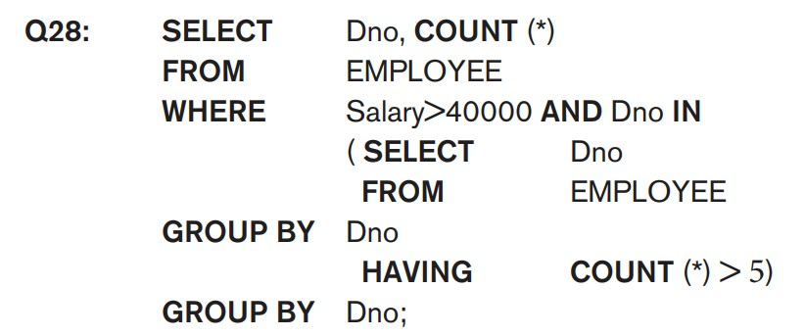
Combining the WHERE and the HAVING Clause (continued)
Correct Specification of the Query:
Note: the WHERE clause applies tuple by tuple whereas HAVING applies to entire group of tuples
For each department that has more than five employees, retrieve the department number and the number of its employees who are making more than $40,000.
■
Copyright © 2017 Pearson India Education Services Pvt. Ltd

Slide 30
Views (Virtual Tables) in SQL
Concept of a view in SQL
Single table derived from other tables called the
defining tables
Considered to be a virtual table that is not necessarily populated
Copyright © 2017 Pearson India Education Services Pvt. Ltd

Slide 31
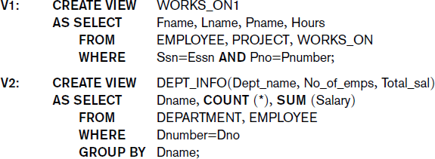
Specification of Views in SQL
CREATE VIEW command
Give table name, list of attribute names, and a query to specify the contents of the view
In V1, attributes retain the names from base tables. In
V2, attributes are assigned names
Copyright © 2017 Pearson India Education Services Pvt. Ltd

Slide 32
Specification of Views in SQL (cont’d.)
Once a View is defined, SQL queries can use the View relation in the FROM clause
View is always up-to-date
Responsibility of the DBMS and not the user
DROP VIEW command
Dispose of a view
Copyright © 2017 Pearson India Education Services Pvt. Ltd

Slide 33
View Update
Update on a view defined on a single table without any
aggregate functions
Can be mapped to an update on underlying base table- possible if the primary key is preserved in the view
Update not permitted on aggregate views. E.g.,
Copyright © 2017 Pearson India Education Services Pvt. Ltd
UV2: UPDATE SET
WHERE
DEPT_INFO
Total_sal=100000
Dname=‘Research’;
cannot be processed because Total_sal is a computed value in the view definition

Slide 34
View Update
A view with a single defining table is updatable if the view attributes contain the primary key of the base relation, as well as all attributes with the NOT NULL constraint that do not have default values specified.
Views defined on multiple tables using joins are generally not
updatable.
Views defined using grouping and aggregate functions are not updatable.
Copyright © 2017 Pearson India Education Services Pvt. Ltd

Slide 35
The ALTER table command
Copyright © 2017 Pearson India Education Services Pvt. Ltd
Alter table actions include:
Adding or dropping a column (attribute)
Changing a column definition
Adding or dropping table constraints
Example:
ALTER TABLE COMPANY.EMPLOYEE ADD COLUMN Job VARCHAR(12);

Slide 36

Adding and Dropping Constraints
Change constraints specified on a table
Add or drop a named constraint
Copyright © 2017 Pearson India Education Services Pvt. Ltd

Slide 37
Dropping Columns, Default Values
To drop a column
Choose either CASCADE or RESTRICT
CASCADE would drop the column from views etc.
RESTRICT is possible if no views refer to it.
ALTER TABLE COMPANY.EMPLOYEE DROP COLUMN
Address CASCADE;
Default values can be dropped and altered :
ALTER TABLE COMPANY.DEPARTMENT ALTER COLUMN Mgr_ssn
DROP DEFAULT;
ALTER TABLE COMPANY.DEPARTMENT ALTER COLUMN Mgr_ssn
SET DEFAULT ‘333445555’;
Copyright © 2017 Pearson India Education Services Pvt. Ltd

Slide 38
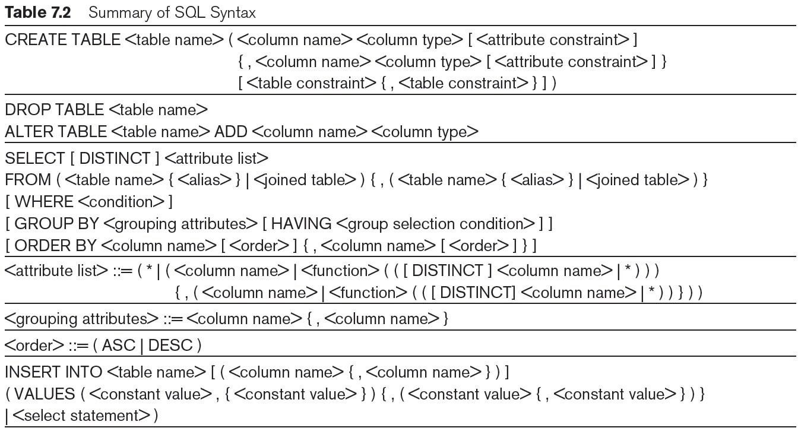
Table 7.2
Syntax
Summary of SQL
Copyright © 2017 Pearson India Education Services Pvt. Ltd
continued on next slide

Slide 39
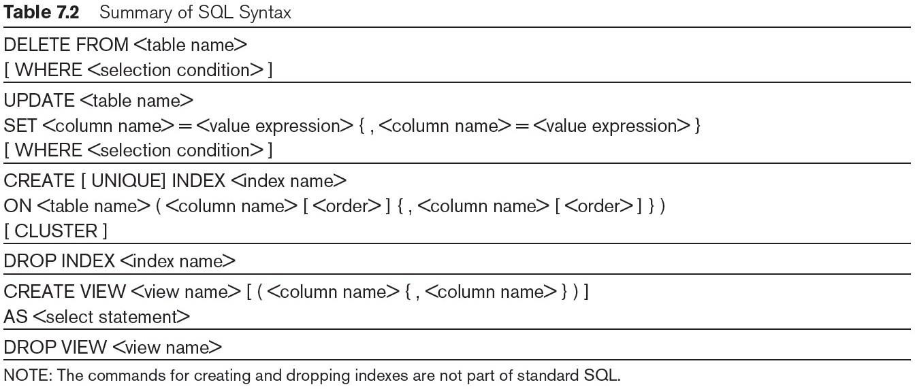
Table 7.2 (continued)
Summary of SQL Syntax
Copyright © 2017 Pearson India Education Services Pvt. Ltd

