Slide 1
Data Mining Basics

Slide 2
Introduction
Data is growing at a phenomenal rate
Users expect more sophisticated information
How?
Find hidden information in a database
Fit data to a model
UNCOVER HIDDEN INFORMATION
DATA MINING

Slide 3
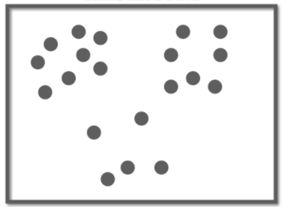
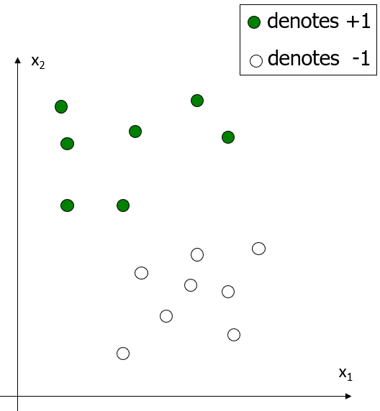
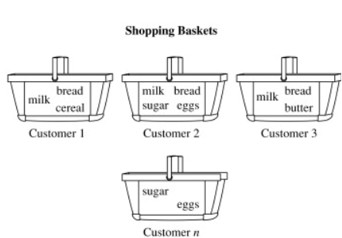
What is Data Mining?
There are many definitions
But most mean essentially the following.
Data mining is to discover interesting patterns from the large
volumes of data.
unknown

Slide 4
What is a Pattern?
“A pattern is the opposite of chaos; it is an entity vaguely defined, that could be given a name.”
e.g.,
fingerprint image,
handwritten word,
human face,
speech signal,
. . .

Slide 5
What is (not) Data Mining?
What is not Data Mining?
Look up phone number in phone directory
Query a Web search engine for information about “Amazon”
What is Data Mining?
Certain names are more prevalent in certain Indian locations
Group together similar documents returned by search engine according to their context (e.g. Amazon rainforest, Amazon.com,)

Slide 6
Database Processing vs. Data Mining Processing
Query
Well defined
SQL
Data
Operational data
Output
Precise
Subset of database
Query
Poorly defined
No precise query language
Data
Not operational data
Output
Fuzzy
Not a subset of database

Slide 7
Query Examples
Database
Find all credit applicants with last name of Smith.
Identify customers who have purchased more than $10,000 in the last month.
Find all customers who have purchased milk
Data Mining
Find all credit applicants who are poor credit risks. (classification)
Identify customers with similar buying habits. (Clustering)
Find all items which are frequently purchased with milk. (association rules)

Slide 8
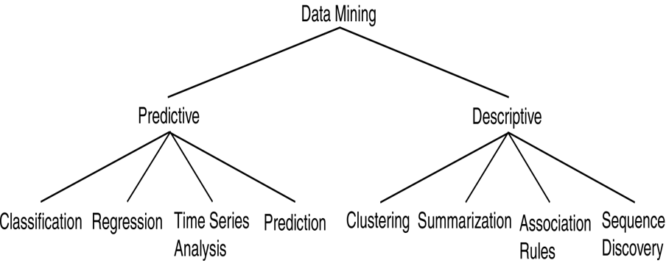
Data Mining Models and Tasks
Use some variables to predict unknown or future values of other variables
Find human-interpretable patterns that describe the data.

Slide 9
Basic Data Mining Tasks
Classification maps data into predefined groups or classes
Supervised learning
The data (observations, measurements, etc.) are labeled with pre-defined classes. It is like that a “teacher” gives the classes (supervision).
Test data are classified into these classes too.
Regression is used to map a data item to a real valued prediction variable.
Supervised learning
Clustering groups similar data together into clusters.
Unsupervised learning
Class labels of the data are unknown
Given a set of data, the task is to establish the existence of classes or clusters in the data

Slide 10
Basic Data Mining Tasks
Summarization maps data into subsets with associated simple descriptions.
Extractive summarization
The main objective is to identify the significant sentences of the text and add them to the summary.
Abstractive summarization
The approach is to identify the important sections, interpret the context and reproduce in a new way
Link Analysis uncovers relationships among data.
Affinity Analysis
Association Rules
Sequential Analysis determines sequential patterns.

Slide 11
Ex: Time Series Analysis
Example: Stock Market
Predict future values
Determine similar patterns over time
Classify behavior

Slide 12
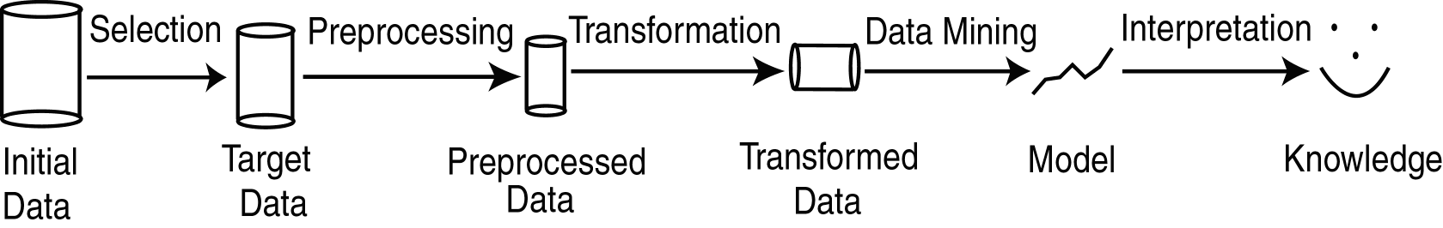
Data Mining vs. KDD
Knowledge Discovery in Databases (KDD): process of finding useful information and patterns in data.
Data Mining: Use of algorithms to extract the information and patterns derived by the KDD process.

Slide 13
KDD Process
Selection: Obtain data from various sources.
Preprocessing: Cleanse data.
Transformation: Convert to common format. Transform to new format.
Data Mining: Obtain desired results.
Interpretation/Evaluation: Present results to user in meaningful manner.

Slide 14
Classification
Given a collection of records (training set )
Each record contains a set of attributes and have an associated class label.
Find a model for class label as a function of the values of other attributes.
Goal: previously unseen records should be assigned a class as accurately as possible.
A test set is used to determine the accuracy of the model.
Usually, the given data set is divided into training and test sets, with training set used to build the model and test set used to validate it.

Slide 15
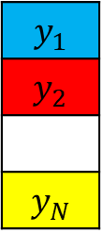
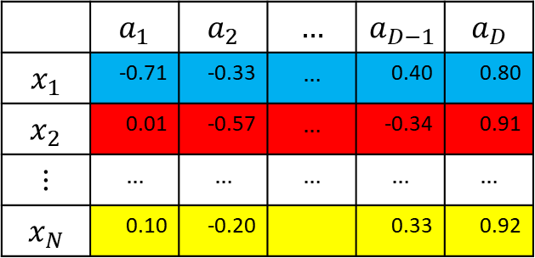

Classification
Features/Attributes
 | $$a_{1}$$ | $$a_{2}$$ | $$…$$ | $$a_{D−1}$$ | $$a_{D}$$
$$x_{1}$$ | -0.71 | -0.33 | $$…$$ | 0.40 | 0.80
$$x_{2}$$ | 0.01 | -0.57 | $$…$$ | -0.34 | 0.91
$$⋮$$ | $$…$$ | $$…$$ | $$…$$ | $$…$$ | $$…$$
$$x_{N}$$ | 0.10 | -0.20 |  | 0.33 | 0.92
Instance/Data Point
$$y_{1}$$
$$y_{2}$$
$$y_{N}$$
Instance/Data Point
Instance/Data Point
X
Y
$$x_{new}$$ | 0.03 | 0.02 | $$…$$ | -0.31 | 0.50
?

Slide 16
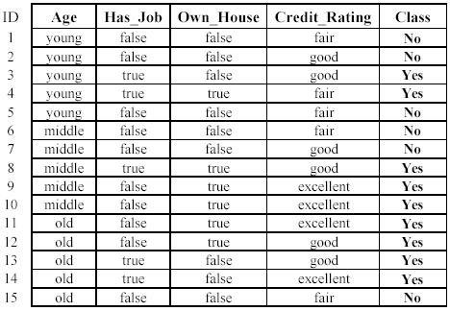
An example: data (loan application)
Approved or not

Slide 17
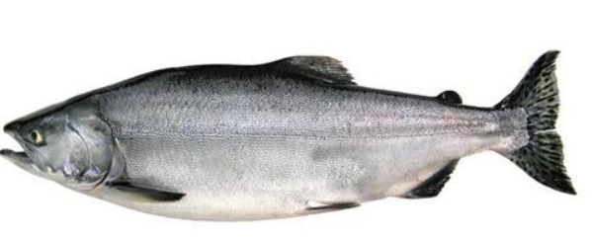
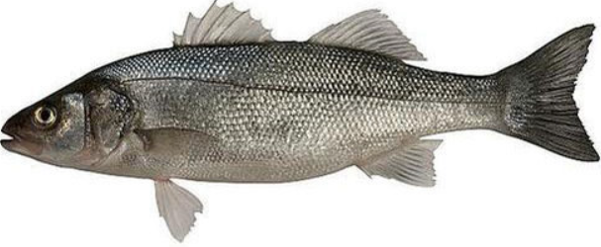
Classification - Example
A fish-packing plant wants to automate the process of sorting incoming fish according to species
As a pilot project, it is decided to try to separate sea bass from salmon using optical sensing
Features (to distinguish):
Length
Lightness
Width
Position of mouth
Salmon
Sea bass

Slide 18
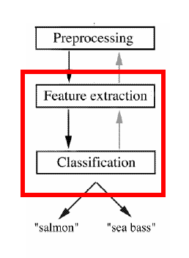
Classification - Example
Preprocessing:
Images of different fishes are isolated from one another and from background;
Feature extraction:
The information of a single fish is then sent to a feature extractor, that measure certain “features” or “properties”;
Classification:
The values of these features are passed to a classifier that evaluates the evidence presented, and build a model to discriminate between the two species

Slide 19
Classification - Example
Domain knowledge:
A sea bass is generally longer than a salmon
Related feature: (or attribute)
Length
Training the classifier:
Some examples are provided to the classifier in this form: <fish_length, fish_name>
These examples are called training examples
The classifier learns itself from the training examples, how to distinguish Salmon from Bass based on the fish_length

Slide 20
Classification - Example
Classification model (hypothesis):
The classifier generates a model from the training data to classify future examples (test examples)
An example of the model is a rule like this:
If Length >= l* then sea bass otherwise salmon
Here the value of l* determined by the classifier
Testing the model
Once we get a model out of the classifier, we may use the classifier to test future examples
The test data is provided in the form <fish_length>
The classifier outputs <fish_type> by checking fish_length against the model

Slide 21
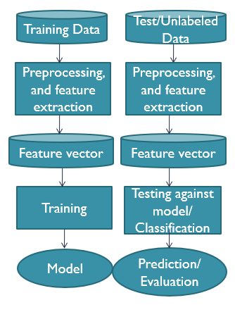
Classification - Example
So the overall classification process goes like this →

Slide 22
Classification: Application I
Direct Marketing
Goal: Reduce cost of mailing by targeting a set of consumers likely to buy a new cell-phone product.
Approach:
Use the data for a similar product introduced before.
We know which customers decided to buy and which decided otherwise. This {buy, don’t buy} decision forms the class attribute.
Collect various demographic, lifestyle, and company-interaction related information about all such customers.
Type of business, where they stay, how much they earn, etc.
Use this information as input attributes to learn a classifier model.

Slide 23
Classification: Application II
Fraud Detection
Goal: Predict fraudulent cases in credit card transactions.
Approach:
Use credit card transactions and the information on its account-holder as attributes.
When does a customer buy, what does he buy, how often he pays on time, etc
Label past transactions as fraud or fair transactions. This forms the class attribute.
Learn a model for the class of the transactions.
Use this model to detect fraud by observing credit card transactions on an account.

Slide 24
Clustering
Given a set of data points, each having a set of attributes, and a similarity measure among them, find clusters such that
Data points in one cluster are more similar to one another.
Data points in separate clusters are less similar to one another.
Similarity Measures:
Euclidean Distance if attributes are continuous.
Other Problem-specific Measures.

Slide 25
Clustering: Application I
Market Segmentation:
Goal: subdivide a market into distinct subsets of customers where any subset may conceivably be selected as a market target to be reached with a distinct marketing mix.
Approach:
Collect different attributes of customers based on their geographical and lifestyle related information.
Find clusters of similar customers.
Measure the clustering quality by observing buying patterns of customers in same cluster vs. those from different clusters.

Slide 26
Clustering: Application II
Document Clustering:
Goal: To find groups of documents that are similar to each other based on the important terms appearing in them.
Approach: To identify frequently occurring terms in each document. Form a similarity measure based on the frequencies of different terms. Use it to cluster.
Gain: Information Retrieval can utilize the clusters to relate a new document or search term to clustered documents.

Slide 27
Association Rule Discovery: Definition
Given a set of records each of which contain some number of items from a given collection;
Produce dependency rules which will predict occurrence of an item based on occurrences of other items.
Rules Discovered:
{Milk} --> {Coke}
{Diaper, Milk} --> {Beer}

Slide 28
Association Rule Discovery: Application I
Marketing and Sales Promotion:
Let the rule discovered be
{Bagels, … } --> {Potato Chips}
Potato Chips as consequent => Can be used to determine what should be done to boost its sales.
Bagels in the antecedent => Can be used to see which products would be affected if the store discontinues selling bagels.
Bagels in antecedent and Potato chips in consequent => Can be used to see what products should be sold with Bagels to promote sale of Potato chips!

Slide 29
Association Rule Discovery: Application II
Supermarket shelf management.
Goal: To identify items that are bought together by sufficiently many customers.
Approach: Process the point-of-sale data collected with barcode scanners to find dependencies among items.
A classic rule --
If a customer buys diaper and milk, then he is very likely to buy beer:

Slide 30
Acknowledgements
Lecture slides modified from
Overview of Data Mining, Mehedy Masud
DATA MINING Introductory and Advanced Topics Part I, Margaret H. Dunham
Data Mining Basics, Arun K Pujari
An Introduction to Data Mining, Prof. S. Sudarshan

Slide 31
Classification Problem
A child has set of toy blocks of different colours and different shapes.
Mother tells the child the following.
These are red blocks
These are blue blocks
Have you learnt?
Any questions?
Let us test your knowledge.

Slide 32
Classification Problem
A child has set of toy blocks of different colours and different shapes.
Mother tells the child the following.
These are red blocks
These are blue blocks
What colour is this?
BLUE

