Slide 1
Data Preprocessing
The process of making the data more suitable for data mining

Slide 2
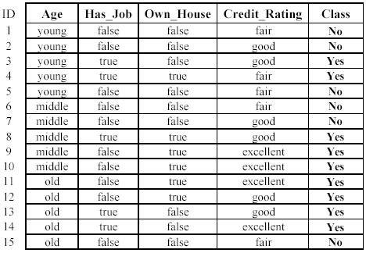
WHAT IS DATA?
Collection of data objects and their attributes
An attribute is a property or characteristic of an object
Examples: eye color of a person, temperature, etc.
Attribute is also known as variable, field, characteristic, or feature
A collection of attributes describe an object
Object is also known as record, point, case, sample, entity, or instance
Attributes
Objects

Slide 3
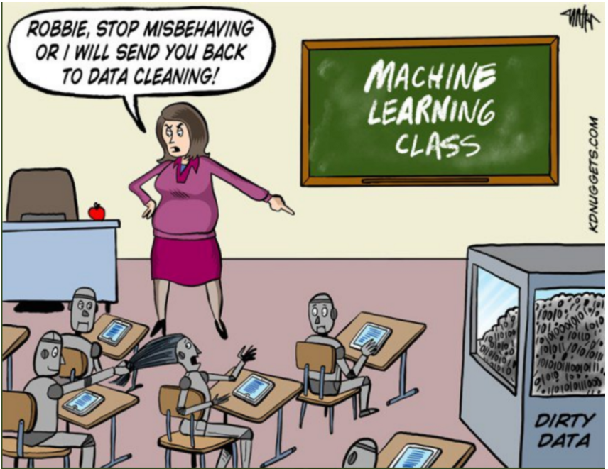
DATA MINING CLASS
Image source: https://www.kdnuggets.com/2017/09/cartoon-machine-learning-class.html

Slide 4
Why Data Preprocessing?
Data in the real world is dirty: Lots of potentially incorrect data, e.g., instrument faulty, human or computer error, transmission error
incomplete: lacking attribute values, lacking certain attributes of interest, or containing only aggregate data
e.g., occupation=“”
noisy: containing errors or outliers
e.g., Salary=“-10”
inconsistent: containing discrepancies in codes or names
e.g., Age=“42” Birthday=“03/07/1997”
e.g., Was rating “1,2,3”, now rating “A, B, C”
e.g., discrepancy between duplicate records

Slide 5
Why Is Data Preprocessing Important?
No quality data, no quality mining results!
Quality decisions must be based on quality data
e.g., duplicate or missing data may cause incorrect or even misleading statistics.
Data warehouse needs consistent integration of quality data

Slide 6
Multi-Dimensional Measure of Data Quality
Measures for data quality: A multidimensional view
Accuracy: correct or wrong, accurate or not
Completeness: not recorded, unavailable, …
Consistency: some modified but some not, dangling, …
Timeliness: timely update?
Believability: how trustable the data are correct?
Interpretability: how easily the data can be understood?

Slide 7
Knowledge discovery from data
Major Tasks in Data Preprocessing
Data cleaning
Fill in missing values, smooth noisy data, identify or remove outliers, and resolve inconsistencies
Data integration
where multiple data sources may be combined
Data reduction
Dimensionality reduction, Data compression
Data transformation
where data are transformed or consolidated into forms appropriate for mining by performing summary or aggregation operations

Slide 8
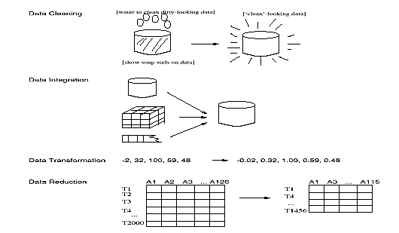
Major Tasks in Data Preprocessing

Slide 9
Data Cleaning
Data cleaning tasks
Fill in missing values
Identify outliers and smooth out noisy data
Correct inconsistent data

Slide 10
Incomplete (Missing) Data
Data is not always available
E.g., many tuples have no recorded value for several attributes, such as customer income in sales data
Missing data may be due to
equipment malfunction
inconsistent with other recorded data and thus deleted
data not entered due to misunderstanding
certain data may not be considered important at the time of entry
not register history or changes of the data
Missing data may need to be inferred

Slide 11
How to Handle Missing Data?
Ignore the tuple: usually done when class label is missing (when doing classification—not effective in certain cases)
Fill in the missing value manually: tedious + infeasible?
Fill in it automatically with
a global constant : e.g., “unknown”, a new class?!
the attribute mean
the attribute mean for all samples belonging to the same class: smarter
the most probable value: inference-based such as Bayesian formula or decision tree

Slide 12
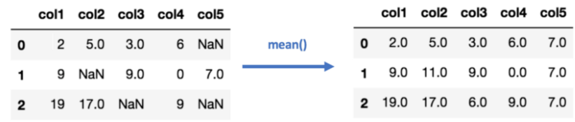
How to Handle Missing Data?

Slide 13
Noisy Data
Noise: random error or variance in a measured variable
Incorrect attribute values may be due to
faulty data collection instruments
data entry problems
data transmission problems
technology limitation
inconsistency in naming convention

Slide 14
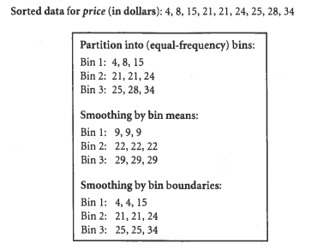
How to Handle Noisy Data?
Binning
first sort data and partition into (equal-frequency) bins
then one can smooth by bin means, smooth by bin median, smooth by bin boundaries, etc.
Regression
smooth by fitting the data into regression functions
Clustering
detect and remove outliers
Combined computer and human inspection
detect suspicious values and check by human (e.g., deal with possible outliers)
`

Slide 15
Regression
y
Y1
Y1’
y = x + 1
X1
x
Linear regression (best line to fit two variables)
Multiple linear regression (more than two variables, fit to a multidimensional surface

Slide 16
Cluster Analysis

Slide 17
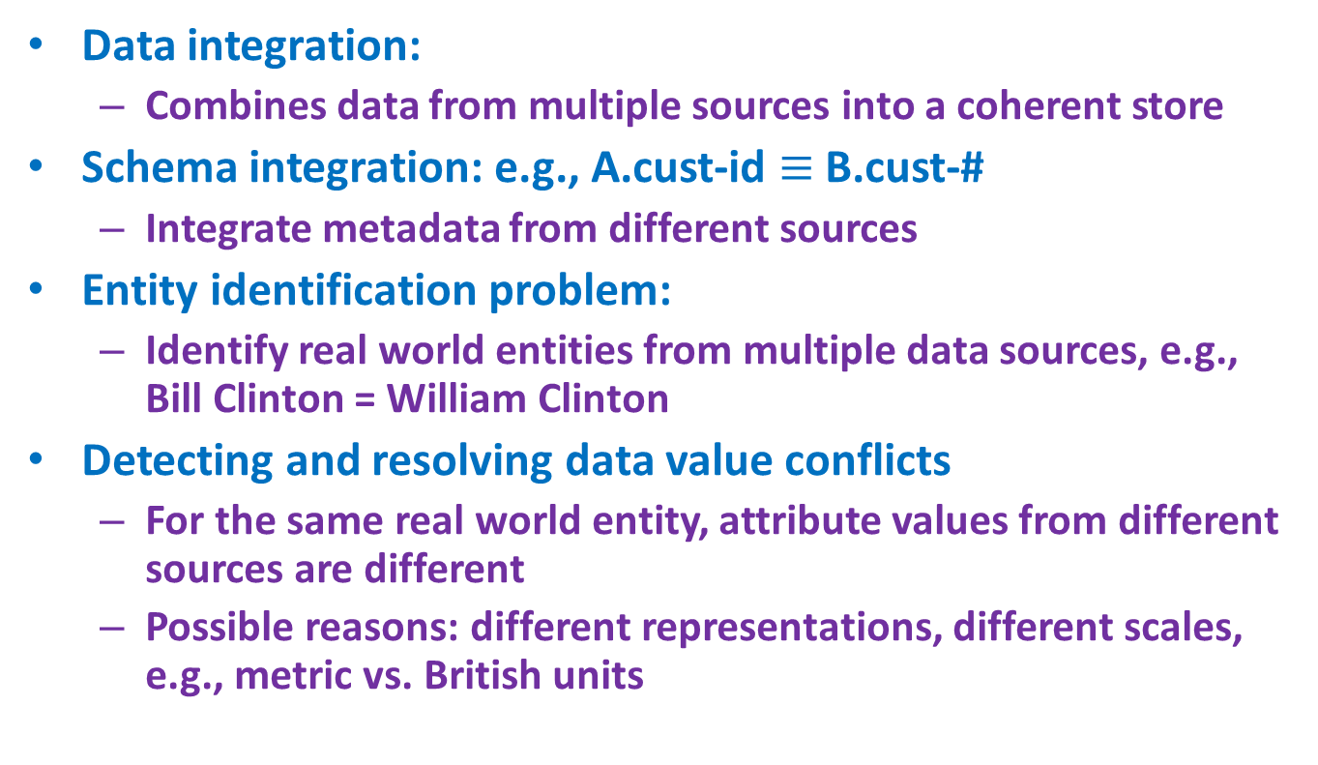
Data Integration
Data integration:
Combines data from multiple sources into a coherent store
Schema integration: e.g., A.cust-id $≡$ B.cust-#
Integrate metadata from different sources
Entity identification problem:
Identify real world entities from multiple data sources, e.g., Bill Clinton = William Clinton
Detecting and resolving data value conflicts
For the same real world entity, attribute values from different sources are different
Possible reasons: different representations, different scales, e.g., metric vs. British units

Slide 18
Handling Redundancy in Data Integration
Redundant data occur often when integration of multiple databases
Object identification: The same attribute or object may have different names in different databases
Derivable data: One attribute may be a “derived” attribute in another table, e.g., annual revenue
Redundant attributes may be able to be detected by correlation analysis

Slide 19
Data Reduction Strategies
Data reduction: Obtain a reduced representation of the data set that is much smaller in volume but yet produces the same (or almost the same) analytical results
Why data reduction? — A database/data warehouse may store terabytes of data. Complex data analysis may take a very long time to run on the complete data set.
Data reduction strategies
Dimensionality reduction, e.g., remove unimportant attributes
Principal Components Analysis (PCA)
Feature subset selection, feature creation
Data compression

Slide 20
Data Reduction : Dimensionality Reduction
Curse of dimensionality
When dimensionality increases, data becomes increasingly sparse
Density and distance between points, which is critical to clustering, outlier analysis, becomes less meaningful
The possible combinations of subspaces will grow exponentially
Dimensionality reduction
Avoid the curse of dimensionality
Help eliminate irrelevant features and reduce noise
Reduce time and space required in data mining
Allow easier visualization
Dimensionality reduction techniques
Principal Component Analysis
feature selection

Slide 21
Principal Component Analysis (PCA)
Find a projection that captures the largest amount of variation in data
The original data are projected onto a much smaller space, resulting in dimensionality reduction. We find the eigenvectors of the covariance matrix, and these eigenvectors define the new space
x₂
e
x₁

Slide 22
Attribute Subset Selection
Another way to reduce dimensionality of data
Redundant attributes
Duplicate much or all of the information contained in one or more other attributes
E.g., purchase price of a product and the amount of sales tax paid
Irrelevant attributes
Contain no information that is useful for the data mining task at hand
E.g., students' ID is often irrelevant to the task of predicting students' GPA

Slide 23
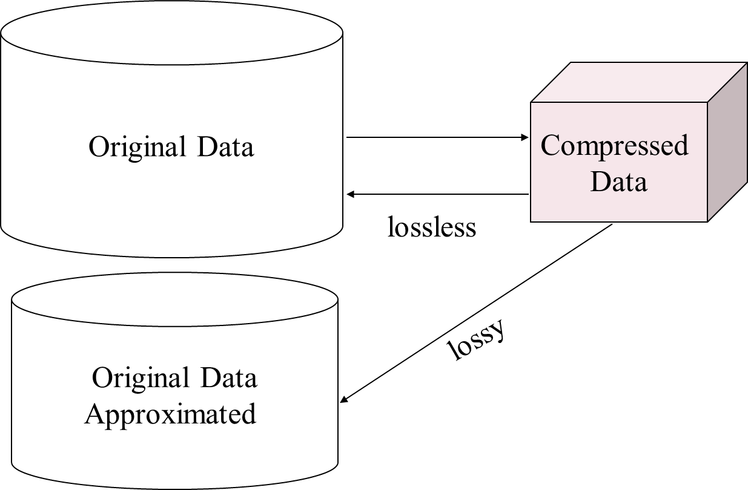
Data Compression

Slide 24
Data Transformation
A function that maps the entire set of values of a given attribute to a new set of replacement values s.t. each old value can be identified with one of the new values
Methods
Smoothing: Remove noise from data (binning, clustering, regression)
Normalization: Scaled to fall within a smaller, specified range
min-max normalization
z-score normalization
normalization by decimal scaling

Slide 25
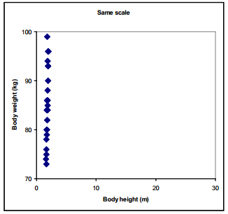
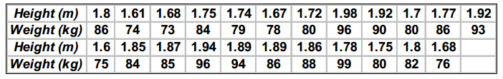
Data Transformation
Scaling
Variables often have substantially different numerical range
A variable with large range has a large variance, whereas a variable with a small range has a small variance
Since PCA is a maximum variance projection method, if follows that a variable with a large variance is more likely to be expressed in modeling than a low-variance variable
Example

Slide 26
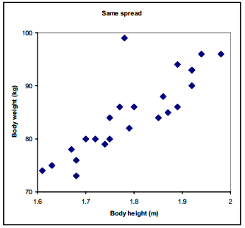
Data Transformation
We can see that the data points only spread in the vertical direction because body weight has much larger numerical range than body height.
Lets zoom the Figure
There is strong correlation between body height and body weight, except for one outlier in the data.

Slide 27
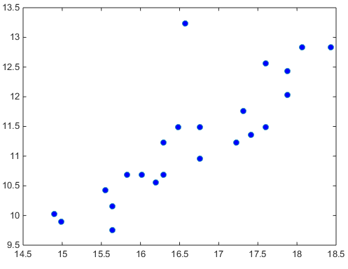
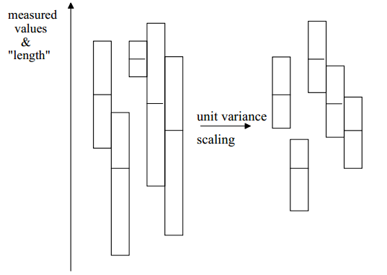
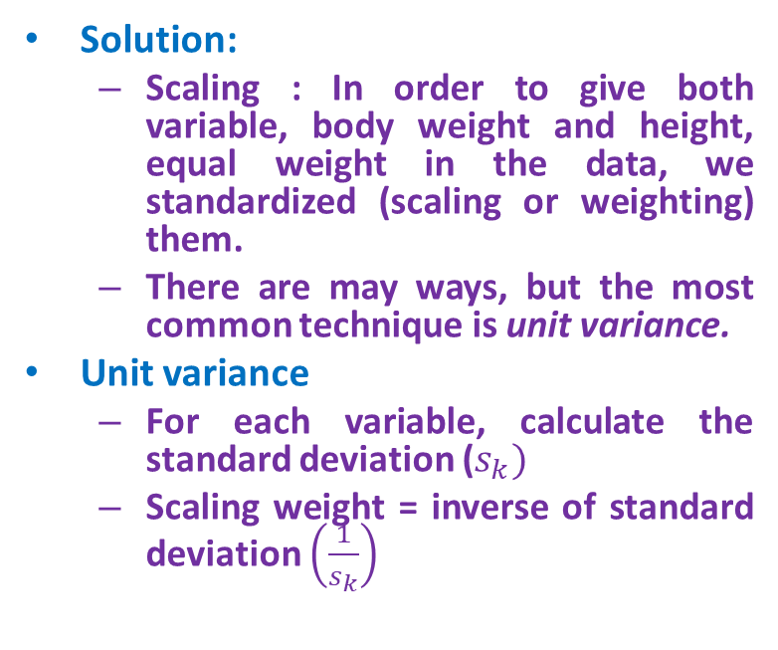
Data Transformation
Solution:
Scaling : In order to give both variable, body weight and height, equal weight in the data, we standardized (scaling or weighting) them.
There are may ways, but the most common technique is unit variance.
Unit variance
For each variable, calculate the standard deviation ($s_{k})$
Scaling weight = inverse of standard deviation $\left(\frac{1}{s_{k}}\right)$

Slide 28
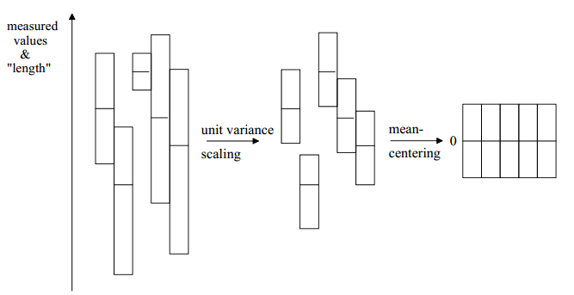
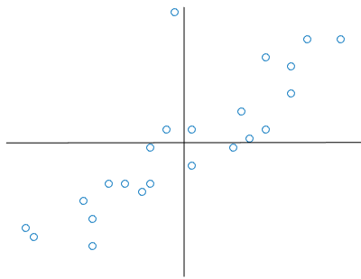
Data Transformation
Mean-Centering
This improves the interpretability of the model.
Calculate average value of each variable and then subtract from the data.
Normalization is not needed.
However, mean centering is essential for performing Principal Component Analysis, as it gives direction of variability across the mean of the samples by creating the covariance matrix.
Without centering, one would be looking at variations about the origin.

Slide 29
min-max normalization
A
8
20
10
15
A
0
1
0.16
0.58
The minimum value is 8
The maximum value is 20
Assume, we want to scale data between 0 and 1,
The new min is 0
The new max is 1

Slide 30
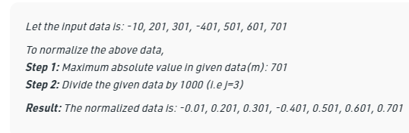
Normalization
Z-score normalization (μ: mean, σ: standard deviation):
Ex. Let μ = 54,000, σ = 16,000. Then $73,000 is mapped to
Normalization by decimal scaling
Where j is the smallest integer such that Max(|ν’|) < 1

Slide 31
Acknowledgements
Lecture slides modified from
Data Mining: Concepts and Techniques (3rd ed.), Jiawei Han, Micheline Kamber, and Jian Pei

