Slide 1
Performance Evaluation

Slide 2
Metrics for Performance Evaluation
Instance | Actual Class | Predicted Class
1 | Pos | Y
2 | Pos | N
3 | Neg | Y
4 | Pos | N
5 | Pos | Y
6 | Pos | N
7 | Neg | Y
8 | Neg | Y
9 | Pos | Y
10 | Neg | Y
11 | Pos | N
12 | Neg | Y
13 | Pos | N
14 | Neg | N
15 | Neg | Y
16 | Neg | Y
17 | Pos | Y
18 | Neg | N
19 | Pos | Y
20 | Neg | N
Focus on the predictive capability of a model
Rather than how fast it takes to classify or build models, scalability, etc.
Confusion Matrix: A confusion matrix contains information about actual and predicted classifications done by a classification system.
 | Predicted Class
Actual Class | True Positive | False Negative
 | False Positive | True Negative

Slide 3
Metrics for Performance Evaluation
Instance | Actual Class | Predicted Class
1 | Pos | Y
2 | Pos | N
3 | Neg | Y
4 | Pos | N
5 | Pos | Y
6 | Pos | N
7 | Neg | Y
8 | Neg | Y
9 | Pos | Y
10 | Neg | Y
11 | Pos | N
12 | Neg | Y
13 | Pos | N
14 | Neg | N
15 | Neg | Y
16 | Neg | Y
17 | Pos | Y
18 | Neg | N
19 | Pos | Y
20 | Neg | N
True Positive: If the instance is positive and it is classified as positive
False Negative: If an instance is positive but the output of classifier is negative
True Negative: : If the instance is negative and it is classified as negative
False Positive: If the instance is negative and it is classified as positive
 | Predicted Class
Actual Class | True Positive | False Negative
 | False Positive | True Negative

Slide 4
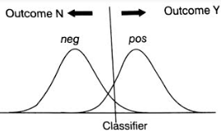
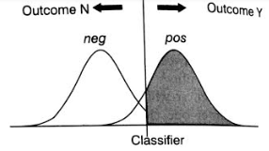
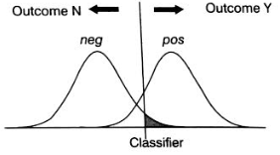
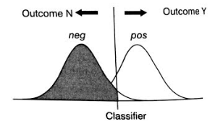
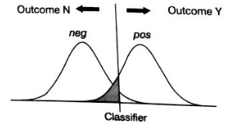
Metrics for Performance Evaluation
True Positive
False Positive
True Negative
False Negative

Slide 5
Metrics for Performance Evaluation
Instance | Actual Class | Predicted Class
1 | Pos | Y
2 | Pos | N
3 | Neg | Y
4 | Pos | N
5 | Pos | Y
6 | Pos | N
7 | Neg | Y
8 | Neg | Y
9 | Pos | Y
10 | Neg | Y
11 | Pos | N
12 | Neg | Y
13 | Pos | N
14 | Neg | N
15 | Neg | Y
16 | Neg | Y
17 | Pos | Y
18 | Neg | N
19 | Pos | Y
20 | Neg | N
 | Predicted Class
Actual Class | True Positive | False Negative
 | False Positive | True Negative
Confusion Matrix
 | 12 | 8
10 | 5 | 5
10 | 7 | 3

Slide 6
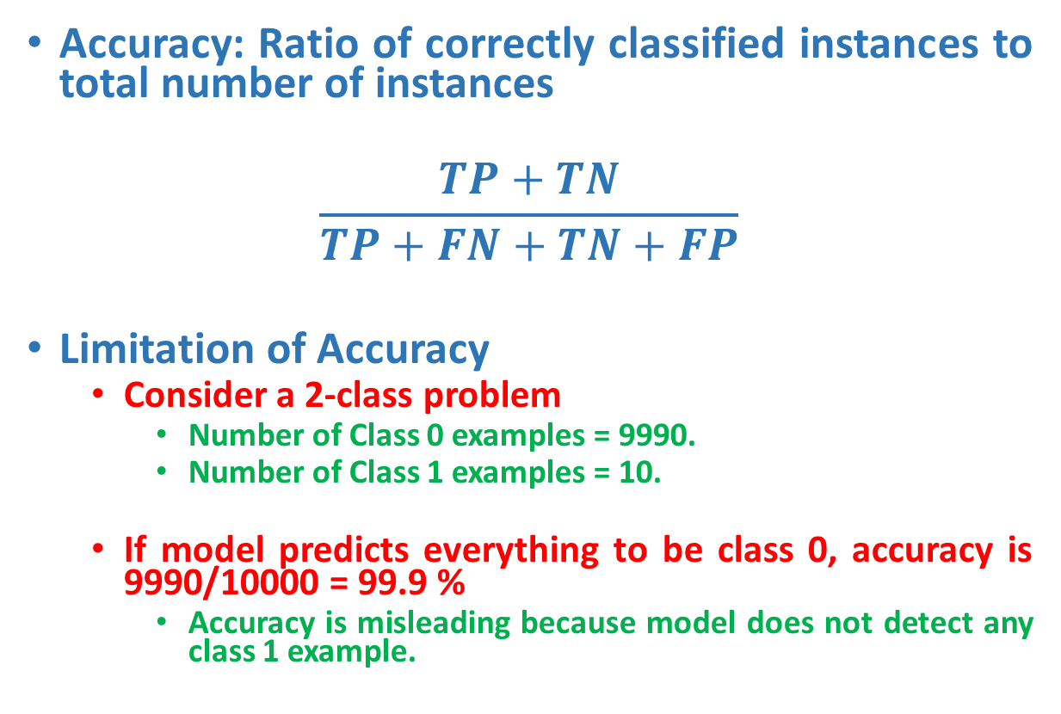
Metrics for Performance Evaluation
Accuracy: Ratio of correctly classified instances to total number of instances
$$\frac{TP+TN}{TP+FN+TN+FP}$$
Limitation of Accuracy
Consider a 2-class problem
Number of Class 0 examples = 9990.
Number of Class 1 examples = 10.
If model predicts everything to be class 0, accuracy is 9990/10000 = 99.9 %
Accuracy is misleading because model does not detect any class 1 example.
 | Predicted Class
Actual Class | True Positive | False Negative
 | False Positive | True Negative

Slide 7
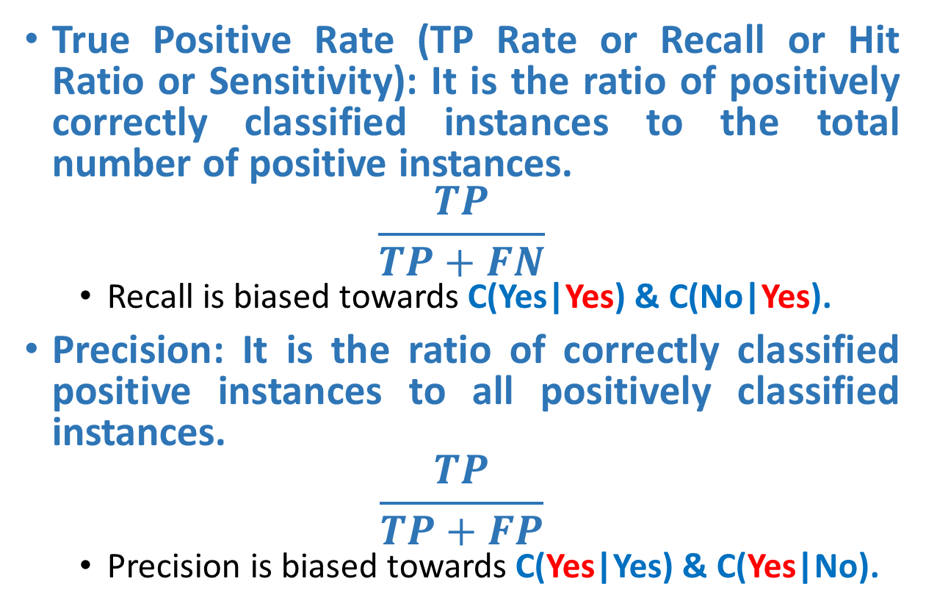
Metrics for Performance Evaluation
True Positive Rate (TP Rate or Recall or Hit Ratio or Sensitivity): It is the ratio of positively correctly classified instances to the total number of positive instances.
$$\frac{TP}{TP+FN}$$
Recall is biased towards C(Yes|Yes) & C(No|Yes).
Precision: It is the ratio of correctly classified positive instances to all positively classified instances.
$$\frac{TP}{TP+FP}$$
Precision is biased towards C(Yes|Yes) & C(Yes|No).
 | Predicted Class
Actual Class | True Positive | False Negative
 | False Positive | True Negative

Slide 8
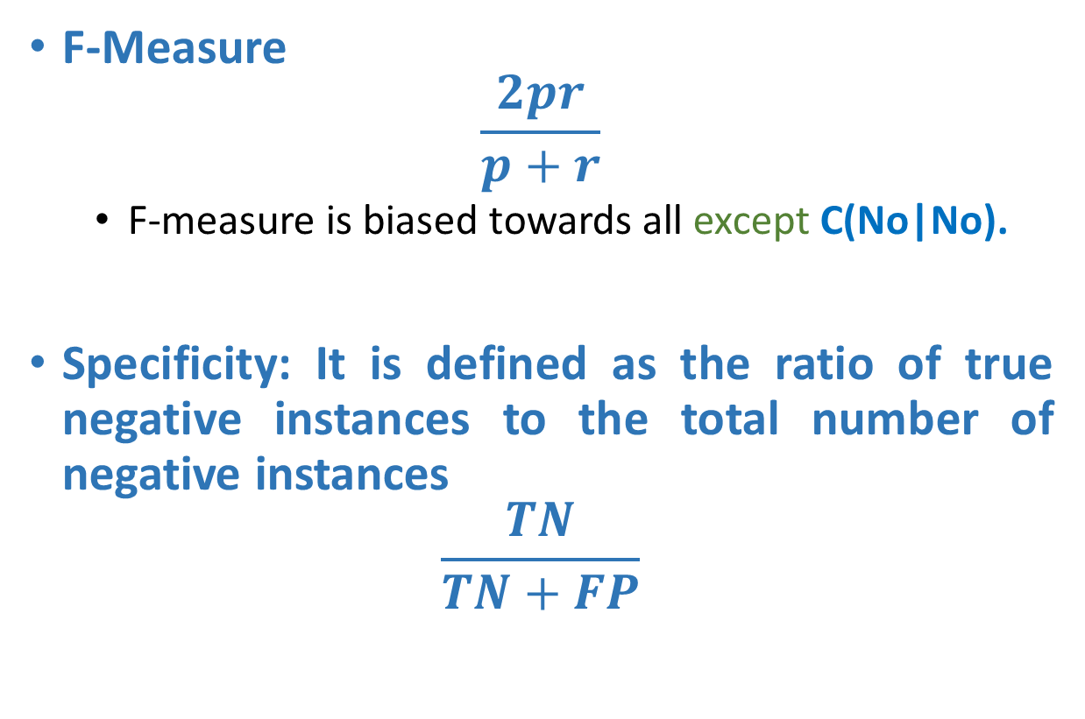
Metrics for Performance Evaluation
F-Measure
$$\frac{2pr}{p+r}$$
F-measure is biased towards all except C(No|No).
Specificity: It is defined as the ratio of true negative instances to the total number of negative instances
$$\frac{TN}{TN+FP}$$

Slide 9
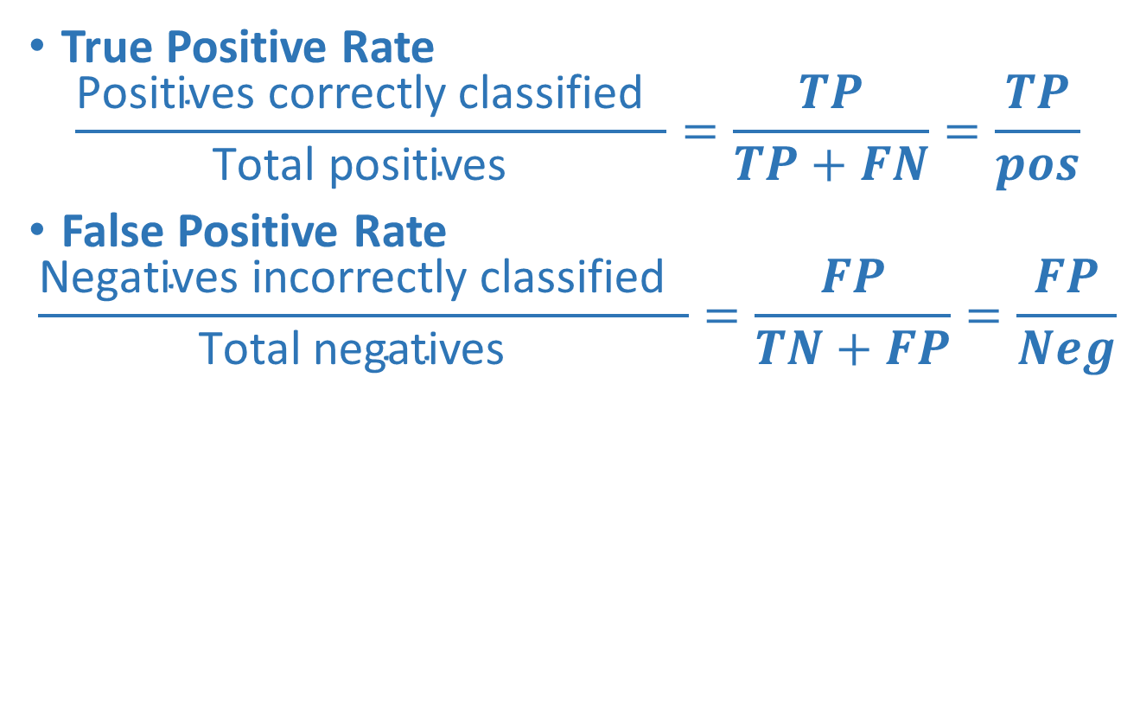
Metrics for Performance Evaluation
True Positive Rate
$$\frac{\text{Positives} \text{correctly} \text{classified} }{\text{Total} \text{positives} }=\frac{TP}{TP+FN}=\frac{TP}{pos}$$
False Positive Rate
$$\frac{\text{Negatives} \text{incorrectly} \text{classified} }{\text{Total} \text{negatives} }=\frac{FP}{TN+FP}=\frac{FP}{Neg}$$
 | Predicted Class
Actual Class | True Positive | False Negative
 | False Positive | True Negative

Slide 10
Problem with Common Evaluation Measures
They describe the state of affairs at a fixed point in a larger evaluation space.
We could get a better grasp on the performance of our learning system if we could judge its behavior at more than a single point in that space.
For that, we should consider the ROC Space

Slide 11
What does it mean to consider a larger evaluation space?
Often, classifiers (e.g., Decision Trees, Rule Learning systems) only issue decisions: true or false.
There is no evaluation space to speak of: we can only judge the value of the classifier’s decision.
WRONG!!! Inside these classifiers, there is a continuous measure that gets pitted against a threshold in order for a decision to be made.
If we could get to that inner process, we could estimate the behavior of our system in a larger space

Slide 12
What does it mean to consider a larger evaluation space?
But why do we care about the inner process?
Well, the classifier’s decision relies on two separate processes.
The modeling of the data distribution;
The decision based on that modeling.
Let’s take the case where (1) is done very reliably, but (2) is badly done. In that case, we would end up with a bad classifier even though the most difficult part of the job (1) was well done.
It is useful to separate (1) from (2) so that (1), the most critical part of the process, can be estimated reliably. As well, if necessary, (2) can easily be modified and improved.

Slide 13
A Concrete Look at the issue: The Neural Network Case (
In a Multiple Layered Perceptron (MLP), we expect the output unit to issue 1 if the example is positive and 0, otherwise.
However, in practice, this is not what happens. The MLP issues a number between 0 and 1 which the user interprets to be 0 or 1.
Usually, this is done by setting a threshold at .5 so that everything above .5 is positive and everything below .5 is negative.
However, this may be a bad threshold. Perhaps we would be better off considering a .75 threshold or a .25 one.

Slide 14
A Concrete Look at the issue: The Neural Network Case
Please, note that a .75 threshold would amount to decreasing the number of false positives at the expense of false negatives. Conversely, a threshold of .25 would amount to decreasing the number of false negative, this time at the expense of false positives.
ROC Spaces allow us to explore such thresholds on a continuous basis.
They provide us with two advantages: 1) They can tell us what the best spot for our threshold is (given where our priority is in terms of sensitivity to one type over the other type of error) and 2) They allow us to see graphically the behavior of our system over the whole range of possible tradeoffs.

Slide 15
A Concrete Look at the Issue: Decision Trees
Unlike an MLP, a Decision Tree only returns a class label. However, we can ask how this label was computed internally.
It was computed by considering the proportion of instances of both classes at the leaf node the example fell in. The decision simply corresponds to the most prevalent class.
There does, however, exist systems whose process cannot be translated into a score. For these systems, a score can be generated from an aggregation process.

Slide 16
ROC Analysis
Definition: ROC Graphs are two-dimensional graphs in which the TP Rate is plotted on the Y Axis and the FP Rate is plotted on the X Axis. A ROC graph depicts relative tradeoffs between benefits (true positives) and costs (false positives)

Slide 17
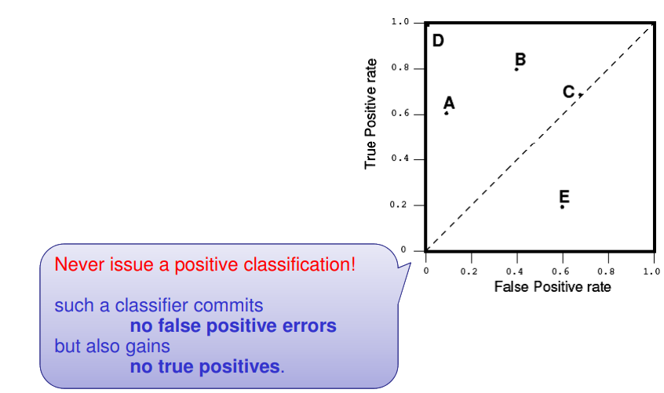
Points in a ROC Graph
Lower left point (0, 0)

Slide 18
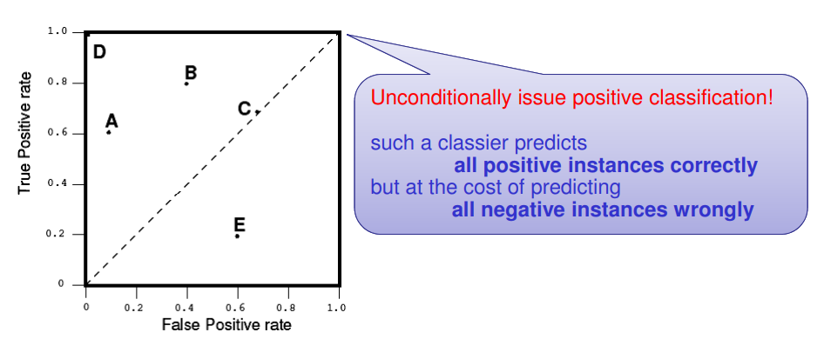
Points in a ROC Graph
Upper Right corner (1, 1)

Slide 19
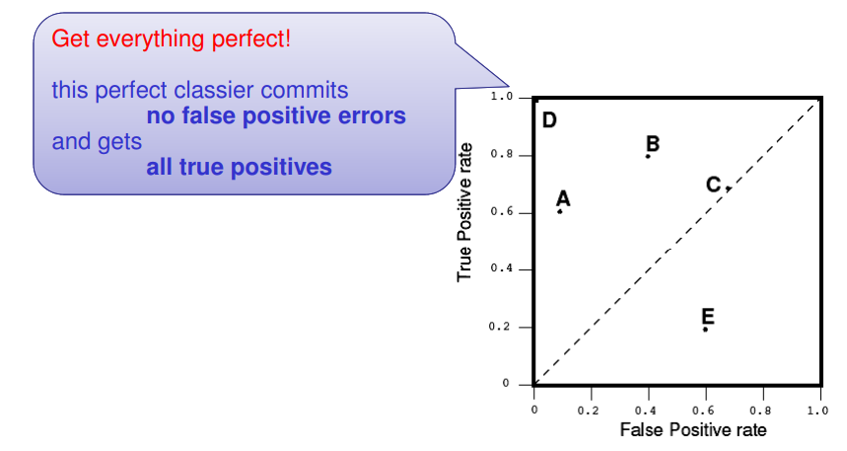
Points in a ROC Graph
Point D (0,1)

Slide 20
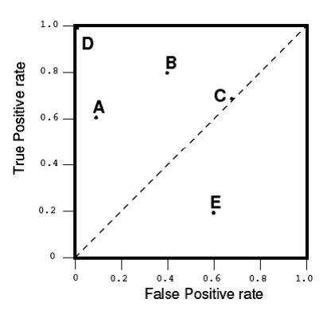
Several Points in ROC Space
A point in ROC space is better than another if it is to the northwest of the other, i.e.
TP rate is higher
FP rate is lower, or both.

Slide 21
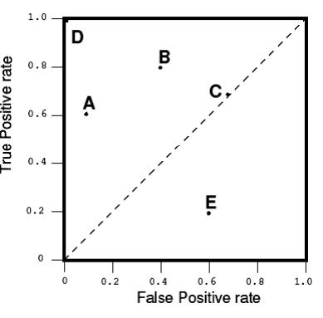
Several Points in ROC Space
Upper and Lower Triangular Areas
Any classifier that appears in the lower right triangle performs worse than random guessing.
This triangle is therefore usually empty in ROC graphs.

Slide 22
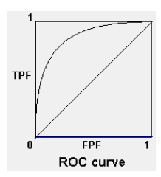
Curves in ROC space
Many classifiers, such as decision trees or rule sets, are designed to produce only a class decision, i.e., a Y or N on each instance.
When such a discrete classier is applied to a test set, it yields a single confusion matrix, which in turn corresponds to one ROC point.
Some classifiers, such as a Naive Bayes classifier, yield an instance probability or score.
Such a ranking or scoring classier can be used with a threshold to produce a discrete (binary) classier:
if the classier output is above the threshold, the classier produces a Y,
else it produces an N.
Each different threshold value produces a different point in ROC space (corresponding to a different confusion matrix).

Slide 23
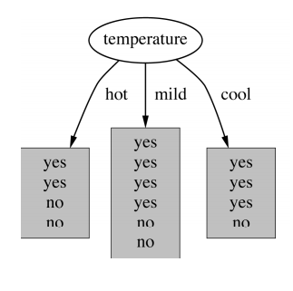
Creating Scoring Classifiers
Many discrete classifier models may easily be converted to scoring classifiers by “looking inside” them at the instance statistics they keep.
For example, a decision tree determines a class label of a leaf node from the proportion of instances at the node; the class decision is simply the most prevalent class.
These class proportions may serve as a score.

Slide 24
Generation of ROC Curve - Algorithm
Exploit monotonicity of thresholded classifications
Any instance that is classified positive with respect to a given threshold, will be classified positive for all lower thresholds as well.
Therefore, we can simply:
sort the test instances decreasing by their scores,
move down the list (lowering the threshold), processing one instance at a time, and
update TPR and FPR as we go
In this way, a ROC graph can be created from a linear scan

Slide 25
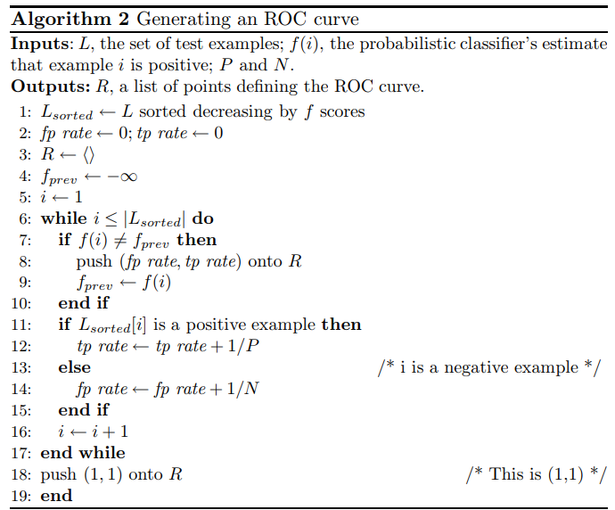
Algorithm
Algorithm in the right side exploits the monotonicity of thresholded classifications:
any instance that is classified as positive with respect to a given threshold will be classified as positive for all lower thresholds.
The function f(i) is the score assigned to instance i by the classifier. In this algorithm, tp rate and fp rate start at zero. Each positive instance increments tp rate by 1/total positives and each negative instance increments fp rate by 1/total negatives.
The algorithm maintains a stack R of ROC points, pushing a new point onto R after each group of tied instances (instances with the same score) is processed.

Slide 26
Algorithm
The final output is the stack R, containing the points on the ROC curve.
Each group of tied instances will therefore generate on the ROC graph a line segment.

Slide 27
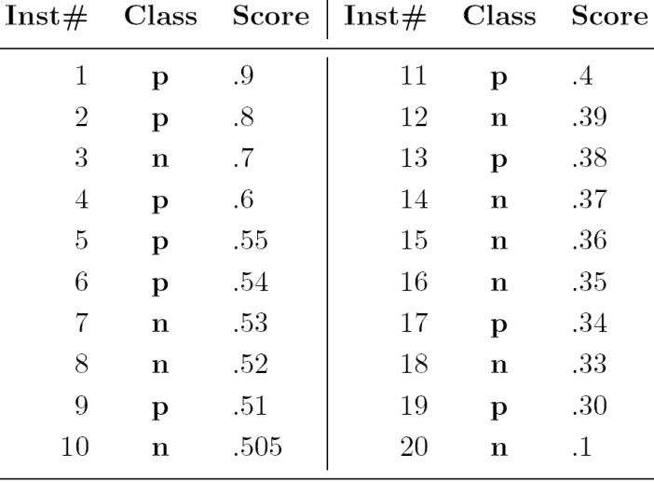
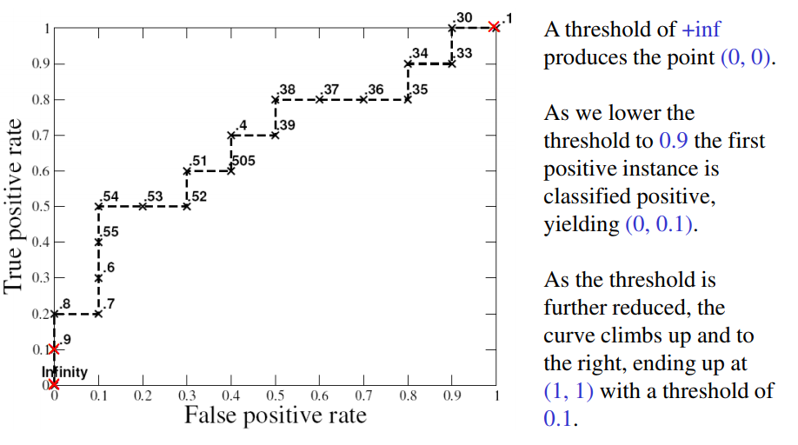
Example

Slide 28
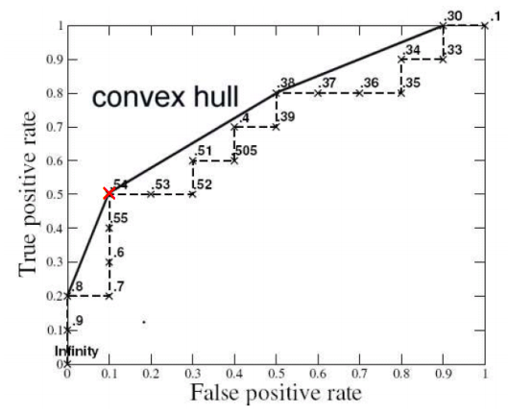
Observations – Accuracy
The ROC point at (0.1, 0.5) produces its highest accuracy (70%).
Note that the × classifier's best accuracy occurs at a threshold of .54, rather than at .5 as we might expect with a balanced class distribution.

Slide 29
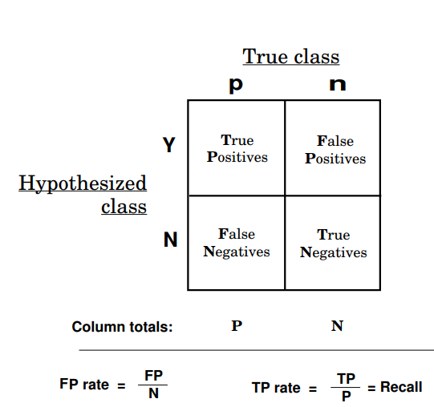
Class skew
ROC Graphs are insensitive to changes in class distribution. I.e., if the proportion of positive to negative instances changes in a test set, the ROC Curve will not change.
Class distribution
the proportion of positive to negative instances is the relationship of the left (+) column to the right (-) column.
Any performance metric that uses values from both columns will be inherently sensitive to class skews.
Metrics such as accuracy, precision, lift and F scores use values from both columns of the confusion matrix. As a class distribution changes these measures will change as well.
ROC graphs are based upon TP rate and FP rate, in which each dimension is a strict columnar ratio, so do not depend on class distributions.

Slide 30
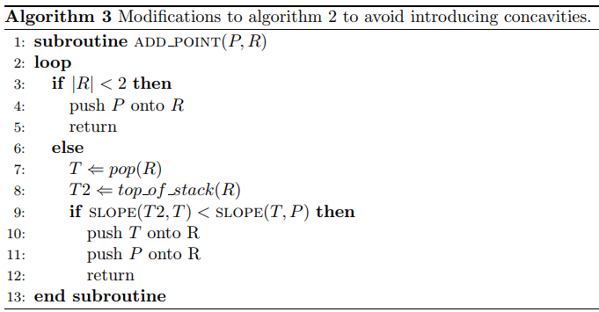
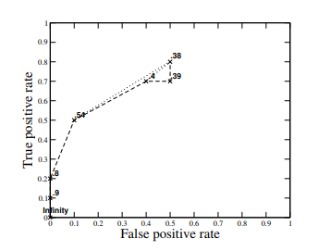
Creating convex ROC curves
A convex ROC curve should have monotonically decreasing slopes. If adding a new point would introduce a line segment of greater slope than the one preceding it, the preceding ROC point is discarded.
Algorithm 2 may be modified to remove concavities simply by replacing the add point subroutine.
This procedure ensures monotonicity of slopes, and thus convexity of the curve

Slide 31
Method to find the “Optimal” Threshold Point
Point on Curve Closest to (0,1)
The optimal value of the threshold is obtained by minimizing the distance between point (0, 1) and any point on the ROC curve
To obtain the optimal threshold to discriminate the instance , this distance is calculated for each observed threshold values, and the point where the distance is minimum is located
For Example
The nearsest ROC point to (0,1) is the point corresponding to the threshold 0.54

Slide 32
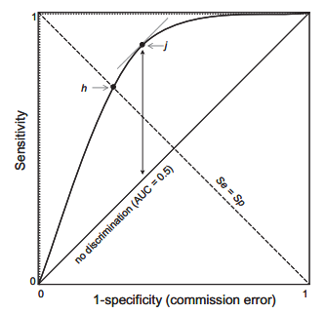
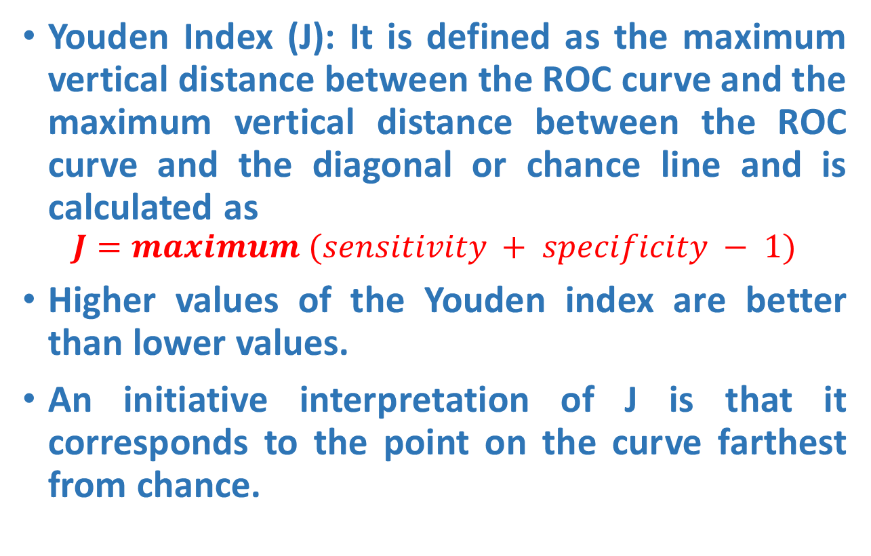
Method to find the “Optimal” Threshold Point
Youden Index (J): It is defined as the maximum vertical distance between the ROC curve and the maximum vertical distance between the ROC curve and the diagonal or chance line and is calculated as
$$J=maximum (sensitivity + specificity − 1)$$
Higher values of the Youden index are better than lower values.
An initiative interpretation of J is that it corresponds to the point on the curve farthest from chance.
$$Specificity= \frac{TN}{TN+FP};1−Specificity=1−\frac{TN}{TN+FP}=FPR$$

Slide 33
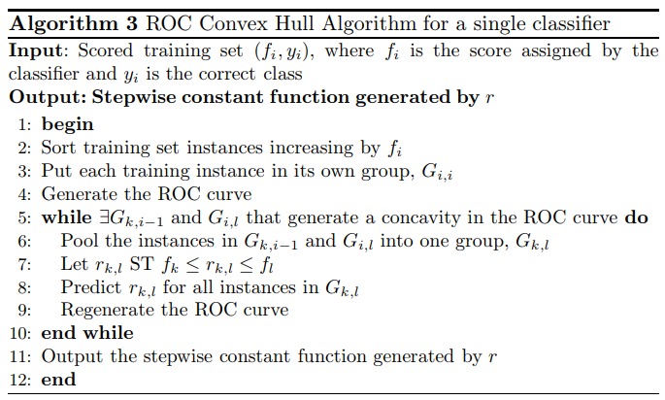
ROC convex hull (ROCCH)
The convex hull of the set of points in ROC space is called the ROC convex hull (ROCCH) of the corresponding set of classifiers.
The ROCCH is a piecewise-linear, concave-down “curve.” Therefore, as x increases, the slope of the ROCCH is monotonically non-increasing with k − 1 discrete values, where k is the number of ROCCH component classifiers, including the degenerate classifiers that define the hull endpoints.
A classifier is potentially optimal if and only if it lies on the convex hull of the set of points in ROC space.

Slide 34
Area under a ROC Curve (AUC)
An ROC curve is a two-dimensional depiction of classifier performance.
However, often since there is no clear predominance of some ROC curve above others, it is difficult to compare two classifiers by looking at the respective curves.
Hence, it is preferable to employ a single value measure which summarizes the performance of the classifier.
A common method is to calculate the area under the ROC curve, abbreviated AUC

Slide 35
Area under a ROC Curve (AUC)
The area under a classifier’s curve expressed as a fraction of the unit square
Its value ranges from zero to one
The AUC is useful when a single number is needed to summarize performance, or when nothing is known about the operating conditions
A ROC curve provides more information than its area
Since the AUC is a portion of the area of the unit square, its value will always be between 0 and 1.0.
However, because random guessing produces the diagonal line between (0,0) and (1, 1), which has an area of 0.5, no realistic classifier should have an AUC less than 0.5.

Slide 36
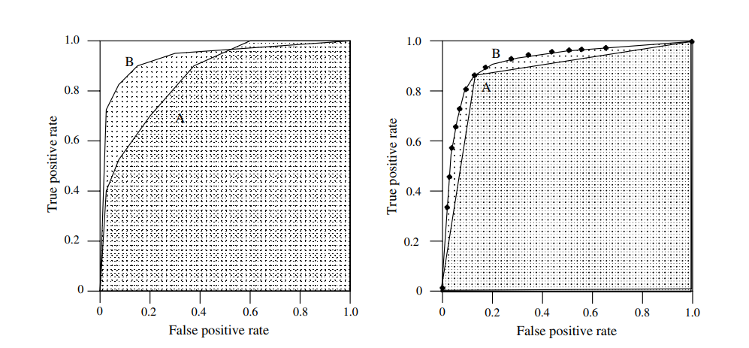
Area under a ROC Curve (AUC)
Figure: a
Figure: b
Fig. a shows the areas under two ROC curves, A and B. Classifier B has greater area and therefore better average performance.
Fig. b shows the area under the curve of a binary classifier A and a scoring classifier B. Classifier A represents the performance of B when B is used with a single, fixed threshold. Though the performance of the two is equal at the fixed point (As threshold), As performance becomes inferior to B further from this point.
It is possible for a high-AUC classifier to perform worse in a specific region of ROC space than a low-AUC classifier. Fig. a shows an example of this: classifier B is generally better than A except at FPR > 0.6 where A has a slight advantage.

Slide 37
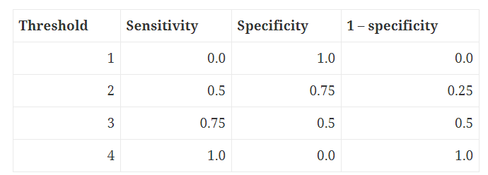
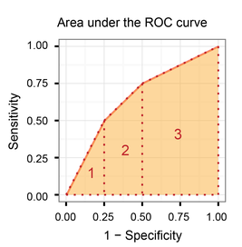
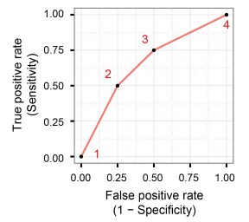
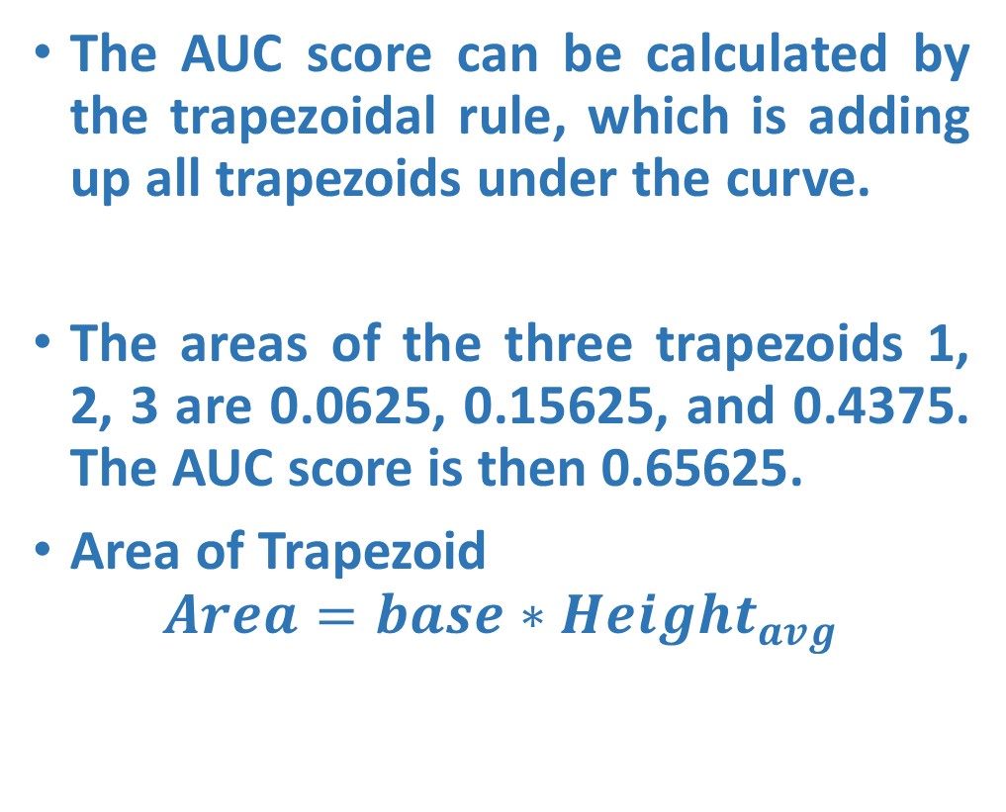
Method to compute AUC
The AUC score can be calculated by the trapezoidal rule, which is adding up all trapezoids under the curve.
The areas of the three trapezoids 1, 2, 3 are 0.0625, 0.15625, and 0.4375. The AUC score is then 0.65625.
Area of Trapezoid
$$Area=base∗Height_{avg}$$

Slide 38
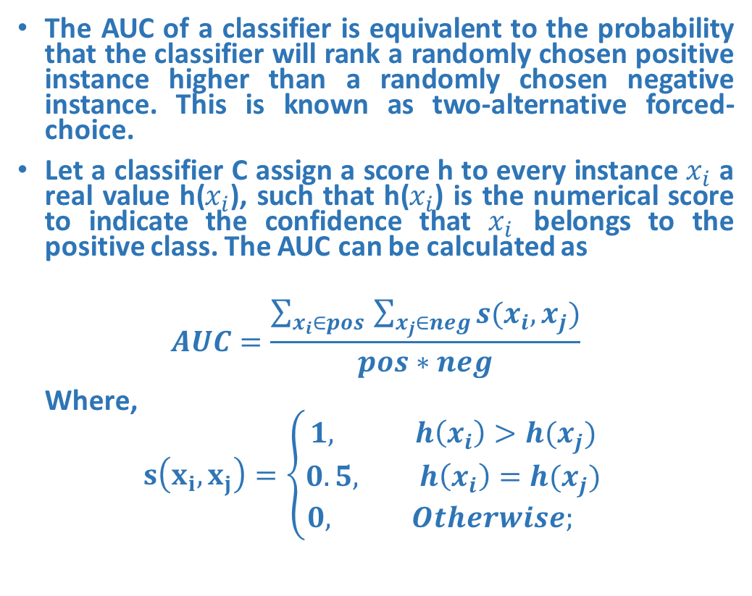
Method to compute AUC
The AUC of a classifier is equivalent to the probability that the classifier will rank a randomly chosen positive instance higher than a randomly chosen negative instance. This is known as two-alternative forced-choice.
Let a classifier C assign a score h to every instance $x_{i}$ a real value h($x_{i}$), such that h($x_{i}$) is the numerical score to indicate the confidence that $x_{i}$ belongs to the positive class. The AUC can be calculated as
$$AUC=\frac{\sum_{x_{i}∈pos }{\sum_{x_{j}∈neg}{s(x_{i},x_{j})}}}{pos∗neg}$$
Where,
$$s\left(x_{i},x_{j}\right)=\left\{\begin{aligned}1, h\left(x_{i}\right)>h(x_{j}) \\ 0.5, h\left(x_{i}\right)=h(x_{j}) \\ 0, Otherwise; \end{aligned}\right.$$

Slide 39
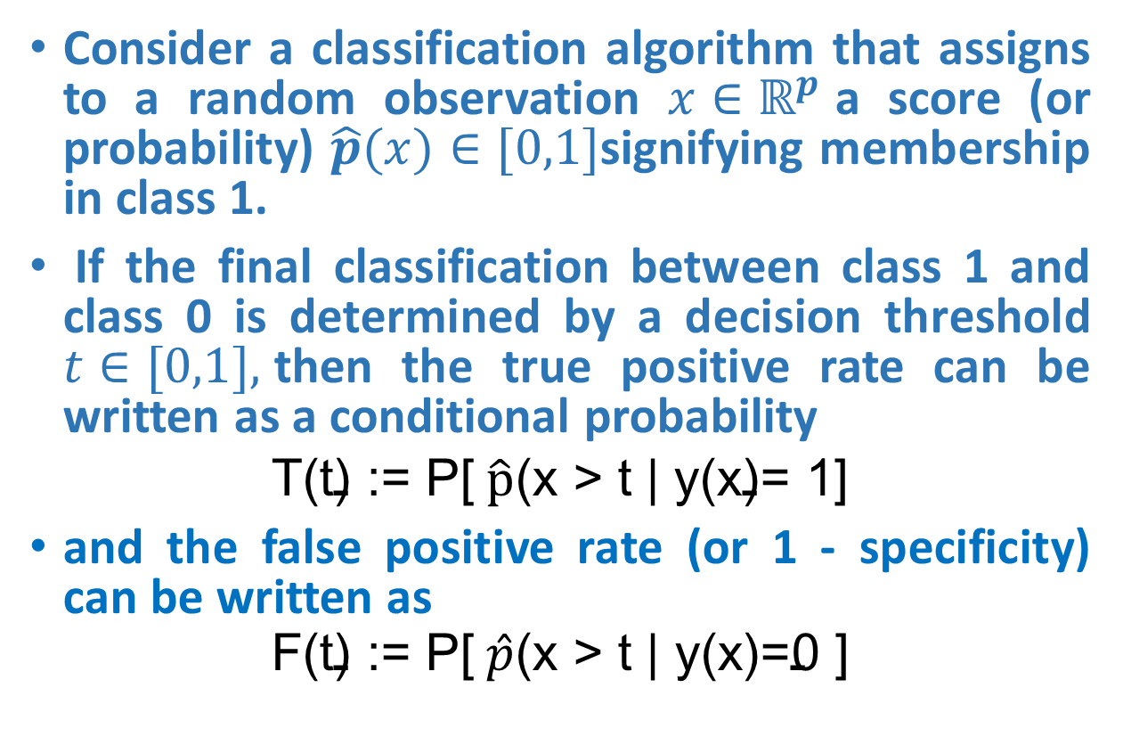
AUC Probabilistic Interpretation
Consider a classification algorithm that assigns to a random observation $x∈ℝ^{p}$a score (or probability) $\hat{p}(x)∈[0,1]$signifying membership in class 1.
If the final classification between class 1 and class 0 is determined by a decision threshold $t∈[0,1],$then the true positive rate can be written as a conditional probability
$$\text{T}\text{(}\text{t}\text{) := }\text{P}\text{[} \hat{p}\text{(}\text{x}\text{ > }\text{t}\text{ | }\text{y}\text{(}\text{x}\text{)= 1]}$$
and the false positive rate (or 1 - specificity) can be written as
$$\text{F}\text{(}\text{t}\text{) := }\text{P}\text{[} \hat{p}\text{(}\text{x}\text{ > }\text{t}\text{ | }\text{y}\text{(}\text{x}\text{)=0 ]}$$

Slide 40
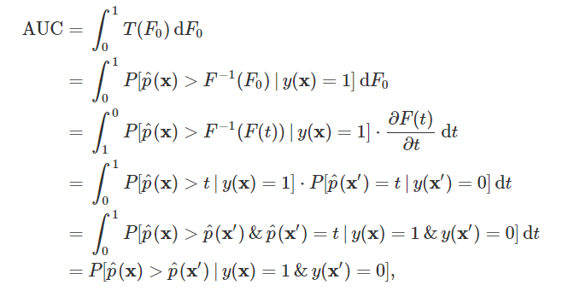
AUC Probabilistic Interpretation
The ROC curve simply plots T(t) against F(t) while varying t from 0 to 1.
Thus, if we view T as a function of F, the AUC can be rewritten as follows.

Slide 41
Averaging ROC Curves
A single ROC Curve is not sufficient to make conclusions about a classifier since it corresponds to only a single trial.
it is analogous to taking the maximum of a set of accuracy figures from a single test set. Without a measure of variance we cannot compare the classifiers
In order to avoid this problem, we need to average several ROC Curves. There are two averaging techniques:
Vertical Averaging
Threshold Averaging

Slide 42
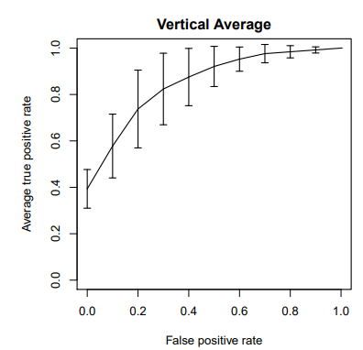
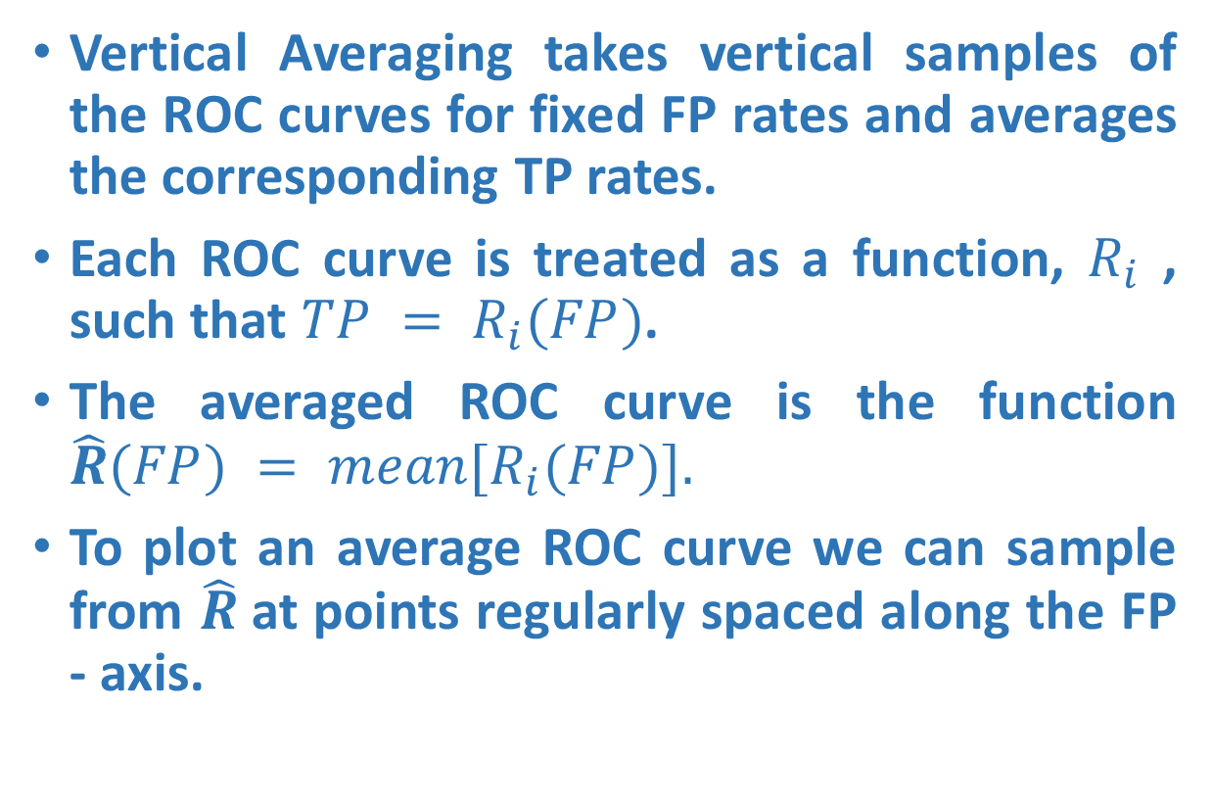
Vertical Averaging
Vertical Averaging takes vertical samples of the ROC curves for fixed FP rates and averages the corresponding TP rates.
Each ROC curve is treated as a function, $R_{i}$ , such that $TP = R_{i}(FP)$.
The averaged ROC curve is the function $\hat{R}(FP) = mean[R_{i}(FP)].$
To plot an average ROC curve we can sample from $\hat{R}$at points regularly spaced along the FP - axis.

Slide 43
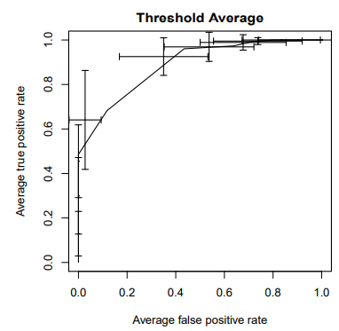
Threshold Averaging
Instead of sampling points based on their positions in ROC space, as vertical averaging does, it samples based on the thresholds that produced these points.
It generates an array T of classifier scores which are sorted from largest to smallest and used as the set of thresholds.
These thresholds are sampled at fixed intervals determined by the number of samples desired.
For a given threshold, the algorithm selects from each ROC curve the point of greatest score less than or equal to the threshold.
These points are then averaged separately along their X and Y axes, with the center point returned in the Avg array.

Slide 44
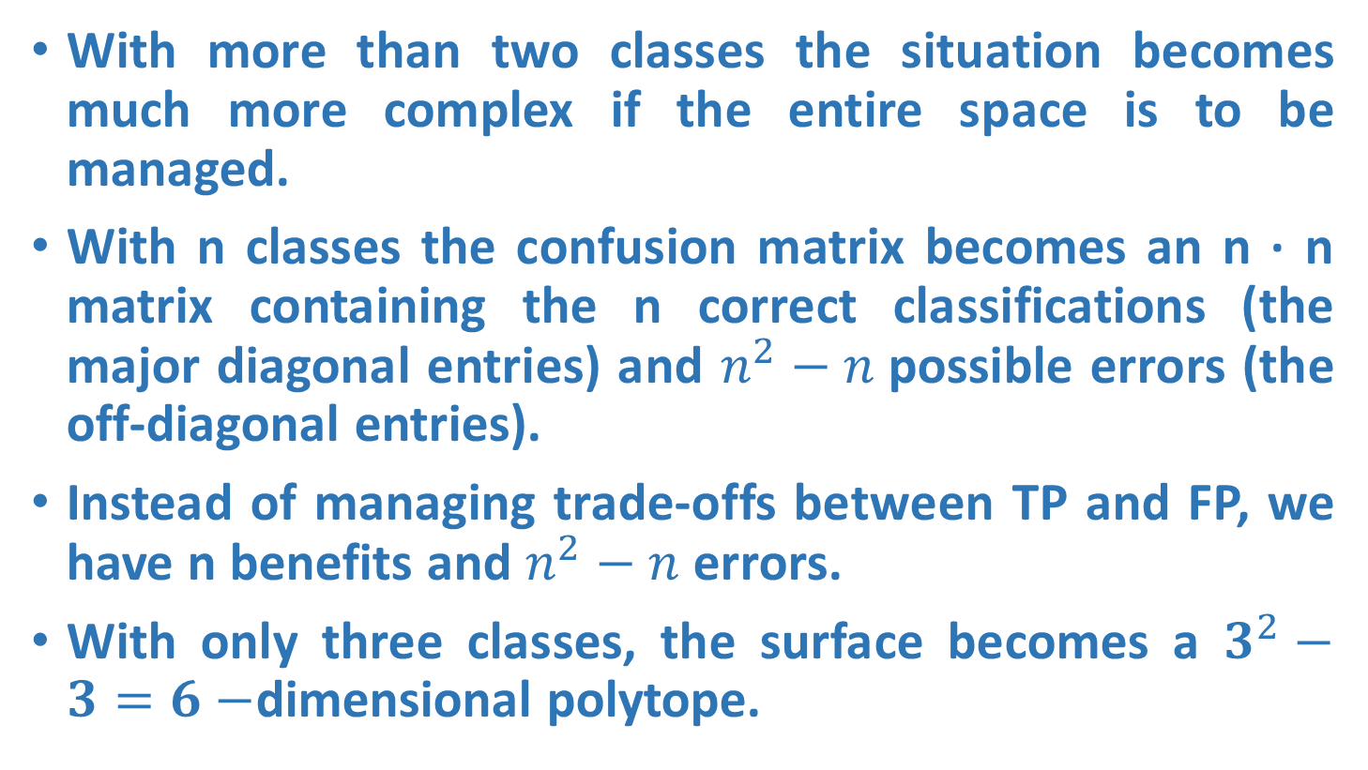
Multi-class ROC graphs
With more than two classes the situation becomes much more complex if the entire space is to be managed.
With n classes the confusion matrix becomes an n · n matrix containing the n correct classifications (the major diagonal entries) and $n^{2}−n$possible errors (the off-diagonal entries).
Instead of managing trade-offs between TP and FP, we have n benefits and $n^{2}−n$errors.
With only three classes, the surface becomes a $3^{2}−3=6−$dimensional polytope.

Slide 45
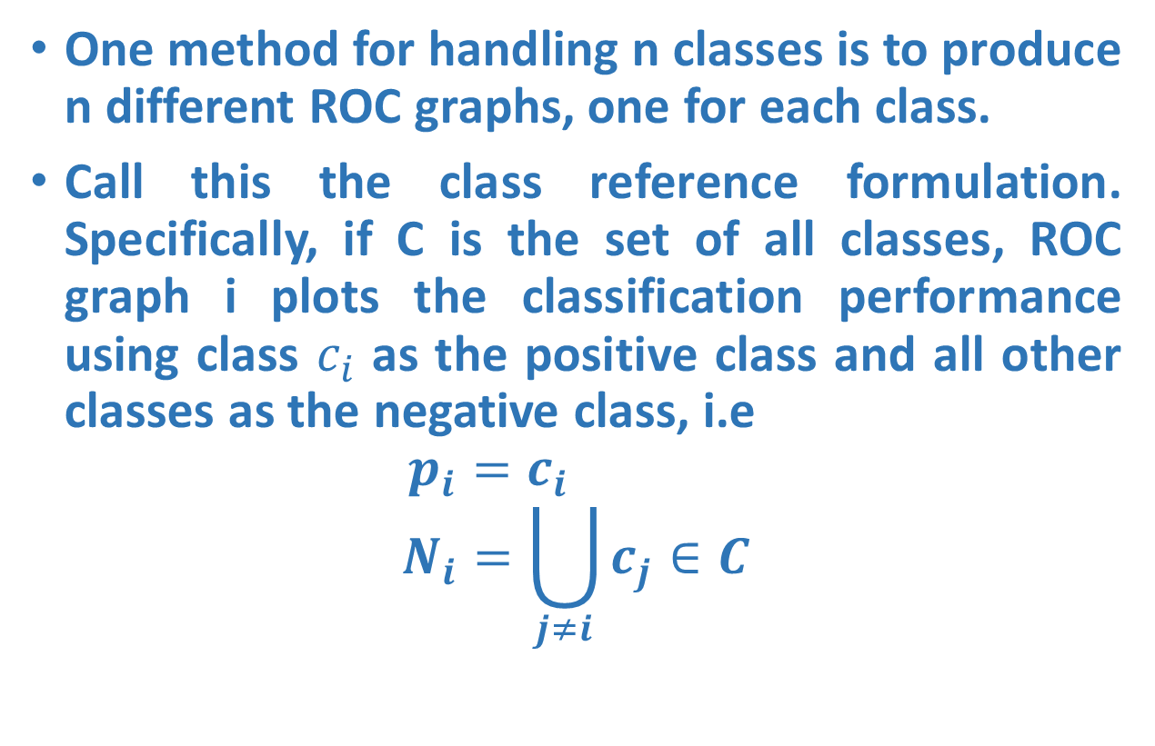
Multi-class ROC graphs
One method for handling n classes is to produce n different ROC graphs, one for each class.
Call this the class reference formulation. Specifically, if C is the set of all classes, ROC graph i plots the classification performance using class $c_{i}$ as the positive class and all other classes as the negative class, i.e
$$p_{i}=c_{i}$$
$$N_{i}=\bigcup_{j≠i}{c_{j}∈C}$$

Slide 46

Multi-class AUC
AUC is equivalent to the probability that the classifier will rank a randomly chosen positive instance higher than a randomly chosen negative instance. From this probabilistic form, they derive a formulation that measures the unweighted pairwise discriminability of classes.
Their measure, which they call M, is equivalent to:
where n is the number of classes and AUC(ci,cj) is the area under the two-class ROC curve involving classes ci and cj.

