Slide 1
Clustering Techniques

Slide 2
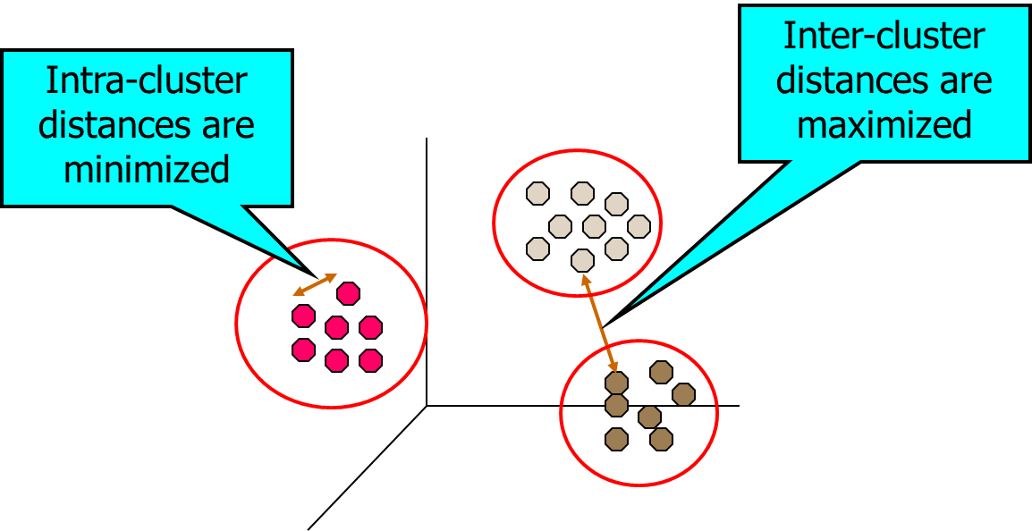
Clustering
Cluster: a collection of data objects
Similar to one another within the same cluster
Dissimilar to the objects in other clusters
Clustering is a technique for finding groups of objects such that the objects in a group will be similar (or related) to one another and different from (or unrelated to) the objects in other groups
Clustering is often called an unsupervised learning task as no class values denoting an a priori grouping of the data instances are given, which is the case in supervised learning.

Slide 3
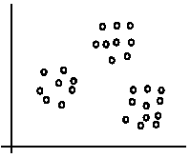
An illustration
The data set has three natural groups of data points, i.e., 3 natural clusters.

Slide 4
Notion of a Cluster can be Ambiguous
How many clusters?
Six Clusters
Two Clusters
Four Clusters

Slide 5
What Is Good Clustering?
A good clustering method will produce high quality clusters with
high intra-class similarity
low inter-class similarity
The quality of a clustering result depends on both the similarity measure used by the method and its implementation.

Slide 6
Examples of Clustering Applications
Marketing: Help marketers discover distinct groups in their customer bases, and then use this knowledge to develop targeted marketing programs
Land use: Identification of areas of similar land use in an earth observation database
Insurance: Identifying groups of motor insurance policy holders with a high average claim cost
City-planning: Identifying groups of houses according to their house type, value, and geographical location
Earth-quake studies: Observed earth quake epicenters should be clustered along continent faults

Slide 7
Requirements of Clustering in Data Mining
Scalability
Ability to deal with different types of attributes
Discovery of clusters with arbitrary shape
Minimal requirements for domain knowledge to determine input parameters
Able to deal with noise and outliers
Insensitive to order of input records
High dimensionality
Incorporation of user-specified constraints
Interpretability and usability

Slide 8
Major Clustering Approaches
Partitioning algorithms: Construct various partitions and then evaluate them by some criterion
Hierarchy algorithms: Create a hierarchical decomposition of the set of data (or objects) using some criterion
Density-based: A cluster is defined as a maximal set of density connected points
Grid-based: These algorithms partition the data space into a finite number of cells to form a grid structure and then form clusters from the cells in the grid structure. Clusters correspond to regions that are more dense in data points than their surroundings

Slide 9

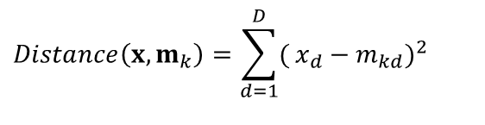
Partitioning Clustering Approach
Partitioning algorithms construct partition of a database of N objects into a set of K clusters.
The partitioning clustering algorithm usually adopts the Iterative Optimization paradigm.
It starts with an initial partition and uses an iterative control strategy.
It tries swapping data points to see if such a swapping improves the quality of clustering.
When swapping does not yield any improvements in clustering, it finds a locally optimal partitioning
in principle, optimal partition achieved via minimizing the sum of squared distance to its “representative object” in each cluster
$$E=Σ_{k=1}^{K}Σ_{x∈C_{k}}Distance(x,m_{k})$$
$$Distance\left(x,m_{k}\right)=\sum_{d=1}^{D}{(}x_{d}−m_{kd})^{2}$$
e.g., Euclidean distance

Slide 10
K-means algorithm
Given the cluster number K, the K-means algorithm is carried out in three steps after initialization:
Initialization: set seed points (randomly)
Assign each object to the cluster of the nearest seed point measured with a specific distance metric
Compute new seed points as the centroids of the clusters of the current partition (the centroid is the centre, i.e., mean point, of the cluster)
Go back to Step 1), stop when no more new assignment (i.e., membership in each cluster no longer changes)

Slide 11
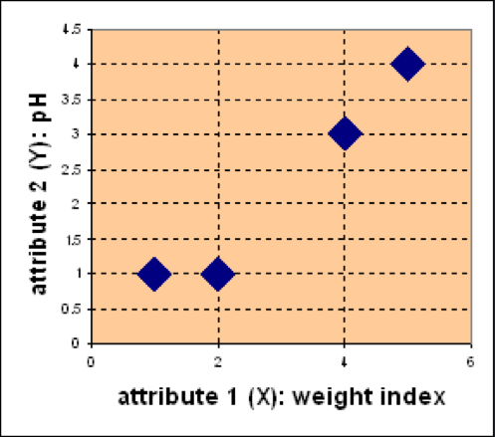
K-means - Example
Problem:
Suppose we have 4 types of medicines and each has two attributes (pH and weight index). Our goal is to group these objects into K=2 group of medicine.
Medicine | Weight | pH-Index
A | 1 | 1
B | 2 | 1
C | 4 | 3
D | 5 | 4
D
C
A
B

Slide 12
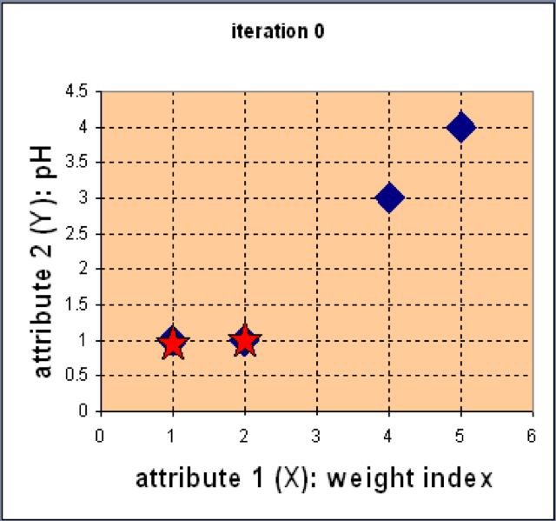
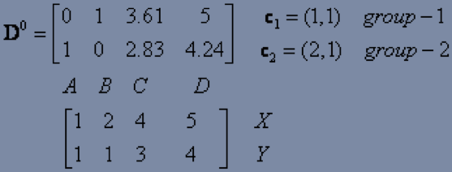
K-means - Example
Step 1: Use initial seed points for partitioning
Assign each object to the cluster
with the nearest seed point

Slide 13
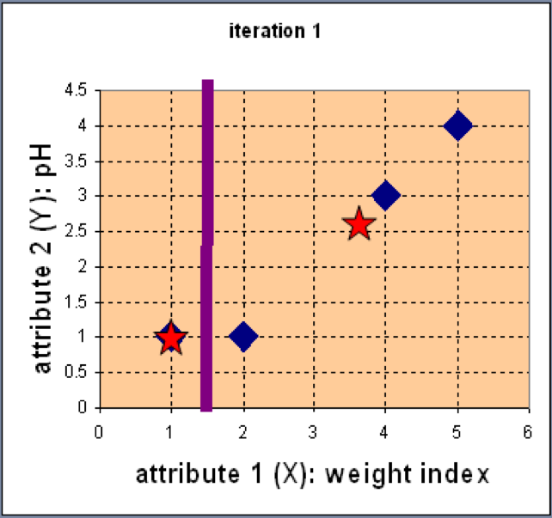
K-means - Example
Step 2: Compute new centroids of the current partition
Knowing the members of each cluster, now we compute the new centroid of each group based on these new memberships.

Slide 14
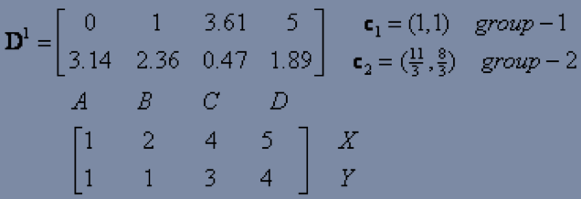
K-means - Example
Step 2: Renew membership based on new centroids
Compute the distance of all objects to the new centroids
Assign the membership to objects

Slide 15
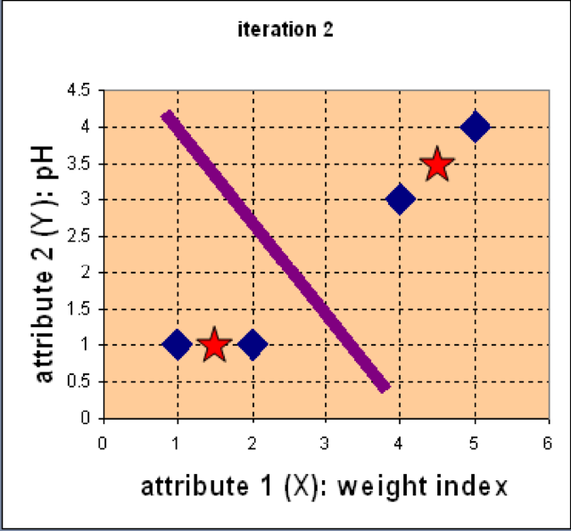
K-means - Example
Step 3: Repeat the first two steps until its convergence
Knowing the members of each cluster, now we compute the new centroid of each group based on these new memberships.

Slide 16
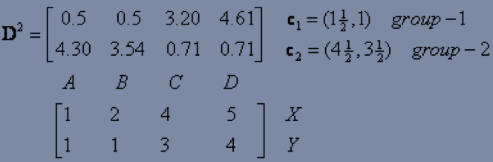
K-means - Example
Step 3: Repeat the first two steps until its convergence
Compute the distance of all objects to the new centroids
Stop due to no new assignment
Membership in each cluster no longer change

Slide 17
Strengths of k-means
Strengths:
Simple: easy to understand and to implement
Efficient: Time complexity: O(tkn), where n is the number of data points, k is the number of clusters, and t is the number of iterations.

Slide 18
Weaknesses of k-means
The algorithm is only applicable if the mean is defined.
The user needs to specify k.
The algorithm is sensitive to outliers
Outliers are data points that are very far away from other data points.
Outliers could be errors in the data recording or some special data points with very different values.

Slide 19
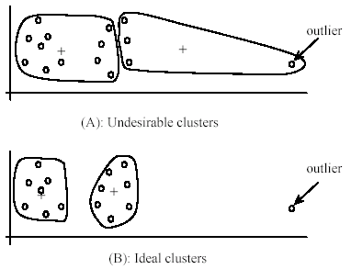
Weaknesses of k-means: Problems with outliers

Slide 20
Weaknesses of k-means: To deal with outliers
One method is to remove some data points in the clustering process that are much further away from the centroids than other data points.
To be safe, we may want to monitor these possible outliers over a few iterations and then decide to remove them.
Another method is to perform random sampling. Since in sampling we only choose a small subset of the data points, the chance of selecting an outlier is very small.
Assign the rest of the data points to the clusters by distance or similarity comparison, or classification

Slide 21
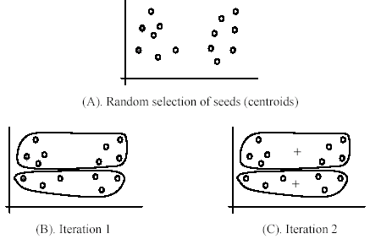
Weaknesses of k-means
The algorithm is sensitive to initial seeds.

Slide 22
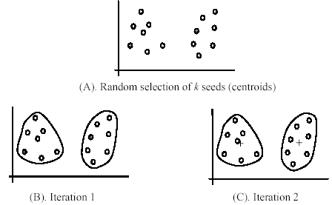
Weaknesses of k-means
If we use different seeds: good results
There are some methods to help choose good seeds

Slide 23
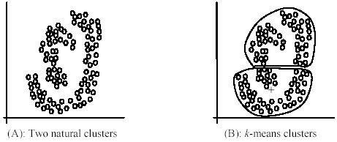
Weaknesses of k-means
The k-means algorithm is not suitable for discovering clusters that are not hyper-ellipsoids (or hyper-spheres).

Slide 24
The K-Medoids Clustering Method
Find representative objects, called medoids, in clusters
PAM (Partitioning Around Medoids)
The algorithm is intended to find a sequence of objects called medoids that are centrally located in clusters
The goal of the algorithm is to minimize the average dissimilarity of objects to their closest selected object.
PAM works effectively for small data sets, but does not scale well for large data sets
CLARA
CLARANS

Slide 25
PAM Partition Around Medoids
Pick a number, k, of random data items as medoids
Calculate
If TC_{mn} < 0, replace m by n and go back to 2
Assign every item to its nearest medoid
The pair (n,m) of medoid/non-medoid
with the smallest impact on clustering quality

Slide 26
Swapping Cost
For each pair of a medoid m and a non-medoid object h, measure whether h is better than m as a medoid
For example, we can use the squared-error criterion
Compute E_{h}-E_{m}
Negative: swapping brings benefit
Choose the minimum swapping cost

Slide 27
K-medoids Example
X1 | 2 | 6
X2 | 3 | 4
X3 | 3 | 8
X4 | 5 | 7
X5 | 6 | 2
X6 | 6 | 4
X7 | 7 | 3
X8 | 7 | 4
X9 | 8 | 5
x10 | 7 | 6
Distances | to X5 | to X9
X1 | 8 | 7
X2 | 5 | 6
X3 | 9 | 8
X4 | 7 | 6
X6 | 2 | 3
X7 | 2 | 3
X8 | 3 | 2
x10 | 5 | 2
Assume k=2
Select X5 and X9 as medoids
Current clustering: {X2,X5,X6,X7},{X1,X3,X4,X8,X9,X10}

Slide 28
K-medoids Example
X1 | 2 | 6
X2 | 3 | 4
X3 | 3 | 8
X4 | 5 | 7
X5 | 6 | 2
X6 | 6 | 4
X7 | 7 | 3
X8 | 7 | 4
X9 | 8 | 5
x10 | 7 | 6
So, now let us choose some other point to be a medoid instead of X5 (6, 2). Let us randomly choose X1 (2, 6).
Not the new medoid set is: (2, 6) and (8, 5). Now repeating the same task as earlier:
Replace X5 by X1 | Before | to X1 | To X9 | Change
X1 | 7 | 0 | 0 | -7
X2 | 5 | 3 | 6 | -2
X3 | 8 | 3 | 8 | -5
X4 | 6 | 4 | 6 | -2
X5 | 0 | 8 | 5 | 5
X6 | 2 | 6 | 3 | 1
X7 | 2 | 8 | 3 | 1
X8 | 2 | 7 | 2 | 0
X9 | 0 | 0 | 0 | 0
x10 | 2 | 5 | 2 | 0
 |  |  |  | -9
Current clustering: {X1,X2,X3,X4},{X5,X6,X7,X8,X9,X10}

Slide 29
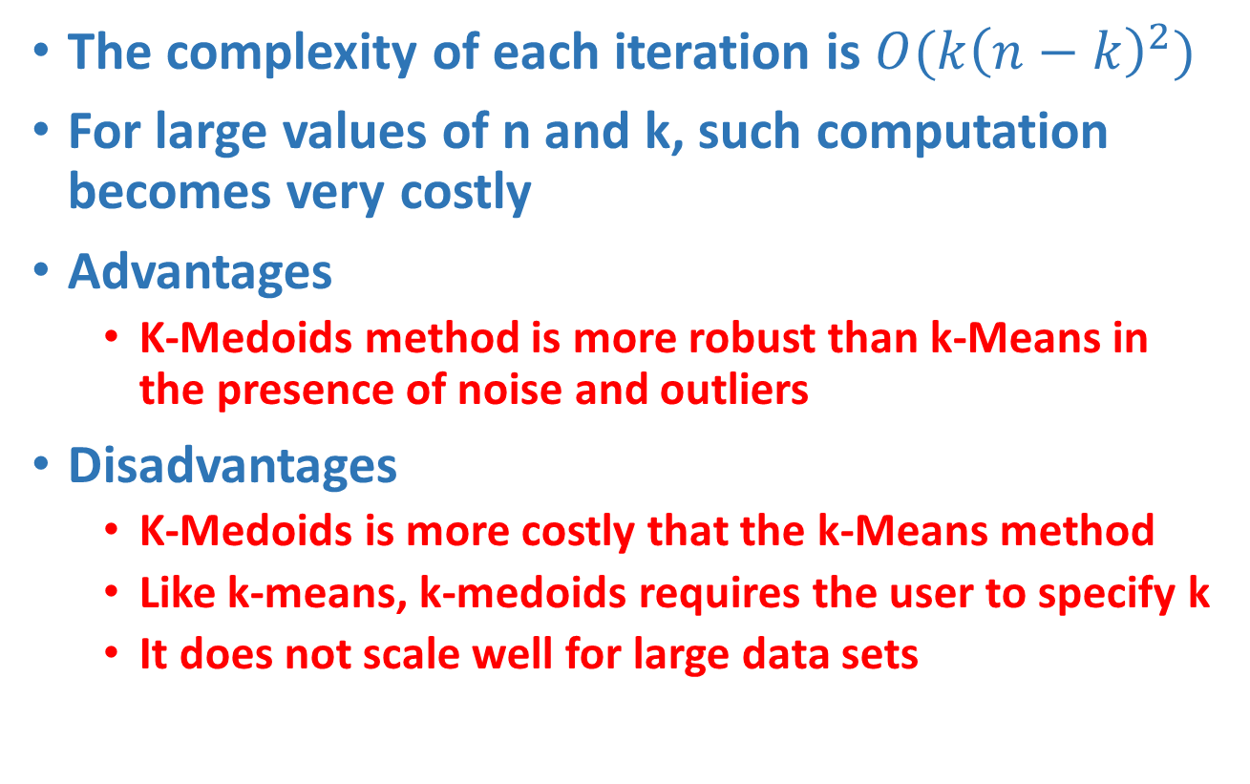
K-medoids Properties
The complexity of each iteration is $O(k{\left(n−k\right)}^{2})$
For large values of n and k, such computation becomes very costly
Advantages
K-Medoids method is more robust than k-Means in the presence of noise and outliers
Disadvantages
K-Medoids is more costly that the k-Means method
Like k-means, k-medoids requires the user to specify k
It does not scale well for large data sets

Slide 30
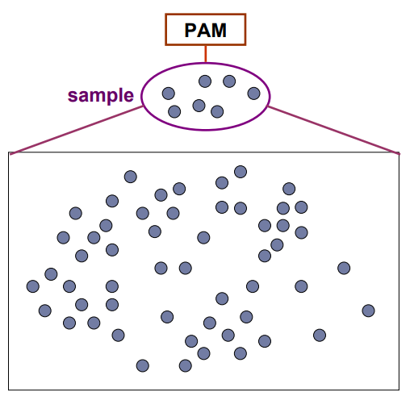
CLARA (Clustering Large Applications)
CLARA (Clustering Large Applications) uses a sampling-based method to deal with large data sets
A random sample should closely represent the original data
The chosen medoids will likely be similar to what would have been chosen from the whole data set

Slide 31
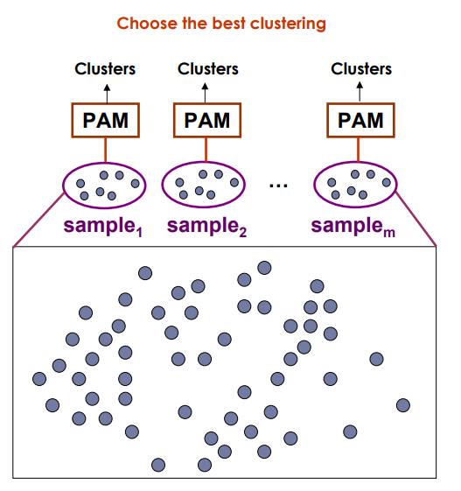
CLARA (Clustering Large Applications)
Draw multiple samples of the data set
Apply PAM to each sample
Return the best clustering

Slide 32
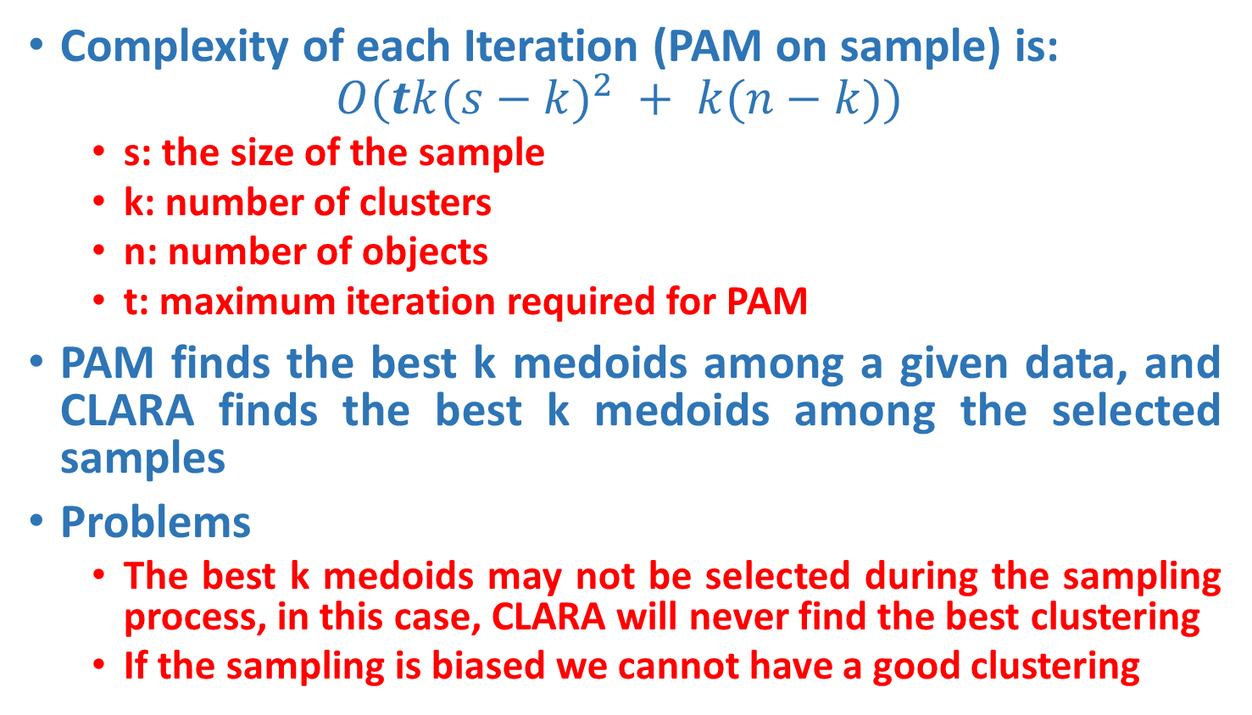
CLARA Properties
Complexity of each Iteration (PAM on sample) is:
$$O(tk({s−k)}^{2} + k(n−k))$$
s: the size of the sample
k: number of clusters
n: number of objects
t: maximum iteration required for PAM
PAM finds the best k medoids among a given data, and CLARA finds the best k medoids among the selected samples
Problems
The best k medoids may not be selected during the sampling process, in this case, CLARA will never find the best clustering
If the sampling is biased we cannot have a good clustering

Slide 33
CLARA - Algorithm
Set mincost to MAXIMUM;
Repeat q times // draws q samples
Create S by drawing s objects randomly from D;
Generate the set of medoids M from S by applying the PAM algorithm;
Compute cost(M,D)
If cost(M, D)<mincost
Mincost = cost(M, D);
Bestset = M;
Endif;
Endrepeat;
Return Bestset;

Slide 34
Complexity of CLARA
Set mincost to MAXIMUM;
Repeat q times
Create S by drawing s objects randomly from D;
Generate the set of medoids M from S by applying the PAM algorithm;
Compute cost(M,D)
If cost(M, D)<mincost
Mincost = cost(M, D);
Bestset = M;
Endif;
Endrepeat;
Return Bestset;
O(1)
O(t(s-k)²*k+(n-k)*k)
O(1)
O(t(s-k)²*k)
O((n-k)*k)
O(1)

Slide 35
CLARANS (“Randomized” CLARA)
CLARANS (A Clustering Algorithm based on Randomized Search)
The clustering process can be presented as searching a graph where every node is a potential solution, that is, a set of k medoids
Two nodes are neighbours if their sets differ by only one medoid
Each node can be assigned a cost that is defined to be the total dissimilarity between every object and the medoid of its cluster
The problem corresponds to search for a minimum on the graph
At each step, all neighbours of current node node are searched; the neighbour which corresponds to the deepest descent in cost is chosen as the next solution

Slide 36
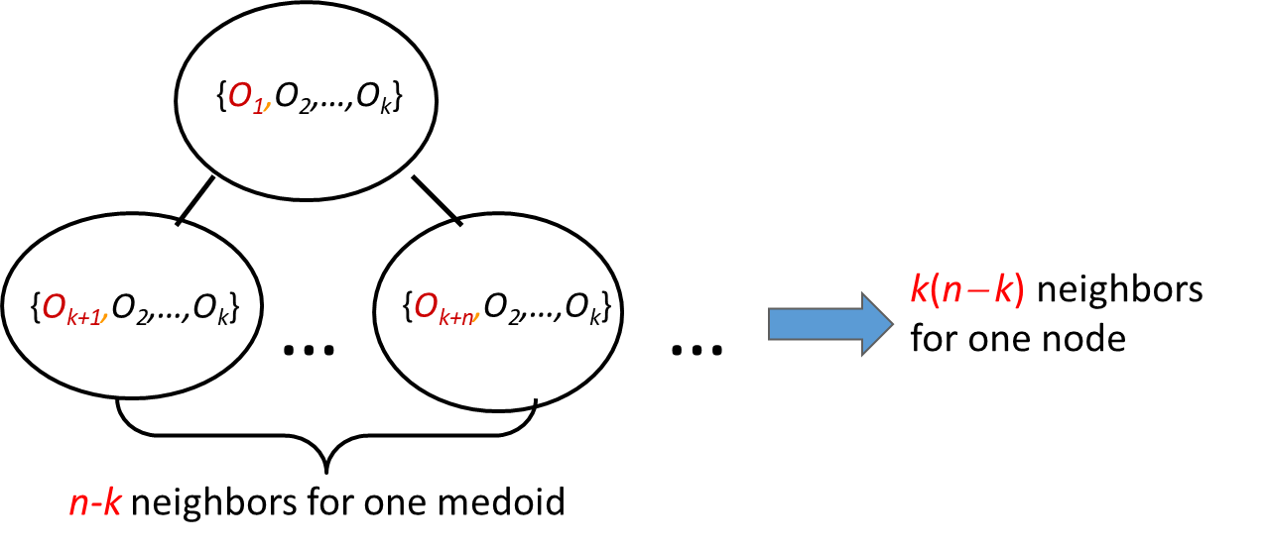
CLARANS (“Randomized” CLARA)
CLARANS (A Clustering Algorithm based on Randomized Search)
The clustering process can be presented as searching a graph where every node is a potential solution, that is, a set of k medoids
Graph Abstraction
Every node is a potential solution (k-medoid)
Two nodes are adjacent if they differ by one medoid
Every node has k(n−k) adjacent nodes

Slide 37
CLARANS (“Randomized” CLARA)
For large values of n and k, examining k(n‐k) neighbours is time consuming.
At each step, CLARANS draws sample of neighbours to examine.
Note that CLARA draws a sample of nodes at the beginning of search; therefore, CLARANS has the benefit of not confining the search to a restricted area.
If the local optimum is found, CLARANS starts with a new randomly selected node in search for a new local optimum. The number of local optimums to search for is a parameter.
It is more efficient and scalable than both PAM and CLARA; returns higher quality clusters.

Slide 38
CLARANS
Compare no more than maxneighbor times
N
C
N
…
<
Local minimum
N
N
C
N
N
…
numlocal
Local minimum
…
Local minimum
…
Best Node
Local minimum

Slide 39
CLARANS - Algorithm
Set mincost to MAXIMUM;
For i=1 to h do // find h local optimum
Randomly select a node as the current node C in the graph;
J = 1; // counter of neighbors
Repeat
Randomly select a neighbor N of C;
If Cost(N,D)<Cost(C,D)
Assign N as the current node C;
J = 1;
Else J++;
Endif;
Until J > m
Update mincost with Cost(C,D) if applicableEnd for;
End For
Return bestnode;

