Slide 1
Introduction

Slide 2
Data Mining
Data mining (knowledge discovery from data)
Extraction of interesting (non-trivial, implicit(dekhkar pata nahi chalta ki es data me keya h), previously unknown and potentially useful) patterns or knowledge from huge amount of data.
Data mining: a misnomer?
Alternative names
Knowledge discovery (mining) in databases (KDD),
knowledge extraction,
data/pattern analysis,
data archeology,
information harvesting,
business intelligence, etc.

Slide 3
Why Data Mining?
The Explosive Growth of Data: from terabytes(10 to the power 40) to petabytes(10 to the power 50).
Data collection and data availability.
Automated data collection tools, database systems, Web, computerized society.
Major sources of abundant data
Business: Web, e-commerce, transactions, stocks, …
Science: Remote sensing, bioinformatics, scientific simulation, …
Society and everyone: news, digital cameras, YouTube, …
We are drowning in data, but starving for knowledge!
“Necessity is the mother of invention”—Data mining—Automated analysis of massive data sets. @Plato

Slide 4
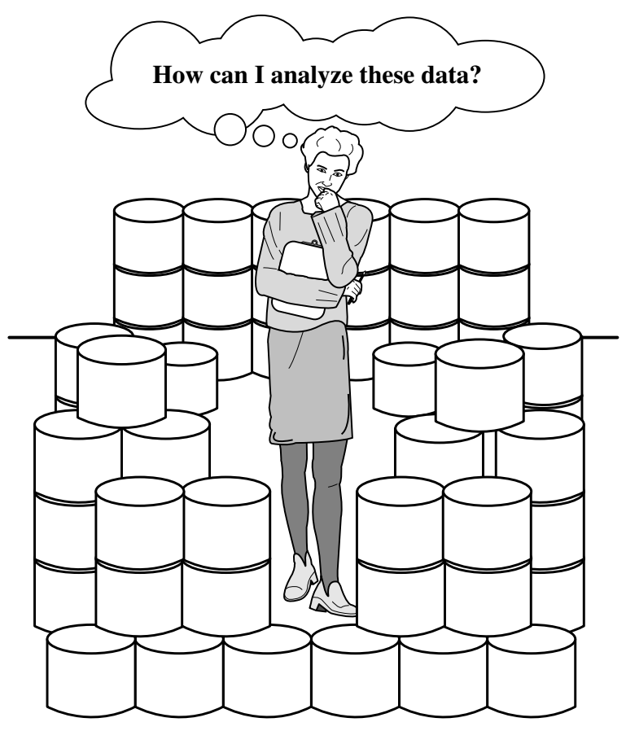
Why Data Mining?
The fast-growing, tremendous amount of data, collected and stored in large and numerous data repositories, has far exceeded our human ability for comprehension without powerful tools.
Data Rich but Information Poor

Slide 5
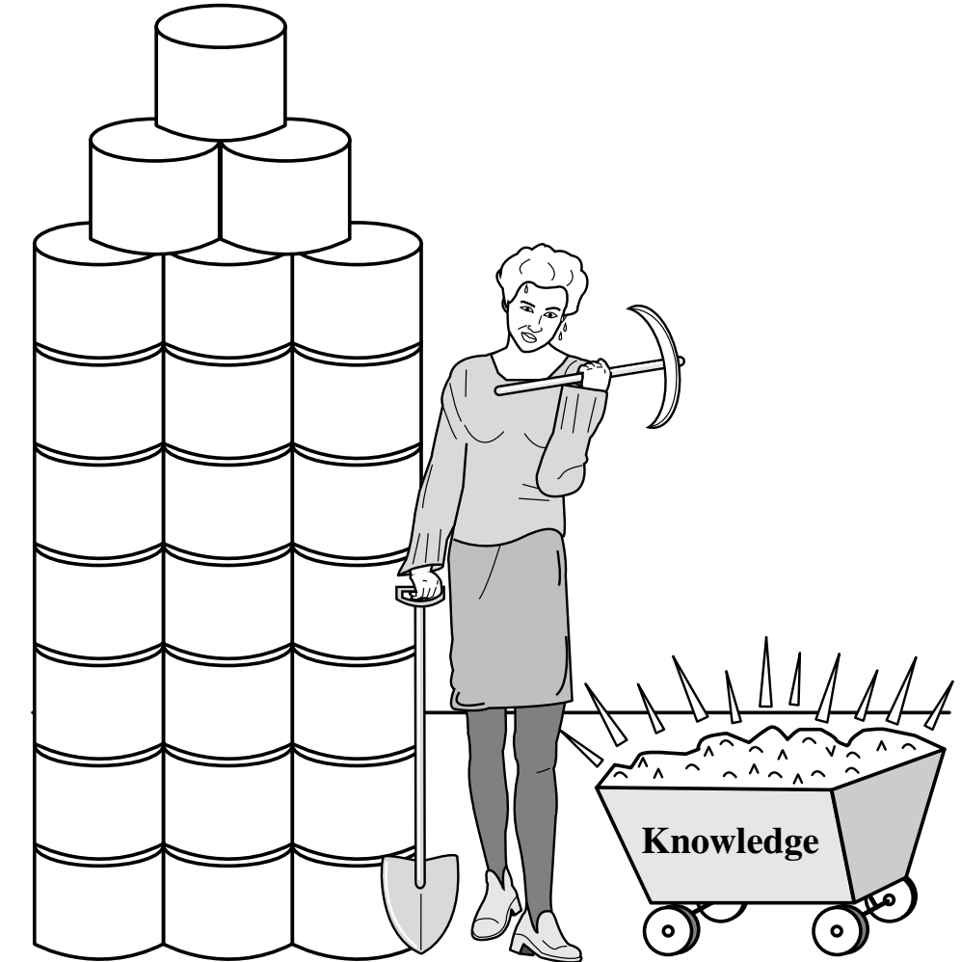
Data Mining
Data mining—searching for knowledge (interesting patterns) in data.
Many people treat data mining as a synonym for another popularly used term, knowledge discovery from data, or KDD.
while others view data mining as merely an essential step in the process of knowledge discovery.

Slide 6
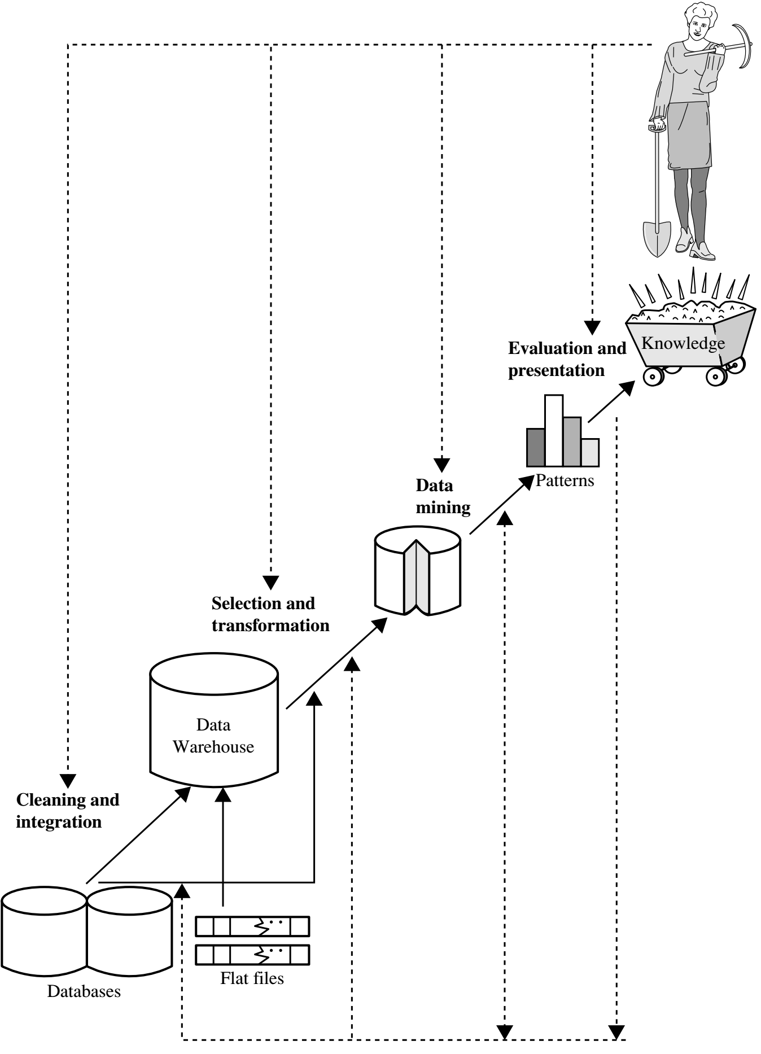
Data Mining
The knowledge discovery process is an iterative sequence of the following steps:
Data cleaning: to remove noise and inconsistent data.
Data integration: multiple data sources may be combined.
Data selection: data relevant to the analysis task are retrieved from the database.
Data transformation: data are transformed and consolidated into forms appropriate for mining by performing summary or aggregation operations.eg : convert dollar in rupees, convert CGPA into percentage

Slide 7
Data Mining
The knowledge discovery process is an iterative sequence of the following steps:
Data mining: intelligent methods are applied to extract data patterns.
Pattern evaluation: to identify the truly interesting patterns representing knowledge based on interestingness measures.
Knowledge presentation: visualization and knowledge representation techniques are used to present mined knowledge to users.

Slide 8
Data Mining
Data mining plays an essential role in the knowledge discovery process.
Data mining is the process of discovering interesting patterns and knowledge from large amounts of data.

Slide 9
What Kinds of Data Can Be Mined?
Data mining can be applied to any kind of data as long as the data are meaningful for a target application.
The most basic forms of Data:
Database Data (It is a collection of data)
Data warehouse Data (It is a collection of database )
Transactional Data (This is the data of small transactional in daily routine life)
Other forms of Data
Data Streams eg: tweets…
Ordered/Sequence Data eg: ticket, bank credits…
Graph or Networked Data
Spatial Data eg: Google maps analysis the traffic using satellite
Text Data
Multimedia Data eg: pictures, videos…
WWW

Slide 10
Data Mining Functionalities and Tasks
There are a number of data mining functionalities:
Mining of frequent patterns, associations, and correlations
Classification(In this we find out the class of things) and Regression(Here we predict the data from the previous data)
Clustering Analysis eg: loan
Outlier Analysis (It take those which are not in clustering)eg: for bank loan defaulter
Data mining functionalities are used to specify the kinds of patterns to be found in data mining tasks.
Data mining tasks can be classified into two categories:
Descriptive: Descriptive mining tasks characterize properties of the data in a target data set.
Predictive: Predictive mining tasks perform induction on the current data in order to make predictions.

Slide 11
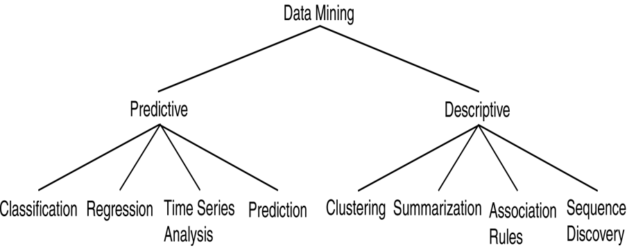
Data Mining Functionalities and Tasks
Use some variables to predict unknown or future values of other variables
Find human-interpretable patterns that describe the data.

Slide 12
Mining Frequent Patterns, Associations, and Correlations
Frequent patterns are patterns that occur frequently in data.
There are many kinds of frequent patterns, including:
Frequent itemsets,
Frequent subsequences (or sequential patterns), and
Frequent substructures.
A frequent itemset typically refers to a set of items that often appear together in a transactional data set.
For example, milk and bread, which are frequently bought together in grocery stores by many customers.

Slide 13
Mining Frequent Patterns, Associations, and Correlations
A frequently subsequence, such as the pattern that customers, tend to purchase first a laptop, followed by a digital camera, and then a memory card, is a (frequent) sequential pattern.
A substructure can refer to different structural forms (e.g., graphs, trees, or lattices) that may be combined with itemsets or subsequences. If a substructure occurs frequently, it is called a (frequent) structured pattern.

Slide 14
Mining Frequent Patterns, Associations, and Correlations
Time series Analysis: Suppose we buy the wheat at the month start so I will buy it again in next months on starting of month, It happens again in at a time interval
Association analysis: Suppose that, as a marketing manager at All Electronics, you want to know which items are frequently purchased together (i.e., within the same transaction). An example of such a rule, mined from the All Electronics transactional database, is
Buys(X, computer”) → buys(X, software) [support = 1%,confidence = 50%]
Association Rules are discarded as uninteresting if they do not satisfy both a minimum support threshold and a minimum confidence threshold.
Additional analysis can be performed to uncover interesting statistical correlations between associated attribute–value pairs.

Slide 15
Mining Frequent Patterns, Associations, and Correlations
Correlation: is measured not only by its support and confidence but also by the correlation between itemsets A and B.
There are several correlation measures rules: Lift, Chi-square χ²

Slide 16
Classification and Regression
Classification is the process of finding a model (or function) that describes and distinguishes data classes or concepts.
The model are derived based on the analysis of a set of training data (i.e., data objects for which the class labels are known).
The model is used to predict the class label of objects for which the class label is unknown.
The derived model may be represented in various forms, such as classification rules (i.e., IF-THEN rules), decision trees, mathematical formulae, neural networks.
There are many other methods for constructing classification models, such as na¨ıve Bayesian classification, support vector machines, and k-nearest-neighbor classification.

Slide 17
Classification and Regression
Classification predicts categorical (discrete, unordered) labels, and regression models continuous-valued functions.
Regression is used to predict missing or unavailable numerical data values rather than (discrete) class labels.
Regression analysis is a statistical methodology that is most often used for numeric prediction.

Slide 18
Cluster Analysis
Unlike classification and regression, which analyze class-labeled (training) data sets, clustering analyzes data objects without consulting class labels.
In many cases, class labeled data may simply not exist at the beginning.
Clustering can be used to generate class labels for a group of data.
The objects are clustered or grouped based on the principle of maximizing the intraclass similarity and minimizing the interclass similarity.

Slide 19
Outlier Analysis
A data set may contain objects that do not comply with the general behavior or model of the data. These data objects are outliers.
Many data mining methods discard outliers as noise or exceptions
However, in some applications (e.g., fraud detection) the rare events can be more interesting than the more regularly occurring ones.
The analysis of outlier data is referred to as outlier analysis or anomaly mining.
Outliers may be detected using statistical tests that assume a distribution or probability model for the data, or
Using distance measures where objects that are remote from any other cluster are considered outliers.

Slide 20
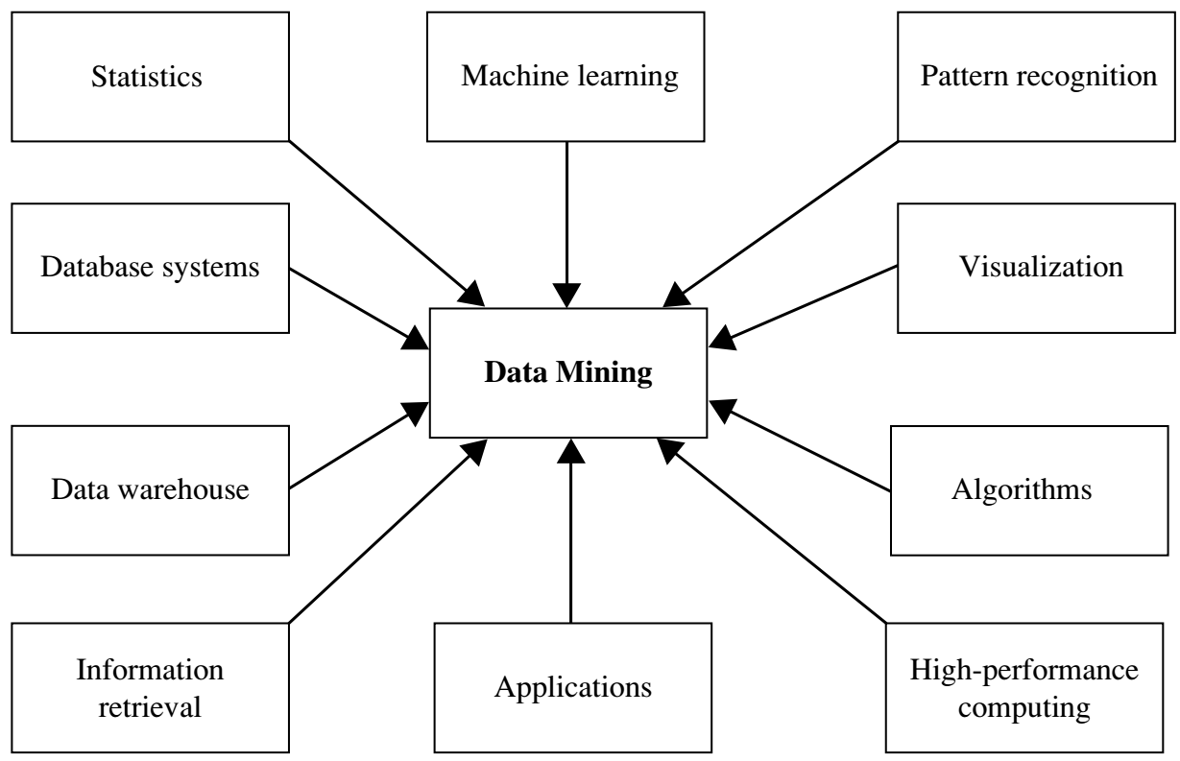
Which Technologies Are Used?
data mining has incorporated many techniques from other domains such as statistics, machine learning, pattern recognition, database and data warehouse systems, information retrieval, visualization, algorithms, high performance computing, and many application domains.
Data mining adopts
techniques from many
domains.

Slide 21
Applications
Data mining has many successful applications, such as:
Business Intelligence
Web Search
Bioinformatics
Health Informatics
Finance
Digital Libraries
Digital Governments
If data is small than we use OLTP (online transitional process)
Data mining tools:- weeka, Rapid minor

