Slide 1
Know Your Data
(Data, and about data)

Slide 2
Getting to Know Your Data
Real-world data are typically noisy, enormous in volume (often several gigabytes or more), and may originate from a hodgepodge of heterogenous sources.
Knowledge about your data is useful for data preprocessing which is the first major task of the data mining process.
What are the types of attributes or fields that make up your data?
What kind of values does each attribute have?
Which attributes are discrete, and which are continuous-valued?
What do the data look like?
How are the values distributed?
Can we measure the similarity of some data objects with respect to others?

Slide 3
What Is an Attribute?
An attribute is a data field, representing a characteristic or feature of a data object.
The nouns attribute, dimension, feature, and variable are often used interchangeably in the literature.
The term dimension is commonly used in data warehousing.
Machine learning literature tends to use the term feature
The statisticians prefer the term variable.
Data mining and database professionals commonly use the term attribute.
Database rows -> data objects; columns ->attributes.

Slide 4
What is Data?
Collection of data objects and their attributes
An attribute is a property or characteristic of an object
Examples: eye color of a person, temperature, etc.
Attribute is also known as variable, field, characteristic, dimension, or feature
A collection of attributes describe an object
Object is also known as record, point, case, sample, entity, or instance
Attributes
Objects

Slide 5
Attribute Types
The type of an attribute is determined by the set of possible values—nominal, binary, ordinal, or numeric—the attribute can have.
Nominal Attributes
Binary Attributes
Ordinal Attributes
Numeric Attributes
Interval-Scaled Attributes
Ratio-Scaled Attributes

Slide 6
Nominal Attributes
Nominal means relating to names.
The values of a nominal attribute are symbols or names of things.
Each value represents some kind of category, code, or state, and so nominal attributes are also referred to as categorical.
The values do not have any meaningful order.
In computer science, the values are also known as enumerations.
For example: that hair_color, marital_status and occupation are attributes.
The values for hair_color can be black, brown, blond, red, gray, and white.
The attribute marital_status can take on the values single, married, divorced, and widowed.
For occupation, the values can be teacher, dentist, programmer, farmer, etc.

Slide 7
Binary Attributes
A binary attribute is a nominal attribute with only two categories or states: 0 or 1, where 0 means that the attribute is absent, and 1 means that it is present.
Binary attributes are referred to as Boolean if the two states correspond to true and false.
The attribute medical test is binary, where a value of 1 means the result of the test for the patient is positive, while 0 means the result is negative.
A binary attribute is symmetric if both of its states are equally valuable and carry the same weight. e.g., gender.
A binary attribute is asymmetric if the outcomes of the states are not equally important, such as the positive and negative outcomes of a medical test for HIV.

Slide 8
Ordinal Attributes
An ordinal attribute is an attribute with possible values that have a meaningful order or ranking among them, but the magnitude between successive values is not known.
For example: the size of drinks available at a fast-food restaurant. This nominal attribute has three possible values: small, medium, and large.
For example: of ordinal attributes include grade (e.g., AC, A, A−, BC.
Other example: Professional ranks can be enumerated in a sequential order: for example, assistant, associate, and full for professors.
Customer satisfaction had the following ordinal categories:
0: very dissatisfied, 1: somewhat dissatisfied,
2: neutral, 3: satisfied, and 4: very satisfied.

Slide 9
Numeric Attributes
A numeric attribute is quantitative; that is, it is a measurable quantity, represented in integer or real values. Numeric attributes can be interval-scaled or ratio-scaled.
Interval-Scaled Attributes:
Interval-scaled attributes are measured on a scale of equal-size units. The values of interval-scaled attributes have order and can be positive, 0, or negative.
In addition to providing a ranking of values, such attributes allow us to compare and quantify the difference between values.
we can compute their mean value, in addition to the median and mode measures of central tendency.

Slide 10
Numeric Attributes
A numeric attribute is quantitative; that is, it is a measurable quantity, represented in integer or real values. Numeric attributes can be interval-scaled or ratio-scaled.
Ratio-Scaled Attributes:
A ratio-scaled attribute is a numeric attribute with an inherent zero-point. That is, if a measurement is ratio-scaled, we can speak of a value as being a multiple (or ratio) of another value.
In addition, the values are ordered, and we can also compute the difference between values, as well as the mean, median, and mode.
Unlike temperatures in Celsius and Fahrenheit, the Kelvin (K) temperature scale has what is considered a true zero-point.
attributes to measure weight, height, latitude and longitude coordinates and monetary quantities (e.g., you are 100 times richer with $100 than with $1).

Slide 11
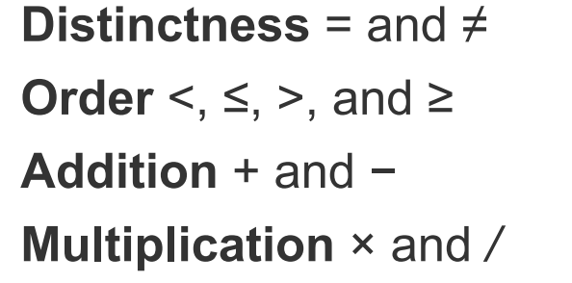
Properties of Attribute Values
The type of an attribute depends on which of the following properties/operations it possesses:
Nominal attribute: distinctness
Ordinal attribute: distinctness & order
Interval attribute: distinctness, order & meaningful differences
Ratio attribute: all 4 properties/operations

Slide 12
Discrete versus Continuous Attributes
A discrete attribute has a finite or countably infinite set of values, which may or may not be represented as integers.
The attributes hair color, smoker, medical test, and drink size each have a finite number of values, and so are discrete.
Discrete attributes may have numeric values, such as 0 and 1 for binary attributes or, the values 0 to 110 for the attribute age.
Note: Binary attributes are a special case of discrete attributes

Slide 13
Discrete versus Continuous Attributes
If an attribute is not discrete, it is continuous. In practice, real values are represented using a finite number of digits.
Continuous attributes are typically represented as floating-point variables.
In literature, the terms numeric attribute and continuous attribute are often used interchangeably.

Slide 14
Important Characteristics of Data
Dimensionality (number of attributes)
High dimensional data brings a number of challenges
Sparsity
Only presence counts
Resolution
Patterns depend on the scale
Size
Type of analysis may depend on size of data

Slide 15
Types of data sets
Record
Data Matrix
Document Data
Transaction Data
Graph
World Wide Web
Molecular Structures
Ordered
Spatial Data
Temporal Data
Sequential Data
Genetic Sequence Data

Slide 16
Record Data
Data that consists of a collection of records, each of which consists of a fixed set of attributes

Slide 17
Data Matrix
If data objects have the same fixed set of numeric attributes, then the data objects can be thought of as points in a multi-dimensional space, where each dimension represents a distinct attribute.
Such a data set can be represented by an m by n matrix, where there are m rows, one for each object, and n columns, one for each attribute

Slide 18
Document Data
Each document becomes a ‘term’ vector
Each term is a component (attribute) of the vector
The value of each component is the number of times the corresponding term occurs in the document.

Slide 19
Transaction Data
A special type of data, where
Each transaction involves a set of items.
For example, consider a grocery store. The set of products purchased by a customer during one shopping trip constitute a transaction, while the individual products that were purchased are the items.
Can represent transaction data as record data.

Slide 20
Graph Data
Examples: Generic graph, a molecule, and webpages
Benzene Molecule: C6H6

Slide 21
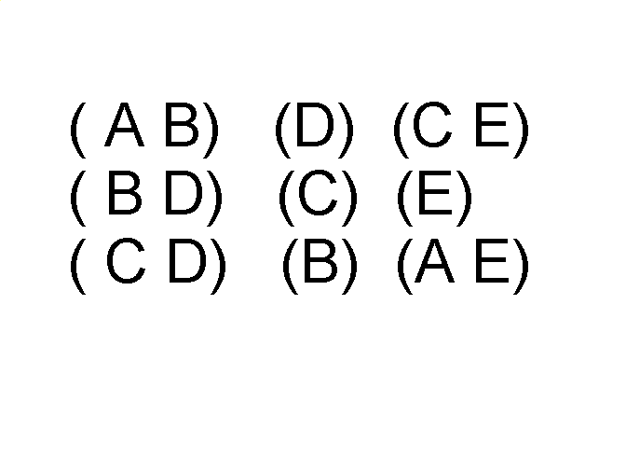
Ordered Data
Sequences of transactions
Items/Events
An element of the sequence

Slide 22
Ordered Data
Genomic sequence data

Slide 23
Data Quality
Poor data quality negatively affects many data processing efforts
What kinds of data quality problems? Examples of data quality problems:
Noise and outliers
Wrong data
Fake data
Missing values
Duplicate data

Slide 24
Noise
For objects, noise is an extraneous object
For attributes, noise refers to modification of original values
Examples: distortion of a person’s voice when talking on a poor phone and “snow” on television screen
The figures below show two sine waves of the same magnitude and different frequencies, the waves combined, and the two sine waves with random noise
The magnitude and shape of the original signal is distorted

Slide 25
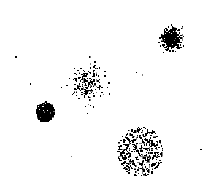
Outliers
Outliers are data objects with characteristics that are considerably different than most of the other data objects in the data set
Case 1: Outliers are noise that interferes with data analysis
Case 2: Outliers are the goal of our analysis
Credit card fraud
Intrusion detection
Causes?

Slide 26
Missing Values
Reasons for missing values
Information is not collected (e.g., people decline to give their age and weight)
Attributes may not be applicable to all cases (e.g., annual income is not applicable to children)
Handling missing values
Eliminate data objects or variables
Estimate missing values
Example: time series of temperature
Example: census results
Ignore the missing value during analysis

Slide 27
Duplicate Data
Data set may include data objects that are duplicates, or almost duplicates of one another
Major issue when merging data from heterogeneous sources
Examples:
Same person with multiple email addresses
Data cleaning
Process of dealing with duplicate data issues
When should duplicate data not be removed?

Slide 28
Measuring Data Similarity and Dissimilarity
In data mining applications, such as clustering, outlier analysis, and nearest-neighbor classification, we need ways to assess how alike or unalike objects are in comparison to one another.
Similarity
Numerical measure of how alike two data objects are
Value is higher when objects are more alike
Often falls in the range [0,1]
Dissimilarity (e.g., distance)
Numerical measure of how different two data objects are
Lower when objects are more alike
Minimum dissimilarity is often 0
Upper limit varies
Proximity refers to a similarity or dissimilarity

Slide 29
Measuring Data Similarity and Dissimilarity
In data mining applications, such as clustering, outlier analysis, and nearest-neighbor classification, we need ways to assess how alike or unalike objects are in comparison to one another.
A cluster is a collection of data objects such that the objects within a cluster are similar to one another and dissimilar to the objects in other clusters.
Outlier analysis also employs clustering-based techniques to identify potential outliers as objects that are highly dissimilar to others.
Knowledge of object similarities can also be used in nearest-neighbor classification schemes where a given object (e.g., a patient) is assigned a class label (relating to, say, a diagnosis) based on its similarity toward other objects in the model.

Slide 30
Measuring Data Similarity and Dissimilarity
Two data structures that are commonly used in clustering, outlier analysis, and nearest-neighbor classification applications:
data matrix (used to store the data objects) and
dissimilarity matrix (used to store dissimilarity values for pairs of objects).
How object dissimilarity can be computed for objects:
Proximity Measures for nominal attributes
Proximity Measures for binary attributes
Proximity Measures for numeric attributes
Proximity Measures for ordinal attributes

Slide 31
Measuring Data Similarity and Dissimilarity
Data Matrix versus Dissimilarity Matrix:
Objects described by multiple attributes.
Suppose that we have n objects (e.g., persons, items, or courses) described by p attributes (also called measurements or features, such as age, height, weight, or gender).
The objects are x₁=(x₁₁,x₁₂,…,x_{1p}), x₂ =(x₂₁,x₂₂,…,x_{2p}), and so on, where x_{ij} is the value for object x_{i} of the j^{th} attribute.
Main memory-based clustering and nearest-neighbor classification algorithms typically operate on Data matrix or Dissimilarity matrix.

Slide 32
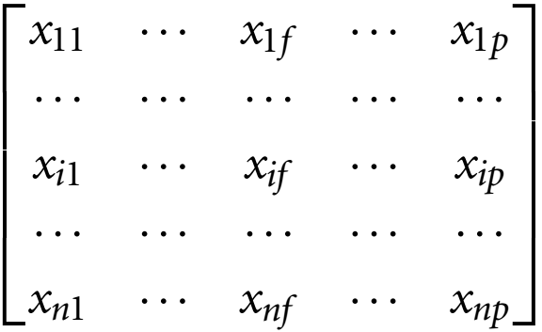
Measuring Data Similarity and Dissimilarity
Data Matrix (or object-by-attribute structure):
This structure stores the n data objects in the form of a relational table, or n-by-p matrix (n objects × p attributes).
Each row corresponds to an object. As part of our notation, we may use f to index through the p attributes.

Slide 33
Measuring Data Similarity and Dissimilarity
Dissimilarity matrix (or object-by-object structure): This structure stores a collection of proximities that are available for all pairs of n objects. It is often represented by an n-by-n table:
where d(i, j) is the measured dissimilarity or “difference” between objects i and j.
In general, d(i, j) is a non-negative number that is close to 0 when objects i and j are highly similar or “near” each other, and becomes larger the more they differ.
Note that d(i, i) = 0 is the difference between an object and itself is 0.
Furthermore, d(i, j) = d(j, i).
Measures of similarity can often be expressed as a function of measures of dissimilarity. For example, for nominal data,
sim(i, j) = 1 − d(i, j)
where sim(i, j) is the similarity between objects i and j.

Slide 34
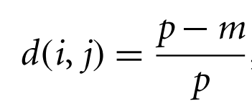
Proximity Measures for Nominal Attributes
A nominal attribute can take on two or more states.
For example, map color is a nominal attribute that may have, five states: red, yellow, green, pink, and blue.
Let the number of states of a nominal attribute be M. The states can be denoted by letters, symbols, or a set of integers, such as 1, 2,…, M. Notice that such integers are used just for data handling and do not represent any specific ordering.
The dissimilarity between two objects i and j can be computed based on the ratio of mismatches:
where m is the number of matches (i.e., the number of attributes for which i and j are in the same state).
p is the total number of attributes describing the objects.

Slide 35
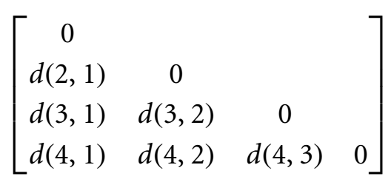
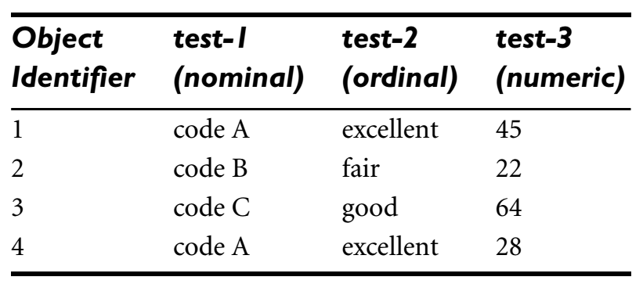
Proximity Measures for Nominal Attributes
The dissimilarity between two objects i and j can be computed based on the ratio of mismatches:
where m is the number of matches (i.e., the number of attributes for which i and j are in the same state).
p is the total number of attributes describing the objects.
we set p = 1(Here we take ordinal attribute);
3
1
2
3

Slide 36
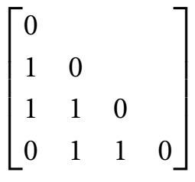
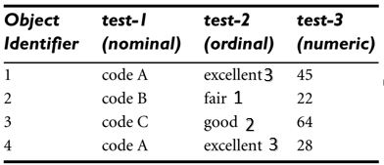
Proximity Measures for Nominal Attributes
The dissimilarity between two objects i and j can be computed based on the ratio of mismatches:
where m is the number of matches (i.e., the number of attributes for which i and j are in the same state).
p is the total number of attributes describing the objects.

Slide 37

Proximity Measures for Nominal Attributes
The similarity can be computed as:
where m is the number of matches (i.e., the number of attributes for which i and j are in the same state).
p is the total number of attributes describing the objects.

Slide 38
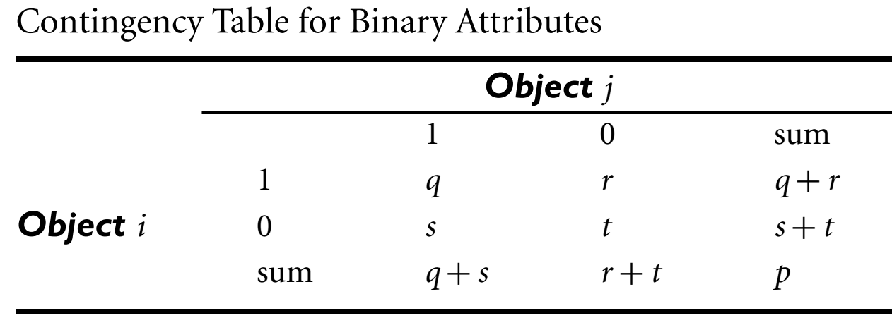
Proximity Measures for Binary Attributes
For symmetric binary attributes, each state is equally valuable.
Symmetric binary attributes are thought of as having the same weight, we have the 2 × 2 contingency table:
00 t
01 s
10 r
11 q
Dissimilarity that is based on symmetric binary attributes is called symmetric binary dissimilarity.

Slide 39
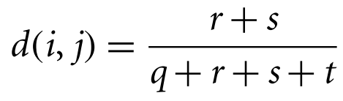
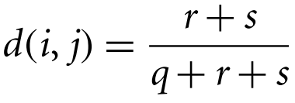
Proximity Measures for Binary Attributes
If objects i and j are described by symmetric binary attributes, then the dissimilarity between i and j is:
The dissimilarity based on asymmetric binary attributes is called asymmetric binary dissimilarity, where the number of negative matches, t, is considered unimportant and is thus ignored in the following computation:

Slide 40
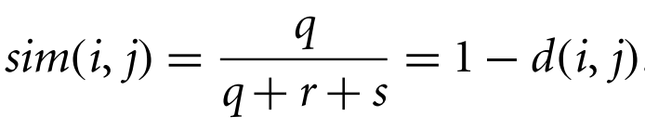
Proximity Measures for Binary Attributes
Complementarily, we can measure the difference between two binary attributes based on the notion of similarity instead of dissimilarity.
For example, the asymmetric binary similarity between the objects i and j can be computed as:
The coefficient sim(i, j) is called the Jaccard coefficient.

Slide 41
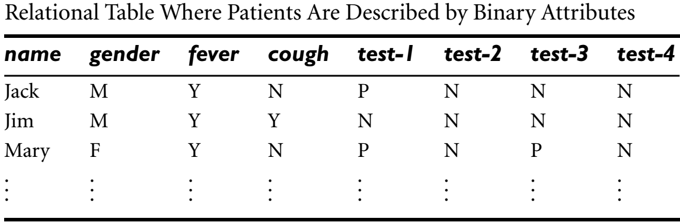





Proximity Measures for Binary Attributes
The dissimilarity based on asymmetric binary attributes is called asymmetric binary dissimilarity, where the number of negative matches, t, is considered unimportant and is thus ignored in the following computation:
Let M=0
Y=1
N=0
P=1
F=0

Slide 42
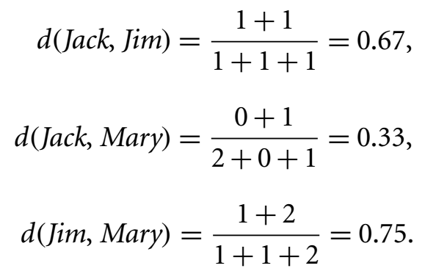
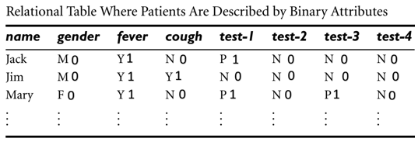
Proximity Measures for Binary Attributes
The dissimilarity based on asymmetric binary attributes is called asymmetric binary dissimilarity, where the number of negative matches, t, is considered unimportant and is thus ignored in the following computation:

Slide 43
Proximity Measures for Binary Attributes
If objects i and j are described by symmetric binary attributes, then the dissimilarity between i and j is:

Slide 44
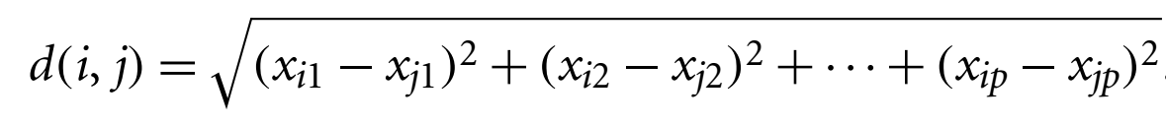
Dissimilarity of Numeric Data: Minkowski Distance
In some cases, the data are normalized before applying distance calculations. This involves transforming the data to fall within a smaller or common range, such as [−1,1] or [0.0, 1.0].
Consider a height attribute, for example, which could be measured in either meters or inches.
Normalizing the data attempts to give all attributes an equal weight.
The most popular distance measure is Euclidean distance (i.e., straight line or “as the crow flies”). Let i = (x_{i1}, x_{i2},…, x_{ip}) and j = (x_{j1}, x_{j2},…, x_{jp}) be two objects described by p numeric attributes. The Euclidean distance between objects i and j is defined as:

Slide 45
Dissimilarity of Numeric Data: Minkowski Distance
Another well-known measure is the Manhattan (or city block) distance, named so because it is the distance in blocks between any two points in a city (such as 2 blocks down and 3 blocks over for a total of 5 blocks). It is defined as:
Both the Euclidean and the Manhattan distance satisfy the following mathematical properties:
Non-negativity: d(i, j) ≥ 0: Distance is a non-negative number.
Identity of indiscernibles: d(i, i) = 0: The distance of an object to itself is 0.
Symmetry: d(i, j) = d(j, i): Distance is a symmetric function.
Triangle inequality: d(i, j) ≤ d(i, k) + d(k, j): Going directly from object i to object j in space is no more than making a detour over any other object k.

Slide 46
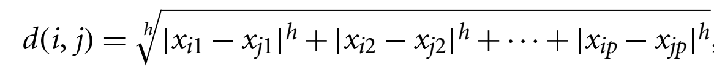
Dissimilarity of Numeric Data: Minkowski Distance
A measure that satisfies these conditions is known as metric. Please note that the non-negativity property is implied by the other three properties.
Minkowski distance is a generalization of the Euclidean and Manhattan distances. It is defined as:
where h is a real number such that h ≥ 1. (Such a distance is also called L_{p} norm in some literature.
Minkowski distance represents the Manhattan distance when h = 1 (i.e., L₁ norm) and Euclidean distance when h = 2 (i.e., L₂ norm).

Slide 47
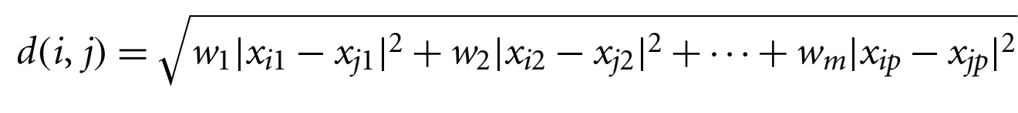
Dissimilarity of Numeric Data: Minkowski Distance
If each attribute is assigned a weight according to its perceived importance, the weighted Euclidean distance can be computed as:
Weighting can also be applied to other distance measures as well.
The supremum distance (also referred to as L_{max}, L_{∞norm} and as the Chebyshev distance) is a generalization of the Minkowski distance for
h → ∞.
Euclidean, Manhattan and Minkowski distance measures are commonly used for computing the dissimilarity of objects described by numeric attributes.

Slide 48
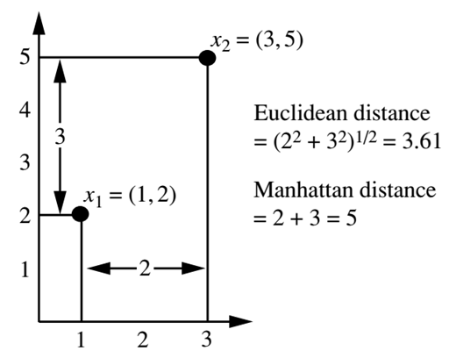
Dissimilarity of Numeric Data: Minkowski Distance
Euclidean, and Manhattan distance:

Slide 49
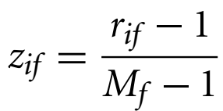
Proximity Measures for Ordinal Attributes
The treatment of ordinal attributes is quite similar to that of numeric attributes when computing dissimilarity between objects. Suppose that f is an attribute from a set of ordinal attributes describing n objects. The dissimilarity computation with respect to f involves the following steps:
The value of f for the ith object is x_{if} , and f has M_{f} ordered states, representing the ranking 1,…,M_{f}. Replace each x_{if} by its corresponding rank, r_{if} ∈ {1,…, M_{f}}.
Since each ordinal attribute can have a different number of states, it is often necessary to map the range of each attribute onto [0.0, 1.0] so that each attribute has equal weight. We perform such data normalization by replacing the rank r_{if} of the i^{th} object in the f^{th} attribute by

Slide 50
Proximity Measures for Ordinal Attributes
Dissimilarity can then be computed using any of the distance measures described in previous slides for numeric attributes, using z_{if} to represent the f value for the i^{th} object.
There are three states for test-2: fair, good, and excellent, that is, M_{f} = 3. For step 1, if we replace each value for test-2 by its rank, the four objects are assigned the ranks 3, 1, 2, and 3, respectively.
Step 2 normalizes the ranking by mapping rank 1 to 0.0, rank 2 to 0.5, and rank 3 to 1.0.
rif=value of tuple while we used
m_{f}=total count of discrete tuples

Slide 51
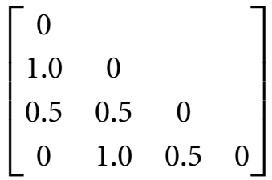
Proximity Measures for Ordinal Attributes
Dissimilarity can then be computed using any of the distance measures described in previous slides for numeric attributes, using z_{if} to represent the f value for the i^{th} object.
There are three states for test-2: fair, good, and excellent, that is, M_{f} = 3. For step 1, if we replace each value for test-2 by its rank, the four objects are assigned the ranks 3, 1, 2, and 3, respectively.
Step 2 normalizes the ranking by mapping rank 1 to 1, 2 to 0.0, rank 3 to 0.5, and rank 4 to 1.0. 0-1=1,0-0.5=0.5,1-1=0,0.5-0=0.5,1-0=1,1-0.5=0.5
Than we subtract zi-zj

Slide 52
Proximity Measures for Ordinal Attributes
Dissimilarity can then be computed using any of the distance measures described in previous slides for numeric attributes, using z_{if} to represent the f value for the i^{th} object..
Similarity values for ordinal attributes can be interpreted from dissimilarity as sim(i,j) = 1 − d(i,j).

Slide 53
Cosine Similarity
A document can be represented by thousands of attributes, each recording the frequency of a particular word (such as a keyword) or phrase in the document.
Thus, each document is an object represented by what is called a term-frequency vector.
Term-frequency vectors are typically very long and sparse (i.e., they have many 0 values).
Applications using such structures include information retrieval, text document clustering, biological taxonomy, and gene feature mapping.
The traditional distance measures that we have studied, do not work well for such sparse numeric data.

Slide 54
Cosine Similarity
For example, two term-frequency vectors may have many 0 values in common, meaning that the corresponding documents do not share many words, but this does not make them similar.
We need a measure that will focus on the words that the two documents do have in common, and the occurrence frequency of such words.
In other words, we need a measure for numeric data that ignores zero-matches.
Cosine similarity is a measure of similarity that can be used to compare documents or, say, give a ranking of documents with respect to a given vector of query words.

Slide 55
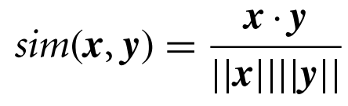


Cosine Similarity
Let x and y be two vectors for comparison. Using the cosine measure as a similarity function, we have
where ||x|| is the Euclidean norm of vector , defined as .
Similarly, ||y|| is the Euclidean norm of vector y. The measure computes the cosine of the angle between vectors x and y.
A cosine value of 0 means that the two vectors are at 90 degrees to each other (orthogonal) and have no match.
The closer the cosine value to 1, the smaller the angle and the greater the match between vectors.
The cosine similarity measure does not obey all of the properties of metric measures, it is referred to as a nonmetric measure.

Slide 56
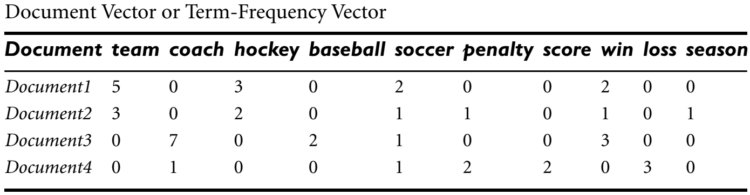
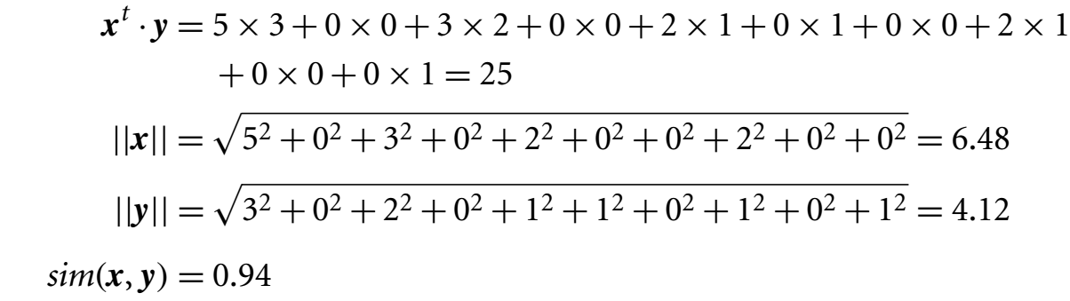
Cosine Similarity
Suppose that x and y are the first two term-frequency vectors. How similar are x and y?
x = (5,0,3,0,2,0,0,2,0,0) and y = (3,0,2,0,1,1,0,1,0,1)

Slide 57
Summary
Data sets are made up of data objects. A data object represents an entity. Data objects are described by attributes. Attributes can be nominal, binary, ordinal, or numeric.
The values of a nominal (or categorical) attribute are symbols or names of things, where each value represents some kind of category, code, or state.
Binary attributes are nominal attributes with only two possible states (such as 1 and 0 or true and false). If the two states are equally important, the attribute is symmetric; otherwise it is asymmetric.
An ordinal attribute is an attribute with possible values that have a meaningful order or ranking among them, but the magnitude between successive values is not known.

Slide 58
Summary
A numeric attribute is quantitative (i.e., it is a measurable quantity) represented in integer or real values. Numeric attribute types can be interval-scaled or ratio-scaled. The values of an interval-scaled attribute are measured in fixed and equal units. Ratio-scaled attributes are numeric attributes with an inherent zero-point. Measurements are ratio-scaled in that we can speak of values as being an order of magnitude larger than the unit of measurement.
Measures of object similarity and dissimilarity are used in data mining applications such as clustering, outlier analysis, and nearest-neighbor classification. Such measures of proximity can be computed for each attribute type, or for combinations of such attributes. Examples include the Jaccard coefficient for asymmetric binary attributes and Euclidean, Manhattan, and Minkowski. For applications involving sparse numeric data vectors, such as term-frequency vectors, the cosine measure.

Slide 59
References
Jiawei Han, Micheline Kamber and Jian Pei, Data Mining: Concepts and Techniques, Morgan Kaufmann, 3rd Edition.

