Slide 1
Association Rule Mining
Apriori, FP Growth & ECLAT

Slide 2
What Is Frequent Pattern Analysis?
Frequent pattern: a pattern (a set of items, subsequences, substructures, etc.) that occurs frequently in a data set
First proposed by Agrawal, Imielinski, and Swami [AIS93] in the context of frequent itemsets and association rule mining
Motivation: Finding inherent regularities in data
  What products were often purchased together?— Beer and diapers?!
  What are the subsequent purchases after buying a PC?
  What kinds of DNA are sensitive to this new drug?
  Can we automatically classify web documents?
Applications
  Basket data analysis, cross-marketing, catalog design, sale campaign analysis, Web log (click stream) analysis, and DNA sequence analysis.

Slide 3
Why Is Freq. Pattern Mining Important?
Freq. pattern: An intrinsic and important property of datasets
Foundation for many essential data mining tasks
  Association, correlation, and causality analysis
  Sequential, structural (e.g., sub-graph) patterns
  Pattern analysis in spatiotemporal, multimedia, time-series, and stream data
  Classification: discriminative, frequent pattern analysis
  Cluster analysis: frequent pattern-based clustering
  Data warehousing: iceberg cube and cube-gradient
  Semantic data compression: fascicles
  Broad applications

Slide 4
Basic Concepts: Frequent Patterns
Tid | Items bought
10 | Beer, Nuts, Diaper
20 | Beer, Coffee, Diaper
30 | Beer, Diaper, Eggs
40 | Nuts, Eggs, Milk
50 | Nuts, Coffee, Diaper, Eggs, Milk
itemset: A set of one or more items
k-itemset X = {x₁, …, x_{k}}
(absolute) support, or, support count of X: Frequency or occurrence of an itemset X
(relative) support, s, is the fraction of transactions that contains X (i.e., the probability that a transaction contains X)
An itemset X is frequent if X’s support is no less than a minsup threshold
Customer
buys both
Customer
buys diaper
Customer
buys beer

Slide 5
Basic Concepts: Association Rules
Find all the rules X → Y with minimum support and confidence
  support, s, probability that a transaction contains X ∪ Y
  confidence, c, conditional probability that a transaction having X also contains Y
Let minsup = 50%, minconf = 50%
Freq. Pat.: Beer:3, Nuts:3, Diaper:4, Eggs:3, {Beer, Diaper}:3
Tid
Items bought
10
Beer, Nuts, Diaper
20
Beer, Coffee, Diaper
30
Beer, Diaper, Eggs
40
Nuts, Eggs, Milk
50
Nuts, Coffee, Diaper, Eggs, Milk
Customer
buys both
Customer
buys diaper
(3/5)*100=60%,(3/3)*100=100%
(3/5)*100=60%,(3/4)*100=75%
Customer
buys beer
Association rules: (many more!)
  Beer → Diaper (60%, 100%)
  Diaper → Beer (60%, 75%)

Slide 6
Closed Patterns and Max-Patterns
A long pattern contains a combinatorial number of sub-patterns, e.g., {a₁, …, a₁₀₀} contains (₁₀₀¹) + (₁₀₀²) + … + (₁¹₀⁰₀⁰) = 2¹⁰⁰ – 1 = 1.27*10³⁰ sub-patterns!
Solution: Mine closed patterns and max-patterns instead
An itemset X is closed if X is frequent and there exists no super-pattern Y כ X, with the same support as X (proposed by Pasquier, et al. @ ICDT’99)
An itemset X is a max-pattern if X is frequent and there exists no frequent super-pattern Y כ X (proposed by Bayardo @ SIGMOD’98)
Closed pattern is a lossless compression of freq. patterns
  Reducing the # of patterns and rules

Slide 7
Closed Patterns and Max-Patterns
Exercise. DB = {<a₁, …, a₁₀₀>, < a₁, …, a₅₀>}
  Min_sup = 1.
What is the set of closed itemset?
  <a₁, …, a₁₀₀>: 1
  < a₁, …, a₅₀>: 2
What is the set of max-pattern?
  <a₁, …, a₁₀₀>: 1
What is the set of all patterns?
  !!

Slide 8
Computational Complexity of Frequent Itemset Mining
How many itemsets are potentially to be generated in the worst case?
  The number of frequent itemsets to be generated is senstive to the minsup threshold
  When minsup is low, there exist potentially an exponential number of frequent itemsets
  The worst case: M^{N} where M: # distinct items, and N: max length of transactions
The worst case complexty vs. the expected probability
  Ex. Suppose Walmart has 10⁴ kinds of products
    The chance to pick up one product 10⁻⁴
    The chance to pick up a particular set of 10 products: ~10⁻⁴⁰
    What is the chance this particular set of 10 products to be frequent 10³ times in 10⁹ transactions?

Slide 9
Chapter 5: Mining Frequent Patterns, Association and Correlations: Basic Concepts and Methods
Basic Concepts
Frequent Itemset Mining Methods
Which Patterns Are Interesting?—Pattern Evaluation Methods
Summary

Slide 10
Scalable Frequent Itemset Mining Methods
Apriori: A Candidate Generation-and-Test Approach
Improving the Efficiency of Apriori
FPGrowth: A Frequent Pattern-Growth Approach
ECLAT: Frequent Pattern Mining with Vertical Data Format

Slide 11
The Downward Closure Property and Scalable Mining Methods
The downward closure property of frequent patterns
  Any subset of a frequent itemset must be frequent
  If {beer, diaper, nuts} is frequent, so is {beer, diaper}
  i.e., every transaction having {beer, diaper, nuts} also contains {beer, diaper}
Scalable mining methods: Three major approaches
  Apriori (Agrawal & Srikant@VLDB’94)
  Freq. pattern growth (FPgrowth—Han, Pei & Yin @SIGMOD’00)
  Vertical data format approach (Charm—Zaki & Hsiao @SDM’02)

Slide 12
Apriori: A Candidate Generation & Test Approach
Apriori pruning principle: If there is any itemset which is infrequent, its superset should not be generated/tested! (Agrawal & Srikant @VLDB’94, Mannila, et al. @ KDD’ 94)
Method:
  Initially, scan DB once to get frequent 1-itemset
  Generate length (k+1) candidate itemsets from length k frequent itemsets
  Test the candidates against DB
  Terminate when no frequent or candidate set can be generated

Slide 13
The Apriori Algorithm—An Example
Sup_{min} = 2
Itemset | sup
{A} | 2
{B} | 3
{C} | 3
{D} | 1
{E} | 3
Database TDB
Itemset | sup
{A} | 2
{B} | 3
{C} | 3
{E} | 3
L₁
Tid | Items
10 | A, C, D
20 | B, C, E
30 | A, B, C, E
40 | B, E
C₁
1st scan
C₂
Itemset | sup
{A, B} | 1
{A, C} | 2
{A, E} | 1
{B, C} | 2
{B, E} | 3
{C, E} | 2
C₂
L₂
Itemset
{A, B}
{A, C}
{A, E}
{B, C}
{B, E}
{C, E}
Itemset | sup
{A, C} | 2
{B, C} | 2
{B, E} | 3
{C, E} | 2
2nd scan
C₃
Itemset
{B, C, E}
3rd scan
L₃
Itemset | sup
{B, C, E} | 2

Slide 14
The Apriori Algorithm (Pseudo-Code)
Ck: Candidate itemset of size k
Lk : frequent itemset of size k
L1 = {frequent items};
for (k = 1; Lk !=∅; k++) do begin
Ck+1 = candidates generated from Lk;
for each transaction t in database do
  increment the count of all candidates in Ck+1 that are contained in t
Lk+1 = candidates in Ck+1 with min_support
end
return ∪k Lk;

Slide 15
Implementation of Apriori
How to generate candidates?
  Step 1: self-joining L_{k}
  Step 2: pruning
Example of Candidate-generation
  L₃={abc, abd, acd, ace, bcd}
  Self-joining: L₃*L₃
    abcd from abc and abd
    acde from acd and ace
  Pruning:
    acde is removed because ade is not in L₃
  C₄ = {abcd}

Slide 16
Scalable Frequent Itemset Mining Methods
Apriori: A Candidate Generation-and-Test Approach
Improving the Efficiency of Apriori
FPGrowth: A Frequent Pattern-Growth Approach
ECLAT: Frequent Pattern Mining with Vertical Data Format
Mining Close Frequent Patterns and Maxpatterns

Slide 17
Further Improvement of the Apriori Method
Major computational challenges
  Multiple scans of transaction database
  Huge number of candidates
  Tedious workload of support counting for candidates
Improving Apriori: general ideas
  Reduce passes of transaction database scans
  Shrink number of candidates
  Facilitate support counting of candidates

Slide 18
Partition: Scan Database Only Twice
Any itemset that is potentially frequent in DB must be frequent in at least one of the partitions of DB
  Scan 1: partition database and find local frequent patterns
  Scan 2: consolidate global frequent patterns
A. Savasere, E. Omiecinski and S. Navathe, VLDB’95
DB₁
+
DB₂
+
+
DB_{k}
= DB
sup₁(i) < σDB₁
sup₂(i) < σDB₂
sup_{k}(i) < σDB_{k}
sup(i) < σDB

Slide 19
DHP: Reduce the Number of Candidates
A k-itemset whose corresponding hashing bucket count is below the threshold cannot be frequent
  Candidates: a, b, c, d, e
  Hash entries
    {ab, ad, ae}
    {bd, be, de}
    …
  Frequent 1-itemset: a, b, d, e
  ab is not a candidate 2-itemset if the sum of count of {ab, ad, ae} is below support threshold
J. Park, M. Chen, and P. Yu. An effective hash-based algorithm for mining association rules. SIGMOD’95
count
itemsets
35
{ab, ad, ae}
88
{bd, be, de}
...
...
102
{yz, qs, wt}
Hash Table

Slide 20
Sampling for Frequent Patterns
Select a sample of original database, mine frequent patterns within sample using Apriori
Scan database once to verify frequent itemsets found in sample, only borders of closure of frequent patterns are checked
  Example: check abcd instead of ab, ac, …, etc.
Scan database again to find missed frequent patterns
H. Toivonen. Sampling large databases for association rules. In VLDB’96

Slide 21
Scalable Frequent Itemset Mining Methods
Apriori: A Candidate Generation-and-Test Approach
Improving the Efficiency of Apriori
FPGrowth: A Frequent Pattern-Growth Approach
ECLAT: Frequent Pattern Mining with Vertical Data Format
Mining Close Frequent Patterns and Maxpatterns

Slide 22
Pattern-Growth Approach: Mining Frequent Patterns Without Candidate Generation
Bottlenecks of the Apriori approach
  Breadth-first (i.e., level-wise) search
  Candidate generation and test
    Often generates a huge number of candidates
The FPGrowth Approach (J. Han, J. Pei, and Y. Yin, SIGMOD’ 00)
  Depth-first search
  Avoid explicit candidate generation
Major philosophy: Grow long patterns from short ones using local frequent items only
  “abc” is a frequent pattern
  Get all transactions having “abc”, i.e., project DB on abc: DB|abc
  “d” is a local frequent item in DB|abc → abcd is a frequent pattern

Slide 23
Construct FP-tree from a Transaction Database
TID Items bought (ordered) frequent items
100 {f, a, c, d, g, i, m, p} {f, c, a, m, p}
200 {a, b, c, f, l, m, o} {f, c, a, b, m}
300 {b, f, h, j, o, w} {f, b}
400 {b, c, k, s, p} {c, b, p}
500 {a, f, c, e, l, p, m, n} {f, c, a, m, p}
min_support = 3
{}
Header Table
Item frequency head
f 4
c 4
a 3
b 3
m 3
p 3
Scan DB once, find frequent 1-itemset (single item pattern)
Sort frequent items in frequency descending order, f-list
Scan DB again, construct FP-tree
f:4
c:1
c:3
b:1
b:1
a:3
p:1
m:2
b:1
F-list = f-c-a-b-m-p
p:2
m:1

Slide 24
Partition Patterns and Databases
Frequent patterns can be partitioned into subsets according to f-list
  F-list = f-c-a-b-m-p
  Patterns containing p
  Patterns having m but no p
  …
  Patterns having c but no a nor b, m, p
  Pattern f
Completeness and non-redundency

Slide 25
Find Patterns Having P From P-conditional Database
Starting at the frequent item header table in the FP-tree
Traverse the FP-tree by following the link of each frequent item p
Accumulate all of transformed prefix paths of item p to form p’s conditional pattern base
{}
Header Table
Item frequency head
f 4
c 4
a 3
b 3
m 3
p 3
f:4
c:1
Conditional pattern bases
item cond. pattern base
c fc:3
a fca:3
b fcab:1, fb:1, cb:1
m fcam:2, fcabm:1
p fcamp:2, cbp:1
c:3
b:1
b:1
a:3
p:1
m:2
b:1
p:2
m:1

Slide 26
From Conditional Pattern-bases to Conditional FP-trees
For each pattern-base
  Accumulate the count for each item in the base
  Construct the FP-tree for the frequent items of the pattern base
m-conditional pattern base:
  fca:2, fcab:1
{}
Header Table
Item frequency head
f 4
c 4
a 3
b 3
m 3
p 3
f:4
c:1
All frequent patterns relate to m
m,
fm, cm, am,
fcm, fam, cam,
fcam
{}
c:3
b:1
b:1

f:3

a:3
p:1
m:2
b:1
c:3
p:2
m:1
a:3
m-conditional FP-tree

Slide 27
A Special Case: Single Prefix Path in FP-tree
Suppose a (conditional) FP-tree T has a shared single prefix-path P
Mining can be decomposed into two parts
  Reduction of the single prefix path into one node
  Concatenation of the mining results of the two parts
{}
a₁:n₁
a₂:n₂
a₃:n₃
{}
r₁
b₁:m₁
C₁:k₁
a₁:n₁
+

r₁
=
b₁:m₁
C₁:k₁
a₂:n₂
C₂:k₂
C₃:k₃
a₃:n₃
C₂:k₂
C₃:k₃

Slide 28
Benefits of the FP-tree Structure
Completeness
  Preserve complete information for frequent pattern mining
  Never break a long pattern of any transaction
Compactness
  Reduce irrelevant info—infrequent items are gone
  Items in frequency descending order: the more frequently occurring, the more likely to be shared
  Never be larger than the original database (not count node-links and the count field)

Slide 29
The Frequent Pattern Growth Mining Method
Idea: Frequent pattern growth
  Recursively grow frequent patterns by pattern and database partition
Method
  For each frequent item, construct its conditional pattern-base, and then its conditional FP-tree
  Repeat the process on each newly created conditional FP-tree
  Until the resulting FP-tree is empty, or it contains only one path—single path will generate all the combinations of its sub-paths, each of which is a frequent pattern

Slide 30
Advantages of the Pattern Growth Approach
Divide-and-conquer:
  Decompose both the mining task and DB according to the frequent patterns obtained so far
  Lead to focused search of smaller databases
Other factors
  No candidate generation, no candidate test
  Compressed database: FP-tree structure
  No repeated scan of entire database
  Basic ops: counting local freq items and building sub FP-tree, no pattern search and matching
A good open-source implementation and refinement of FPGrowth
  FPGrowth+ (Grahne and J. Zhu, FIMI'03)

Slide 31
Scalable Frequent Itemset Mining Methods
Apriori: A Candidate Generation-and-Test Approach
Improving the Efficiency of Apriori
FPGrowth: A Frequent Pattern-Growth Approach
ECLAT: Frequent Pattern Mining with Vertical Data Format
Mining Close Frequent Patterns and Maxpatterns

Slide 32
ECLAT: Mining by Exploring Vertical Data Format
Vertical format: t(AB) = {T₁₁, T₂₅, …}
  tid-list: list of trans.-ids containing an itemset
Deriving frequent patterns based on vertical intersections
  t(X) = t(Y): X and Y always happen together
  t(X) ⊂ t(Y): transaction having X always has Y
Using diffset to accelerate mining
  Only keep track of differences of tids
  t(X) = {T₁, T₂, T₃}, t(XY) = {T₁, T₃}
  Diffset (XY, X) = {T₂}
Eclat (Zaki et al. @KDD’97)
Mining Closed patterns using vertical format: CHARM (Zaki & Hsiao@SDM’02)

Slide 33
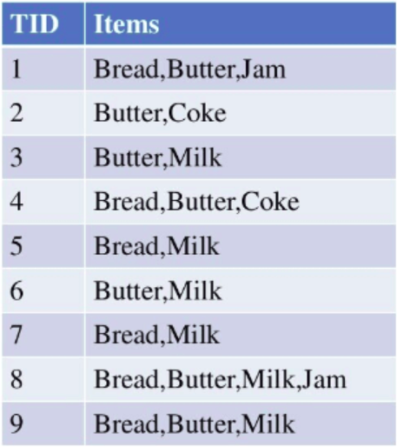
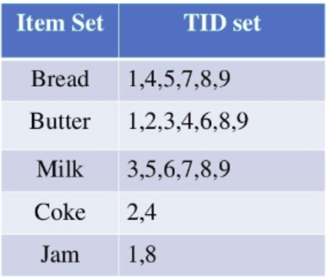
ECLAT: Mining by Exploring Vertical Data Format
ECLAT algorithm stands for Equivalence Class Clustering and bottom-up Lattice Traversal.
Vertical dataset
Horizontal dataset

Slide 34
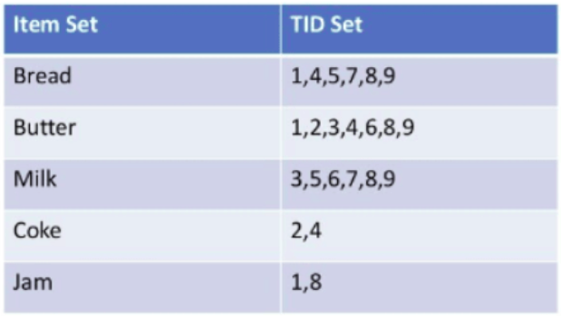
ECLAT: Mining by Exploring Vertical Data Format
ECLAT algorithm stands for Equivalence Class Clustering and bottom-up Lattice Traversal.
min_sup=2

Slide 35
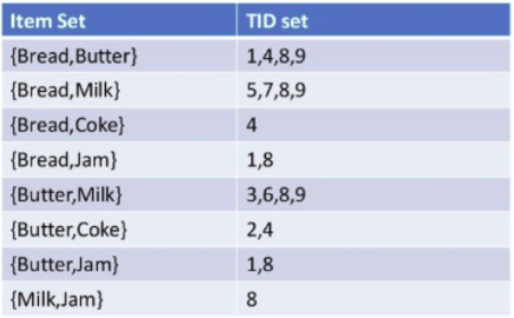
ECLAT: Mining by Exploring Vertical Data Format
ECLAT algorithm stands for Equivalence Class Clustering and bottom-up Lattice Traversal.
min_sup=2

Slide 36
ECLAT: Mining by Exploring Vertical Data Format
Eclat Algorithm:
Get tidlist for each item in the database. Here, we scan the entire database. The tidlist of item {a} is the list of transactions in which item {a} is contained.
Intersect the tidlist of item {a} with the tidlist of item {b} and generate a new transaction list whose elements are transactions in which both items {a} and {b} are found.
Repeat step 1 on {a}-conditional to other items in the database.
For all other items, repeat the above steps.

Slide 37
ECLAT: Mining by Exploring Vertical Data Format
Advantages:
Eclat algorithm has low memory requirements compared to Apriori as it uses the Depth-First Search approach.
The Eclat algorithm does not repeatedly scan the data to discover frequent itemsets, thus, is generally faster than the Apriori algorithm.
Eclat algorithm can work for big dataset compared to Apriori algorithm.

Slide 38
Scalable Frequent Itemset Mining Methods
Apriori: A Candidate Generation-and-Test Approach
Improving the Efficiency of Apriori
FPGrowth: A Frequent Pattern-Growth Approach
ECLAT: Frequent Pattern Mining with Vertical Data Format
Mining Close Frequent Patterns and Maxpatterns

Slide 39
Mining Frequent Closed Patterns: CLOSET
Flist: list of all frequent items in support ascending order
  Flist: d-a-f-e-c
Divide search space
  Patterns having d
  Patterns having d but no a, etc.
Find frequent closed pattern recursively
  Every transaction having d also has cfa → cfad is a frequent closed pattern
J. Pei, J. Han & R. Mao. “CLOSET: An Efficient Algorithm for Mining Frequent Closed Itemsets", DMKD'00.
Min_sup=2
TID | Items
10 | a, c, d, e, f
20 | a, b, e
30 | c, e, f
40 | a, c, d, f
50 | c, e, f

Slide 40
CLOSET+: Mining Closed Itemsets by Pattern-Growth
Itemset merging: if Y appears in every occurrence of X, then Y is merged with X
Sub-itemset pruning: if Y כ X, and sup(X) = sup(Y), X and all of X’s descendants in the set enumeration tree can be pruned
Hybrid tree projection
  Bottom-up physical tree-projection
  Top-down pseudo tree-projection
Item skipping: if a local frequent item has the same support in several header tables at different levels, one can prune it from the header table at higher levels
Efficient subset checking

Slide 41
MaxMiner: Mining Max-Patterns
1st scan: find frequent items
  A, B, C, D, E
2nd scan: find support for
  AB, AC, AD, AE, ABCDE
  BC, BD, BE, BCDE
  CD, CE, CDE, DE
Since BCDE is a max-pattern, no need to check BCD, BDE, CDE in later scan
R. Bayardo. Efficiently mining long patterns from databases. SIGMOD’98
Tid | Items
10 | A, B, C, D, E
20 | B, C, D, E,
30 | A, C, D, F
Potential max-patterns

Slide 42
Summary
Basic concepts: association rules, support-confident framework, closed and max-patterns
Scalable frequent pattern mining methods
  Apriori (Candidate generation & test)
  Projection-based (FPgrowth, CLOSET+, ...)
  Vertical format approach (ECLAT, CHARM, ...)
Which patterns are interesting?
  Pattern evaluation methods

Slide 43
Ref: Basic Concepts of Frequent Pattern Mining
(Association Rules) R. Agrawal, T. Imielinski, and A. Swami. Mining association rules between sets of items in large databases. SIGMOD'93
(Max-pattern) R. J. Bayardo. Efficiently mining long patterns from databases. SIGMOD'98
(Closed-pattern) N. Pasquier, Y. Bastide, R. Taouil, and L. Lakhal. Discovering frequent closed itemsets for association rules. ICDT'99
(Sequential pattern) R. Agrawal and R. Srikant. Mining sequential patterns. ICDE'95

Slide 44
Ref: Apriori and Its Improvements
R. Agrawal and R. Srikant. Fast algorithms for mining association rules. VLDB'94
H. Mannila, H. Toivonen, and A. I. Verkamo. Efficient algorithms for discovering association rules. KDD'94
A. Savasere, E. Omiecinski, and S. Navathe. An efficient algorithm for mining association rules in large databases. VLDB'95
J. S. Park, M. S. Chen, and P. S. Yu. An effective hash-based algorithm for mining association rules. SIGMOD'95
H. Toivonen. Sampling large databases for association rules. VLDB'96
S. Brin, R. Motwani, J. D. Ullman, and S. Tsur. Dynamic itemset counting and implication rules for market basket analysis. SIGMOD'97
S. Sarawagi, S. Thomas, and R. Agrawal. Integrating association rule mining with relational database systems: Alternatives and implications. SIGMOD'98

Slide 45
Ref: Depth-First, Projection-Based FP Mining
R. Agarwal, C. Aggarwal, and V. V. V. Prasad. A tree projection algorithm for generation of frequent itemsets. J. Parallel and Distributed Computing, 2002.
G. Grahne and J. Zhu, Efficiently Using Prefix-Trees in Mining Frequent Itemsets, Proc. FIMI'03
B. Goethals and M. Zaki. An introduction to workshop on frequent itemset mining implementations. Proc. ICDM’03 Int. Workshop on Frequent Itemset Mining Implementations (FIMI’03), Melbourne, FL, Nov. 2003
J. Han, J. Pei, and Y. Yin. Mining frequent patterns without candidate generation. SIGMOD’ 00
J. Liu, Y. Pan, K. Wang, and J. Han. Mining Frequent Item Sets by Opportunistic Projection. KDD'02
J. Han, J. Wang, Y. Lu, and P. Tzvetkov. Mining Top-K Frequent Closed Patterns without Minimum Support. ICDM'02
J. Wang, J. Han, and J. Pei. CLOSET+: Searching for the Best Strategies for Mining Frequent Closed Itemsets. KDD'03

Slide 46
Ref: Vertical Format and Row Enumeration Methods
M. J. Zaki, S. Parthasarathy, M. Ogihara, and W. Li. Parallel algorithm for discovery of association rules. DAMI:97.
M. J. Zaki and C. J. Hsiao. CHARM: An Efficient Algorithm for Closed Itemset Mining, SDM'02.
C. Bucila, J. Gehrke, D. Kifer, and W. White. DualMiner: A Dual-Pruning Algorithm for Itemsets with Constraints. KDD’02.
F. Pan, G. Cong, A. K. H. Tung, J. Yang, and M. Zaki , CARPENTER: Finding Closed Patterns in Long Biological Datasets. KDD'03.
H. Liu, J. Han, D. Xin, and Z. Shao, Mining Interesting Patterns from Very High Dimensional Data: A Top-Down Row Enumeration Approach, SDM'06.

Slide 47
Ref: Mining Correlations and Interesting Rules
S. Brin, R. Motwani, and C. Silverstein. Beyond market basket: Generalizing association rules to correlations. SIGMOD'97.
M. Klemettinen, H. Mannila, P. Ronkainen, H. Toivonen, and A. I. Verkamo. Finding interesting rules from large sets of discovered association rules. CIKM'94.
R. J. Hilderman and H. J. Hamilton. Knowledge Discovery and Measures of Interest. Kluwer Academic, 2001.
C. Silverstein, S. Brin, R. Motwani, and J. Ullman. Scalable techniques for mining causal structures. VLDB'98.
P.-N. Tan, V. Kumar, and J. Srivastava. Selecting the Right Interestingness Measure for Association Patterns. KDD'02.
E. Omiecinski. Alternative Interest Measures for Mining Associations. TKDE’03.
T. Wu, Y. Chen, and J. Han, “Re-Examination of Interestingness Measures in Pattern Mining: A Unified Framework", Data Mining and Knowledge Discovery, 21(3):371-397, 2010

