Slide 1
Computer Networks – TCP Congestion and Flow Control

Slide 2
OBJECTIVE
Discuss relation of TCP with other protocols
Discuss flow control in TCP
Understand TCP segment format
Discuss TCP connection establishment (3 Way Handshake) and connection termination (4 Way Handshake)
Discuss window and acknowledgement strategy in TCP

Slide 3
The TCP
TCP is a Transport Layer protocol whose primary purpose is to provide reliable and secure connection service between pairs of processes.
To provide this service on top of less reliable internet communication system, it requires facilities in the following areas
  Basic data transfer
  Reliability
  Flow Control
  Multiplexing
  Connections
  Congestion Control

Slide 4
TCP Operation - Basic Data Transfer
TCP is able to transfer a continuous stream of bytes in each direction between its users.
It does so by packaging some number of bytes into segments for transmission through the internet system.
In general, the TCP decides when to block and forward data at their own convenience.

Slide 5
TCP Operation - Reliability
The TCP must recover from data that is damaged, lost, duplicated, or delivered out of order by the internet communication system.
Sequence number - This is assigned a sequence number to each octet transmitted.
  The receiving process must send a positive acknowledgment (ACK) for the received octet. If the ACK is not received within a timeout interval, the data is retransmitted.
  At the receiver, the sequence numbers are used to correctly order segments that may be received out of order and to eliminate duplicates.
Checksum – Corrupted segments are handled by adding a checksum to each segment transmitted, checking it at the receiver, and discarding damaged segments.

Slide 6
TCP Operation – Flow Control
TCP provides flow control by providing a means for the receiver to govern the amount of data sent by the sender.
  This is achieved by returning a "window" with every ACK indicating a range of acceptable sequence numbers beyond the last segment successfully received.
  The window indicates an allowed number of bytes that the sender may transmit before receiving further permission.
This communication between processes to synchronize the bytes in the window is controlled by the Sliding Window protocol

Slide 7

TCP Flow Control
flow control
receive side of TCP connection has a receive buffer:
sender won’t overflow
receiver’s buffer by
transmitting too much,
too fast
speed-matching service: matching the send rate to the receiving app’s drain rate
application process may be slow at reading from buffer
Slide courtesy: Kurose and Ross, “Computer Networking: A Top Down Approach featuring the Internet”, 3/e, Chapter 4, Pearson Education, 2005

Slide 8
TCP Operation - Multiplexing
TCP allows multiple application programs on a given machine to communicate concurrently using the TCP services.
TCP also demultiplexes incoming TCP traffic among application programs. It uses protocol port numbers to identify the ultimate destination within a machine.
Port numbers, concatenated with the network and host addresses from the internet communication layer, form a socket. A pair of sockets uniquely identifies each connection.
A socket may be simultaneously used in multiple connections.

Slide 9
TCP Operation - Connections
The reliability and flow control mechanisms require that TCP initializes and maintains certain status information for each data stream.
The combination of this information, including sockets, sequence numbers, and window sizes, is called a connection.
Each connection is uniquely specified by a pair of sockets identifying its two sides.

Slide 10
Congestion Control
Congestion:
informally: “too many sources sending too much data too fast for network to handle”
different from flow control!
manifestations:
  lost packets (buffer overflow at routers)
  long delays (queueing in router buffers)

Slide 11
Approaches towards congestion control
Two broad approaches towards congestion control:
End-end congestion control:
no explicit feedback from network
congestion inferred from end-system observed loss, delay
approach taken by TCP
Network-assisted congestion control:
routers provide feedback to end systems
  single bit indicating congestion (SNA, DECbit, TCP/IP ECN, ATM)
  explicit rate sender should send at
Slide courtesy: Kurose and Ross, “Computer Networking: A Top Down Approach featuring the Internet”, 3/e, Chapter 4, Pearson Education, 2005

Slide 12

TCP congestion control: additive increase, multiplicative decrease
Approach: increase transmission rate (window size), probing for usable bandwidth, until loss occurs
  additive increase: increase CongWin by 1 MSS every RTT until loss detected
  multiplicative decrease: cut CongWin in half after loss
Slide courtesy: Kurose and Ross, “Computer Networking: A Top Down Approach featuring the Internet”, 3/e, Chapter 4, Pearson Education, 2005
Saw tooth
behavior: probing
for bandwidth
congestion window size
time

Slide 13
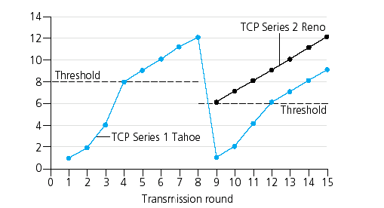
Implementation of Congestion Control
Congestion Window Size (MSS)
Picture courtesy: Kurose and Ross, “Computer Networking: A Top Down Approach featuring the Internet”, 3/e, Chapter 4, Pearson Education, 2005

Slide 14
TCP Congestion Control
When CongWin is below Threshold, sender in slow-start phase, window grows exponentially.
When CongWin is above Threshold, sender is in congestion-avoidance phase, window grows linearly.
When a triple duplicate ACK occurs, Threshold set to CongWin/2 and CongWin set to Threshold.
When timeout occurs, Threshold set to CongWin/2 and CongWin is set to 1 MSS
Slide courtesy: Kurose and Ross, “Computer Networking: A Top Down Approach featuring the Internet”, 3/e, Chapter 4, Pearson Education, 2005

Slide 15
Connection Oriented Transmission
TCP Connection oriented transmission requires three phases :
  Connection Establishment
  Data Transfer
  Connection Termination

Slide 16
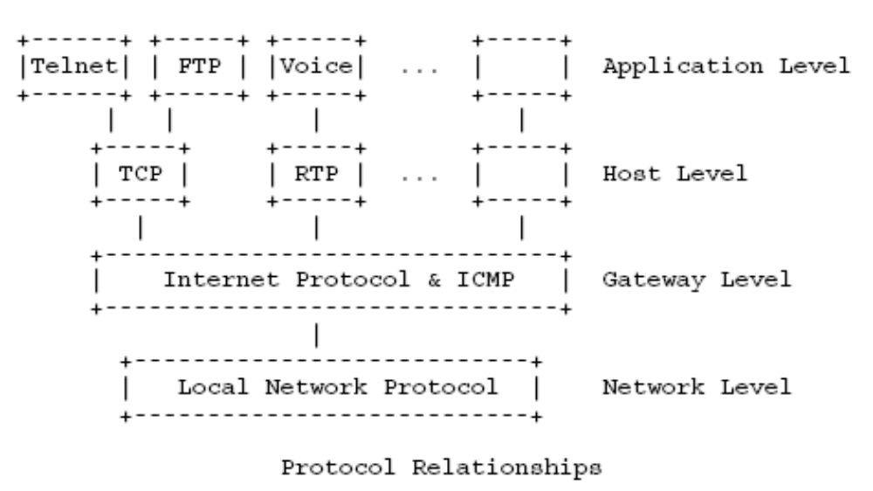
Relationship to other protocols
Picture Courtesy: RFC 793

Slide 17
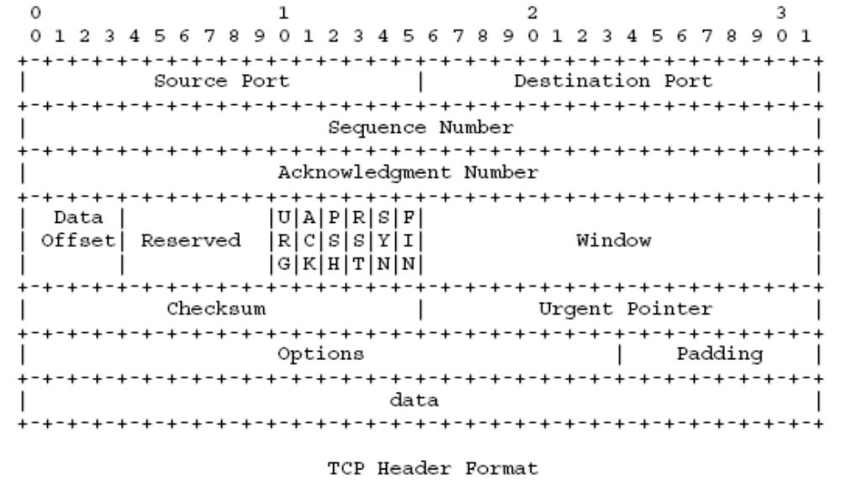
TCP Header Format
Picture Courtesy: RFC 793
Notes:
For More detailed discussion of the Segment format Refer RFC 793

Slide 18
TCP Segment Format (contd…)
Source port – Source port Number (16 bit)
Destination Port – Destination port Number (16 bit)
Sequence No – Sequence number of the first data byte in this segment (except when SYN is present) (32 bit)
  Note: (Seq No refers to bytes flowing in the same direction as the segment and Ack no refers to bytes flowing in the opposite direction from the segment)
Acknowledgement Number – Byte number that the source expects to receive next (32 bit)
Data offset - Length of the segment Header measured in 4 byte words (4 bit)
Control Bits - (URG,ACK,PSH,RST,SYN,FIN)

Slide 19
Connection Establishment
    Suppose host A wishes to establish a connection with host B
    Each side sends its own initial sequence Number and also receives a confirmation from the other side.
      1)A→B (SYN , my sequence Number is X)
      2)A←B(ACK , your sequence Number is X)
      3) A←B(SYN , my sequence Number is Y)
      4) A→B(ACK , your sequence Number is Y)
    Steps 2 & 3 can be combined in a single message , so this procedure is called Three way Handshake

Slide 20
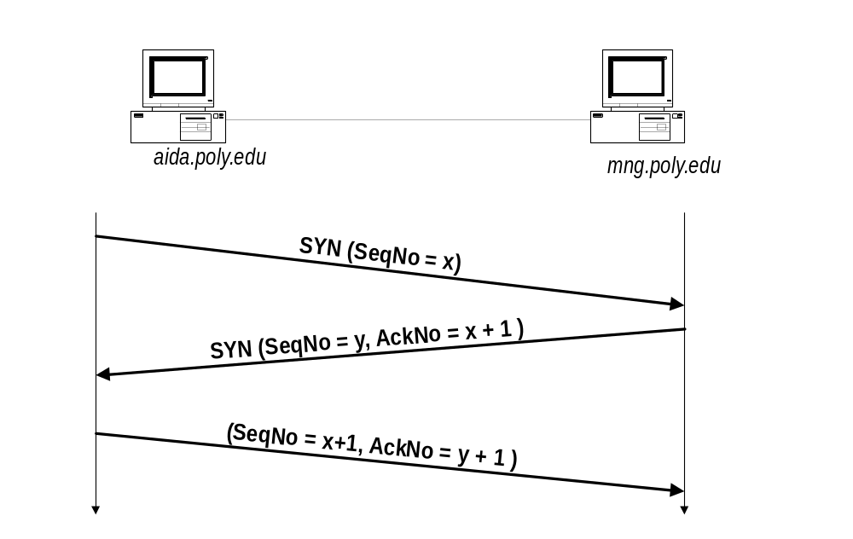
Connection Establishment contd…

Slide 21
An Example of 3 way Handshake
      TCP A TCP B
      1.closed Listen
      2.SYN-SENT(Seq=100,syn) => SYN-RECV
      3.Established <=(Seq=300,Ack=101,syn,ack) SYN-RECV
      4.Established( Seq=101,Ack=301,ack)=> Established
      5.Established (Seq=101,Ack=301,ack,data)=> Established
      Note : Seq No of the segment in line 5 is same as in line 4 because ACK does not occupy sequence Number space.
Notes:
Note : Seq (Sequence Number)
Syn ( SYN Flag) , ack ( ACK Flag)

Slide 22
Necessity of 3 way Handshake
Sequence Numbers are not tied to a global clock in the network and TCP’s may have different mechanisms for choosing the initial sequence Number (ISN).
The receiver of the first SYN has no way of knowing whether the segment was an old delayed one or not .So it must ask the sender to verify the SYN.

Slide 23
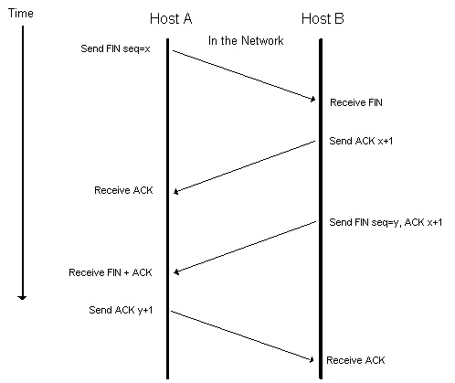
Connection Termination

Slide 24
Connection Termination
In the previous slide Host A performs active close (TCP sends a FIN segment , which means it has finished sending data)
The other end (Host B) that receives the FIN performs the passive close .FIN is being Acknowledged (FIN occupies one Byte in seq no space)The receipt of FIN is also passed to the application as an end-of-file.
The application (in Host B) that received the end of file will close its socket.This causes TCP to send to send a FIN.
The TCP on the system that receives this Final FIN (the end that did the active close) acknowledges the FIN.
Notes:
Here note that HOST B(passive closing side) sends the Ack of the FIN immediately . Since TCP informs the application of this close ,getting any response from the application may take time . So since Host A has already received ACK of its FIN the FIN will not be resend .

Slide 25
Necessity of 4 way Handshake
To implement TCP’S full duplex connection termination reliably.
To allow old duplicate segments to expire in the network.

Slide 26
Acknowledgement strategy in TCP
When data arrives at the receiver, the protocol specifies that it send back an acknowledgement of this data
  Bytes of data are sequentially numbered so the receiver can acknowledge data by naming the highest numbered byte of data it has received , which also acknowledges the previous bytes (actually it identifies the first byte of data which it has not yet received)
  So the acknowledgement mechanism is cumulative.

Slide 27
User Datagram Protocol (UDP)

Slide 28
TOC
User Datagram Protocol
UDP – Features
UDP Datagram Header Format

Slide 29
User Datagram Protocol
The User Datagram Protocol is defined to make available a datagram mode of packet-switched computer communication in the environment of an interconnected set of computer networks. This protocol assumes that the Internet Protocol (IP) is used as the underlying protocol.
Each output operation in a process produces exactly one UDP datagram, which causes one IP datagram to be sent .
  This is different from TCP where the amount of data written by an application may have little relationship to what actually gets sent in a single IP datagram

Slide 30
UDP -Features
This protocol provides a procedure for application programs to send messages to other programs with a minimum of protocol mechanism.
The protocol is transaction oriented, and delivery and duplicate protection are not guaranteed.
Applications requiring ordered reliable delivery of streams of data should use the Transmission Control Protocol (TCP)

Slide 31
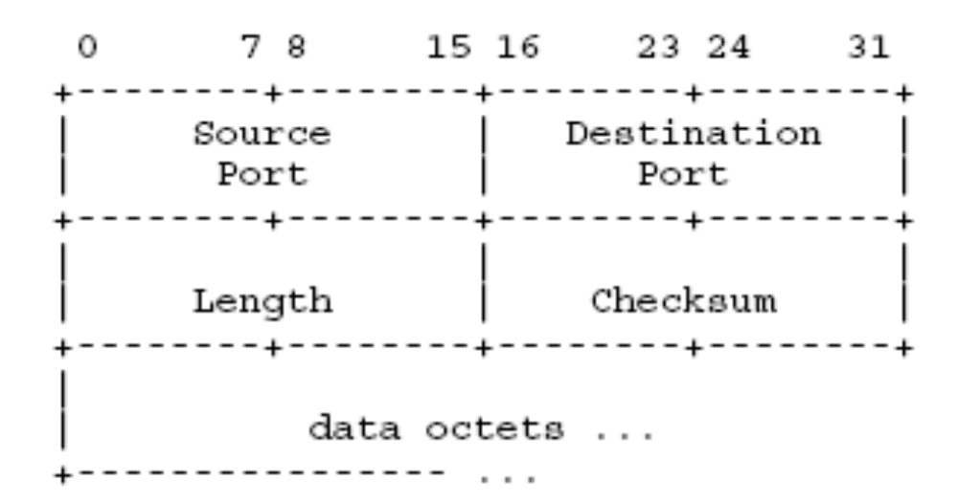
UDP Datagram Header Format
Notes:
Source Port(16 bit) is an optional field, when meaningful, it indicates the port of the sending process, and may be assumed to be the port to which a
reply should be addressed in the absence of any other information. If not used, a value of zero is inserted.
Destination Port(16 bit) has a meaning within the context of a particular internet destination address.
Length(16 bit) is the length in octets of this user datagram including this header and the data. (This means the minimum value of the length is eight.) – Sending a UDP data
Checksum (16 bit ) – Covers the UDP Header and the UDP Data.

Slide 32
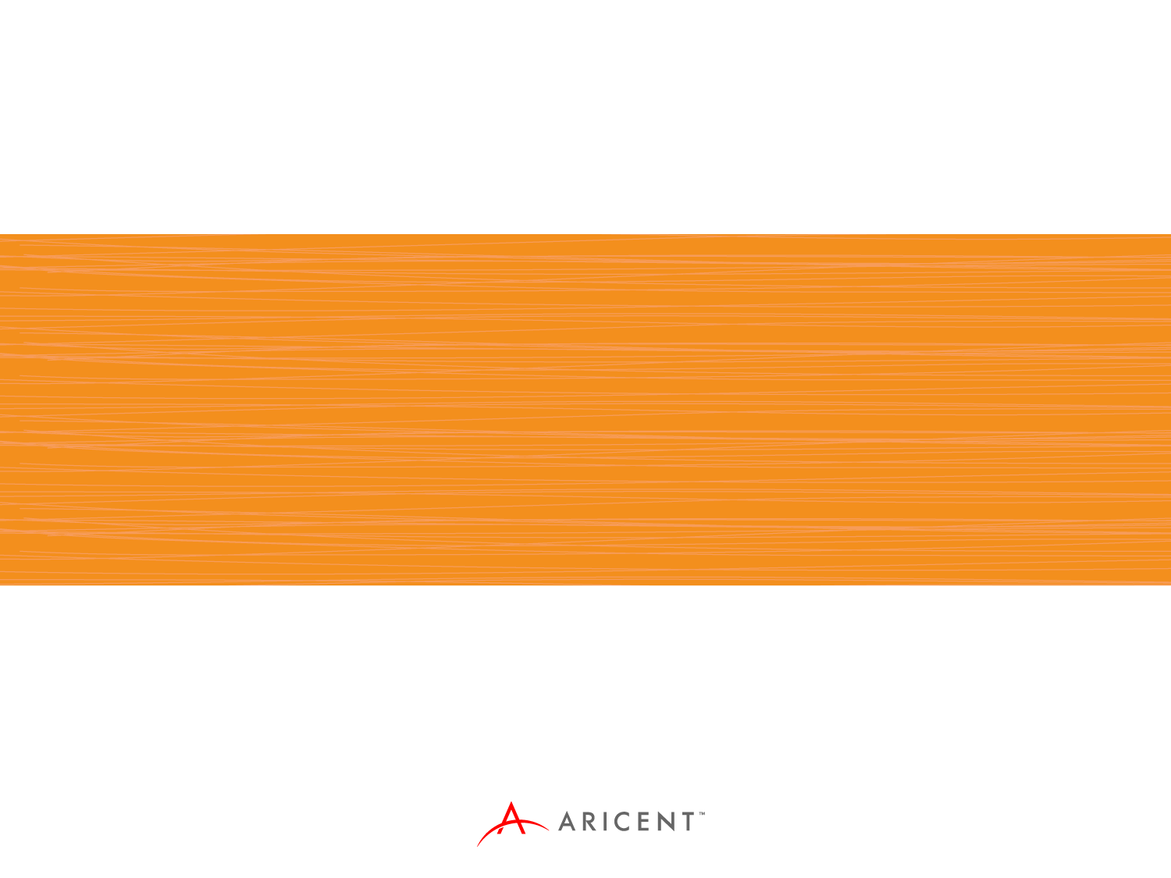
Thank You

Slide 33
Disclaimer
Aricent makes no representations or warranties with respect to contents of these slides and the same are being provided “as is”. The content/materials in the slides are of a general nature and are not intended to address the specific circumstances of any particular individual or entity. The material may provide links to internet sites (for the convenience of users) over which Aricent has no control and for which Aricent assumes no responsibility for the availability or content of these external sites. While the attempt has been to acknowledge sources of materials wherever traceable to an individual or an institution; any materials not specifically acknowledged is purely unintentional

