Slide 1
Computer Networks – Networking Tools

Slide 2
Objective
Use the following networking tools with common options
  ping
  Traceroute/tracert
  Netstat
  route
  Arp
  Ifconfig/ipconfig
  Wireshark

Slide 3
Ping
Uses the ICMP ECHO_REQUEST datagram to get an ICMP ECHO_REPLY datagram from a host or gateway.
  If host responds ping will report that host is alive.
The ping command is useful for
  Determining the status of the network and various foreign hosts
  Tracking and isolating hardware and software problems
  Testing and measuring network parameters

Slide 4
Ping – Sample Output
  $ ping –c 5 10.203.161.9
  PING 10.203.161.9 (10.203.161.9) 56(84) bytes of data.
  64 bytes from 10.203.161.9: icmp_seq=0 ttl=255 time=0.201 ms
  64 bytes from 10.203.161.9: icmp_seq=1 ttl=255 time=0.133 ms
  64 bytes from 10.203.161.9: icmp_seq=2 ttl=255 time=0.132 ms
  64 bytes from 10.203.161.9: icmp_seq=3 ttl=255 time=0.124 ms
  64 bytes from 10.203.161.9: icmp_seq=4 ttl=255 time=0.146 ms
  --- 10.203.161.9 ping statistics ---
  5 packets transmitted, 5 received, 0% packet loss, time 3999ms
  rtt min/avg/max = 0.124/0.147/0.201/0.028 ms
Notes:
IP Address of the Remote Host = 10.203.161.9
Why 56(84) Bytes of data ?
Note : ICMP Header(Type +Code+Chechsum+Identifier+Sequence Number) for echo reply/request =8 Byte .
By default 56 Bytes of data so ICMP Message Length =56+8=64.
Min IP Header Length = 20 Byte . So IPV4 Message Length =64+20=84 Bytes.
The parameter c specifies Number of echo request here it is 5.
Use parameter s to specify a larger packet size.
Sequence Number – To match reply with requests.
RTT(Round Trip Time) = Arrival Time – Departure Time.
Check ping –c 5 google.co.in (Note the Times)
Note the TTL value there (233 or 232 , decremented from 255 Assume it was set to 255(Depends On the Implementation) )
Here the TTL Value =255 , Why ?
http://www.ping127001.com/pingpage.htm

Slide 5
Ping – Common Options for Linux
By default ping will continue sending echo requests , until CTRL-C is pressed and then prints the statistics
    -c ( Specify Number of packets to send )
    -p (Pad Data Bytes with pattern )
    -q ( Specifies Quiet Output , summary is printed)
    -s ( Specify the Number of data bytes to send , By default its is 56 Bytes)
    -R (record route option. Maximum 10 IP addresses can be recorded)
Notes:
ping -c 5 -R anthra
PING nishant.hss.hns.com (10.203.142.25) 56(124) bytes of data.
Note the size of the IP Packet =124 Bytes
64 bytes from nishant.hss.hns.com (10.203.142.25): icmp_seq=0 ttl=253 time=15.0
ms
NOP
RR: tsus006.hss.hns.com (10.203.161.7)
gurtr008.hss.hns.com (10.203.129.197)
10.203.142.1
nishant.hss.hns.com (10.203.142.25)
gurtr003.hss.hns.com (10.203.129.193)
10.203.161.1
tsus006.hss.hns.com (10.203.161.7)
64 bytes from nishant.hss.hns.com (10.203.142.25): icmp_seq=1 ttl=253 time=20.3
ms
NOP (same route)
64 bytes from nishant.hss.hns.com (10.203.142.25): icmp_seq=2 ttl=253 time=9.78
ms
NOP (same route)
64 bytes from nishant.hss.hns.com (10.203.142.25): icmp_seq=3 ttl=253 time=33.2
ms
NOP (same route)
64 bytes from nishant.hss.hns.com (10.203.142.25): icmp_seq=4 ttl=253 time=19.0
ms
NOP (same route)
--- nishant.hss.hns.com ping statistics ---
5 packets transmitted, 5 received, 0% packet loss, time 13046ms
rtt min/avg/max/mdev = 9.789/19.504/33.248/7.795 ms, pipe 2

Slide 6
Traceroute
Traceroute is a network tool used to determine the route taken by packets across an IP network.
  The traceroute tool is available on practically all Unix-like operating systems
Traceroute utilizes the IP protocol `time to live' field and attempts to elicit an ICMP TIME_EXCEEDED response from each gateway along the path to some host.
  The only mandatory parameter is the destination host name or IP number
  The default probe datagram length is 40 bytes, but this may be increased by specifying a packet length (in bytes) after the destination host name

Slide 7
An Example Output of traceroute ( tracert in windows)
tracert google.co.in
Tracing route to google.co.in [72.14.207.104] over a maximum of 30 hops:
1 <1 ms <1 ms <1 ms 10.203.163.129
2 2 ms 2 ms 2 ms 10.203.129.193
3 3 ms 3 ms * 192.168.203.1
4 5 ms 4 ms 4 ms 125.62.159.9
5 37 ms 39 ms 46 ms 125.62.159.17
6 42 ms 50 ms 43 ms 125.62.159.18
7 41 ms 457 ms 58 ms 192.168.203.18
…………………..
15 286 ms 286 ms 329 ms 72.14.197.165
16 280 ms 359 ms 282 ms 209.85.130.8
17 322 ms 810 ms 452 ms 64.233.174.81
18 419 ms 307 ms 331 ms 216.239.43.68
19 463 ms 411 ms 503 ms 66.249.95.198
20 438 ms 393 ms 329 ms 66.249.94.50
21 371 ms 422 ms 372 ms 64.233.174.43
22 325 ms 374 ms 442 ms eh-in-f104.google.com [72.14.207.104]
Notes:
The screen shot is not having some rows.
Used tracert in windows.
Note In each row three round trip times are shown .
Refer the man page.

Slide 8
Implementation of traceroute
It attempts to trace the route an IP packet would follow to some internet host by launching UDP probe packets with a small ttl (time to live) then listening for an ICMP "time exceeded" reply from a gateway.
Probes are started with a ttl of one and increase by one until an ICMP "port unreachable" (which means "host“ is reached ) is received or hit a max (which defaults to 30 hops).
Three probes are sent at each ttl setting and a line is printed showing the address of the gateway and round trip time of each probe. If the probe answers come from different gateways, the address of each responding system will be printed.
If there is no response within a 5 sec. timeout interval , a "*" is printed for that probe.
The destination host should not process the UDP probe packets so the destination port is set to an unlikely value.
Notes:
Possible experiments
Use –q(Change Number of probes, per packet)
-m(Change the Number of Hops)
-w(Change timeout interval)
-p(Change destination UDP Port)

Slide 9
Netstat
netstat (=network statistics) is a command-line tool that displays
  network connections (both incoming and outgoing),
  routing tables
  number of network interface statistics.
It is available on Unix, Unix-like operating systems.
One of the very useful feature is that it can indicate states of a TCP Connection

Slide 10
Netstat – some options
-a : Shows Both Listening and Non Listening sockets
-l : Show only Listening sockets .
-r :Displays the contents of the kernel Routing table .
-i : Provides Information on the interfaces
-n : This flag print numeric addresses , instead of trying to find names for networks
-s:Displays Statistics for protocols
Notes:
Note netstat –ts or netstat –us displays statics for tcp ,udp respectively (Options , checked in Linux)

Slide 11
Netstat – An example ( Indicating states of a TCP Connection)
Proto Recv-Q Send-Q Local Address Foreign Address Stat
tcp 0 0 172.16.110.195:43389 0.0.0.0:* LISTEN
tcp 0 0 tsus050:43389 10.203.161.7:42191 ESTABLISHED
Notes:
Explanation : First Line shows a Listening Socket ( A server process Bound to Port 43389)
2nd Line Shows an Established Socket after Completing 3 Way TCP Handshake( A client Connected to this process from IP Specified
By Foreign IP)
The first line was generated using netstat –l –n (Print Listening Sockets , And Do not Convert numbers to name )
The second line was generated using netstat –a (-n was not specified , so tsus050 in place of 172.16.110.195)

Slide 12
arp
It is a command for address resolution display and control
[root@tsus050 ~]# arp -a
? (172.16.110.193) at 00:17:0E:1C:7E:FF [ether] on eth0
tsus200 (172.16.110.196) at <incomplete> on eth0
Now if the command arp –a is being run on the same m/c after some time .The second entry no longer available
[root@tsus050 ~]# arp -a
? (172.16.110.193) at 00:17:0E:1C:7E:FF [ether] on eth0
Notes:
The output of command arp –a ( run on machine 172.16.110.195) . The host 172.16.110.196 shown as incomplete ( The entry will not be there after some time )
? Implies name not resolved
172.16.110.193 ( is the default gateway of the host 172.16.110.195 )

Slide 13
ifconfig
ifconfig is used to configure the kernel-resident network interfaces. It is used at boot time to set up interfaces as necessary.
  After that, it is usually only needed when debugging or when system tuning is needed.
If no arguments are given, ifconfig displays the status of the currently active interfaces.

Slide 14
Ifconfig – output
[root@tsus050 ~]# ifconfig
eth0 Link encap:Ethernet HWaddr 00:0E:0C:AB:76:A4
inet addr:172.16.110.195 Bcast:172.16.110.207 Mask:255.255.255.240
inet6 addr: fe80::20e:cff:feab:76a4/64 Scope:Link
UP BROADCAST RUNNING MULTICAST MTU:1500 Metric:1
RX packets:3569120 errors:0 dropped:0 overruns:0 frame:0
TX packets:4130887 errors:0 dropped:0 overruns:0 carrier:0
collisions:0 txqueuelen:1000
RX bytes:447663311 (426.9 MiB) TX bytes:2402982829 (2.2 GiB)
Base address:0xdc80 Memory:dfce0000-dfd00000
lo Link encap:Local Loopback
inet addr:127.0.0.1 Mask:255.0.0.0
inet6 addr: ::1/128 Scope:Host
UP LOOPBACK RUNNING MTU:16436 Metric:1
RX packets:3217 errors:0 dropped:0 overruns:0 frame:0
TX packets:3217 errors:0 dropped:0 overruns:0 carrier:0
collisions:0 txqueuelen:0
RX bytes:2412478 (2.3 MiB) TX bytes:2412478 (2.3 MiB)
Notes:
Output shown on 172.16.110.195 ( As root )
Also in the Command prompt in the Windows Machine , show the output of ipconfig -all

Slide 15
Wireshark
Wireshark is a network packet analyzer.
  A network packet analyzer will try to capture network packets and tries to display that packet data as detailed as possible.
You could think of a network packet analyzer as a measuring device used to examine what's going on inside a network cable, just like a voltmeter is used by an electrician to examine what's going on inside an electric cable

Slide 16
Wireshark – Some uses
Network administrators use it to troubleshoot network problems
Network security engineers use it to examine security problems
Developers use it to debug protocol implementations
People use it to learn network protocol internals

Slide 17
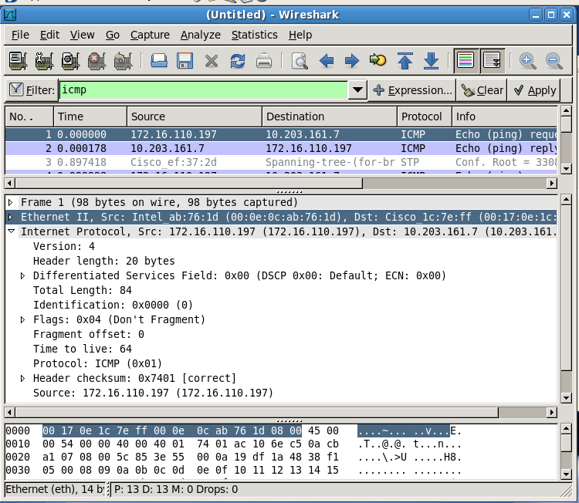
Wireshark Screen Interface
Notes:
Highlight that an ICMP Packet was capture .( Generated using Ping ) .
Mention that before the Capture Interface is set to etho , before starting to capture packets.

Slide 18
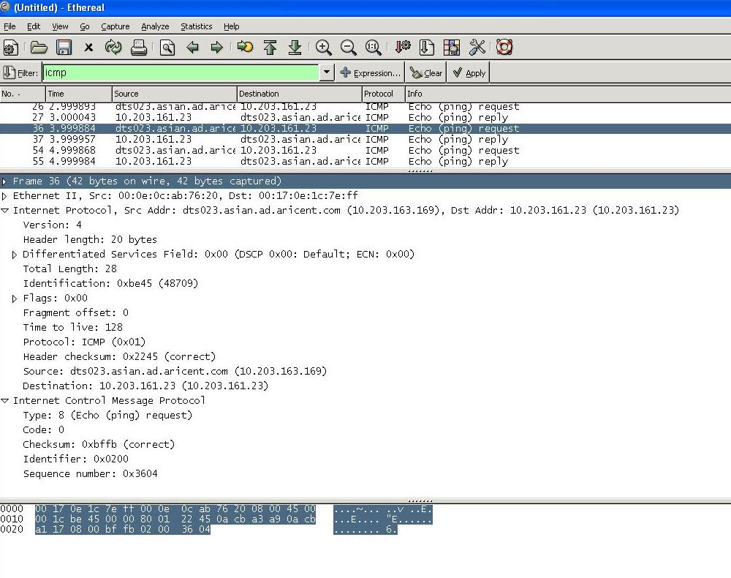
Ethereal/Wireshark Screen Interface
Notes:
ping -l 0 -t 10.203.161.23 is run on command prompt of a PC running Ethereal on Windows.

Slide 19

Thank You

Slide 20
Disclaimer
Aricent makes no representations or warranties with respect to contents of these slides and the same are being provided “as is”. The content/materials in the slides are of a general nature and are not intended to address the specific circumstances of any particular individual or entity. The material may provide links to internet sites (for the convenience of users) over which Aricent has no control and for which Aricent assumes no responsibility for the availability or content of these external sites. While the attempt has been to acknowledge sources of materials wherever traceable to an individual or an institution; any materials not specifically acknowledged is purely unintentional

