Slide 1
Metrics for Evaluating Classifier Performance
The evaluation metrics assess how good or how accurate your classifier is at predicting the class label of tuples.
Use validation test set of class-labeled tuples instead of training set when assessing accuracy.

Slide 2
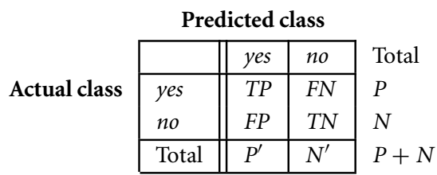
Metrics for Evaluating Classifier Performance
There are four additional terms we need to know that are the “building blocks” used in computing many evaluation measures.
These terms are summarized in the confusion matrix.
True positives (TP): These refer to the positive tuples that were correctly labeled by the classifier. Let TP be the number of true positives.
True negatives (TN): These are the negative tuples that were correctly labeled by the classifier. Let TN be the number of true negatives.

Slide 3
Metrics for Evaluating Classifier Performance
There are four additional terms we need to know that are the “building blocks” used in computing many evaluation measures.
False positives (FP): These are the negative tuples that were incorrectly labeled as positive.
e.g., tuples of class buys_computer = no for which the classifier predicted buys_computer = yes. Let FP be the number of false positives.
False negatives (FN): These are the positive tuples that were mislabeled as negative.
e.g., tuples of class buys_computer = yes for which the classifier predicted buys_computer = no. Let FN be the number of false negatives.

Slide 4
Metrics for Evaluating Classifier Performance
The confusion matrix is a useful tool for analyzing how well your classifier can recognize tuples of different classes.
TP and TN tell us when the classifier is getting things right.
while FP and FN tell us when the classifier is getting things wrong (i.e., mislabeling).
Given m classes (where m ≥ 2), a confusion matrix is a table of at least size m by m. An entry, CM_{i,j} in the first m rows and m columns indicates the number of tuples of class i that were labeled by the classifier as class j.
Good accuracy: ideally most of the tuples would be represented along the diagonal of the confusion matrix, from entry CM_{1,1} to CM_{m,m}.
Rest of the entries being zero or close to zero. That is, ideally, FP and FN are around zero.

Slide 5
Metrics for Evaluating Classifier Performance
The table may have additional rows or columns to provide totals.
For example, in the confusion matrix has P and N as shown in table.
In addition, P’ is the number of tuples that were labeled as positive (TP + FP).
N’ is the number of tuples that were labeled as negative (TN + FN).
The total number of tuples is TP + TN + FP + TN, or P + N, or P’ + N’.

Slide 6
Metrics for Evaluating Classifier Performance
The accuracy (or recognition) of a classifier on a given test set is the percentage of test set tuples that are correctly classified by the classifier.
Accuracy reflects how well the classifier recognizes tuples of the various classes.
Accuracy =$\frac{TP+TN}{TP+FN+FP+TN}$

Slide 7
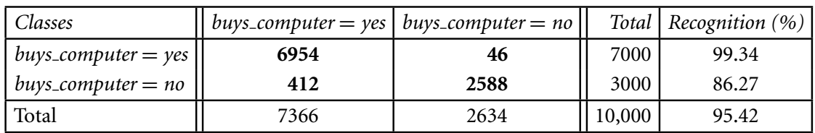
Metrics for Evaluating Classifier Performance
The accuracy (or recognition) of a classifier on a given test set is the percentage of test set tuples that are correctly classified by the classifier.
Accuracy reflects how well the classifier recognizes tuples of the various classes.
Accuracy =$\frac{TP+TN}{TP+FN+FP+TN}$

Slide 8
Metrics for Evaluating Classifier Performance
The accuracy (or recognition) of a classifier on a given test set is the percentage of test set tuples that are correctly classified by the classifier.
Accuracy reflects how well the classifier recognizes tuples of the various classes.
Accuracy =$\frac{TP+TN}{TP+FN+FP+TN}$
Accuracy=$\frac{6954+2588}{10000}∗100=95.42$

Slide 9
Metrics for Evaluating Classifier Performance
Error rate (or misclassification rate) of a classifier, M.
simply 1 − accuracy(M), where accuracy(M) is the accuracy of M.
Error rate=$\frac{FP+FN}{TP+FN+FP+TN}$

Slide 10
Metrics for Evaluating Classifier Performance
Error rate (or misclassification rate) of a classifier, M.
simply 1 − accuracy(M), where accuracy(M) is the accuracy of M.
Error rate=$\frac{FP+FN}{TP+FN+FP+TN}$

Slide 11
Metrics for Evaluating Classifier Performance
Class Imbalance Problem:
where the main class of interest is rare. That is, the data set distribution reflects a significant majority of the negative class and a minority positive class.
For example, in fraud detection applications, the class of interest (or positive class) is “fraud,” which occurs much less frequently than the negative “nonfraudulant” class.
In medical data, there may be a rare class, such as “cancer.” Suppose that you have trained a classifier to classify medical data tuples, where the class label attribute is “cancer” and the possible class values are “yes” and “no.” An accuracy rate of, say, 97% may make the classifier seem quite accurate.
But what if only, say, 3% of the training tuples are actually cancer? Clearly, an accuracy rate of 97% may not be acceptable—the classifier could be correctly labeling only the noncancer tuples, for instance, and misclassifying all the cancer tuples.

Slide 12
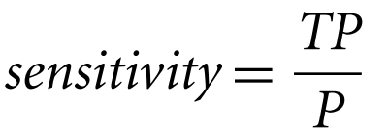
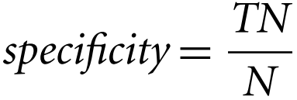
Metrics for Evaluating Classifier Performance
The sensitivity and specificity measures can be used to overcome the Class Imbalance Problem.
sensitivity is also referred to as the true positive (recognition) rate (i.e., the proportion of positive tuples that are correctly identified),
specificity is the true negative rate (i.e., the proportion of negative tuples that are correctly identified).

Slide 13
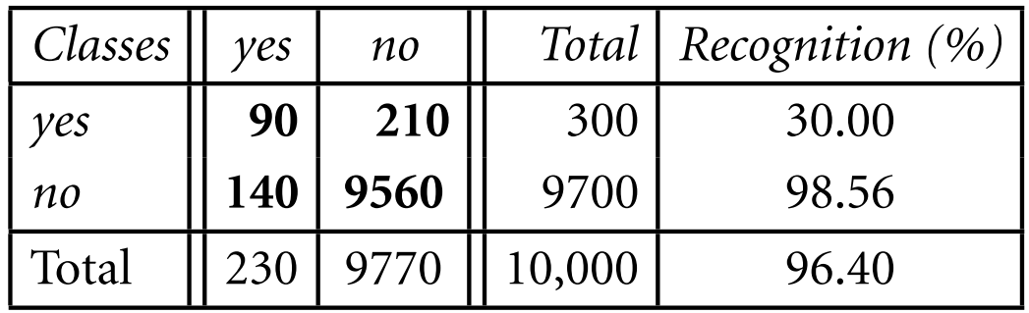
Metrics for Evaluating Classifier Performance
The sensitivity and specificity measures can be used to overcome the Class Imbalance Problem.
sensitivity is also referred to as the true positive (recognition) rate (i.e., the proportion of positive tuples that are correctly identified),
specificity is the true negative rate (i.e., the proportion of negative tuples that are correctly identified).

Slide 14
Metrics for Evaluating Classifier Performance
The sensitivity and specificity measures can be used to overcome the Class Imbalance Problem.
Although the classifier has a high accuracy, it’s ability to correctly label the positive (rare) class is poor given its low sensitivity.
It has high specificity, meaning that it can accurately recognize negative tuples.

Slide 15


Metrics for Evaluating Classifier Performance
The precision and recall measures are also widely used in classification.
Precision can be thought of as a measure of exactness (i.e., what percentage of tuples labeled as positive are actually such).
The recall is a measure of completeness (what percentage of positive tuples are labeled as such).
If recall seems familiar, that’s because it is the same as sensitivity (or the true positive rate).

Slide 16
Metrics for Evaluating Classifier Performance
A perfect precision score of 1.0 for a class C means that every tuple that the classifier labeled as belonging to class C does indeed belong to class C.
However, it does not tell us anything about the number of class C tuples that the classifier mislabeled.
A perfect recall score of 1.0 for C means that every item from class C was labeled as such, but it does not tell us how many other tuples were incorrectly labeled as belonging to class C.
There tends to be an inverse relationship between precision and recall, where it is possible to increase one at the cost of reducing the other.

Slide 17
Metrics for Evaluating Classifier Performance
An alternative way to use precision and recall is to combine them into a single measure.
The F measure (also known as F₁ score or F-score) the F_{β} measure.
The F measure is the harmonic mean of precision and recall.
It gives equal weight to precision and recall.
$$F−Score=\frac{2∗precision∗recall}{precision+recall}$$

Slide 18

Metrics for Evaluating Classifier Performance
where β is a non-negative real number.
The F_{β} measure is a weighted measure of precision and recall. It assigns β times as much weight to recall as to precision.
Commonly used F_{β} measures are F₂ (which weights recall twice as much as precision) and
F_{0.5} (which weights precision twice as much as recall).

Slide 19
Metrics for Evaluating Classifier Performance
In addition to accuracy-based measures, classifiers can also be compared with respect to the following additional aspects:
Speed: This refers to the computational costs involved in generating and using the given classifier.
Robustness: This is the ability of the classifier to make correct predictions given noisy data or data with missing values. Robustness is typically assessed with a series of synthetic data sets representing increasing degrees of noise and missing values.
Scalability: This refers to the ability to construct the classifier efficiently given large amounts of data. Scalability is typically assessed with a series of data sets of increasing size.

Slide 20
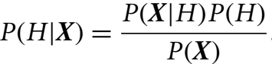
Bayes Classification
Bayesian classifiers are statistical classifiers.
Bayesian classifier can predict class membership probabilities such as the probability that a given tuple belongs to a particular class.
Bayesian classification is based on Bayes’ theorem.
A simple Bayesian classifier known as the naïve Bayesian classifier.
Naïve Bayesian classifiers assume that the effect of an attribute value on a given class is independent of the values of the other attributes.
Bayes’ theorem is useful in that it provides a way of calculating the posterior probability, P(H|X) from P(H), P(X|H), and P(X).

Slide 21
Bayes Classification
For example, X is a 35-year-old customer with an income of $40,000. Suppose that H is the hypothesis that our customer will buy a computer.
Then P(H|X) reflects the probability that customer X will buy a computer given that we know the customer’s age and income.

Slide 22
Bayes Classification
Naïve Bayesian classifiers assume that the effect of an attribute value on a given class is independent of the values of the other attributes.
For example, X is a 35-year-old customer with an income of $40,000. Suppose that H is the hypothesis that our customer will buy a computer.
Then P(H|X) reflects the probability that customer X will buy a computer given that we know the customer’s age and income.

Slide 23
Examples
1. SpamAssassin works as a mail filter to identify the spam in which users train the system. In emails, it considers patterns in the words which are marked as spam by the users. For Example, it may have learned that the word “release” is marked as spam in 30% of the emails. Concluding 0.8% of non-spam mails which includes the word “release” and 40% of all emails which are received by the user is spam. Find the probability that a mail is a spam if the word “release” seems in it.
Solution :
Given, P(Release | Spam) = 0.30
P(Release | Non Spam) = 0.008
P(Spam) = 0.40 => P(Non Spam) = 0.40
Now, using Bayes’ Theorem: P(Spam | Release) = P(Release | Spam) * P(Spam) / P(Release)
= 0.30 * 0.40 / (0.40 * 0.30 + 0.30 * 0.008) = 0.980
Hence, the required probability is 0.980.

Slide 24
2. Bag1 contains 4 white and 8 black balls and Bag2 contains 5 white and 3 black balls. From one of the bag one ball is drawn at random and the ball which is drawn comes out as black. Find the probability that the ball is drawn from Bag1.
Solution: Given, Let E1, E2 and A be the three events where,
E1 = Event of selecting Bag1
E2 = Event of selecting Bag2
A = Event of drawing black ball
Now,
P(E1) = P(E2) = 1/2 P(drawing a black ball from Bag1) = P(A|E1) = 8/12 = 2/3
P(drawing a black ball from Bag2) = P(A|E2) = 3/8
By using Bayes' Theorem, the probability of drawing a black ball from Bag1,
P(E1|A) = P(A|E1) * P(E1) / P(A|E1) * P(E1) + P(A|E2) * P(E2) [P(A|E1) * P(E1) + P(A|E2) * P(E2) = Total Probability]
= (2/3 * 1/2) / (2/3 * 1/2 + 3/8 * 1/2) = 16/25
Hence, the probability that the ball is drawn from Bag1 is 16/25

Slide 25
Naïve Bayesian Classification
Naïve Bayesian classifier, or simple Bayesian classifier, works as follows:
Let D be a training set of tuples and their associated class labels. As usual, each tuple is represented by an n-dimensional attribute vector, X = (x₁, x₂,…, x_{n}), depicting n measurements made on the tuple from n attributes, respectively, A₁, A₂,…, A_{n}.
Suppose that there are m classes, C1, C2,:::, Cm. Given a tuple, X, the classifier will predict that X belongs to the class having the highest posterior probability, conditioned on X. That is, the na¨ıve Bayesian classifier predicts that tuple X belongs to the class Ci if and only if

Slide 26

Naïve Bayesian Classification
Naïve Bayesian classifier, or simple Bayesian classifier, works as follows:
Suppose that there are m classes, C1, C2,…, C_{m}. Given a tuple, X, the classifier will predict that X belongs to the class having the highest posterior probability, conditioned on X. That is, the naïve Bayesian classifier predicts that tuple X belongs to the class C_{i} if and only if
Thus, we maximize P(C_{i}|X). The class C_{i} for which P(C_{i}|X) is maximized is called the maximum posteriori hypothesis. By Bayes’ theorem:

Slide 27

Naïve Bayesian Classification
As P(X) is constant for all classes, only P(X|C_{i})P(C_{i}) needs to be maximized. Note that the class prior probabilities may be estimated by P(C_{i})=|C_{i,D}|/|D|, where |C_{i,D}| is the number of training tuples of class C_{i} in D.
A simplified assumption: attributes are conditionally independent (i.e., no dependence relation between attributes):
This greatly reduces the computation cost: Only counts the class distribution.

Slide 28
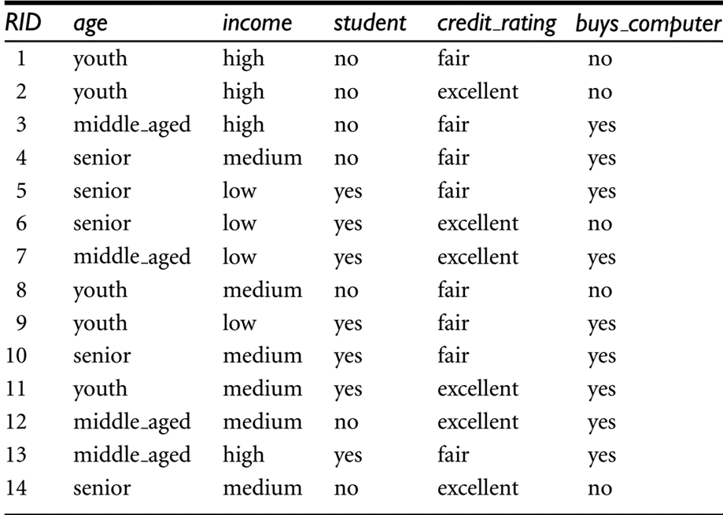

Naïve Bayesian Classification
Predicting a class label using naïve Bayesian classification.
For example, we wish to classify
We need to maximize P(X|C_{i})P(C_{i}), for i=1, 2.
P(C_{i}), the prior probability of each class, can be computed based on the training tuples:

Slide 29
Naïve Bayesian Classification
Predicting a class label using naïve Bayesian classification.
For example, we wish to classify
We need to maximize P(X|C_{i})P(C_{i}), for i=1, 2.
To compute P(X|C_{i}), we compute the following conditional probabilities:

Slide 30
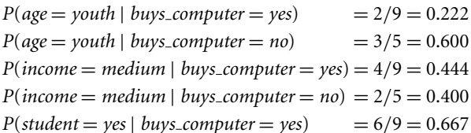

Naïve Bayesian Classification
Predicting a class label using naïve Bayesian classification.
To compute P(X|C_{i}), we compute the following conditional probabilities:

Slide 31
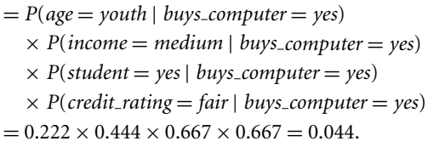
Naïve Bayesian Classification

Slide 32
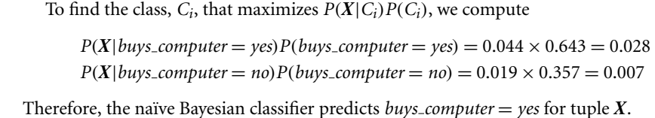
Naïve Bayesian Classification

Slide 33
Rule-Based Classification
Rule-based classifiers, where the learned model is represented as a set of IF-THEN rules:
IF condition THEN conclusion
Example: IF age = youth AND student = yes THEN buys_computer = yes
Rule-based classifiers can be generated, either from a decision tree or
Directly from the training data using a sequential covering algorithm.

Slide 34
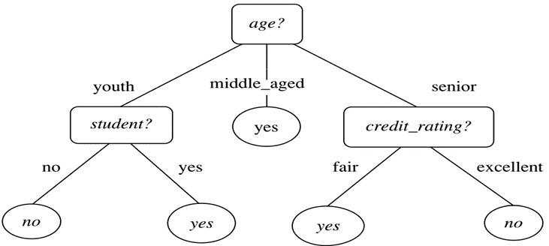
Rule-Based Classification: Using Decision Tree
Rules are easier to understand than large trees.
One rule is created for each path from the root to a leaf.
Each attribute-value pair along a path forms a conjunction: the leaf holds the class prediction.
Rules are mutually exclusive and exhaustive.
Example: Rule extraction from our buys_computer decision-tree.
IF age = young AND student = no THEN buys_computer = no
IF age = young AND student = yes THEN buys_computer = yes
IF age = mid-age THEN buys_computer = yes
IF age = old AND credit_rating = excellent THEN buys_computer = no
IF age = old AND credit_rating = fair THEN buys_computer = yes

Slide 35
Rule-Based Classification: Using Sequential Covering Algorithm
Sequential covering algorithm: Extracts rules directly from training data.
Typical sequential covering algorithms: FOIL, AQ, CN2, RIPPER.
Rules are learned sequentially, each for a given class C_{i} will cover many tuples of Ci but none (or few) of the tuples of other classes.
Steps:
Rules are learned one at a time
Each time a rule is learned, the tuples covered by the rules are removed
Repeat the process on the remaining tuples until termination condition, e.g., when no more training examples or when the quality of a rule returned is below a user-specified threshold
Comp. w. decision-tree induction: learning a set of rules simultaneously.

Slide 36
Instance-based Classification
Instance-based learning (sometimes called memory-based learning) compares new problem instances with instances seen in training, which have been stored in memory.
Because computation is postponed until a new instance is observed, these algorithms are sometimes referred to as "lazy“.
Store training examples and delay the processing until a new instance must be classified.

Slide 37
Instance-based Classification
Lazy vs Eager learning
Lazy learning:
Simply stores training data (or only minor processing) and waits until it is given a test tuple.
Lazy learning as sees the test tuple it performs generalization to classify the tuple based on its similarity to the stored training tuples.
Eager learning:
Given a set of training tuples, constructs a classification model before receiving new (e.g., test) data to classify.
Eager learning model are ready and eager to classify previously unseen tuples.
Lazy: less time in training but more time in predicting.

