Slide 1

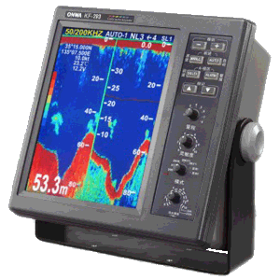
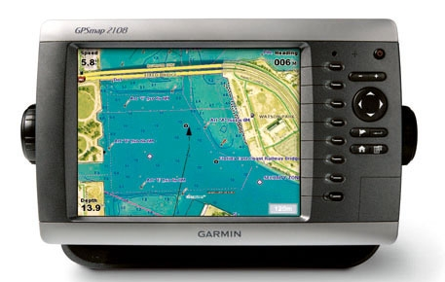
Data conversion
Primarily engaged in the design and manufacture of marine electronics equipment
Popular in Southeast Asia market
A conversion of user data
From ONWA to GARMIN
User data involves
Waypoints
Routes
Tracks
ONWA
GARMIN

Slide 2
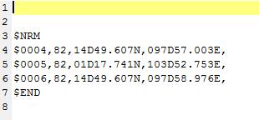
Waypoint(1/3)
Waypoint
Keyword
Start: “$NRM”
End : “$END”
Data format description
$ | 0 | 0 | 0 | 4 | , | 8 | 2 | , | 1 | 4 | D | 4 | 9 | . | 6 | 0 | 7 | N | , | 0 | 9 | 7 | D | 5 | 7 | , | 0 | 0 | 3 | E | ,
Name
Latitude
Longitude
1 | 0 | 0 | 0 | 0 | 0 | 1 | 0
On/Off
Symbol

Slide 3
Waypoint(2/3)
1 | 4 | D | 4 | 9 | . | 6 | 0 | 7 | N | , | 0 | 9 | 7 | D | 5 | 7 | . | 0 | 0 | 3 | E
N |  | 1 | 4 | ° | 4 | 9 | . | 6 | 0 | 7 | ‘ | E | 0 | 9 | 7 | ° | 5 | 7 | . | 0 | 0 | 3 | ‘
Latitude/Longitude format
Degree
Minute
Second
Data format conversion

Slide 4
Waypoint(3/3)
Input data
no
“$NRM”?
Add new waypoint to the list
yes
Getline
“$END”?
no
Data format conversion
yes
Exit

Slide 5
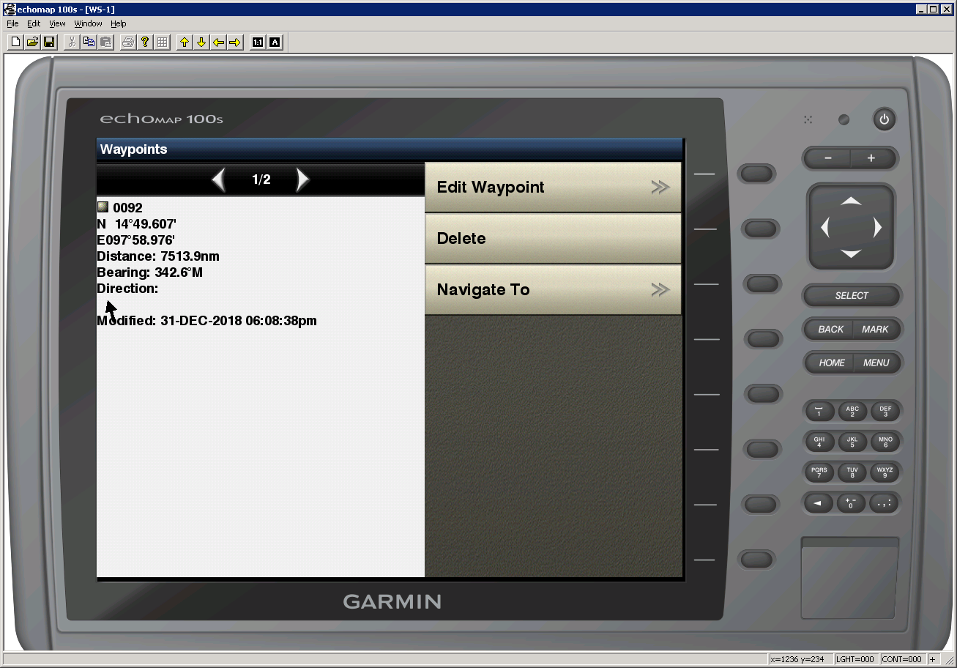
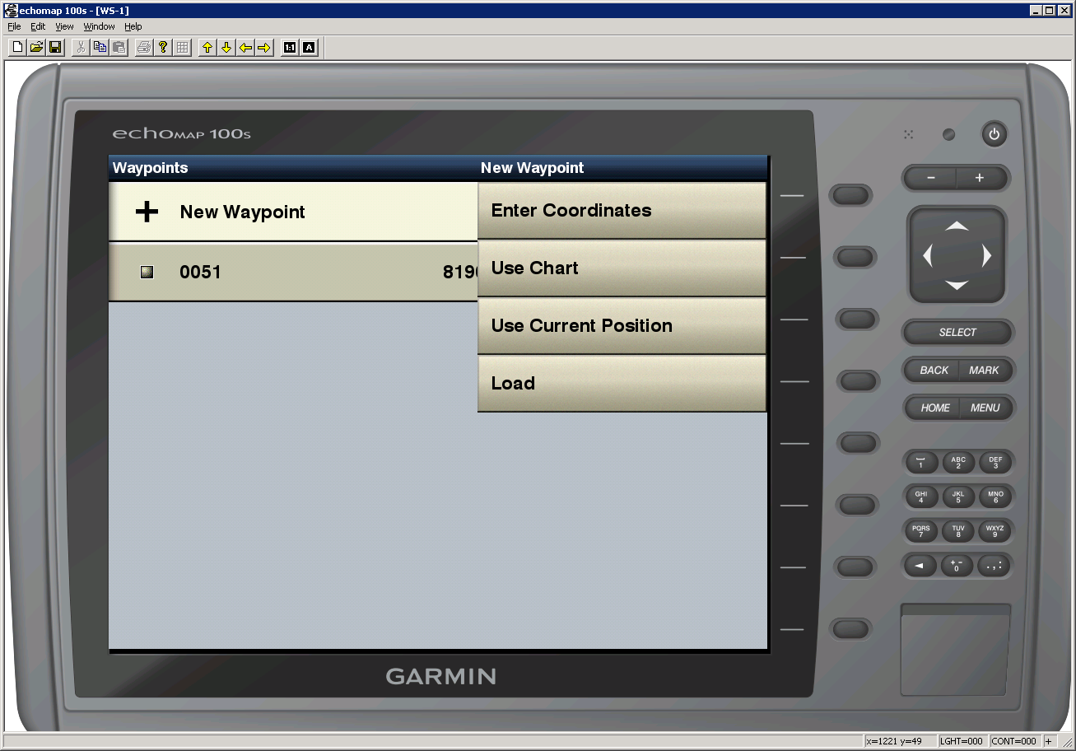
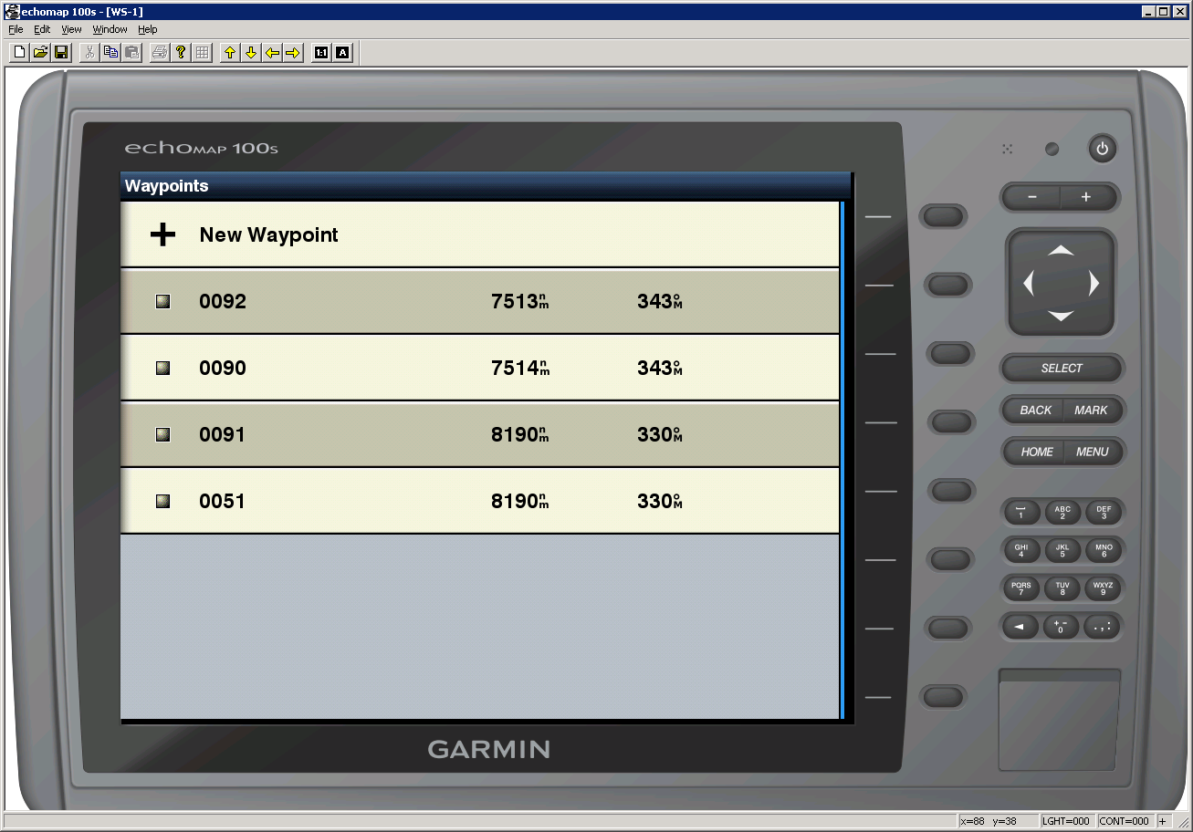
Demo

Slide 6

Route(1/3)
Route
Keyword
Start: “$RUT”
End : “$END”
Data format description
$ | 0 | 0 | 0 | 1 | , | C | 0 | , | 0 | 1 | D | 2 | 9 | . | 7 | 4 | 1 | N | , | 1 | 0 | 3 | D | 5 | 2 | . | 7 | 5 | 3 | E
Name
Latitude
Longitude
1 | 1 | 0 | 0 | 0 | 0 | 0 | 0
On/Off

Slide 7
Route(2/3)
Input data
no
“$RUT”?
yes
Create new route
Add new waypoint to the list
Getline
“$END”?
no
Data format conversion
yes
Exit

Slide 8
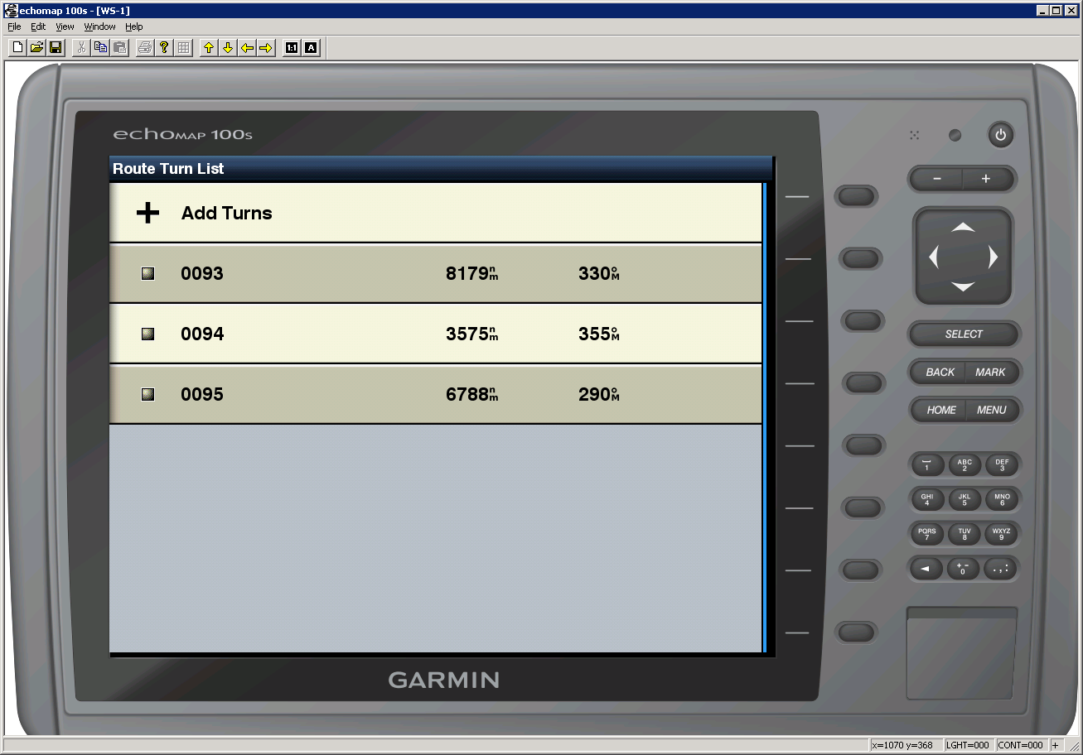
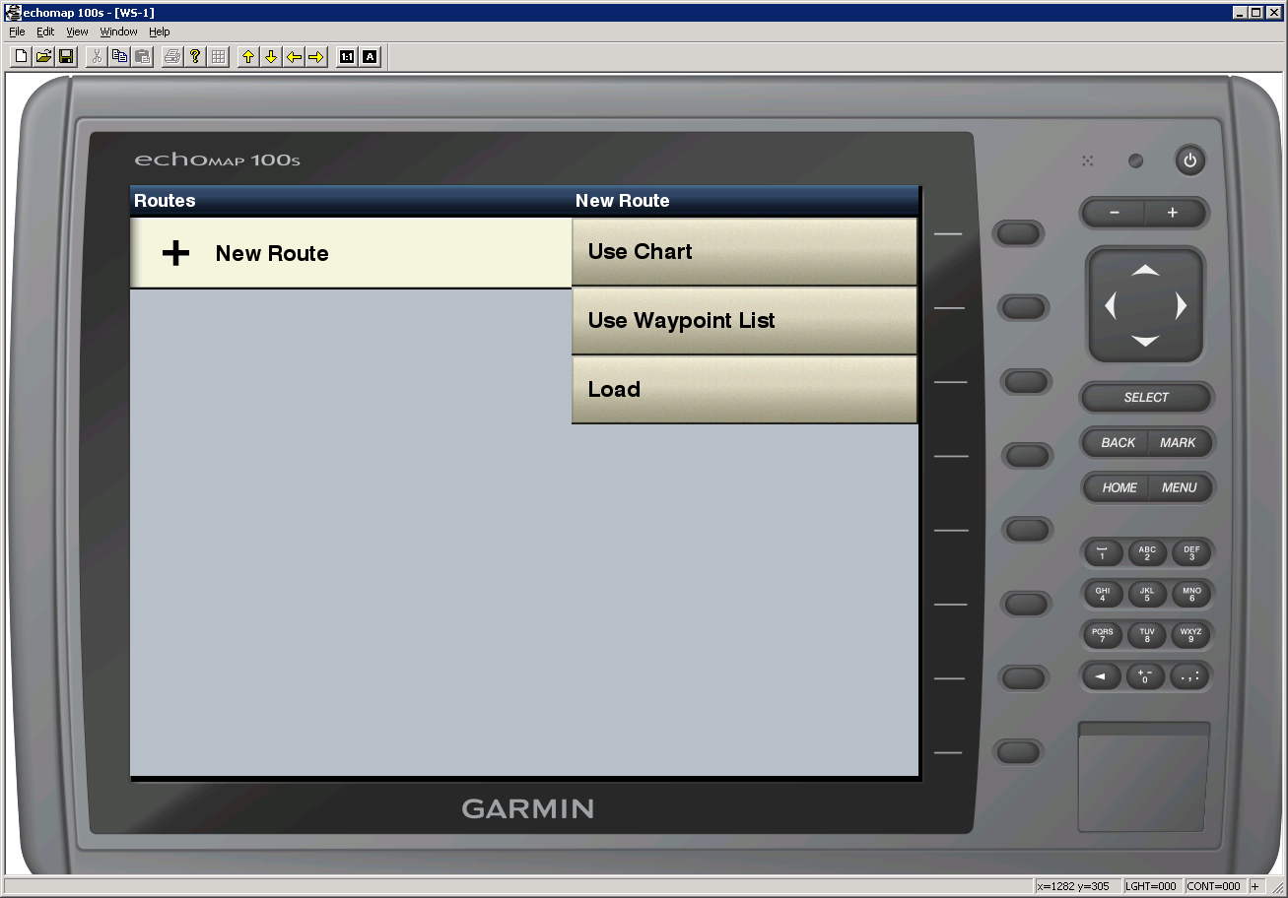
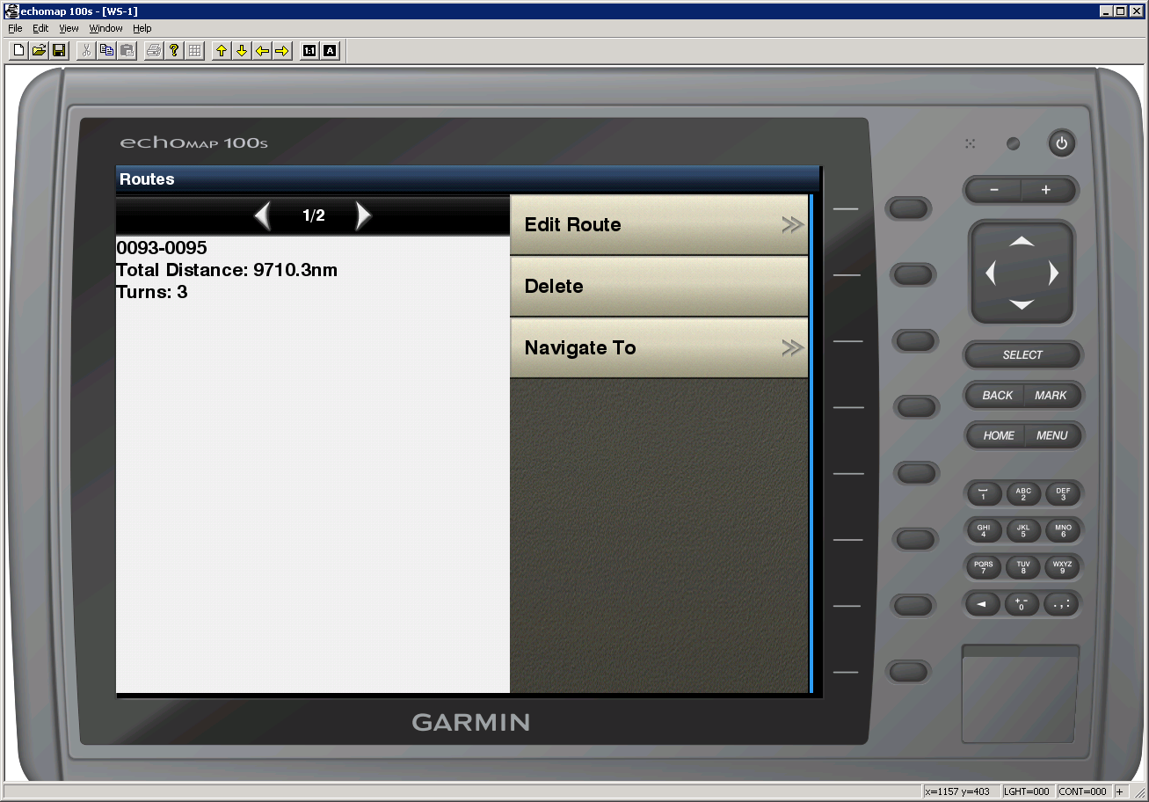
Route(3/3)

Slide 9
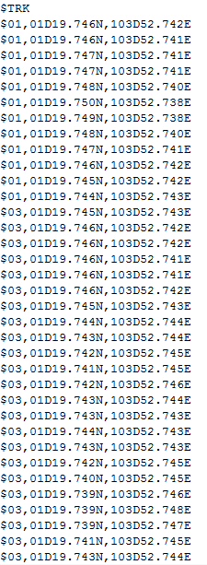
Track(1/3)
Track
Keyword
Start: “$TRK”
End : “$END”
Data format description
$ | 0 | 1 | , | 0 | 1 | D | 2 | 9 | . | 7 | 4 | 1 | N | , | 1 | 0 | 3 | D | 5 | 2 | , | 7 | 5 | 3 | E
Name
Latitude
Longitude

Slide 10
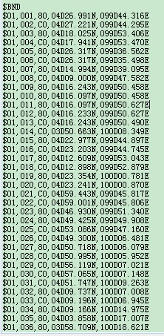
Track(1/3)
BDY
Keyword
Start: “$BND”
End : “$END”
Data format description
$ | 0 | 1 | , | 0 | 0 | 1 | , | 8 | 0 | , | 0 | 4 | D | 2 | 6 | . | 9 | 4 | 1 | N | , | 1 | 0 | 3 | D | 5 | 2 | , | 7 | 5 | 3 | E
Name
Latitude
Longitude

Slide 11
Track(2/3)
Input data
“$TRK”?
no
yes
Filename exist?
no
yes
Create new track
Add new track point to the track
Getline
“$END”?
no
Data format conversion
yes
Exit

